Slide 1


Estimating Activity-Travel Patterns from Cellular Network Data
15th TRB Transportation Planning Applications Conference
Luning Zhang and Jing Dong, Iowa State University
Xuesong Zhou, Arizona State University
May 18, 2015, Atlantic City, NJ

Slide 2
Objective
Estimate the most likely activity patterns on the transportation network using cellphone data
  home activity duration
  major office/work activity duration
  frequently-visited other locations
  rough estimate of departure and arrival times

Slide 3
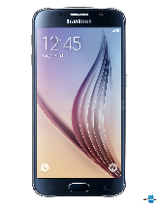

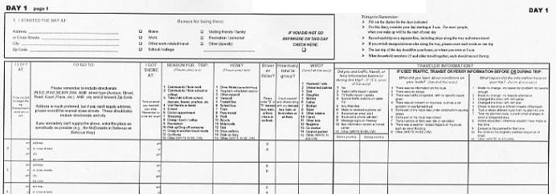
Data Description
Cellphone use data
  Phone locations are based on cell towers
Travel diaries

Slide 4
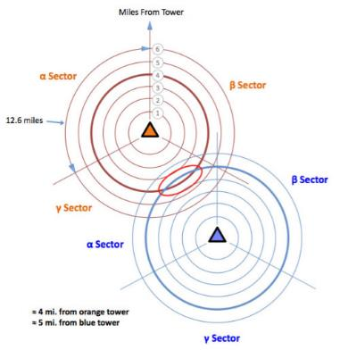
Challenges - Inaccuracy
Signal strength varies:
  Network Coverage
  Network Congestion
  Obstruction
  Hardware and software
Signal fluctuation happens may occur due to several factors:
  Network Congestion
  Radio interference
  Reflective/absorbent surfaces
Ref: http://wrongfulconvictionsblog.org/2012/06/01/cell-tower-triangulation-how-it-works/

Slide 5
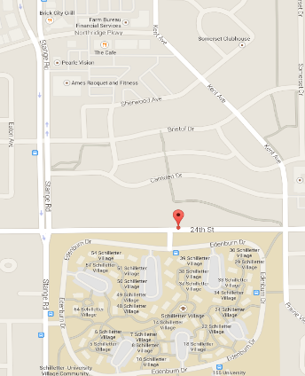
Challenges - Multiple mapping
Cell location area may include multiple territorial function
commercial area
residential area
working area

Slide 6
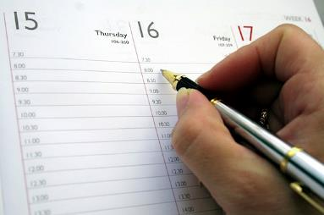
Data Preparation
Travel diary data are recorded at one-hour increment
The travel day is segmented in 24 hours

Slide 7
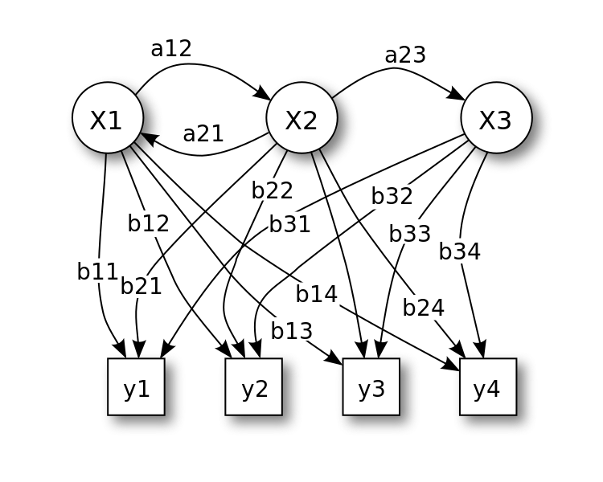
Methodology – HMM
Hidden Markov model
x — states (real activity)
y — observations (cell location)
a — state transition probabilities
b — emission probabilities
Ref: http://en.wikipedia.org/wiki/Hidden_Markov_model#/media/File:HiddenMarkovModel.svg

Slide 8
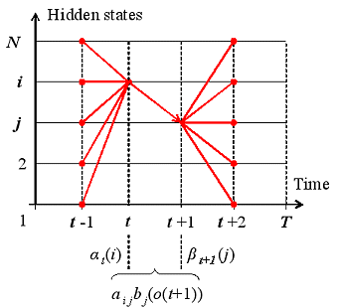
Methodology – Baum-Welch Alg.
Given a new cell location sequence, Baum-Welch algorithm can adjust model parameters to maximize the probability of the sequence given the model
Ref: http://www.shokhirev.com/nikolai/abc/alg/hmm/hmm.html

Slide 9
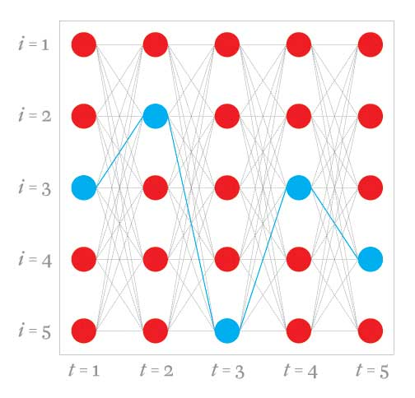
Methodology – Viterbi Algorithm
Given a new sequence of cell location, Viterbi algorithm can find the most likely sequence of activities
Ref: http://spectrum.ieee.org/geek-life/profiles/2010-medal-of-honor-winner-andrew-j-viterbi

Slide 10
Result
17:00 -> 18:00 | Home | Office | Lab | Gym | Other
Home | 0.5 | 0 | 0 | 0 | 0.5
Office | 0 | 0 | 0 | 1 | 0
Lab | 0.2 | 0 | 0.4 | 0.2 | 0.2
Gym | 0 | 0 | 0 | 1 | 0
Other | 0 | 0 | 0 | 0 | 1
7:00 -> 8:00 | Home | Lab | Other
Home | 0.78 | 0.22 | 0.00
Lab | 0.00 | 1.00 | 0.00
Other | 0.50 | 0.00 | 0.50
Example of transition matrix 7:00~8:00 and 17:00~18:00

Slide 11
Conclusion
Cellphone data can be used to supplement traditional travel survey data
Cell location inaccuracy and multiple mapping issues are addressed using Hidden Markov model
Activity patterns can be estimated using Baum-Welch algorithm

