Slide 1
Selected Findings from FTA Traffic Assignment & Feedback Research
Howard Slavin
Jonathan Brandon
Jim Lam
Kanchana Nanduri
Caliper Corporation
May 2015

Slide 2
Acknowledgements
We wish to acknowledge the encouragement and technical involvement of FTA and FHWA planning staff, and modelers from ARC, MAG, NCTCOG, SANDAG, and PSRC.
The findings presented, however, solely reflect the view of the authors and not those of U.S. DOT or any of the participating MPOs.

Slide 3
Research Motivation
Congressional interest in highway benefits of major transit improvements
FTA relies on congested travel times and other model output for new starts evaluation
Congested travel times underpin nearly all travel demand modeling components and forecasts for other purposes
Travel demand models are the quantitative basis for transportation planning in the U.S.
Convergence problems have been identified as a source of error in models

Slide 4
Background
Congested auto travel times are the major determinant of model components
Congested travel times have historically been modeled rather than measured
User equilibrium traffic assignment is the model paradigm that produces congested travel times
Feedback is intended to be used to obtain consistent model travel times

Slide 5
FTA Traffic Assignment and Feedback Research Project Overview
Inventory/Assessment of Practices of the 30 Largest MPOs
Review of 5 of the better MPO Models
Examination of Traffic Assignment Methods
Examination of Feedback Methods
Comparison of Modeled & Measured Travel times
Project Impact Analysis
Cross-cutting Conclusions

Slide 6
Assessment of 2011 Current Practices
Nearly universal coverage of the 30 largest MPOs
Widespread deficiencies in traffic assignment methods
Use of problematic assignment techniques and closure metrics – only 50% used a good metric
Low convergence targets for the relative gap-many at .01 or larger, few at .001, 2 at .0001
Feedback insufficiently and inefficiently computed-often only one time period, ad hoc methods and metrics, often stop at 5% flow diff.

Slide 7
Research Questions
How much convergence error is there in deployed MPO models?
How much TA convergence is enough for project evaluation?
How hard is it to achieve with current algorithms and commercial software?
How significant is feedback convergence?
How achievable is feedback convergence?
How realistic are model-generated congested travel times?

Slide 8
Study Approach
Work only with real, deployed models using those from ARC, MAG, NCTCOG, SANDAG, & PSRC
In-depth review of modeling practices
Perform empirical tests of model variants and project impacts
Compare travel times with those from commercial sources
Examine how impact assessments are influenced by chosen methods and convergence levels

Slide 9
Motivating Example of Convergence Error: Impact of Blue Line Service Improvements at 1% Relative Gap

Slide 10
Road Impacts of Blue Line Service Improvements at 1E-6 Relative Gap

Slide 11
Feedback Practices
Most MPOs use ad hoc measures
Most do feedback for only one time period
Many do naïve speed feedback
Many do not have converged traffic assignments
Common reliance on % Link Flow differences between iterations
Practices governed more by run time issues than appropriateness

Slide 12
Feedback Research Questions
Basic Methodological Framework
Convergence Metrics
Convexity/Uniqueness Issues
Computational Approaches
Achievable Levels
Computational Burden

Slide 13
How much does good practice or bad practice matter?
Central question for our empirical work
Relevant to many modeling choices
We attempt to find and quantify the answers

Slide 14
How much error is there in the link flows in an unconverged assignment?
Can be quantified
Using the convergence abilities of improved methods, we can compare less converged solutions with highly converged ones.

Slide 15
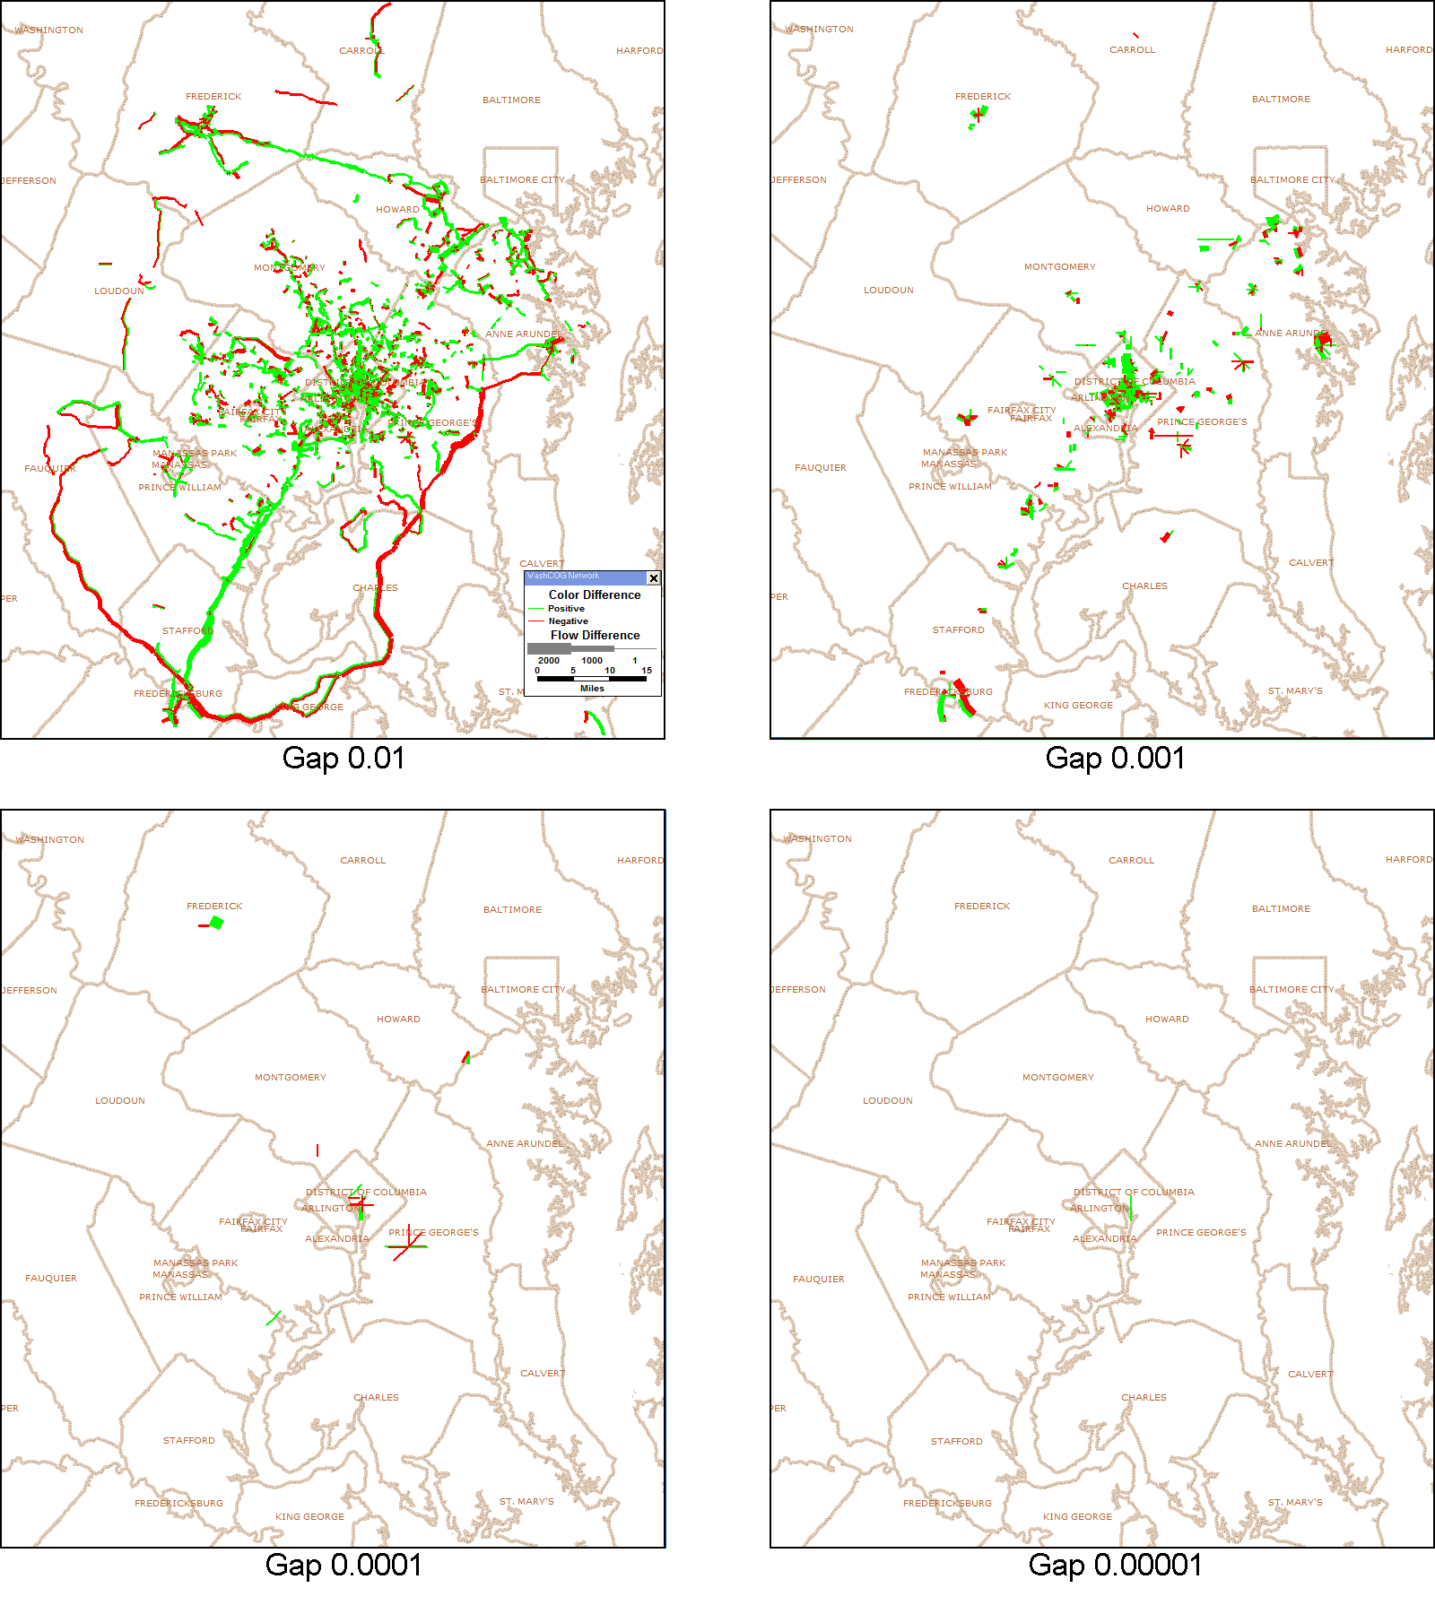
Flow Difference Maps Comparing assignments at different relative gaps with the equilibrium solution

Slide 16
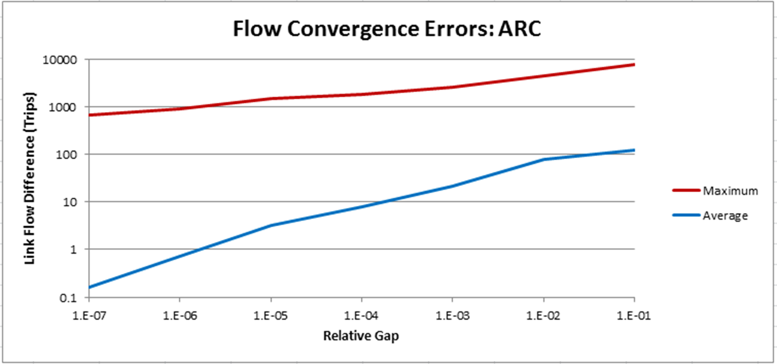

Slide 17
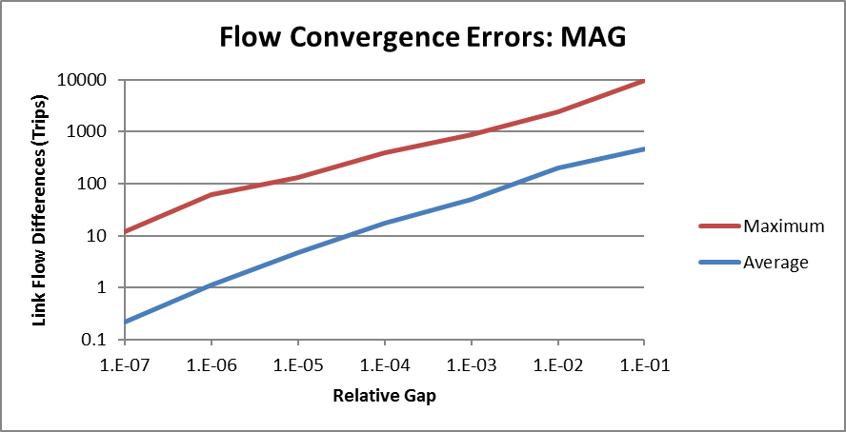

Slide 18
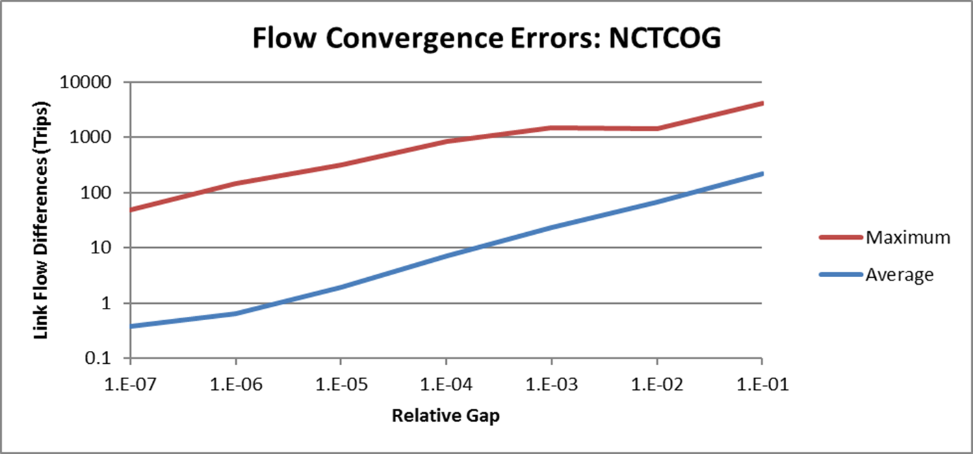

Slide 19
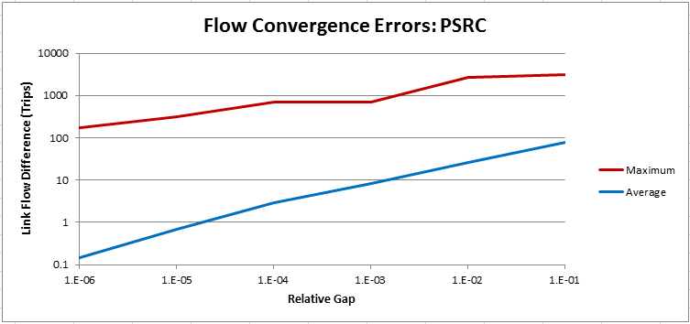

Slide 20
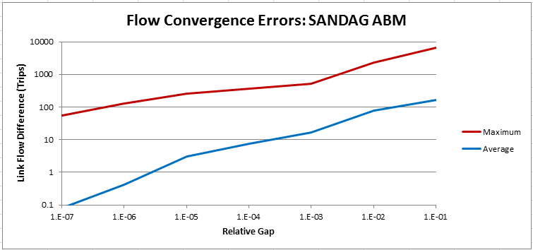

Slide 21
Assignments to 1E-4 Relative Gap with the Bi-conjugate FW Algorithm on a 12 core computer
Assignments to 1.E-4 Relative Gap with Bi-conjugate FW Algorithm on a 12 core computer
MPO | ARC | MAG | NCTCOG | PSRC | SANDAG ABM | SANDAG trip-based
METHOD | BFW | BFW | BFW | BFW | BFW | BFW
TIME PERIOD | AM | AM | AM | AM | AM | AM
CONVERGENCE | 1.E-4 | 1.E-4 | 1.E-4 | 1.E-4 | 1.E-4 | 1.E-4
NUMBER OF ITERATIONS | 80 | 51 | 153 | 66 | 45 | 39
COMPUTATIONAL TIME | 32 min | 7 min 19 s | 31 min | 40 min | 35 min | 26 min
TOTAL VMT | 40,264,910 | 29,356,528 | 35,209,830 | 13,122,656 | 16,934,816 | 15,727,035
TOTAL VHT | 1,244,615 | 889,645 | 1,089,180 | 447,006 | 490,625 | 443,486

Slide 22
Traffic Assignment Validation
Current validation against counts appears quite insufficient
Counts must be by time period and direction to be useful for validation
Sample size considerations are warranted for statistical significance
Validation against counts and speeds would be attractive
Validation of multi-class assignment is not performed, but should be

Slide 23
Traffic Assignment Findings
Tighter convergence is useful and achievable with current software packages and published methods
Deployed models have substantial convergence error and spurious project impacts
The degree of convergence that is useful may be problem-dependent and can be assessed through straightforward comparisons.

Slide 24
Project Impact Analysis
At least one highway project and one transit project for each MPO
More extensive tests for MAG, NCTCOG, & SANDAG performed by Caliper
Limited tests for ARC and PSRC
Varied analysis protocols with and without feedback

Slide 25
Example of a SANDAG Region Road Project—New Section of SR 52

Slide 26
Highway assign Rel. Gap | Type of model run | ∆ AM VMT (Project-base) | ∆ AM VHT (Project-base) | ∆ AM Highway trips | ∆ AM Transit trips
5e-4 | Highway AM assignment only | -33,360 | -14,035 | 0 | N/A (no transit assign)
1.E-5 | Highway AM assignment only | -56,950 | -3,172 | 0 | N/A (no transit assign)
1.E-6 | Highway AM assignment only | -56,850 | -3,179 | 0 | N/A (no transit assign)
5e-4 | Single loop run with 100% ABM sample | -18,324 | -1,262 | +700 | +1167
1.E-6 | Single loop run with 100% ABM sample | -28,519 | -1,644 | +275 | +30
5e-4 | Full model with feedback | -17,582 | -1,214 | +658 | +1161
1.E-5 | Full model with feedback | -33,774 | -1,952 | +88 | +1004
1.E-6 | Full model with feedback | -26,197 | -1,565 | +390 | +43
Table 7-10: SANDAG Highway Project Impact Summary

Slide 27
Two new transit routes in Phoenix

Slide 28
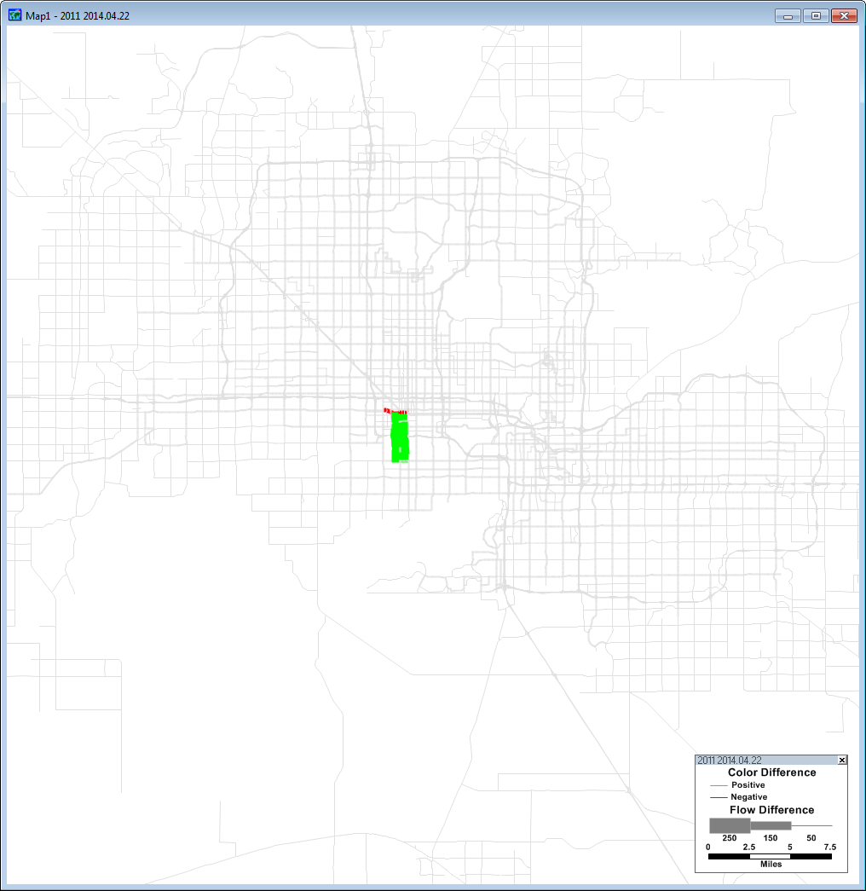
Transit Flow Changes

Slide 29
Highway Flow Changes at 1e-4

Slide 30
Highway Flow Differences at 1e-6

Slide 31
MAG Transit Project Run Summary
: MAG Transit Project Impact Run Summary
Highway assign RG | Type of model run | ∆ PM VMT (Project–base) | ∆ PM VHT (Project–base) | ∆ PM Highway trips | ∆ PM Transit trips | ∆ PM PHT (Project-base)
1.E-4 | Mode choice & assign only | -410 | -60 | -44 | +66 | +57
1.E-6 | Mode choice & assign only | -660 | -34 | -41 | +56 | +40
1.E-4 | model with feedback | -2,190 | -107 | -81 | +65 | +54
1.E-5 | model with feedback | -654 | -38 | -36 | +57 | +33
1.E-6 | model with feedback | -615 | -32 | -39 | +59 | +39

Slide 32
Feedback Good Practices
Start with refined estimates of congested travel times for the first model loop
Have an explicit formal, global definition of feedback convergence
Use a valid feedback methodology
Use tightly converged traffic assignments
Achieve feedback convergence for each time period

Slide 33
Comparison of Feedback Approaches

Slide 34
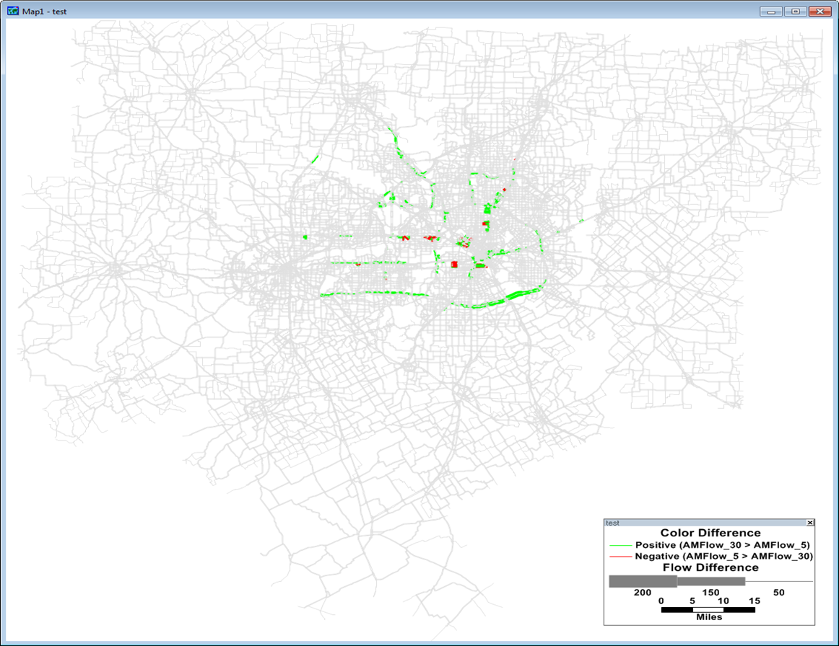
Flow differences between 5 loops and 30 loops

Slide 35
Auto Travel Time Analysis
Comparison of Model times with HERE Real Time
Based upon TMC segments
HERE data harvested for several days and averaged
Performed once for June as proof of concept and then repeated for 3 September weekdays
Comparisons for AM period and for various categories of facilities
Comparison with INRIX and Micro-simulated DTA speeds for MAG
O-D travel time analysis using Google data

Slide 36
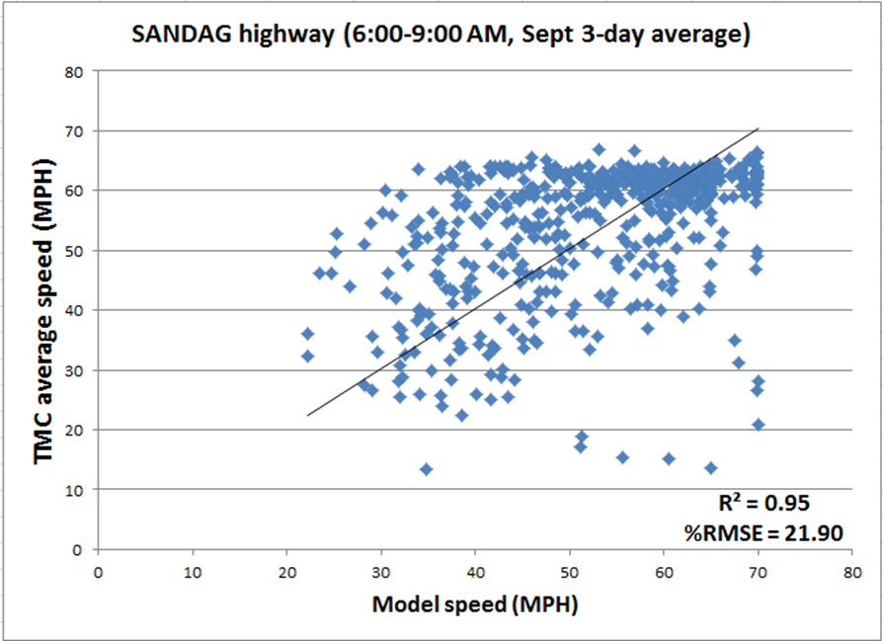
Highway Speed Comparison

Slide 37
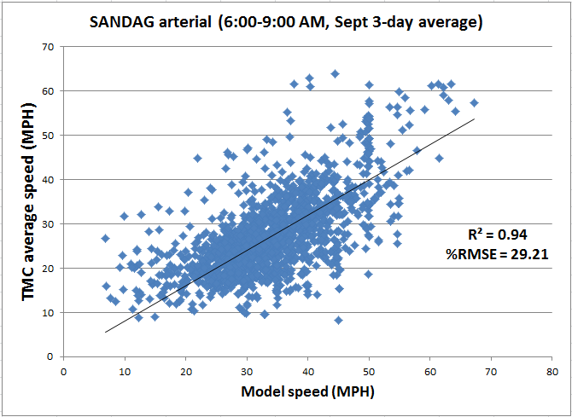
Arterial Speed Comparison

Slide 38
Freeway speeds higher than predicted

Slide 39
Problems with signal delay

Slide 40
Micro-simulated DTA v. Planning Model Travel Times

Slide 41
Micro-simulated DTA Times v. INRIX

Slide 42
Some Observations and Conclusions
MPO models are continuously changing so characterizations are dated as soon as made
There is room for improvement even in the better models
Estimates of project impacts vary significantly with assignment convergence levels
More convergence is needed but convergence is, by itself, not enough
Better practices and better quality control are needed
So are better modeled speeds and better external validation
Existing methods appear to be able to resolve project impacts including the highway impacts of transit projects when properly implemented
Numerous research questions abound for further investigation

