Slide 1
Taking a Walk:
Modeling Pedestrians and Bicycles
at the Street Level
15th TRB National Transportation Planning Applications Conference
Atlantic City, NJ
May 17-21

Slide 2
Where We’ve Been
Established practice that modeling and estimating active transportation demand requires a fine grained network and detailed zonal structure

Slide 3
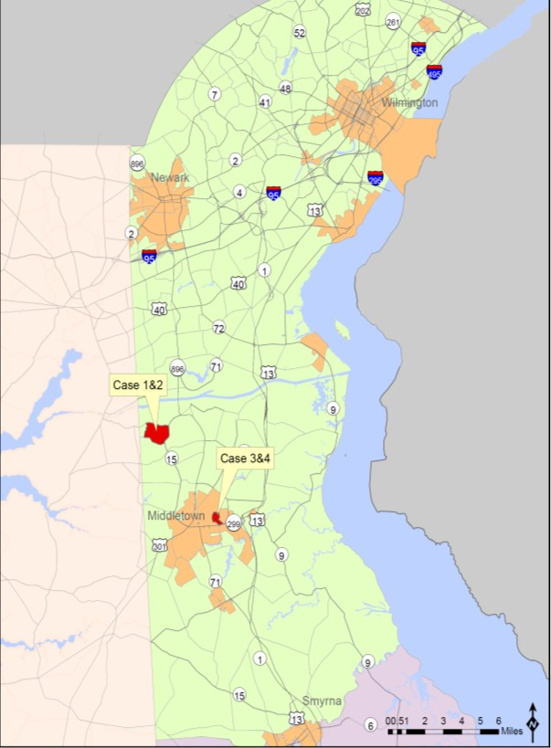
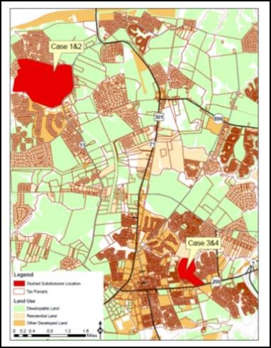
Case Studies
200 unit subdivisions in Southern New Castle County
  Suburban Middletown
    Case Studies 1 & 2
  Urban Middletown
    Case Studies 3 & 4

Slide 4
Model Results for Study Area Trips

Slide 5
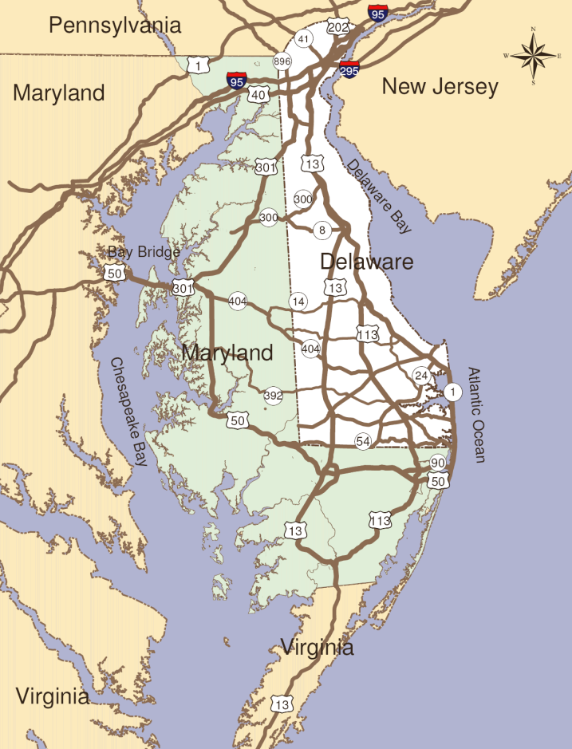
DelDOT Peninsula Model Background
Background:
  Delaware plus Maryland’s “Eastern Shore”
  Population of 1.2 Million
  5,375 sq. miles

Slide 6
Developed LUTSAM to Streamline Process
Community Design Scenarios
3-D Image Models
GIS
Peak Hour Travel
Auto, Bus, Bike, & Ped
Travel Model
Analysis & Visualization
Performance Measures
Simulation

Slide 7
Opportunities for Refinement
Enhanced network and zonal structure
Representation of biking and walking
Inclusion of accessibility

Slide 8
Enhanced Network and Zonal Structure
Converted Model Network to Geodatabase
  Routable Centerline File
  RIMS Database
  GIS file that can be maintained annually
  Detailed information such as sidewalks, shoulder width, street width
Traffic Analysis Zone Resolutions
  Standard (973 Zones)
  Census Block (24,115 Census Blocks)
  Tax Parcel (403,791 Tax Parcels)
Resolution specified by TAZ

Slide 9
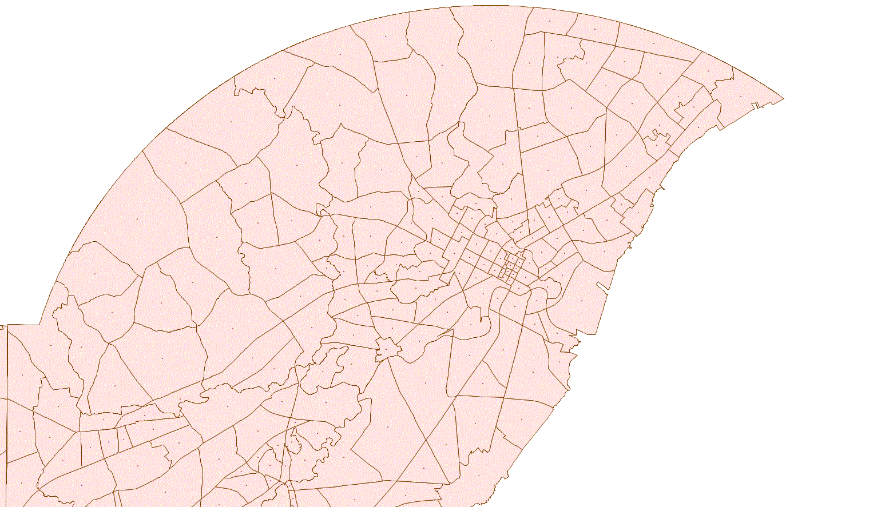
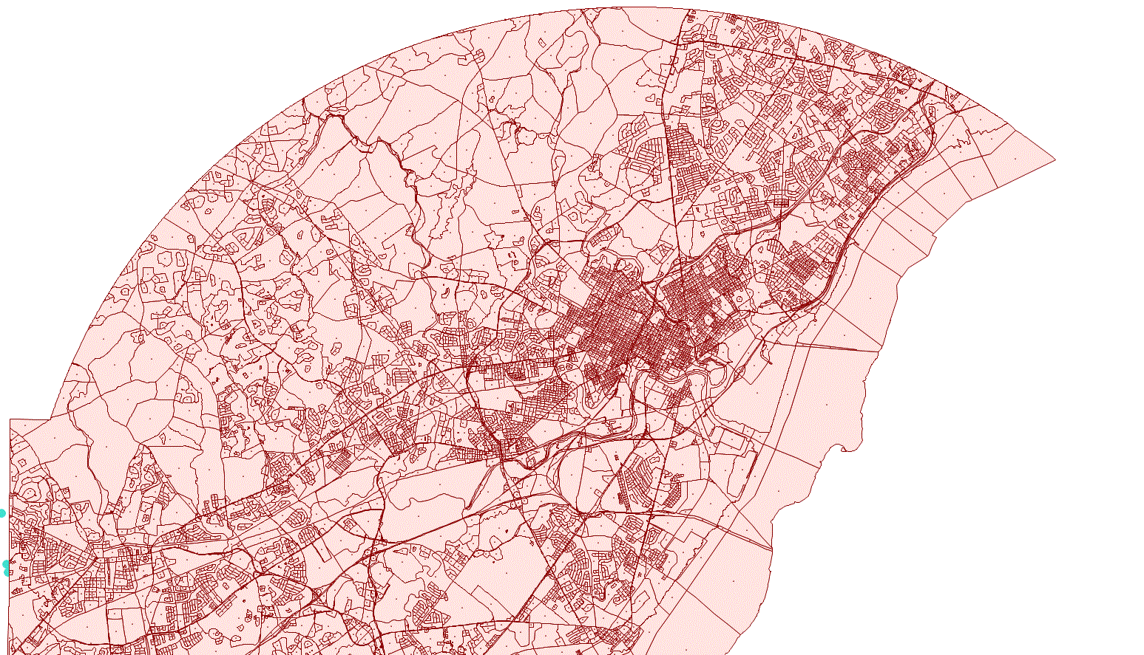
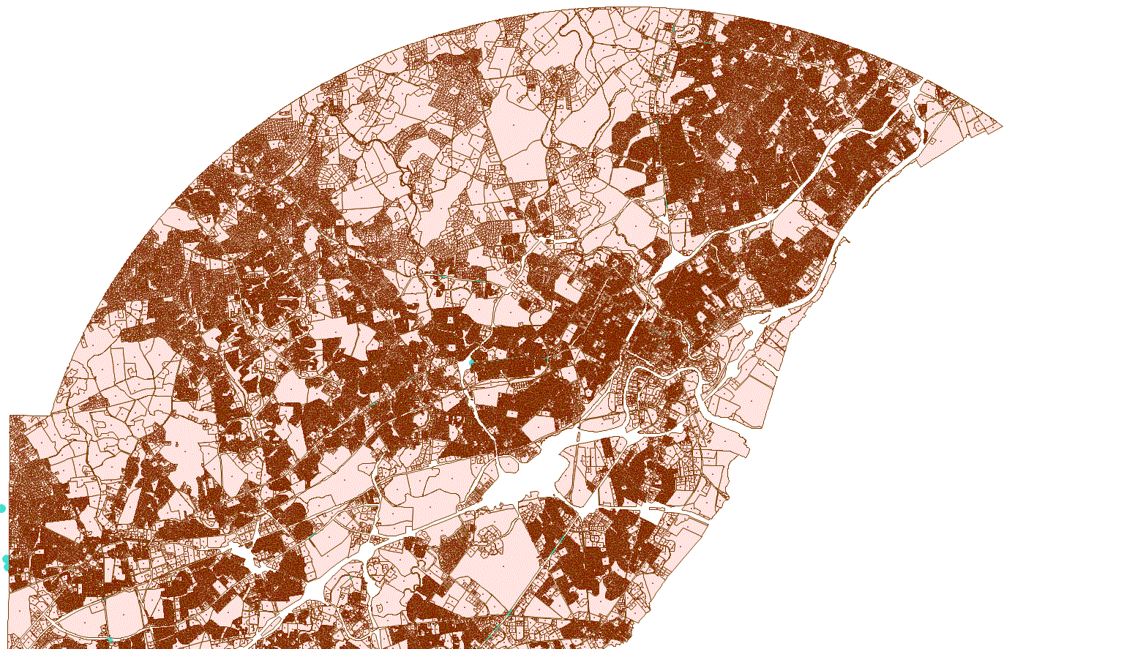
Zonal Structure
PENINSULA
CENSUS BLOCK
TAX PARCEL

Slide 10
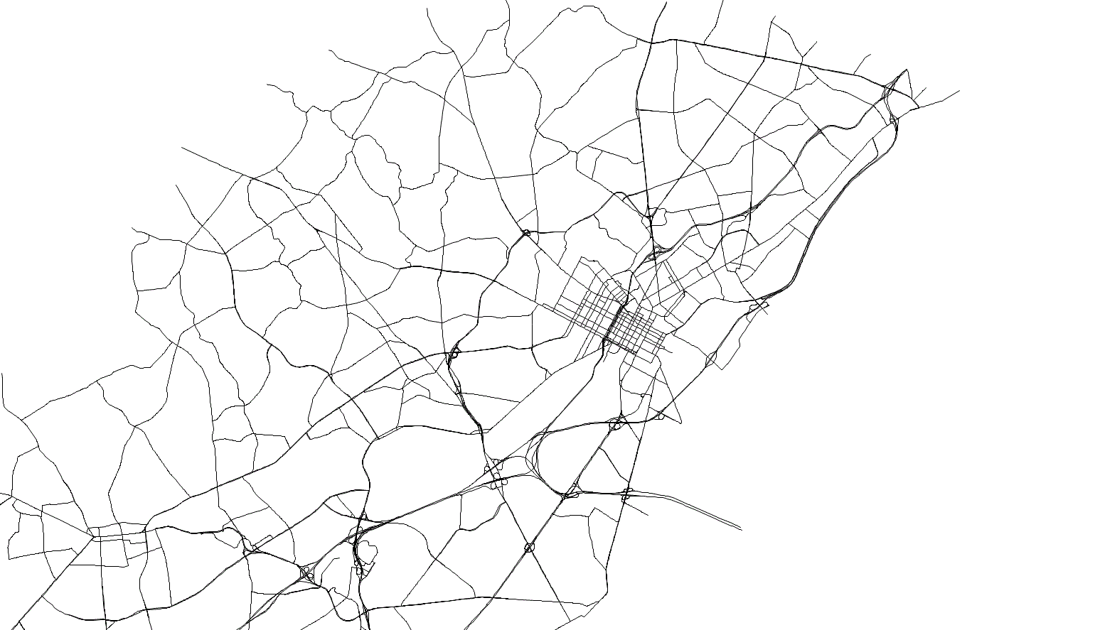
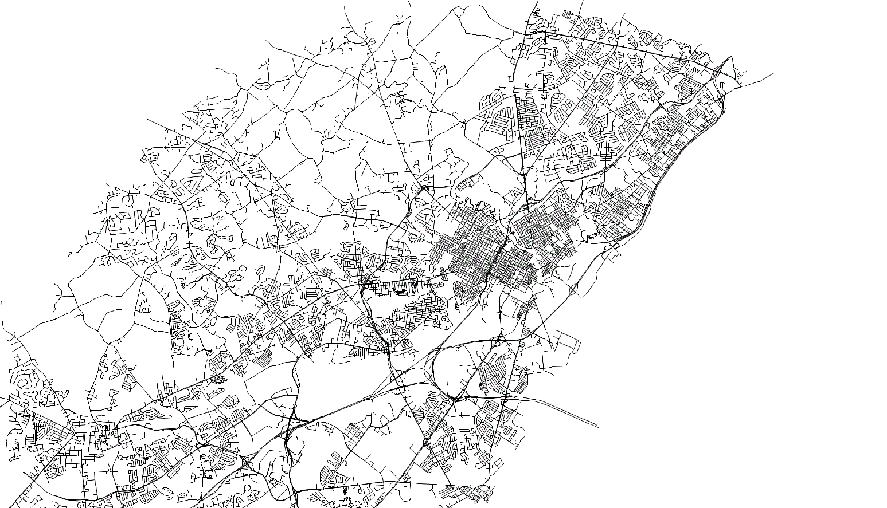
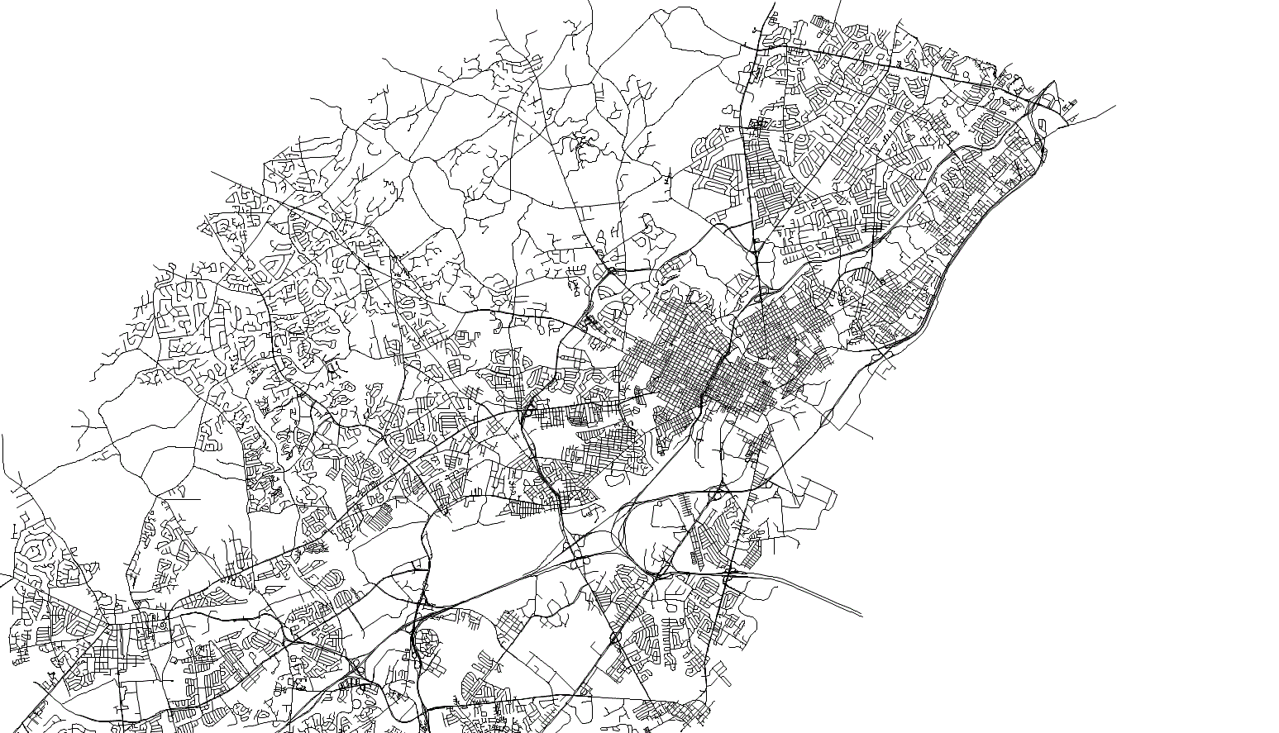
Travel Network – New Castle County
PENINSULA
CENSUS BLOCK
TAX PARCEL

Slide 11
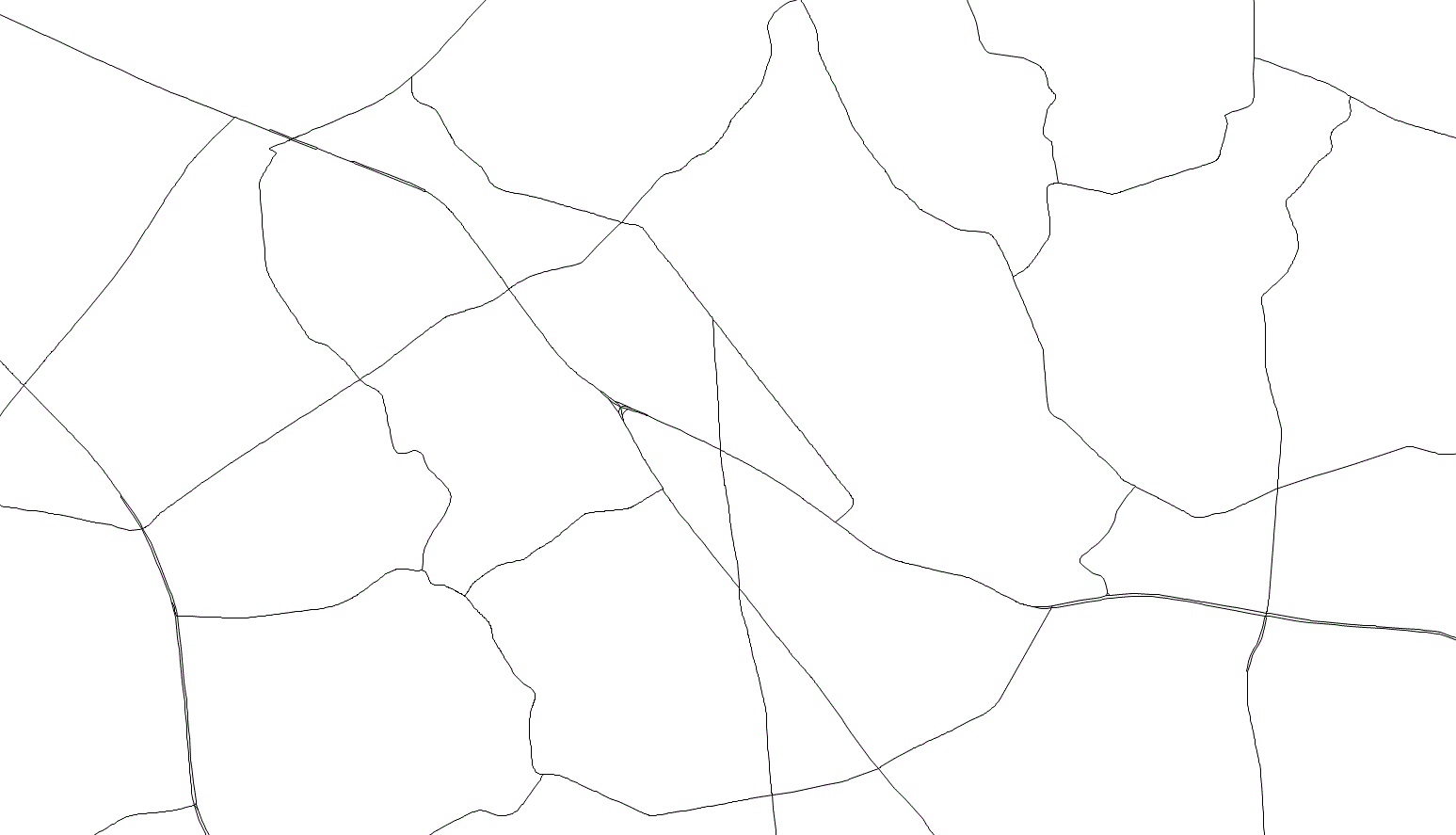
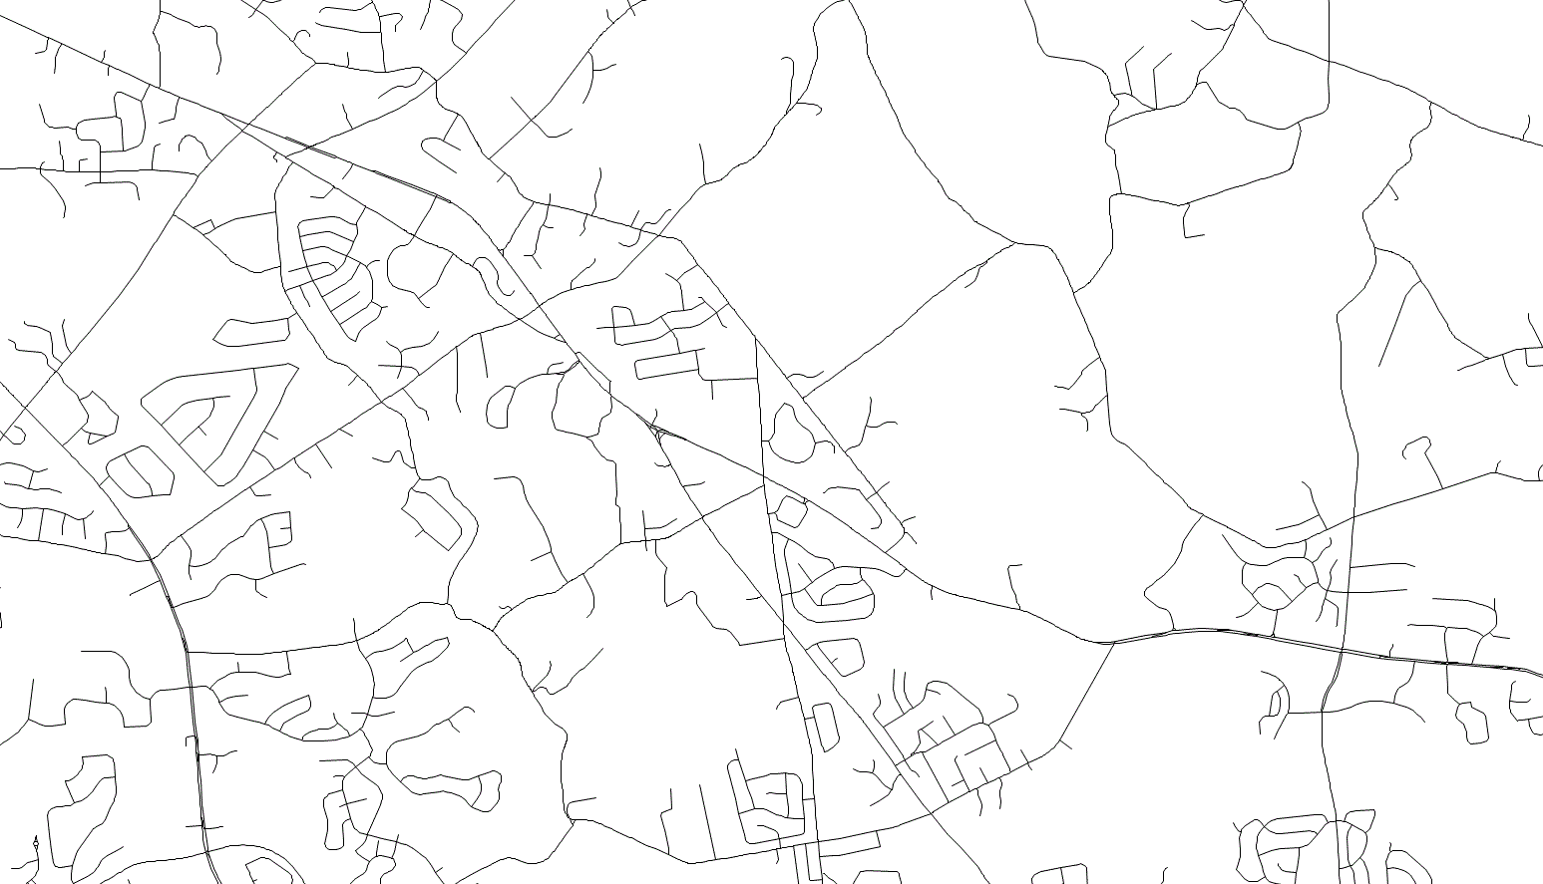
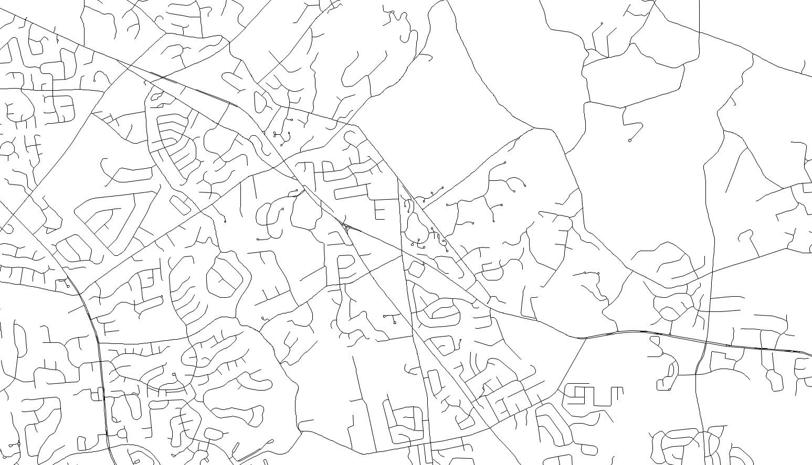
Travel Network – Suburban Area
PENINSULA
CENSUS BLOCK
TAX PARCEL

Slide 12
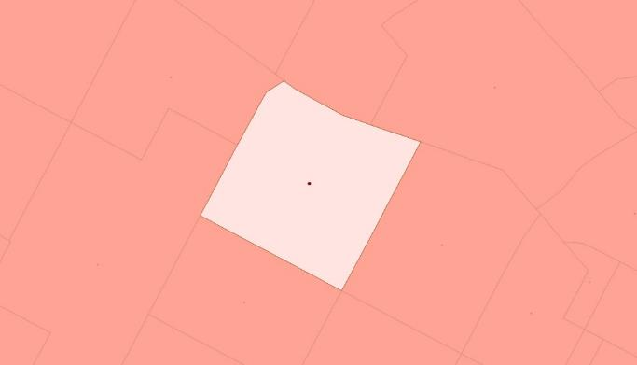
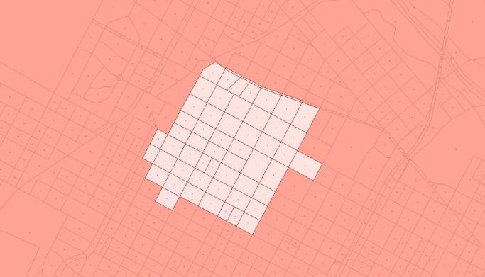
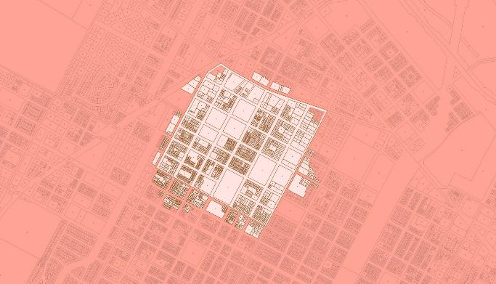
Destinations Available within 0.25 Miles
PENINSULA
1 INTRAZONAL
CENSUS BLOCK
57 CENSUS BLOCKS
TAX PARCEL
1257 PARCELS

Slide 13
Representation of Biking and Walking
Annual Survey Background
  Delaware Travel Monitoring System (DTMS)
  Annual polling since 1997
  Survey conducted by University of Delaware’s Center for Applied Demography and Survey Research (CADSR)
  Computer Assisted Telephone Interviewing Over 60,000 survey trips in comprehensive database

Slide 14
Representation of Biking and Walking
Enhanced DTMS survey in 2012
  Changes included introducing a new set of walking, bicycling, and transit specific questions
  Prompted respondent to report recreational trips
  Surveyed preference on comfort with walking or bicycling, maximum distance willing to use either mode

Slide 15
Representation of Biking and Walking
Improved Results
  Number of reported walk and bike trips increased
Trip Mode | 2010 | 2011 | 2012* | 2013* | 2014*
Walk | 1% | 3% | 12% | 10% | 11%
Bike | 0% | 0% | 1% | 1% | 1%
Bus | 1% | 1% | 1% | 1% | 1%
Car | 98% | 95% | 86% | 89% | 86%
*enhanced DTMS survey year

Slide 16
Improved Survey Results

Slide 17
Improved Survey Results

Slide 18
Improved Survey Results

Slide 19
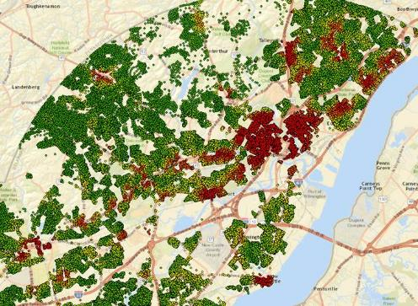
Influence of Accessibility on Travel Mode
What level of accessibility influences travel mode the most?
  1 mile
  0.5 miles
  0.25 miles

Slide 20
1 Mile Accessibility (Walk Trips)

Slide 21
0.5 Mile Accessibility (Walk Trips)

Slide 22
0.25 Mile Accessibility (Walk Trips)

Slide 23
0.25 Mile Accessibility (Walk)

Slide 24
Next Steps
Develop hybrid model that includes accessibility, distance, and presence of infrastructure (Late Summer 2015)
Streamline inclusion in statewide model (Early Fall 2015)
Sensitivity testing (Late Fall 2015)

Slide 25
Conclusions
Revised travel network, improved travel survey, and accessibility-based model will greatly enhance the ability to estimate active transportation at the street level
Revised process will streamline the ability to quickly provide results to decision makers

Slide 26



Questions?
Scott Thompson-Graves
724-779-7940
sthompson-graves@wrallp.com
Mike DuRoss
302-760-2110
michael.duross@state.de.us
Dave Racca
302-831-1698
dracca@udel.edu
Li Li
703-293-7423
lli@wrallp.com
Ashley Tracy
724-779-7940
atracy@wrallp.com

