Slide 1
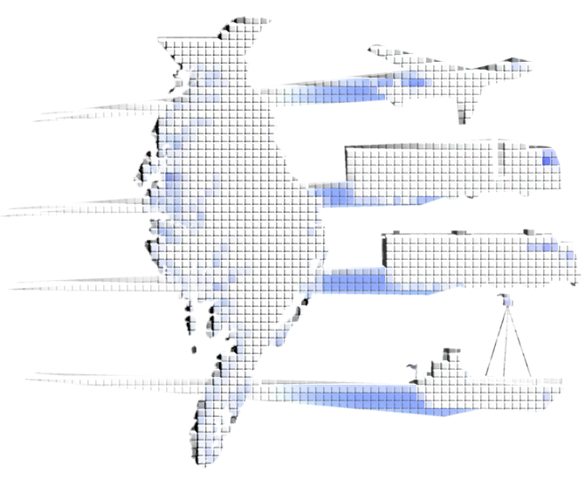
Forget the Box:
Scenario Planning Customization for the Delmarva Freight Plan
15th TRB National Transportation Planning Applications Conference
Atlantic City, NJ
May 17-21, 2015

Slide 2
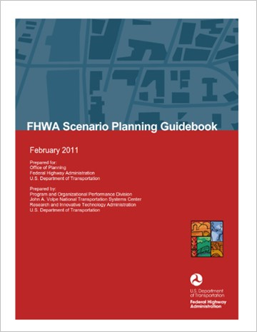
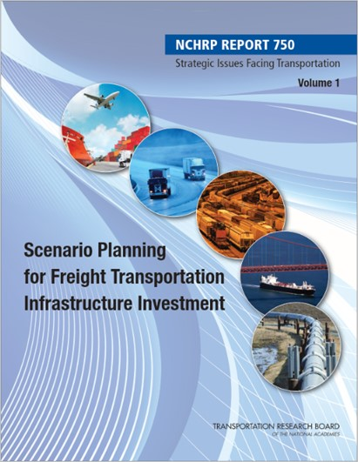
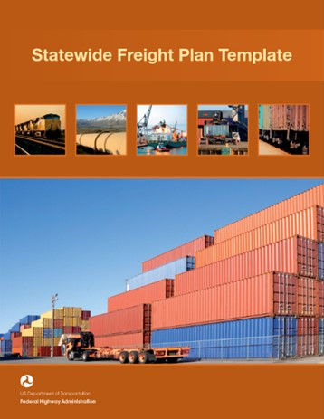
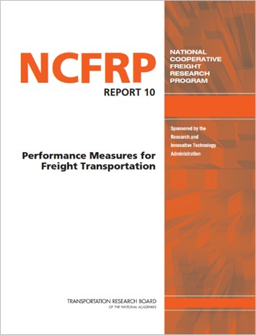
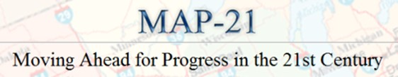
Recent Trends
2011
2013
2012
Notes:
Policy guidance in 2011 included how-to guidance from FHWA, NCFRP, and others relative to general scenario planning, freight planning, and performance measurement specific to freight.
MAP-21 introduced significant freight provisions, performance management, and optional scenario development.
NCHRP 750 defined scenarios as “methodically constructed stories” and applied those direct to freight infrastructure investments.

Slide 3
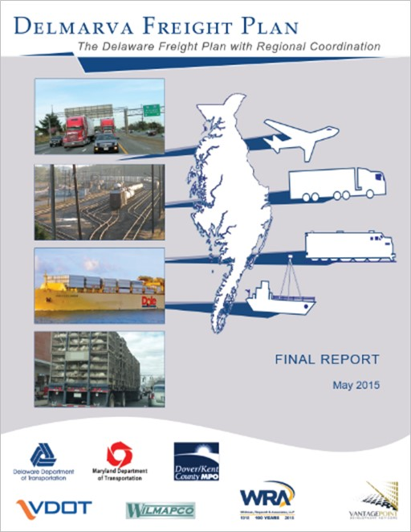
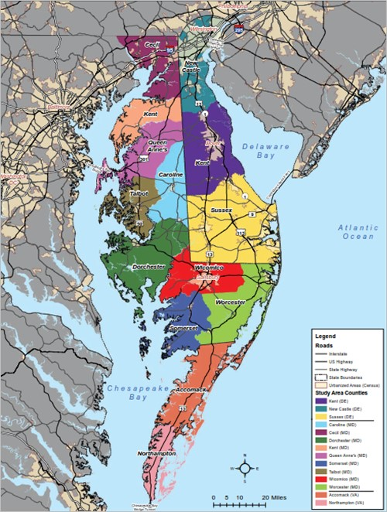






Delmarva Freight Plan
PA
NJ
MD
DE
VA
Notes:
Highlights of the Delmarva Freight Plan included:
Multi-jurisdictional coordination
Commodity flow modeling
Performance-based scenario planning
Project screening & prioritization
Funding & implementation opportunities

Slide 4
Scenario Planning Process
Background Planning
Scenario Development
System Perspectives
Corridor Perspectives
Action Plan

Slide 5
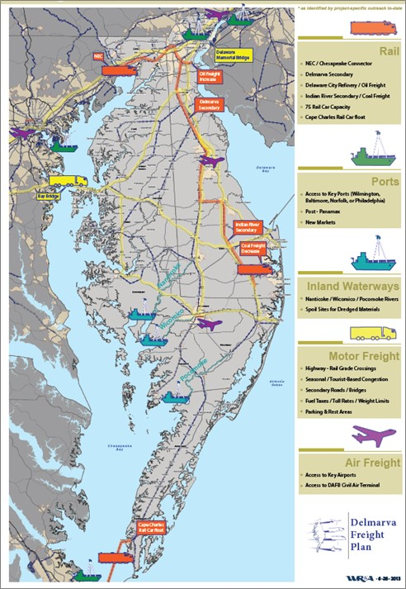
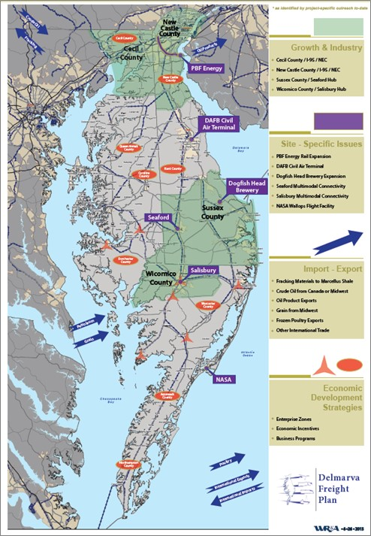
Background Planning
Concerns
Opportunities
Notes:
Includes document reviews, outreach & planning insights, and other efforts to help identify freight focus areas and key issues.

Slide 6


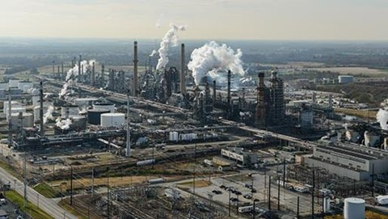
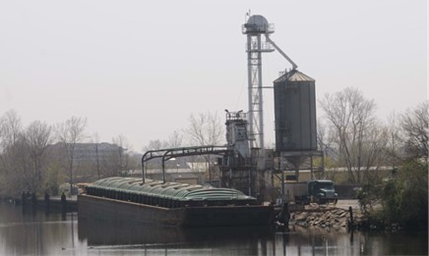


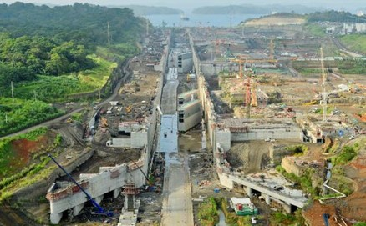
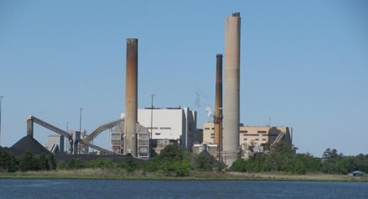

Background Planning
External Forces…

Slide 7
Scenario Development
Six Scenarios
Baseline – 2010 Existing
Baseline – 2040 Future
Constraint – w/ Trendline Growth
Constraint – w/ Accelerated Growth
Enhancement – w/ Trendline Growth
Enhancement – w/ Accelerated Growth

Slide 8
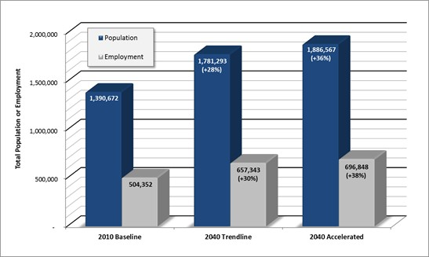



Economic Influence
Trendline
Growth
Accelerated
Growth
Census
WILMAPCO
Targeted industries
Market shifts
Notes:
Targeted industries included food mfg, petroleum/coal prod, chemical mfg, fab metals, transportation & utilities, and wholesale trade.
Market shifts reflected poultry exports, agribusiness or grain imports, higher-value crops or value-added food products.

Slide 9
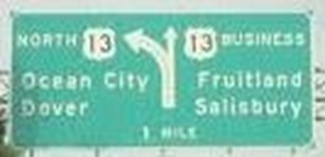
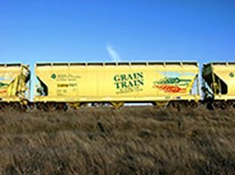
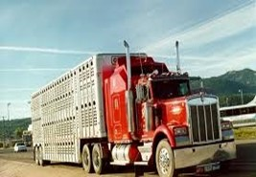
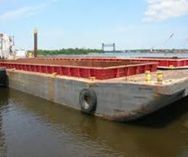
Infrastructure Influence
Multimodal Constraint
Multimodal Enhancement
Rail constraints
Barge constraints
Truck reliance
Rail improvements
Bridge upgrades
Intermodal access

Slide 10
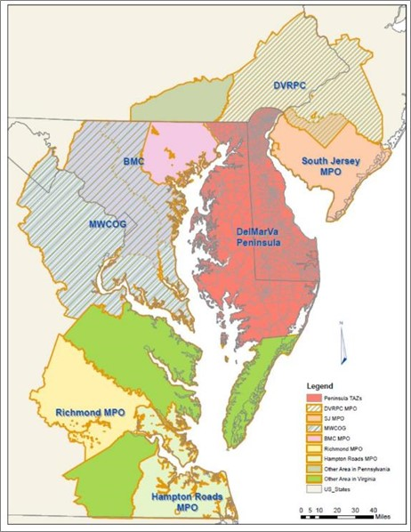
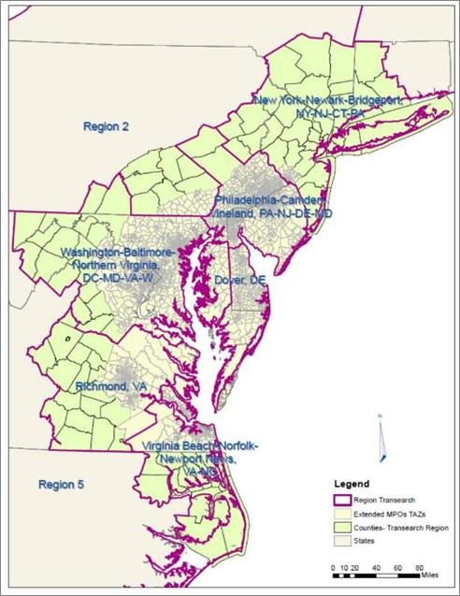
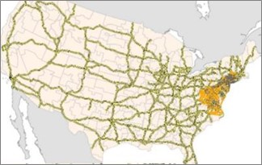
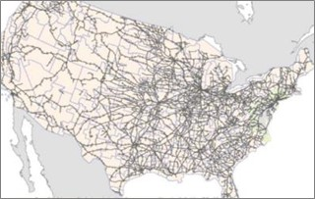
Detailing the Scenarios
Commodity Flow Model
Notes:
Quantitative tool for performance measurement, system wide or corridor level assessments, industry or commodity specific flow characteristics, and scenario planning. Model steps included:
Generation
Modal Distribution
Transport Logistics Nodes
Fine Distribution Model
Vehicle Model
Urban Goods Models

Slide 11
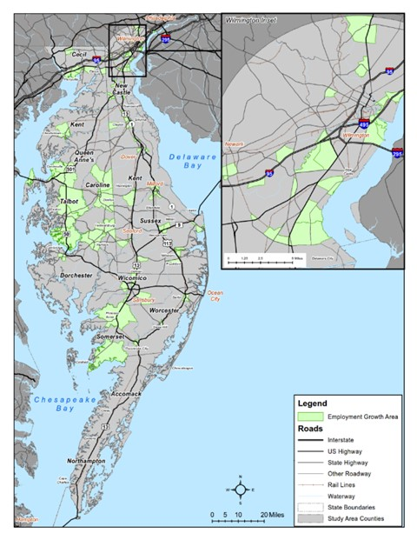
Detailing the Scenarios
Accelerated Growth
  x 120% Background
  x 140% Targeted Industries
  x 105% Market Shifts
  x Model Productivity Factors
Growth Levels & Locations
8% add’l pop & employ vs. Trendline
14% add’l freight vs. Trendline
Notes:
By employment category, accelerated growth may appear as either an increase vs. Trendline growth, or a decreased rate of decline vs. Trendline Growth
Trendline growth adds 70-80% freight vs. Baseline, and accelerated growth adds 14% additional freight beyond the Trendline.
Accelerated Growth areas were assigned to high volume employment areas, high proportional growth areas, major employment or freight transfer hubs, based on surrounding transportation infrastructure, based on surrounding land use patterns, and based on the location of known industrial parks, enterprise zones, or other incentive areas.

Slide 12
Detailing the Scenarios
Delaware City Refinery
  Grow oil to TAZ
Indian River Power Plant
  Delete coal to TAZ
  Panama Canal Expansion
  Explore & isolate FAF import/exports
  Grow select flows by 20% (10M tons)
Trip Table Revisions

Slide 13
Detailing the Scenarios
Highway Projects
  Modify highway model network
Rail Bridge Constraints
  Delete rail network links
River Constraints
  Delete river network links
  Adjust trip table and O-D pairings
Network Revisions

Slide 14
Detailing the Scenarios
Rail Service or Access
  Modify rail network link speeds
Highway/Rail Grade Separation
  Modify highway network link speeds
Intermodal Operations
  Add new transportation logistics node
  Adjust model weighting factors
Other Factors

Slide 15
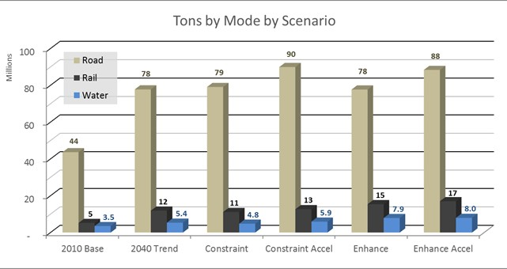
Interpreting the Scenarios
System Perspectives
Example: Tons by Mode by Scenario
Impact of accelerated growth on truck levels
Notes:
System Perspectives include mode splits, travel time impacts, and general trends or implications relative to how the scenario affects the broader region.

Slide 16
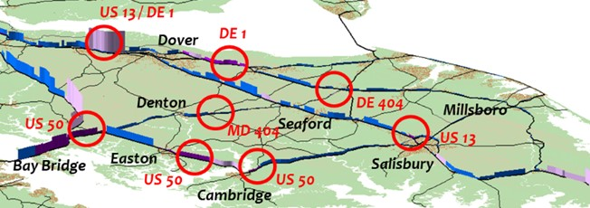
Interpreting the Scenarios
Corridor Perspectives
Example: Truck VHT by LOS
Impact of truck vs. barge traffic to Salisbury
Notes:
Corridor perspectives include corridor-specific travel impacts and the identification of hot-spots or future study needs that may or may not have a project on the books. At this stage, quantitative scenario results can also be used to assess more or less project need under any given scenario both now and into the future.

Slide 17
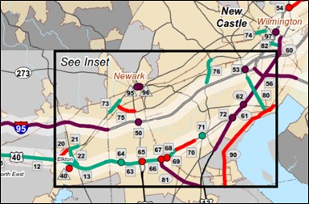
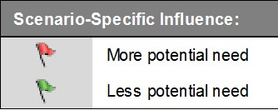
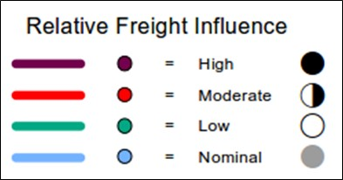
Interpreting the Scenarios
Action Plan
Example: Scenario Influence as part
of project screening & prioritization
Notes:
The Final Action Plan includes the results of the project screening and prioritization process, guiding principles and policies that may be used to help move toward, move away from, or simply react to future scenario possibilities, and implementation or plan enhancement options such as performance monitoring needs, follow-up scenarios, or other areas to investigate.

Slide 18
Closing Thoughts
Scenario Planners must…
Engage stakeholders
Accept uncertainty
Beware of technical limbo
Scenario Planning will…
Support regional perspectives
Help to inform decision-making
Serve as a planning catalyst

Slide 19



Questions?
Chad D. Reese
724-779-7940
creese@wrallp.com
Mike DuRoss
302-760-2110
michael.duross@state.de.us
Scott Thompson-Graves
724-779-7940
sthompson-graves@wrallp.com
Dan Blevins
302-737-6205
dblevins@wilmapco.org

