Slide 1


No Horsing Around, A Hole in One with Mobile Phone Data
Using Mobile Phone Location Data to Support Corridor Analysis
Rhett Fussell, PE
Craig Gresham, PE
National Transportation Planning Applications Conference
Atlantic City, NJ
May 19, 2015
Notes:
Anyone wanna guess what a horse a hole in one and mobile phone data have in common?

Slide 2
What Are We Chatting About?
The Project & Why Mobile Phone Data?
Our Data
The Outcome- “A Hole in One”
Thoughts for You

Slide 3
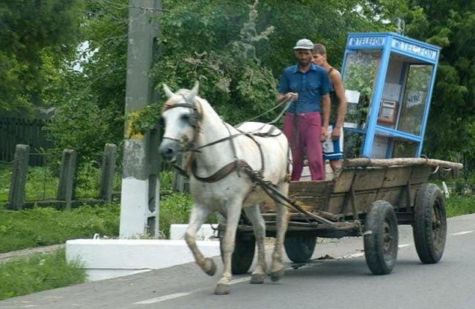
The Project & why mobile phone data
No Horsing Around!!!
Notes:
Horse on mobile phone???? Yes it is NC…..no this not our version of mobile phone data

Slide 4
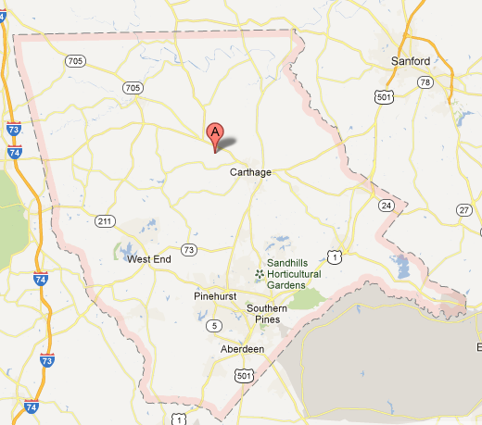
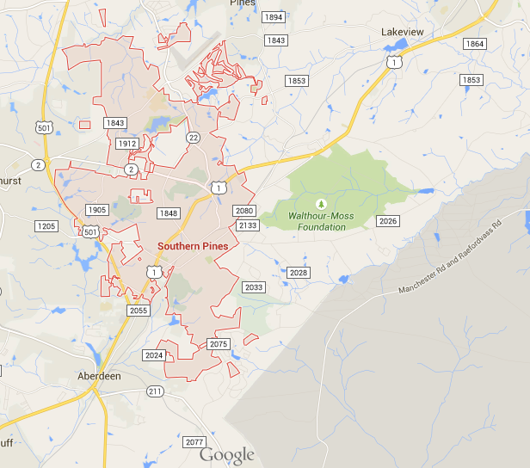


The Project: Moore County Region
(Southwest of Raleigh, NC)
Notes:
Anyone know where Moore Co is? And why you would care??
Mostly a corridor issue but they had to build a simple four step model to handle and have data support.
NIMBY

Slide 5
Why Mobile Phone Data?
  NCDOT Controversial Project
      Bypass Through Prime Land
  Borrowing Model Structure
  Needed a Data Source that Was Reliable
      Trustworthy & Not Biased By Locals
  Cheap and Easy Data to Help The Modelers
      $10k-25k versus $250K Survey
Something to Hang Our Hat On!!
Notes:
Borrowing Model Structure had No HH Survey, wasn’t sure of travel patterns –more on next slide

Slide 6
Why Mobile Phone Data?
  Local Travel Only?
  Needed to Know Resident vs Non-Resident
  Through Trips

Slide 7
Our data
Notes:
Horse on mobile phone????

Slide 8
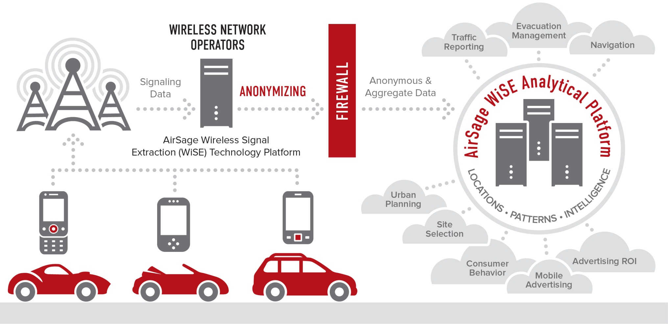
AirSage WiSE Platform
Notes:
Any time a signal ping is made…data, turn on or off phone, tower contact, just has to be on.

Slide 9
Methodology – Subscriber Classification
Assign a 'home zone' as being wherever a subscriber was during 'home time' for at least half the weekdays (20 for Moore County) during the study period. 'home time' is from 9 PM to 7 AM.
Residents are defined as having a 'home zone' in the study area.
Non-Residents are outside Moore County
Notes:
Lots of pings between theses hours.

Slide 10
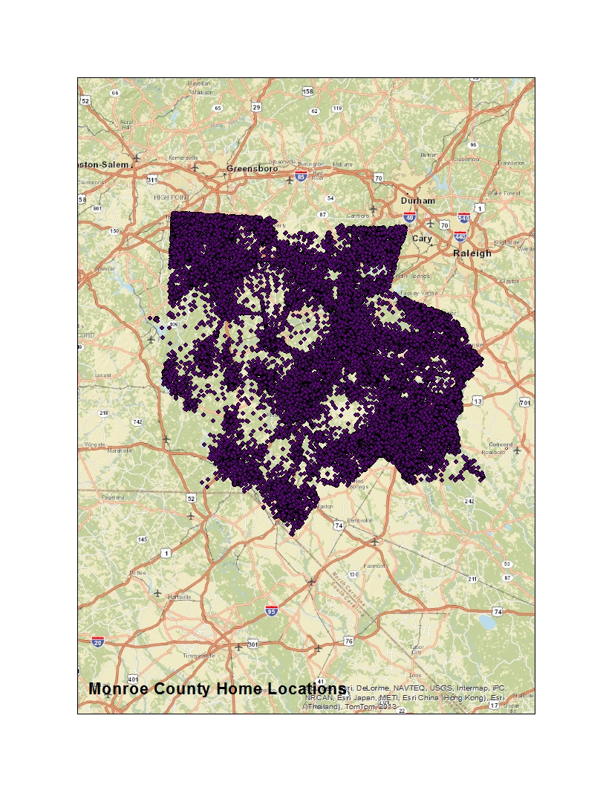

Data Fast Facts
1 month of Verizon Data
11 Million Recorded Trips
~3 Million Unique Devices
Notes:
*Based on Airsage Mobile Device Methodology
11,590,819 - Total number of trips recorded
3,017,382 Unique mobiles seen at least once in focus study area
weekend data is only used to help determine the home and work locations of the devices. This data is NOT USED in developing the OD matrices used in the analysis described for Moore County

Slide 11
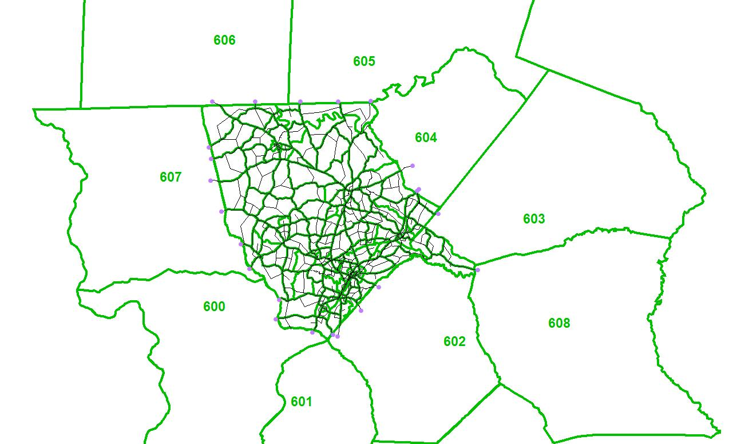
Airsage TAZ System
Notes:
Reason I am showing this data- proper development of zones is important

Slide 12
Moore County Study Facts & Figures
Trip Type | Trip | Percentage
Total | 378,965 | 100%
IE_NonResident | 6,245 | 2%
II_NonResident | 10,561 | 3%
II_Resident | 274,351 | 72%
IE_Resident | 80,878 | 21%
EE_Trips | 6,930 | 2%
Notes:
Lot of people are leaving this county to work elsewhere

Slide 13
Comparison of Raw Data
Purpose | Person Trips |  |  | % of Internal Trips
 | Model | Airsage | % Diff | Model | Airsage
HBW | 55,489 | 52,991 | -4.5% | 19% | 19%
HBO | 145,224 | 136,381 | -6.1% | 49% | 48%
NHB | 92,902 | 95,539 | 2.8% | 32% | 34%
EIIE | 99,076 | 102,117 | 3.1%
EE (vehicle) | 12,084 | 12,084 | 0.0%
Total | 404,775 | 399,112 | -1.4%
Notes:
Did we have confidence in the data???? We did a few initial comparison before we did anything to the travel model. This is running the model using the borrowed rates etc from Fayetteville “as is” right. So generally the airsage verified we werent far off

Slide 14
HBW Trips Raw Comparison
This is not the calibrated model. This was raw data comparison of airsage to initial borrowed model
Notes:
Yellow is again using the trip dist from fay model and then comparing to the airsage data- again that we werent off that far but that we could then adjust things.

Slide 15
The Outcome…A Visual Impact
A Hole in One
Notes:
Horse on mobile phone????

Slide 16
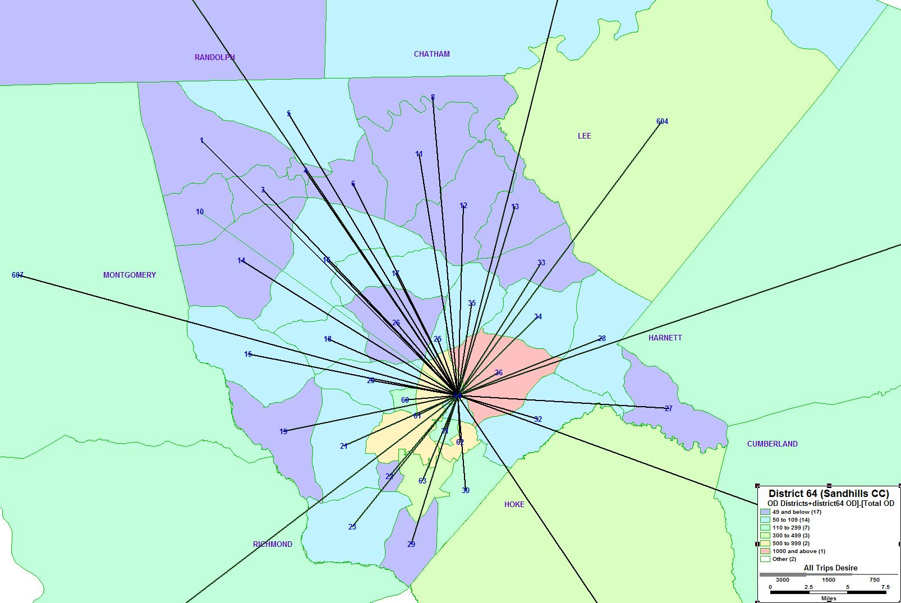
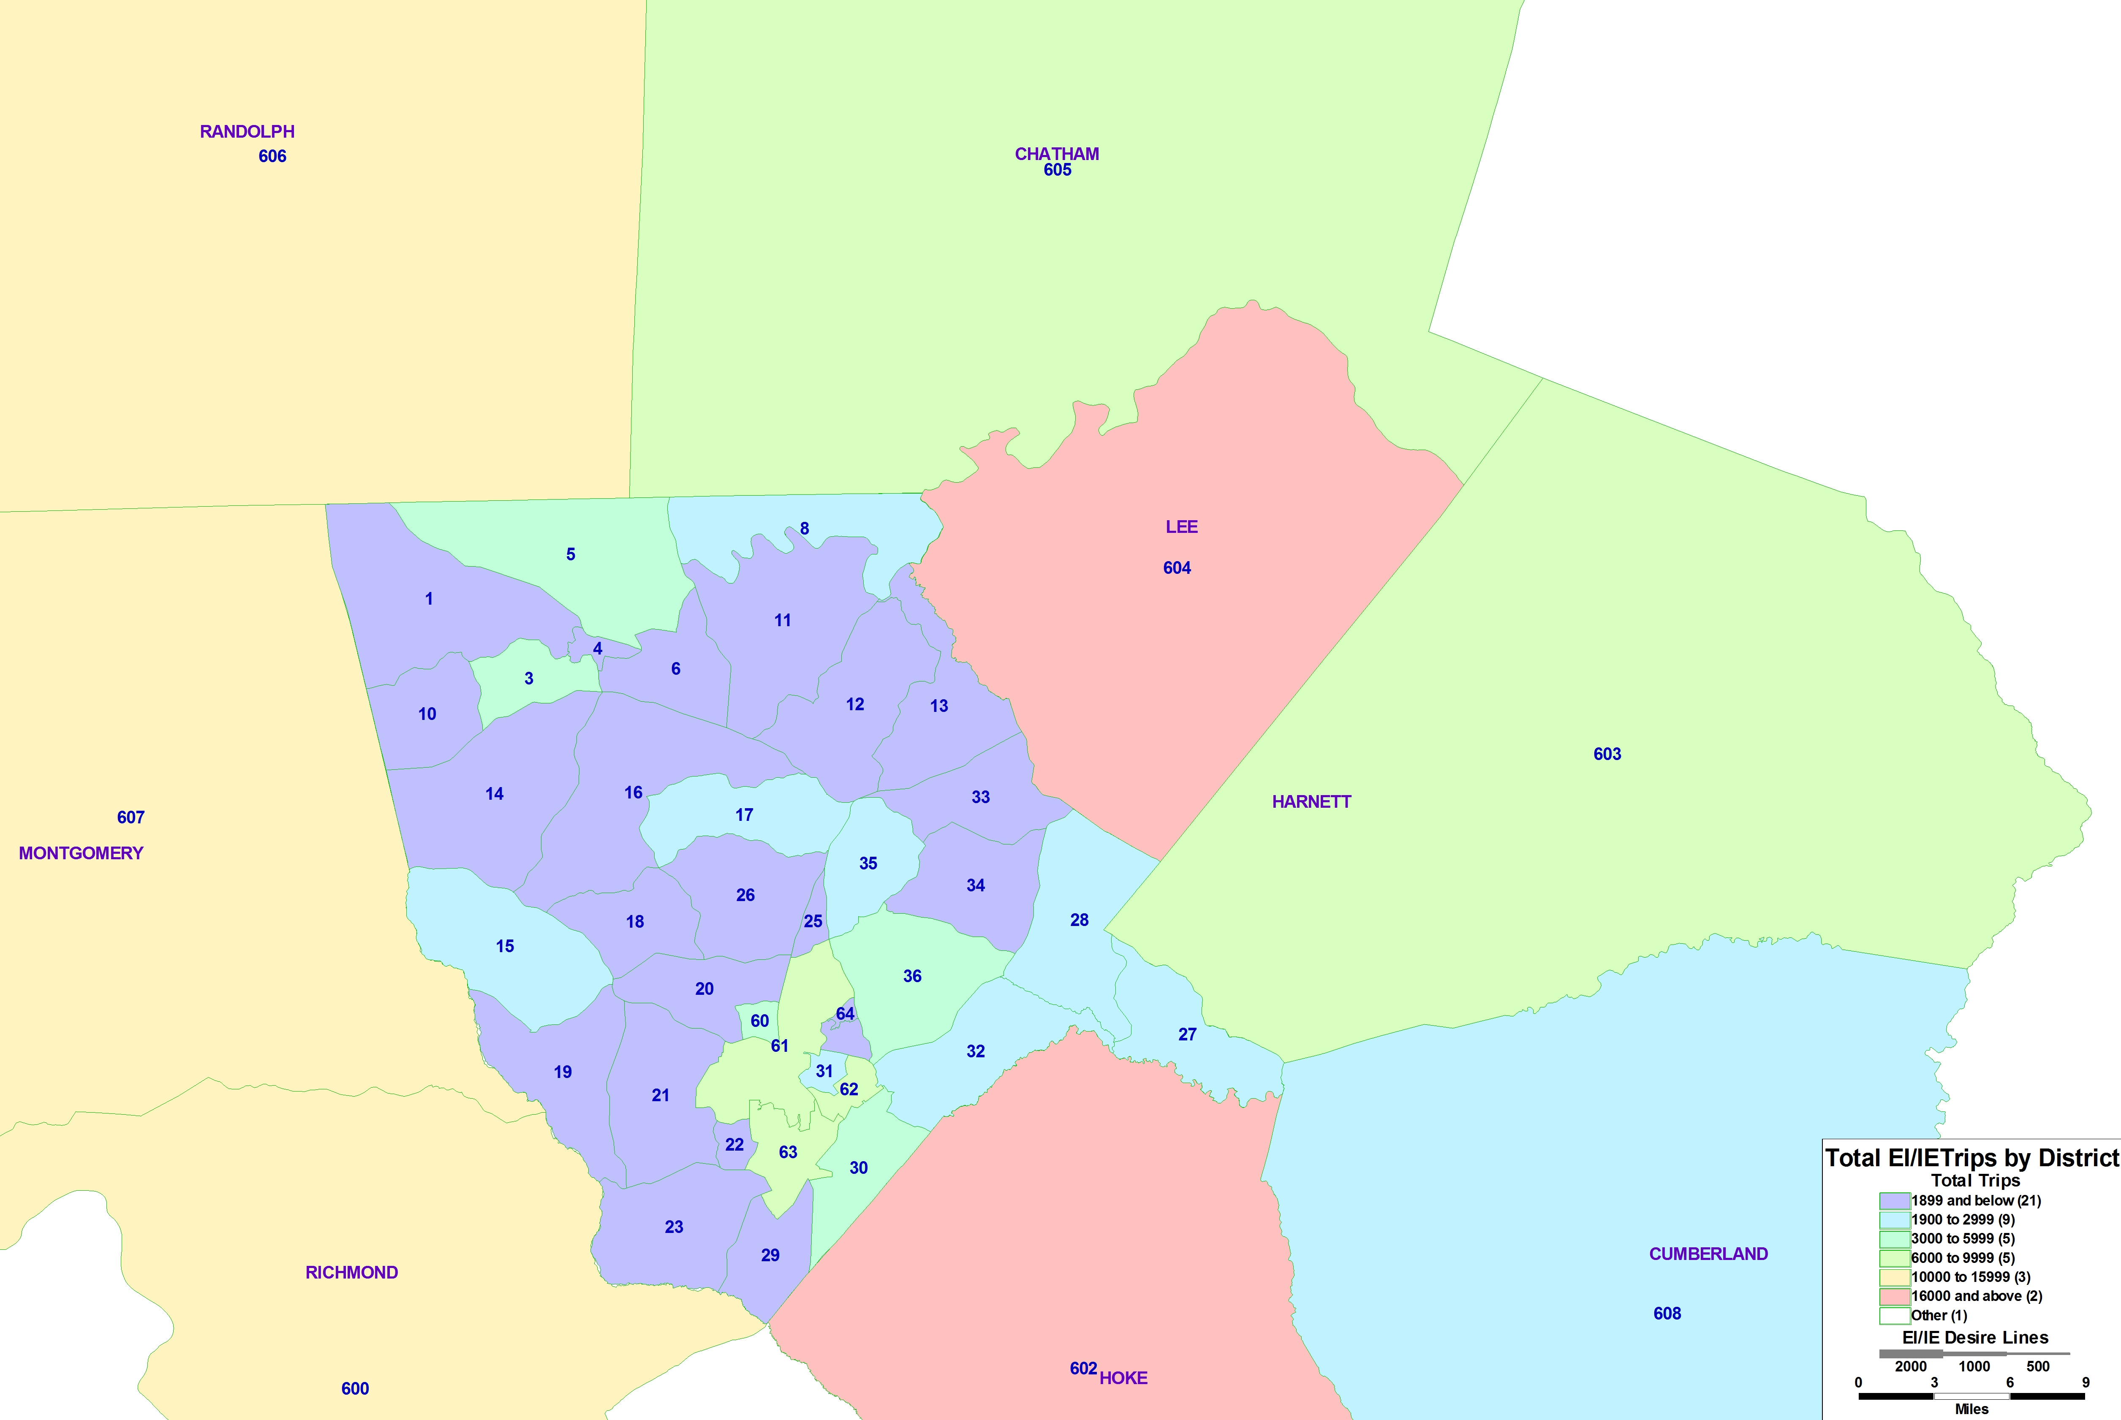
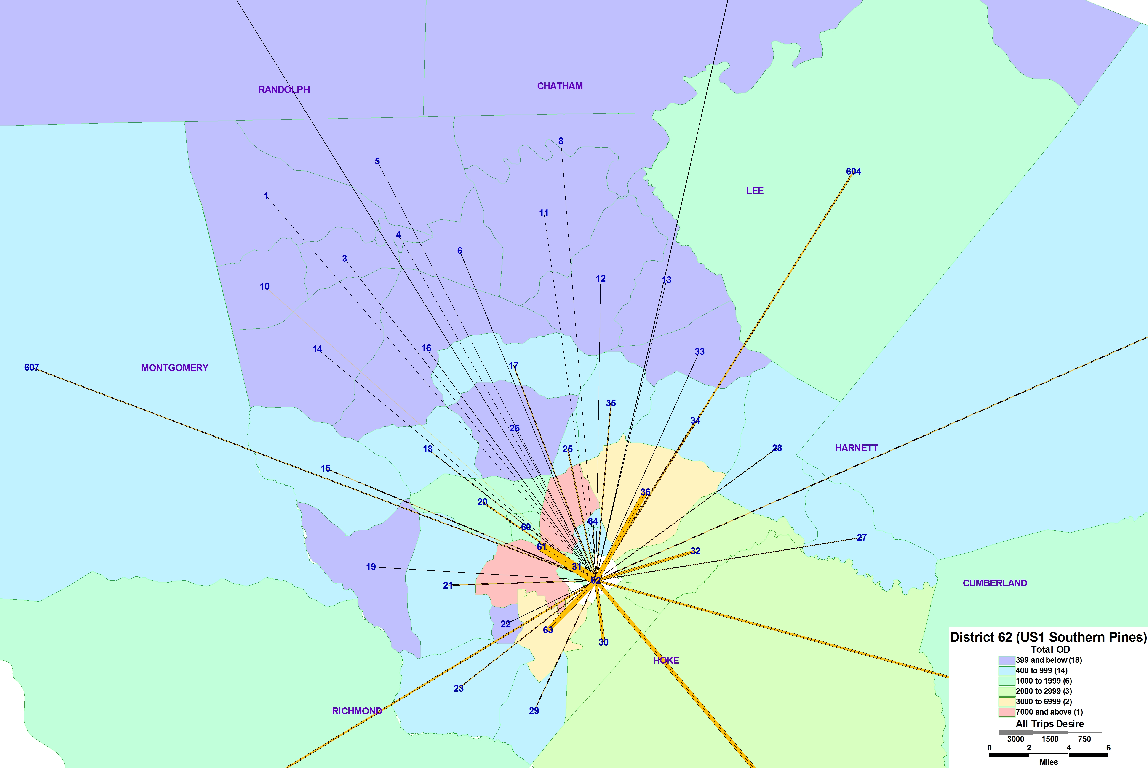
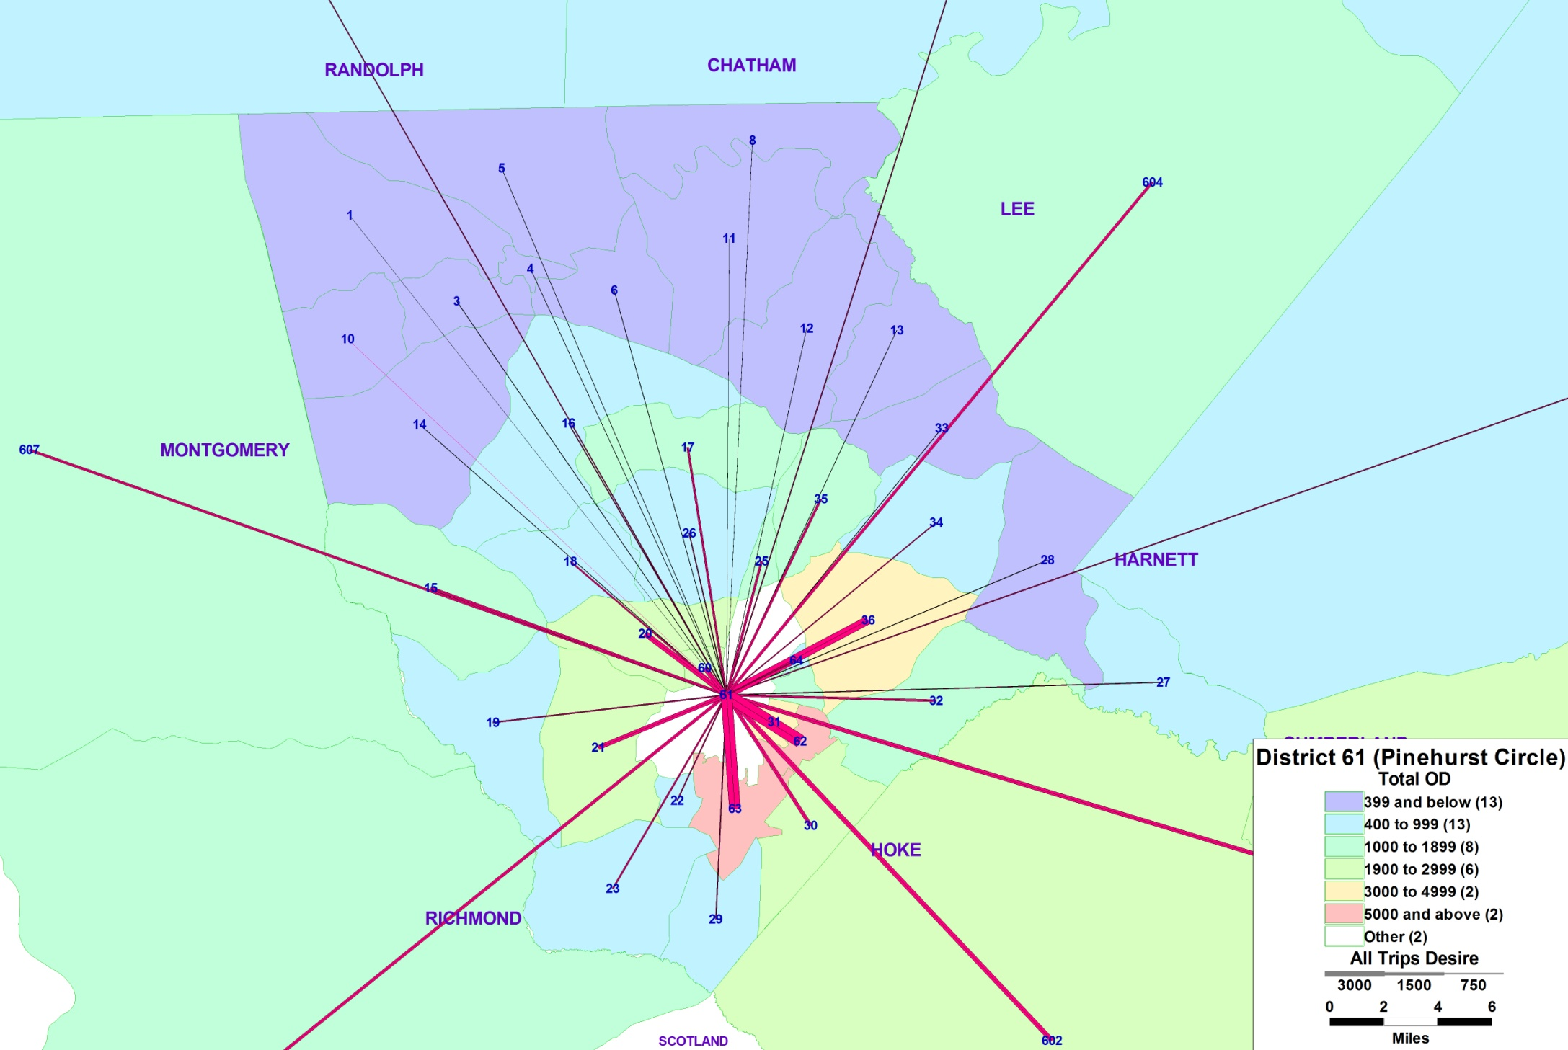
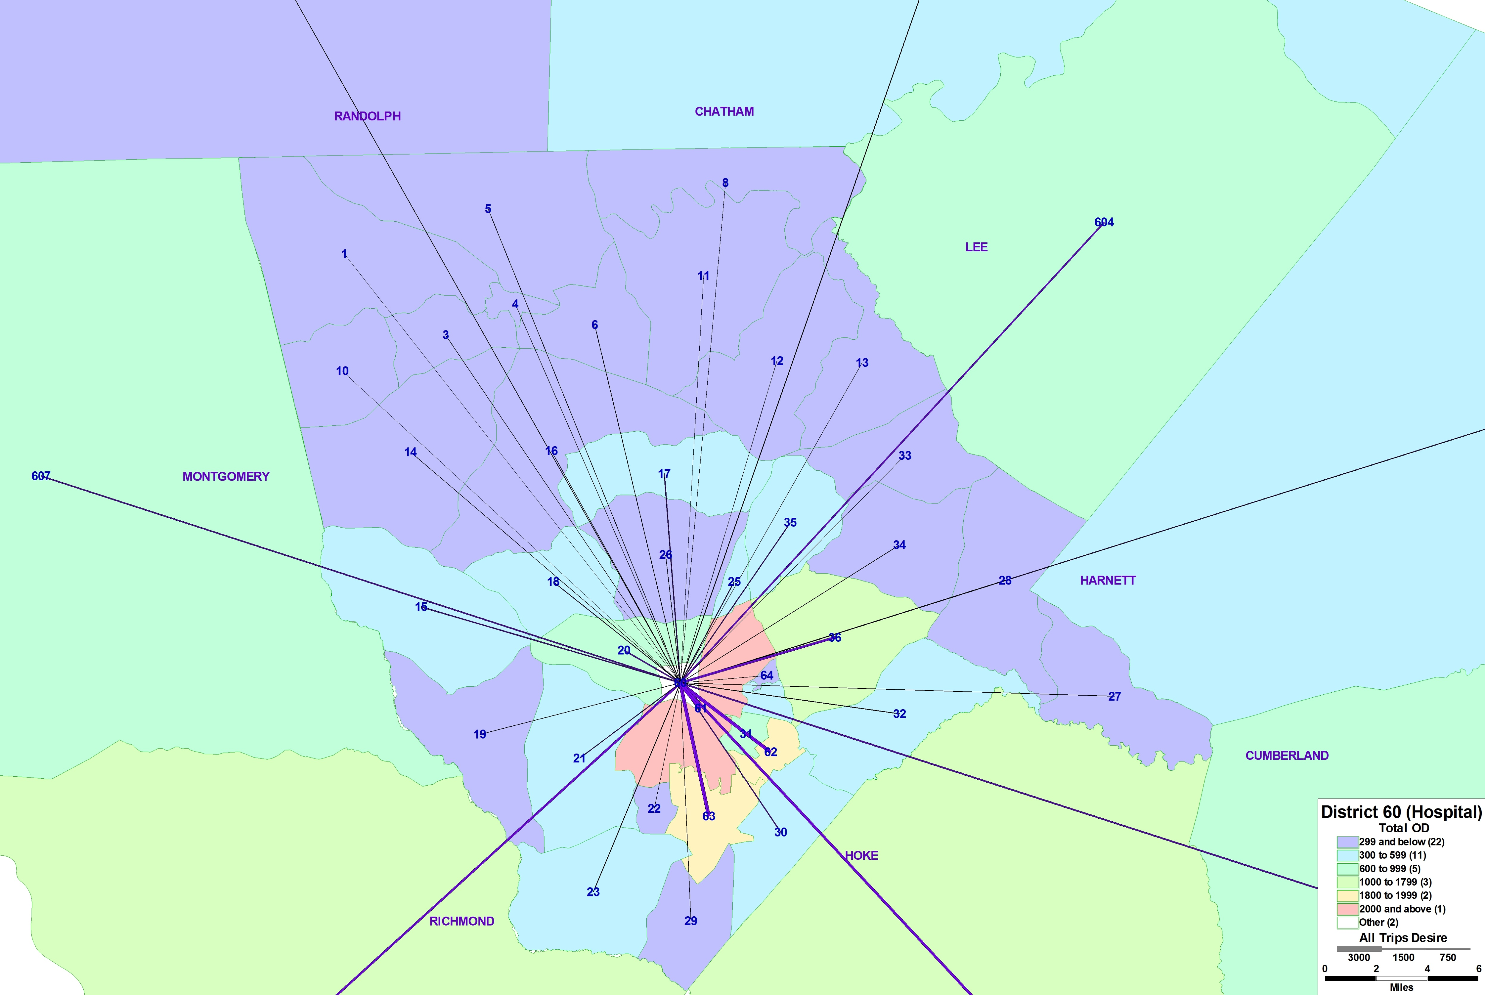
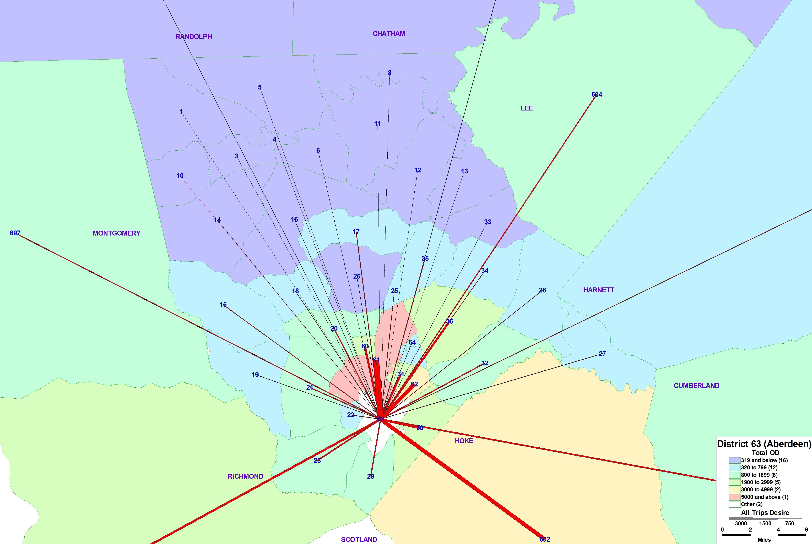
Pinehurst Circle ODs
Notes:
For these figures you will see we grouped TAZs into “districts” so that we could get all the flows into that particular region
The lines on this map show the DESIRE to go between two areas and the thickness of the lines shows the higher flows!
We have color coded the districts so that you can visually see which areas are the most attractive to travel to from the key location.
Lot of people coming through the circle are headed into downtown southern pines obviously but also outside of the county

Slide 17
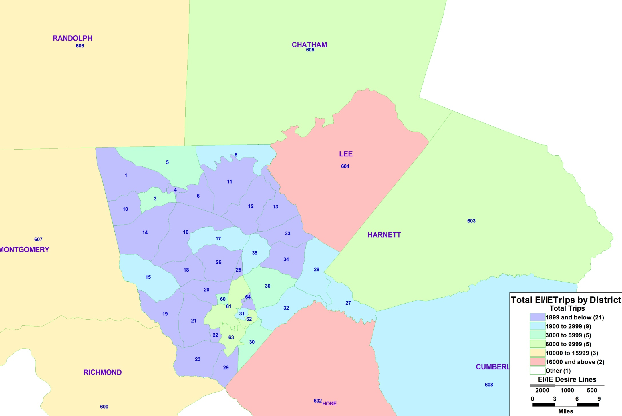
Trips Leaving Moore County Daily
(External to Internal)
County | Total EI/IE Trips | % of EI Trips
Chatham | 7,668 | 9%
Randolph | 11,752 | 13%
Lee | 16,852 | 19%
Montgomery | 11,364 | 13%
Cumberland | 2,093 | 2%
Richmond | 10,908 | 13%
Harnett | 6,865 | 8%
Hoke | 19,619 | 23%
Total | 87,120 | 100%
Notes:
So this map essentially shows that flow pattern. To make it easier to read we have placed ALL EI/IE trips into the district. So you see that Lee county

Slide 18
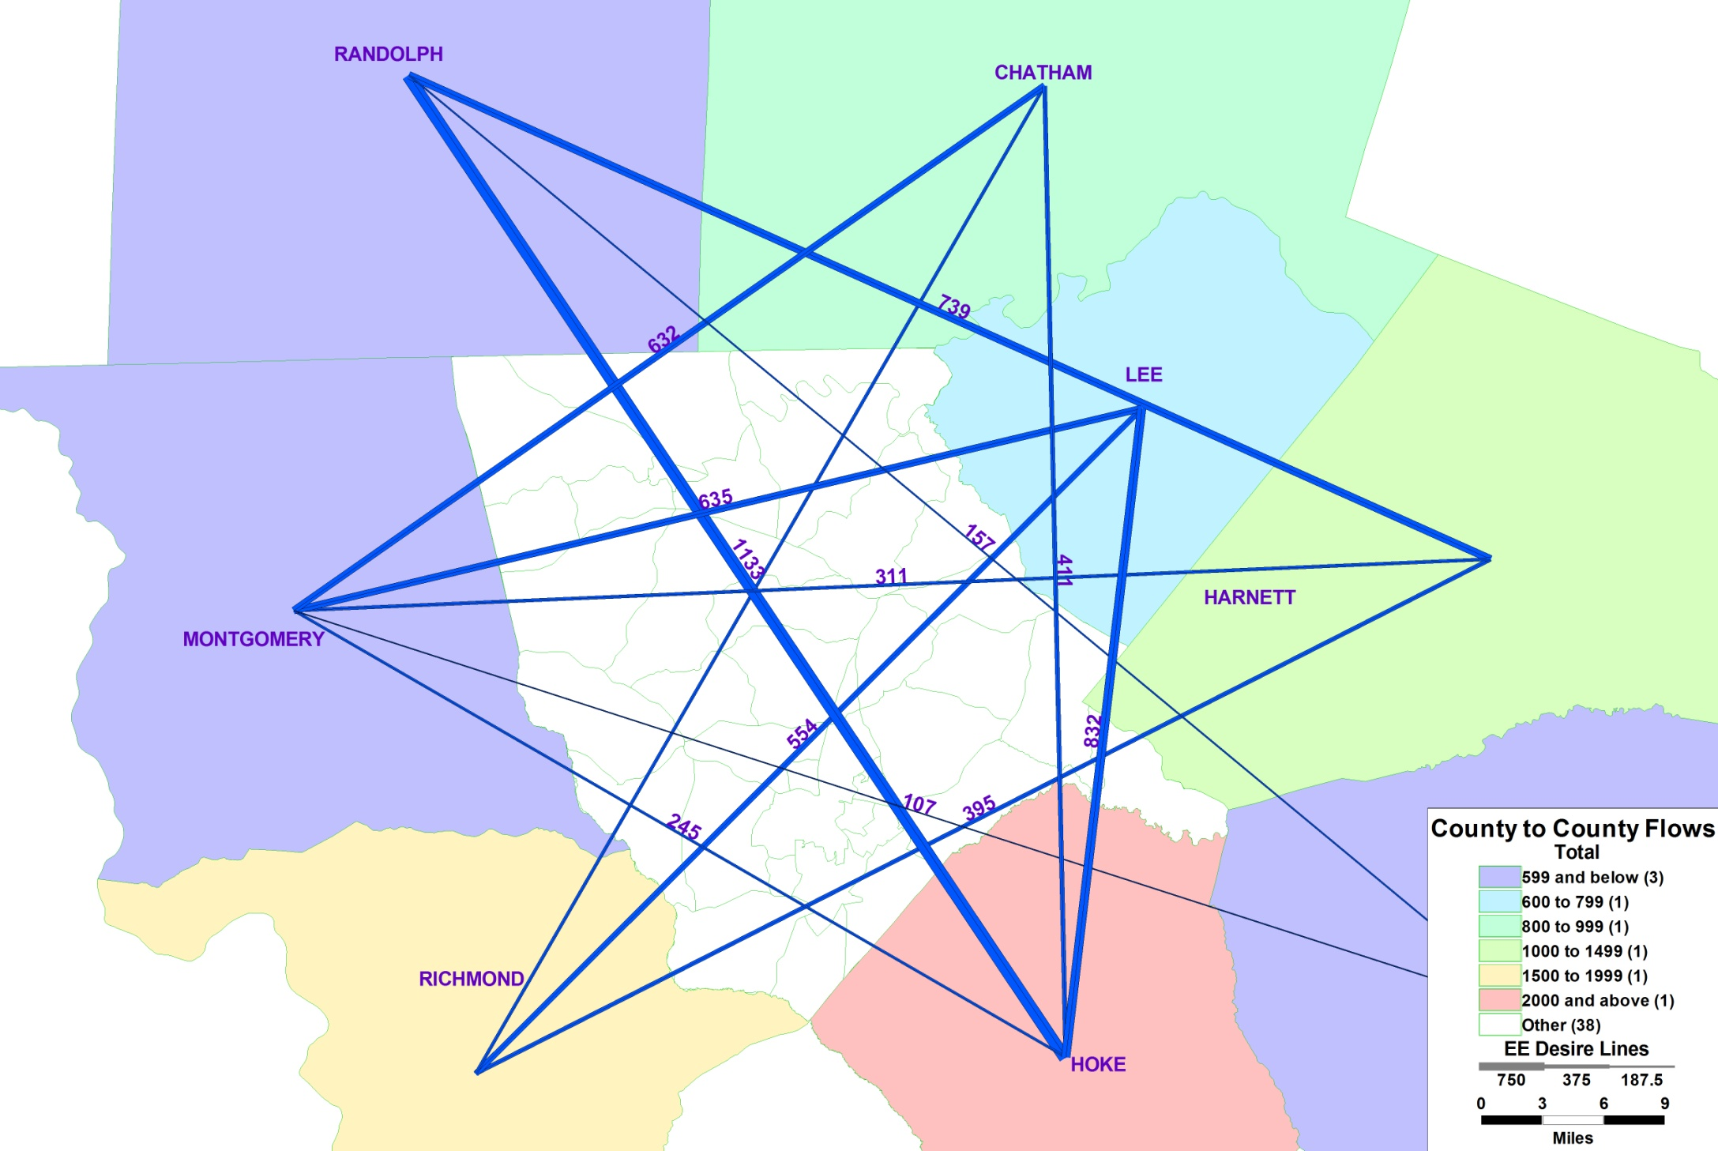
County to County Flows
(Through Trips)
Notes:
This shows the through trips. It doesn’t show the routes they take but it emphasizes the counties that have the most amount of people going through the Moore County area.

Slide 19
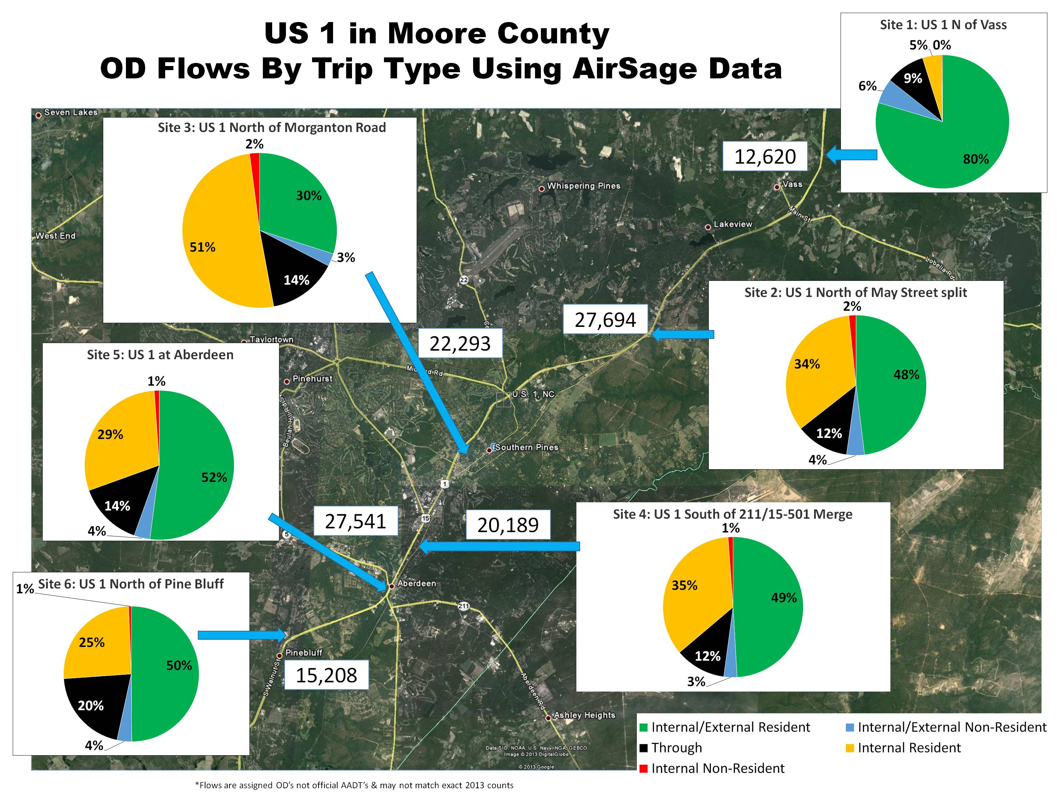
Notes:
This showed them that a lot of the links were not just internal traffic, that a lot of it is going outside of the county and that portions are also through. That likely will continue into the future.
These results and this map was far more important to the success of the study than any model or persons opinion.

Slide 20
Thoughts for You!
  Start with the End in Mind….Why Do I Need this?
  Break up districts/TAZs to get flows on right roads outside region
    Accounting for actual “travel flows” properly
  Understand Unusual regionality
    Hospitals
    Shift workers
    Special events
Notes:
get purpose or OD wrong

Slide 21
Thoughts for You!
  Gives you LOCAL travel data
    Understand resident/Non resident patterns
  Gives “unbiased” samples and representative data
  Un-intrusive/easy to collect
  Provides outstanding visual information to decision makers
Notes:
They were learning and we were learning. Much better process now

Slide 22





Many Thanks to Our Other Friends
Contact:
Rhett Fussell, PE
Parsons Brinckerhoff
Fussell@pbworld.com
Notes:
Thanks the NCDOT staff and the local planning organization

