Slide 1
rubber-banding in aggregate tour based models
15th TRB National Planning Applications Conference
Routenwahl im IV - Teil 2
Klaus Nökel
Chetan Joshi, Portland
Klaus Nokel, Karlsruhe
Arne Schneck, Karlsruhe

Slide 2
agenda
Background
Methodology
Real World Application
Remarks
Chetan Joshi, Portland

Slide 3


background
Aggregate tour-based approach involves explicit modeling of activities of homogeneously divided behavioral groups/ socio-economic groups aggregated at a zonal level.
  Matrix based
  No simulation
Home-Work-Home
Home-Work-Rec-Home

Slide 4
background
Rubber-banding
Makes the choice of stop locations along a tour more realistic by penalizing out of way travel…
Stop1
Stop2
Home
Work

Slide 5
methodology
Tour is divided into a half tour based on a given primary activity
Consider a tour HSWH (Home – Sports – Work – Home) with Work as the primary activity
This would be divided into two half-tours
  Home – Sports – Work (HSW)
  Work – Home (WH)

Slide 6

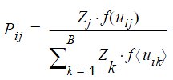

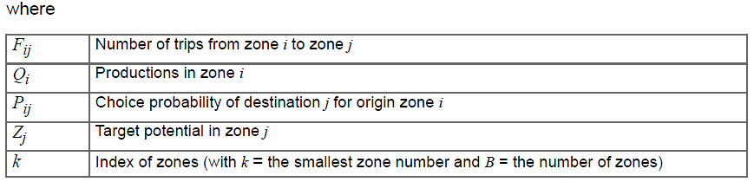
methodology
Compute trip distribution/destination choice and mode choice for the main activity on half-tour (H → W) first instead of H→S and then S→W

Slide 7

methodology
Insert stops S1, S2, … Sn between H → W such that out of way cost of the half tour is minimized:
  Use composite cost of the tour legs as utility:
  H→S + S→W
  Probability of selecting a stop location based on the above utility is thus:
  where,
  i=index of origin
  k=index of stop location
  Zk= size variable for stop location k
  U(HS),(SW) – utilities of traveling to destination thorough a given stop location
  w = weight of the rubber band

Slide 8
methodology
Multiply probabilities with trips on main activity to obtain trips on each leg of the tour:
  T(H→S1) = T(H→W) X P(H→S1)
  T(H→S2) = T(H→W) X P(H→S2)
  …..
  T(H→Sn) = T(H→W) X P(H→Sn)
  T(S1→W) = TransposeAdd(T(H→S1))
  T(S2→W) = TransposeAdd(T(H→S2))
  …..
  T(Sn→W) = TransposeAdd(T(H→Sn))
Leg HS
 | H | S1 | S2 | W
H |  | T(HS1) | T(HS2)
S1
S2
W
Leg SW
 | H | S1 | S2 | W
H
S1 |  |  |  | T(S1W)
S2 |  |  |  | T(S2W)
W

Slide 9
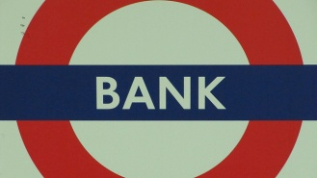
methodology
For multiple stops on tour the method is extended by using a successive destination choice and matrix transpose operations till the end of the half tour
HSBW computed as: H→S→W to get H→S and then S→B→W to get S→B and B→W
S→B→W
H→S→W

Slide 10
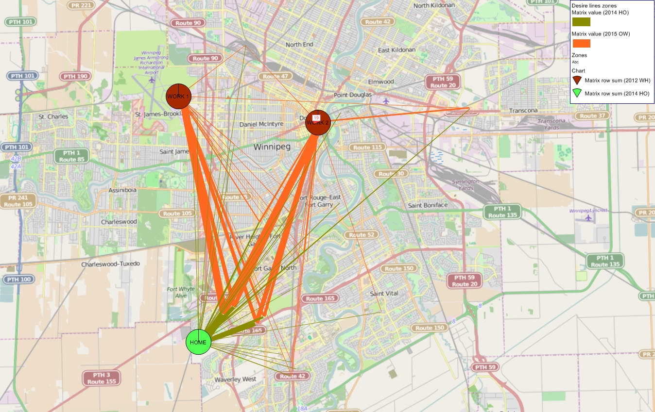
Real world Application
The rubber-banding method was applied to model en route stops in the Winnipeg Tour Based Model (different values of w were tested):
w = 0

Slide 11
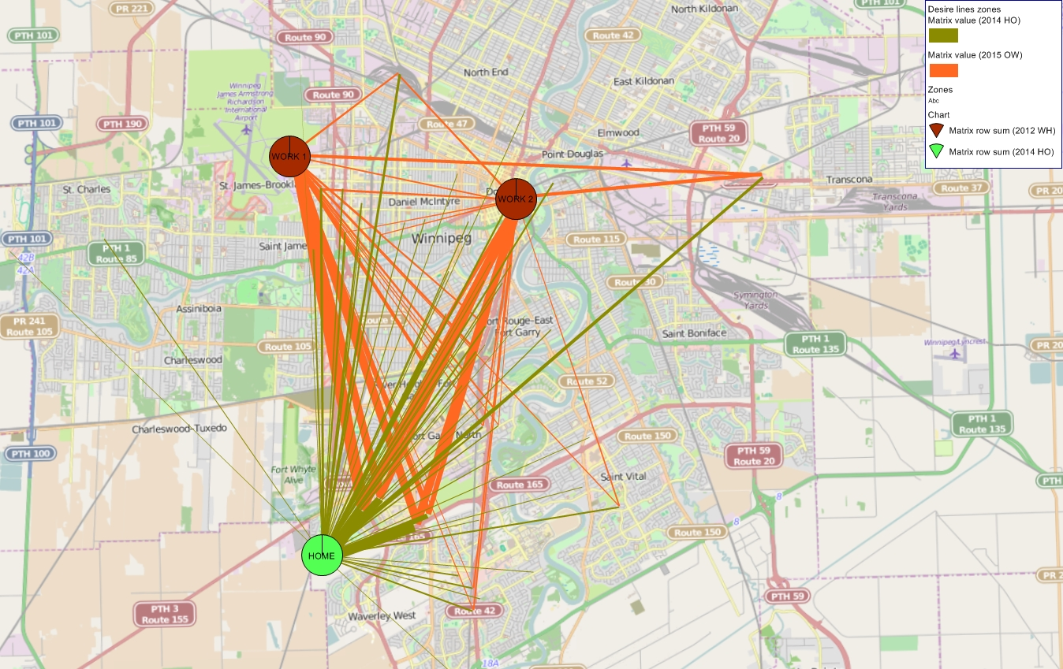
Real world Application
The rubber-banding method was applied to model en route stops in the Winnipeg Tour Based Model (different values of w were tested):
w = 0.25

Slide 12
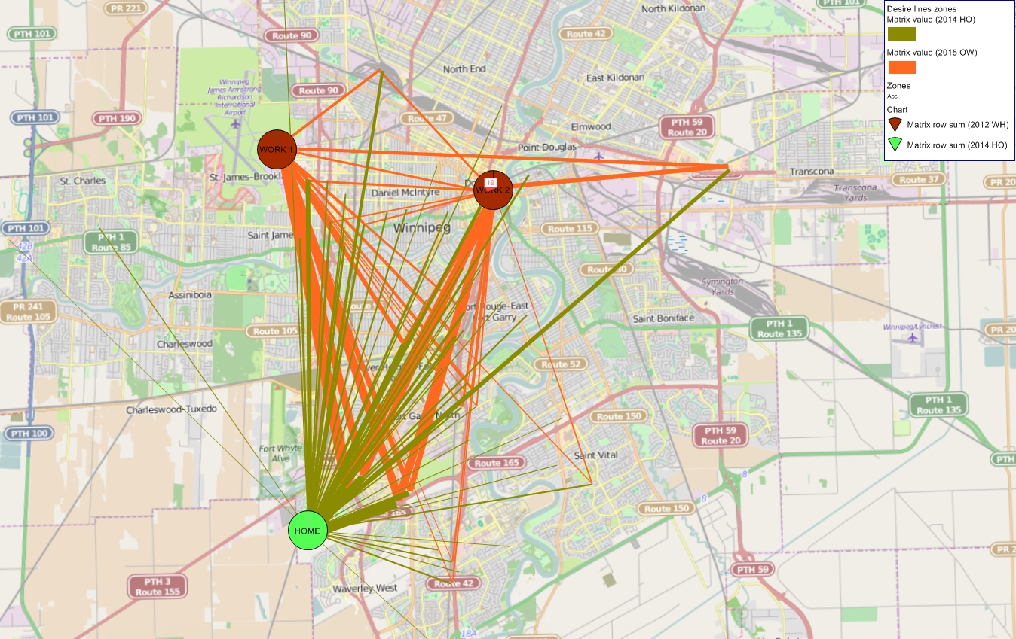
Real world Application
The rubber-banding method was applied to model en route stops in the Winnipeg Tour Based Model (different values of w were tested):
w = 0.50

Slide 13
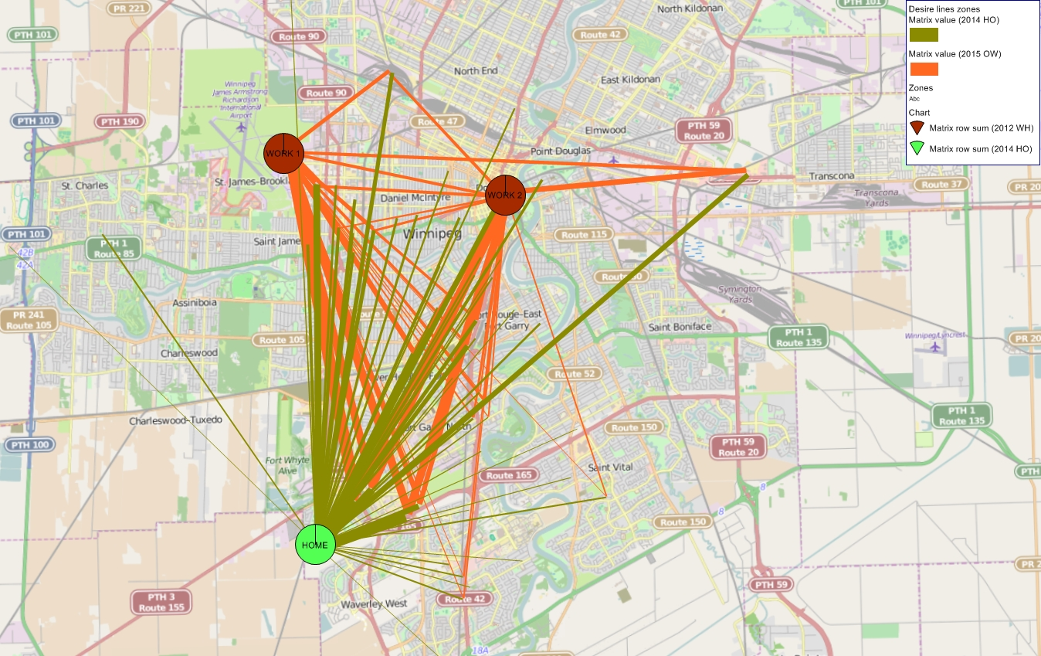
Real world Application
The rubber-banding method was applied to model en route stops in the Winnipeg Tour Based Model (different values of w were tested):
w = 0.75

Slide 14

Real world Application
The rubber-banding method was applied to model en route stops in the Winnipeg Tour Based Model (different values of w were tested):
w = 1.0

Slide 15
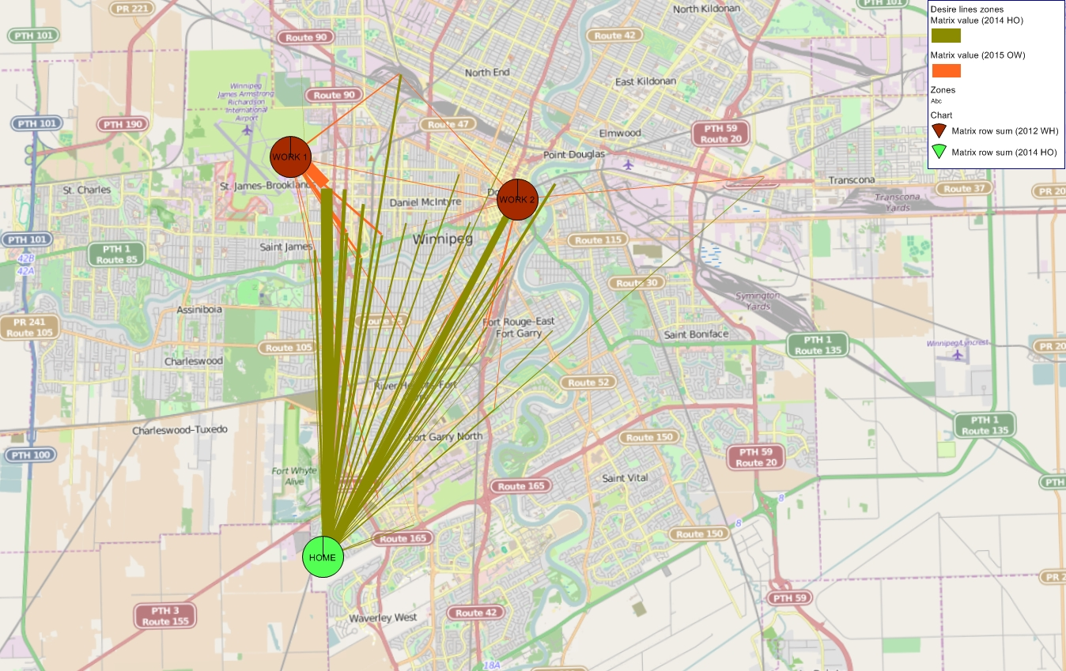
Real world Application
The rubber-banding method was applied to model en route stops in the Winnipeg Tour Based Model (different values of w were tested):
w = 3.0

Slide 16
Real world Application
Two extreme cases with w = 0 and w = 3:
w = 0
w = 3

Slide 17
remarks
  Overall rubber-banding is a useful method that allows potentially better modeling of stop location choice along a tour
  It is still a good idea to check and correct underlying land use and attraction equations for potential destinations
  It is best to involve the agency and use their local knowledge of the area to calibrate weights of the rubber-banding function
  Application of rubber-banding results in some increase in model run time (One DStrata with 1136 Zone with 70 tour types ~6min) but not necessarily much in memory usage

