Slide 1
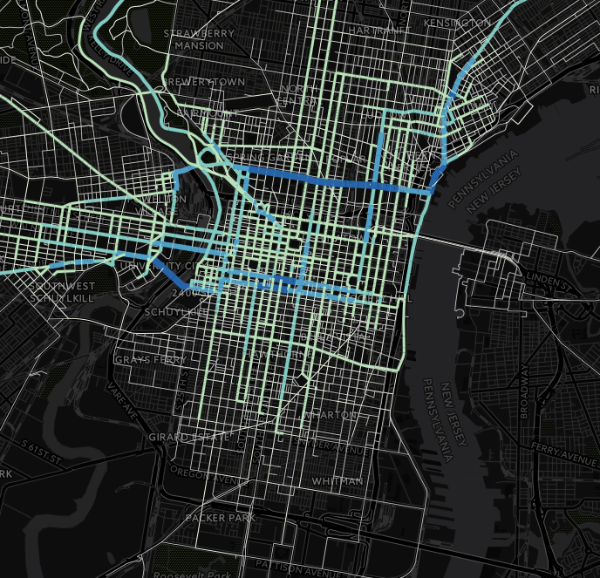
Automatically Cleaning and Processing Bicycle GPS Traces
Will Tsay
May 17, 2015

Slide 2
Delaware Valley Regional Planning Commission
Regional MPO
2 States
9 Counties
355 Municipalities
5.5 Million Population
3,800 sq. miles
Notes:
Created in 1965, the Delaware Valley Regional Planning Commission (DVRPC) is the federally designated Metropolitan Planning Organization (MPO) for the Delaware Valley region (Greater Philadelphia region). Somewhat unique among MPOs in that we are a bi-state agency covering sections of nj and pa. The region includes Bucks, Chester, Delaware, and Montgomery counties as well as the City of Philadelphia, in Pennsylvania; and Burlington, Camden, Gloucester, and Mercer counties in New Jersey. These nine counties together comprise over 3,800 square miles and are made up of over 350 municipalities. The region is home to 5.5 million residents and 2.8 million jobs. Land use varies from the dense urban core of Center City Philadelphia to the open rural areas of the New Jersey Pinelands.

Slide 3
Outline
CyclePhilly Smartphone App
GPS Data Collection
GPS Data Processing
Processing Results
Limitations
Future

Slide 4
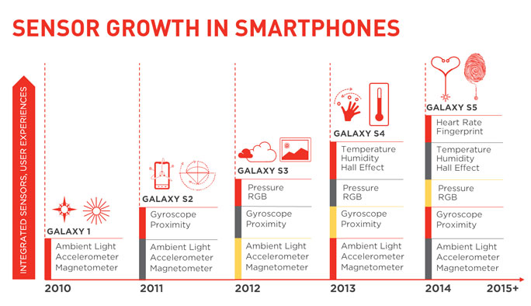
Smarter Phones
Source: Qualcomm Technologies, Inc Press Release April 24, 2014
Notes:
Source: Qualcomm Press Release

Slide 5
Sensor Capabilities
Sensors
Applications
Motion
Linear
Rotational
Environmental
Photometer
Thermometer
Positional
Magnetometers
Proximity
Navigational
A
User activity
Screen orientation
B
Screen brightness
Phone self-preservation
C
Compass
RFID, NFC, Screen shutoff
GPS, GLONASS, Galileo

Slide 6
Lineage
CycleTracks
(San Francisco)
Cycle Atlanta
Phone App Code
Server Database Code
CyclePhilly

Slide 7
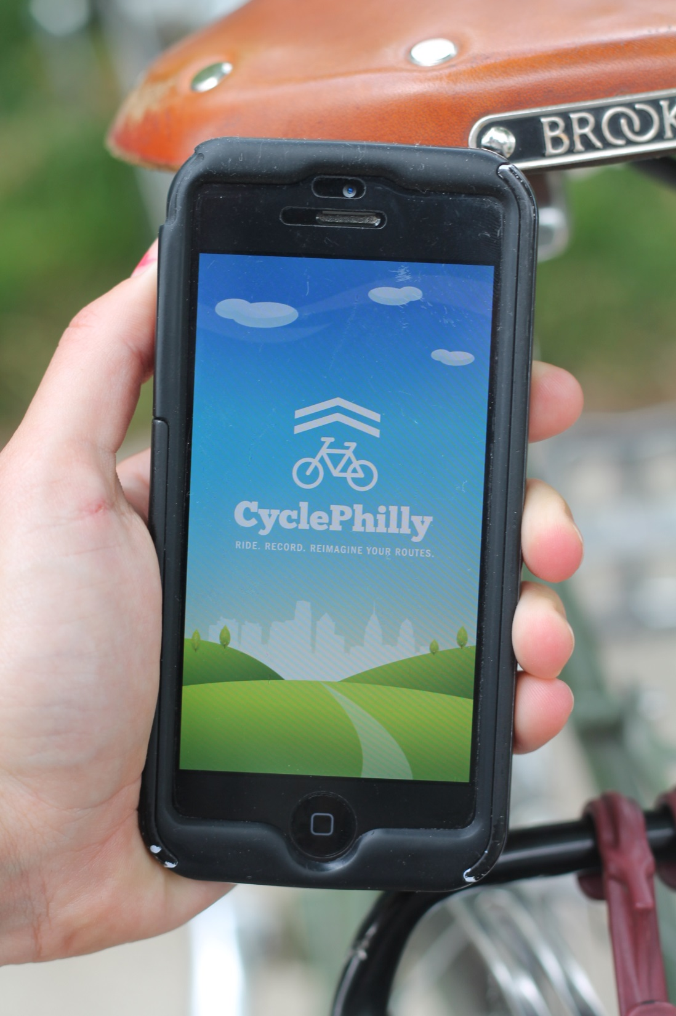
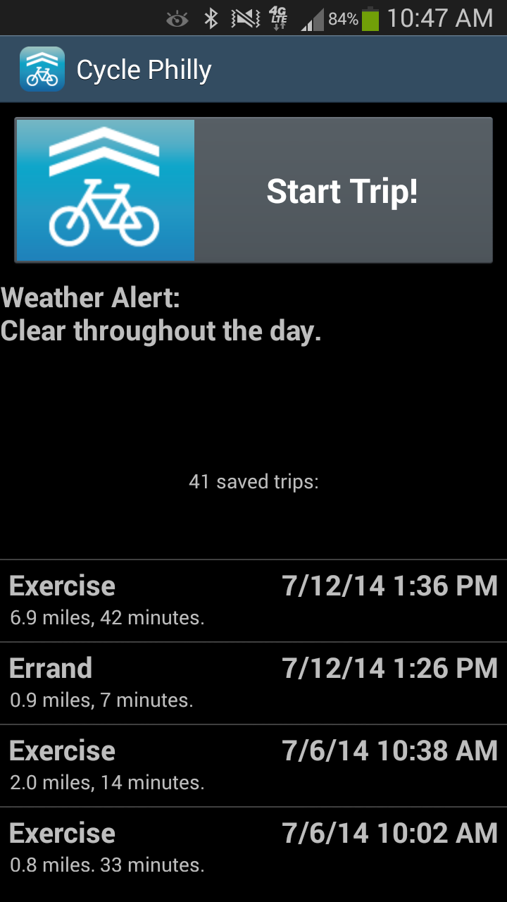

Slide 8
User Demographics
User Characteristics
Age
Ethnicity
Gender
Income (Household)
Cycling Frequency
Cyclist Classification
Cycling History

Slide 9
Data Collection Flow
Cycle Philly
GPS Tracking
Data Upload
User starts recording their trip
App records time-stamped geographic coordinates
Once the trip is completed, recorded data is uploaded

Slide 10
Data Processing
Written in Python 2.7 (64-bit)
SciPy (spatial)
NetworkX (path finding)
PyShp (Shapefile IO)
Runs Multithreaded
Visualization
CartoDB, Leaflet
Tools used are freely available

Slide 11
Data Processing Flow
GPS Traces
DVRPC
Data Processing
GPS traces related
to street network
Public Database
Open Street
Map

Slide 12
Data Sources
Open Street Map
Road Type
Directionality
CyclePhilly GPS Traces
Longitude, Latitude
GPS Accuracy
Speed
OSM Data accuracy/completeness is critical

Slide 13
Handling Raw Data
GPS accuracy variability
Urban (Street) Canyon
Obscured line of sight
Anonymization concerns
Accidental multi-modal trips
… other unspecified strangeness

Slide 14
Cleaning & Anonymization
Raw GPS Trace
Convex Hull
Note 1:
Polygon generation iteration sequentially adds points in trace
Note 2:
Point in Polygon iterates over all points in the trace to flag points within the generated polygons
Centroid
< Min. Radius
Polygon Radius
Point in Polygon
Cleaned Trace
OK
Polygon Generation

Slide 15
Cleaning & Anonymization
RAW
Polygon Generated

Slide 16
Cleaning & Anonymization
Polygon Generated
Trip Clipped

Slide 17
Trip Snapping
Cleaned Trace
OSM Network
GPS Points
K-D Tree
Link Hedge
Weighted SP Search
Note:
K-D Tree: K-dimensional binary tree – enables efficient searching by splitting groups of data
Snapped Trace

Slide 18
Trip Snapping
Raw Trace
Raw Trace – Snapped Trace

Slide 19
Trip Snapping
Raw Trace – Snapped Trace
Snapped Trace

Slide 20
All Trips

Slide 21
Link Selection

Slide 22
Purpose: Errand

Slide 23
Purpose: Exercise

Slide 24
Purpose: Shopping

Slide 25
Purpose: Social

Slide 26
Final Data Overview
May – October, 2014
330 Users
9200 Trips
5600 Commute Purpose
3500 Non-Commute
~18,000,000 rows (1.5 GB)

Slide 27
Rider Characteristics
Notes:
338 Users

Slide 28
Trips by Purpose
Notes:
5674 Commute trips

Slide 29
Trips by Purpose
Notes:
3555 Non-commute trips

Slide 30
Travel Time by Purpose

Slide 31
Travel Time by Purpose

Slide 32
Issues/Limitations
Data Collection
Un-calibrated data
Duplication of trips
Users voluntarily log trips
Algorithm
Backtracking
Round trips
Small spurs
Notes:
Issues coloured red, Limitations coloured blue

Slide 33
Future
Improvements
Phone app re-write
Collect additional sensor data
Easier debugging
Uses
Possible bike path choice model
Seasonal correction factor
Complement to permanent & mobile bike counts

Slide 34
Data:
http://www.dvrpc.org/webmaps/cyclephilly
Questions:
wtsay@dvrpc.org
May 17, 2015

