Slide 1
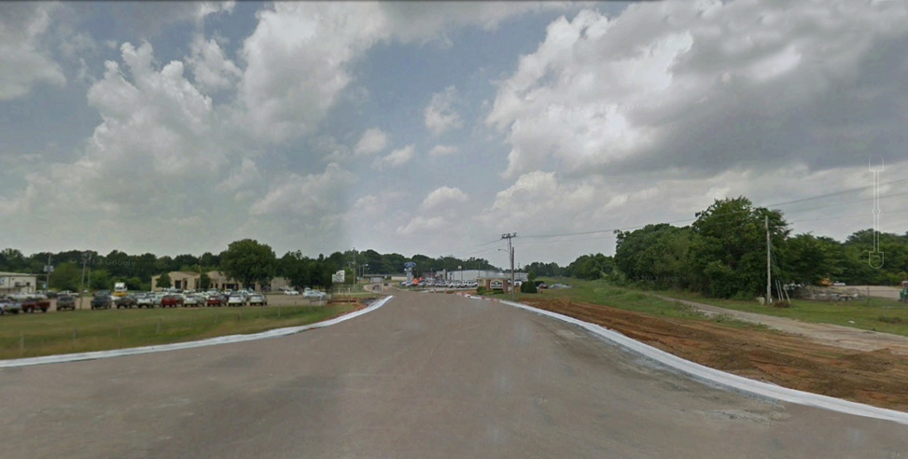

Linking Rural Development and Transportation Using a Land Use-Transportation Decision Support Tool
Brian J. Morton
John Poros
Joe Huegy
Notes:
Carter Avenue looking north, New Albany, MS

Slide 2
Primary Staff and Funding
Brian J. Morton, Ph.D.
Senior Research Associate and Principal Investigator
Center for Urban and Regional Studies
University of North Carolina – Chapel Hill
John Poros, M.Arch.
Director, Carl Small Town Center
Mississippi State University
Joseph Huegy, AICP
Director, Travel Behavior Modeling Group
Institute for Transportation Research and Education
North Carolina State University
Southeastern Transportation Research, Innovation, Development & Education Center (STRIDE)
Project 2012-003

Slide 3
Project’s Goals
To imagine alternate futures for a small-town/rural area in northeastern Mississippi experiencing rapid and radical change due to growth of automobile manufacturing – while also encouraging heritage/bicycle tourism
To assess the alternate futures quantitatively and qualitatively

Slide 4
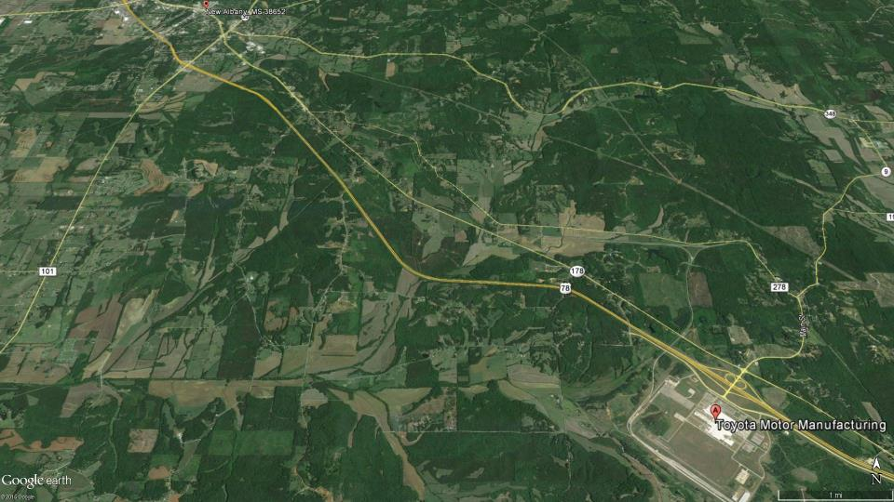
New Albany and Toyota

Slide 5
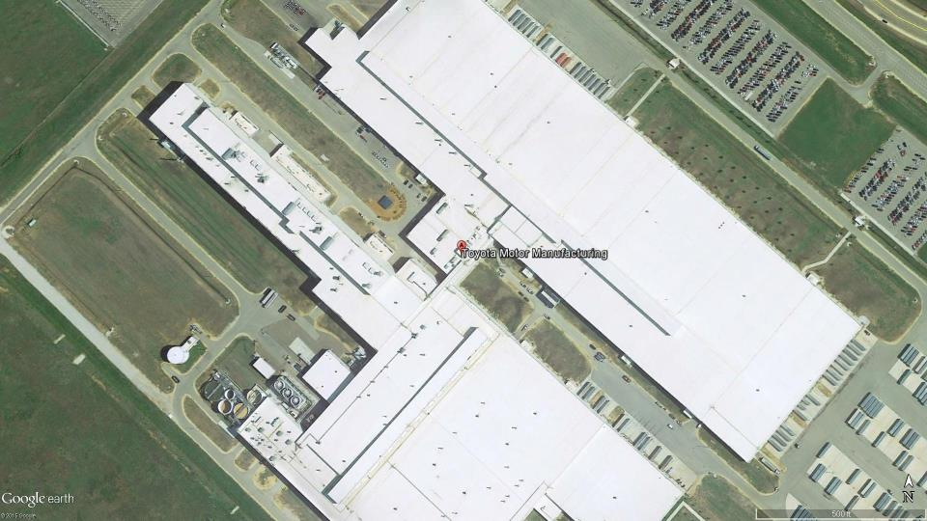
Toyota

Slide 6
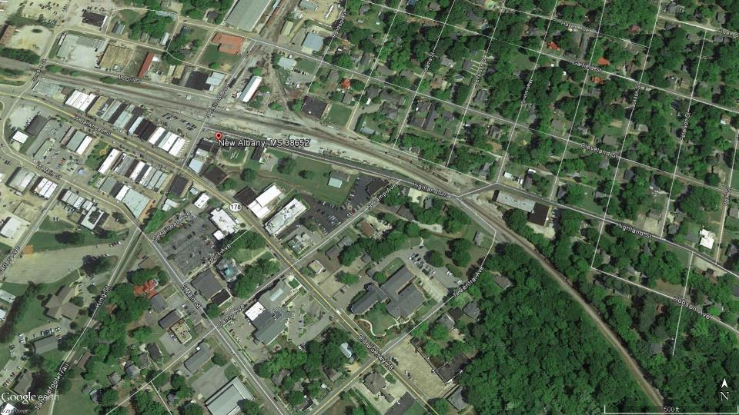
New Albany
Notes:
Note that this picture has the same scale as the picture of Toyota’s factory

Slide 7
Analytical Tools
CommunityViz build-out analyses
Bicycle suitability evaluations
Streetscape renderings
Integrated land use - travel demand model (focus of presentation)

Slide 8
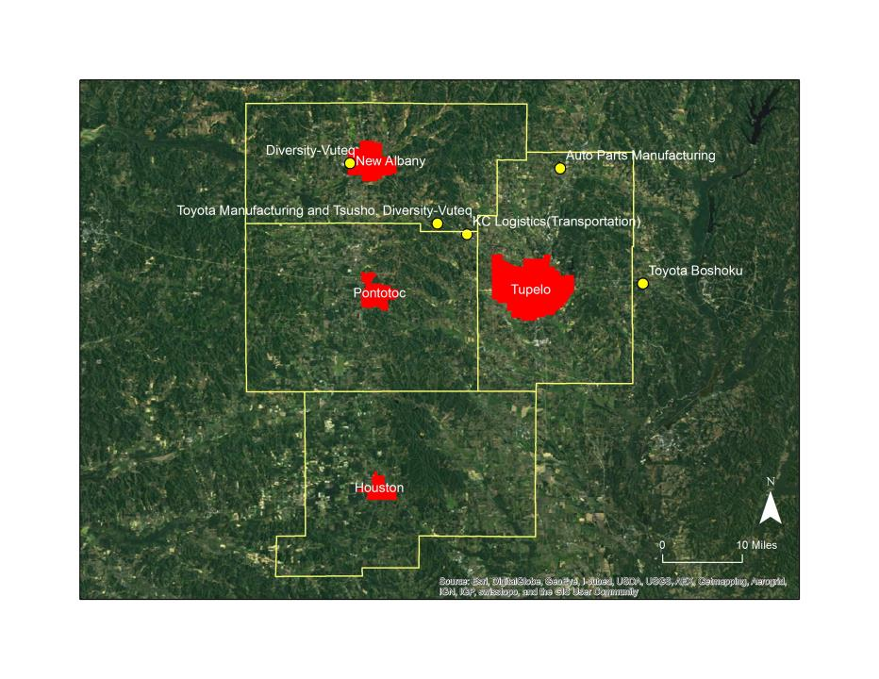
Study Area
County boundaries, four largest towns, and new factories

Slide 9
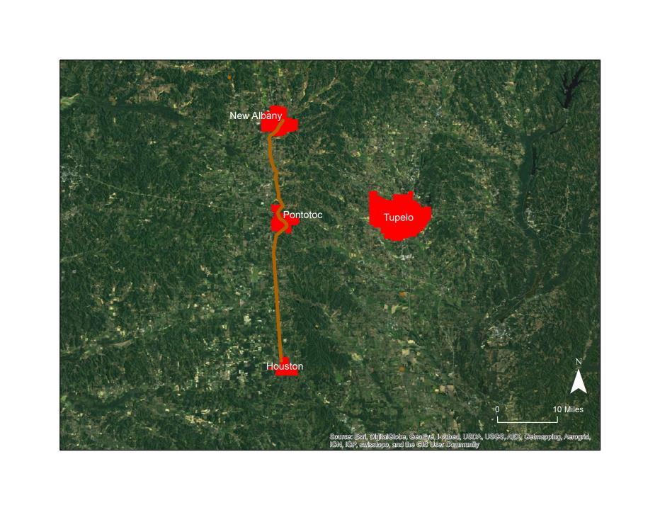
Study Area
Four largest towns and Tanglefoot Trail

Slide 10
Land Use – Travel Demand Model
TRANUS-based model simulates the economy, household population, housing, locations of jobs and housing, and household travel
Travel is induced by economic exchanges
  Businesses hire labor ➔ commute trips
  Households purchase stuff ➔ shopping trips
Trips are also included through a trip table: external commuting trips to/from a defined buffer
Model illuminates way in which different land use patterns affect travel in response to hypothetical but realistic growth

Slide 11
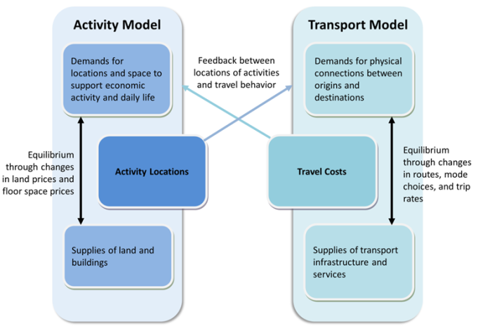

Slide 12

Alternate Futures: Method
Compared to the base scenario (year 2000) –
Manufacturing jobs increase by 3,108 in the four study-area counties
Households increase to provide new manufacturing workers
Commercial jobs increase to provide goods and services
demand by new households
Households further increase to provide new commercial
workers
5,345 new households total
1,393 new commercial jobs total
Tanglefoot Trail opens and bicycle-oriented connectors are built

Slide 13
“Two Towns” Future
Pre-growth manufacturing jobs, households, and ag/natural-resources jobs stay in place
Pre-growth commercial jobs are allowed to move
Manufacturing employment increases in the census block groups containing Toyota’s factory and the Tier 1 suppliers
Locations of new commercial jobs are unconstrained but are attracted to census block groups that are targets for household growth
Household growth is allowed only in New Albany and Tupelo

Slide 14
“Four Towns” Future
Pre-growth manufacturing jobs, households, and ag/natural-resources jobs stay in place
Pre-growth commercial jobs are allowed to move
Manufacturing employment increases in the census block groups containing Toyota’s factory and the Tier 1 suppliers
Locations of new commercial jobs are unconstrained but are attracted to census block groups that are targets for household growth
Household growth is allowed only in New Albany, Tupelo, Houston, and Pontotoc

Slide 15
Results and Lessons Learned
Modeling process
  Comprehensive package of assessment tools for a rural area can be developed with modest resources and with public-domain data
  Land use sub-model is very challenging
Travel results
  Two Towns Future: compared to base scenario (year 2000), daily VMT per person decreases by 0.74
  Four Towns Future: daily VMT per person decreases by 0.19
Implications for development
  Co-locate new households and commercial businesses
  Regionally distributed, town-centered growth is (somewhat) more transportation-efficient
Qualitative results: small towns can gracefully accommodate increased density – see next two slides

Slide 16
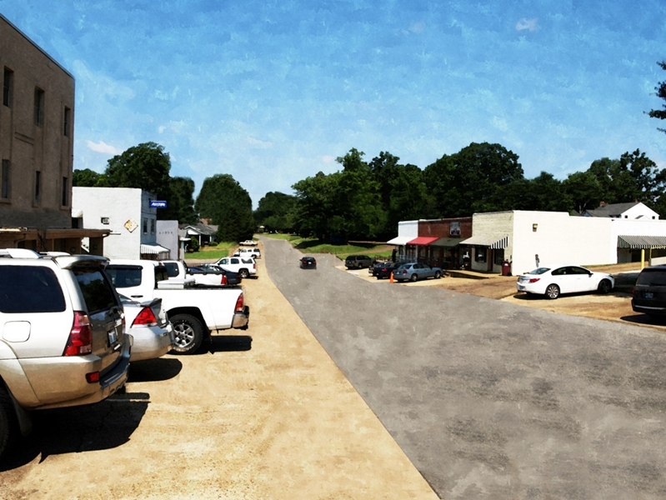
Notes:
Washington Street, Houston, MS – before (current conditions)

Slide 17
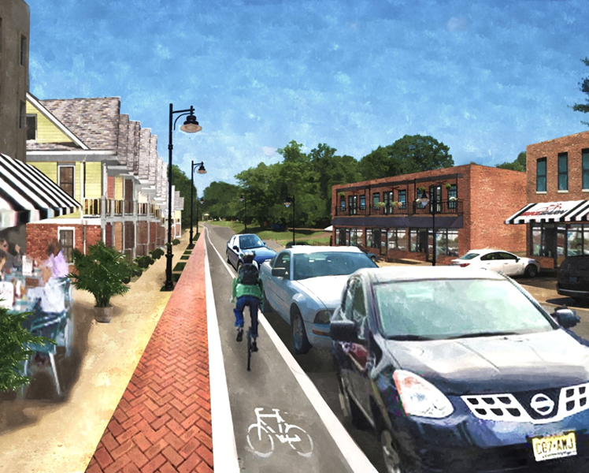
Notes:
Washington Street, Houston, MS -- after

