Slide 1
Configurable & Reusable Software for Activity-Based Travel Demand Modeling
Formal Specification Framework and More
Presented by Jessica Guo

Slide 2
Objectives
Why develop ABM software that are Configurable, Reusable, Maintainable, Extensible?
How - Design tactics

Slide 3
One Size Does Not Fit All
Agency resources and constraints
System requirements (hardware, OS, software)
Budget
Data format
Policy environment
Model sensitivity
Model scope & complexity
Vary by Agency
Change over Time

Slide 4
CT-RAMP
Family | Characteristics | Example
Lightweight | individual daily activity pattern, tour generation with stops, tour and trip level choices | Oregon statewide model
Classic | coordinated daily activity patterns, joint travel, tour generation with subsequent stop frequency | ARC, MTC-TM1
Advanced | multiple resolutions for space and networks (MAZs, TAZs, TAPs) | SANDAG, MTC-TM2
Next-Gen | tour formulation models, high temporal resolution, escorting, space-time constraints | MAG, Ohio3C
DTA-Integrated | schedule adjustment, vehicle trajectory mining, revised feedback and iteration procedures | CMAP

Slide 5
Reusable Software - How?
Frequency
System Reuse
Component Reuse
Function Reuse
Code Scavenging
Complexity

Slide 6
“Software Must be Designed for Reuse”
Tracz, W. (1990), Where does reuse start? Software Engineering Notes 15(2), 42-26

Slide 7
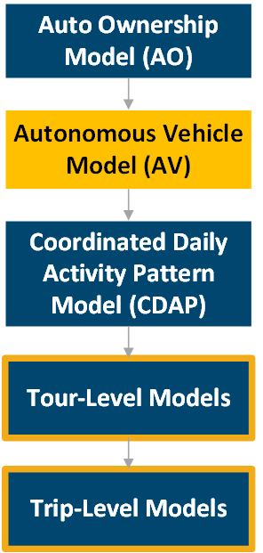
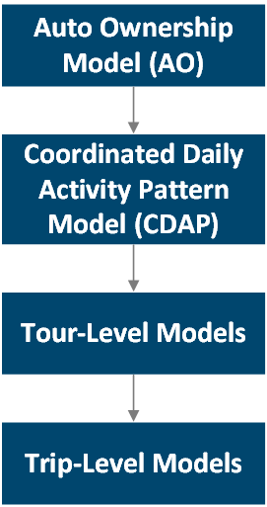
Example
Model Update
Software Update
Notes:
The example of introducing Autonomous Vehicles (AV) to an ABM will be used to examine how changes to the modeling framework lead to changes in software and how to maximize software reuse under such circumstances.

Slide 8
Design Tactic #1
Standardized Interface
Simulation Engine
AV Model
CDAP Model
Trip-Level Models
Tour-Level Models
AO Model

Slide 9
Design Tactic #2
Separation of Concerns
Simulation Engine
AV Model
CDAP Model
Trip-Level Models
Tour-Level Models
AO Model
Data Access, Utility Calculation,
Choice Probability Calculation, Random Number Draw, …
Notes:
Separation of Concerns is “the process of separating a computer program into distinct features that overlap in functionality as little as possible”

Slide 10
Design Tactic #3
Layered Architecture
External Applications
Development Utilities
Visualization Tool
Integration Layer
Logging/Tracing Tool
Customization Layer
Front-End User Interface
Reporting Tool
Configuration Layer
Core Layer
Sim. Monitoring Console
Configuration Console
Data Access Layer
Notes:
Integration Layer: Event Scheduler; Interface to external applications; Environment setup
Customization Layer: Code developed based on client-specific requirements; Model components not readily supported by modules in the Configuration Layer
Configuration Layer: Library of parameterized modules (e.g. mode choice model) that can be configured (e.g. mode alternatives) through external data for project-specific choice context; Includes generic implementations of sub-models, population synthesizer, accessibility calculator, TVPB, etc.
Core Layer: fundamental computational blocks such as a new expression language parser, equation calculator, meta-utility calculator, model solvers (Logit, MDCEV, etc.)
Data Access Layer: Analogous to the current variants of Population Data Managers, Matrix Data Managers, etc.; Interface to internal/external DBMS or data engines that host the various data inputs to the system

Slide 11
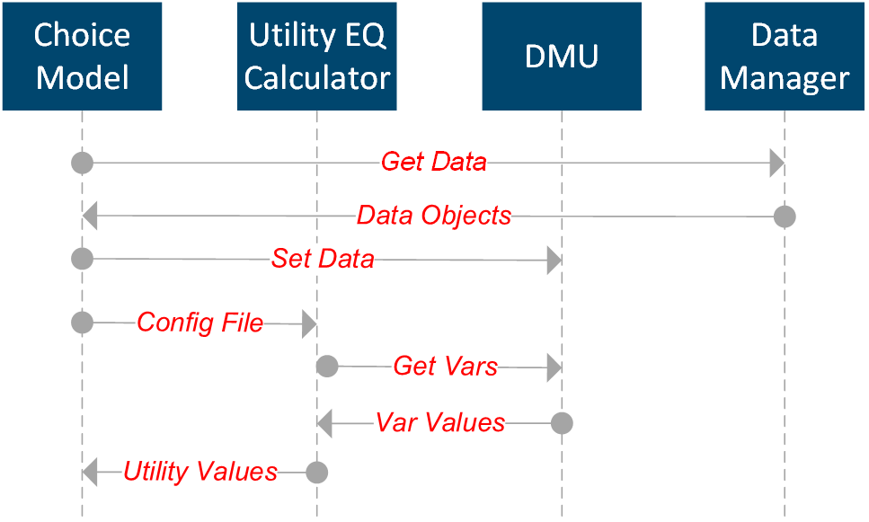

Slide 12
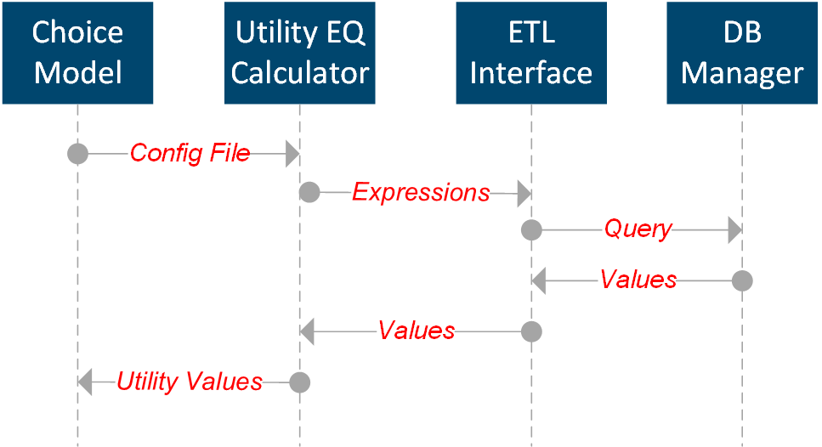

Slide 13
Design Tactic #4
Utility Expression Language
Household.HasAv
Person.HasAvAcccess
Vehicle.IsAutonomous
Object Reference
Field access
Unary operations: EXP(), LN()
Binary operations: +, &, |
Ternary operations: ?:, IF(a,b,c)
Filter: Tours using a AV
Aggregation: MAX(), COUNT()

Slide 14
Design Tactic #5
Meta Modeling Language
Household.HasAv
Person.HasAvAcccess
Vehicle.IsAutonomous
Construct/alter choice set dynamically
Define logic for transient variables
Specify meta-utilities
Specify econometric structure
Configure model application flow

Slide 15
Domain Specific Expression and Modeling Language
Utility Expression Language + Meta Modeling Language
Enhance system transparency
Standardize interface
Raise level of abstraction
Promote greater reuse of software artifacts

Slide 16
Configurable & Reusable Software for Activity-Based Travel Demand Modeling
Contact
Jessica Guo, PhD, CAP Supervising Planner Systems Analysis Group Parsons Brinckerhoff Portland, OR 503-478-2342 guojy@pbworld.com www.pbworld.com

