Slide 1

Evaluation and Application of
Active Traffic and Demand Management (ATDM) Strategies, including Managed Lanes for
Urban Corridors in Ohio
Naveen Juvva
Manish Jain
May 18, 2015

Slide 2
Acknowledgements
The Ohio Department of Transportation
AECOM
  John Gray
  Sara Carini
  Hadi Sadrsadat (now at RSG)
Parsons Brinckerhoff
  Chris Swenson
KPMG
Engage Public Affairs

Slide 3
Agenda
Study Overview
ATDM Strategies
Screening Process
Modeling Methodology
Modeling Results
Conclusions

Slide 4
Study Overview
ODOT Context
  Cost of congestion in Ohio
  Funding shortfalls - $111 billion statewide
ODOT’s Vision: Access Ohio 2040
  Near and long-term strategies
  Investigate feasibility of ATDM solutions in Ohio
  Goals : Preservation, Mobility and Efficiency, Accessibility, Safety and Economic Development

Slide 5
Study Overview
Study Purpose
  Identify corridors and ATDM strategies
  Evaluate ATDM strategies
  Identify a pilot project with recommended ATDM strategies
  Develop implementation plan

Slide 6
Study Overview
Why ATDM?
  Dynamically manage recurrent and non-recurrent congestion
  Combines elements of addressing capacity scarcity
    Build more lanes
    Reduce demand
    Manage existing lanes
  Benefits of ATDM
    Improved throughput and safety on the corridor
    Improved travel reliability and smoothed flows in the system

Slide 7
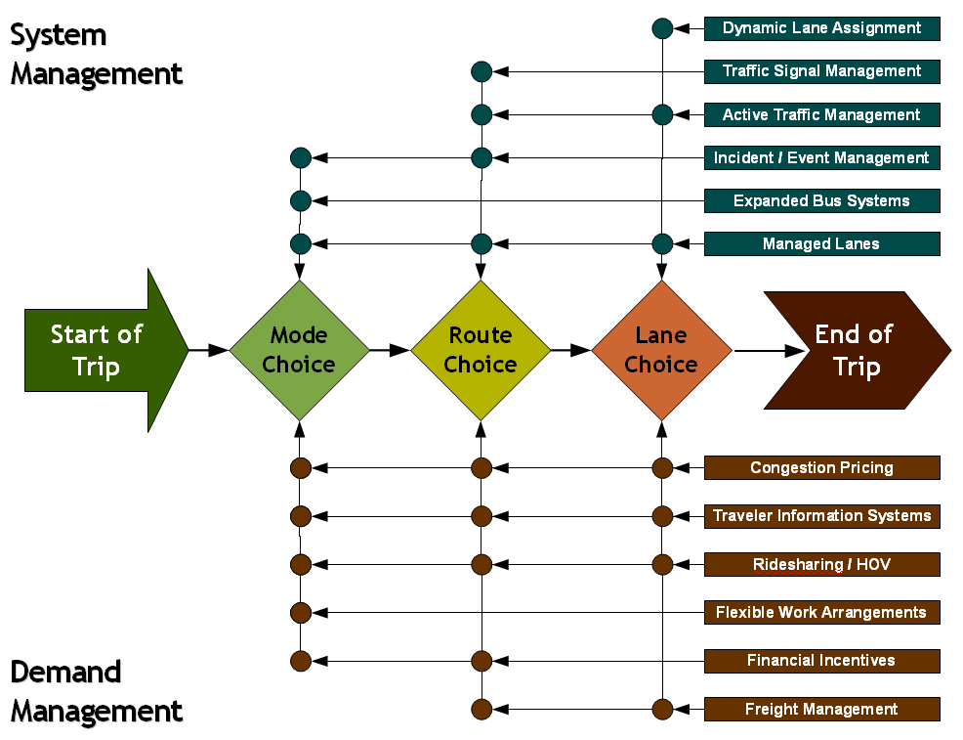
Study Overview
ATDM success requires a focus on trips

Slide 8
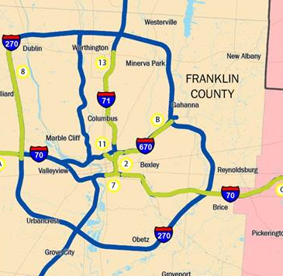
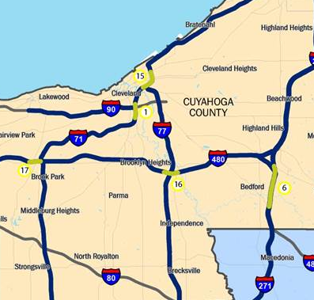
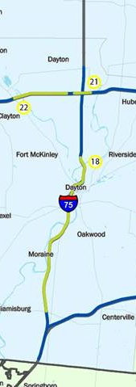
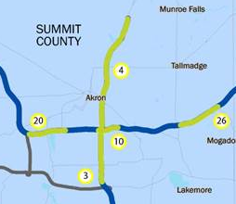
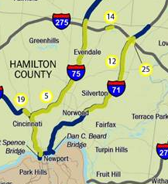
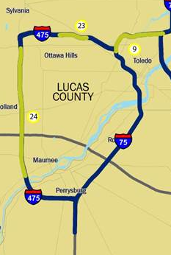
Columbus
Cleveland
Dayton
Akron
Cincinnati
Toledo

Slide 9
Study Overview
ATDM Strategies Considered
  Hard Shoulder Running (HSR)
  Contra Flow Lanes
  HOV Lanes
  Bus Only Lanes
  Managed Lanes
  TMC Improvements
  Integrated Corridor Management
  Truck Only Lanes
  Speed Harmonization
  Incident Response
  Dynamic Message Signs
  Dynamic Route Planning
  Dynamic Ramp Metering (DRM)
  Dynamic Lane Assignment (DLA)
  Queue Warning

Slide 10
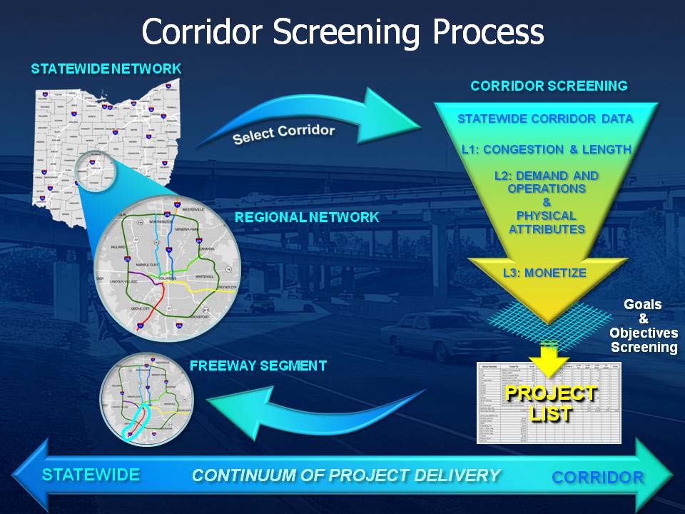
Screening Process

Slide 11
Screening Process
Primary Screening
  Existing congestion
  Right-of-way availability
  Public support
Secondary Screening
  Fatal flaws – pinch points, contra-flow lanes
  Travel time reliability – passenger and freight
  Throughput and travel delays
  Financial feasibility
  Safety
Strategies ranked by total score weighted by criteria

Slide 12
Screening Process
Tertiary Screening
  Quantify impacts of ATDM strategies
    Travel Demand Modeling
  High-level Capital costs
  O&M costs
  Benefit-Cost Analysis
  Policy Considerations
    Policy, Concept of Operations (ConOps) and Implementation

Slide 13
Modeling Methodology
Modeling ATDM Strategies – Methodology
  Static Assignment Model
  Dynamic Assignment Model
    Dynamic Lane Assignment
  Off-Model
Modeling Tools
  OKI Regional Model / ODOT Statewide Model
  TRANSIMS

Slide 14
Modeling Methodology
Mobility measures:
  Reliability
  Peak Speed
  VMT, VHT and VHD
  Vehicle/Person Throughput
  Freight/ Transit Travel Time
  Incident Delays
Corridor and regional level

Slide 15
Modeling Methodology
Managed Lanes
  Add-Lane modeled as Managed Lane in each direction
  Dynamically Priced
    SOV and HOV pay per mile toll
    (2012$): 5 to 20 cents per mile
    Trucks Not Allowed
  Project goal : guarantee reliable travel time (>50 MPH)
  Static Assignment Toll Choice Model

Slide 16
Base Year Model – VOT Distribution

Slide 17
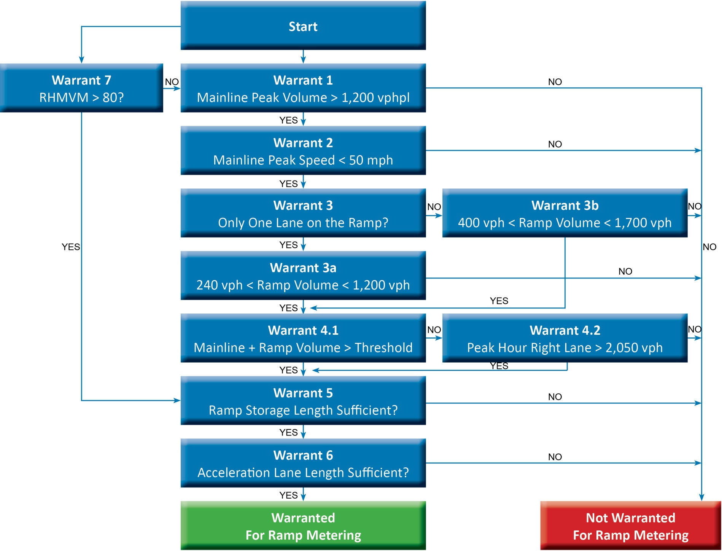
Modeling Methodology
FDOT Ramp Meter Warrant Methodology
Dynamic Ramp Metering
  FDOT methodology to identify ramp metering locations
  Combination of
    Travel Demand Model
    Off-Model - IDAS
    Dynamic Assignment Model

Slide 18
Modeling Methodology
Hard Shoulder Running with Mixed Traffic
  Shoulder opened for Traffic in peak direction of travel
  Applies Static Assignment Model
Bus Hard Shoulder Running
  Estimate growth in ridership for routes associated with corridors
  Identify portion of routes that have hard shoulder running
  Estimate travel time benefits
    0.1 to 8.3 minutes per trip – based on empirical evidence

Slide 19
Modeling Methodology
Speed Harmonization
  Discrete vehicle dynamic simulation model required to effectively quantify operational changes
  TRANSIMS in dynamic traffic assignment mode (Router only) was implemented
    Results benchmarked against the ramp metering strategy
    40% to 60% compliance to variable speed
    Speed harmonization benefits assumed to be 50% of benefits from ramp metering strategy

Slide 20
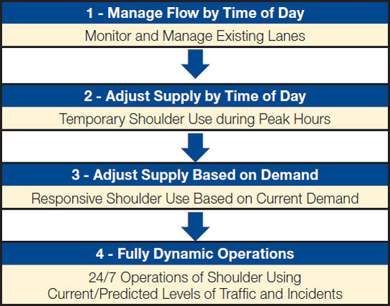
Modeling Methodology
Dynamic Lane Assignment
  Incident Management
  Recurring Congestion Management
Combined benefits of
  Hard Shoulder Running with mixed traffic use
  Speed Harmonization

Slide 21
Modeling Methodology
Off-model Qualitative Analysis
Corridor Improvements
  Dynamic Merge Control
  ATM – Queue Warning
  ATM – Variable Speed/Harmonization
Regional Improvements
  TMC Improvements
  Incident Response
  Integrated Corridor Management
  Dynamic Route Planning

Slide 22
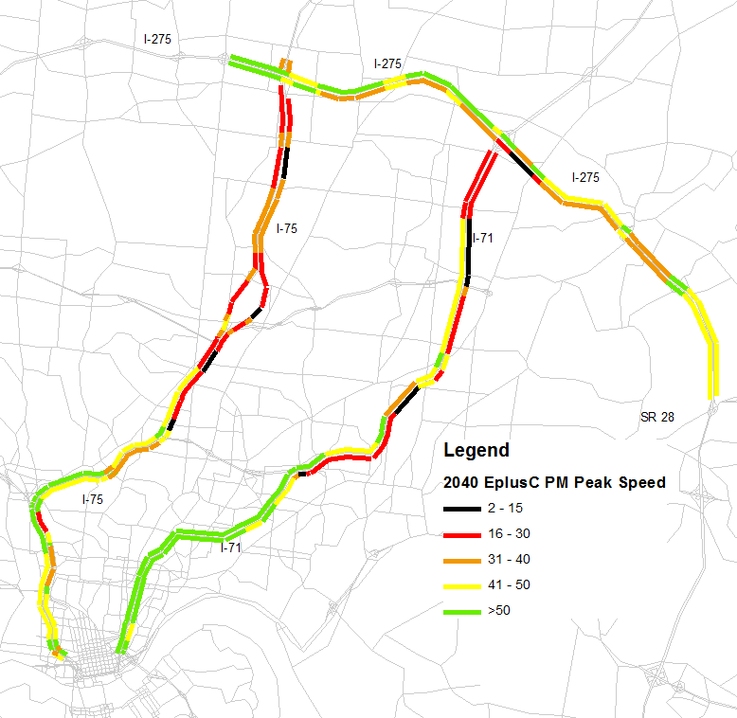
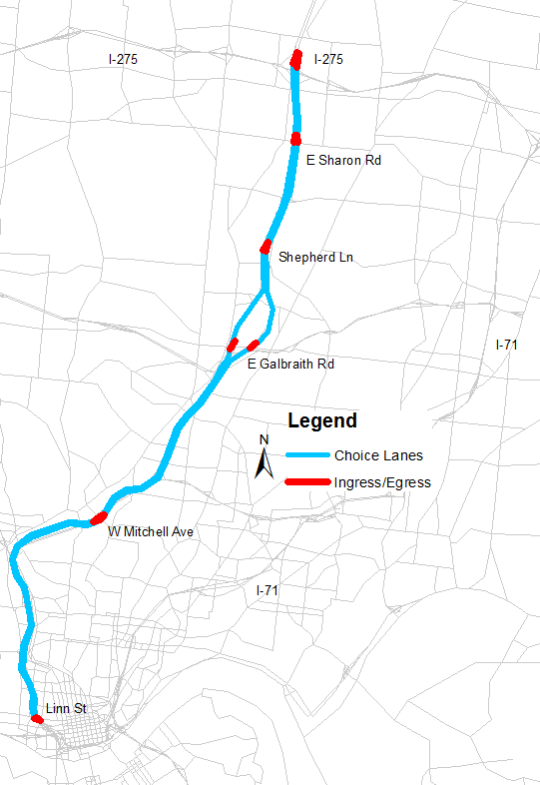
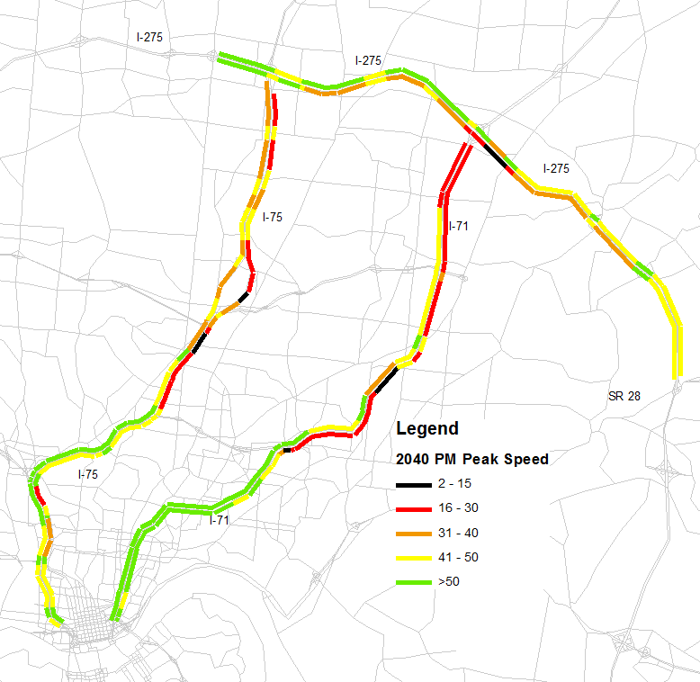
Modeling Results – Managed Lanes
2040 PM – Existing + Committed
I-75 Managed Lanes
2040 PM – ML

Slide 23
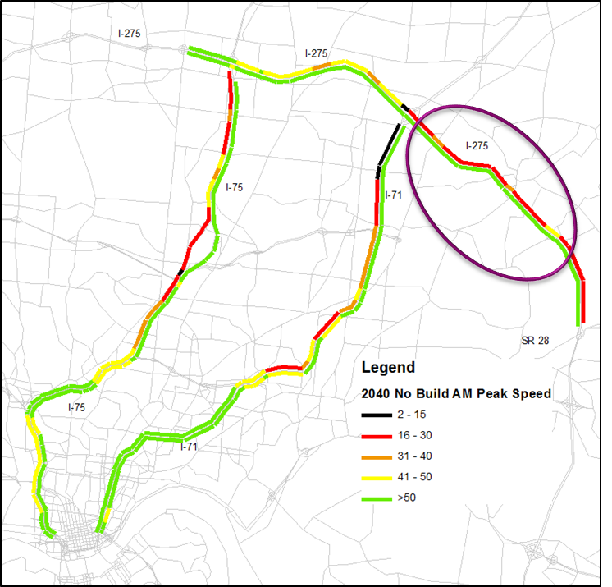
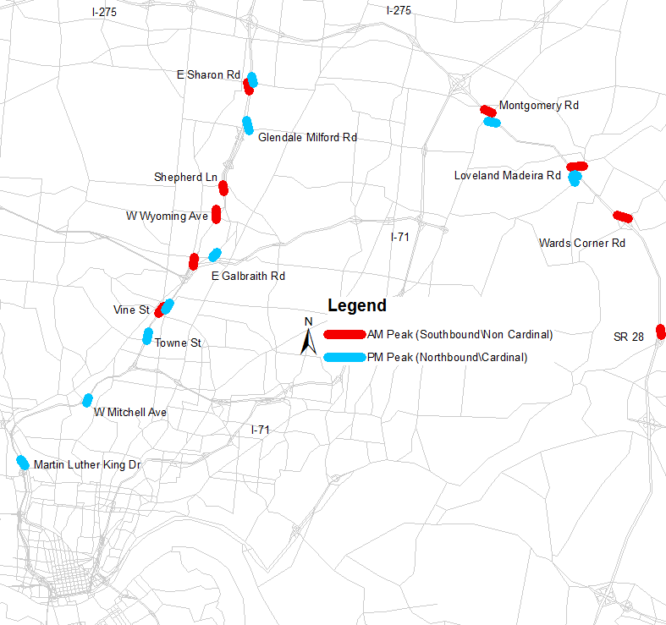
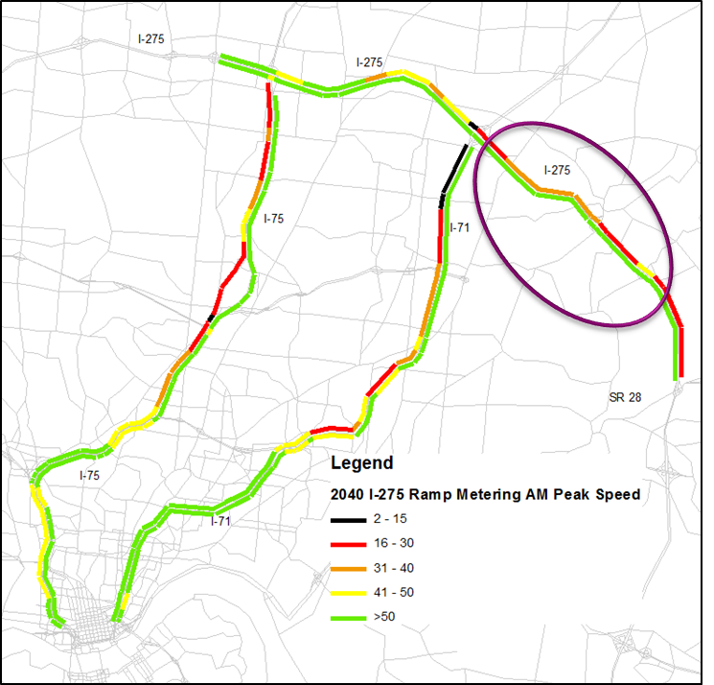
Modeling Results – Dynamic Ramp Metering
2040 AM – No Build
Dynamic Ramp Metering
2040 AM – DRM

Slide 24
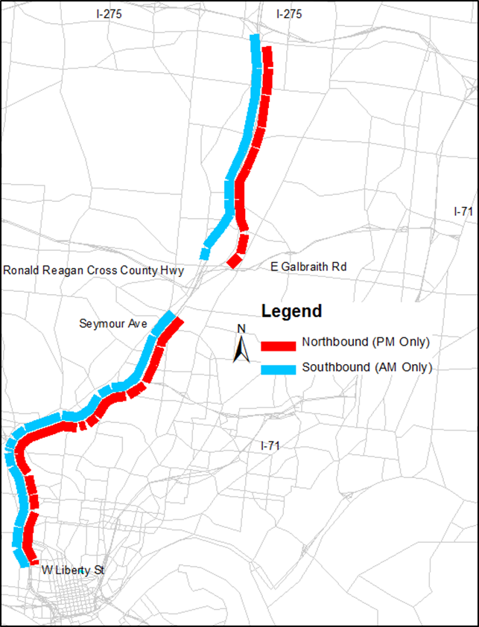
Modeling Results – HSR Mixed Use
2040 AM – No Build
I-75 HSR Mixed Use
2040 AM – HSR

Slide 25
Economic Analysis Overview
Quantitative Analysis—Preliminary Benefit Cost Ratio (BCR)
  Preliminary screening process
  Strategies with BCR above 1.0
  Relative scale of BCR by strategy
Qualitative Rating—Potential for Wider Economic Benefits
  Productivity/agglomeration
  Economic competitiveness
  Investments avoided/delayed
Overall Ranking

Slide 26
BCA Methodology
Benefits
  Outputs from Travel Demand Model
  Time Based Benefits
  VMT Based Benefits
Costs
  Capital Costs
  Lifecycle Costs
  Annual O&M

Slide 27
Overall Economic Analysis Rankings

Slide 28
Conclusions
Multiple modeling tools and methods
  Validate model against ground truth
  Benchmark model results against empirical data
  Model individual strategies and combine results
Strategies
  Managed Lanes: Consider starter and ultimate configuration; range of pricing policies
  Dynamic Lane Assignment: Include dynamic ramp metering, responsive lane control, speed harmonization, and hard shoulder
  Modest benefits of implementing Speed Harmonization alone
Next Steps

