Slide 1
Innovative Methodology to Identify Congested Roadways and Bottlenecks
15th TRB National Transportation
Planning Applications Conference
Praveen Pasumarthy, P.E., PTOE, CDM Smith
Chris Edmonston, AICP, FDOT
Paul Fang, FDOT

Slide 2
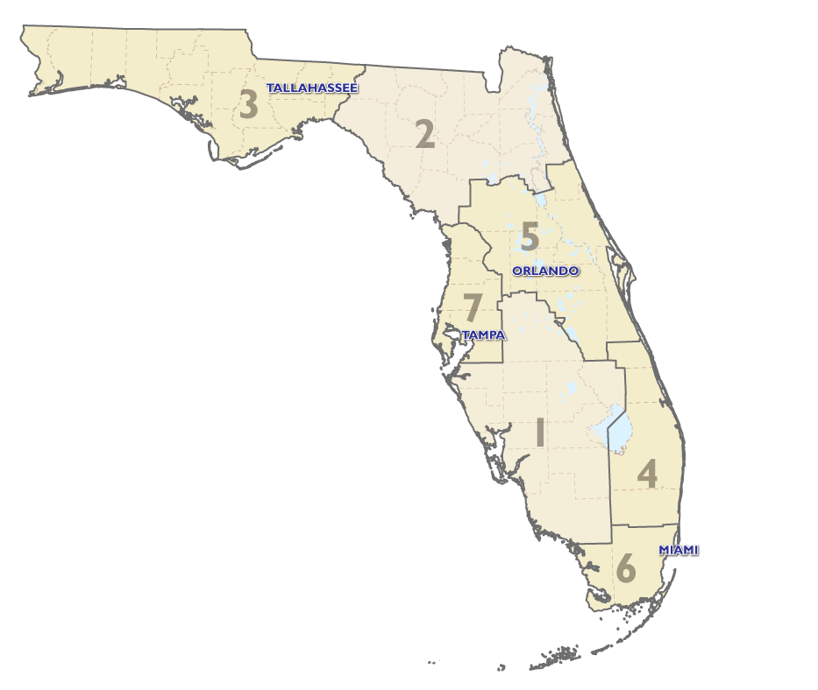
Introduction
Background
Study Purpose
Scope of Study
Study Findings
Next Steps

Slide 3
Background
Notes:
Strategic Intermodal System (SIS) was created in 2003
Designate facilities and services of statewide significance
Serve the mobility needs of citizens, businesses, and visitors
Help Florida to
become a worldwide economic leader,
enhance economic prosperity and competitiveness,
enrich quality of life, and
reflect responsible environmental stewardship.

Slide 4
Study Purpose
Identify bottlenecks on Strategic Intermodal System (SIS)
Use the data available with FDOT
Identify bottlenecks at statewide and district level
Present the results in easy to understand format

Slide 5
Scope of the Study
Activity 1: Data review
Data available with FDOT
Vehicle probe data
Activity 2: Methodology to identify bottlenecks
Research efforts in the field of congestion and bottlenecks
Contemporary practices by DOTs, MPOs, etc.
Develop the methodology
Activity 3: Identify bottlenecks
Analyze the data
Prepare maps/graphics

Slide 6
Data Sources
Existing FDOT Data Sources
Roadway Characteristics Inventory (RCI)
Traffic Monitoring Program
Telemetered Traffic Monitoring Sites (TTMSs)
Portable Traffic Monitoring Sites (PTMSs)
Vehicle Probe Data
INRIX’s Vehicle Probe Data – Phase I
FHWA’s NPMRDS from HERE – Phase II

Slide 7
FHWA’s NPMRDS on NHS

Slide 8
FHWA’s NPMRDS on SIS

Slide 9
Coverage of FHWA’s NPMRDS
Passenger Data
Freight Data

Slide 10
Coverage of FHWA’s NPMRDS
Hourly
Daily
Monthly
Passenger
Freight

Slide 11
Methodology to identify bottlenecks
Summary of research efforts in the field of congestion and bottlenecks
Contemporary practices
National performance reports
State DOT practices
MPO/Local government practices
Recommended methodology to identify bottlenecks on SIS network

Slide 12
Congestion
FHWA defines congestion as “an excess of vehicles on a roadway at a particular time resulting in speeds that are slower - sometimes much slower - than normal or free flow speeds”
Recurring and non-recurring congestion

Slide 13
Bottleneck
Bottleneck can be defined as “a localized section of highway that experiences reduced speeds and inherent delays due to a recurring operational influence or a nonrecurring impacting event”
Recurring and non-recurring bottlenecks
Bottleneck occurs on a subordinate segment of a facility
Bottleneck certainly constitutes congestion, but congestion is often more than a bottleneck

Slide 14
Bottleneck

Slide 15
Recommended methodology
STEP 1:
Determine the purpose
STEP 2:
Develop a plan based on the uses and users
STEP 3:
Collect and process required data
STEP 4:
Calculate performance measures and identify bottleneck & congestion
STEP 5:
Communicate in a meaningful way

Slide 16
Recommended methodology
STEP 1:
Determine the purpose
Primary purpose would be for planning purposes
Bottlenecks should be identified using maps
Resulting product should be easy to understand and interesting to read
STEP 2:
Develop a plan based on the uses and users
STEP 3:
Collect and process required data
STEP 4:
Calculate performance measures and identify bottleneck & congestion
STEP 5:
Communicate in a meaningful way

Slide 17
Recommended methodology
STEP 1:
Determine the purpose
Bottlenecks identified for auto and truck mode
Bottlenecks identified based on weekday travel patterns
Travel time reliability measures are used
Yearly trends will be reported
Statewide and district-level measures will be reported
STEP 2:
Develop a plan based on the uses and users
STEP 3:
Collect and process required data
STEP 4:
Calculate performance measures and identify bottleneck & congestion
STEP 5:
Communicate in a meaningful way

Slide 18
Recommended methodology
STEP 1:
Determine the purpose
Vehicle probe data from FHWA will be used
FDOT data will be used for mapping purposes
STEP 2:
Develop a plan based on the uses and users
STEP 3:
Collect and process required data
STEP 4:
Calculate performance measures and identify bottleneck & congestion
STEP 5:
Communicate in a meaningful way

Slide 19
Recommended methodology
STEP 1:
Determine the purpose
Process FHWA NPMRDS data
Identify performance measures
Define and identify bottlenecks
STEP 2:
Develop a plan based on the uses and users
STEP 3:
Collect and process required data
STEP 4:
Calculate performance measures and identify bottleneck & congestion
STEP 5:
Communicate in a meaningful way

Slide 20
Recommended methodology
STEP 1:
Determine the purpose
Display results in easy-to-understand tables and graphics
Present the yearly trends
Present results statewide and by district
STEP 2:
Develop a plan based on the uses and users
STEP 3:
Collect and process required data
STEP 4:
Calculate performance measures and identify bottleneck & congestion
STEP 5:
Communicate in a meaningful way

Slide 21
Quantify Congestion/Bottleneck
NCHRP Report 398: Quantifying Congestion (1997)
Presented methods to measure congestion
Difficult to conceive of a single value to describe congestion
Four components in a congested roadway system
Duration – amount of time congestion affects the travel system
Extent – number of people or vehicles or geographic area affected by congestion
Intensity – severity of the congestion
Reliability – variation in the other three elements

Slide 22
Quantify Congestion/Bottleneck
Phase I Methodology
Phase II Methodology
Duration:
Extent:
Intensity:
Reliability:
Frequency of Congestion
None
None
Planning Time Index
Duration:
Extent:
Intensity:
Reliability:
Frequency of Congestion
Vehicle Miles Traveled
Vehicle Hours of Delay
Planning Time Index

Slide 23
Statewide sis Bottlenecks

Slide 24
Next Steps
Phase II of the study is underway to identify the causes of top bottlenecks and suggest corrective actions
Incorporate the bottlenecks in FDOT’s Strategic Investment Tool
Update the list of top bottlenecks every two years
Update methodology using advancements in and coverage of vehicle probe data

Slide 25
CONTACT
Praveen Pasumarthy, PE, PTOE
CDM Smith
pasumarthyvs@cdmsmith.com
850-386-9548

