Slide 1

Multi-Point Loading in the Pedestrian Trip Assignment
Presenting to the 15th TRB National Transportation Planning Applications Conference, May 16-20t^{h}, 2015
by
Yanping Zhang & Felix Nwoko
Durham-Chapel Hill-Carrboro MPO/City of Durham

Slide 2
Background
  NC Triangle Region Model (TRM) Forecasts Non-motorized Trips
  Resolution issues in project applications because of larger size of TAZs. It results
    A considerable amount of intra-zonal trips that cannot be loaded onto the network
    Unrealistically loading of trips, that concentrates on only one or two directions

Slide 3
Resolution Issue

Slide 4
Traditional Method
  Splitting TAZs into smaller Pedestrian Analysis Zones (PAZ)
  Developing the pedestrian model based on PAZs

Slide 5










Multi-Point Loading/Assignment (MPA)

Slide 6
Standard Assignment
  Weak control on local loading directions
  No loading of intra-zonal trips
6th St
400
Zone Centroid - Origin
West Ave
33.3%
East Ave
600
200
Zone Centroid - Destination
33.3%
Access Point
200
33.3%
600
Centroid
Connector
400
7th St

Slide 7
Multi-Point Assignment (MPA)
Type 1 - Fixed Loading Rate
Strong control on loading directions for
inter-zonal trips
6th St
West Ave
300
East Ave
Zone Centroid - Origin
25%
600
240
60
Zone Centroid - Destination
40%
10%
240
Access Point
60
25%
600
Centroid
Connector
300
7th St

Slide 8
Trip Matrix Dis-aggregation
TAZ | 1 | 2
1 | 400 | 1200
2 | 0 | 0
  Original
  Dis-aggregated
Intra-Zone | Loading Rate | 11 | 12 | 13 | 14 | Total Origin Trips
Receiving Rate |  | 10% | 25% | 25% | 40%
11 | 10% | 4 | 10 | 10 | 16 | 40
12 | 25% | 10 | 25 | 25 | 40 | 100
13 | 25% | 10 | 25 | 25 | 40 | 100
14 | 40% | 16 | 40 | 40 | 64 | 160
Total Dest Trips |  | 40 | 100 | 100 | 160 | 400

Slide 9
Intra-zonal Trip Loading
Original Intra-zonal Trips = 400 (25%)
Disaggregated Intra-zonal Trips = 118 (7.4%)
6th St
West Ave
East Ave
Zone Centroid - Origin
75
25%
Zone Centroid - Destination
96
40%
118
10%
36
Access Point
25%
75
Centroid
Connector
7th St

Slide 10
Type 2 – Fixed/Variable Rate MPA
40% O-D Trips Loaded onto West Ave
60% O-D Trips other 3 directions, i.e. r1+r2+r3=60%
6th St
West Ave
East Ave
50%
r2
40%
r1
r3
50%
7th St

Slide 11
Assignment Model
Logit Model/STOCH Algorithm
Factors for Time Impedance
Time Factor | w/o Sidewalk | w/ Sidewalk
Local Road & Collector | 1.15 | 1
Minor Arterial | 1.7 | 1.15
Major Arterial | 1.7 | 1.3

Slide 12
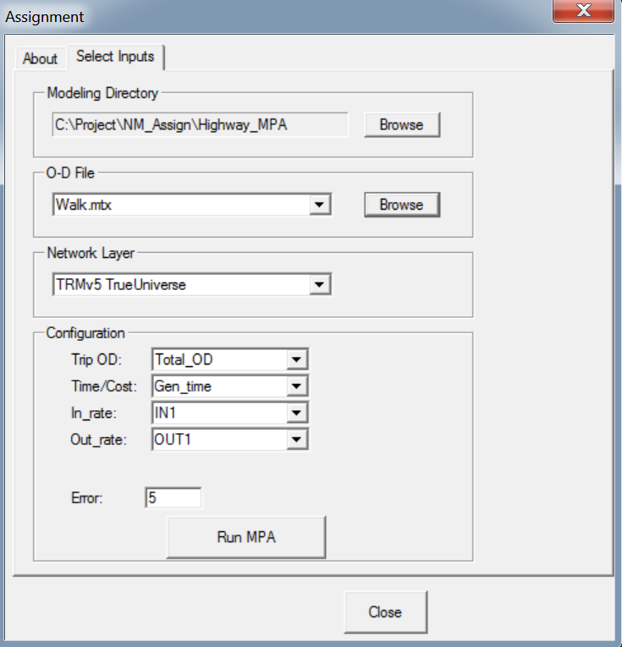
Multi-Point Assignment (MPA) Tool
Coded in GISDK for use in TransCAD

Slide 13
Test 1 – Intra-Zonal Trip Reduction
Test on equally loading on all connectors
of each centroids
 | Region |  | Urban Area
 | Original | MPA | Original | MPA
Intra-zonal Trips | 85,425 | 43,068 | 36,309 | 16,578
All Trips | 381,900 | 381,900 | 273,222 | 272,448
Percent | 22.37% | 11.28% | 13.29% | 6.08%
Background – Method – Test - Summary

Slide 14
Test 2 – Walk Trips Between Rail Station & TAZs
Extraction of Walk Trips between Station & TAZs is from,
Transit Assignment of Rail Park & Ride Trips to/from Rail Station
Transit Assignment of Kiss & Ride Trips to/from Rail Station
Transit Assignment of Walk Trips to/from Rail Station

Slide 15
Test 2 – Walk Trips Between Rail Station & TAZ 343
Standard Assignment

Slide 16
Test 2 – Walk Trip Change by MPA
Building Square Footage used for dis-aggregation

Slide 17
Summary
MPA is a quick response method
Reduction of intra-zonal trips by MPA
Correcting unrealistically loading directions
Thoughts:
Using Production/Attraction Loading rates for the further reduction of intra-zonal trips
Development of intra zonal trip model

