Slide 1

Sampling Rates for Transit Rider Surveys
An Initial Analysis
Notes:
Good afternoon everyone! I'll be presenting the results of the sampling rate aspects of the research effort led by FTA.

Slide 2
Motivations
FTA requirements for rider surveys
  Model development for project forecasts
  Before-and-After Studies of complete projects
Another frequently asked question:
What is the necessary sample size/rate?
FTA response, so far
  10 percent average seems to have been adequate
  Less for larger systems; more for smaller systems
Notes:
FTA requires rider surveys in the two instances shown here. Perhaps the most common question that FTA receives from transit agencies is: "How large a sample do we need?" I'm sure many of you here have asked them this question. Well...

Slide 3
Traditional practice
Sample size determined by:
  Often, rule-of-thumb uniform rate … 10%
  Sometimes: nominal sample-size computation of required sample for individual routes
But, computations are often:
  Aggregate – all trips on a route
  Absent scrutiny of components: time period, direction
  Largely invariant in number of samples across routes
  Absent attention to actual statistical significance
Notes:
Current practice doesn't seem to provide much help in answering the question. Traditionally, the sample size is often determined by applying the nearly ubiquitous 10% rule of thumb. But these computations are often aggregate, and applied at the route level at best. And the components and results are seldomly scrutinized. Attention to statistical significance seems to be absent generally.

Slide 4
An investigation into markets
Design AM-peak sample for each rail station
Use faregate counts of station-to-station trips
Compute sample needed to characterize:
  Flows between stations – because transportation is about moving people from here to there
  Number of trips from each entry station:
    To exits aggregated into 20 station groups
    For three income classifications
  Given accuracy requirements (95%; ±10 percent )
Notes:
This analysis used the AM peak period data at Washington rail stations that Laura mentioned. We were focused on the sample needed to characterize the flows between stations, because transportation after all is about moving people from here to there. Specifically, we are characterizing the flows by three income classifications - high, medium and low income - given specified accuracy requirements.

Slide 5
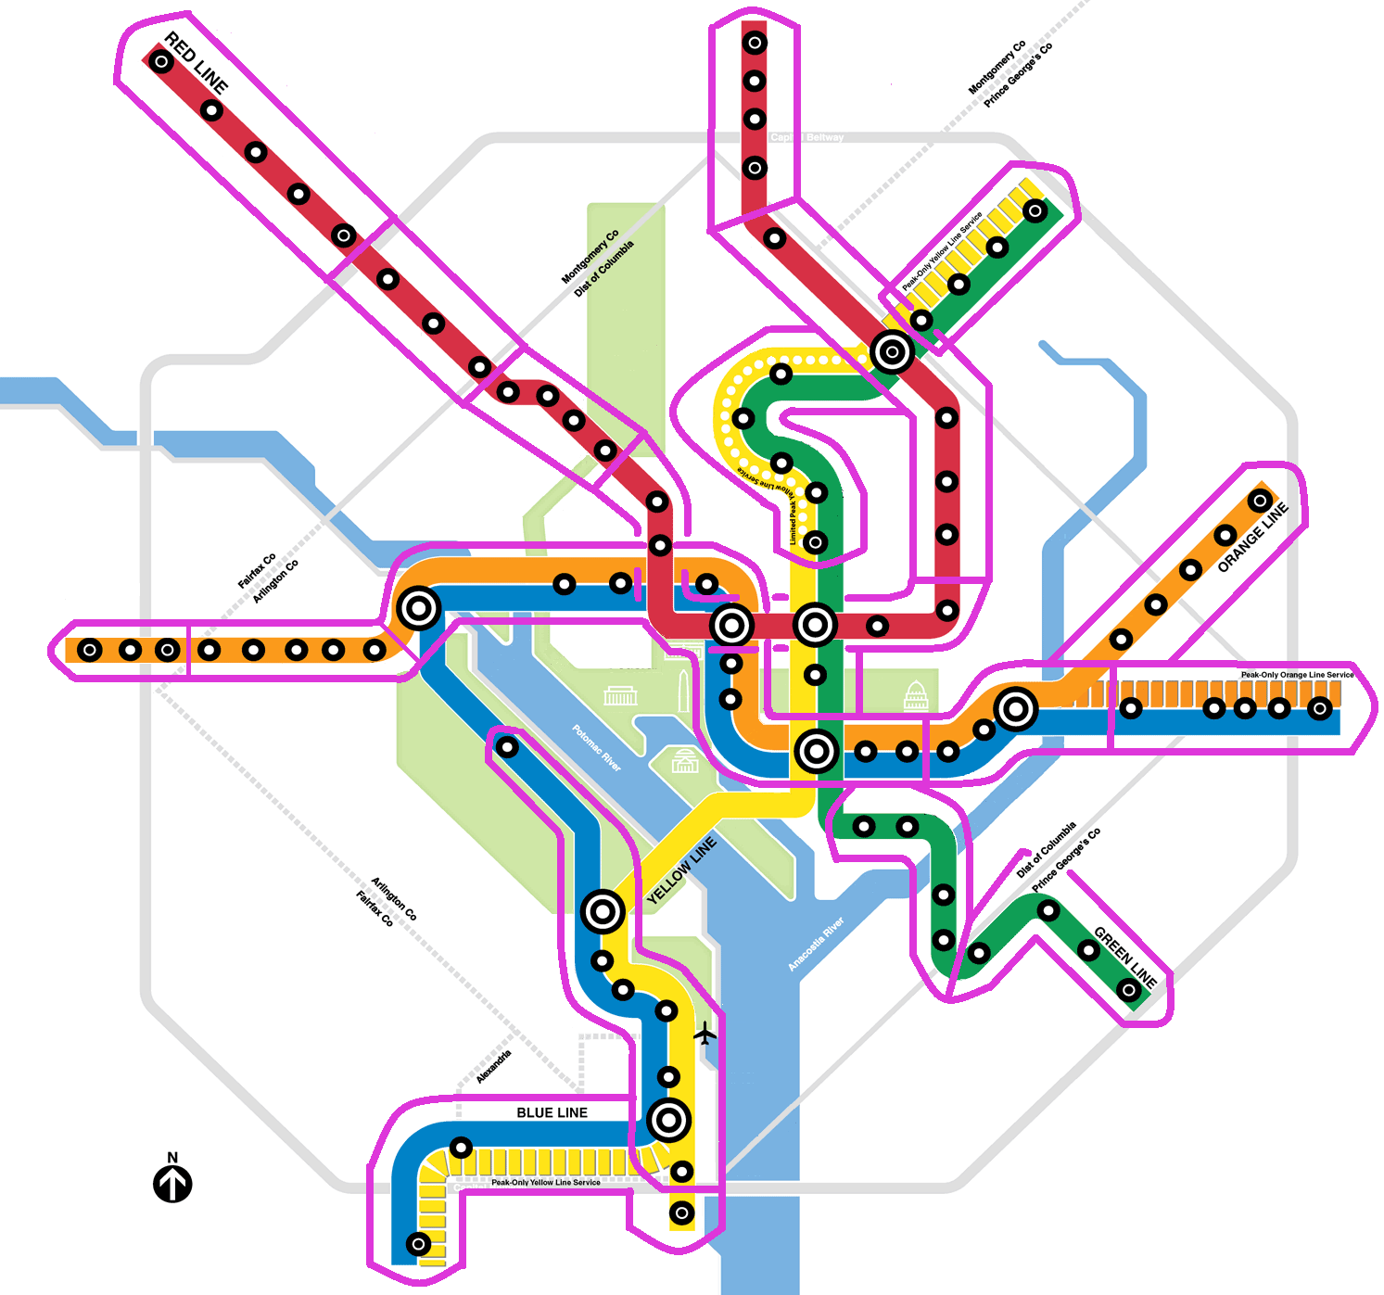
MetroRail map and station groups
Vienna Station
Congress Heights Station
Notes:
The 86 Metrorail stations were grouped into the 20 station groups shown here. The two stations I'll be discussing most here are Vienna and Congress Heights. Vienna is a suburban commuter station, with riders primarily commuting to the District. It has ~10,000 boardings in the AM period. Congress Heights riders' travel patterns are much more dispersed. It has ~1,500 riders in the AM period, making about 5x smaller than the Vienna station.

Slide 6
Sample-size calculation
And sample is assumed to be unbiased
Notes:
The sample size computations use this equation. It is similar to ones that I'm sure many of you have seen. This particular version includes the Finite Population Correction Factor so that we can be more accurate for smaller volume populations. I need to mention, and emphasize quite strongly, that this equation requires a very important but often overlooked assumption. That is that the sample collected in the field be unbiased; that is, completely devoid of any response or sampling biases. A biased sample will require additional samples to undo the bias.

Slide 7
Known: AM-Peak trip flows from Vienna station
Need to know: flows by income class
Trips by income class from Vienna station to each station group (to be estimated from survey data)
Trips from Vienna station to each station group (known from fare-gate data)
Vienna Station
10,388 Entries AM-Peak
Notes:
Here is a graphical representation of what we want to know. From our faregate counts we know the number of entries into the Vienna station, and we know the number of trips from Vienna to the other 20 station groups. What we want to determine, is to find the proportions of high, medium and low income riders to each of the 20 station groups. So we go from one known vector left of the arrows to the three unknown vectors to the right of the arrows.

Slide 8
Sample calculations: large flow
Vienna station to Rosslyn-CapitolSouth group
Exit Station Group | Income Class | Assumed Percent | Required Exit Samples
Rosslyn through Capitol South (inclusive) | L | 50% | 95
 | M | 25% | 72
 | H | 25% | 72
 | Total | 100% | 95
Necessary Samples of Entries at Vienna Station
Required Exit Samples | 95
Vienna-to-Group Exits | 5,069
Exit-Group Sampling Rate | 1.9%
Required Entry Samples | 196
For 95 percent confidence and a ±10 percent interval
Worst-case assumption for income distribution: 50% in one cell
Required samples = max, not sum, across income groups
Required exit sampling rate is very small because N is very large
Notes:
This slide demonstrates our sample size calculations for a large-volume flow. The equation I showed you on slide 6 is applied to each income group. Now the "worst case" assumption is where the largest sample size possible is required given a total flow. With the equation that "worst case" occurs if one of the income groups comprise 50% of the total. So in this case we have assumed that one of the groups, the low income group, is 50% of the total. Now you only need the maximum number of samples of the three computations (click), since the larger sample also covers, or includes, the required sample of the other groups. The table on the right summarizes the outputs of the sample size computations. For this flow, we require 95 samples from the 5,069 riders destined for the Rosslyn-Capitol South station group. This results in a 1.9% sampling rate - 95 divided by 5,069. However, since the surveys are conducted at the entry station, you need to collect 196 samples - that's 1.9% of the nearly 10,000 riders from Vienna - because of the 196 samples you collect, 95 of those will be from the intended exit group.

Slide 9
Sample calculations: medium flow
Vienna station to Archives-L’Enfant group
Exit Station Group | Income Class | Assumed Percent | Required Exit Samples
Archives through L’Enfant Plaza (inclusive) | L | 50% | 82
 | M | 25% | 64
 | H | 25% | 64
 | Total | 100% | 82
Necessary Samples of Entries at Vienna Station
Required Exit Samples | 82
Vienna-to-Group Exits | 550
Exit-Group Sampling Rate | 14.9%
Required Entry Samples | 1,540
For 95 percent confidence and a ±10 percent interval
Compared to largest exit-station group:
  Required exit samples slightly less, but group exits much less
  So, exit sampling rate is much higher, though still plausible
  Entry samples will include large over-samples from larger exit groups
Notes:
Slide 9 demonstrates the same computations, but for an exit station group with a medium-sized number of riders, in this case just 550. So walking through the table on the right: the sample size of the worst case assumption is 82, that's 14.9% of this exit station group. If you were just interested in riders going to this station group, you would need 10,000 x 14.9% samples, or 1,540. I'm sure you all noticed that although this exit station flow is lower than the one on the previous slide, it requires a sample size ~7.5 times larger than the one needed for the much larger exit station group on the previous slide.

Slide 10
Sample calculations: small flow
Vienna station to ShadyGrove-Grosvenor group
Exit Station Group | Income Class | Assumed Percent | Required Exit Samples
Franconia through Huntingtn (inclusive) | L | 50% | 16
 | M | 25% | 15
 | H | 25% | 15
 | Total | 100% | 16
Necessary Samples of Entries at Vienna Station
Required Exit Samples | 16
Vienna-to-Group Exits | 18
Exit-Group Sampling Rate | 88.9%
Required Entry Samples | 8,077
For 95 percent confidence and a ±10 percent interval
Compared to largest exit-station group:
  Required exit samples decline, but approach number of group exits
  So, exit sampling rate approaches 100%
  Entry samples will include huge over-samples from larger exit groups
Notes:
Slide 10 shows the computations for a really small flow...this exit station group is just 18 people in the morning peak. The sample size is 16...that's a 89% sampling rate. If your survey is conducted at the Vienna entry station, you would need to collect over 8,000 samples. Holy cow!

Slide 11
Initial observations (1)
Sampling rate for entry station driven (to nearly 100%) by exit station-group with smallest exit flows → unrealistic
Possible response
  Specify the scope of the accuracy requirement
    Confidence: 95%
    Margin of error: ±10%
    Scope: at least 80% of entries
Notes:
So what did we learn from these experiments? As you saw with the previous 3 slides, the overall sampling rate for the entry station is driven by the exit station group with the smallest flow. If you want a consistent and tight statistical accuracy for all exit groups, you will generally end up with sampling rates approaching 100%. From a practical context, sampling rates that high are just unrealistic. So what can we do to have more pragmatic sampling rates? One way is to decide how many of the flows in a given exit group you apply the accuracy requirement to. This is what we call the scope.

Slide 12
Scope of the accuracy specification
Conf = 95%
MOE =10%
Exit Groups Sorted by Exit Volume | Characteristics |  |  |  | # of Entry Samples
 | Flow | #Samp | Samp% | Scope%
Rosslyn-CapSouth | 5,069 | 95 | 1.9% | 49% | 196
Dupont-Union.Sta | 1,860 | 92 | 4.9% | 67% | 507
E.Falls.Ch-Ct.House | 1,006 | 88 | 8.7% | 77% | 899
Nat.Arpt-Arl.Cem | 712 | 85 | 11.9% | 84% | 1,230
Archives-L’Enfant | 550 | 82 | 14.9% | 90% | 1,540
Vienna-W.Falls.Ch | 261 | 71 | 27.2% | 92% | 2,812
Congr.Hts-Wfront | 189 | 64 | 33.9% | 93% | 3,505
: | : | : | : | : | :
: | : | : | : | : | :
Franc-Huntington | 18 | 16 | 88.9% | 99.9% | 9,189
Benning.Rd-Largo | 4 | 4 | 100.0% | 100.0% | 10,338
Total exits | 10,338 | --- | --- | --- | ---
Vienna Station
Notes:
Here is an example of computing the sample size for a defined scope. Let's say you want the accuracy requirement to apply to 80% of the entries going to the largest exit groups. In this table the exit station groups are sorted by flow size, largest first. We then compute the required number of entry samples needed for the 95/10 accuracy requirement. The first row is identical to the example a few slides ago. (click) The first row is 49% of all entries at Vienna. (click) The two largest groups comprise 67% of all entries. (click 2x) You can keep adding the next largest group to the scope of accuracy specification. In this example we stop (click) at 80% - technically 84%. The 84% scope requires 1,230 samples - that's about a 12% sampling rate overall for Vienna. Since small groups require disproportionately higher sample sizes, focusing on the larger groups helps keep survey costs down while keeping the focus on the major markets.

Slide 13
Scope of the accuracy specification
Conf = 95%
MOE =10%
Exit Groups Sorted by Exit Volume | Characteristics |  |  |  | # of Entry Samples
 | Flow | #Samp | Samp% | Scope%
Dupont-UnionSta. | 272 | 72 | 26.5% | 18% | 272
Rosslyn-CapSouth | 252 | 70 | 27.8% | 35% | 528
Archives-L’Enfant | 213 | 67 | 31.5% | 49% | 739
NY Ave.-Takoma | 133 | 57 | 42.9% | 58% | 875
Georgia Ave.-U St. | 107 | 51 | 47.7% | 65% | 981
Congress Hts.-Wfnt | 91 | 47 | 51.6% | 71% | 1071
: | : | : | : | : | :
: | : | : | : | : | :
SilverSpr.-Glenmont | 18 | 16 | 88.9% | 98% | 1,479
Benning Rd.-Largo | 16 | 14 | 87.5% | 99% | 1,494
Franc-Huntington | 11 | 10 | 90.9% | 100% | 1,509
Total exits | 1,509 | --- | --- | --- | ---
Congress Heights Station
Notes:
Here is the same example for Congress Heights. Since it has a lower number of entries the sampling requirement is much higher than Vienna's. (click 6x) At 71% scope the sample size requirement alone is ~67%, that's 1,071 divided by 1,509.

Slide 14
Initial observations (2)
Required sampling rate increased by worst-case assumption on income distribution
Possible response
  Find some data on income distributions – previous rider survey?
  Compute income distribution of trips entering each stations
Notes:
So specifying the scope helps. But we still have the fact that the required sampling rate is highest because of our "worst case" assumption. What might help with that is locating some external data on income distribution and computing the sample sizes from that data.

Slide 15
Initial observations (3)
Uniform sampling rate for all entries at station:
  Oversamples large flows
  Under-samples others
  Get lots of records from small flows that have no statistical significance
Possible response: sample at different rates
  Compute rate for each within-scope exit-group
  Decide what to do about small-flow cells
  Set upper limits on large-flow cells
  Pre-screen riders in the field
Notes:
There's another tactic that might help reduce sampling requirements. We would like to sample different markets at different rates, rather than just apply a uniform rates to all markets - because from the slides 8-10, you saw that applying the sampling rate from a medium flow would lead to oversamples of the large flow, and undersamples of smaller flows. Sampling markets at different rates gives you the flexibility to set upper sample limits for large flows - because you'll reach your large flow sample quota before you satisfy the limits of smaller groups. So the tactic to reduce sampling requirements is to pre-survey screen the riders. In pre-screening, the surveyor would approach a rider and ask for their destination first. If the limit associated with the rider's group has been reached, the surveyor would say thank you and proceed to contact the next rider. If the limit has not been reached, only then would the surveyor continue with the survey.

Slide 16
Sampling quotas by exit group
Contacts
Conf = 95%
MOE =10%
Exit Groups Sorted by Exit Volume | Characteristics |  |  |  | # of Entry Samples
 | Flow | #Samp | Samp% | Scope%
Rosslyn-CapSouth | 5,069 | 95 | 1.9% | 49% | 196
Dupont-Union.Sta | 1,860 | +92 | 4.9% | 67% | 507
E.Falls.Ch-Ct.House | 1,006 | +88 | 8.7% | 77% | 899
Nat.Arpt-Arl.Cem | 712 | +85 | 11.9% | 84% | 1,230
Archives-L’Enfant | 550 | 82 | 14.9% | 90% | 1,540
Vienna-W.Falls.Ch | 261 | 71 | 27.2% | 92% | 2,812
Congr.Hts-Wfront | 189 | 64 | 33.9% | 93% | 3,505
: | : | : | : | : | :
: | : | : | : | : | :
Franc-Huntington | 18 | 16 | 88.9% | 99.9% | 9,189
Benning.Rd-Largo | 4 | 4 | 100.0% | 100.0% | 10,338
Total exits | 10,338 | --- | --- | --- | ---
Vienna Station
Notes:
Slide 16 is an example of this pre-screening method. Here we show the same calculations as previously, but that the number of samples in the upper right is now (click) - contacts since these are people we approach, but don't necessarily continue with a full survey. (click) The number of samples (click) would be the sum (click) of the circled values (click). Again like the previous slides we proceeded until we reached a 80% scope.

Slide 17

Experimental design
Obtain station-to-station counts → Case 1
Plus, find external data on income? → Case 2
Plus, apply quotas by exit group? → Case 3
And
  Specify confidence level = 95%
  Specify margin of error = varies within each case
  Specify scope = varies within each case
Notes:
We set up some experiments to see how sample size requirements change if you use external income distribution data; this Case 2. Case 3 includes Case 2 and uses the pre-screening method. Laura's just convinced you that you need flow counts for expansion, so that's our initial Case 1. The experiments assume a constant 95% confidence interval and we vary the scope and margins of error.

Slide 18
Caution on Margins of Error
Sample A: MOE = ±10%
To CBD
% low inc.
To non-CBD
% low inc.
Sample B: MOE = ±30%
To CBD
% low inc.
To non-CBD
% low inc.
Sample mean
Sample with ±10% MOE is able to differentiate average incomes between two populations while a sample with ±30% MOE from the same populations cannot.
Bounds
Notes:
Before I show any results I need to caution you all about the impacts of widening margins of error. In the first example here, the desired MOE is +/- 10%. This means that the difference in the proportions of two markets must be greater than 20 percentage points to be significant. This is because the MOEs are interpreted to be in percentage points, not relative to the mean. In this second example (click) a 30% MOE has been assumed. This MOE specification makes it much more difficult to identify statistical differences between the two markets. So your ability to make conclusions can be hampered by wide MOEs, in some cases hampered severely.

Slide 19
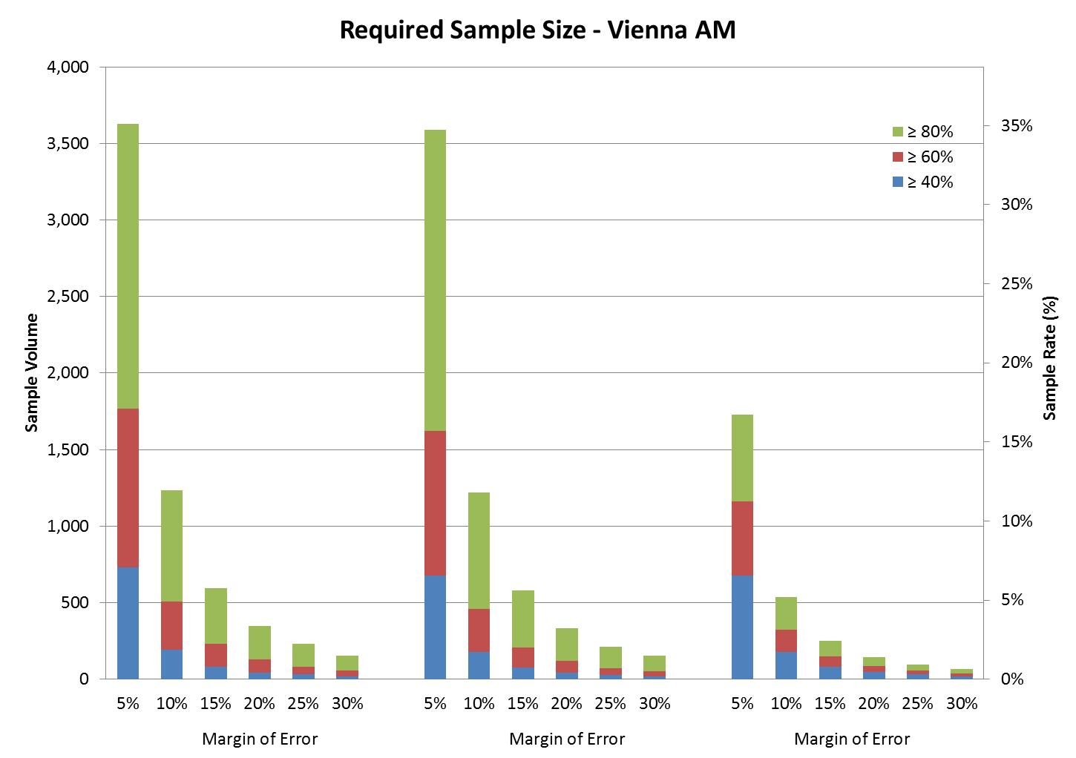
Confidence level is 95 percent
Scope
Case 1
Case 2
Case 3
Illustration on slide 14
Notes:
Here are the sample size results for the Vienna station. The three sets of bars reflect the 3 cases I enumerated two slides ago. The different colored bars reflect the different scope levels, and the bars within in each group reflect the MOEs. The y-axis on the left is sample size while on the right is the sampling rate. (pause) The sampling rate here is maximum of ~35% with a tight MOE, worst case income assumption, and no pre-screening. The sampling rate is just a percent or so when you have a wide MOE, use a previous income distribution and employ pre-screening.

Slide 20
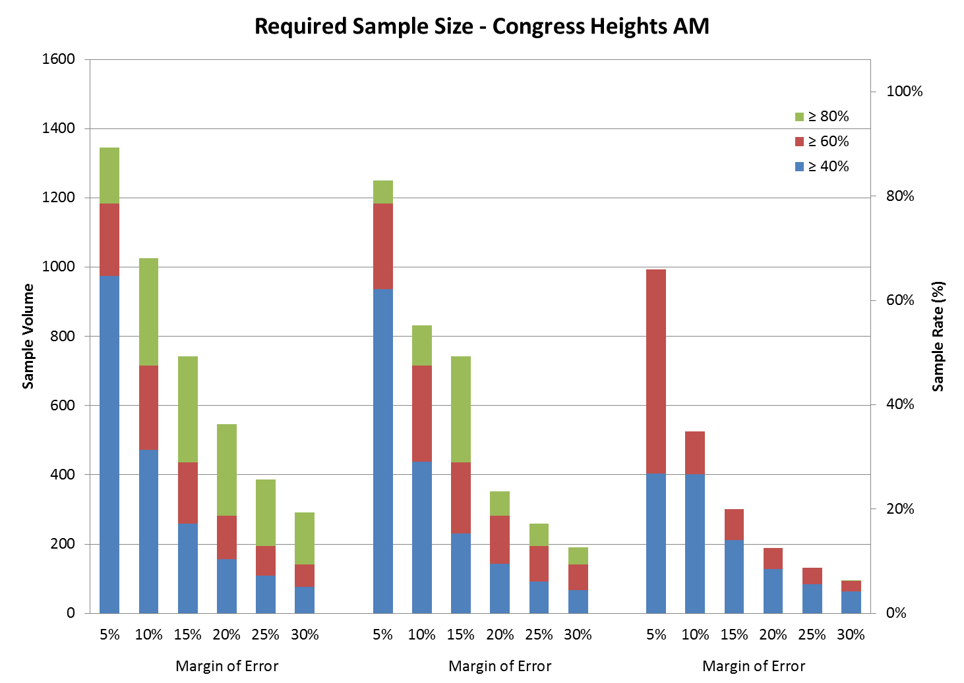
Confidence level is 95 percent
Scope
Case 1
Case 2
Case 3
Notes:
This slide shows the same metrics but for the Congress Heights station. (pause) Note the maximum sampling rate in these experiments is almost 90% and the smallest is about 5%. The trends here are similar to the previous slide - Case 3 produces the lowest requirements - but the reduction from the Case 1 sizes are more modest than for Vienna. These are just two stations...How big is the impact if you apply Case 3 and look at all entry stations for all 4 time periods in the Washington station?

Slide 21
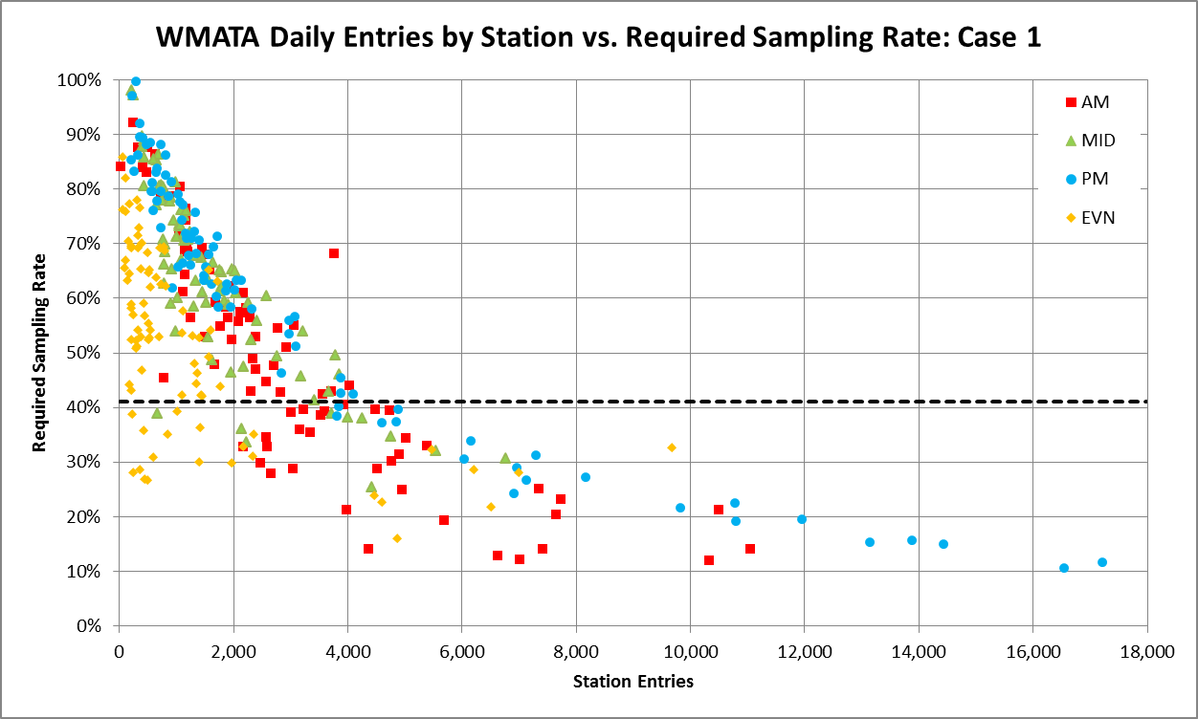
Outcomes for All Entry Stations (Case 1)
Congress Heights
Specifications:
- Confidence level = 95%
- Margin of error = 10%
- Scope = 80%
Consequences
- Required Samples = 95,751
- System-wide Sampling Rate = 41%
System required average sampling rate = 36%
Vienna
Notes:
These are the Case 1 sample requirements for all station/time period combinations, there are 86 x 4 = 344 station/time period dots here. Note that many station/time period combinations - if not most - have 60-90% sample rates. But if you use previous income distribution information and pre-screening you can lower the sampling rates and it would look like this....

Slide 22
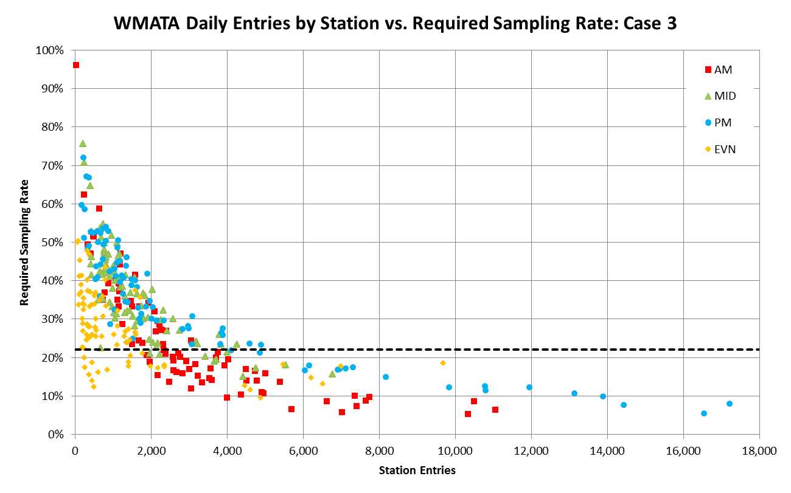
Outcomes for All Entry Stations (Case 3)
Specifications:
- Confidence level = 95%
- Margin of error = 10%
- Scope = 80%
Consequences
- Required Samples = 95,751
- System-wide Sampling Rate = 22%
Congress Heights
Vienna
Notes:
That cluster of dots is now generally between 30-50%. That's a significant reduction in effort, but still much higher than the traditional practice. That made us say...

Slide 23
Yikes! What do we do?
In sample design, consider
  Adopting Case 3 strategy (on-to-off data, quotas, prior data)
  Loosening accuracy requirement (95% → 90%?)
  Identifying priority data needs
  Further aggregating exit-station-groups
  Avoiding interviews with too-small exit-station-groups
  Shifting effort saved with quotas to smaller-volume stations
  Dropping hopelessly small entry-stations (?!)
  Recognizing that some markets are beyond reach
  Ensuring that the budget is realistic given stated data needs
Notes:
Yikes! How can we tailor sampling rates even further? We have some responses here that go beyond the Case 3 strategy. I can't run through all of them but I do want to highlight #3 - know what you need and focus resources accordingly - and be aware of #7 and 8 - there may be some small markets that just may be too small to survey and beyond logistical reach in the field.

Slide 24
Yikes! What do we do? (continued)
In using the data,
  Recognize varying levels of accuracy for different markets
  Convey the level of accuracy to others
  Recognize that N-dimensional cross-tabulations (N≥3) are likely to reflect statistically insignificant information
Notes:
If you apply these techniques, you need to be aware that different markets will have different accuracy levels. Consequently, any application of the data requires that you be aware of the implications and also convey this information to other users of the data. When using the data, it's important to remember that n-dimensional crosstabs, where n >= 3, are likely to have statistically insignificant information.

Slide 25
Conclusions
Traditional practice appears naïve
  Aggregate computations overstate accuracy outcome
  Uniform sampling rates ignore individual markets
  Large markets may well be over-sampled
  Small markets may be beyond reach, statistically
  Instruments are just one aspect, not the primary one
Sample design needs more attention
  On-to-off data to define the sampling frame
  Levels of aggregation that recognize market sizes
  New methods in the field to make best use of budget
Notes:
Our first conclusion is that traditional practice appears naive because the implications of a uniform sampling rate have not been fully understood. Larger markets may be oversampled while smaller markets may be undersampled. Small markets are indeed a challenge logistically. And the focus of survey preparation typically focuses primarily on the survey instrument rather than other aspects of the survey. The second conclusion is that survey sample design clearly needs more attention in the future. On-to-off information is really important in this regard. Serious discussions about addressing smaller markets need to happen, especially the impacts and consequences of surveying them or not surveying them. And any application of new methods in the field, like pre-screening, should be identified and worked in the design so that survey resources can be fully optmized.

Slide 26
Thank you.
Questions?
Notes:
Thanks very much for listening. Any questions?

