Slide 1
Analysis of Truck Route Choice using Truck-GPS Data
Mohammadreza Kamali, USF
Abdul Pinjari, USF
Krishnan Viswanathan, CDM Smith

Slide 2
Outline
ATRI Data Overview
Initial Study
Data Preparation
Map Matching
Discussion

Slide 3
ATRI’s Truck GPS Dataset
The ATRI-FPM initiative beginning in 2001
Joint venture by ATRI and FHWA for monitoring freight performance on key corridors
Satellite data from trucking companies who use GPS to monitor their fleet
“Big Data” real-time data streams reaching up to 1 Billion GPS data points per week
What is in (or known about) the data…
GPS data for a large number of trucks
Spatial &temporal coordinates for every GPS data point
Predominantly FHWA class 8 or above (tractor-trailers 5-axles or more)
What is not in the data…
Commodity transported, full-truck load/LTL, # axles, or other details of individual trucks
Purpose or other details of the trips being made
No other modes of freight movement
Sampling details unknown (except at the aggregate level)
Non-disclosure agreements to protect data confidentiality
3

Slide 4
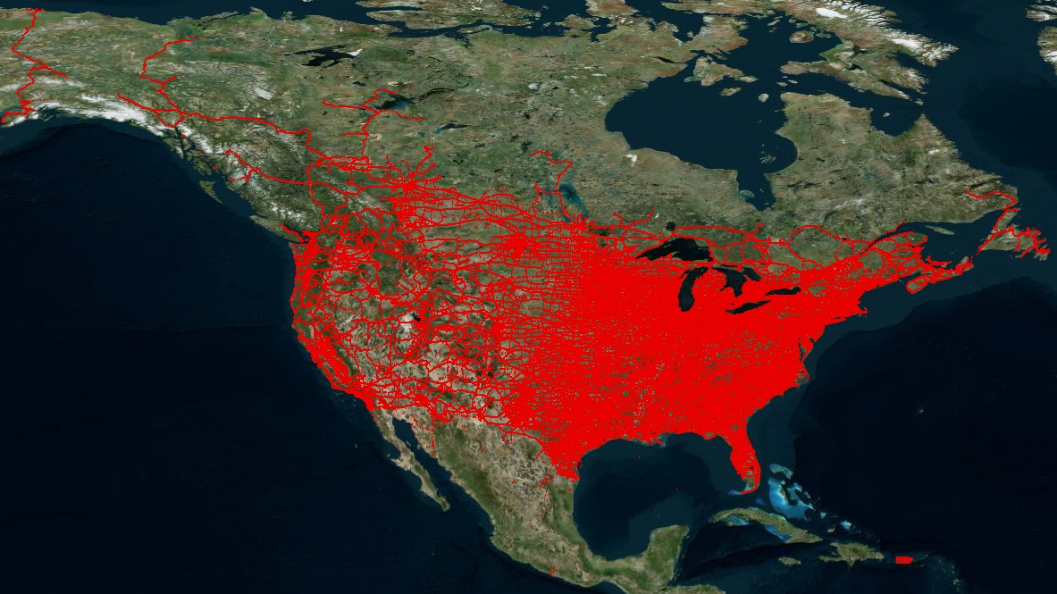
ATRI Truck GPS Dataset – One Day
4

Slide 5
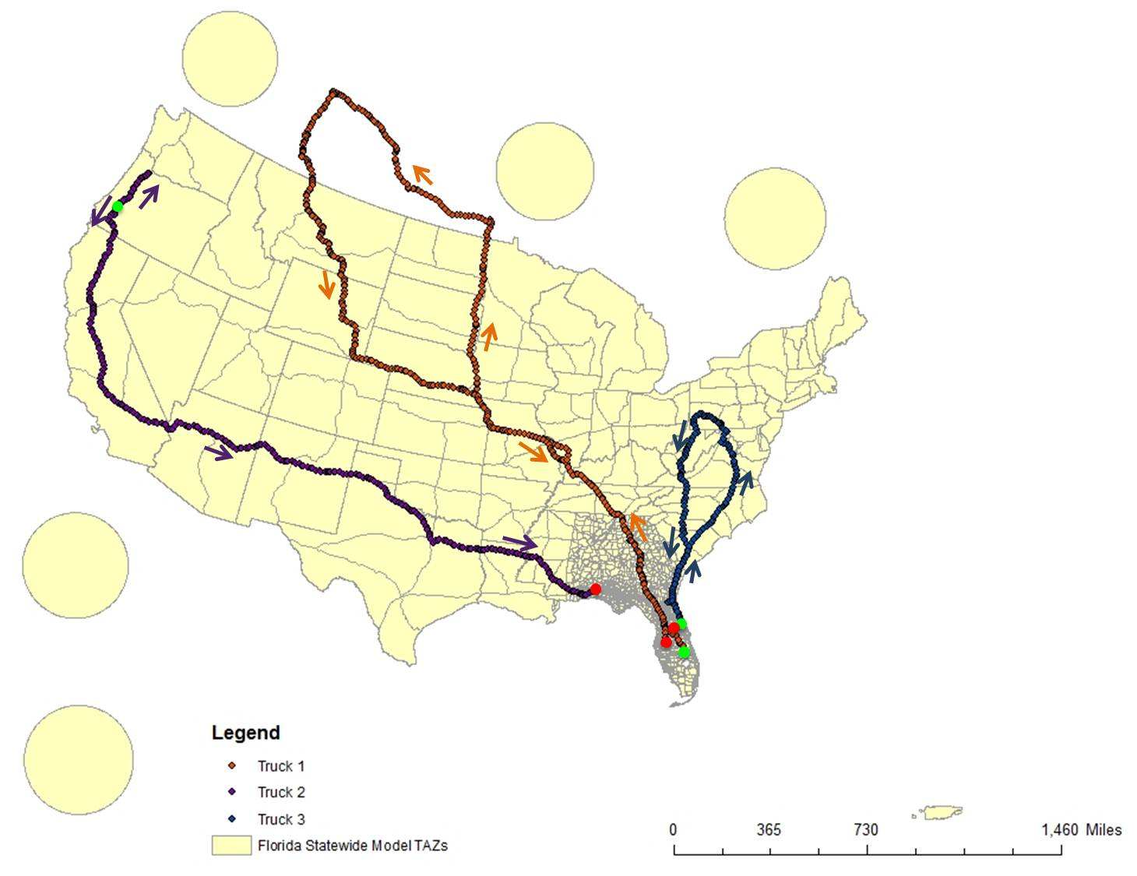
Examples of Truck Movements in the Data
5

Slide 6
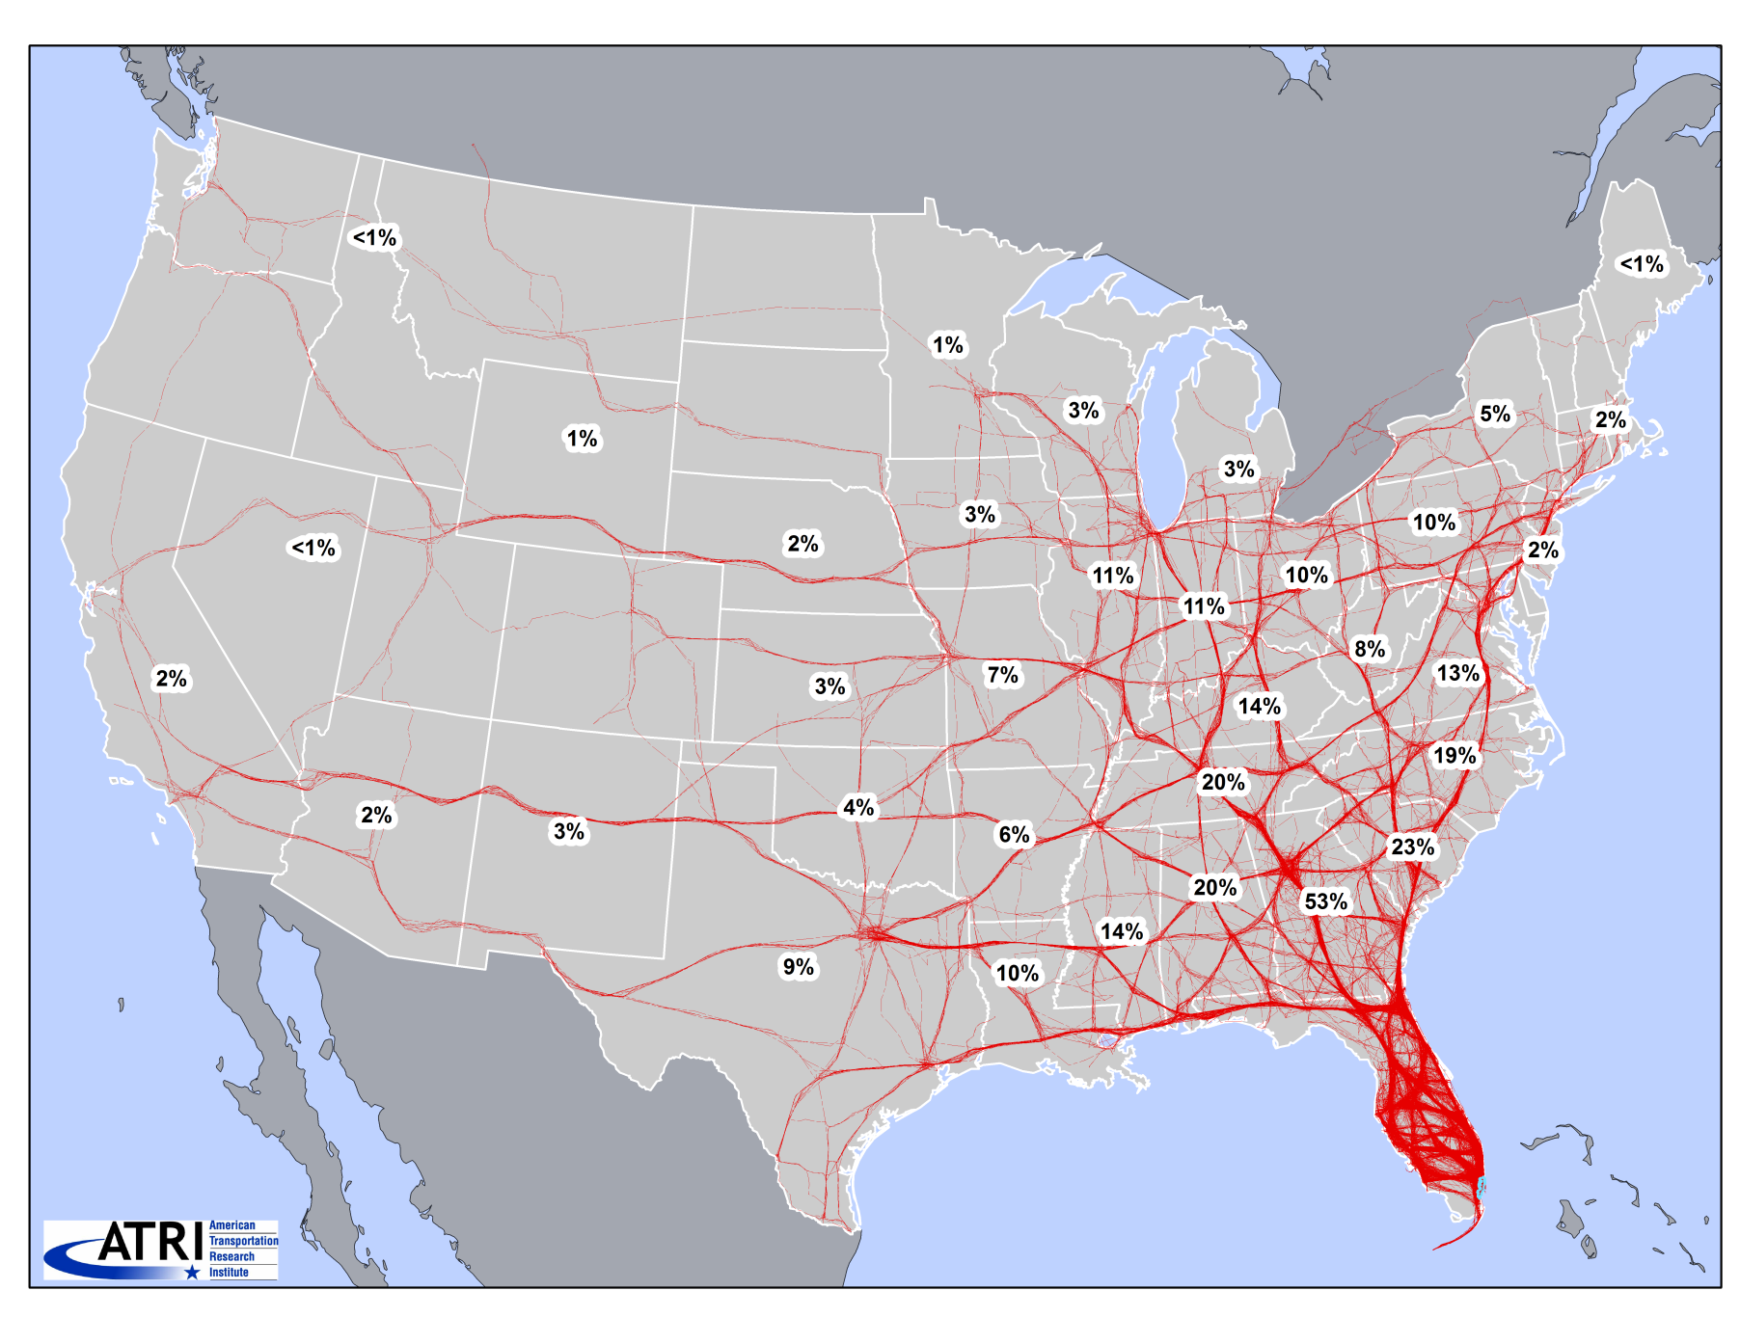
Locations visited during a week by 1000 Trucks starting in Miami, FL
6

Slide 7
Conversion of GPS Data into Truck Trips: Consider the end-use
For urban models
For statewide, national, or megaregional models
Short trips are of interest
All vehicle trip ends (except at traffic stops) may be of interest
Stops in rest areas are valid trip ends for tour-based urban truck models
Stops with short dwell-time buffers (except traffic stops) are of interest
Truck types include a large share of single unit trucks
Focus is on long-haul movements
Only pickup/delivery trip ends are of interest to FL statewide model
Stops in rest areas need to be eliminated to get to the pickup/delivery location
Stops with very short dwell-time buffers may not be of interest
Predominantly FHWA class 8 or above (5 axles or more)
Do NOT work with 1-day GPS data (1 week or more is preferable)
7

Slide 8
Conversion of GPS Data into Truck Trips for FL Statewide Model
Broad steps in the algorithm (TRB Paper #15-6031)
Identify stops based on spatial movement and speed between consecutive GPS points (<5mph)
Derive a preliminary set of trips based on a minimum dwell-time buffer of 30 min (eliminate stops of duration < 30 min)
Eliminate rest stops
Used a rest-areas land-use file (very useful but not exhaustive of all rest areas)
Eliminated stops in close proximity of interstates (<800 ft, again no magic number here)
Join consecutive trips ending and beginning at rest stops
Find circular trips (with ratio of air distance to network distance < 0.7)
Break circular trips into shorter (valid)trips by allowing smaller stop dwell-time buffers at the destinations (redo steps 3 and 4)
Join insignificant (< 1mile) trips to a preceding long trip or eliminate them
Scope for improvement
Detailed land-use and refinement of parameters (dwell-time buffer, etc.)
8

Slide 9
Convert GPS Data into Truck Trips
Derived over 2 Million truck trips derived from over 145 Million GPS records during 4 months (March – June) in 2010.
1.27 Million trips starting and/or ending in Florida
Note: Rules were developed to remove what were considered medium/light trucks (FHWA class 7 or below)
 | # GPS records (Millions) | # Trucks (Thousands) | # Trips starting and/or ending in Florida (Thousands)
March 2010 | 39.0 | 61.7 | 340
April 2010 | 35.7 | 58.7 | 320
May 2010 | 35.1 | 45.6 | 306
June 2010 | 35.2 | 45.4 | 305
Total | 145 Million GPS records |  | 1.27 Million truck trips
9

Slide 10
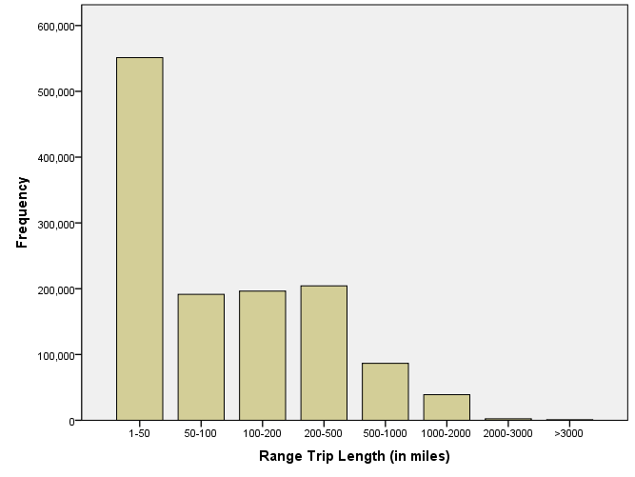
Trip Length Distribution (Trips Starting and/or Ending in FL)
10

Slide 11
Time of Day Profile (Trips Starting and/or Ending in Tampa)
Weekdays
Frequency (Percentage)
Time of day (0 is 12AM)
Number of trips :61,465
11
Time-of-day Profile of Trips Derived from 4 Months of ATRI Data
(March, April, May, June 2010)

Slide 12
Time of Day Profile (Trips Starting and/or Ending in Tampa)
Weekend
Frequency (Percentage)
Time of day (0 is 12AM)
Number of trips : 7,780
12
Time-of-day Profile of Trips Derived from 4 Months of ATRI Data
(March, April, May, June 2010)

Slide 13
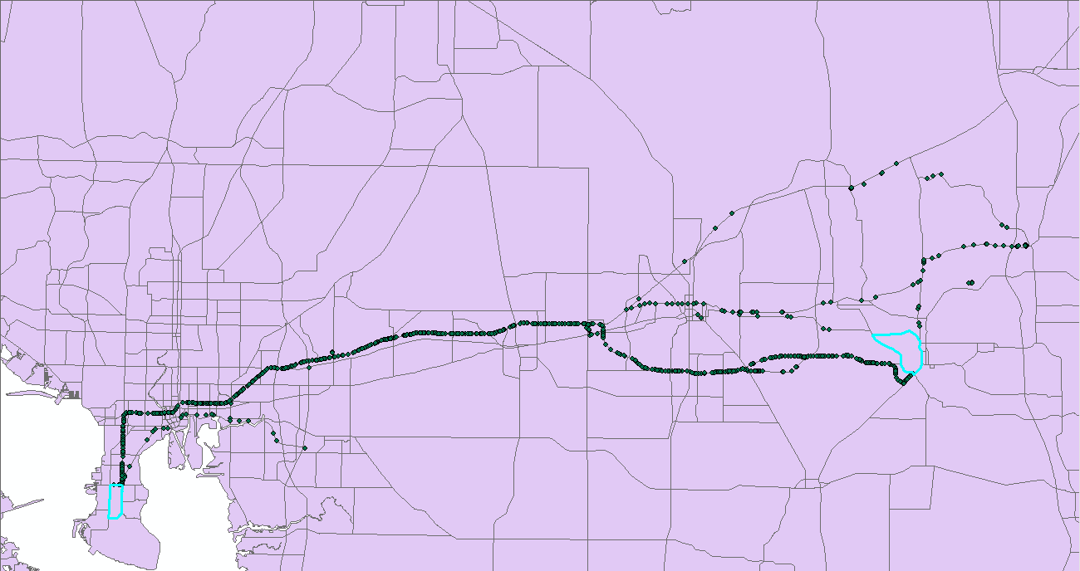
OD Travel Time Measurement
Useful for
Validating the freight travel demand model outcomes
Truck travel time skim inputs to the model
See below for a sample OD pair: Origin TAZ #4526 & Destination TAZ #1863
Destination TAZ
Origin TAZ
13
Route choice for 134 trips between Origin TAZ #4526 & Destination TAZ #1863

Slide 14
Travel Time Measurement for a Sample OD
14
Distribution of Measured Travel Time Between TAZ #4526 & TAZ #1863

Slide 15
ATRI Truck Travel Times vs. Google Maps (for 100 OD pairs)
OD travel times from trucks are smaller than those measured using ATRI data, perhaps because Google Maps travel times are based on passenger car travel times.
15

Slide 16
ATRI Truck Travel Times vs. Travel Times used in Florida Statewide Model
OD Travel times used in FLSWM are much lower than those measured using ATRI data, primarily because FLSWM travel times are based on passenger car travel times.
Probe data can be used to generate better truck travel time information for FLSWM
16

Slide 17
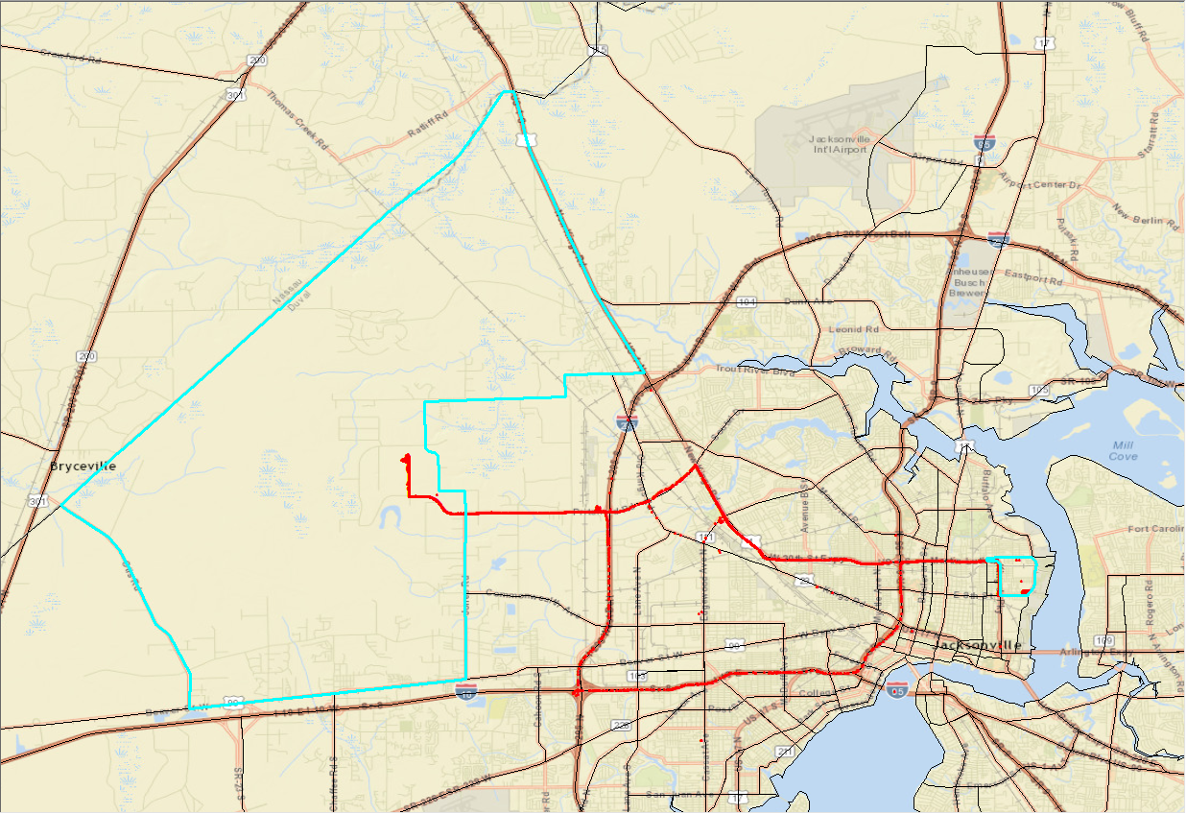
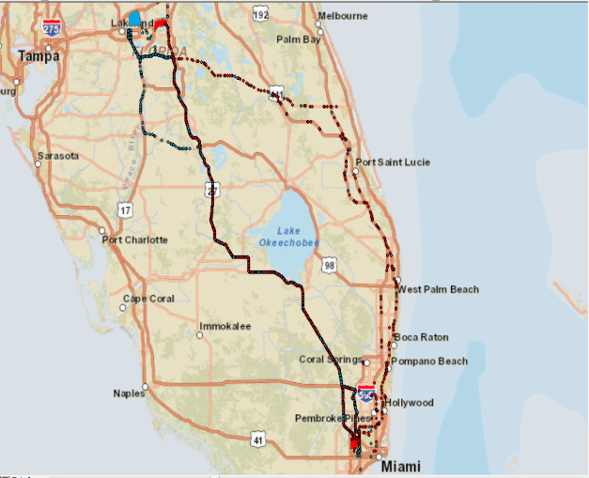
Initial Study
The goal was to visually measure the variability in the routes
Provided insights regarding the route variability in different geographic scales
Notes:
Travel time and tolls are two factors that impact trucks route choice the most
The route choice also relies heavily on the network structure
some trucks make minor deliveries before they get to their destination TAZ by taking longer routes

Slide 18
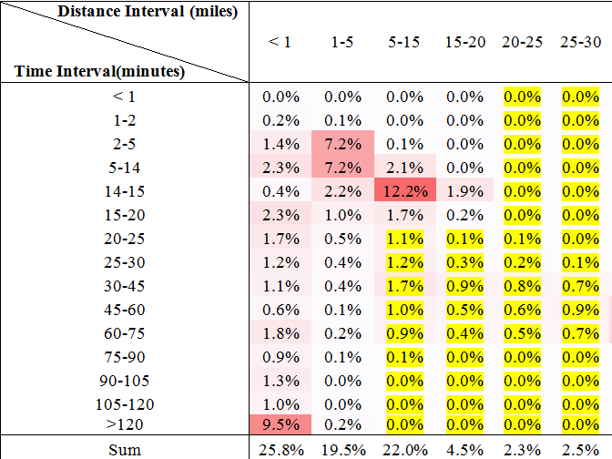
Data preparation
 | # Trips | # Truck IDs | # OD Pairs
Data with Spot Speed | 558,642 | 11,682 | 163,101
Data without Spot Speed | 571,983 | 128,251 | 227,457
Sum | 1,130,625 | 139,933 | 390,558
Notes:
Two important factors about the GPS data:
Temporal difference (ping rate)
Spatial difference
Sufficient amount of data should be also available
Data:
4 months in 2010
With spot speed and without spot speed
The previous table shows that the majority of combined GPS data falls within 20 minutes largest ping rate and 20 miles corresponding spatial difference. Therefore, the data with largest ping rate less than 20 minutes and corresponding spatial difference less than 20 miles, and also the data with largest ping rate greater than 20 minutes and corresponding spatial difference less than 5 miles were kept for the final analysis. The yellow shaded area in the table above shows the removed portion.

Slide 19
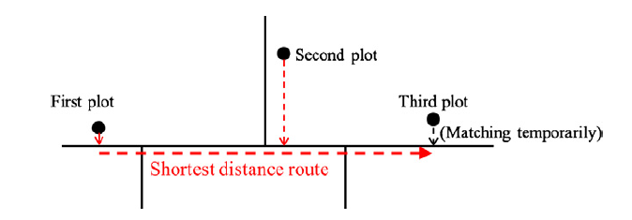
Map matching
GPS points must be matched with the correct link
Notes:
To model the trucks route choice, one should have a mathematical representation of the routes taken by trucks. This mathematical representation is usually introduced as links and nodes on a network. GPS data by itself cannot identify which links have been traveled by the truck on a certain network. Therefore, a process called “Map-Matching” needs to be implemented to snap the GPS points to their corresponding link on a network. In this thesis a certain map-matching technique based on the literature will be used to derive the links and nodes.
Match the first point to the nearest link, match the second point with a certain distance from the first, match the third point in a similar fashion, Temporarily match the third plot to the nearest link whose direction is consistent with that from the second plot to the third plot. This is called the ‘third link.’ Search for the route with the shortest distance from the first link to the third link. Match the second and sub-second plots to the nearest links on the route.
Shortest distance between 1st link and 3rd link
Multi candidate links for the 3rd point
Application of link cost

Slide 20
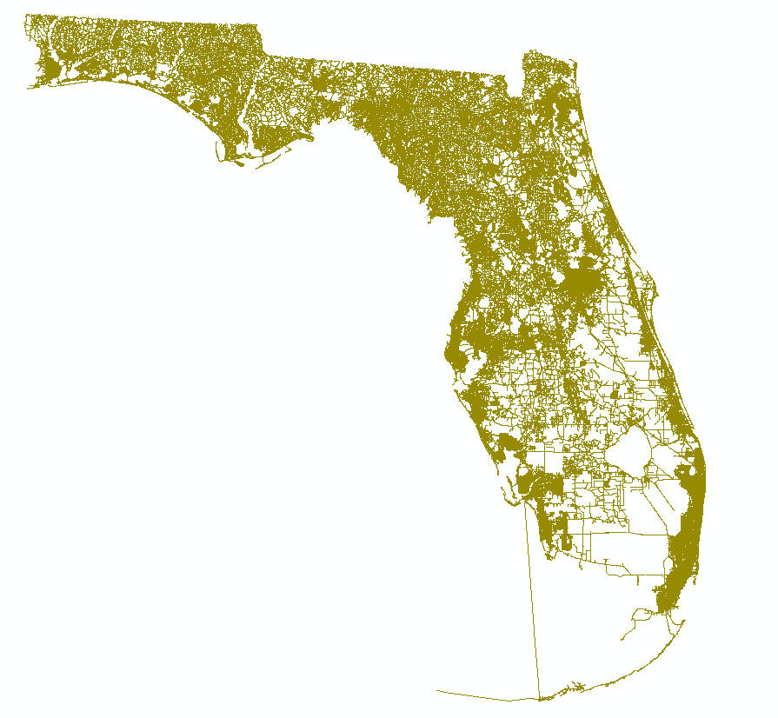
Map matching
Notes:
Navteq taken as base network

Slide 21
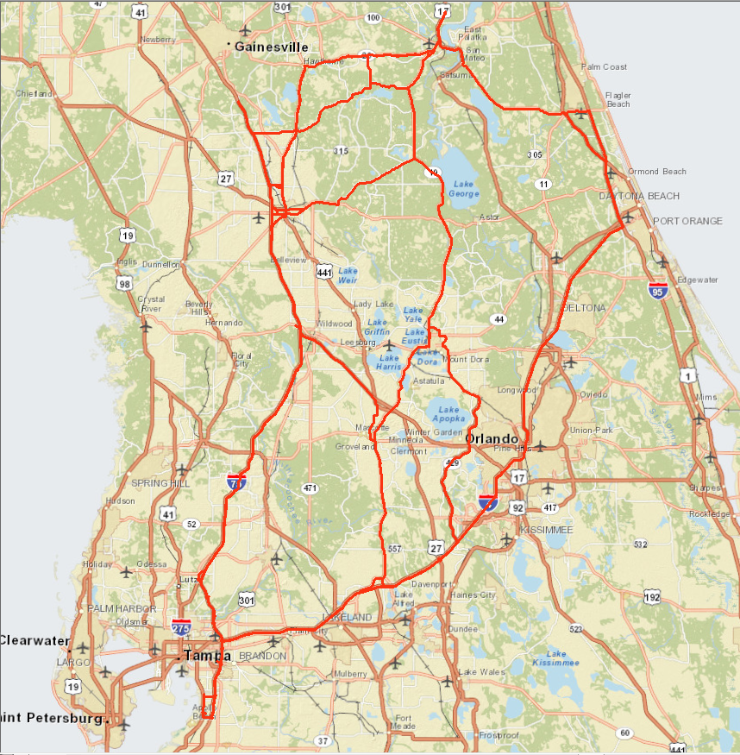
Map matching
Notes:
GPS points snapped to the nearest link
a simple approach of map matching has been taken to be able to move forward quickly and explore future steps. All 36 trips between two OD pairs in Florida were chosen as a small sample to work with. The GPS data corresponding to these trips are with spot speed. All the GPS points in this ample which had spot speed less than 5 miles were removed to avoid any stops on the route. The GPS points for these trips were extracted and then the “Near Analysis Tool” in ArcGIS was used to match them with the nearest link on Navteq network. Furthermore, the network analyst tool was used to find the routes for those 36 trips. To use the network analyst, all the GPS points belonging to each trip have to be imported as stops so that network analyst finds the shortest route between each consecutive stop for each route. The following figure shows all the 36 routes in red lines on a map:

Slide 22
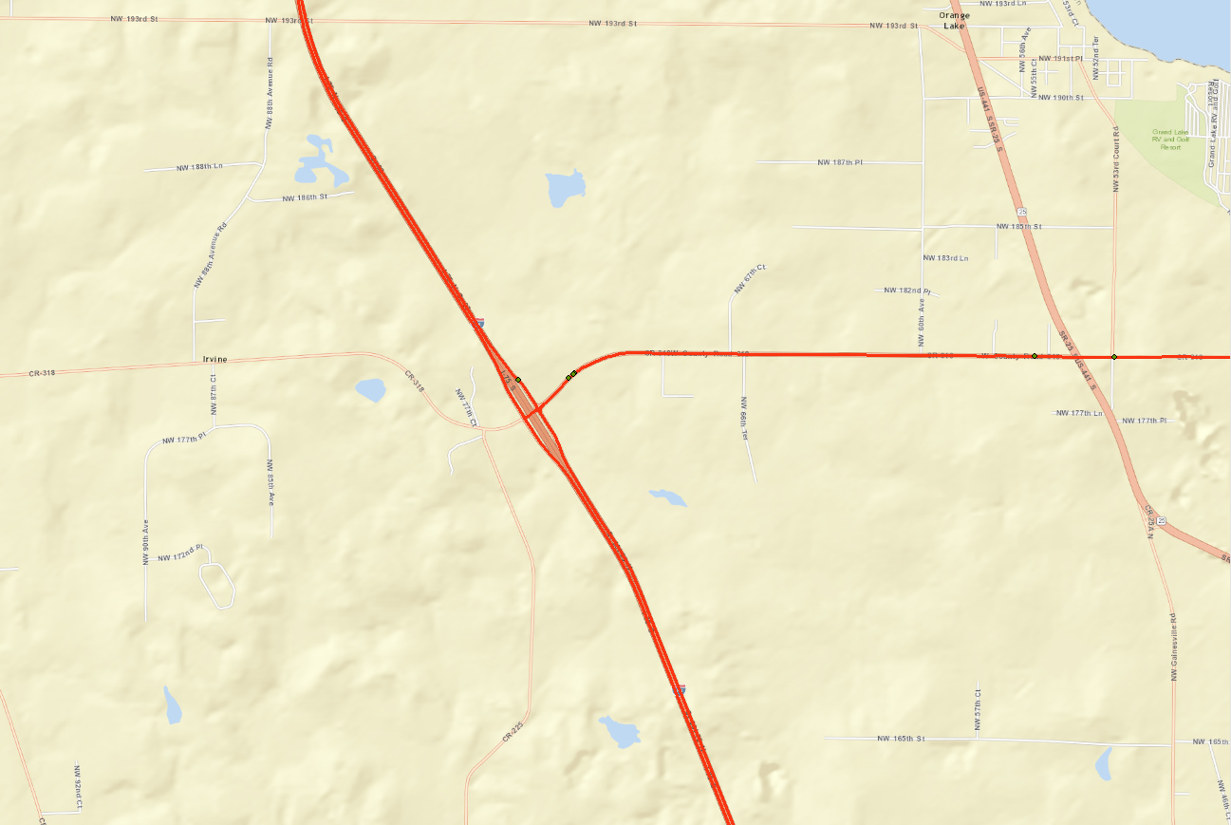
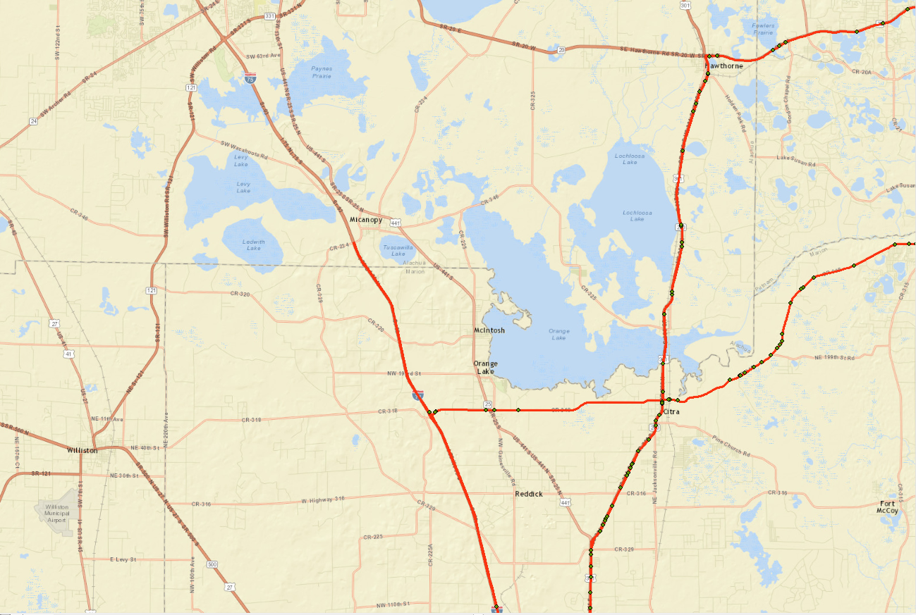
Map matching
Notes:
Issue: smaller trips within the main trip
Even though the routes can easily be extracted this way, there will be some anomalies in the routes. Since some of these 36 trips consist of smaller trips, some unusual routes can be seen:
The GPS point in the green ring is where the truck has probably stopped. The spot speed for this point is less than 20 mph
The part of a route in the green ring is caused by smaller trips within the bigger trip

Slide 23
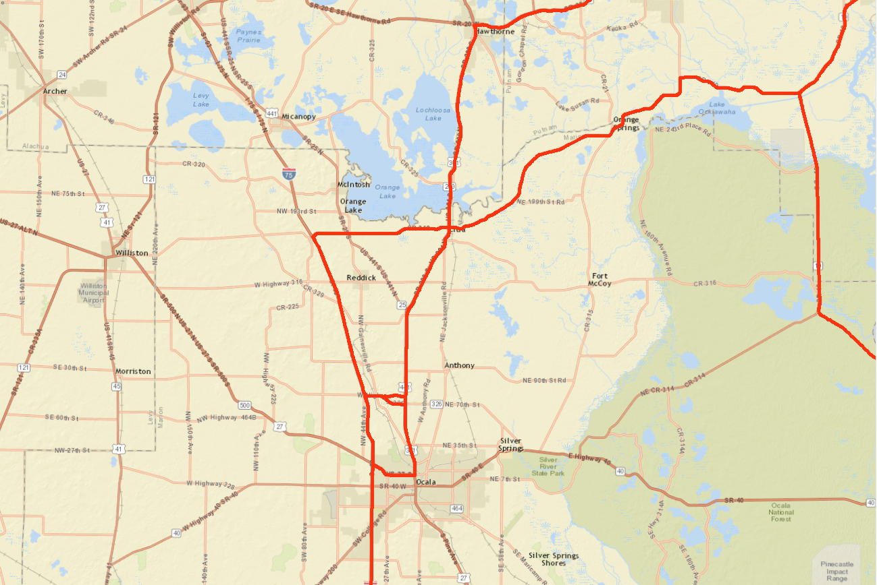
Map matching
Notes:
Possible solution: removing data with spot speed < 20 mph (or larger)
The GPS point in green ring in figure 5 is the one that is making this problem. After reviewing several other similar cases in the 36 trips it was found out that all these GPS points have spot speed less than 20mph and it was decided to remove all the GPS points with spot speed less than 20mph to resolve this issue.

Slide 24
Discussion
No information on the decision maker
Minimum travel time assumption
Relying on network analyst for getting the routes
Smaller trips within a major trip
Removing GPS point with spot speed < 20 mph ?
Building the choice set
Does this data represent the choice set?
Map-matching
Is it really necessary?
Notes:
Network analyst does not provide the links
Possible solutions:
Buffer
Joining
Calculating route attributes
Building the model
Deriving the truck routes as network links
The network analyst does not provide the routes with the corresponding links. Therefore, one should find a way to get the links for each route given the shape of the route.
One possible solution can be making a very small buffer around the entire route and considering the links that fall inside. This approach will give all the links plus small parts of unrelated links. If all the links smaller than a threshold are removed then there is a possibility that some of the related links are also removed.
Another approach could be spatial joining between route shape and the network. This approach needs to be tested.
Providing attributes for each route
Having gotten the links, one can calculate route attributes like travel time, facility type, number of lanes etc. for each route to be used in the model. Navteq network provide this information for each link.
Modeling
Having derived the links and necessary information, one can move to the modeling step. In this part a choice set will be introduced based on the routes that have been derived already, and then the modeling part begins using the network information as the alternative attributes. As of right now there is no information on the decision maker attributes due to the confidentiality ties imposed on the data and in turn, the model will not be able to capture the decision maker (e.g. truck driver or trucking company) preferences. A multinomial logit model (MNL) will be used to explain the route choice patterns of trucks.

Slide 25
Acknowledgements
Florida Department of Transportation
Frank Tabatabaee, Thomas Hill, Ed Hutchinson
Vidya Mysore – FHWA
American Transportation Research Institute (ATRI)
Jeff Short, Lisa Park, Dave Pierce, Dan Murray
Current and former USF Students
Aayush Thakur
Akbar Zanjani
Mohammadreza Kamali
Anissa Irmania
Vaibhav Rastogi
Jonathan Koons

Slide 26
CONTACT
Abdul Pinjari
apinjari@usf.edu
Maz Kamali
mkamali@mail.usf.edu
Krishnan Viswanathan
viswanathank@cdmsmith.com

