Slide 1
Sensitivity to Recreational Travel
A Mountain of Opportunities for Travel Demand in the Central Wasatch
Jennifer Ziebarth | May 21, 2015
Kyle Cook
Mike Wallace
Notes:
Thank organizers and early-morning attendees and project sponsors

Slide 2
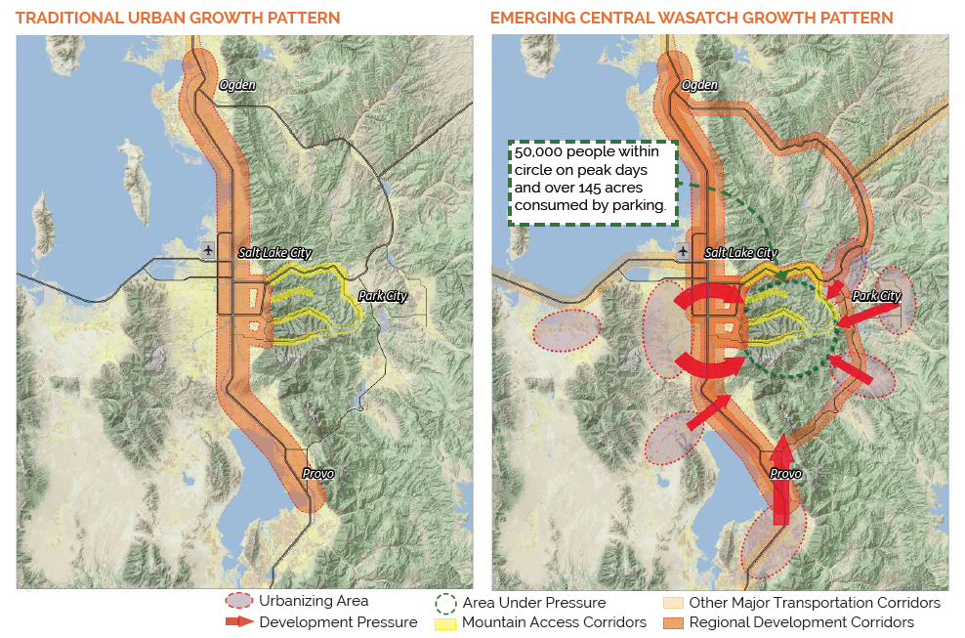
Notes:
Since we're a long way from Utah, let me start with a quick orientation: Salt Lake City is here, with Wasatch mountains to the east. Traditionally, urban growth has been along the front range of the mountains, stretching from Ogden to Provo, but in recent years there has been increasing growth in and around Park City. This area between Salt Lake City and Park City is full of recreational opportunities and has faced ...

Slide 3
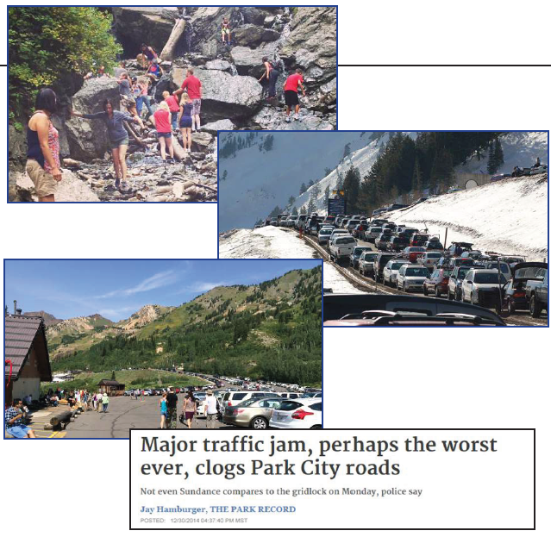
Notes:
... increasing pressure from the fast growth of population and visitors. If the situation is not addressed, the area will soon face a mountain of problems.

Slide 4
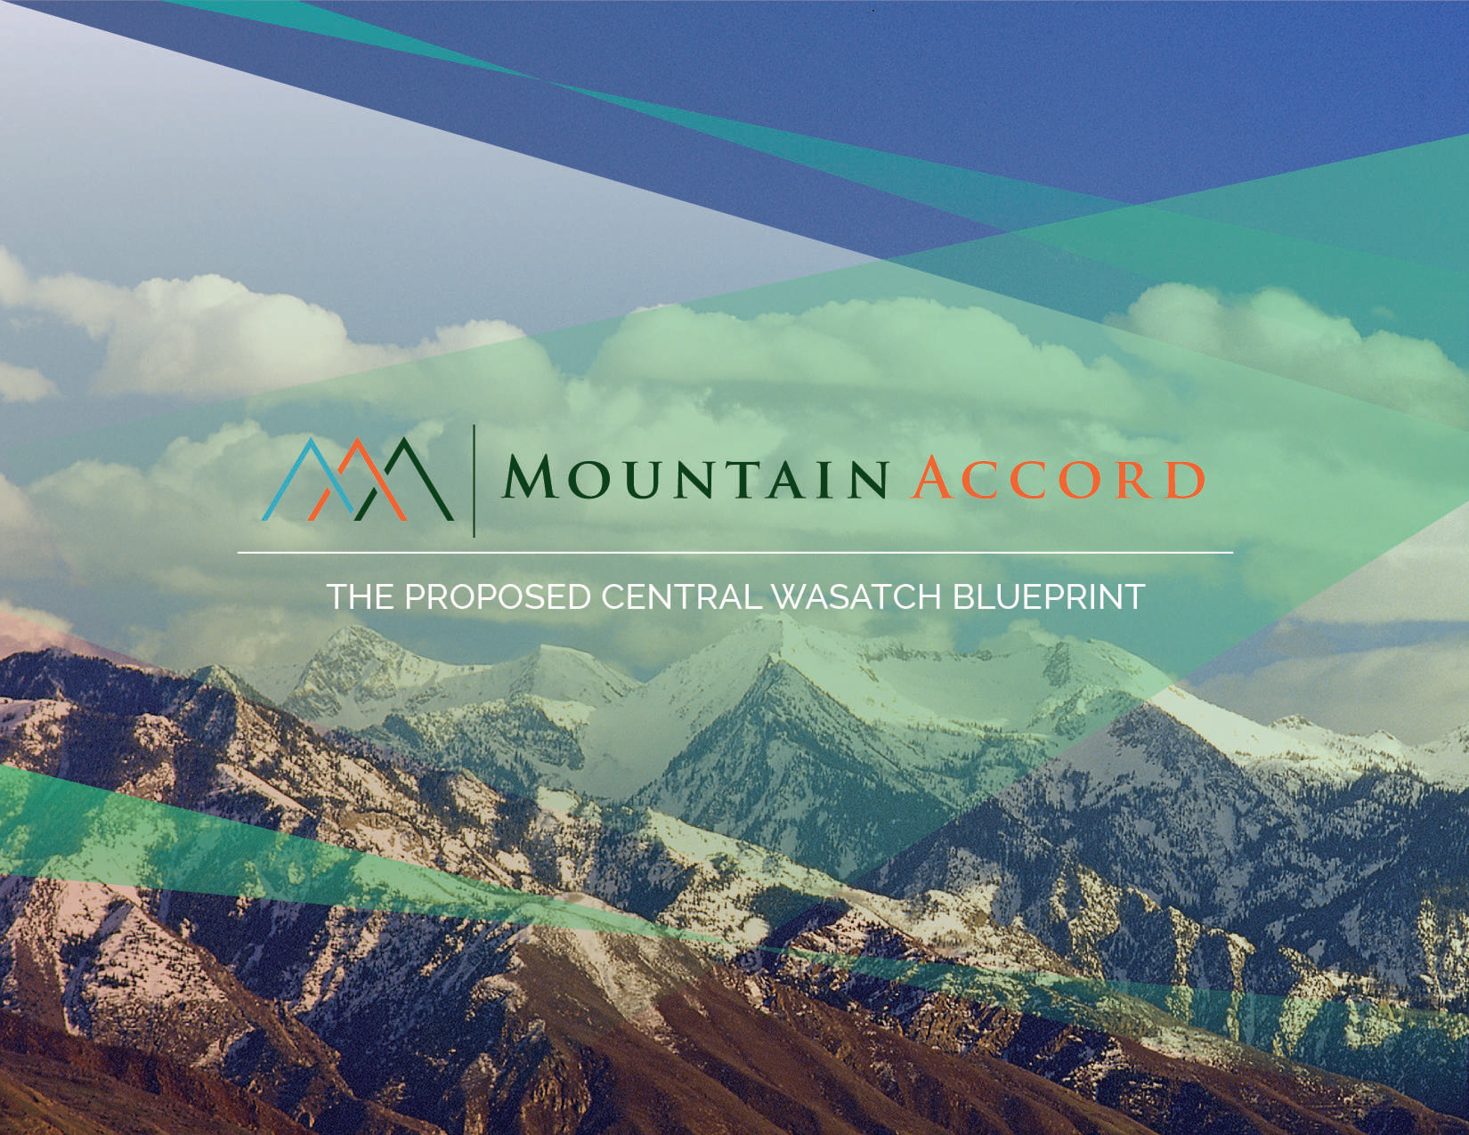
Notes:
The Mountain Accord Program is a significant regional study that considers, among other things, the future of transportation and land use in the Central Wasatch Mountains. The program's goals include expansion of transit service to mountain destination, improved transit connections between the valley and the Wasatch Back and within Park City, as well as improved safety and access for bicycles and pedestrians.

Slide 5
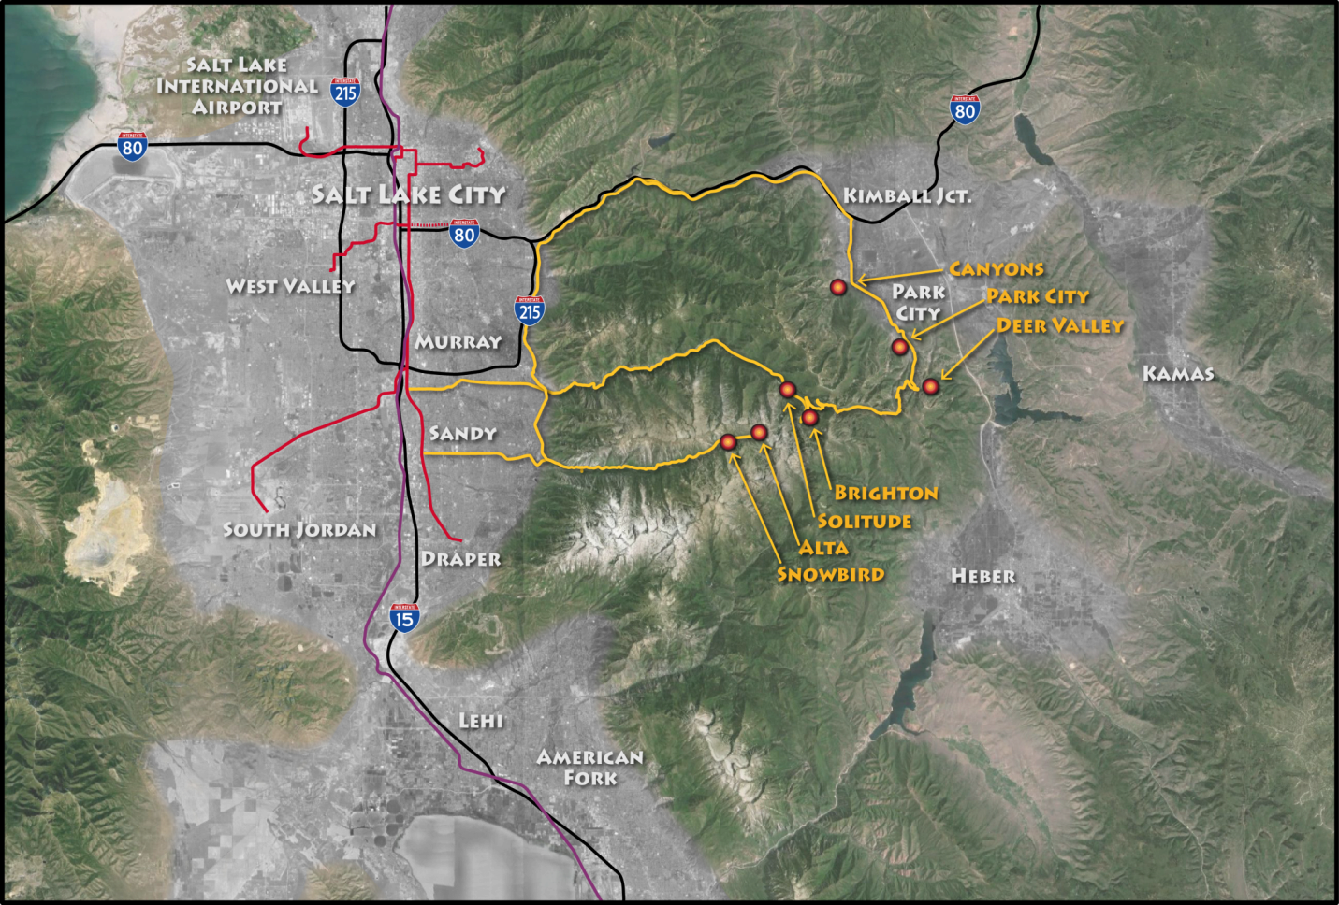
Notes:
To evaluate transportation alternatives, a natural tool is a travel demand model. Our model pivots off the existing MPO model; but that model extends only to the mouths of the canyons, so first we needed an expanded geography that includes the canyon areas as well as Summit and Wasatch counties, including Park City.

Slide 6
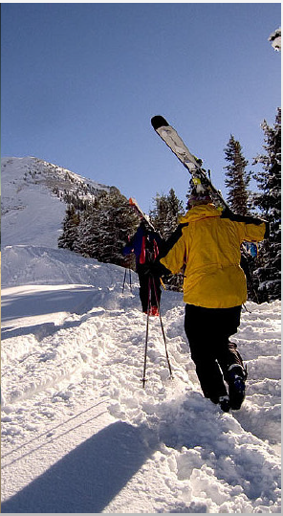
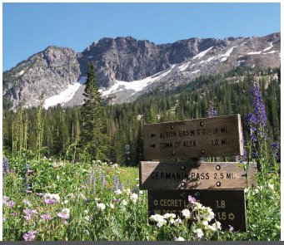
Notes:
But every bit as crucial is to develop a model which is sensitive to the kind of recreational travel that the area experiences. That recreational travel differs by season, and includes both residents and visitors whose travel patterns are likely quite different. For the mathematically inclined among us, this is 16 different combinations -- in other words, a mountain of options for types of recreational travel.
In an ideal world, we'd have data available to help us understand all 16 combinations. So let's turn now to the data available for this project.

Slide 7
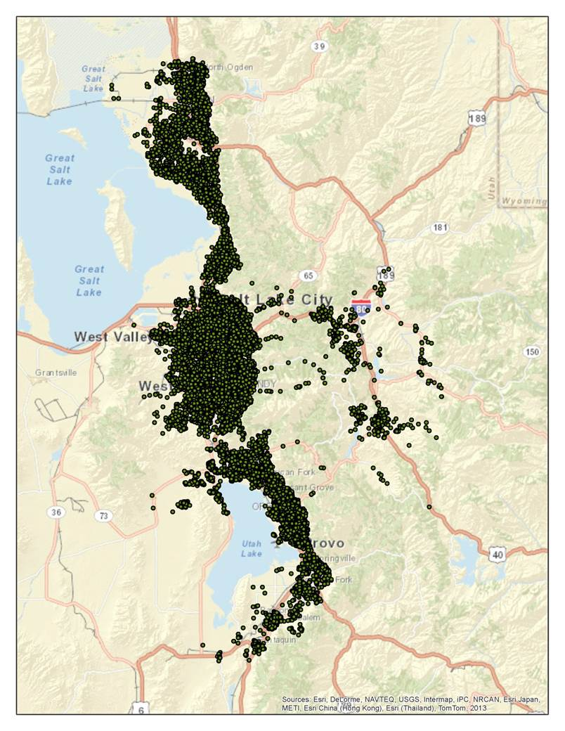
Data sources
2010 Census
Utah Governor’s Office of Management and Budget (GOMB)
Utah Department of Workforce Services (DWS)
2012 Utah household travel survey
AirSage origin-destination data
Utah skier survey
Season pass holder zip codes
RRC
  Future skier day projections
  Hotel rooms, seasonal occupancy
Notes:
Any model development project is awash in data: census data, household travel survey data, employment & land use data. But to model recreational travel, we need to get creative and find some additional kinds of data. In this project we also acquired cellphone origin-destination data from AirSage, trailhead parking utilization data, a skier survey, hotel room availability and occupancy, details about recreation-focused employment, and projections of future ski trends in the state. A mountain of data, not entirely consistent among different sources. How to make reasonable use of this data??

Slide 8
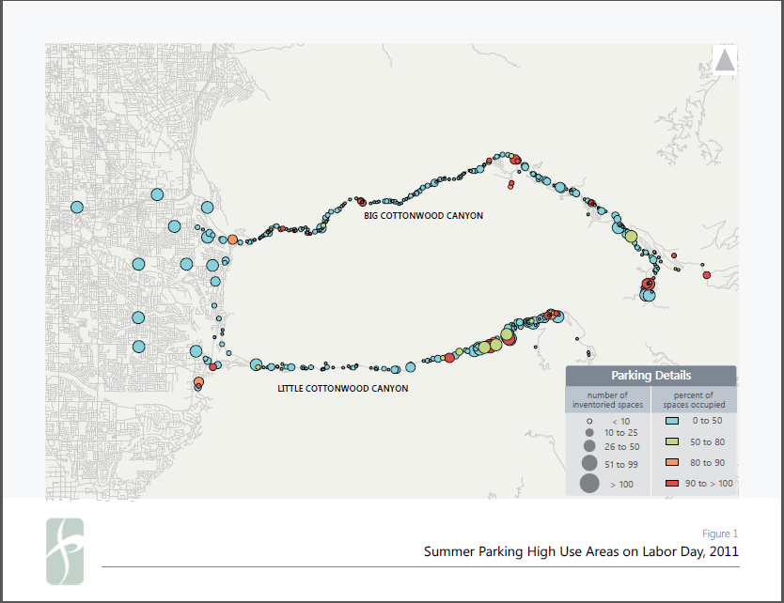
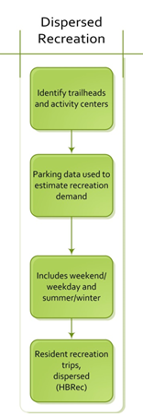
Notes:
Two patterns of recreational travel emerged at the intersection of highly relevant and data availability. The first recreational pattern we focused on was dispersed recreational travel, as measured by trailhead parking availability and utilization data. The data indicated that this form of dispersed travel was undertaken much more by residents than by visitors, so for the sake of simplicity in our initial efforts, we limited the modeling of this dispersed travel to residents.

Slide 9
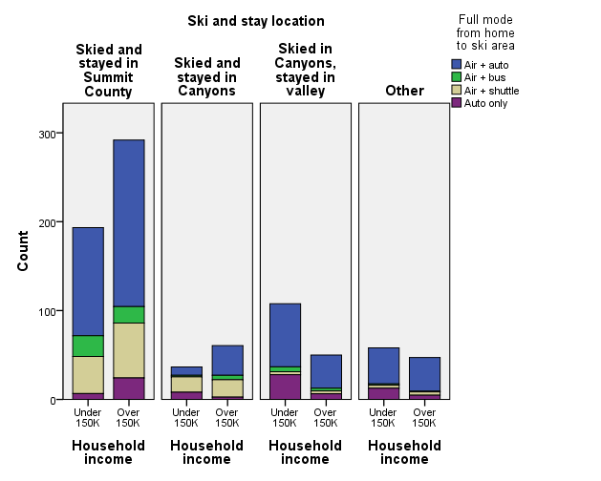
Notes:
The second pattern of recreational travel at the intersection of relevance and data availability was resort-oriented winter recreational travel: in other words, ski travel. A detailed skier survey as well as ski industry expert projections of future trends gave us the ability not only to estimate models of ski travel but to forecast them as well. In the model, this form of resort-oriented recreational travel is undertaken by both residents and visitors.

Slide 10
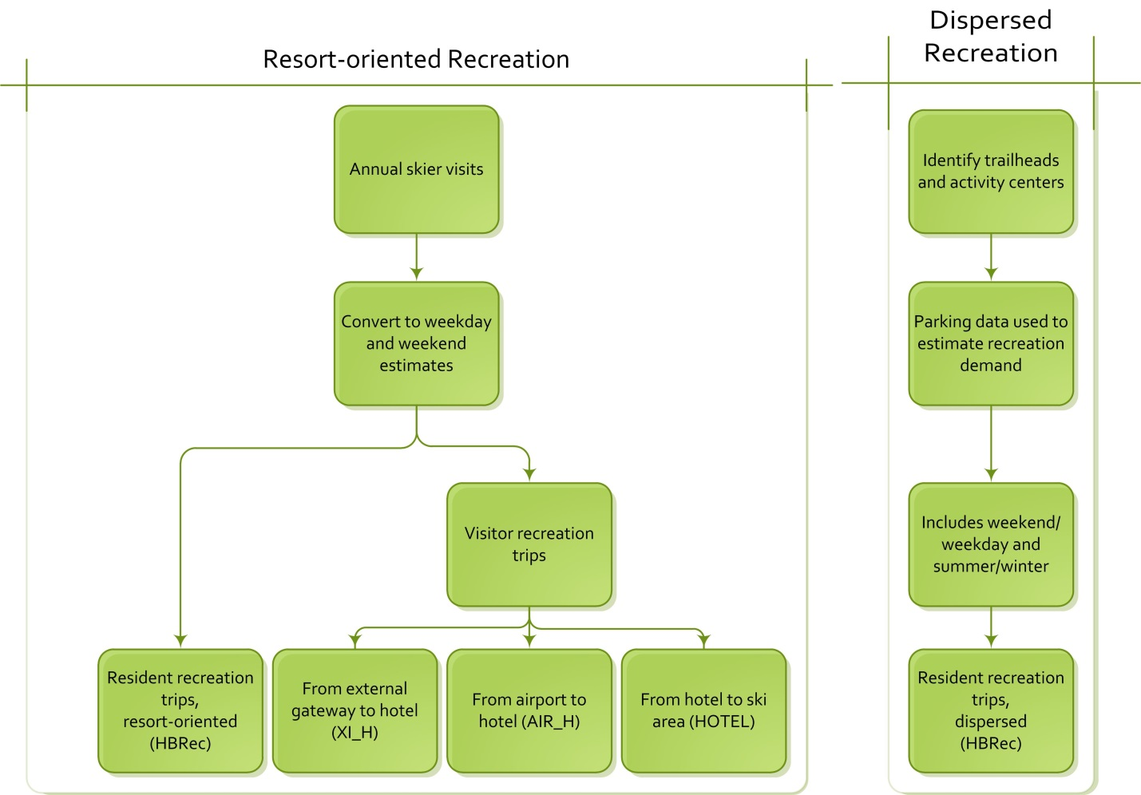
Notes:
Having determined two forms of recreational travel suitable for inclusion in the model, we next needed to consider how to structure recreational travel within the model. For dispersed travel, (talk through flowchart). For resort-oriented travel, we made some simplifying assumptions that residents would travel directly from home to ski, while visitors would travel from airports or gateways to hotels (either in the valley or at the ski areas), and from there onward to ski resorts.

Slide 11
Mountain-oriented Trip Purposes
Residents
Purpose | Name | Description
Home-based recreation | HBREC | Residential travel between households and recreation destinations
Visitors
Purpose | Name | Description
Travel between hotels and ski areas | HOTEL | Visitor travel with trip ends at lodging location and ski area
Travel between hotels and airport | AIR_H | Visitor travel with trip ends at lodging and airport
Travel between external gateways and hotels | XI_H | Visitor travel with trip ends at lodging and external gateway
Notes:
With this structure in mind, the additions we needed to make to the model's trip purposes and land use inputs were clear. Hotel beds served as attractions for gateway and airport to hotel trips. Dispersed trailhead parking data was converted to person trips to serve as attractions for summer resident rec trips, and ski data was converted to person rips to serve as attractions for winter resident rec trips and vision hotel to ski trips.

Slide 12
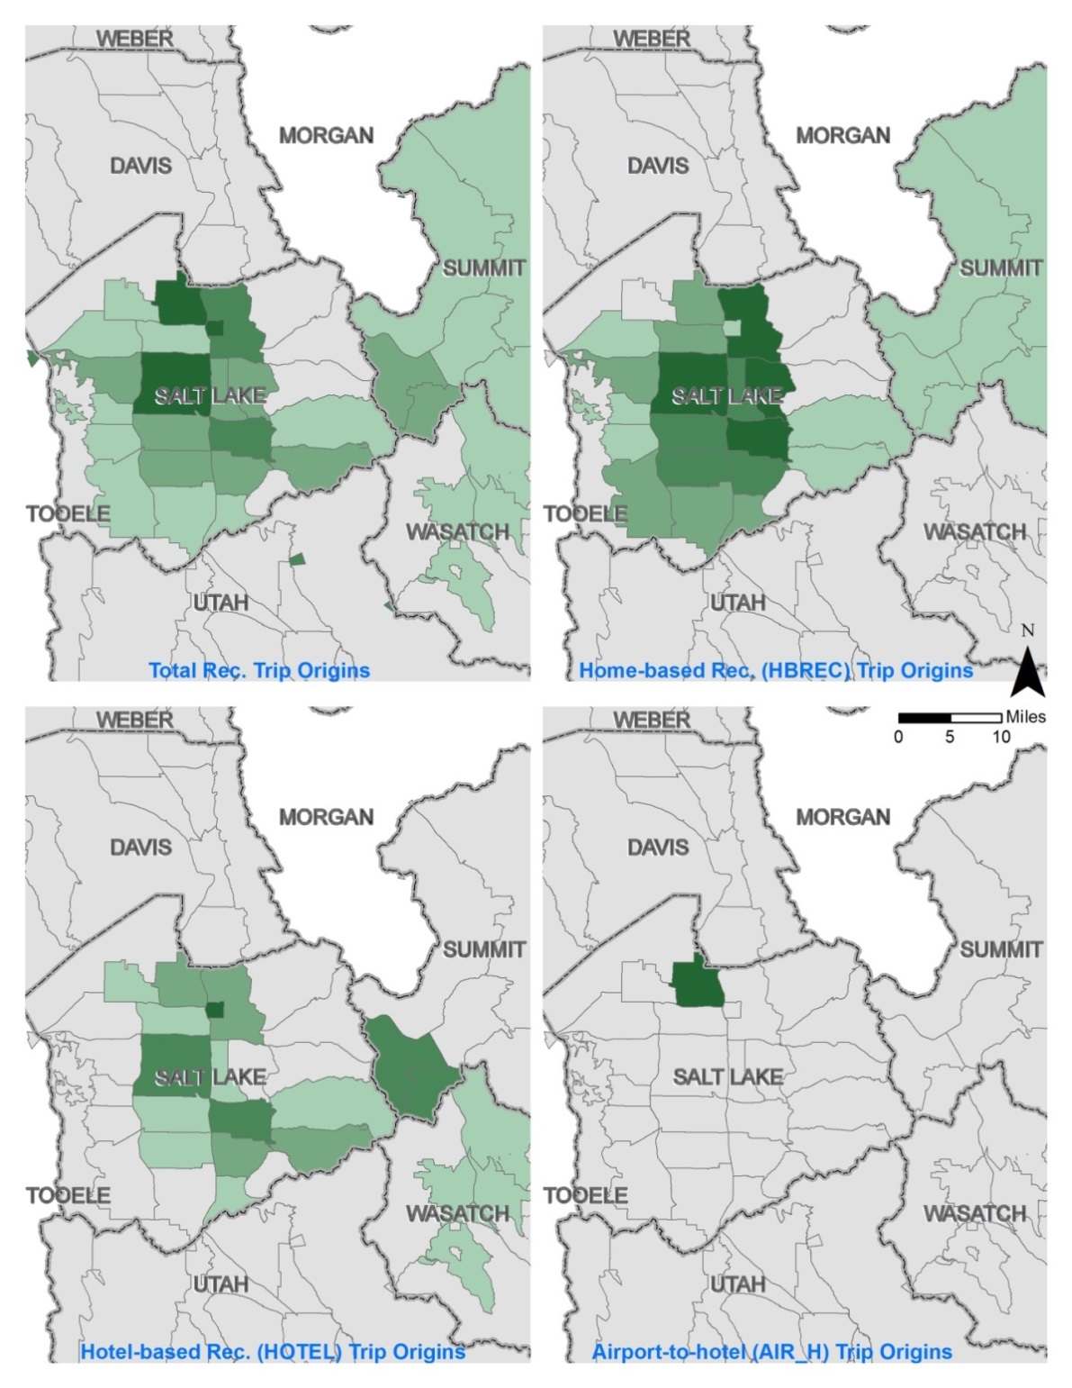
Notes:
Trip productions for recreational trip purposes.
some further notes: balance to attractions, hbrec estimated as subset of hbother but total kept as before. To avoid double counting, trip attractions were adjusted for other purposes too eg work, shop. Something about mode choice, and reference to adjustments made in i70 project.

Slide 13
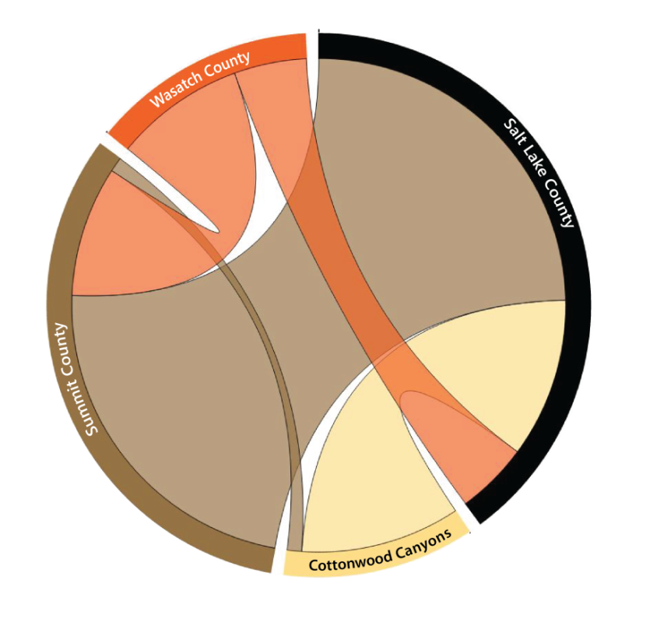
Notes:
Large scale OD data from cellphones: airsage. To help validate -- as well as to help understand inter regional trips through new model gateways -- we used district level cello phone od data. Might add in that this data can help us understand weekend versus weekday travel as well.

Slide 14
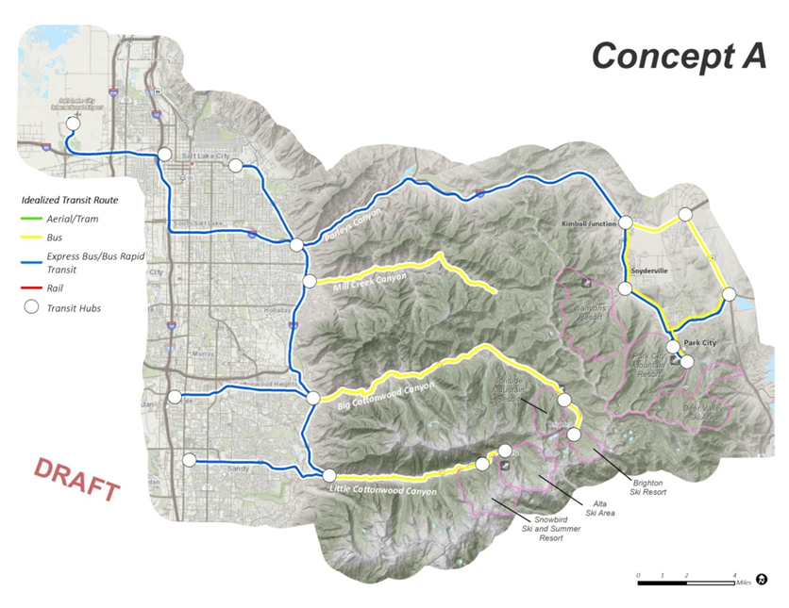
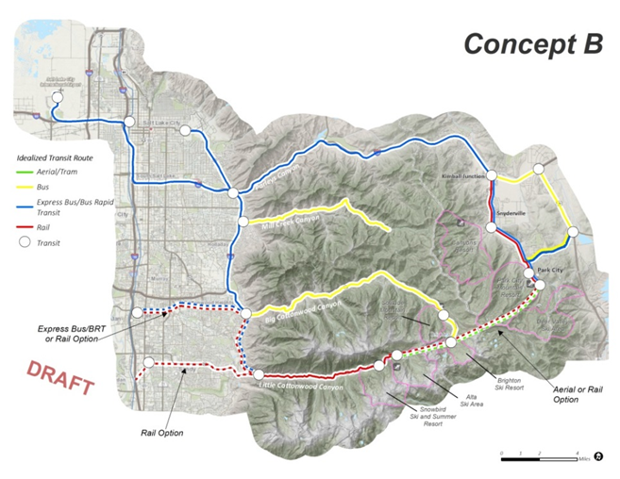
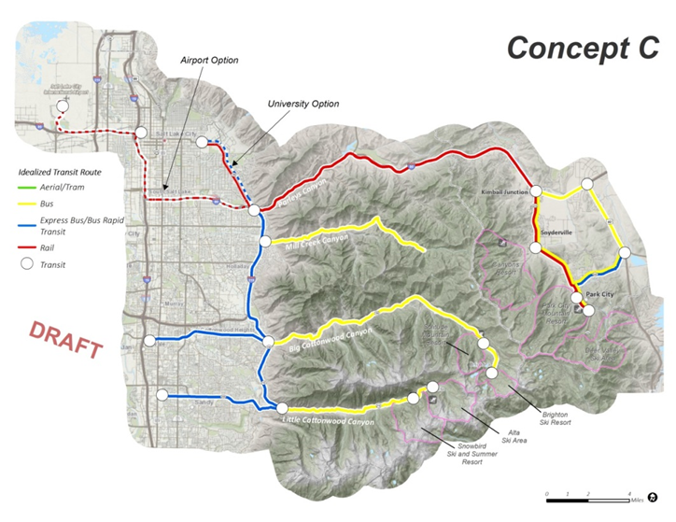
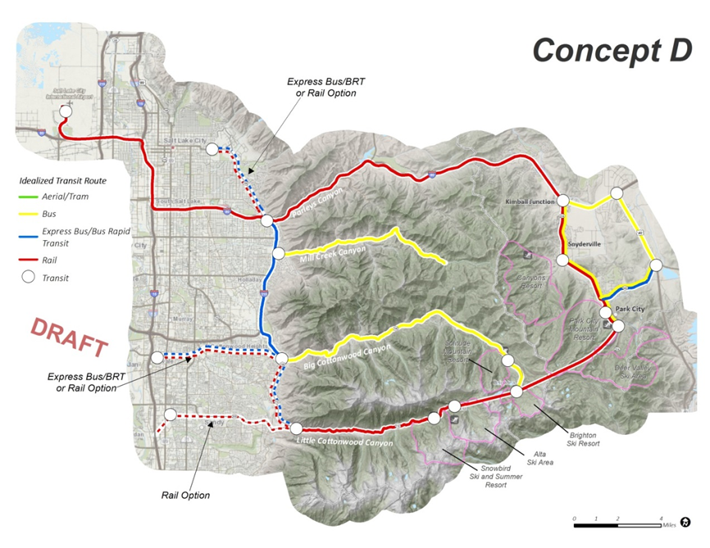
Notes:
All models wrong, but some useful. Having calibrated and validated the model, we now believe it to be useful....... And it is now being used by the Moutnqin Accord program for its intended purpose, evaluating scenarios for managing demand for travel, particularly recreational travel, in the beautiful central Wasatch.

Slide 15


Contact: j.ziebarth@fehrandpeers.com

