Slide 1
Conflating Multiple Trueshape Networks for an Enterprise GIS
Qiang Li, Daniel Consulting, Inc.
Subrat Mahapatra, Maryland State Highway Administration
Tanya King, Daniel Consulting, Inc.
Brad Spittel, KCI Technologies, Inc.

Slide 2
Introduction
SHA Request to develop a Multimodal Transportation Network Model and Geodatabase to support Maryland Statewide Transportation Model (MSTM) and SHA Enterprise GIS (eGIS)
Existing CUBE Network Database for MSTM
  Stick Lines - lack accurate geographic reference
  Not match either State Highway Network data or MPO Network data
  Not compatible with SHA eGIS
  Isolated data tables

Slide 3
Develop Master Network Geodatabase
Multimodal and Multiyear Transportation Networks
True Shape links – real distance of highway/transit segments
Highway and transit elements are dynamically linked and geographically referenced
Integrate with the MSTM and SHA Enterprise GIS
Incorporate ArcGIS-based network editing tools developed by Daniel Consultants, Inc.
Provide better match with other network data (e.g. Toll Road, TIP, Traffic Counts)
Directly Export Cube Network Files (e.g. Cube geodatabase, .dbf, and Cube shape)

Slide 4
Geodatabase Development Steps
Design the Structure of Geodatabase
True Shape Network Conflation
Transfer Network Attributes from various Sources
  Update Transit Networks
  Integrate Special Network Data (e.g. Toll, TIP, Traffic Counts, etc.)

Slide 5
MSTM Network Geodatabase Structure
Highway Links Feature Class
Node ID
Highway Nodes Feature Class
A/B Node ID
Node ID
Transit Links Feature Class
Line ID
Transit Stops Feature Class
Transit Lines Feature Class
Line ID
Line ID

Slide 6
True Shape Conflation Process
Target Network
Source Network
Data Preprocessing/QA
Manual Matching
Manual Process
Node/Link Matching
Integrate Networks & Data QA/QC
Automation Process
Network Topology Check
Attribute Transfer

Slide 7
True Shape Network Data Sources
Travel Demand Model based Network Data sources
  Baltimore Metropolitan Concil
  MWCOG
  Consultants, KCI
Non-demand Model Oriented Network Data source
  SHA Road Centerline Shape file
  Commercial network data, Nevtaq or Tom Tom
Use existing stick network and realign network links based on true shape curvatures from true shape GIS networks

Slide 8
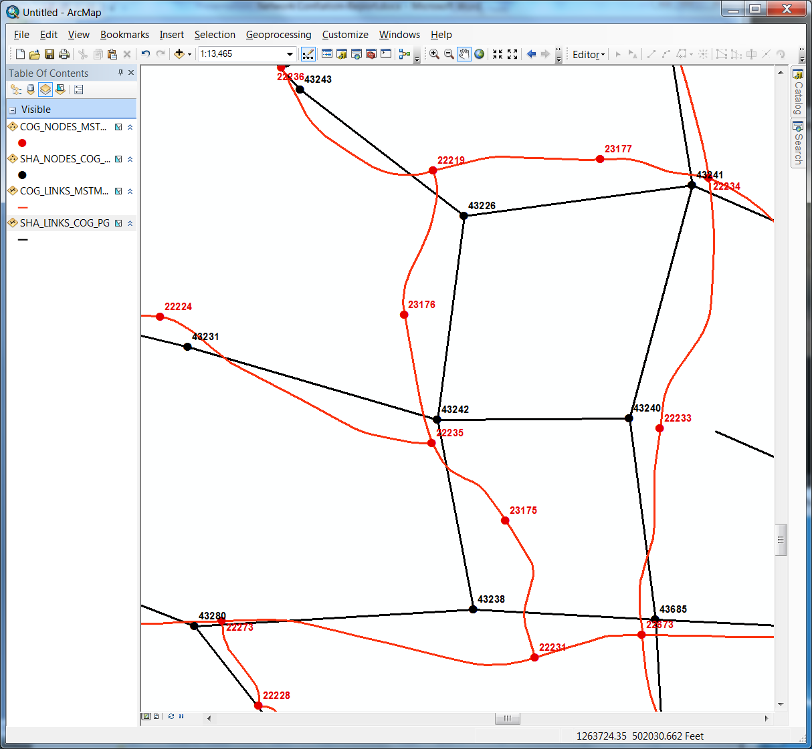
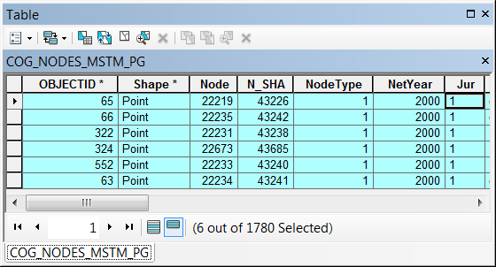
Network Conflation Process
Automation Conflation
  Customized GIS application tools (VB.NET)
  Create crosswalk tables to record the matched nodes between the Target and Source networks

Slide 9
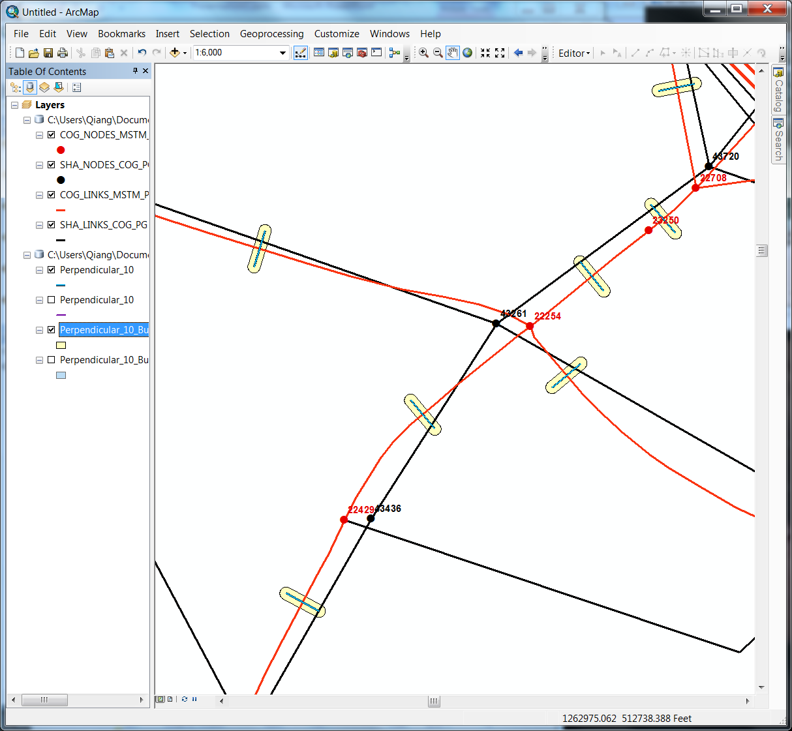
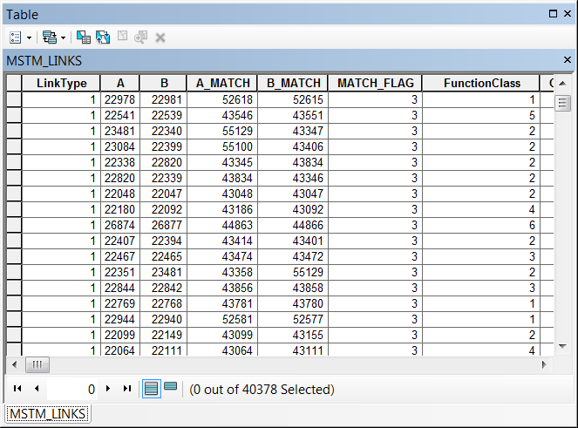
Network Conflation Process
Automation Conflation
  Create crosswalk tables to record the matched links between the Target and Source networks

Slide 10
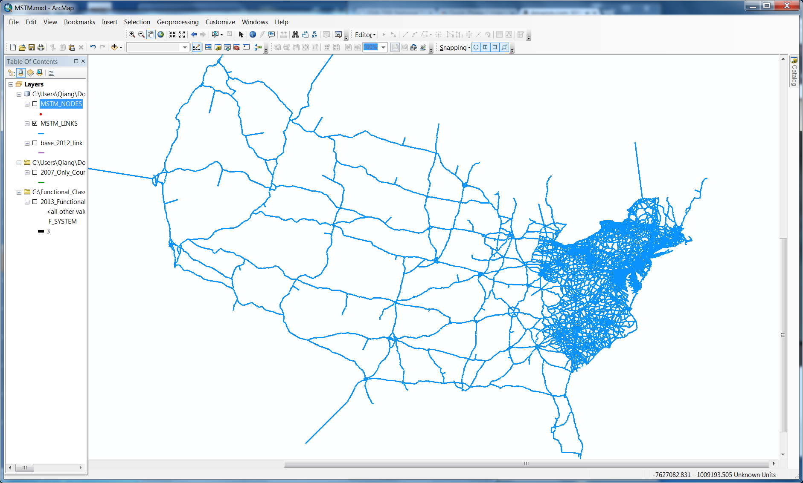
Integrated True Shape MSTM Network

Slide 11
Transfer Critical Network Attributes
Road Name and Alternative Road Name
From Node/To Node (A/B)
Facility Functional Classification code (SWFT)
One Way Road (ONEWAY)
Free Flow Speed (FFSPD)
Number of Lanes (AMLane/PMLane/OPLane)
Lane Configurations (AMLimit/PMLimit/OPLimit)
  HOV, Truck Allowed, etc
Others

Slide 12
Integrate Special Network Data
Toll Roads
Short or Long Term Transportation Improvement Projects
Traffic Counts (SHA Traffic Counts Stations/Segments)
Time Penalty and Turn Prohibition file
Transit Line and Station

