Slide 1

Forming Third-Party Speed Data for use in a Congestion Monitoring Plan
Presentation at the
15th TRB National Transportation Planning Applications Conference
Atlantic City, NJ
Monday, May 18th
Nick Wood, P.E.
Texas A&M Transportation Institute (TTI)
Notes:
Hello, and thanks for coming so early to this session on Data Collection and Management. My name is Nick Wood and I am with the Texas A&M Transportation Institute. The presentation you are about to see is on “Forming Third-Party Speed Data for use in a Congestion Management Plan.

Slide 2




Acknowledgements
From TTI:
  Joan Hudson Boya Dai Shawn Turner
Cathy Stephens and the CAMPO staff
Notes:
This presentation would not have been possible without contributions from a number of individuals on the project. Joan Hudson, led the project for TTI, along with assistance from Boya Dai and Shawn Turner. Cathy Stephens from the Capital Area Metropolitan Planning Organization (or CAMPO) in Austin, Texas was instrumental in supporting the research.

Slide 3
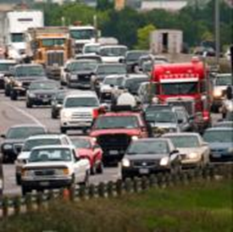
Background and Introduction
CMP is a Federal requirement
  Systematic framework for analyzing & incorporating congestion management into planning process
CAMPO uses a Roadway Congestion Analysis to meet part of that requirement
  Six counties in Central Texas, surrounding Austin
  Conducted every two years
Old methods are problematic
  Floating car method is limited
  New technologies can be harnessed
Notes:
The Congestion Management Process (CMP) is a federal requirement that provides a systematic framework for analyzing and managing recurring congestion and for incorporating congestion management into the planning process. As part of the CMP, the Capital Area Metropolitan Planning Organization (CAMPO) – which represents six counties in Central Texas (near Austin) – has conducted a Roadway Congestion Analysis every two years. For past analyses, CAMPO utilized the floating car method to gather travel time and speed data.

Slide 4
2012 Roadway Congestion Analysis
New to the Roadway Congestion Analysis
  RFP issued for speed data
  Variety of sources– third-party providers and in-house Bluetooth readers
  Volume weighting – higher volume roads have a higher ranking
  Performance measures
Extent of Study
  Over 1,300 centerline miles included
  942 segments
  2.8 miles in length on average
Notes:
Texas A&M Transportation Institute (TTI) in 2013 to complete the 2012 Roadway Congestion Analysis study using new sources of data, a new process of weighting the speed data with volume data, and new performance measures not previously reported in CAMPO congestion monitoring projects. Over 1,300 centerline miles of highways and arterials across the six-county CAMPO region were evaluated. When considering each direction of travel, over 2,600 miles were included. The results are presented in 942 segments with an average length of 2.8 miles each.

Slide 5
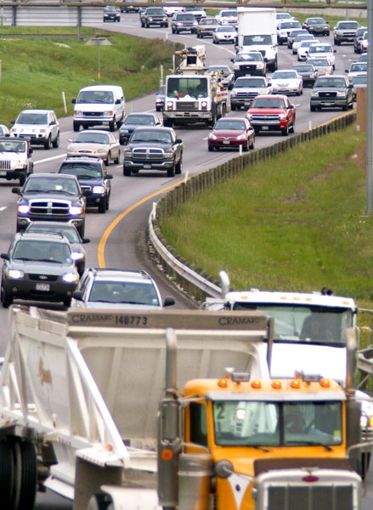
RFP for Roadway Speed Data
TTI issued RFP on behalf of CAMPO for historical speed data
Required Specifications
  Speed data shall be provided for 2012 year
  Data provided in a table and GIS
  15-minute intervals
  Averaged by day of week
  Key metrics (min, max, percentiles)
Two vendors responded

Slide 6
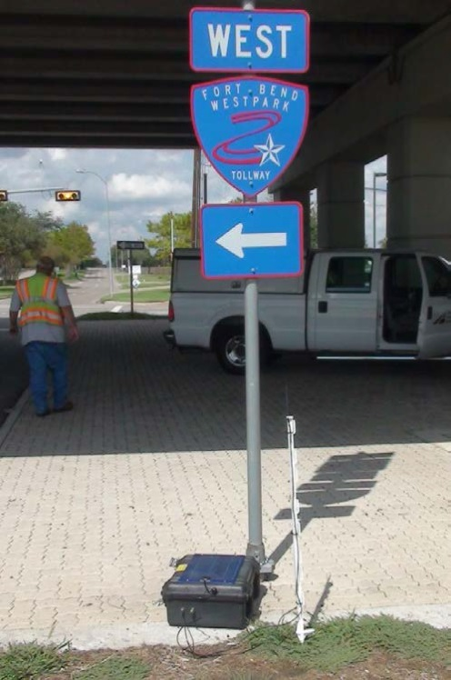
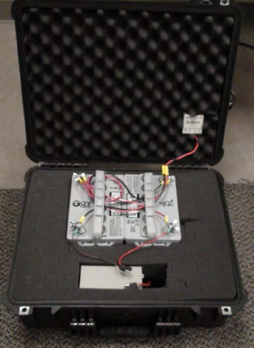
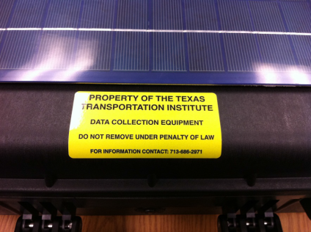
Data Sources and Description
Motor vehicle speed data
  2012 INRIX TMC (traffic message channel)
  2013 INRIX XD Traffic
  Anonymous Wireless Address Matching (AWAM) with Bluetooth readers, Feb 2014
Coverage issues
Differences in years were noted in final report
Notes:
In the end, the contract was not awarded to a vendor, and CAMPO decided to acquire data from TxDOT off their State contract for no cost to the project. The vendor that TxDOT uses is INRIX.
Motor vehicle speeds were obtained from three datasets for this project:
2012 INRIX TMC (traffic message channel), 15-minute average weekday speeds – the TMC network is an industry standard. You can get data from several providers on TMC-covered roadways.
2013 INRIX XD Traffic, 15-minute average weekday speeds - a new data source released a couple of months ago with a wider coverage area
Anonymous Wireless Address Matching (AWAM) Using Bluetooth Readers - February 2014
It is important to note that 8% of the total annual delay for the CAMPO region was captured by Bluetooth equipment. 9% was captured with the latest INRIX XD Traffic dataset. Many communities are using data from companies who offer TMC level coverage. INRIX XD is wider coverage.

Slide 7
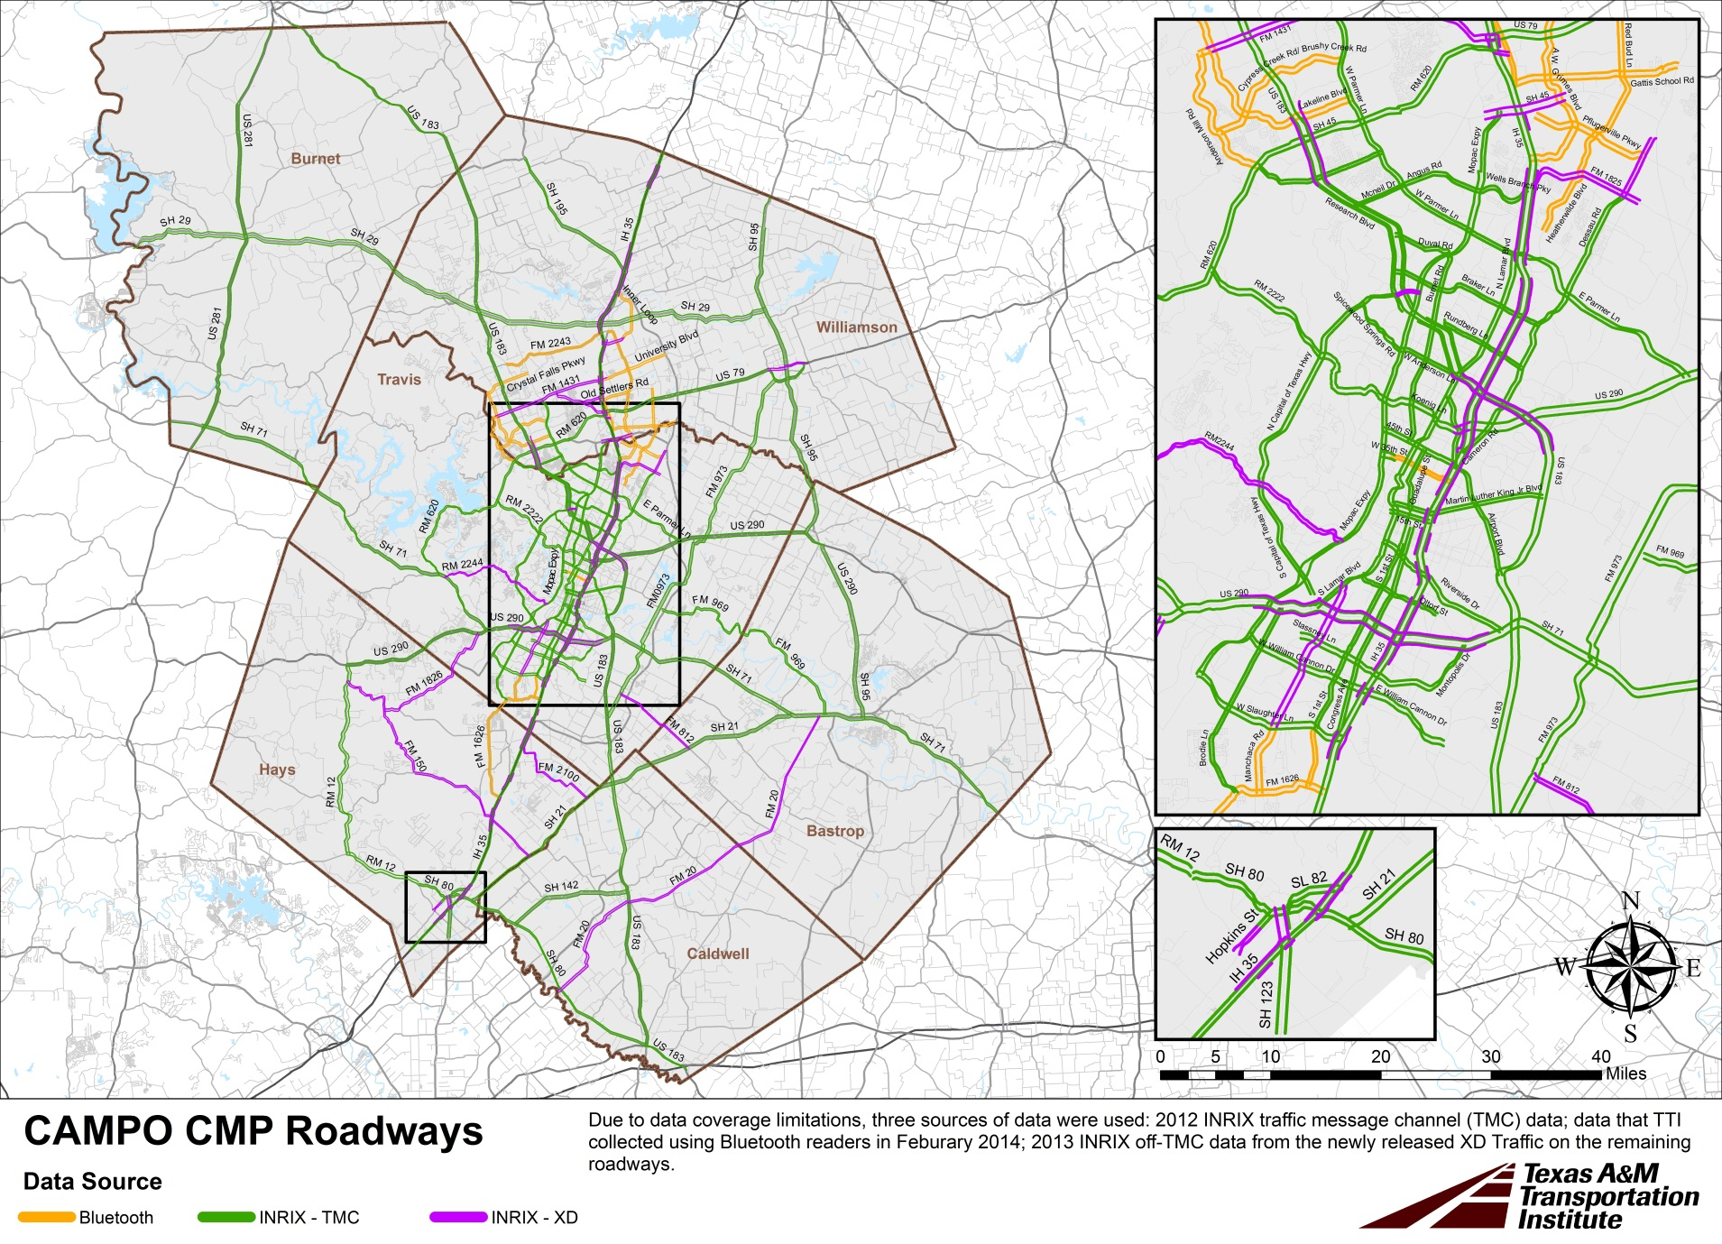
Notes:
This map shows all of the roadways included in the study. The green lines are where we received 2012 data on the TMC covered roadways. Where unavailable from the TMC network, we got either INRIX XD (magenta) or gathered data ourselves using Bluetooth readers (yellow-orange).

Slide 8
Methodology for Analysis
Segmentation
  Shorter segments in densely populated urban areas
  Medium segments in suburban areas
  Longer segments in rural areas
Conflation
  Match the motor vehicle volume data to the speed data
  Allows for volume-weighting
Rolling peak periods
  2-hour worst total delay selected from 6-10am, 3:30-8:30pm
Reference speeds based on non-congested travel or speed limit (whichever is lower)
Notes:
Determining the reporting segments was a significant task. INRIX TMCs are very short so we combined them together to make appropriate length segments for determining congestion patterns. When looking at very detailed congestion data on short links, one can sometimes miss the big picture. We didn’t want to go too big like taking all of I-35 from Ben White to 290 East, but we didn’t want to go too small either.
This analysis uses shorter roadway segments in densely populated urban roadways and medium length roadway segments in suburban areas. Longer roadway segments are evaluated in rural parts of the region.
A process called conflation was used next to match the desired segment with the volume data from the TxDOT RHINO information.
A rolling peak period was selected as the window of time during the AM and PM by which to calculate these performance measures. Between the hours of 6-10am and 3:30-8:30pm, the worst (or highest) two hours of total vehicle delay was chosen as the peak period. The idea being that some areas peak earlier or later than others so using a set 4:30-6:30pm time window for example may be missing the worst 2 hour window.

Slide 9
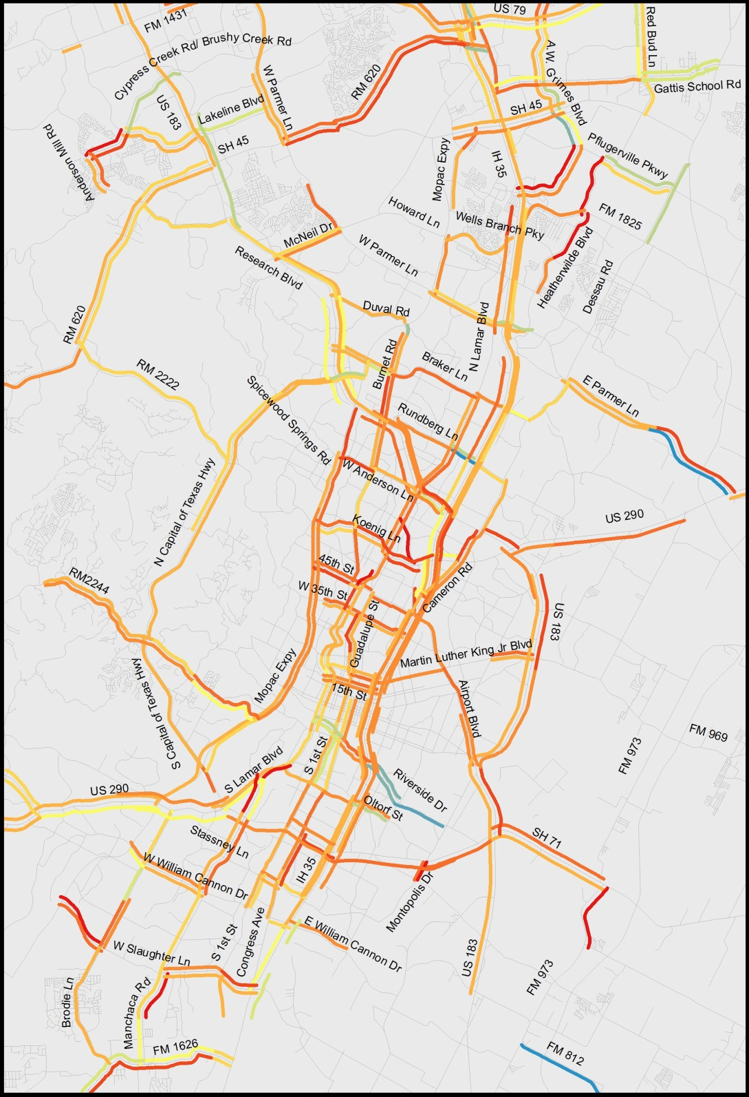

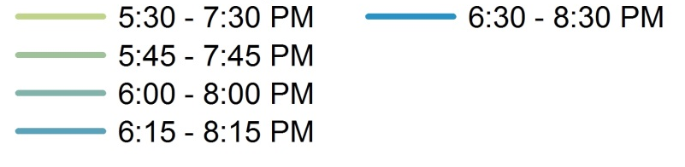
Rolling Peak Periods
Created because peak of congestion occurs differently for different parts of the region
Example: A Policy Board Member from an outlying area may be unhappy with limited time period based on CBD.
PM Peak Periods (Selected)
Notes:
This is a visual of the rolling peak period. As you can see, congestion varies differently by segment.

Slide 10
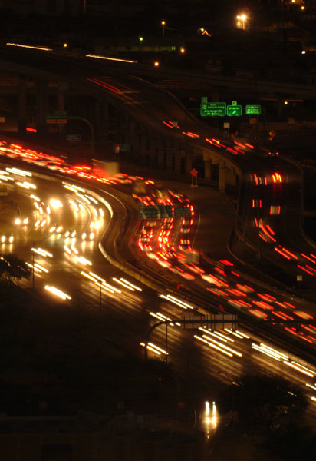
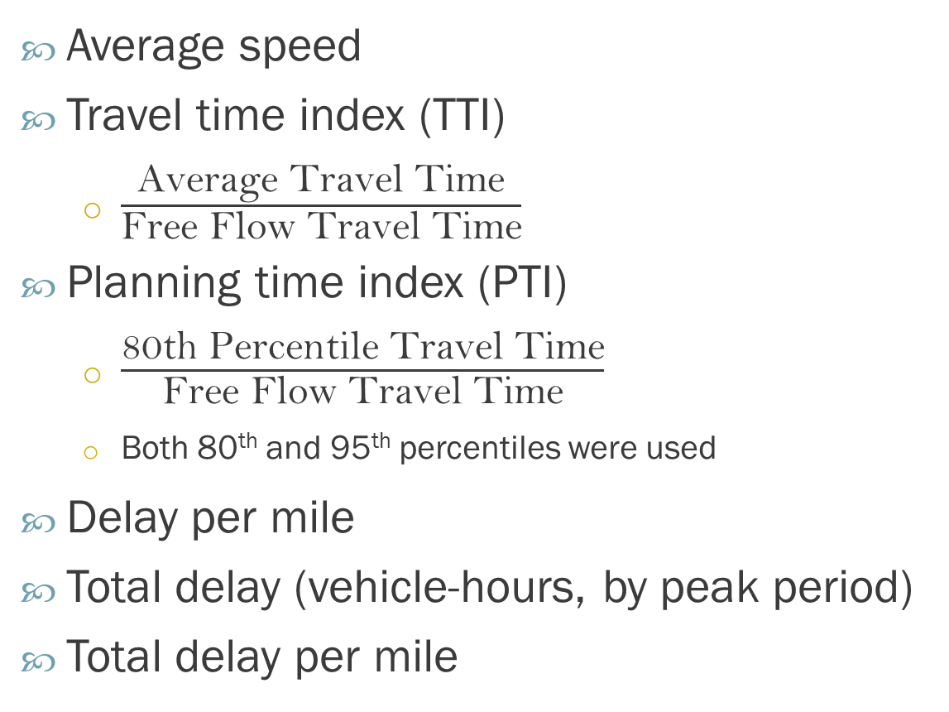
Performance Measures
Average speed
Travel time index (TTI)
  $\frac{\text{Average} \text{Travel} \text{Time}}{\text{Free} \text{Flow} \text{Travel} \text{Time}}$
Planning time index (PTI)
  $\frac{\text{80}\text{th} \text{Percentile} \text{Travel} \text{Time}}{\text{Free} \text{Flow} \text{Travel} \text{Time}}$
  Both 80th and 95th percentiles were used
Delay per mile
Total delay (vehicle-hours, by peak period)
Total delay per mile
Notes:
We worked with CAMPO staff to review and identify performance measurements.
Several were discussed and ultimately five primary measures were selected by CAMPO staff: Average speed, Travel Time Index, Planning Time Index, delay per mile, and total delay. We added total delay per mile to normalize by segment length.
Each of these captures one or more elements of the four dimensions of congestion:
Intensity—how bad congestion can get
Duration—how long congested conditions can last
Extent—the number of people impacted by congestion
Variability—how congestion can change over time (also known as Reliability)

Slide 11
Results
1,300 miles of roadway
Average delay
  200,000 vehicle-hours per weekday
Annual delay
  Only 2012 TMC: 44 million veh-hours
  Including 2013 xD: 48 million veh-hours
  Including Bluetooth: Total of 52 million veh-hours
Notes:
Across 1,300 of roadway, the CAMPO region experiences an average of 200,000 vehicle-hours of daily delay and over the course of a year 52 million vehicle-hours of delay in the CAMPO region.

Slide 12
Most Congested - PM Peak Period
Notes:
Here is an example of our rankings for total delay for the average weekday afternoon peak period. As you can see, I-35 is the most congested roadway in the region.

Slide 13
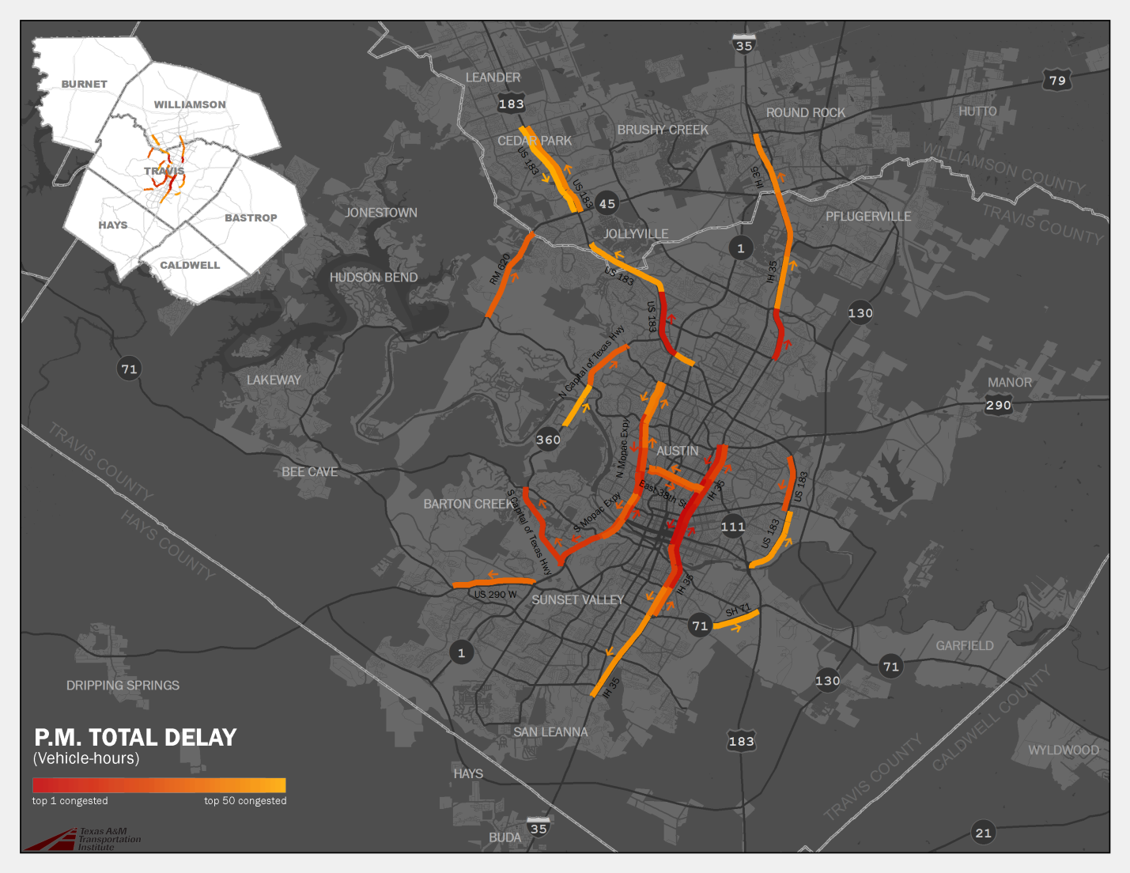
Top 50 Most Congested Roadway Segments - PM
Notes:
And here is the visual of the Top 50 Most Congested Segments… Note how the black background contrasts well with the orange segments.

Slide 14
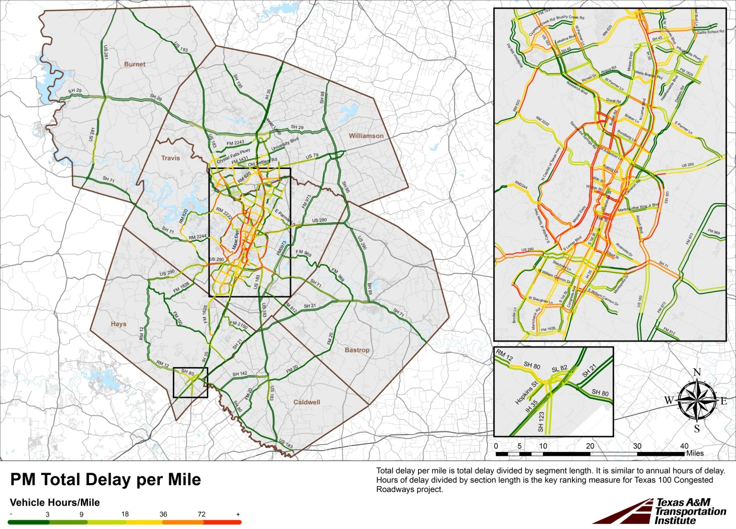
Notes:
Here is a map of delay per mile for the average weekday afternoon peak period. As you can see, most of the higher delay – marked in red – is shown near the center of the map. Some red also shows up in the northern suburbs on roads that were not covered by the third-party TMC or xD datasets.

Slide 15
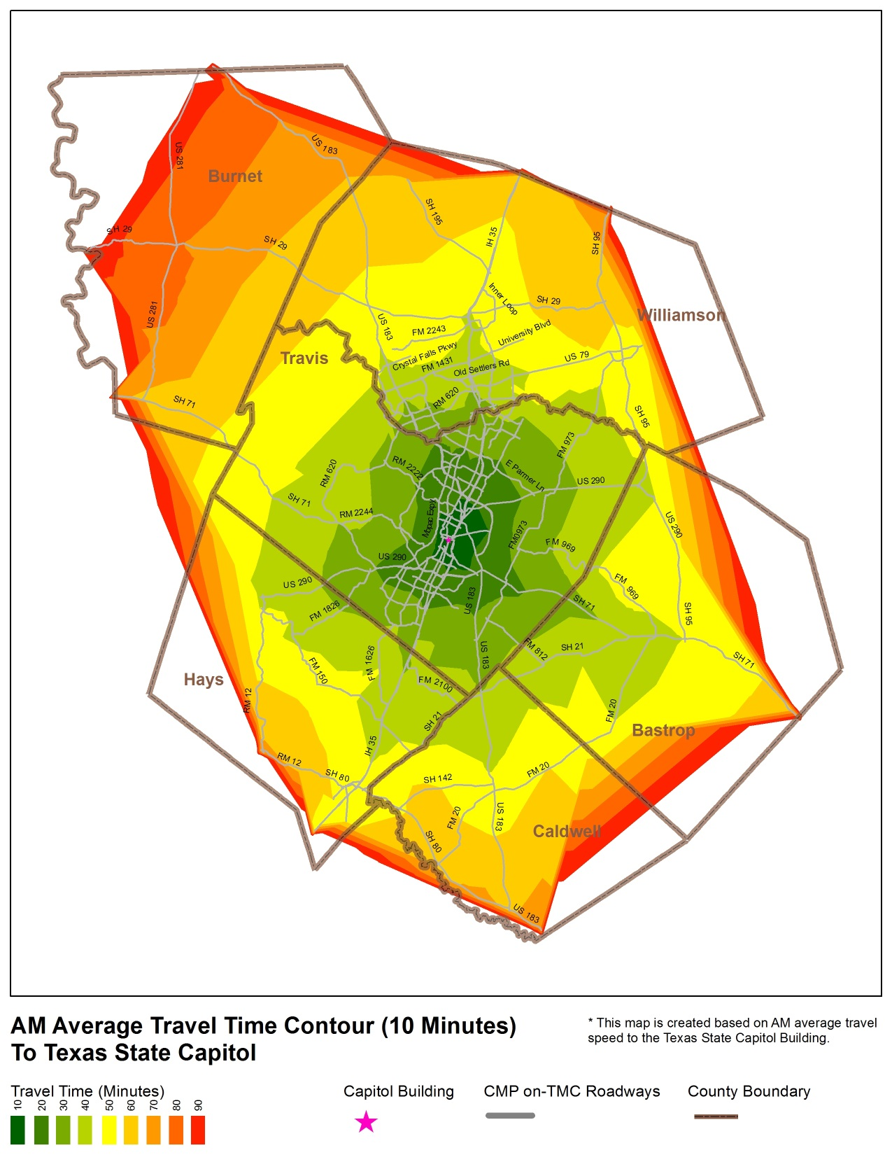
Notes:
We also tried contour maps to show travel times, using the Network Analyst tool within ArcGIS. This travel time contour map reflects the AM peak travel times to downtown Austin.

Slide 16
Lessons Learned
Travel times runs are problematic
  Costly to collect
  Not longitudinally representative
Quality Control is Important!
  Flat line speed profiles are not good
Visualization helps to tell the story
  Make an effort to create eye-popping graphics
Future CMPs and analyses will rely more on combing different data sources together
  Formats and methodologies will likely not match
  Document the limitations
Notes:
And here is a summary of lessons learned from the project…

Slide 17
Questions
Contact info:
  Nick Wood, P.E., nickwood@tamu.edu
  Joan G. Hudson, P.E., j-hudson@tamu.edu
  Boya Dai, b-dai@ttimail.tamu.edu
  Shawn Turner, P.E., shawn-turner@tamu.edu
Notes:
I welcome your questions and have included contact information if you think of something later.

