Slide 1
Supporting Sustainable Growth and Conservation with Four Step Transportation Models Ken Choi, Maryland Department of Planning Joe Tassone, Maryland Department of Planning Mark Radovic, Gannett Fleming, Inc. Subrat Mahapatra, Maryland State Highway Administration

Slide 2
Maryland Context
19th in population, 5.8m
2035, 1.0 m more residents, 700K jobs
Planning Act of 1992, Smart Growth Act 1998, Priority Funding Areas (PFAs)
SHA, Maryland State Transportation Model
Application to support Sustainable Transportation Land Use objectives

Slide 3
STLU Objectives
Concentrate most residential and commercial origins and destinations in PFAs
Integrate land use/ transportation to increase non-SOV modes
Reduce travel times, VMT, TLU footprints, and greenhouse gas emissions from mobile sources

Slide 4
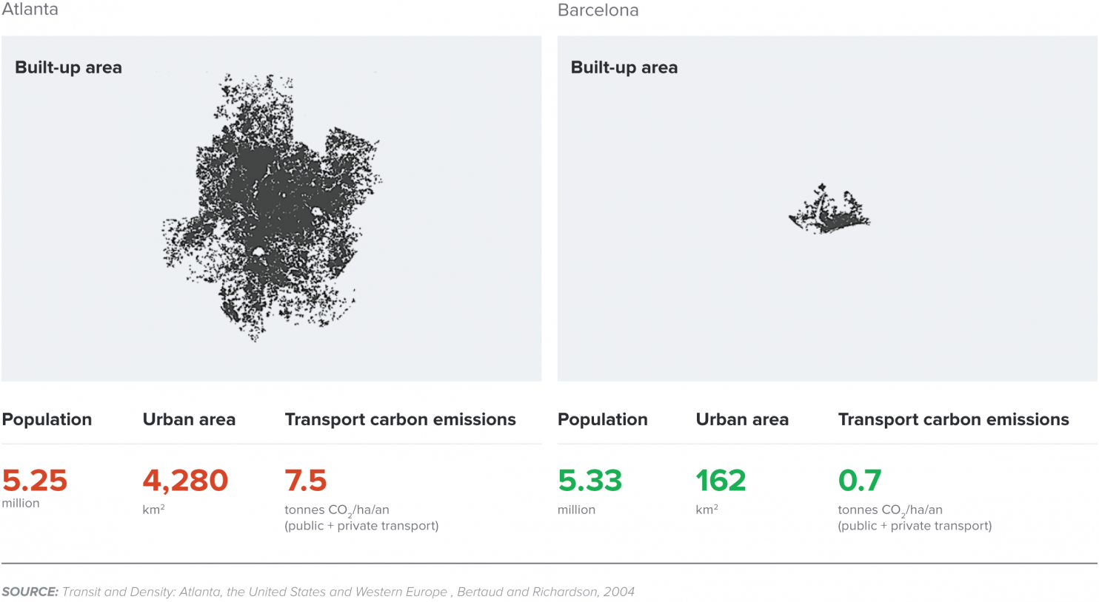
Comparative Land Use & Transportation Carbon Footprints,
Atlanta & Barcelona

Slide 5
County Transportation/land use footprints Per 100 Residents
Acres – how much land is occupied by residents and their employment destinations,
Distance – how far residents travel to employment destinations
Footprints = Residential Acres + [Employment Acres X Distance Multiplier]

Slide 6
VMT per Capita
Average distance driven each day by jurisdiction
To and from all origins and destinations within a jurisdiction
Divided by the total number of jobs plus residents

Slide 7
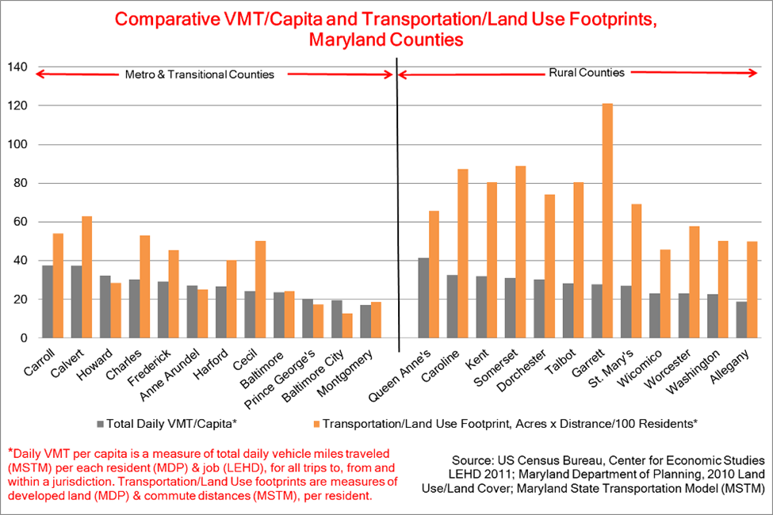

Slide 8
What Gives? Land Use/ Transportation Cycle
Increasingly segregated, isolated land uses
Congestion, increased travel demand
Highway creation, expansion
Increased market access
More segregated development
More congestion
Increased costs

Slide 9
General Roadway Lane Mileages as the function of Population Growth

Slide 10
Infrastructure/ Cost Savings, Smart Growth vs. Trend, 2010 and 2030
333,000 Acres Less Residential Development
2,900 & 1,500 less Community & General lane miles.
Cost Saving $29.4 Billion:
$12 & $17 Billion less for Community & General road construction
$253 & $130 Million less to maintain Community & General roads

Slide 11
What if Transportation & Land Use were Integrated? Baltimore City and County, 2035

Slide 12
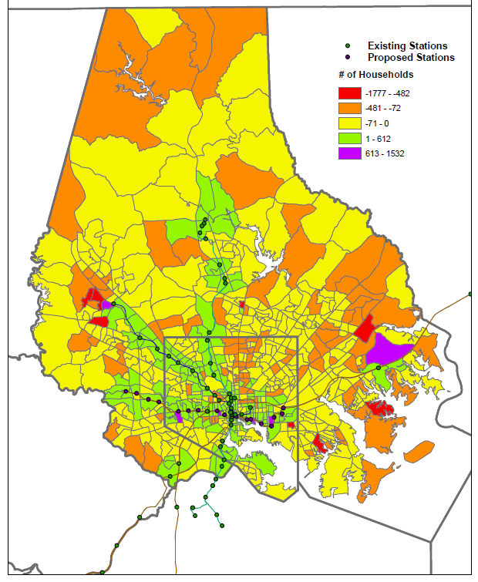
Redistribution of Projected
New HHs in 2035

Slide 13
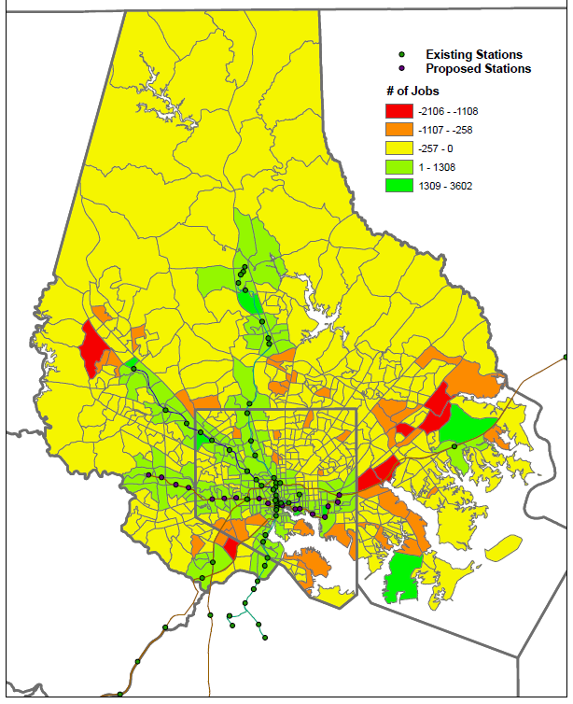
Redistribution of Projected
New Jobs in 2035

Slide 14
Effects at City/County Scale Baltimore City and County, 2035
Forecast: 1.54m residents, 950K jobs
TOD TAZs around rail stops: 244 of 710 TAZs (34%)
New Red Line light rail
4.5 & 5.3% more of total city/county projected residents & jobs in TOD TAZs
Result:
6.3% increase in projected total city/county transit ridership

Slide 15
Effects at Regional Scale Baltimore Metro Region
Forecast: 2.99m residents, 1.84m jobs
2.3 & 2.7% more of regional residents & jobs in TOD TAZs in 2035
Results:
5.3% increase in total region transit ridership
5.2% reduction in VMT/ capita, pop’n that live or work in TOD TAZs

Slide 16
Summary Findings
Shift of 2.5% of Baltimore Region Jobs + Population from Non-TOD to TOD TAZs leads to 5.3% Increase in Transit Ridership.
VMT/Capita reduced by 5.2% for TOD TAZ pop’ns in Baltimore City/ County
Model limitations: e.g., no mode choice response to increased walk/bike access in TODs

Slide 17
Conclusions
Integrated TLU mixed use/ transit development has significant potential to improve TLU relationship, support STLU objectives
Future opportunity to explore better TLU scenarios (e.g. land use options, community design, transit services, service frequency, model enhancements, etc.)

