Slide 1
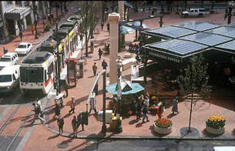
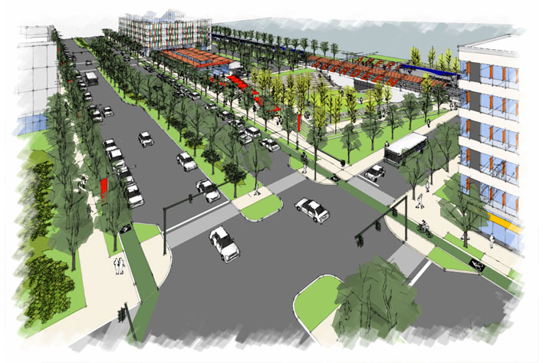
Developing Analytical Processes and Tools to Evaluate Transit-Oriented Developments
15th TRB National Transportation Planning Applications Conference
May 21, 2015
Scott Holcomb, PE, Gannett Fleming, Inc.
Mark Radovic, Gannett Fleming, Inc.
Derek Gunn, MD State Highway Administration

Slide 2
Status of TODs In Maryland
Maryland legislature defined TODs as "a dense, mixed-use deliberately-planned development within a half-mile of transit stations that is designed to increase transit ridership."
Maryland Department of Transportation promotes TOD as a “tool to support economic development, to promote transit ridership, and to maximize the efficient use of transportation infrastructure.”
Source – Maryland Dept. of Transportation TOD Website Page

Slide 3
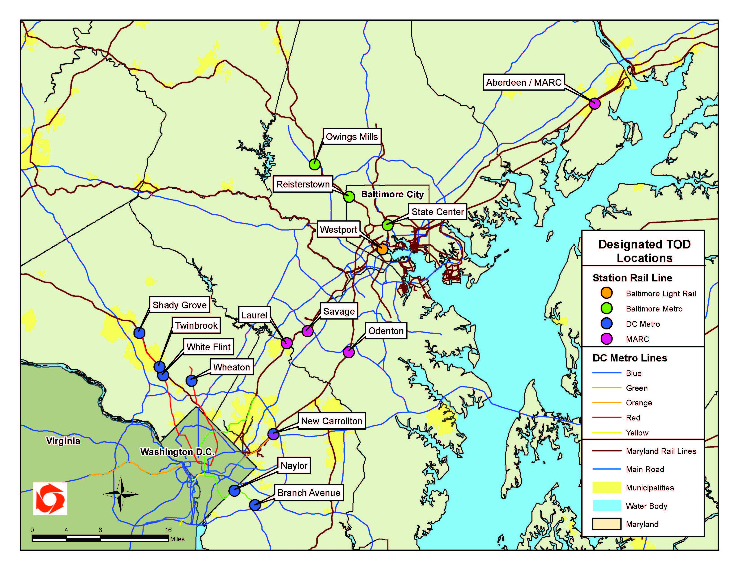
Status of TODs In Maryland
To support use of TOD in Maryland, MDOT initiated the TOD Designation Program – Access to economic and technical assistance
Source – Maryland Dept. of Transportation Website TOD Page

Slide 4
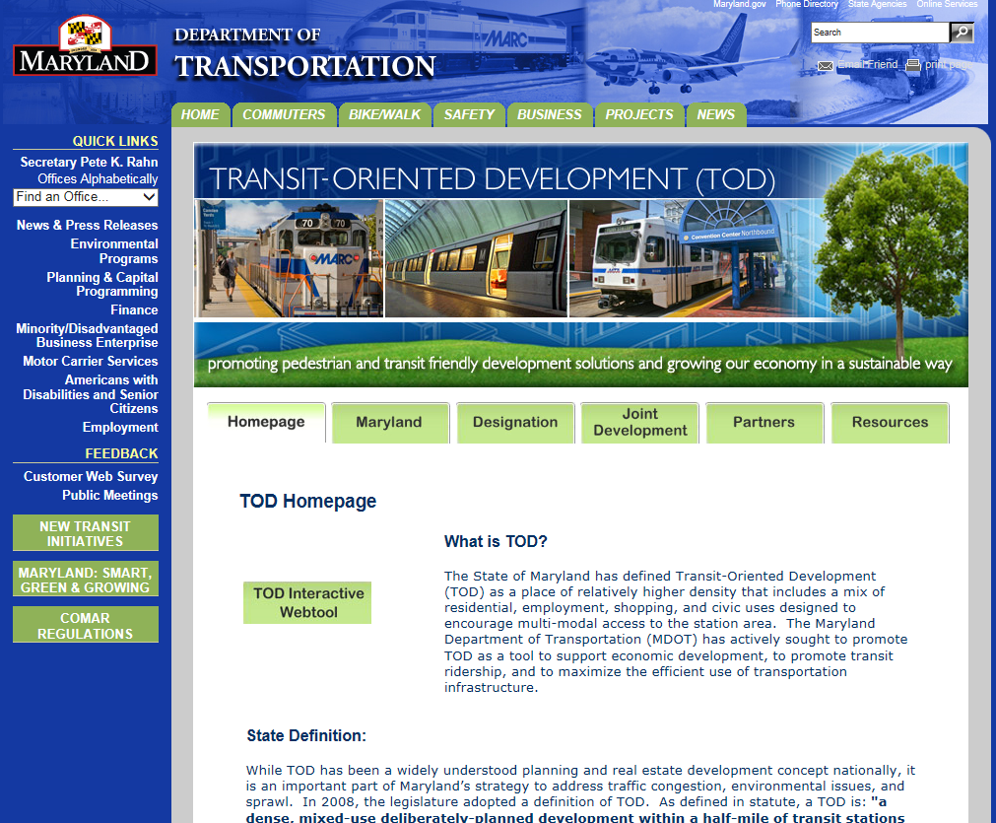
Developing MDOT’s TOD Support Framework
MDOT TOD website provides information on TOD programs and resources (http://www.mdot.maryland.gov/2012HomeContent.html)

Slide 5
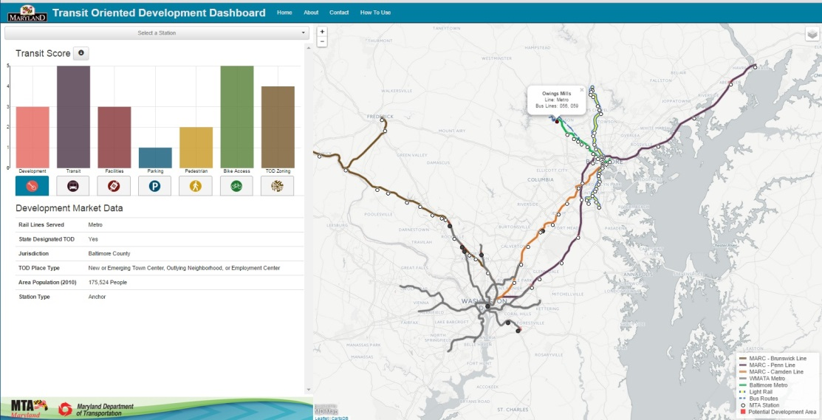
Developing MDOT’s TOD Support Framework
Modal administrations (State Highway and Transit Administrations) developing tools and methodologies for evaluations –
  TOD Development Guidelines Publication in review
  TOD Dashboard web
  application under
  development
MD Transit Administration

Slide 6

TOD Place Types
Place Types guide SHA, MTA, local governments, and developers on design and configuration of transportation elements of a TOD project.
SHA and MTA developed four distinct place types. TODs do not come in one shape or size.
  Downtown
  Urban Neighborhood
  Town Center, Suburban Corridor,
  or Employment Center
  Village Center or Rural Town

Slide 7
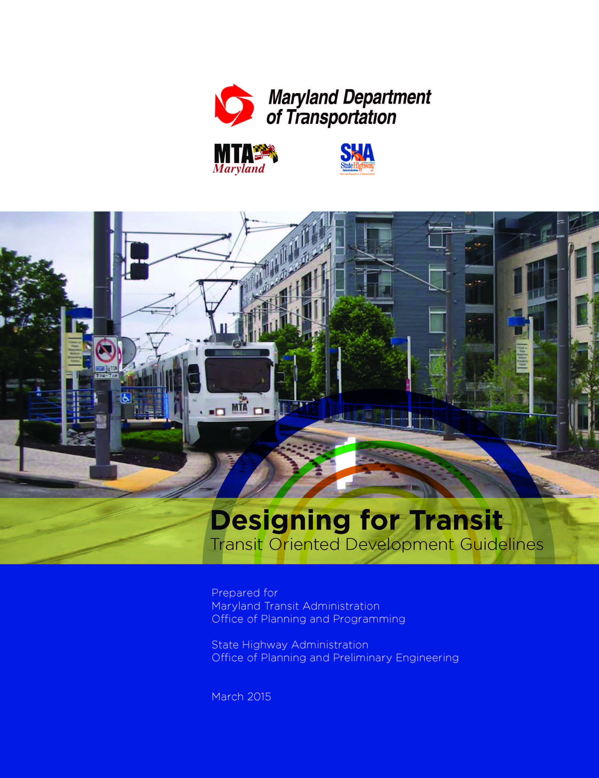
TOD Place Types
TOD Place Types are characterized by:
  variations in network connectivity
  development form
  parking provisions
  intermodal splits
  regional network analysis
  the ease of intermodal connections
  public space
  pedestrian access
  bicycle access and parking
  the number and frequency of transit services

Slide 8
Tools for Evaluation of TOD Transportation Elements
Place Types provide goals for transportation element design and performance
Agencies need to evaluate mode splits, internal capture, regional impacts, and internal operations
Issues:
  Traditional analyses focused on suburban growth
  MPO/Statewide Travel Demand Models provide static analyses and operational models not multimodal
  Integrate travel demand and operational analysis

Slide 9
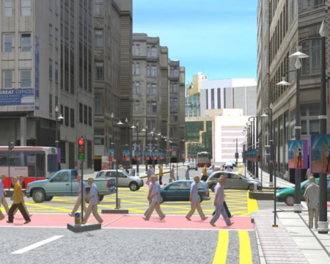
Tools for Evaluation of TOD Transportation Elements
SHA working with University of Maryland to develop methodology with DTALite assignment modeling combined with VISSIM operational analyses
  Dynamic assignment
  Internal trip capture
  Block level modeling
  Multimodal capabilities
  including bicycle and
  pedestrian modes
  - Visualization

Slide 10
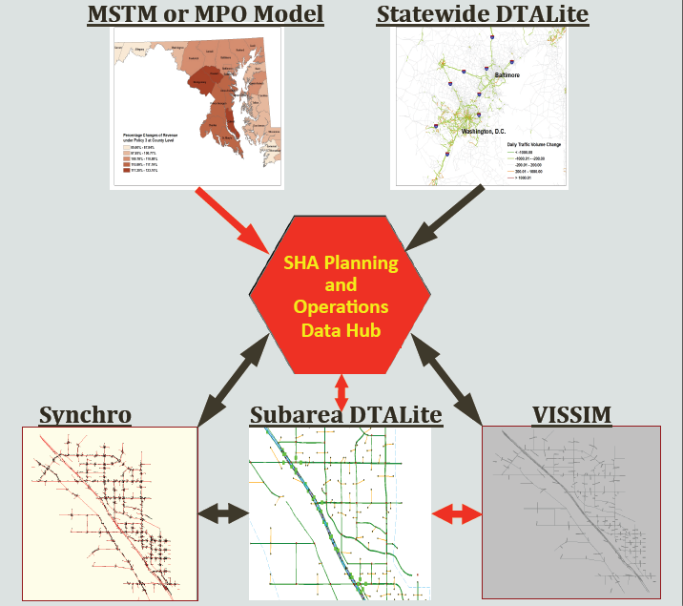
DTALite and VISSIM
  DTAlite Subarea Analysis and VISSIM simulation part of developing SHA Planning and Operations Data Hub
Source – University of Maryland

Slide 11
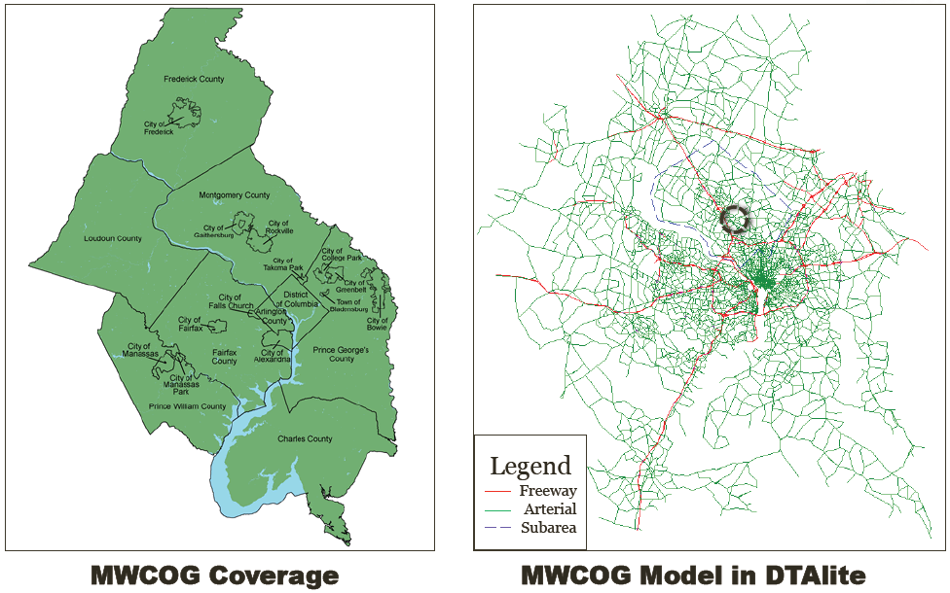
DTALite and VISSIM
Source – University of Maryland

Slide 12
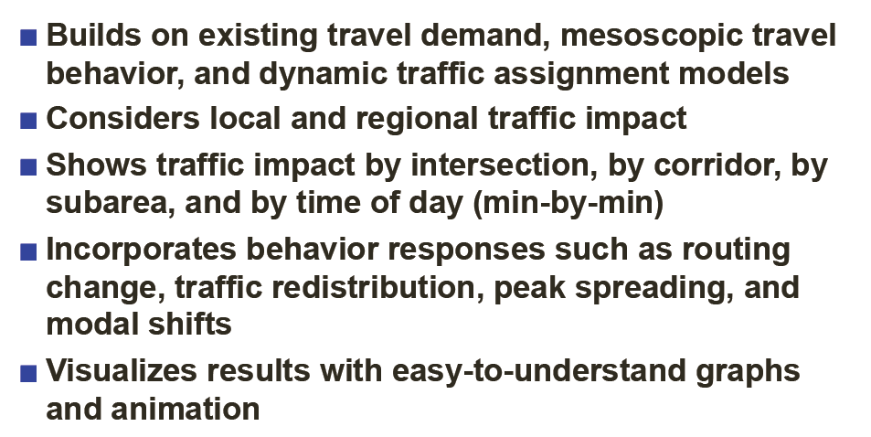
DTALite and VISSIM
DTALite/VISSIM Methodology provides:
Source – University of Maryland

Slide 13
Thank You
Thank you:
    University of Maryland National Transportation Center
    SHA Data Services Engineering Division
    SHA Regional and Intermodal Planning Division
    SHA Access Permits Division
    Maryland Transit Administration
    Maryland Department of Transportation
Contact Information:
    Scott Holcomb, Project Manager
    Gannett Fleming, Inc.
    sholcomb@gfnet.com (443-348-2017)
    sholcomb@sha.state.md.us (410-545-5647)

