Slide 1

How to Put “Best Practice” into
Traffic Assignment Practice
Ken Cervenka
Federal Transit Administration
Ken.Cervenka@dot.gov
TRB National Transportation Planning Applications Conference
May 20, 2015

Slide 2
Sources of Information
TMIP listserv (and other) discussions
Before 2007
  MPO model development manager (NCTCOG)
Since 2007
  FTA reviewer of New Starts forecasts
Since 2011
  FTA-sponsored research (Caliper as contractor)

Slide 3
Core Research Findings
Tighter assignment convergence offers more stability in results
Approach for feedback to distribution matters
But lots of room for model improvements
  More than just good convergence/feedback techniques needed to get useful predictions
    Traffic volumes and travel times by time-of-day
    Vehicle hours saved between alternatives

Slide 4
Why Travel Times Matter
Trip (or tour) distribution and mode choice
  Don’t “calibrate around” bad travel times!
Air quality analysis
Information for the public/decision-makers
  Mobility improvements
    Vehicle hours saved (no-build to build)
  Accessibility improvements
    XX jobs/services/residents reachable in YY minutes

Slide 5
Some Good-Practice Tips
Usually not possible to just “start over”
So look (carefully) at what you have right now
  Quantity and quality of real-world travel data
  The coded road and transit networks
  Check the predicted traffic volumes and times
    Compare to the model calibration year
    Compare to a different observable year
      With different real-world network and demographic inputs
      A “dynamic validation” or “retrospective analysis” test

Slide 6
Traffic Counts
Be clear on what you are modeling
  Which time periods of a weekday, by direction
    Non-holidays, while schools are in session?
    A spring or fall “seasonal” average?
    Recurring congestion, only?
  For passenger vehicle + truck classes?

Slide 7
Traffic Counts (cont.)
So how many link counts are needed?
  For one “representative” day, or multiple days
  Maybe a “minimum number” for each county and functional class (e.g., 200 per time-of-day)
    Or a “percent of links” rule of thumb
    Or for “districts” rather than counties
    Consider volume/capacity groups
    Consider detailed corridor study needs
  Include all links on screen lines (cut lines)

Slide 8
Travel Times
Multiple Big Data sources available
  Be clear on what you are modeling
  Easier access (than counts) to multiple days
  FHWA’s license of HERE data
    National Performance Management Research Data Set
    Covers National Highway System
  Google/other vendors for “point to point” times

Slide 9
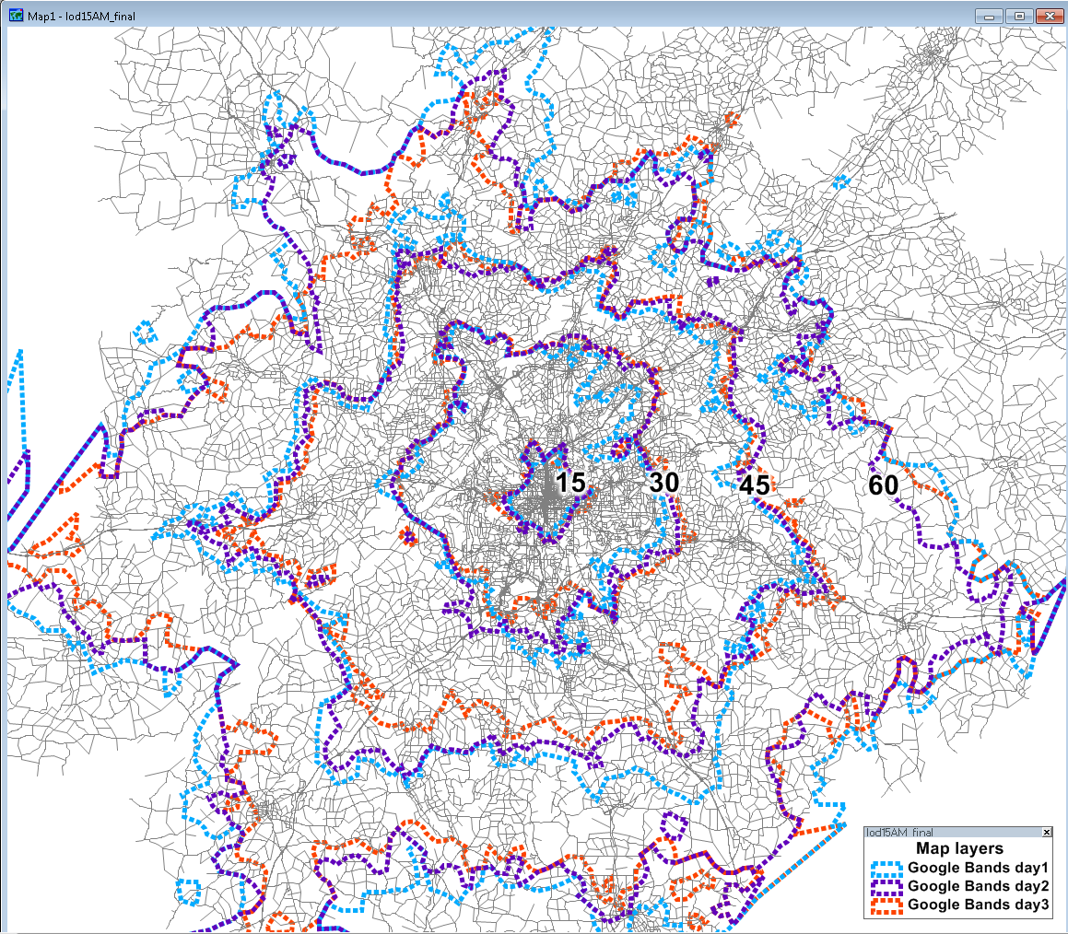
AM Peak Google-Based Times to Atlanta CBD (for three different days)

Slide 10
Coded Roadway Networks
Spatial rectification to quickly find errors
Which links to include
  Relevance of zone sizes and centroid connectors
Directional capacities by time-of-day
  Based on number of “mid-block” lanes?
  Consideration of intersection treatment?
Calculation of “free speed” travel times
  Caution on using posted speed limits

Slide 11
Validation Tests – Traffic Volumes
Consider a 2010 calibrated model
  Compare 2010 link volumes to 2010 counts
    The typical “percent RMSE” checks
      By time-of-day, not just weekday
      By functional class
      By volume/capacity ratio groups
    Screen line (cut line) and cordon line checks
      A “rough” way of finding possible trip table problems
    Color-coded map showing big and really big differences
      Individual links
      District-level VMT

Slide 12
Validation Tests - Travel Times
Consider a 2010 calibrated model
  Many tests similar to the link volume checks
  For individual links and road segments
  District-level VHT
  Travel time contours (isochrones)
  TAZ-to-TAZ checks

Slide 13
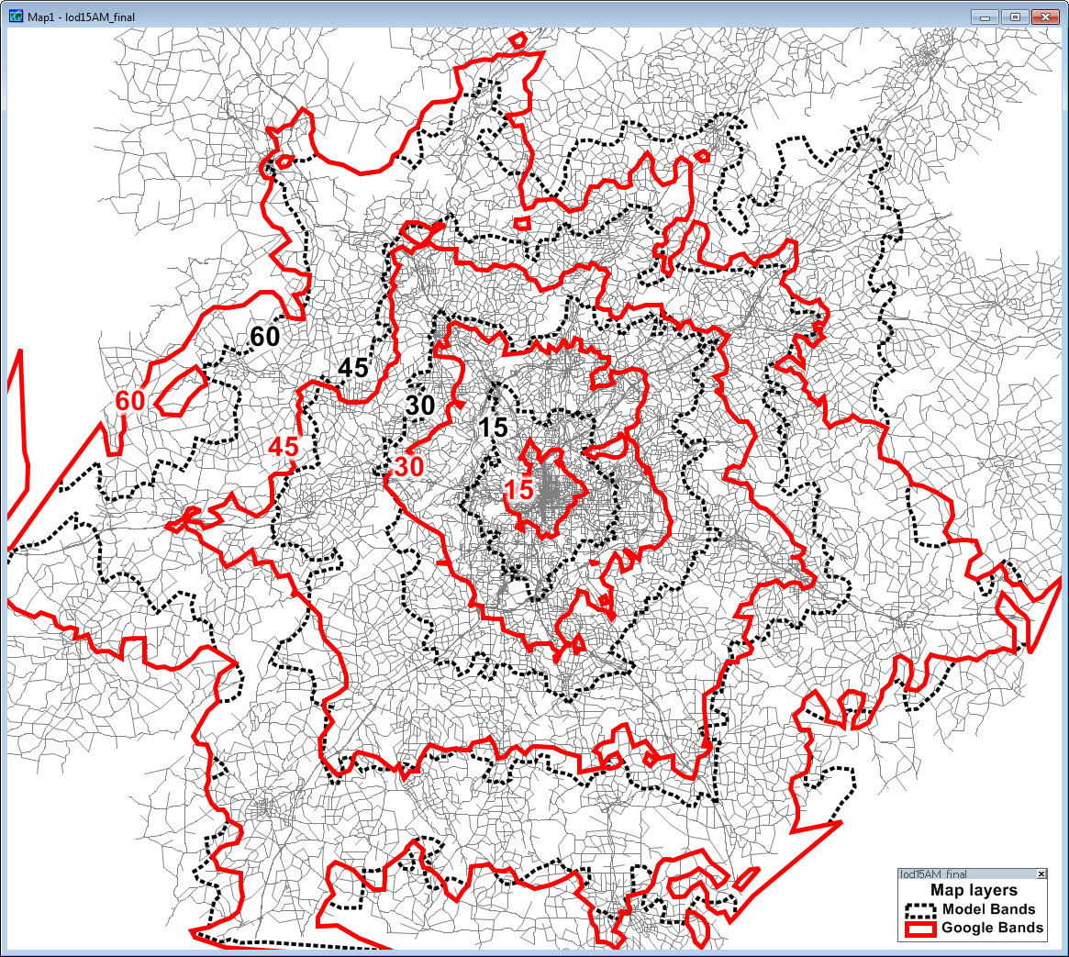
AM Peak Travel Times to Atlanta CBD

Slide 14
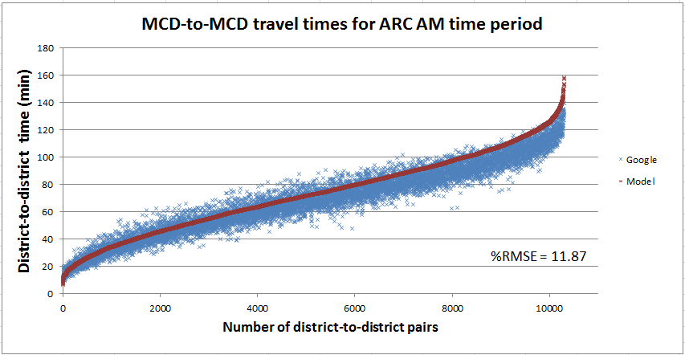
AM Peak “District-to-District” Travel Times
(MCD = Minor Civil Division)

Slide 15
Dynamic Validation Tests
Prepare a 2015 prediction
  Use the 2010 calibrated model equations
  Use the real-world 2015 demographics/networks as the 2015 model’s input
  Compare 2015 predicted to 2015 observed
Also compare the 2010-to-2015 “change”
  Both predicted and observed
  Can also be the 2010-to-2005 “change”

Slide 16
Challenge: Vehicle Trip Tables
Are the predicted travel patterns realistic?
  An issue for static, DTA, or micro-simulation
  More than a trip length frequency distribution check
  Usefulness of purchased OD flow data?
Long-range forecasting issues
  What if local traffic demand exceeds capacity?
  Compare to short-range forecasts
    Strange changes in trip tables
    Big drops in speeds

Slide 17
Federal Transit Administration
www.fta.dot.gov

