Slide 1
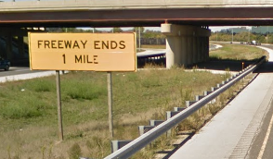
Application of an Activity-based Model for a Toll Road Study in Chicago
Matt Stratton
Parsons Brinckerhoff
May 19, 2015

Slide 2
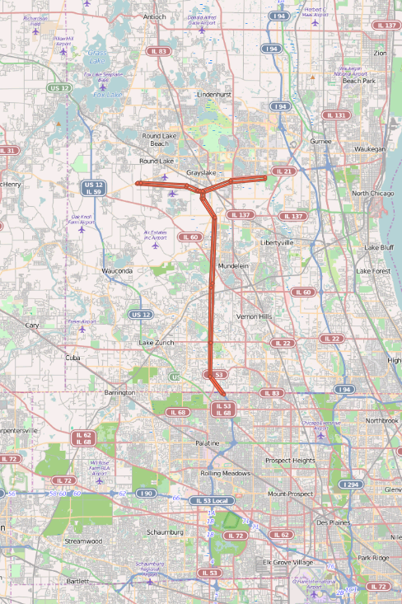
IL-53 Extension
Blue Ribbon Advisory Council
  2011-2012
Feasibility Study
  2013-2014
  Traffic and Revenue for Bonding Capacity

Slide 3
Model Background
CMAP Pricing Model (2011)
  Previous applications
    CMAP Congestion Pricing Campaign (2012)
    I-90 Tollway (2012)

Slide 4
Integrated
Model System
CT-RAMP Demand Model
Network Simulations
Java
Emme
Coordinated Travel Regional Activity-based Modeling Platform
Route choice for trucks & non-ABM autos
Assign ABM trips
Times, tolls, & distance

Slide 5
CT-RAMP Overview
Population Synthesis
Long-term
Mobility
Daily
Tour level
Trip level
Work
School
Auto ownership
Free parking
Activity pattern
Destination
Time of day
Mode
Stop frequency
Mode
Parking location
Departure time
Stop location
Assignment
Trip tables
List of trips
Network Simulations

Slide 6
Network Simulations
Route Choice Model
  Toll vs. Free
  Explicit modeling of toll users by OD pair
  Accounts for toll bias
  Allows for VOT segmentation beyond # of assignable classes
Multi-class path-based assignment

Slide 7
Multi-Class Assignment
Vehicle Type | Non-toll SOV | Non-toll HOV2 | Non-toll HOV3+ | Toll SOV | Toll HOV2 | Toll HOV3+
Autos | 1 | 3 | 5 | 2 | 4 | 6
Light trucks | 7 |  |  | 8
Medium trucks | 9 |  |  | 10
Heavy trucks | 11 |  |  | 12

Slide 8
EMME
Assignment
Macro
Structure

Slide 9
Value of Time
VOT by…
  Household
  Person type
  Travel purpose
  Vehicle occupancy
RSG Tollway User Survey

Slide 10
VOT & Parameter Variation

Slide 11
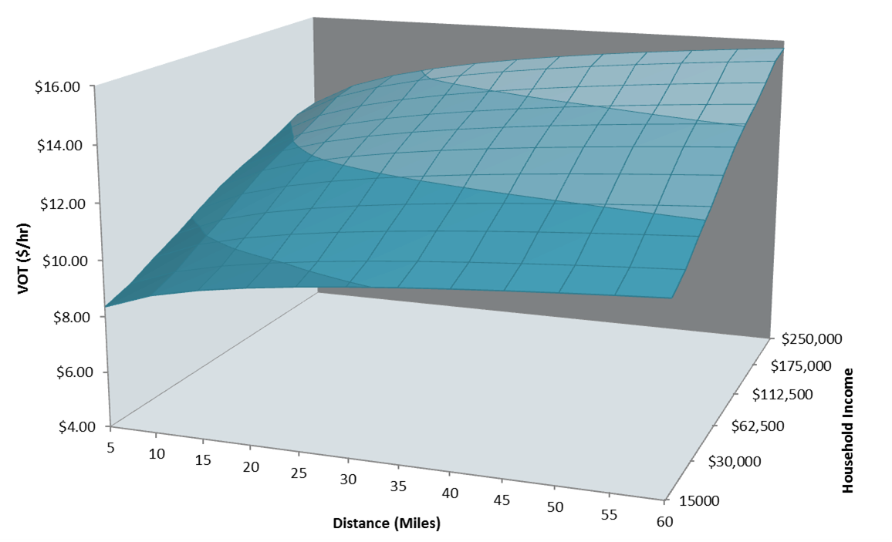
Tollway User Survey VOT

Slide 12
Traffic Validation
Toll Facility | Toll Plaza | Daily Traffic (2010)
 |  | Obs. Auto | Model Auto | Obs. Truck | Model Truck
I-94/294 | Waukegan | 51,000 | 55,000 | 14,000 | 15,000
 | Edens Spur | 46,000 | 47,000 | 5,000 | 5,000
 | Touhy | 81,000 | 82,000 | 9,000 | 10,000
I-90 | Elgin | 81,000 | 65,000 | 13,000 | 15,000
 | Devon | 86,000 | 81,000 | 7,000 | 4,000
 | River Rd | 66,000 | 61,000 | 3,000 | 3,000
I-355 | Army Trail | 108,000 | 106,000 | 9,000 | 7,000
 | Boughton Rd | 110,000 | 116,000 | 12,000 | 12,000

Slide 13
Revenue Validation
Toll Facility | Location | Daily Revenue (2010 $)
 |  | Obs. Auto | Model Auto | Obs. Truck | Model Truck
I-94/294 | Waukegan | 38,000 | 41,000 | 49,000 | 50,000
 | Edens Spur | 23,000 | 24,000 | 10,000 | 11,000
 | Touhy | 40,000 | 41,000 | 19,000 | 21,000
I-90 | Elgin | 32,000 | 26,000 | 23,000 | 27,000
 | Devon | 35,000 | 33,000 | 12,000 | 6,000
 | River Rd | 27,000 | 25,000 | 5,000 | 5,000
I-355 | Army Trail | 54,000 | 53,000 | 18,000 | 13,000
 | Boughton Rd | 55,000 | 58,000 | 25,000 | 25,000

Slide 14
Build Scenarios
4 lanes @ 45 mph
  Alternative 1
4 lanes @ 55 mph
6 lanes @ 45 mph
6 lanes @ 55 mph

Slide 15
Alternative 1
Variants
Index tolls to inflation
Congestion pricing
Construction schedule
Toll existing IL-53
6 lane IL-53 trunk
Variable speed limit
Toll sensitivity
Max. revenue

Slide 16
Equity Concerns
 | Household Income in IL-53 Travel Market
Travel Mode | 25th Percentile | Median | 75th Percentile
Auto Non-toll | $ 30,000 | $ 41,000 | $ 73,000
Auto Toll | $ 33,000 | $ 50,000 | $ 82,000

Slide 17
Auto Occupancy
 | SOV % by Auto Toll Rate
Time of Day | $0.10 | $0.20 | $0.20 + peak pricing | $0.35
8 PM - 6 AM | 77% | 65% | 67% | 20%
6 AM - 7 AM | 91% | 90% | 88% | 81%
7 AM - 9 AM | 89% | 87% | 85% | 81%
9 AM - 10 AM | 85% | 81% | 81% | 64%
10 AM - 2 PM | 84% | 81% | 82% | 69%
2 PM - 4 PM | 85% | 82% | 83% | 71%
4 PM - 6 PM | 87% | 85% | 84% | 77%
6 PM - 8 PM | 82% | 79% | 79% | 64%

Slide 18
Computing Setup
Distributed Computing
  Main: 64+GB RAM and 12 processors
  Worker: 16+GB RAM and 8 processors
Hyper-threading

Slide 19
Run Times
Validation/Calibration Setup
  1 Global Iteration with Traffic Assignment:
    Demand Model w/ 20% of households
  11 hours
Application Setup
  3 Global Iterations with Traffic Assignments:
    Demand Model w/ 20, 35, & 50%
  36 hours

Slide 20
What did we learn?
Importance of Value of Time
Destination and Time of Day Choice
Network and zone system detail
Network micro-simulation or more assignment classes
Lead time

Slide 21
Questions?
Contact: Matt Stratton, strattonma@pbworld.com
Co-author: Peter Vovsha
Contributors: Ben Stabler, Binny Paul, Mary Lupa, Ron Shimizu

