Slide 1
Urban Mobility Management, Planning and Operations Utilizing Incentive Based Strategies
and Big Data Analytics
presented to
TRB 15th National Transportation Planning Applications Conference
presented by
Metropia, Inc.
Vassilis Papayannoulis, Ph.D.
Mia Zmud
May 18, 2015

Slide 2
Acknowledgments
Federal Highway Administration
Central Texas Regional Mobility Authority
Los Angeles DOT
South California Association of Governments
Pima Association of Governments
Sun Tran
Ali Arian, University of Arizona

Slide 3
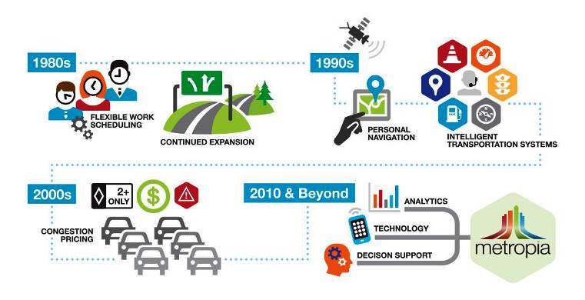
Travel Demand Management
A general approach to influence people’s travel behavior.

Slide 4
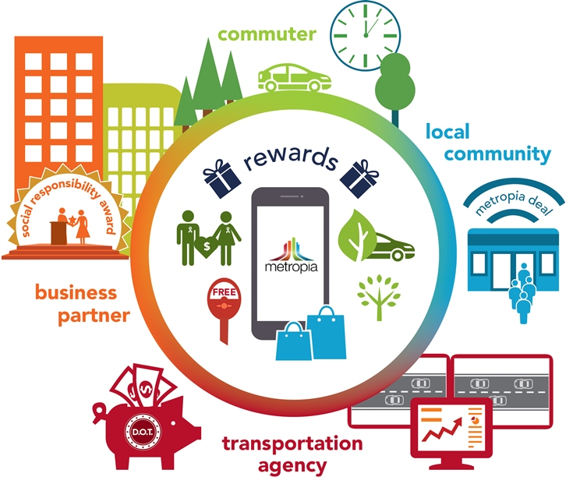
Metropia’s Ecosystem:
Community-Based and Incentivizing Change

Slide 5
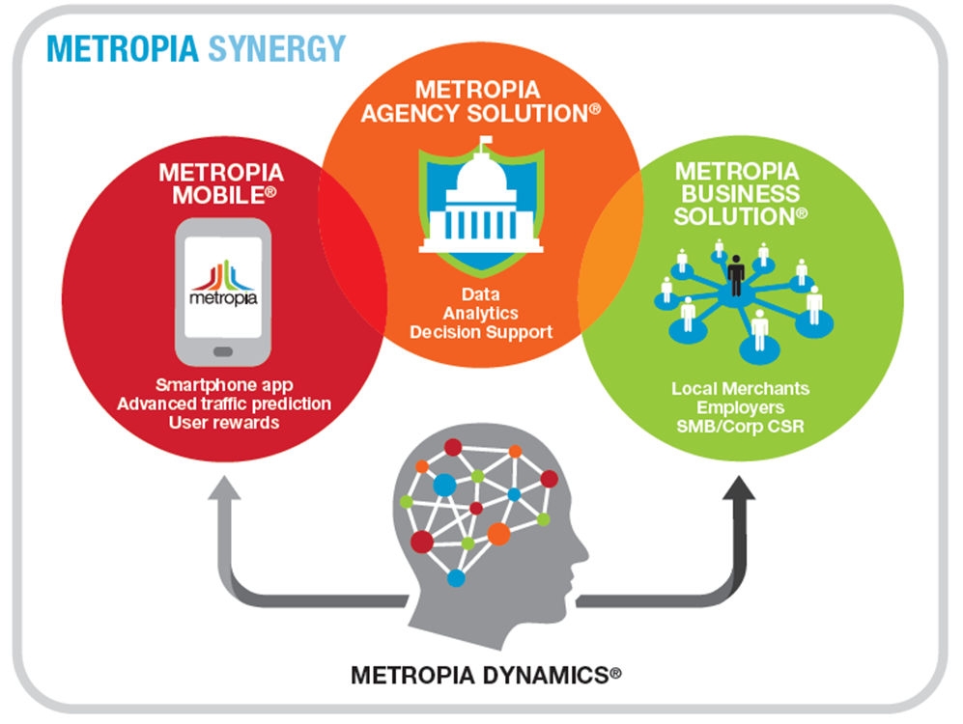
Metropia Synergy Platform
  A sustainable, safe and efficient transportation system
  Metropia Mobile - Smarter commuting decisions
    Patented travel prediction and load balancing algorithms
    Fuses real time + Historical travel time data
    Metropia App Features
        Departure time and routing information
        Pre-plan and reserve trips
        Turn-by-turn voice navigation (validation)
        Incentivizes travel behavior changes (earn points)
        Earn more points for shifting departure out of peak period or alternative route
  Deployment Schedule
    Currently in Tucson, AZ and Austin, TX
    Beta test in NYC (NYCDOT’s DriveSmart program) Summer 2015
    Los Angeles and other cities later this year

Slide 6
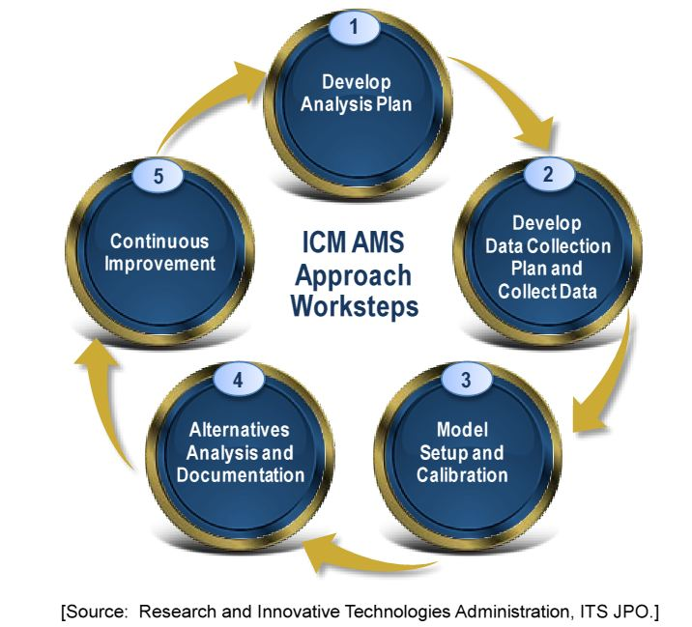
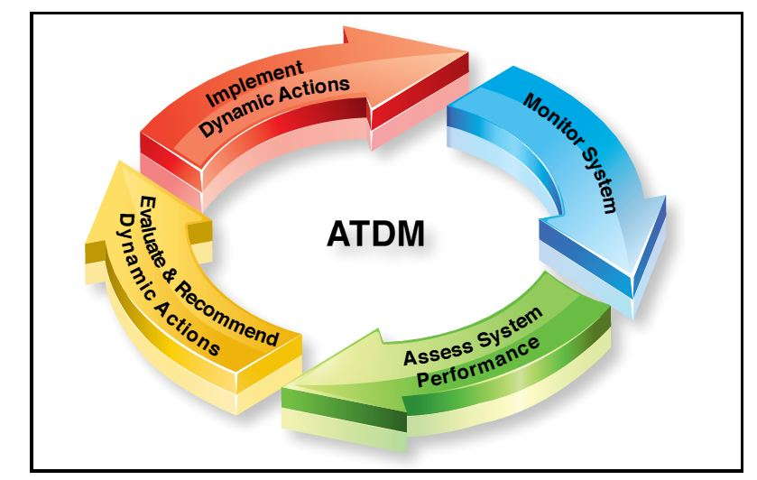
Consistent with FHWA’s ATDM & ICM Frameworks
Source: ATDM Program Brief: An Introduction to Active Transportation and Demand Management, FHWA, June 2012
Source: FHWA Traffic Analysis Toolbox Volume VIII : Integrated Corridor Management Analysis, Modeling and Simulation Guide

Slide 7
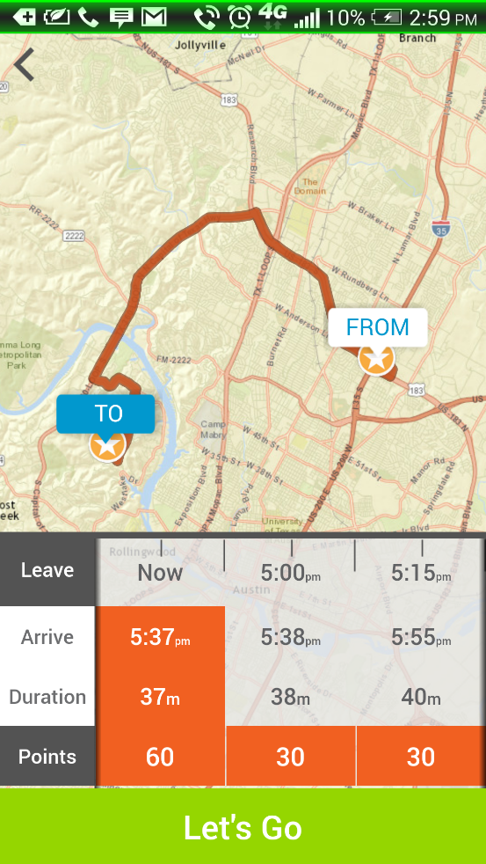
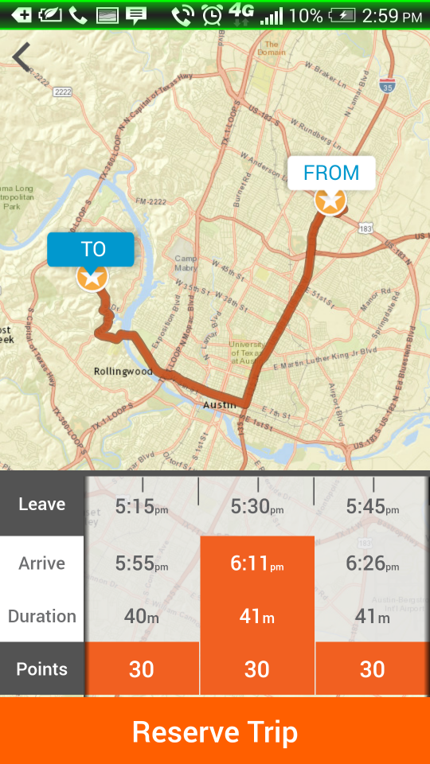
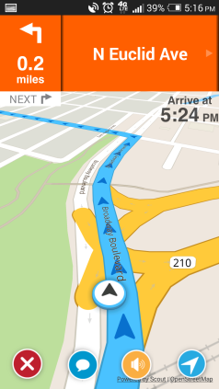
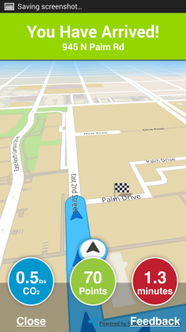
Predictive Routing and Load Balancing
Reserve
Validate

Slide 8
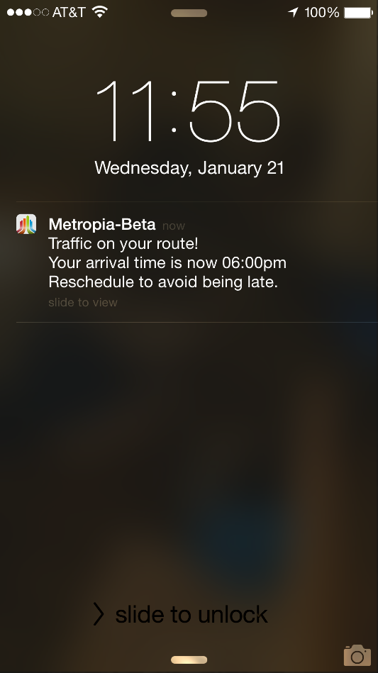
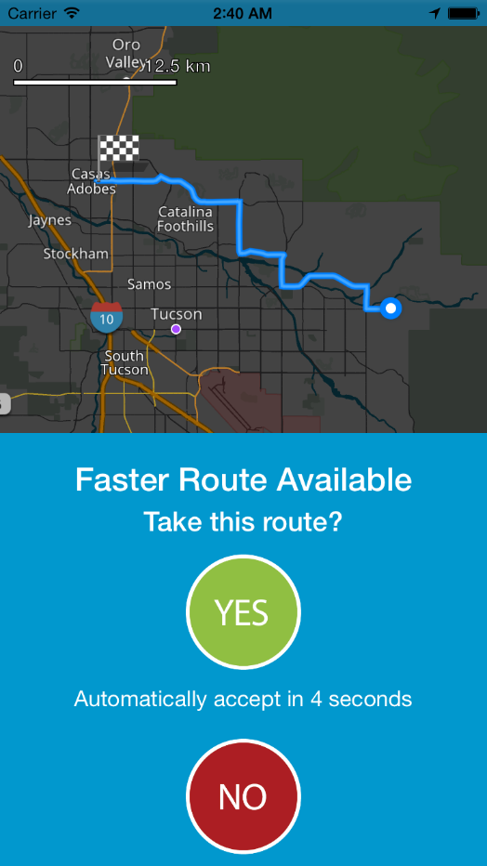
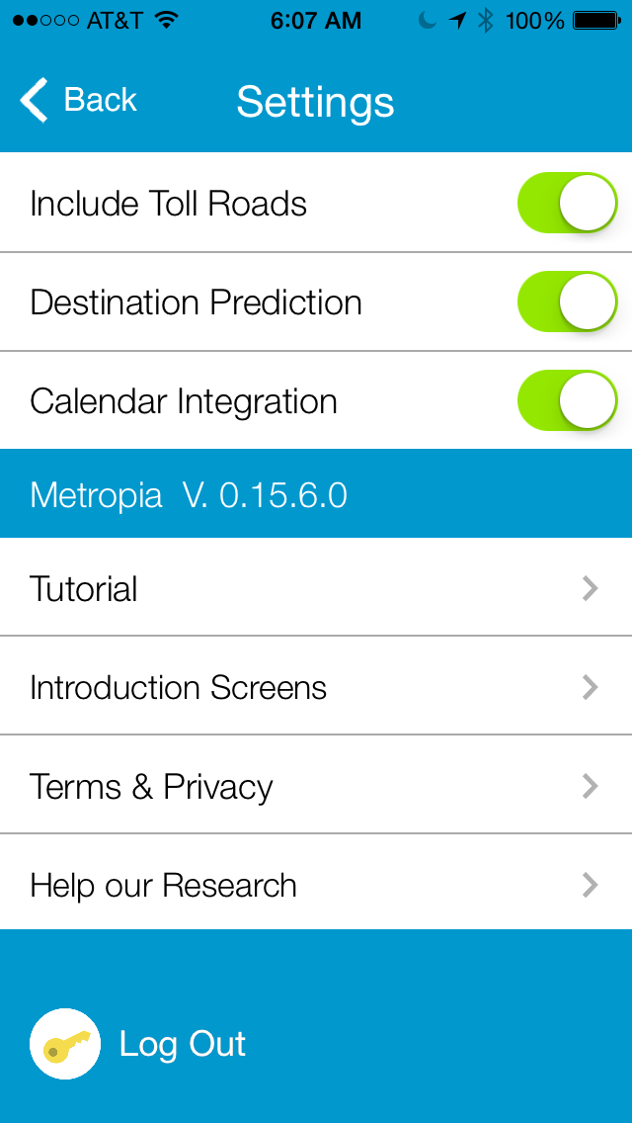
Dynamic In-App Messaging
Pre-trip and en-route alerts when routes and travel times change due to unplanned incidents
Route preferences (toll), predicted destinations based on history,
and calendar integration

Slide 9
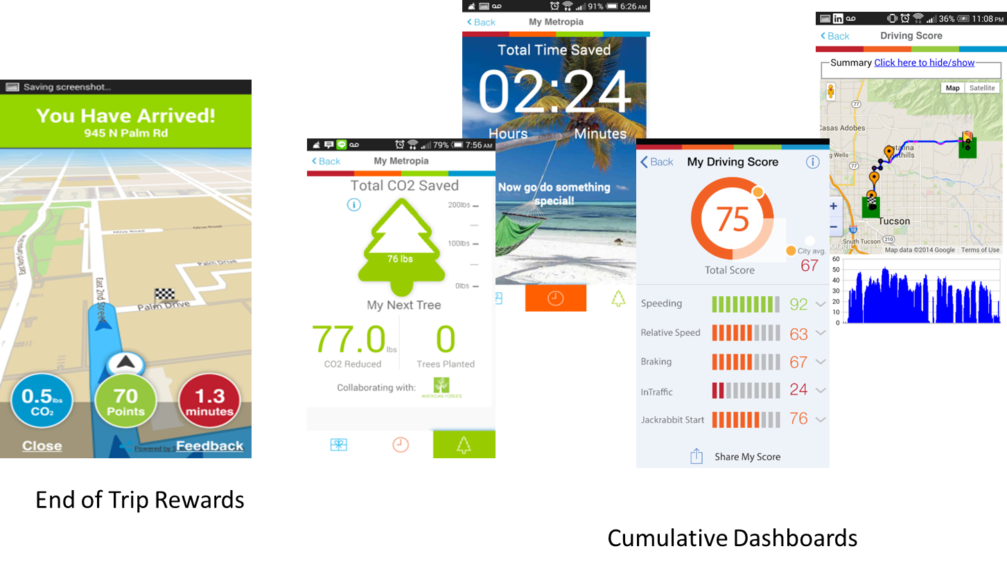
Points, CO2, Travel Time Savings and Driving Scores

Slide 10
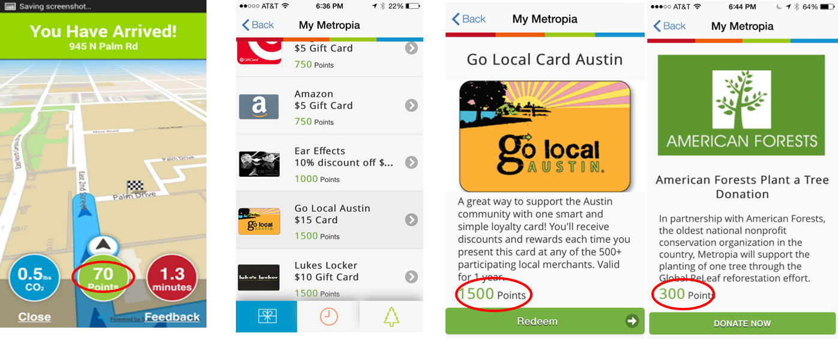
Incentivize and Reward Change
Points can be exchanged for local merchant rewards, local musician music, donated to plant trees and more

Slide 11
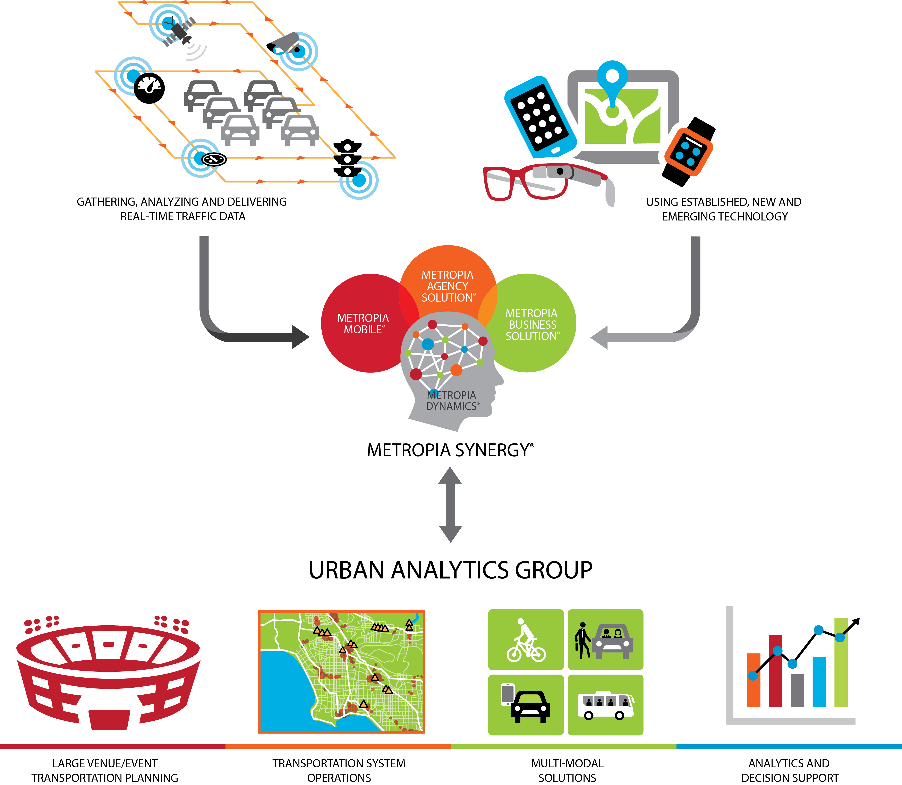
Leveraging Data with Creative and Innovative
Cutting-edge Solutions

Slide 12
Applications
Metropia’s Urban Analytics Group leverages the data collected by Metropia’s Synergy platform and its supporting analytics algorithms to provide innovative, cutting-edge solutions to meet transportation planning and system operations needs.
Travel patterns analysis
Activity-based transportation model validation and calibration
Corridor travel times and speeds
Mobility and reliability measures
Intersection delays
Real-time management of transportation networks
Driving behavior and safety analysis
Incentive-based strategies such as User-Based Insurance (UBI),
Congestion pricing, non-toll strategies such as VMT Fee-based strategies
Parking management strategies
Special event and large venue management

Slide 13
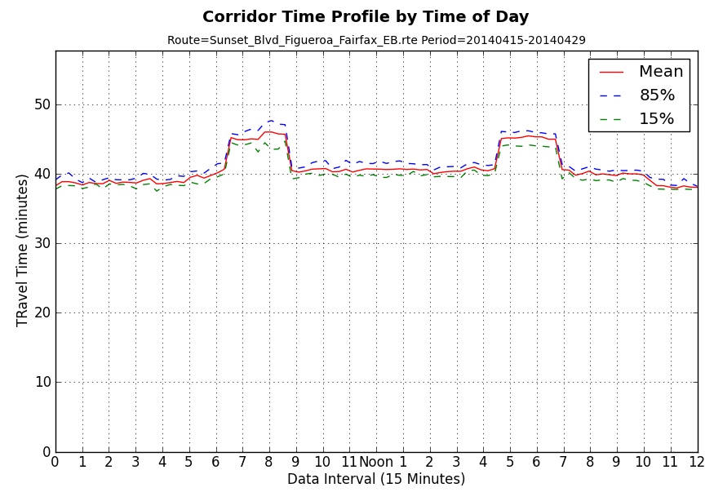
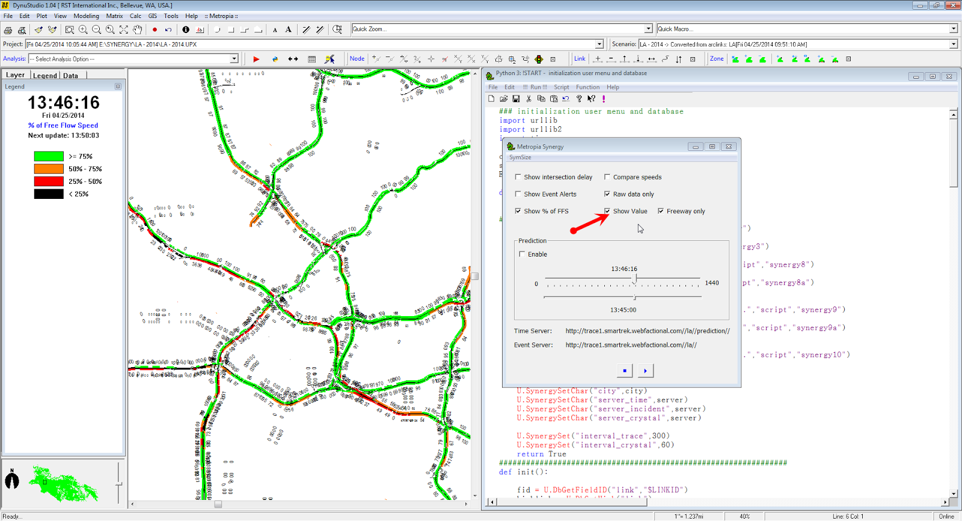
Congestion Management/Real Time Operations
Real time traffic condition
Travel time reliability measures

Slide 14
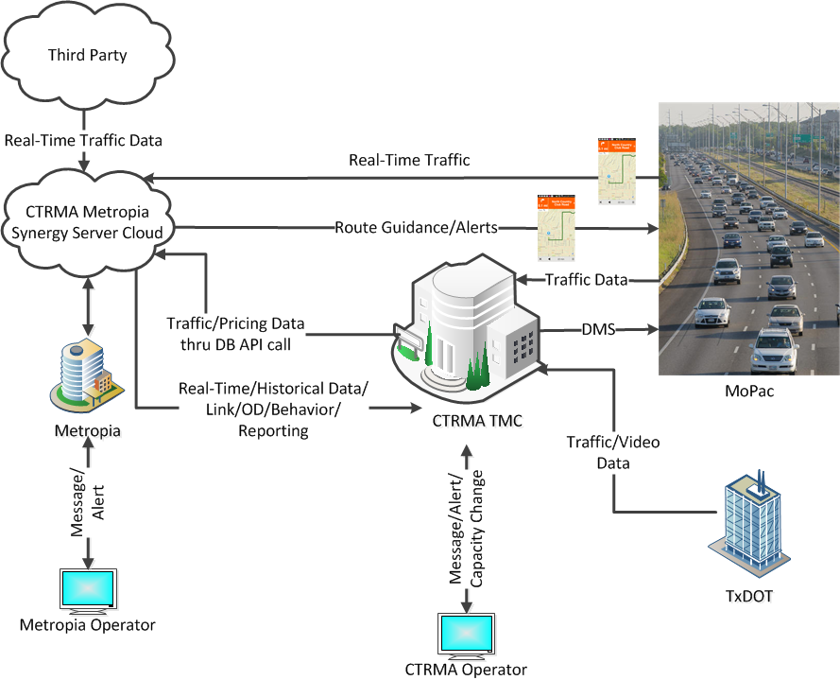
Real-Time Management Framework

Slide 15
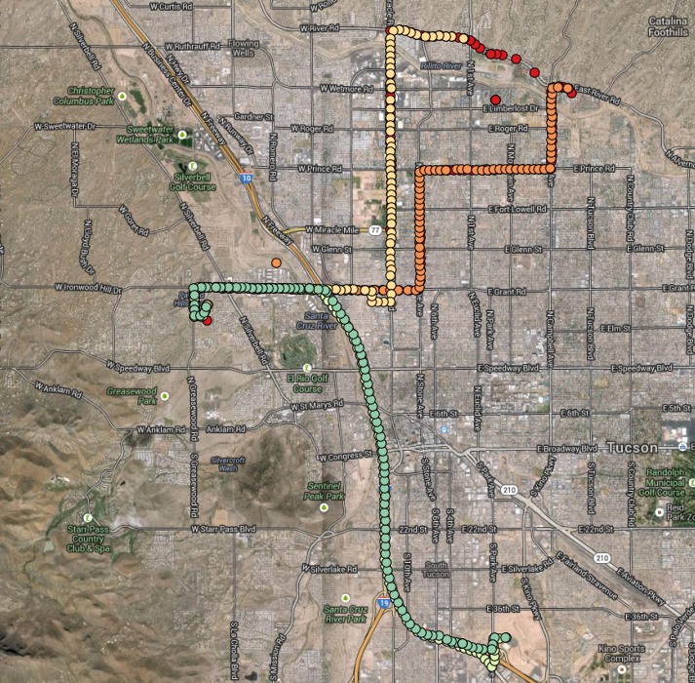
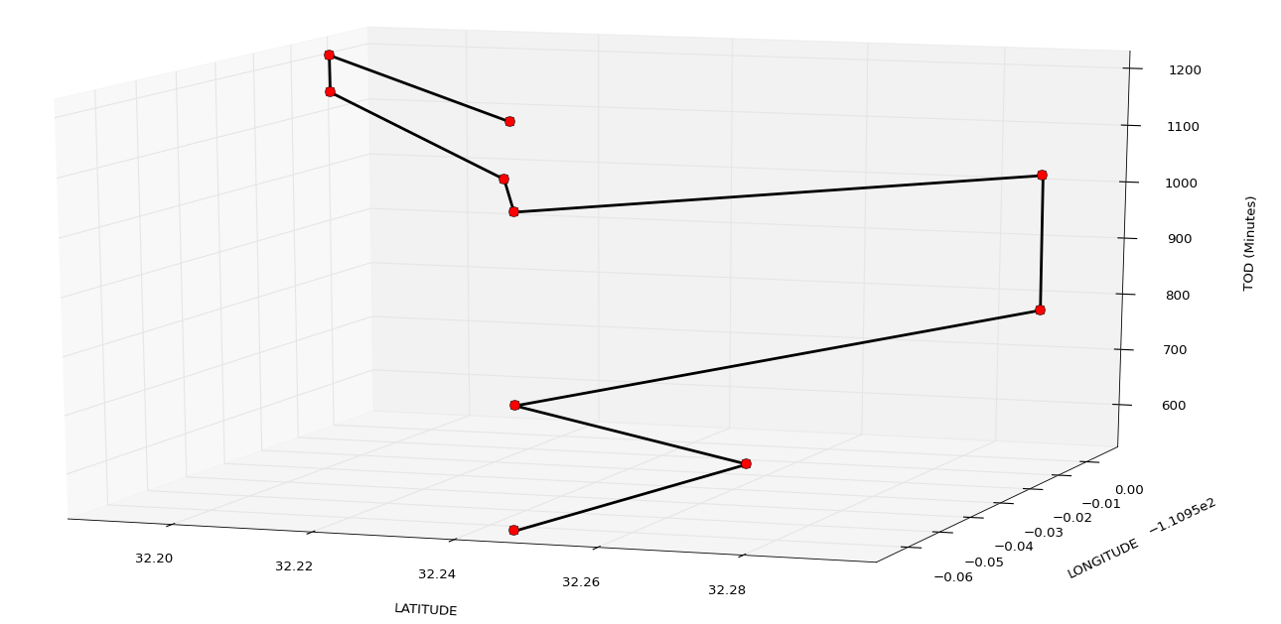
Validation of Activity-Based Models
Activity History
Activity Pattern
Work
Shopping
Work
Home
Home
Shopping

Slide 16
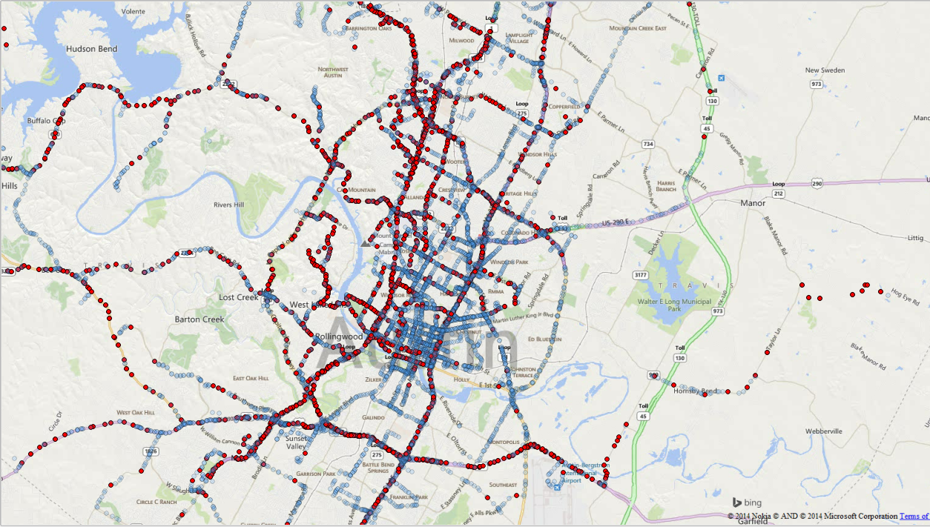
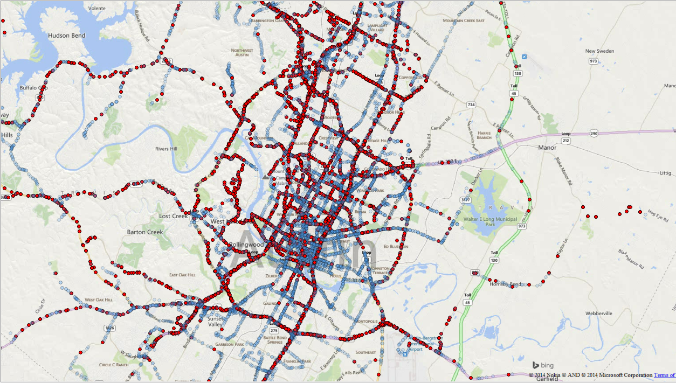
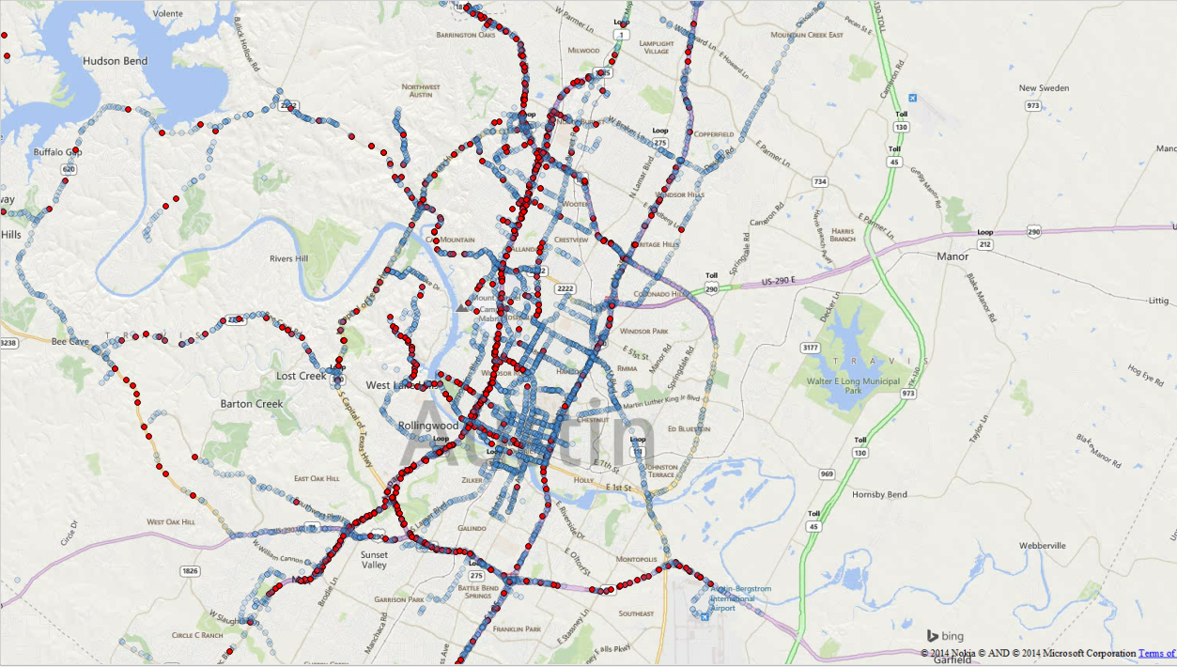
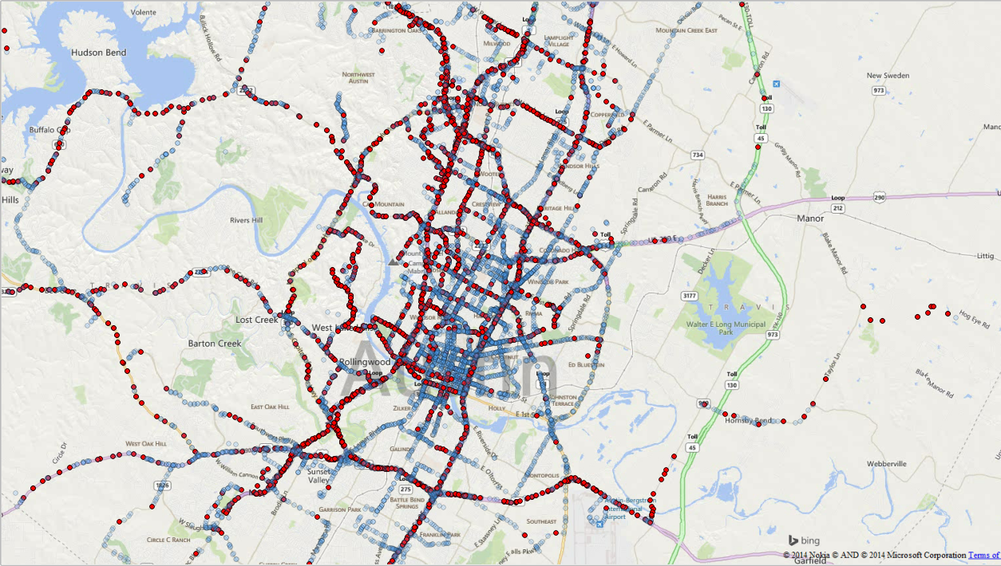


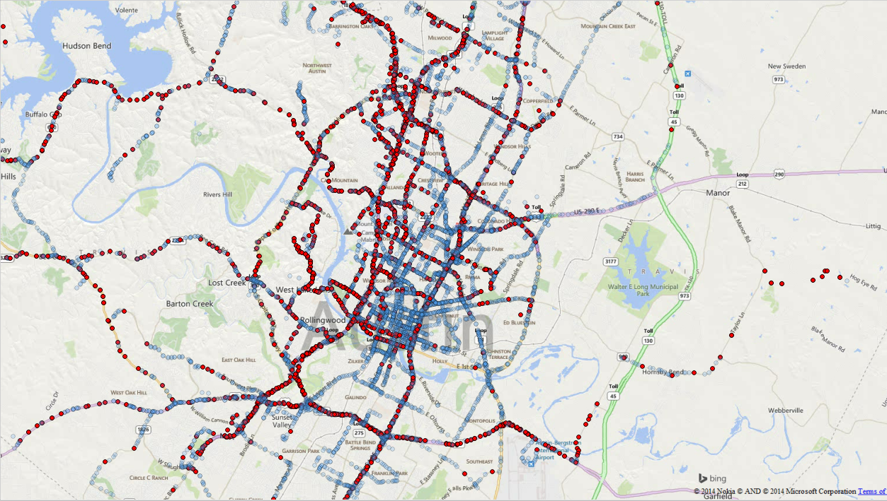
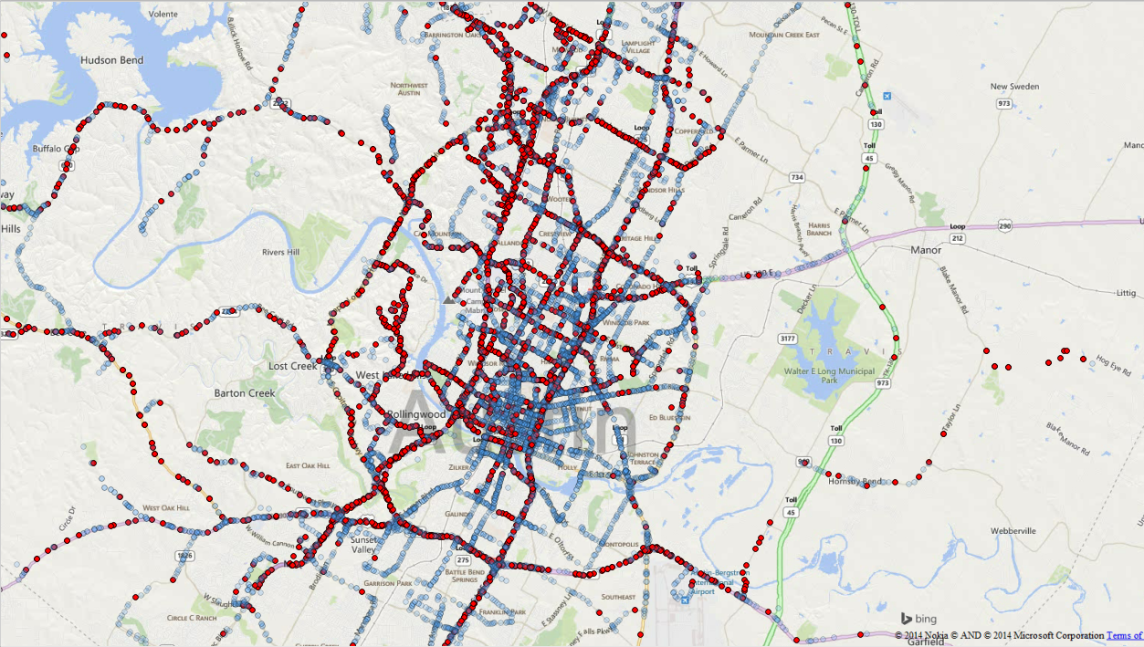
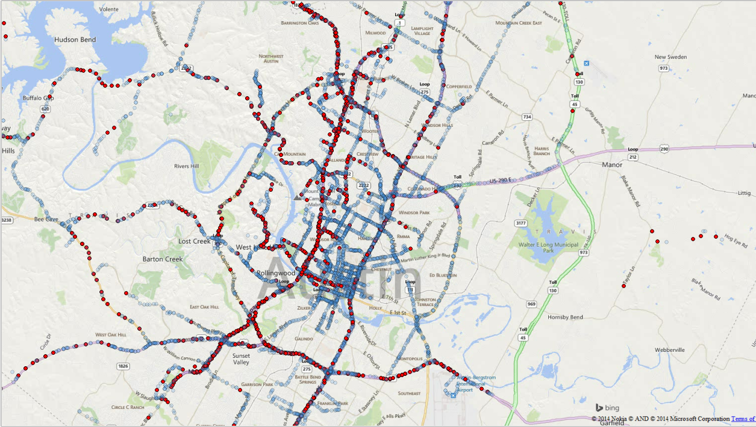
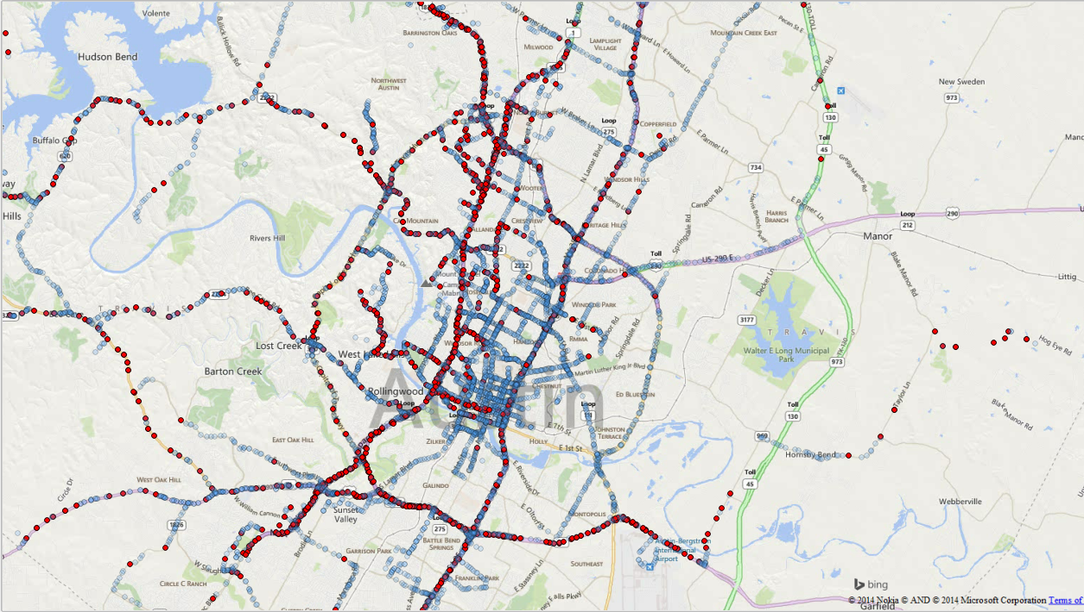
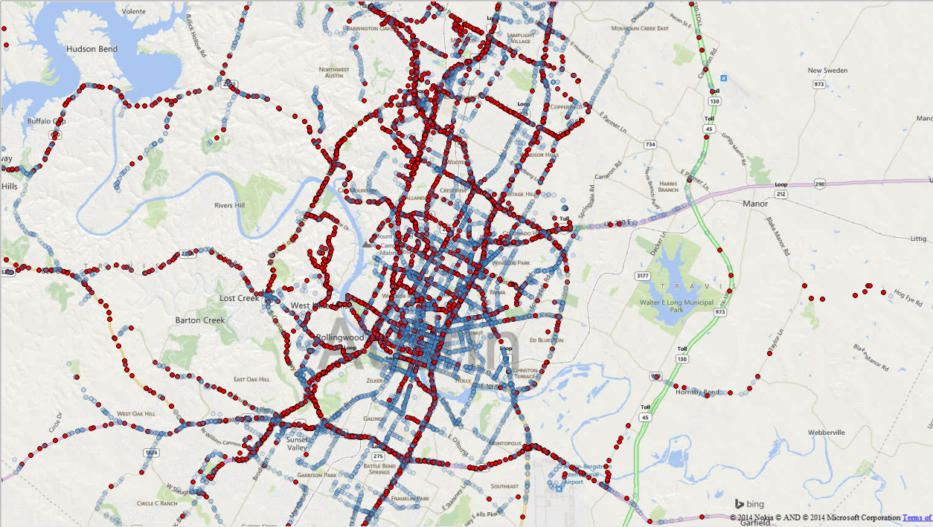

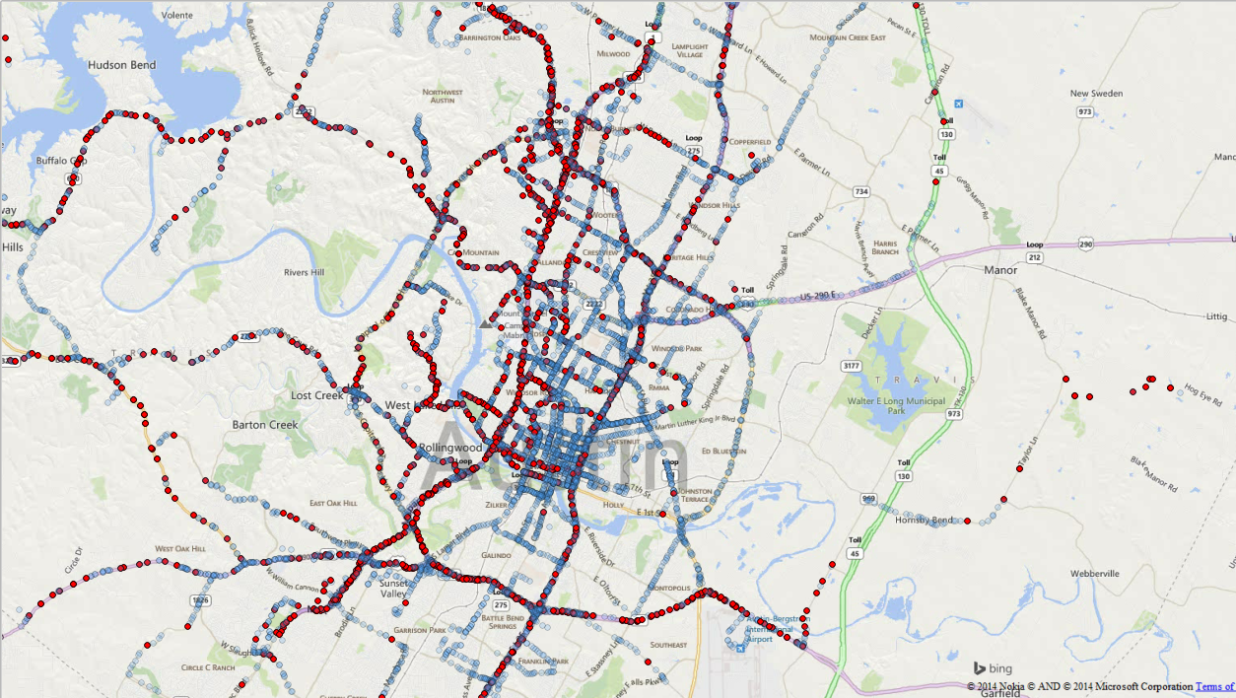
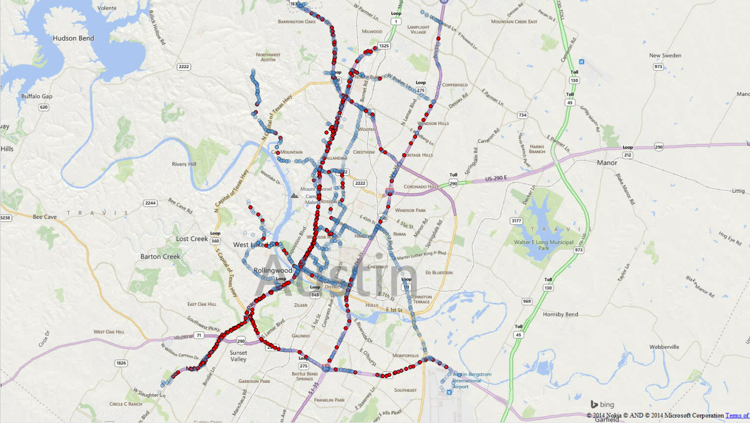
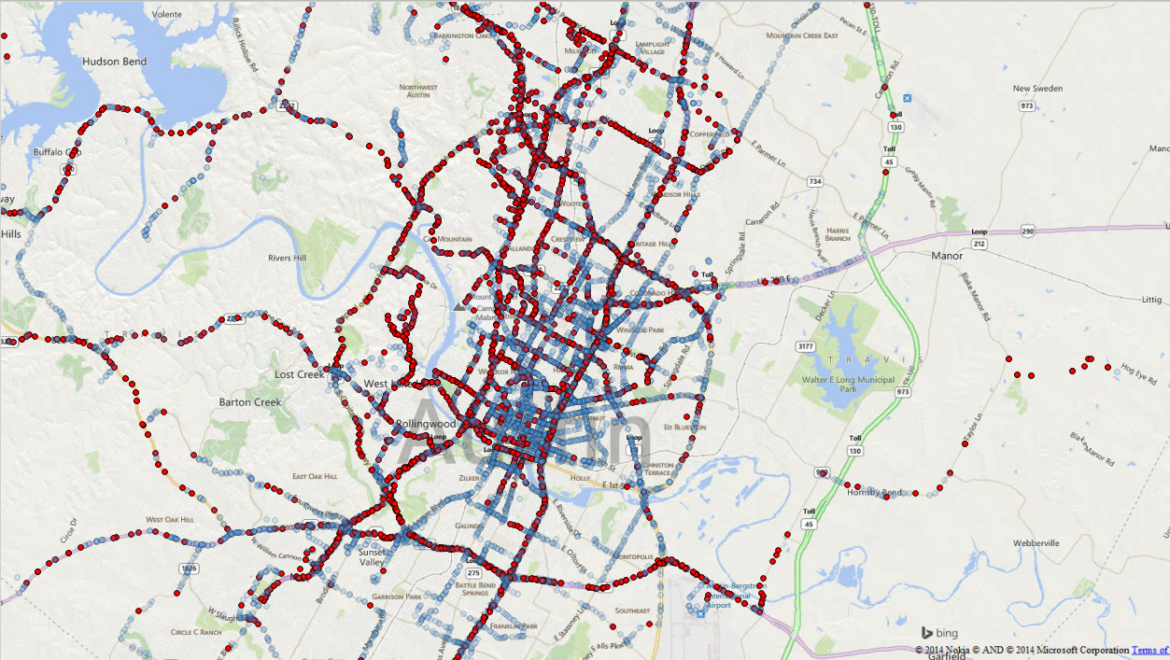

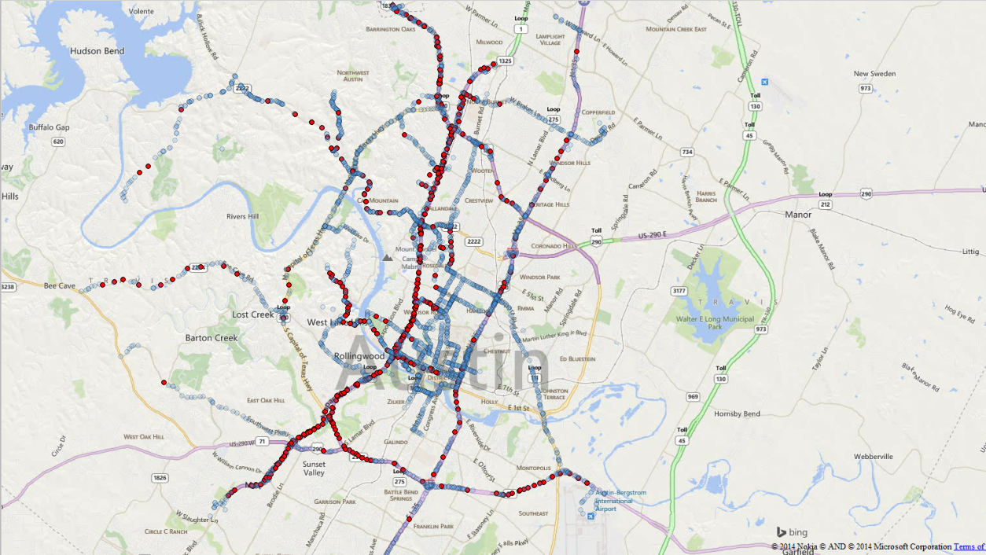
Austin Data Coverage (Weeks 1-16)
1
2
3
4
5
6
7
8
9
10
11
12
13
14
15
16
17

Slide 17
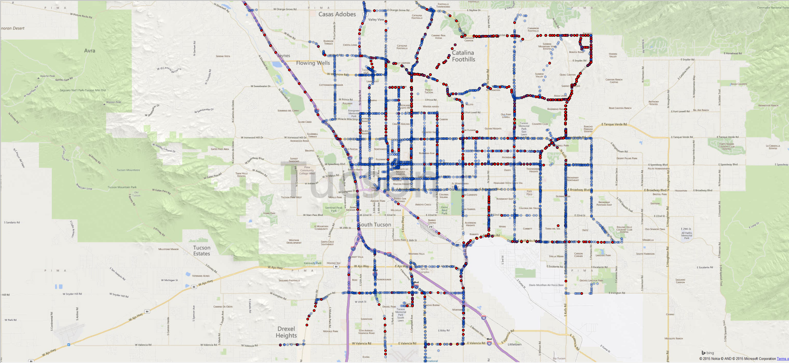
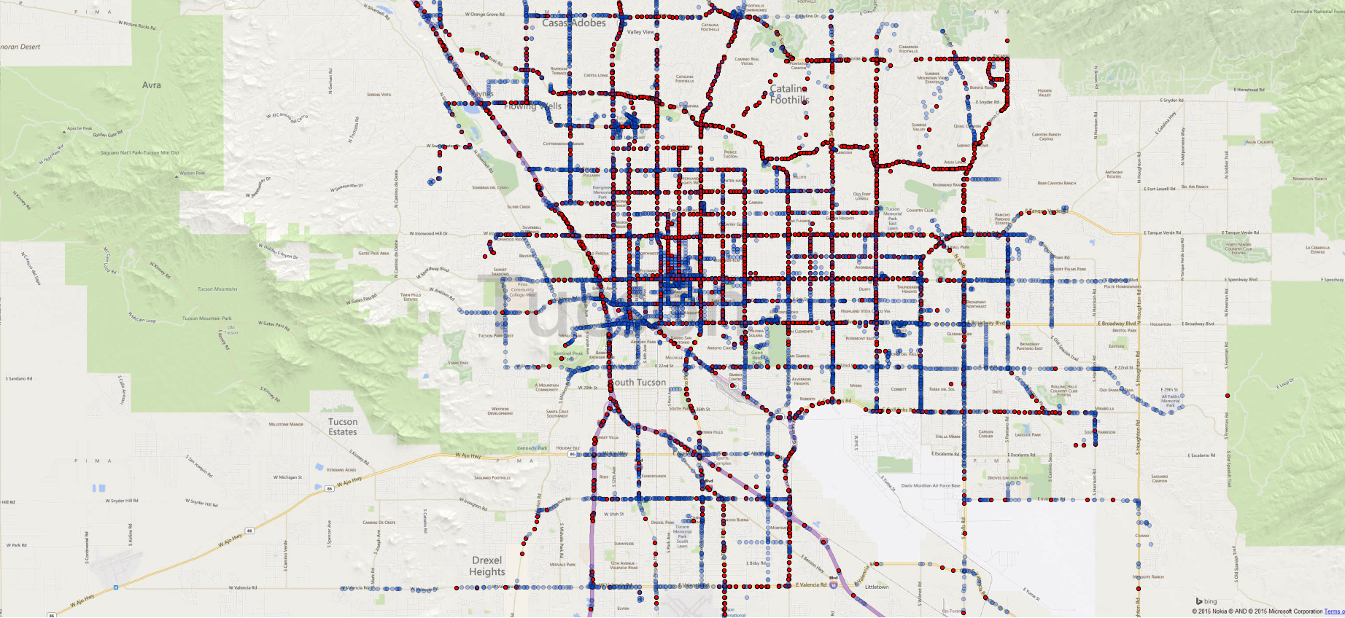
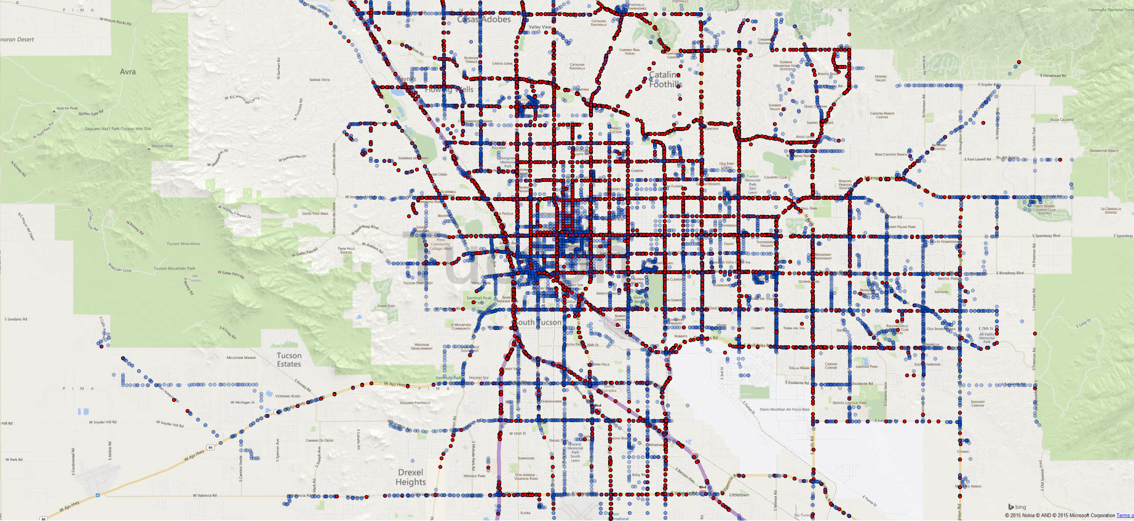
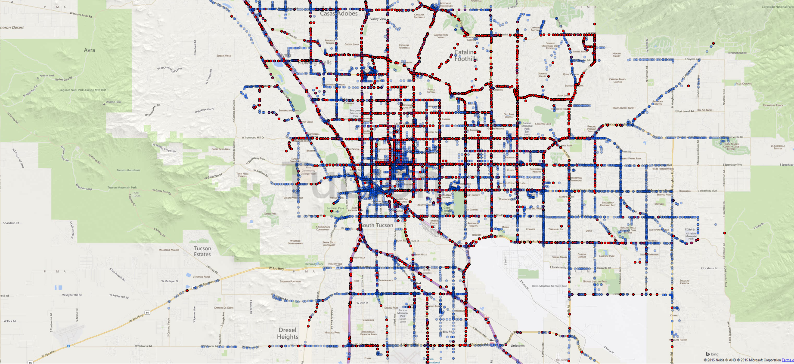
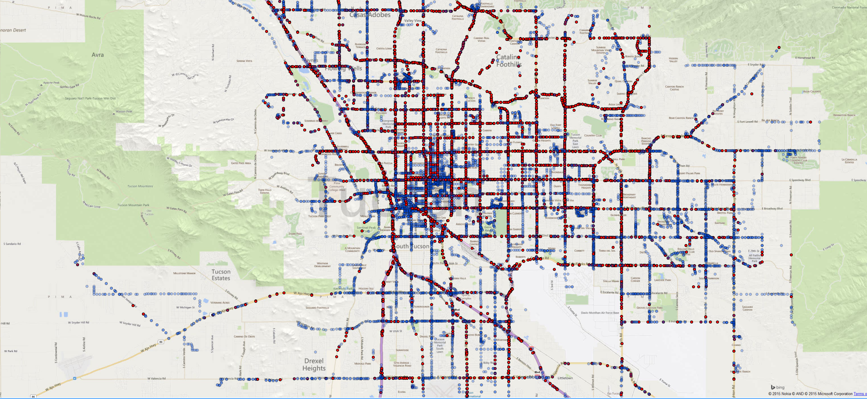
Tucson Data Coverage (30 days)

Slide 18
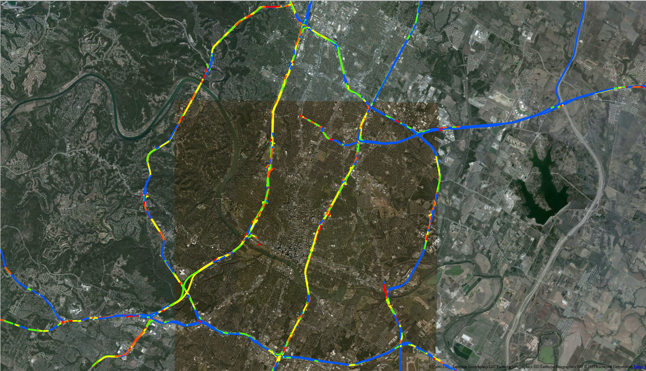
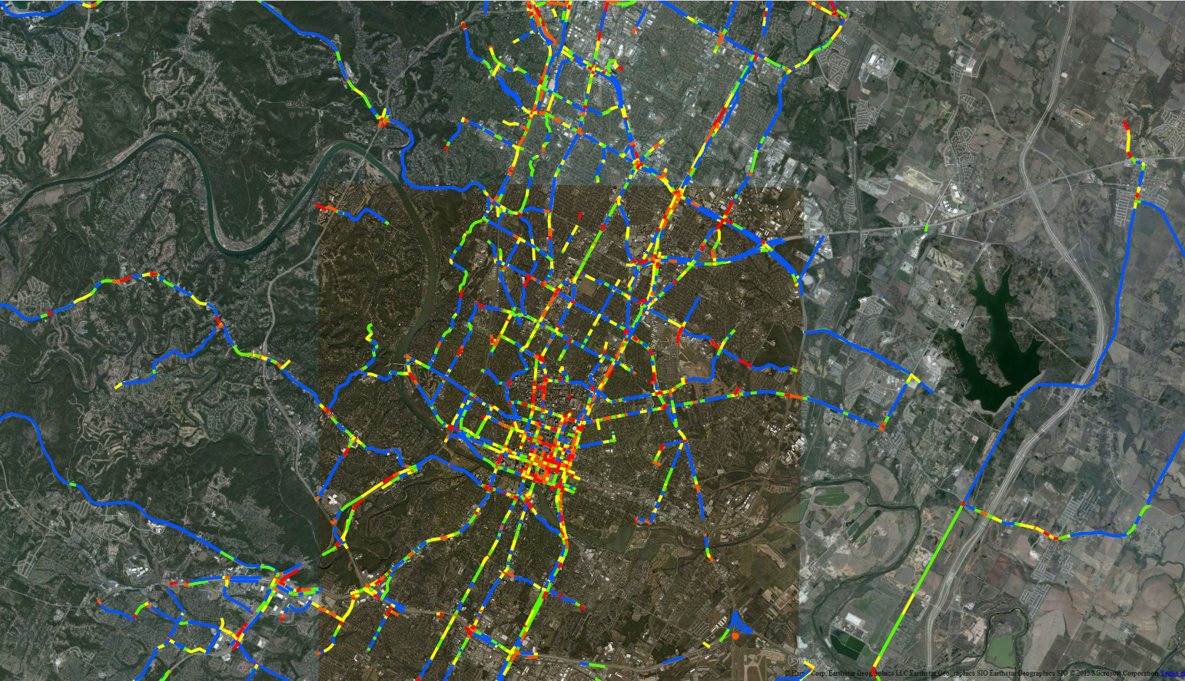
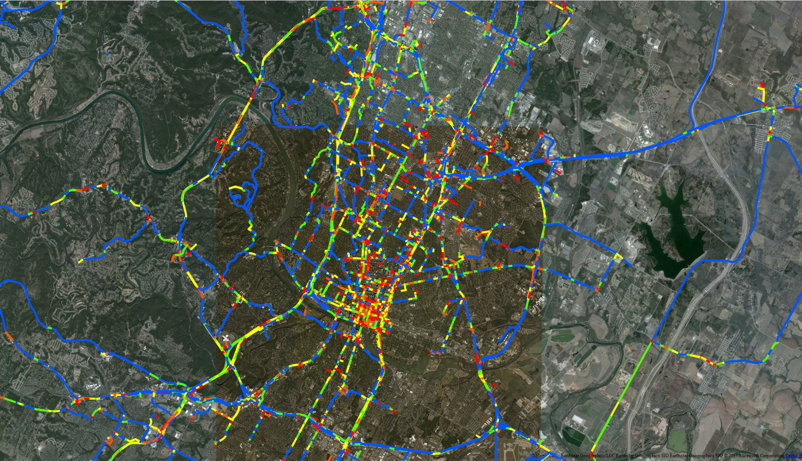
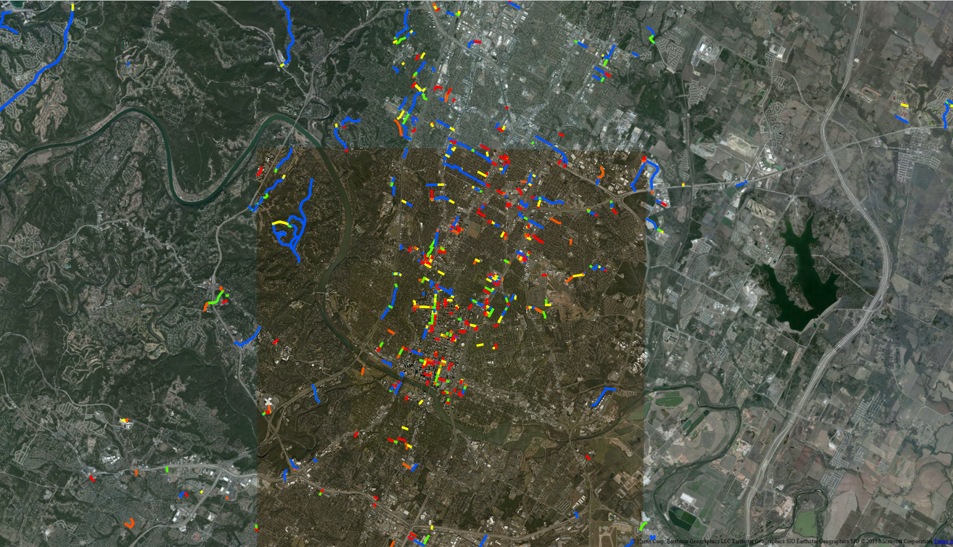
Austin Weekday PH Congestion

Slide 19
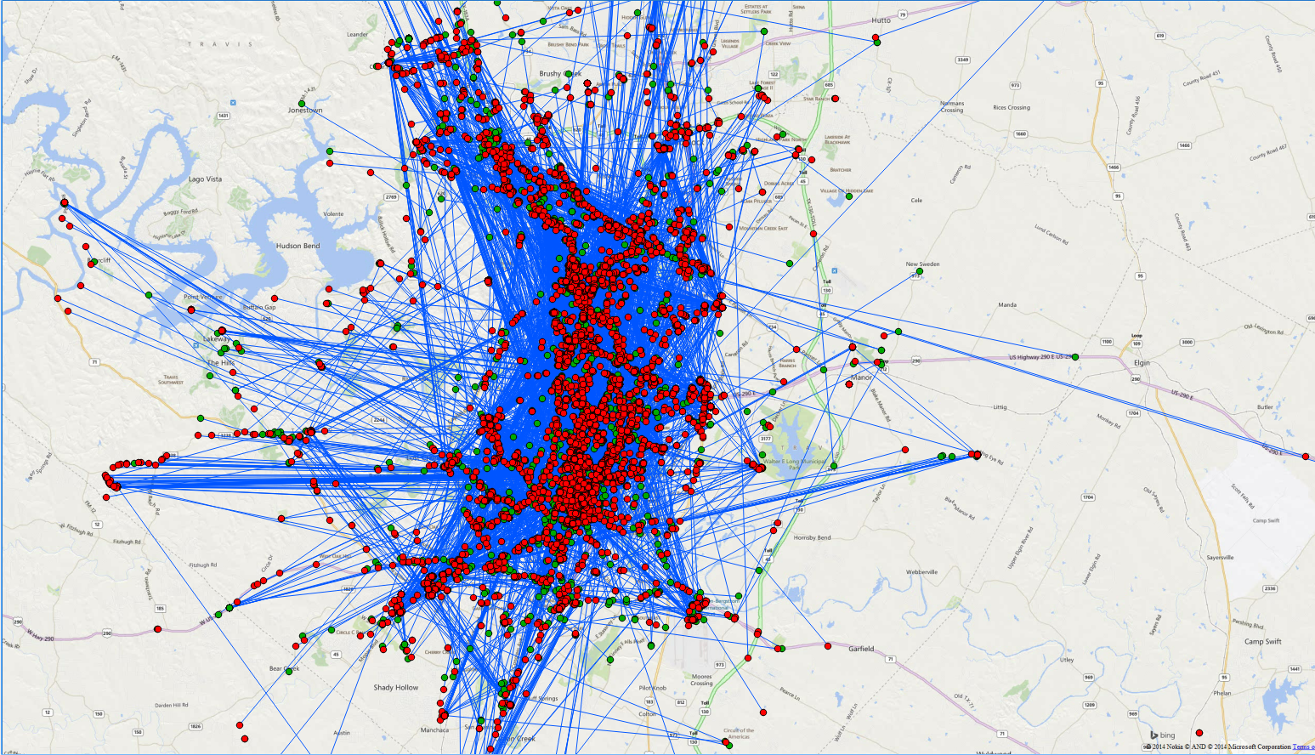
Austin User OD Pattern

Slide 20
Multi-Modal
“Lead Generation” Concept
City
Existing Riders
More Targeted
Non-Riders = Effective Lead Gen
Travel Time Reliability
Potential non-Riders
Targeting
Improve LOS
Matching Transit Routes with Users OD through Data Analytics

Slide 21
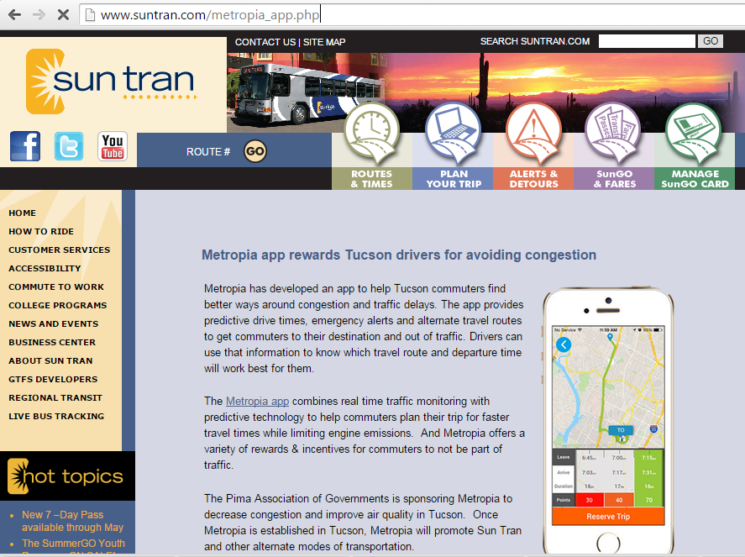
Metropia & Sun Tran

Slide 22
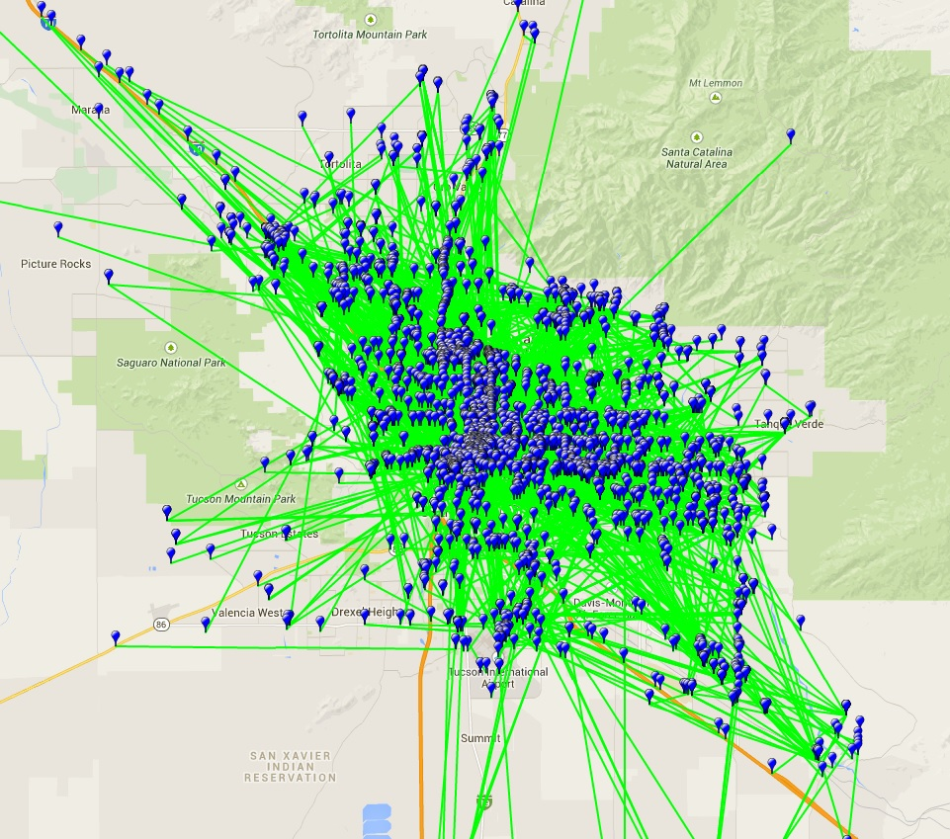
Metropia User Data
2,600 Trips
  Feb 1 – to – March 18: Lab testing
  March 19 (launch)- March 30
Each trip
  Origin Locations
  Destination Locations
  Start Time
  End Time

Slide 23
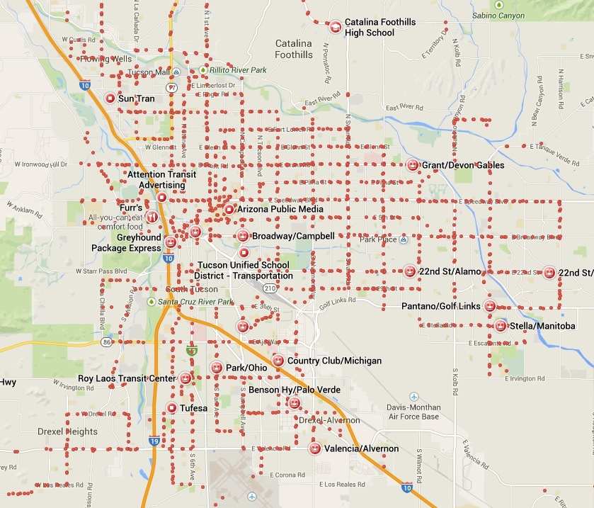
Public Transit Data
Location of stops
Details of each route
Schedule of stops

Slide 24
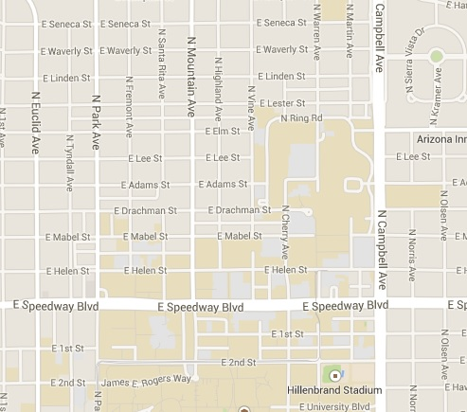


Method
7:30
8:00
Your Travel Time
Public Transit Travel Time
Transfer
Time
Ingress Dist.
Egress Dist.
Socio-demographics

Slide 25
Metropia User Trips vs Walking Distance
Up to 15% of user trips can be serviced by transit based on a 3000 ft. walking distance (door-to-door) and 25 min travel time flexibility.

Slide 26
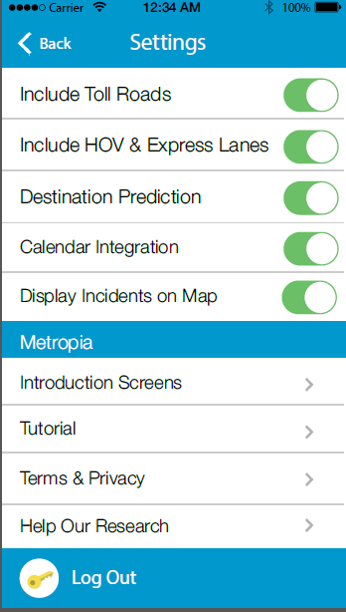
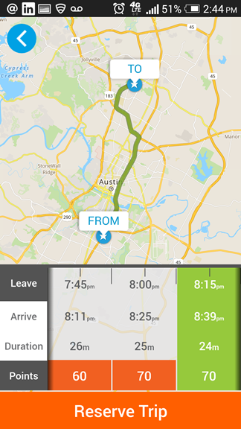
Metropia Ridesharing
No pre-matching needed.
All ridesharing Metropia users just need to start the rideshare trip at the same time.
Metropia automatically matches trajectory to determine validity of shared ride.
Extra points awarded to shared rides.
Simple, easy, and accurate.
+
Drive Alone
Share Ride
Drive Alone
Share Ride

Slide 27

Thank You
Q&A

