Slide 1
Data Development for a Fully Dynamic Transportation Demand and Supply Model
TRB Applications Conference
Wednesday May 20th, 2015
Notes:
1

Slide 2
Project Introduction
Develop Region-Wide DTA Model for San Diego
Integrate DTA Model with the SANDAG ABM
Desired Outcome:
  Analysis of projects that improve system efficiency
Notes:
Project awarded to PB - mid 2013.
DTA partner, TSS, selected - end of 2013
Model development workshop - mid 2014 (NY)
Network Creation and Calibration workshop - 2 months ago (SD)
Final DTA model network - summer 2015
Integration of ABM and DTA network - mid 2016

Slide 3
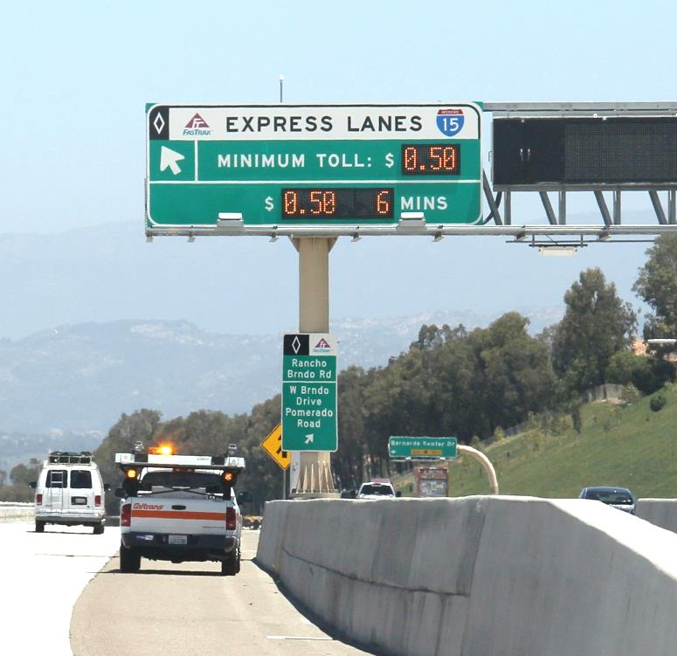
Why DTA-ABM Integration
Congestion Duration
Dynamic Tolling
Travel Time Reliability
Refined Speeds for Air Quality Analysis
Finer Time Period Resolution
for the ABM Choice models
Launching Point for New ICM Corridors
Notes:
SANDAGs current macroscopic model implementation within our ABM framework has several key limitations.
A DTA with ABM integration can provide
- better information on congestion location, duration, and queue length impacts
- handle peak period congestion tolling algorithms
- TOD based travel times for daily variability and multiple simulations for possible reliability
- more refined data for feeding into Air Quality software. EMFAC takes VMT by speed bin and DTA will provide better temporal resolution for this.
- SANDAG’s ABM works at a ½ hour resolution. Providing detailed temporal data will provide better information for choice models by capturing the variability in travel time conditions through the peak periods.
- SANDAG has an integrated corridor management system along I-15 from San Diego to Escondido. The ICM uses real-time Aimsun microsimulation. The updated networks for DTA, network relationship to RAMS signal data, and more refined demand tables will create a less intensive modeling process for starting new corridors.

Slide 4
DTA-ABM Interface
General Framework
SANDAG
GIS DATABASE (TCOVED)
Activity Based Model
(CT-RAMP)
Dynamic Traffic Assignment
(Aimsun)
Notes:
The SANDAG GIS Database/network serves as the host of all data points and attributes.
This data is then exported to the either the ABM or the DTA (Mesoscopic) model.
The ABM uses network data from the GIS to create accessibility measures used in choice models and for AT modeling.
The DTA model uses shape files and other txt/xml files to build a completed detailed model.
The GIS to DTA to GIS functionality is highlighted within this presentation.

Slide 5
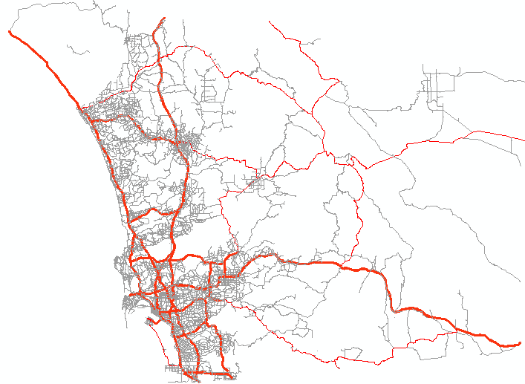
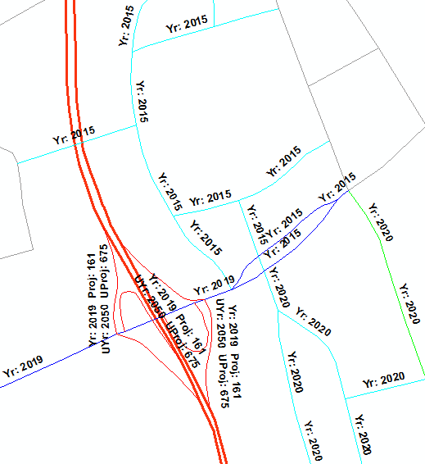
GIS Network Database
TCOVED Master Network Framework
  Road & transit network data
  Contains all future project phasing
Goal: Support Meso and Macro Networks in 1 GIS Database
Notes:
SANDAG has been maintaining our modeling network in GIS for approximately 3 decades
Our current TCOVED base year is 1990 and contains a collection of local, TIP, & Regional Plan projects from throughout the years. Each link can be coded up to 4 future phases.
The transit network is a route system based on an LRS of the roadway arcs. We store up to 20 configurations for each inbound or outbound route and 5 different headways for each configuration.
TCOVED (Current and future)
Arcs 45,510
Nodes = 32,560
Controlled Intersections = 10,853
Signals = 4,442
4-way stops = 1,514
Ramp Meters = 508
Transit Routes = 548 (not route configurations)
TAPs = 2,500
2015 Hwycov
Arcs = 40,997
Nodes = 30,817
Controlled Intersections = 10,280
Signals = 3,686
4-way stops = 1,355
Ramp Meters = 338
Transit Routes = 280

Slide 6


Challenges with Existing Structure
Network Attributes Configured for Macroscopic Assignment
  Missing minor intersection approaches
  Missing intersection details:
    U-turns
    Turn bay lengths
    Number of turn bays
    No turn on red signage
  Controller IDs and signal timing details
  3,600+ signalized intersections
Notes:
The current state of the attributes within the GIS model are set to feed a Macroscopic modeling process. This creates a new challenge when switch to a more detailed lane and turn oriented DTA model that includes turning bays, realistic signals and individual vehicles.
These challenges include such things as:
-A number of minor roads, side street and driveways to trip generating centers are not included but are needed to properly model the signal and lane by lane operations.
-As listed a large number of the Intersection approach details are either incorrectly coded or are missing completely.
-In order to be able to import the signal controller details the signalized nodes need to be correctly matched to the real world controller IDs.
-There are over 3600 signalized intersections that need to be checked and updated

Slide 7
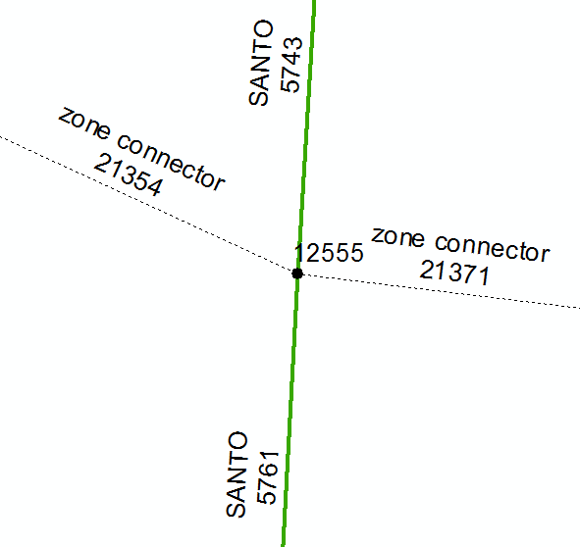
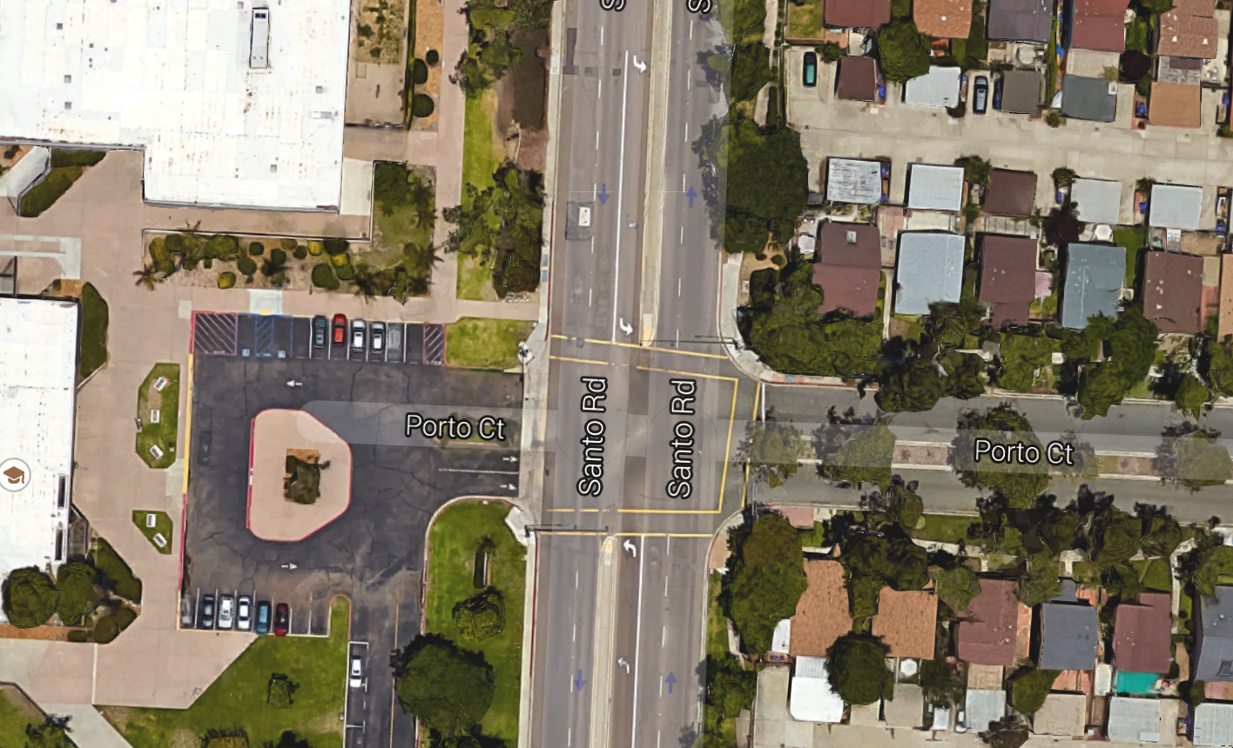
Existing Network Structure
Current GIS
Network
Actual Geometry
Notes:
Here is an example of a signalized intersection in the City of San Diego community of Tierrasanta. The intersection connects a major arterial (Santo Rd) with a local high school (Junipero Serra HS) and a local housing development collector (Porto Ct).
In the macroscopic model we had a less than ideal representation of 2 zone connectors feeding into the intersection with no information on the connectors for number of lanes or turn lanes.

Slide 8
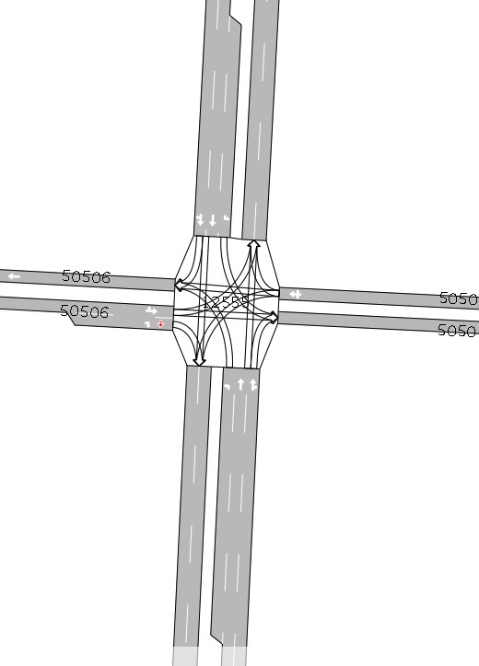
Updated Network Structure
Updated Network
Actual Geometry
Notes:
Updating the network for a closer geometric representation DTA we included
- Cross street approaches (Porto Ct & Junipero Serra HS driveway)
- Turns by lane
-- Including the shared turns such as WB Porto Ct shared left & thru lane
- Actual turn bays with appropriate lengths for the left lanes on Santo Rd

Slide 9
Network Database
DTA Network Generation Framework
GIS Network
Shape File
Updated GIS attributes
Aimsun Network Import
Aimsun Network Calibration
Notes:
GIS to DTA to GIS timeline
From the GIS a shape file is extracted including all details including the latest updated attributes from the network update process.
Shape file with some extract txt/xml files such as turn prohibitions and signal timing data are imported using scripts into Aimsun to generate the Aimsun DTA network.
The network will then be calibrated using the demands from the ABM model. The attribute changes due to the calibration will then be exported in the form of a csv file and imported back into the GIS Network for future network builds.

Slide 10
Data Interfaces
Integrated Corridor Management System
SANDAG GIS (TCOVED)
RAMS
CPS
Node and Links
Transit Routes
RMIS
Manual Signal Parameters
Traffic Counts
Historical Travel Times
Parameters
Aimsun Network
Notes:
The Integrated Corridor Management System (developed for the I-15 corridor and the San Diego region) includes a Data Hub that collects and stores data from the external systems this includes some data elements, key to having an accurate model. The sources critical to this project are:
RAMS – Regional Arterial Management System – Base-year signal timing plans (70% coverage of the county);
RMIS – Ramp Metering Information systems – Base year ramp metering inventory and timing parameters/algorithms;
CPS – Congestion Pricing System – Base year toll schedule algorithms, sensor locations;
Manual Signal Parameters – For the 30% of signals not currently in the RAMS files manual signal timing data is being collected and stored. (placed within ICM as the plan is to have 100% signals within the system);
The SANDAG GIS is the data sets currently stored within the GIS database:
Node and link
base and future year highway network geography/shape;
Through & approach Lnes;
Speed;
Control type (Signal, Stop, Yield);
Turn prohibitions;
Transit Route Configuration
Base and Future Transit route itinerary
Route Type (local, express, BRT)
Headways (for 5 periods)
Traffic Count Data
Base-year traffic counts;
Travel Time Data
Base Year and historical speed data from INRIX
Parameters – Aimsun calibration parameters to generate calibrated networks.

Slide 11
Network Update Fields
Item | Task | Data Entry
Mid-block lanes | Review | Aimsun (if fix is needed)
Thru, left, right bays | Review | Aimsun (if fix is needed)
Shared TLR, TL, TR, LR | Review / Collect | Aimsun (if fix is needed)
Right and left bay lengths | Collect | Aimsun
U-turns | Collect | Aimsun
No turn on red | Collect | Aimsun
Transit queue jumps | Collect | Excel
Lane usage restrictions (time) | Collect | Excel
Notes:
Data collection efforts focused on signalized intersections and key attributes that needed to be reviewed or collected.
Additional information such as lane usage restrictions (buses, HOV, trucks) especially by TOD were collected outside the network.
Data entry was done in Aimsun to be fed back upstream to the TCOVED.
Shared Lane terminology – lanes that have multiple movements allowed through the intersection
TLR – Thru / Left / Right
TL – Thru / Left
TR – Thru / Right
LR – Left / Right (found at T intersections)

Slide 12
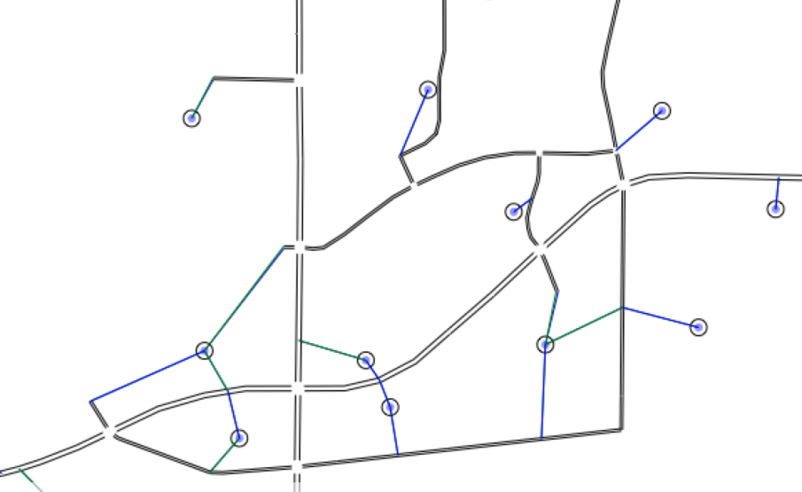
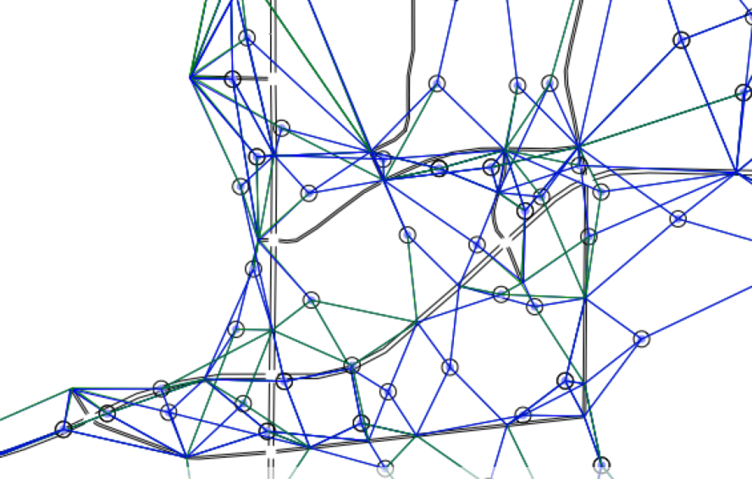
Importation Process
Exportation from ArcInfo Coverage to Shapefile
  Adds QuicNet signal controller IDs
  Creates MGRA (MAZ) to network nodes correspondence
TAZ (4,996 Centroids)
MGRA (23,002 Centroids)
Notes:
We made modifications to the current ETL (extract transform load) process from ArcInfo coverage to specific scenario/year macroscopic network in order to push out a DTA level network with the new network attributes. These modifications include:
- Absorbing signal controller IDs from a SANDAG maintained GIS shapefile of current regional traffic signals
-- This will allow Aimsun to load the correct signal timing plans from the RAMS (Regional Arterial Management System) database
- Python script to create an MGRA to node correspondence table which controls for connection length, barriers (canyons, water bodies), and type of node (freeways, ramps, signalized excluded)

Slide 13
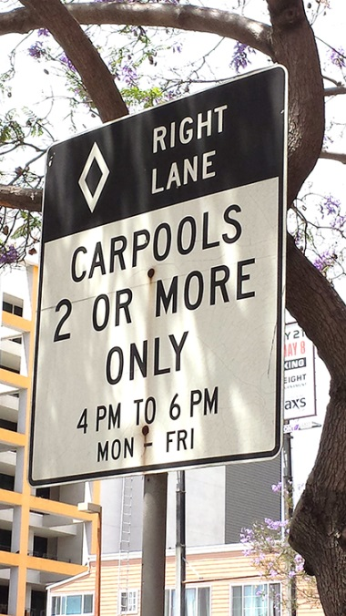
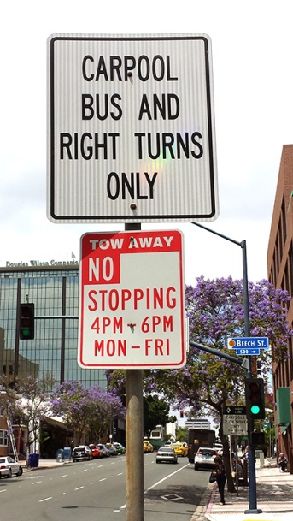
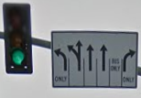
Importation Process
Importation to Aimsun Using Python Scripts
  Node names
  Time of day (TOD) lane closures and configurations
  HOV/Truck/Transit links and prohibitions
  Auxiliary lanes
Notes:
- Node names (external ids from the GIS) are imported to keep the unity between the GIS network and the Aimsun network;
- Time of day restrictions such as parking lanes, HOV lanes and time restricted turns
Vehicle lane or section restrictions like HOV lanes, Truck Limitations (no truck in the left lane, no trucks over 4 tonnes…)
Auxiliary lanes – the additional lane connection an on-ramp and an off-ramp within a weaving section.

Slide 14
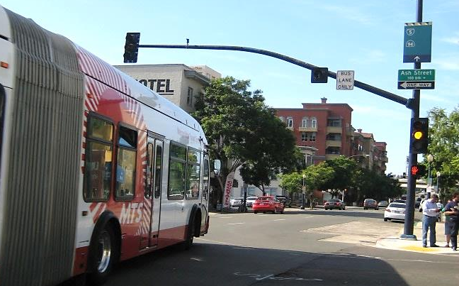
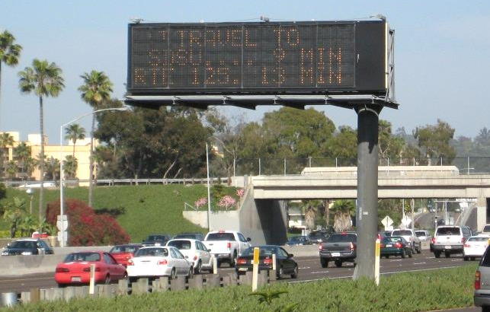
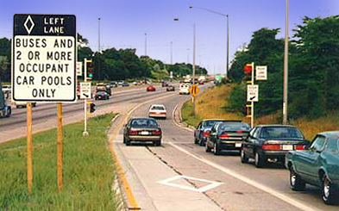
Importation Process
Importation to Aimsun Using Python Scripts
  Transit details
  TOD tolling details
  Turn bays and ramps
Notes:
-the transit network and routes are imported and mapped to the road network to automatically add the transit routes/stops/headways and stations.
-TOD tolling schedule details are load to correctly capture the tolling along the I-15 corridor and the 125 corridor;
All turn bay and ramp configurations and lengths are imported from the GIS data set. When no data is available default lengths are added;
Ramp script also aligns the on and off ramps to the correct side of the roadway;

Slide 15
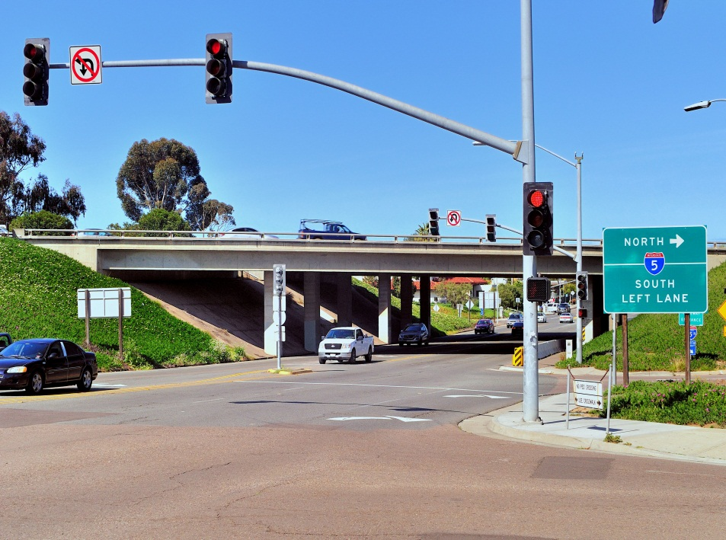
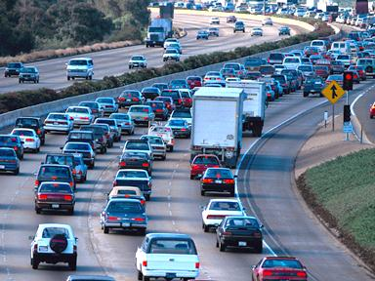
Importation Process
Importation to Aimsun Using Python Scripts
  Intersection controls
    Signal timing/phases
  ABM demand data
Notes:
-Using the detailed RAMS xml inventories and the manual data sets combined with nema phasing and the coded RAMS IDs the intersection signal controls are automatically populated through out the network;
-Demands for both the TAZ and MGRAs are imported from an exportation from the ABM model. Allows for initial running of the DTA for calibration purposes.

Slide 16
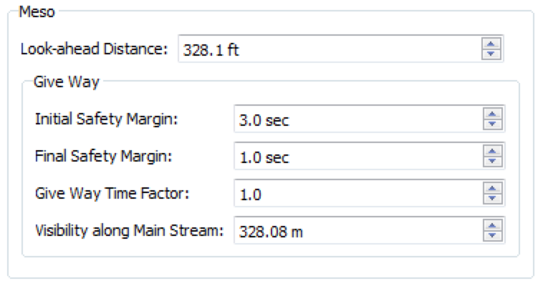
Calibration Parameters
Parameters Stored Such As
  Look-ahead distance
  Give way time factor
  Visibility distance
Sample Aimsun Parameters
Notes:
These are typical parameters used when calibrating a network.
Shown here is a screen from a turning movement within Aimsun where the parameters for the Look-ahead distance (how far back a vehicle sees the turn) and the give way parameters are changed within Aimsun.
Other parameters to be used could be:
Jam density
Right turn factor
Penalize shared
Penalize slow
Look ahead
Initial and final safety margins
Give way time factor
Visibility distance

Slide 17
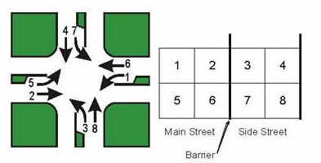
Next Steps/Challenges
Existing Signal timing data
  Only 70% of data in standardized format
  Large amount of data in pdf or doc format needs conversion to standardized database
  NEMA approach phasing import data needed
Notes:
The RAMS (Regional Arterial Management) system contains signal timings for all connected signals in the regional which accounts for 70% of the signals in the San Diego Region.
The other 30% are not connected and require additional coordination with City staff to obtain signal information.
One item not currently in RAMS is the signal phasing orientation. This is typically set at the controller and captured on paper templates for the office, but is not in databases. We are manually collecting the orientation and storing it for DTA usage and future pushback to RAMS.
*Side notes
Typically in NEMA convention
- Even numbers are Thru movements
- Odd numbers are turning movements
- Thru + Turn numbers add to 7 or 11
- 2,5 & 6,1 are usually the main street
- 4,7 & 8,3 are usually the side street
Automated approach was tried for setting orientation. 80-90% accurate, but left the remainder to be potentially discovered during calibration or left in error.

Slide 18

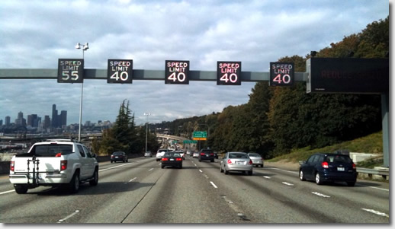
What do we want to test??
Future Projects
  ITS/System management applications
  Signal timing
  Transit improvements/projects
Notes:
Network Management Policies
ICM
Dynamic Lane Use Control - Adding, Modifying or Extending restrictions (ToD, Transit only, HOV2, HOV3+, turns, etc.)
Dynamic Managed Lanes
Traffic Management Plans
Dynamic Toll Pricing
Adaptive Ramp Metering
Adaptive Traffic Signal Control
Variable speed limits
Short/long term construction closures
VMT fee or Pay as you drive insurance
Transit
Preferential Measures
queue jumping
exclusive phasing
BRT routes
Transit schedule adherence
Other Policies
Vehicle Automation / Cooperative Adaptive Cruise Control

Slide 19
Project Team
DTA Project Team
  Rick Curry, SANDAG rick.curry@sandag.org
  Matthew Juckes, TSS-Transport Simulation Systems, Inc. matthew.juckes@aimsun.com
  Pascal Volet, Parsons Brinckerhoff volet@pbworld.com
  Joel Freedman, RSG joel.freedman@rsginc.com
SANDAG Regional Models Manager
  Clint Daniels, SANDAG clint.daniels@sandag.org
Notes:
Questions?

