Slide 1

An Integrated ABM-DTA Model for the Chicago Metropolitan Region
Improving Level-of-Service measures
Kermit Wies, Craig Heither, CMAP
Peter Vovsha, Jim Hicks, PB
Hani Mahmassani, Ali Zockaie, NU

Slide 2
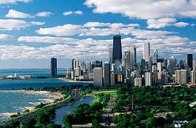
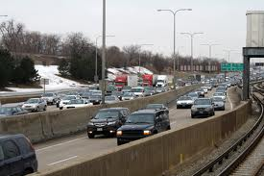
Greetings from Chicago
Applications to the CMAP region
10M pop.
4,000 sq.mi.
500 transit lines
30M trips daily
CMAP modeled region:

Slide 3
Our Planning Application Problem
In a congested region:
  Planned tours are complex
  Travel times are unreliable
Resulting in:
  Shorter activity durations
  Stress to planned activities
  Travelers may adjust “on-the-fly” by:
    Changing route
    Changing schedule
    Changing planned activities
Ignoring the sequence and consistency of these
results in overestimated demand

Slide 4
Mechanical Challenges
Updating network Level-of-Service “on-the-fly”
Making individuals react to updated LOS
  When to reroute
  When to reschedule an activity
  When to revise the daily activity pattern
How to retain individual Learning
Intuitively maintain sequence and consistency of tours

Slide 5
Conventional LOS treatment
Borrowed from established trip-based feedback technique
Notes:
In early C10 projects, the feedback was structured as a set of aggregate LOS skims instead of individual LOS experiences. However, this was very quickly recognized as a dead end.

Slide 6
What’s wrong with Convention?
Too Little Information: One average value represents a sequence of actual costs
Not intuitive. Individuals learn and adapt incrementally
Too Much Information: Full matrix of information is not needed
Segmentation by class/vehicle/time period becomes infeasible
Notes:
LOS skims are crude averages and surrogates.
This is also a good example where computers punish us for applying straightforward models. OD skim matrices is not a good object to store and manipulate LOS data.

Slide 7
Travel “Stress”
Behavioral meaning:
  Travel time: Experienced > Expected
  Revise planned route, schedule, activity
Measured by:
  Total daily travel time
  Travel overhead (travel time / activity time)
Notes:
To make this concept operational, we introduce a measure of travel stress that is calculated for each person and subsequently HH.
An individual with travel choices consistent with travel times and travel times being stable can be re-run with all choices regenerated but this daily pattern will not be any better than the previous one. For example, destination choices in a rural area where travel times are close to free flow time can be fixed from the first global iteration on.

Slide 8
How do we “Learn”
Level I: Personal en route knowledge
“my routes”
(i.e. individual’s current trajectory)
Level II: Shared en route knowledge
“my friends’ routes”
(i.e. overlapping current trajectories)
Level III: Generic public knowledge
“traffic reports”
(i.e. matrix skims)
Notes:
In summary, to support the LOS variables for the outer loop when a full ABM is run we apply a 3-tier approach.

Slide 9
Our Approach
Daily Plan Consistency
En route schedule consistency
Stress
Notes:
We are pursuing a different two-level approach for equilibration. In particular, for the external loop we apply some new methods that eliminate the need for full-matrix LOS skims.
Let me give you some details about both internal and external loops.

Slide 10
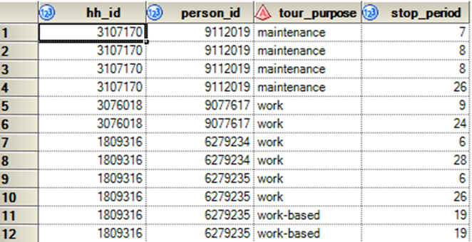
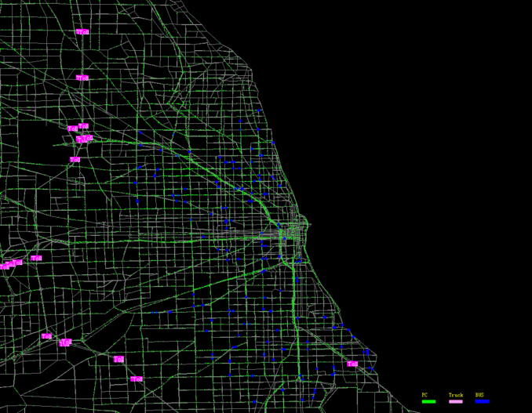
CMAP Ingredients
Activity-Based Model (ABM)
  Highway Pricing
  Transit Modernization
Dynamic Traffic Assignment (DTA)
  Multimodal
  Regional Scale

Slide 11
ABM needs to “talk” to DTA
ABM revised to offer:
  Finer temporal resolution
  Explicit driver and passenger roles
  Consistent destination choice sets

Slide 12

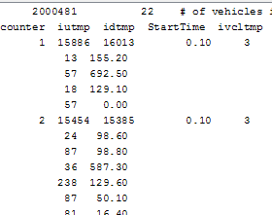
Enhanced temporal resolution
Before
After
Stop periods are in 30 minute blocks
Stop periods are in 6 minute increments

Slide 13
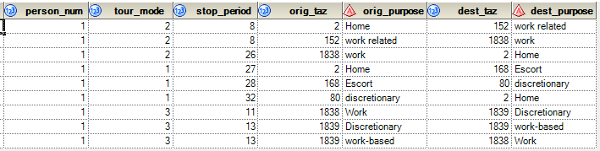
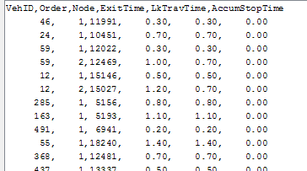
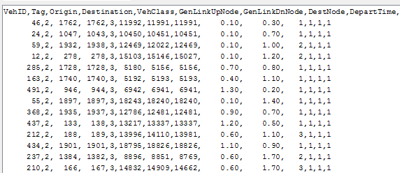





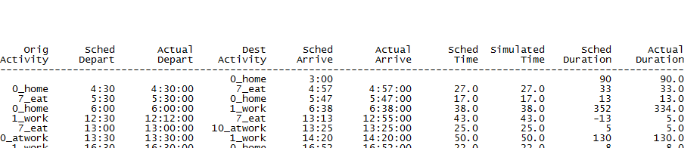
Individual schedule consistency
Before
After
Tour description:
Static Skims:
Multi-hour assignment periods
Continuous vehicle loading
Notes:
Between 5 and 8 p.m. (180 minutes) this person makes 4 stops covering about 50 miles through the most congested part of Chicago. Static skims show about 130 minutes of travel time. So about 75% of the time is spent driving. The intervening stops are escort and discretionary. If there is an incident that increases the first leg to 90 minutes, the escort and discretionary legs need to be adjusted.

Slide 14
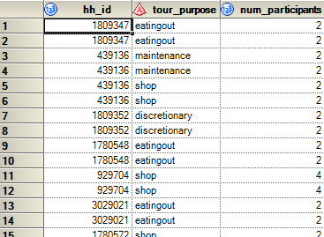
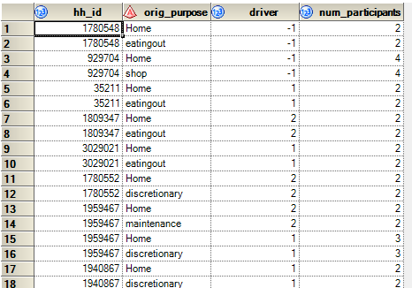
Explicit driver and passenger roles in carpools
Before
After
Only the number of persons in the vehicle is known
Driver is identified

Slide 15
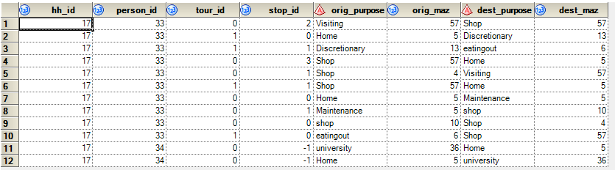
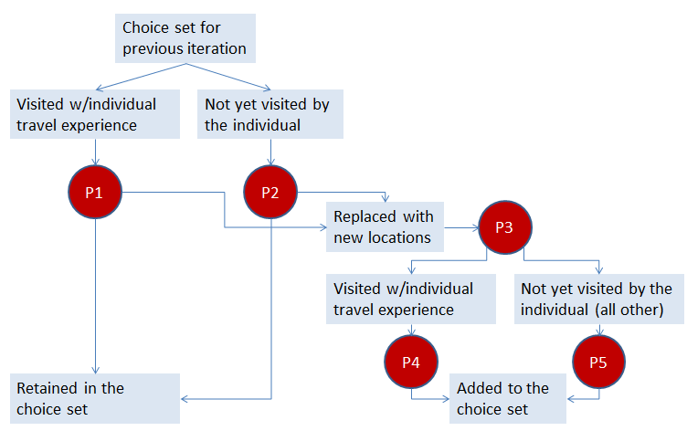
Updated destination choice sets
Before
After
All destination choices are reconsidered between global iterations
Encountered destination choices are remembered between global iterations

Slide 16
DTA needs to “talk” to ABM
  Individual Value-of-Time (VOT)
  Individual trajectories
  Multimodal Tour Processor

Slide 17
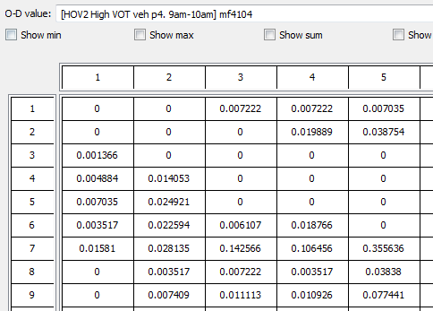
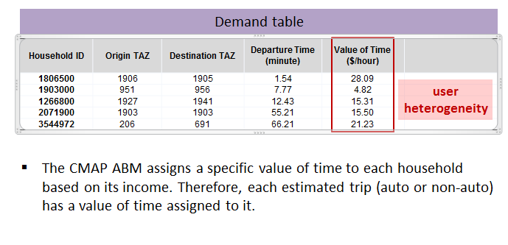
Individual Value-of-Time (VOT)
Before
After
Uniform VOT given at triptable level
Individual VOT “rides along” with each trip

Slide 18
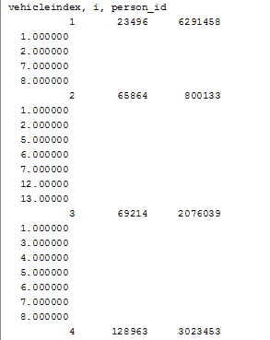
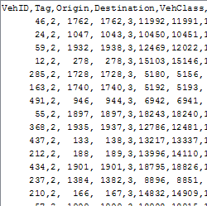
Individual trajectories
Before
After
Only vehicles are identified
Vehicles and occupants are identified

Slide 19
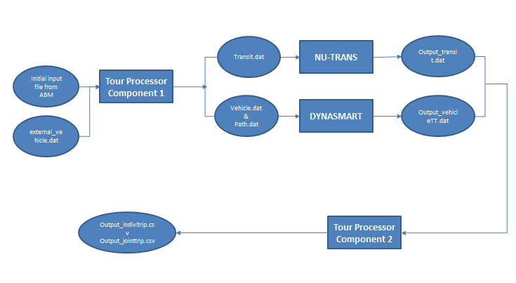
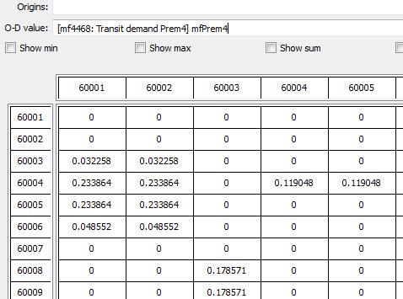
Multimodal Tour Processor
Before
After
Discrete triptables loaded “as is”
Individual trip lists “reorganized” by mode

Slide 20
In Summary
Travelers may adjust “on-the-fly” by:
  altering their route
  altering their planned schedule
  altering their planned activities
DTA Permits on-the-fly schedule adjustments
ABM Re-Plans “stressed” households
TPAC, May 17-20, 2015
Notes:
Some brief conclusions.

Slide 21

Thank You!
Kermit Wies
kwies@cmap.illinois.gov

