Slide 1
Traffic Forecasts to Support Detour Route Planning During Highway Reconstruction
TRB Applications Conference – May 17, 2015

Slide 2
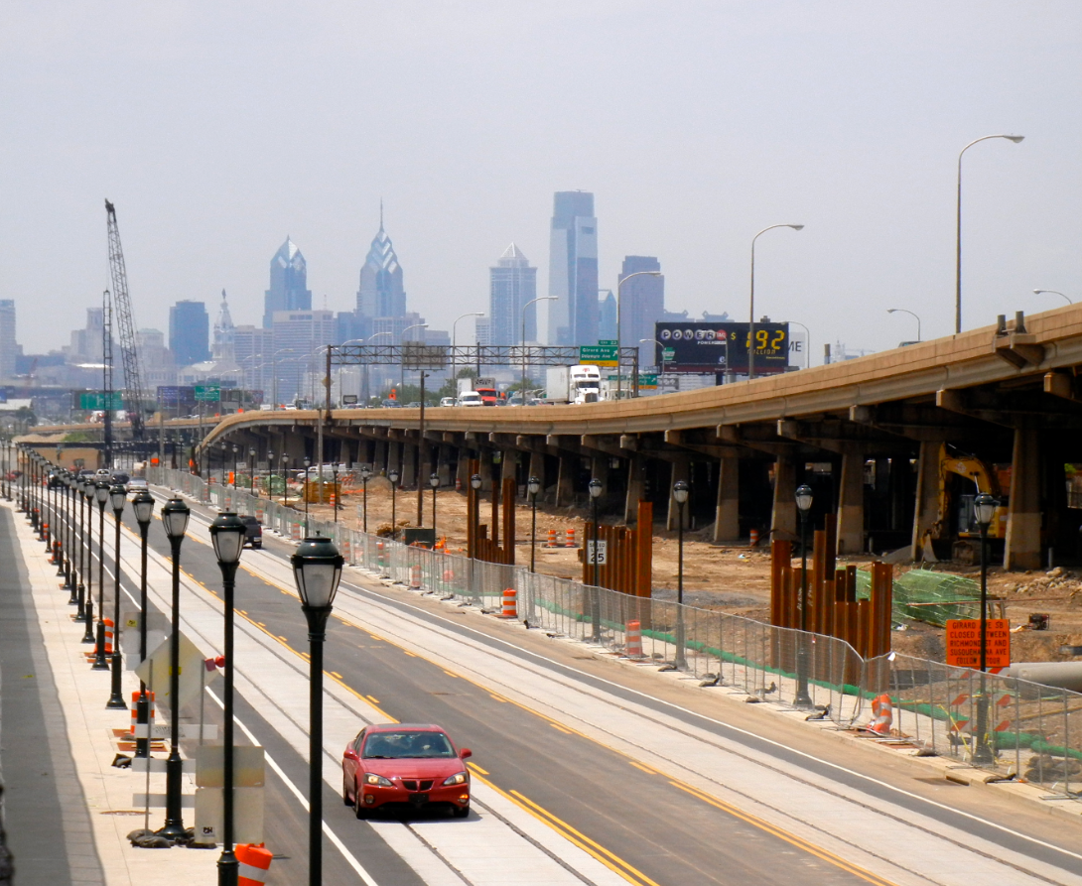
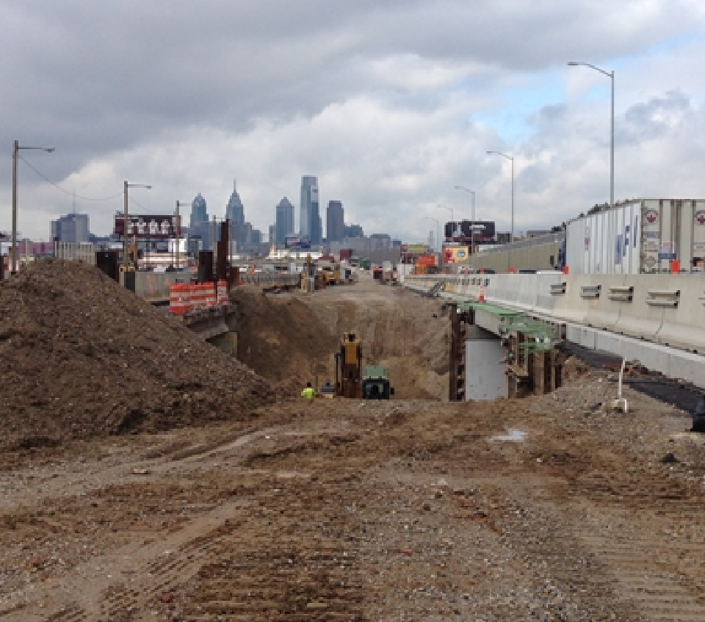
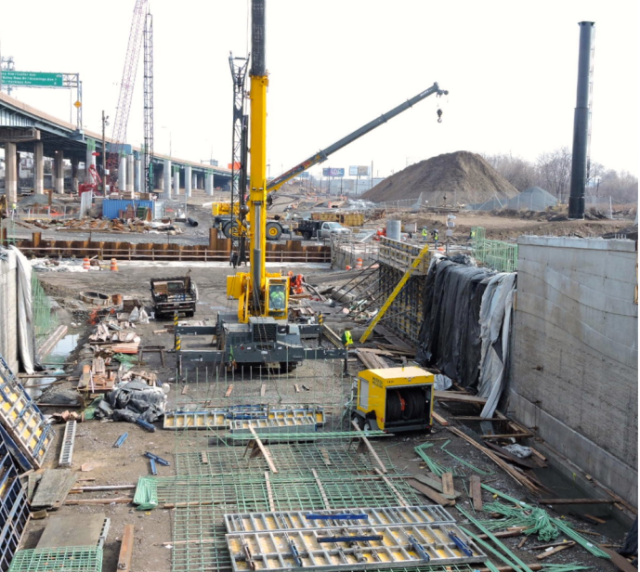
I-95 Reconstruction, Philadelphia, PA

Slide 3
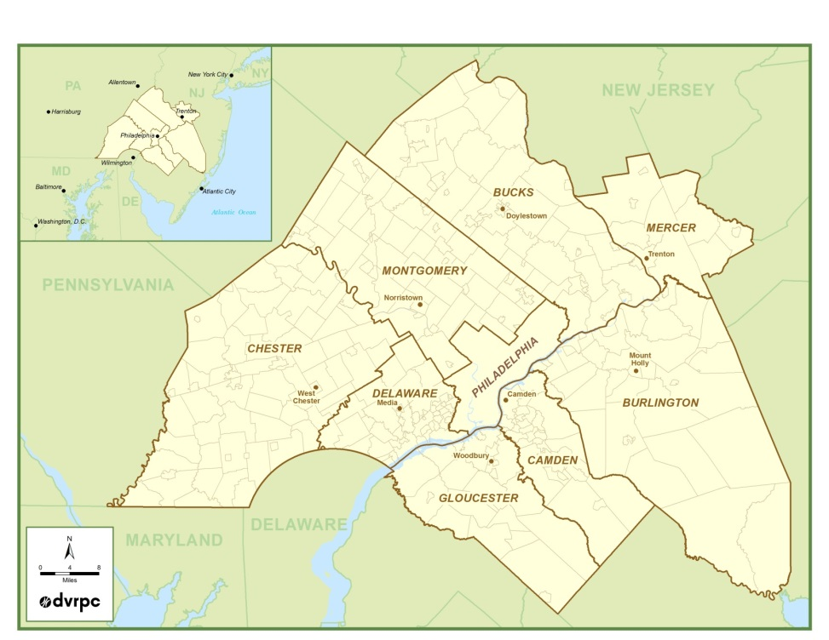
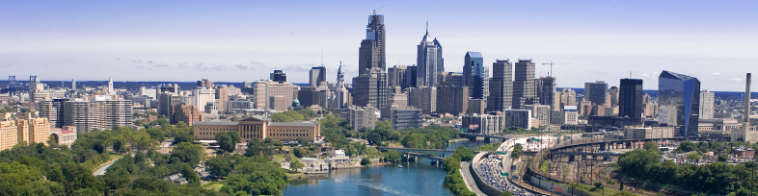

Delaware Valley Regional Planning Commission
Metropolitan Planning Organization (MPO) for the greater Philadelphia region

Slide 4
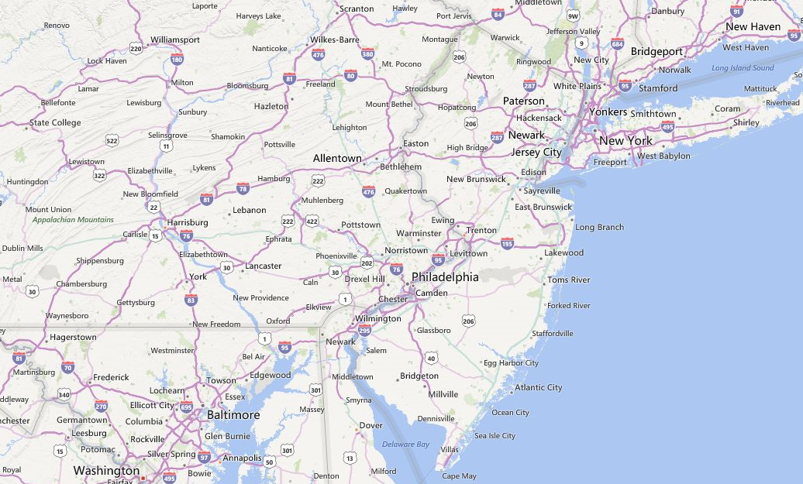
Location

Slide 5
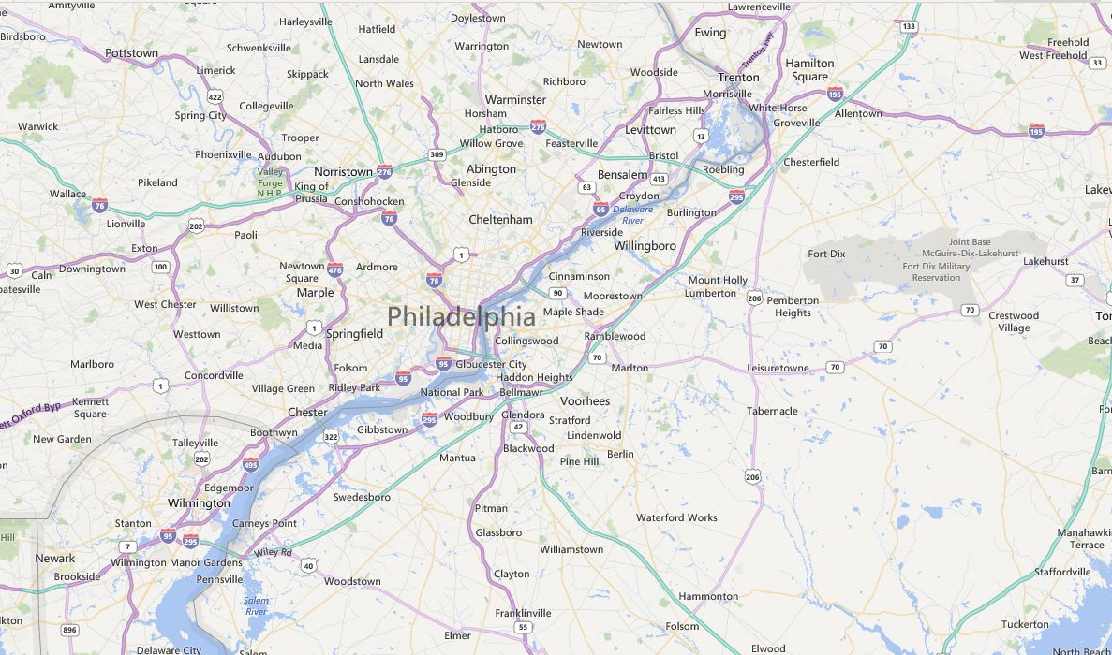
Location

Slide 6
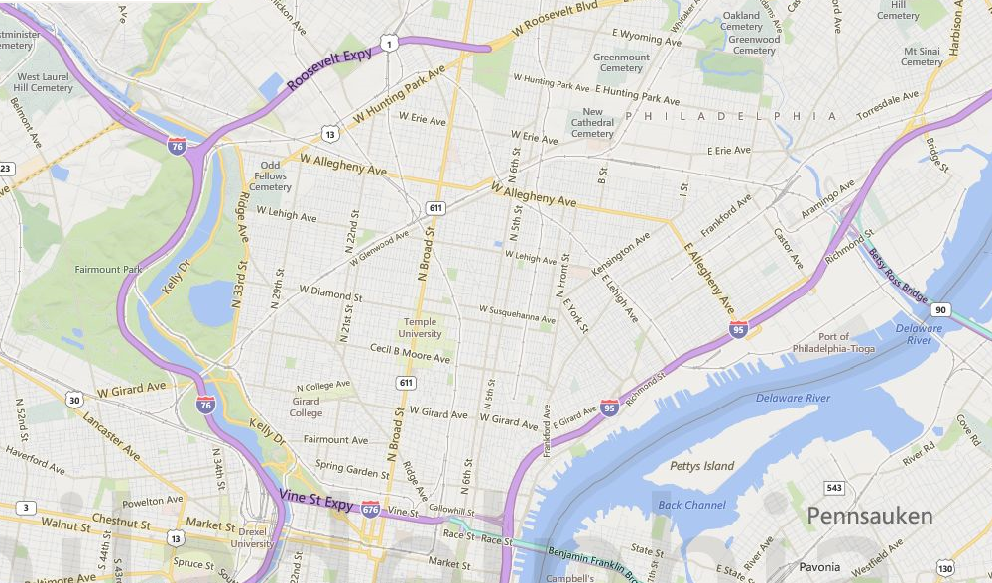
Location

Slide 7
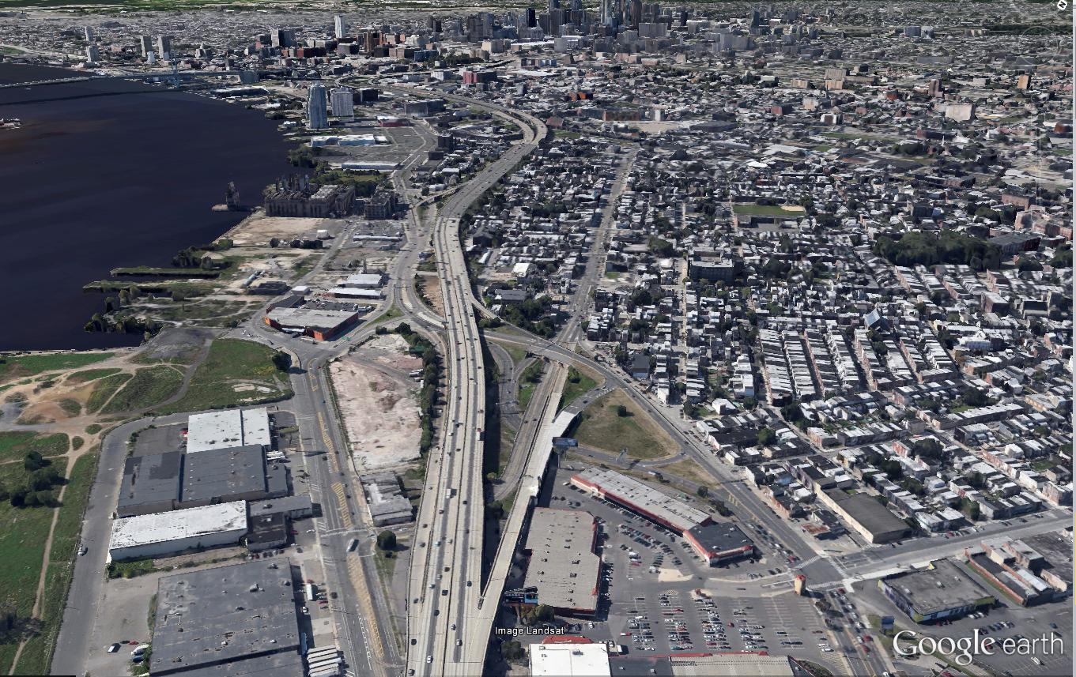
Interstate 95 Corridor

Slide 8
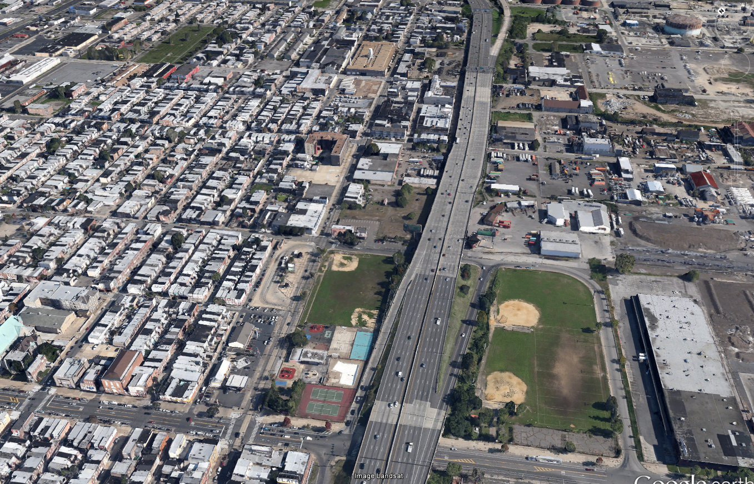
Interstate 95 Corridor

Slide 9
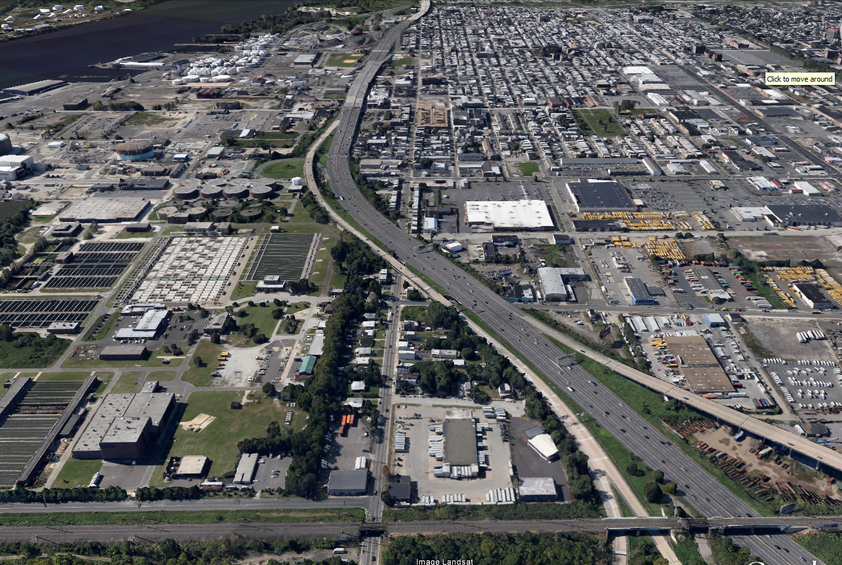
Interstate 95 Corridor

Slide 10
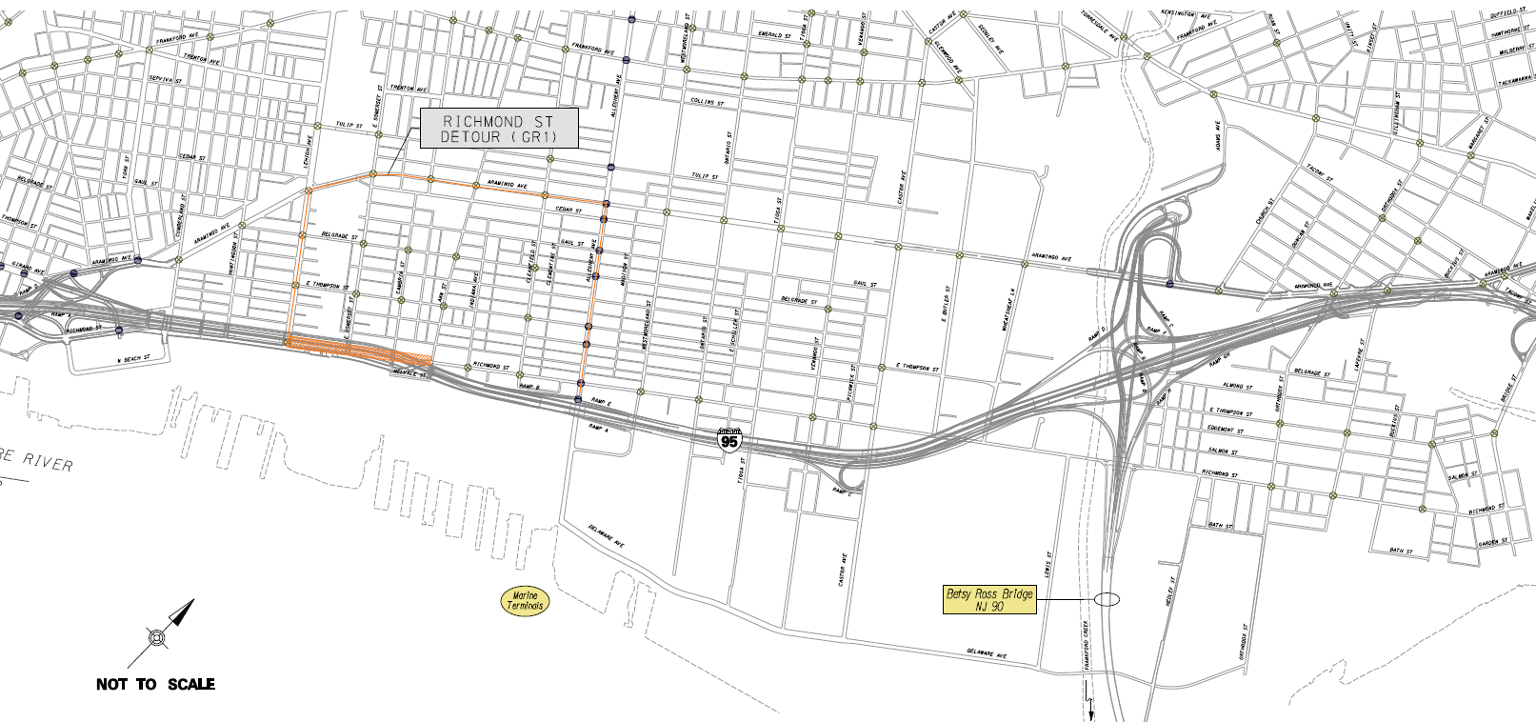
2014 Detours

Slide 11
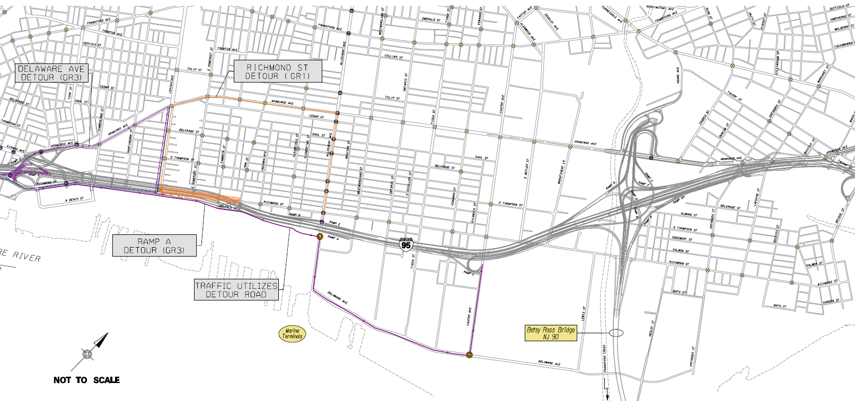
2015 Detours

Slide 12
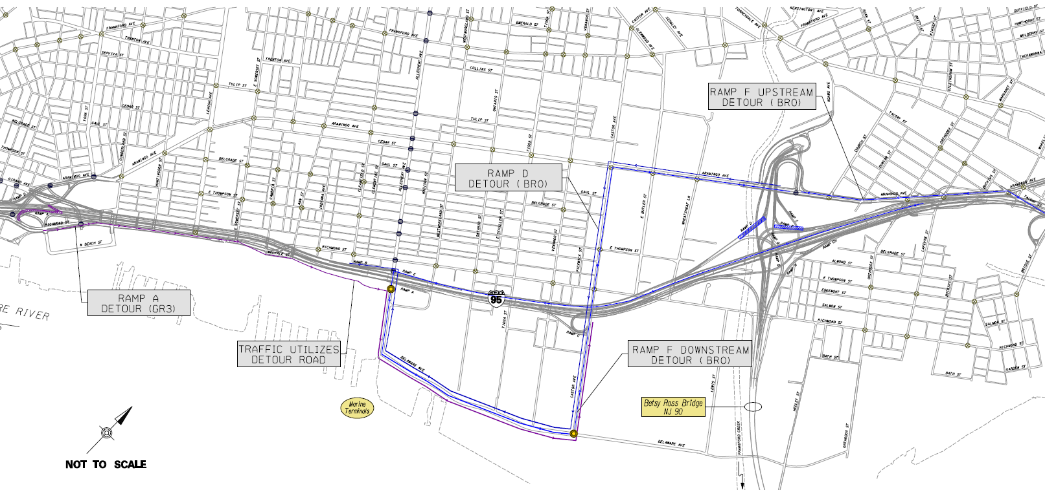
2016 Detours

Slide 13
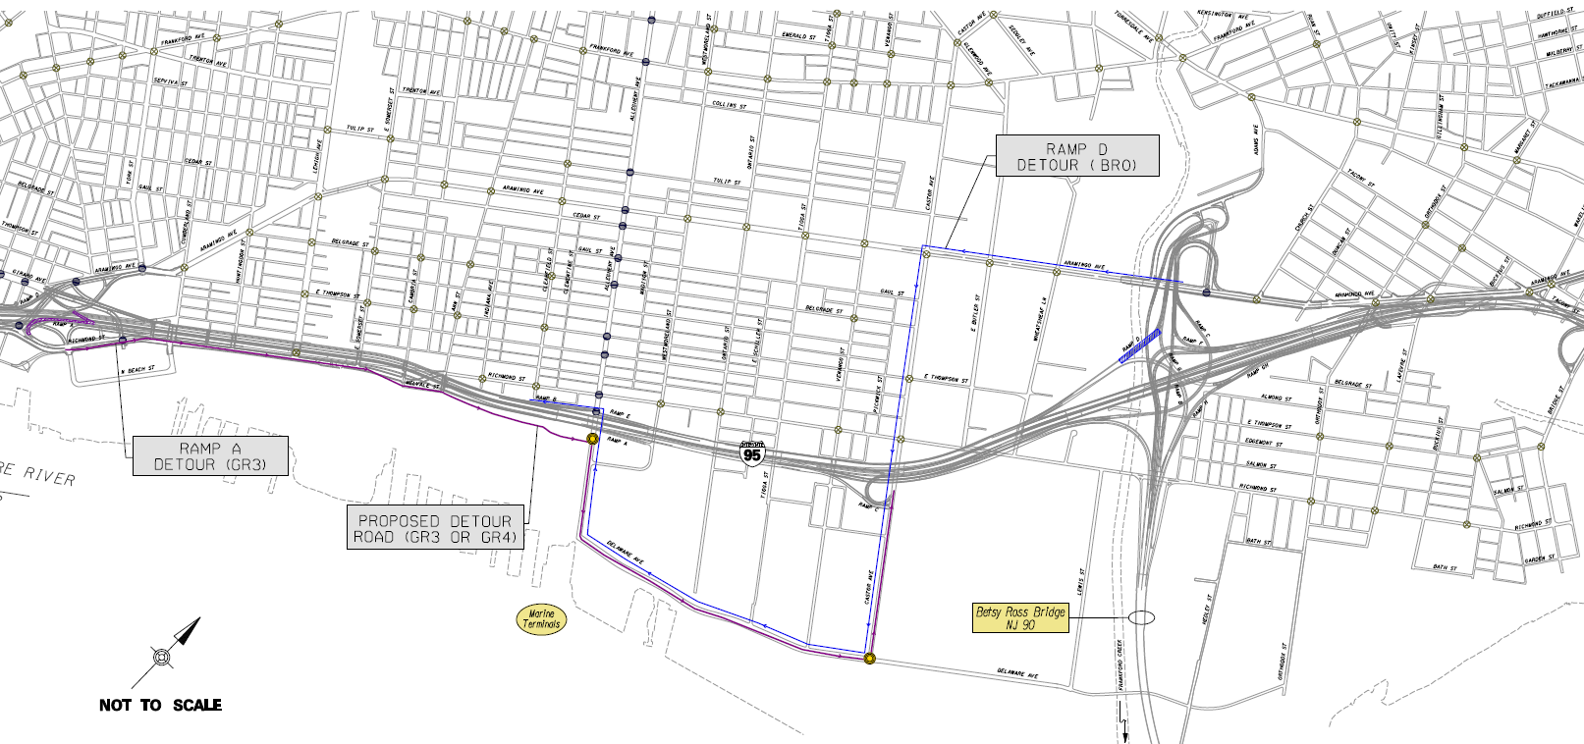
2017 Detours

Slide 14
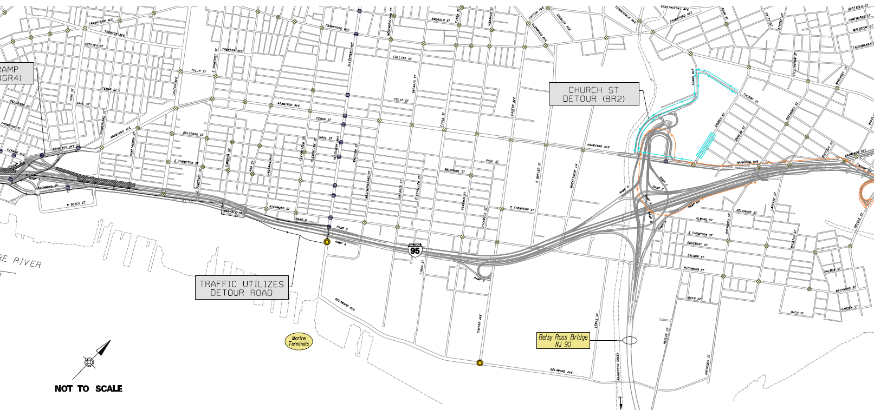
2018 Detours

Slide 15
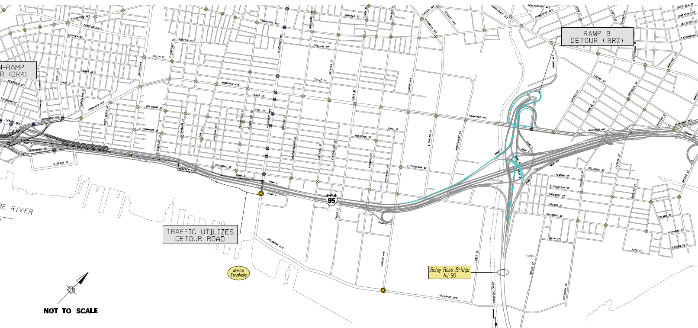
2019 Detours

Slide 16
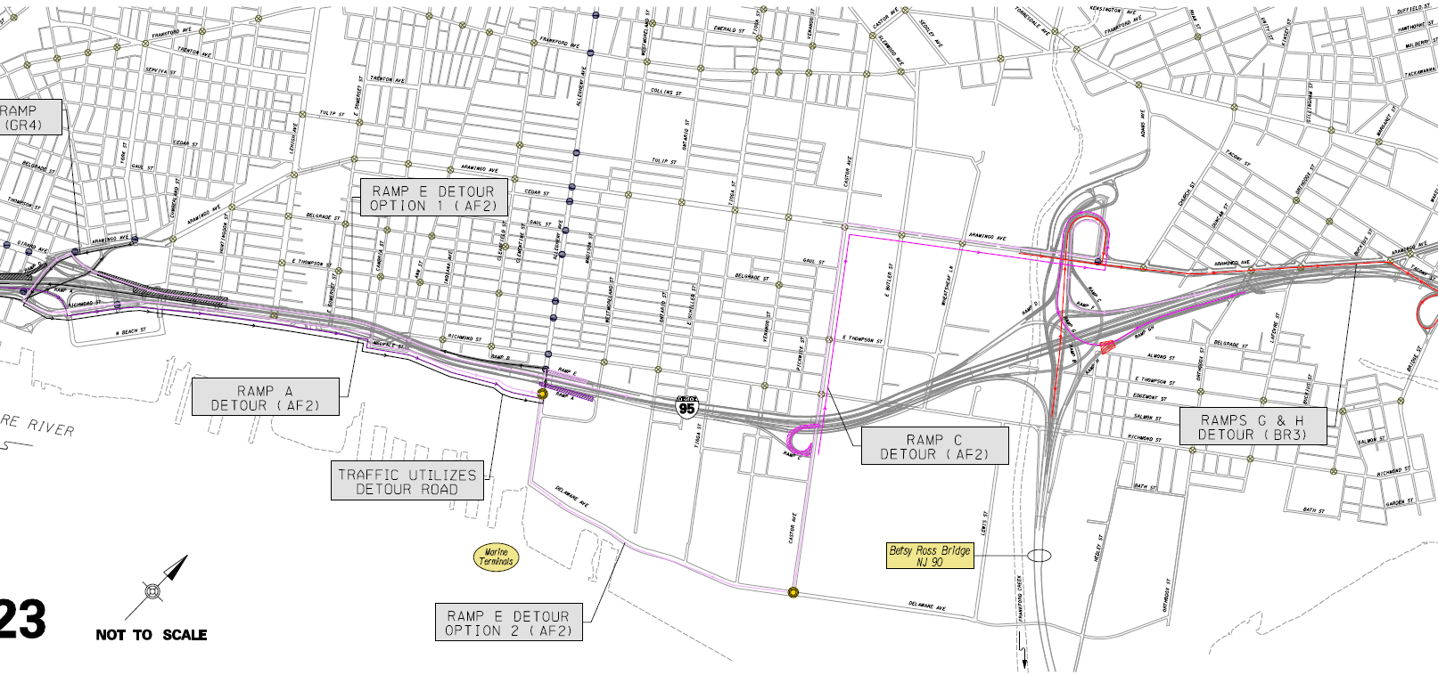
2020 Detours

Slide 17
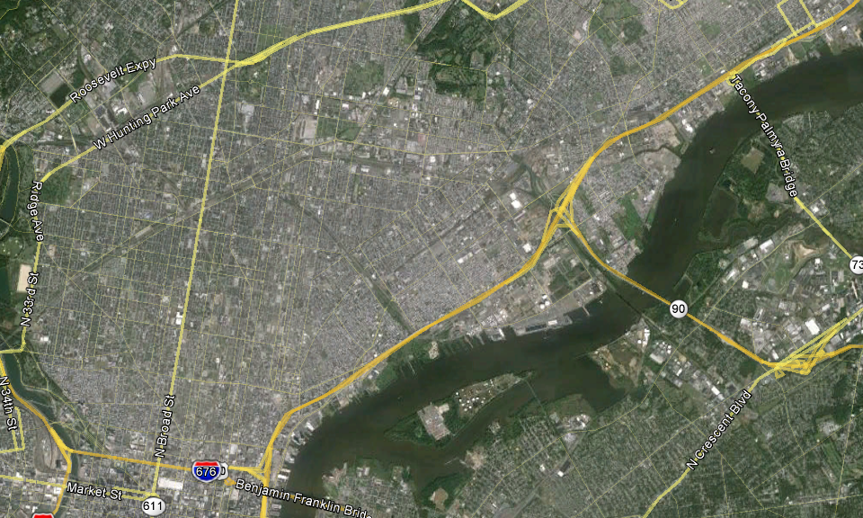
Study Area

Slide 18
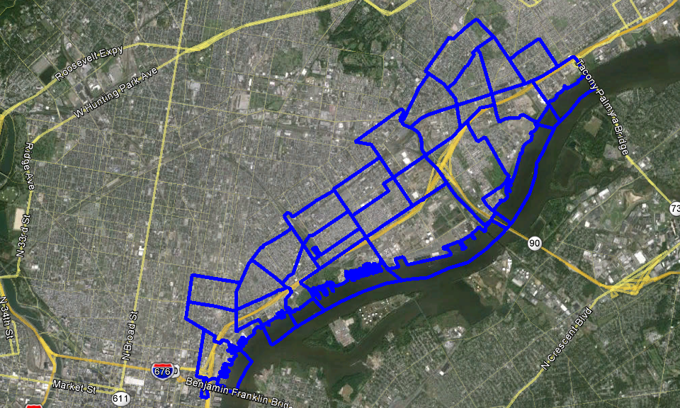
Study Area - TAZs

Slide 19
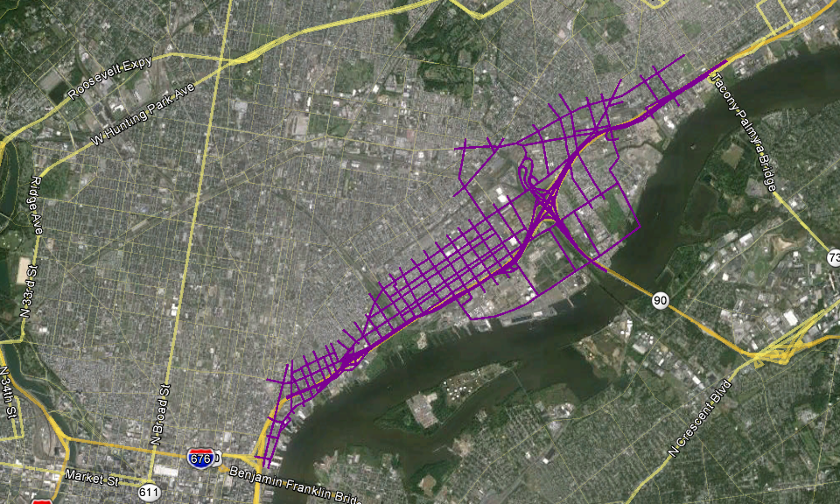
Study Area - Highway Links

Slide 20
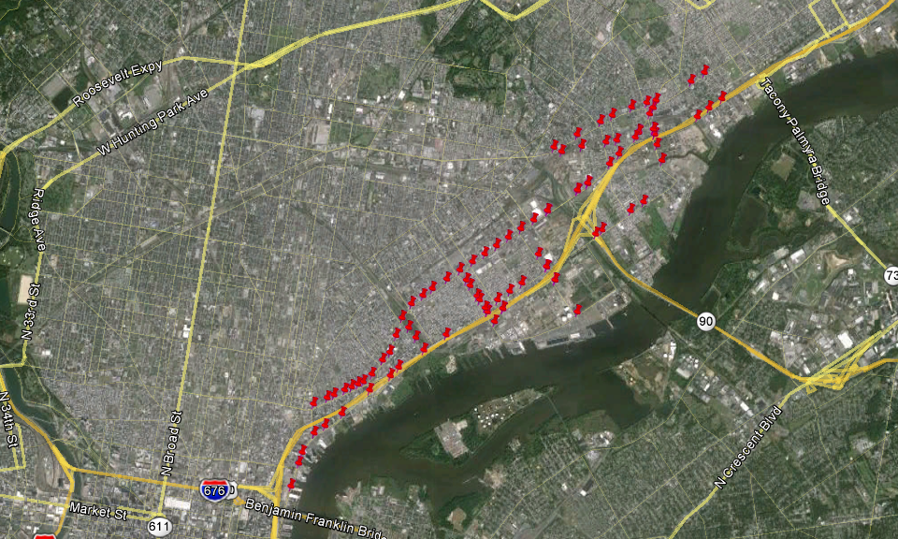
Signalized Intersections

Slide 21
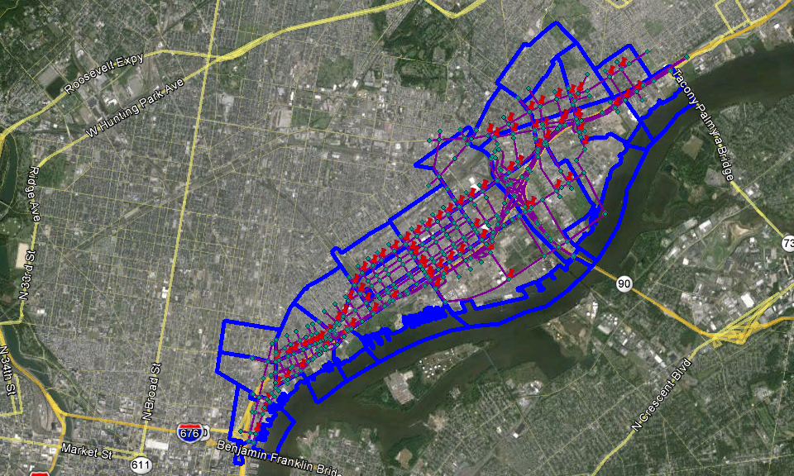
Study Area

Slide 22
Forecasting Options
Microsimulation
  Staffing issues and other commitments
Dynamic Traffic Assignment
  Lack of in-house DTA model and limited experience
  Consultant delivery issues
4-Step Travel Demand Model
  Adapt existing model for non-traditional purpose

Slide 23
Regional Model
Calibrate Regional Travel Demand Model
  Volumes on I-95, interchange ramps, parallel and intersecting roads
    Time-of-Day
    Direction
  I-95 Travel Times
    Time-of-Day
    Direction
  Origins and Destinations
    Interchange to Interchange
  Transit ridership
    Subway
    Regional Rail
    Buses

Slide 24
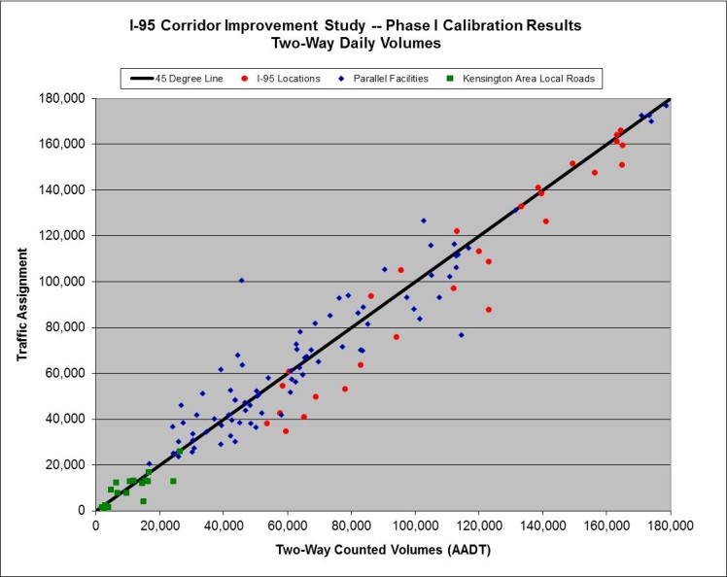
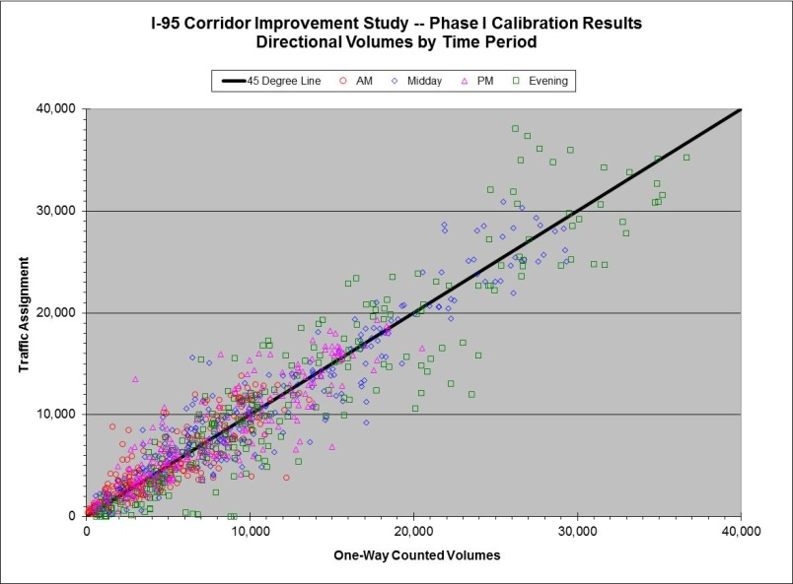
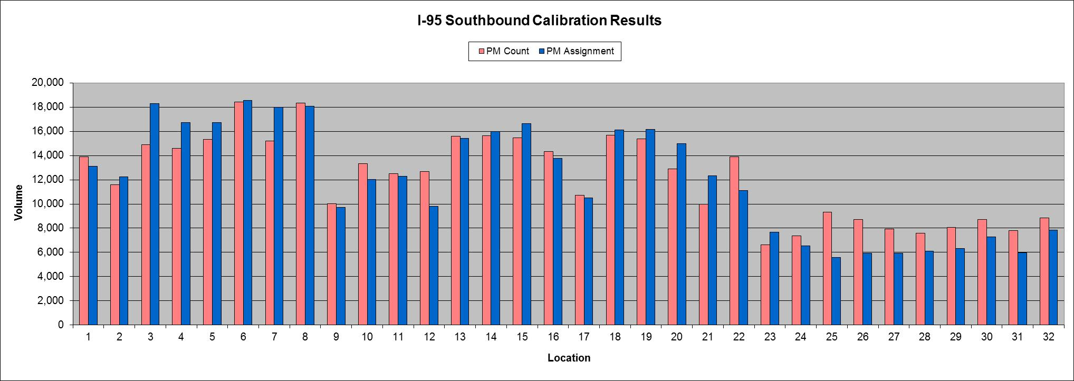
Calibration Results

Slide 25
Sub-Network Model
Extract Sub-Network and trip tables for AM and PM peak periods
Factor peak period demand to peak hour demand
Insert hourly link capacities
Calibrate Sub-Network model

Slide 26
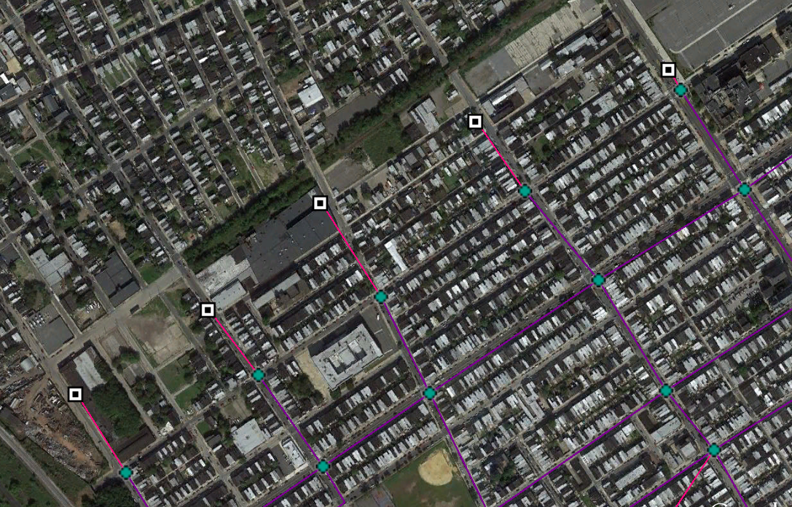
Sub-Network Cordon Locations

Slide 27
Sub-Network ODME
Cordons
Traffic Analysis Zones
Iterate
Highway Links
Turning Movements
Final Assignment

Slide 28
Sub-Network Calibration
Balance base-year volumes
Use turn capacities and/or turn penalties
Adjust link free-flow speeds
Iterate

Slide 29
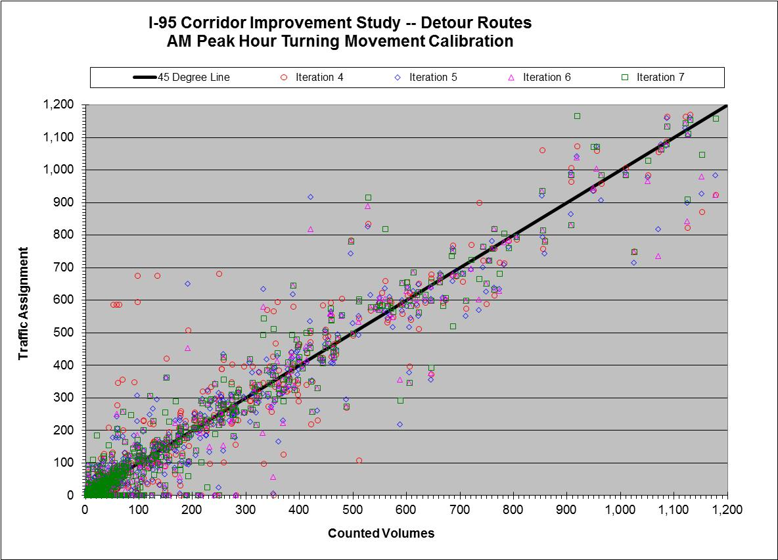
Turning Movement Calibration Results

Slide 30
Detour Route Forecasts
Apply growth factor to base year trip table to represent future year
Remove links that will be closed to traffic; reduce freeway lanes if needed
Code designated detour route
  Increase free flow speed by 2.0 mph
Re-assign trip table to new network
Apply change in individual turning movement volumes to base year traffic count
Re-balance volumes between intersections, as needed
QA/QC

Slide 31
Questions?
Matthew Gates
Manager, Office of Modeling and Analysis
Delaware Valley Regional Planning Commission
mgates@dvrpc.org
(215) 238-2911

