Slide 1
Climate Change Modeling
How Reducing Greenhouse Gas Emissions is Shaping Great Communities in Oregon
15th TRB National Transportation Planning Applications Conference
Air Quality and Climate Change
Cloud City - Air Quality and Climate Change
Wednesday, May 20, 2015 3:30 PM - 5:00 PM
Thaya Patton
Portland Metro
Transportation Researcher and Modeler

Slide 2






Oregon Project Partners
Kim Ellis, Portland Metro
Josh Roll, Lane Council of Governments
Ali Bonakdar, Corvallis Area MPO
Tara Weidner, Oregon DOT
Bob Cortright, Oregon DLCD
Andrea Hamberg, Eric Main and Nicole Iroz-Elardo, Oregon Health Authority

Slide 3
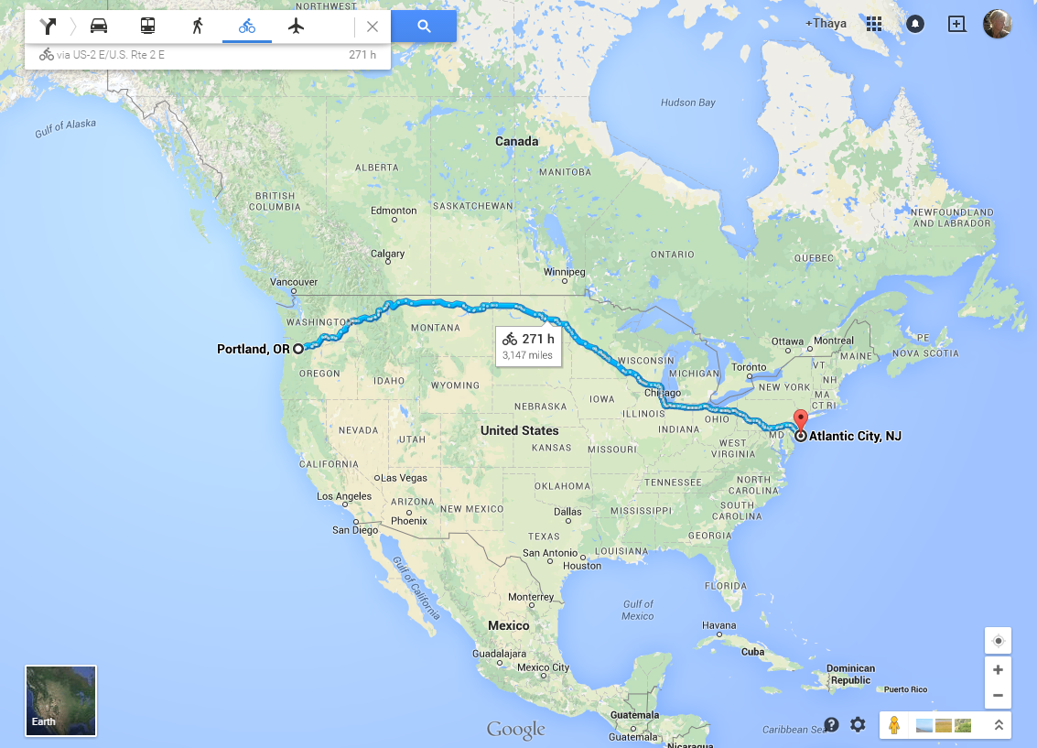
Notes:
Oregon is a state on the west coast
Cycling is very popular

Slide 4
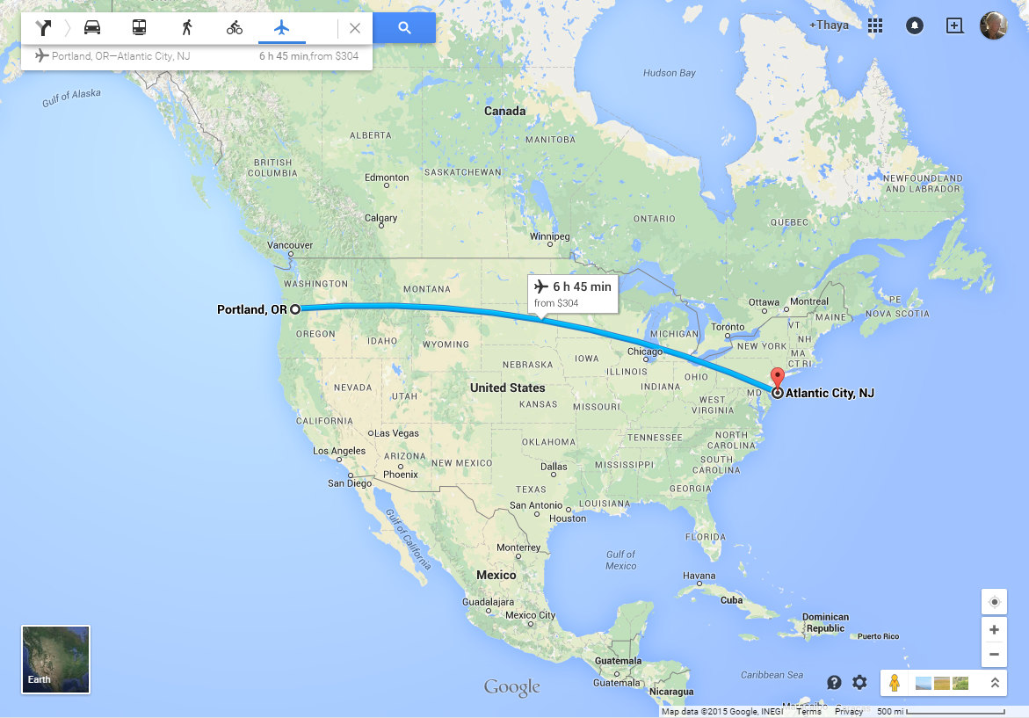
Notes:
I didn’t ride my bike here, I flew, but I did figure out that cycling would have produced only 1/15th of the GHG of flying.

Slide 5
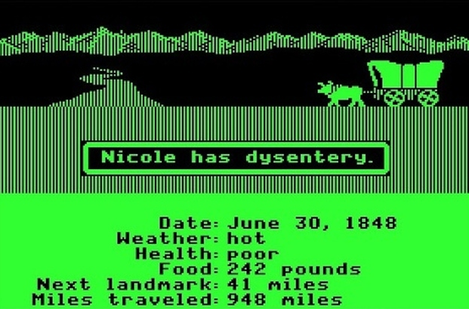
Notes:
If I had biked it still would have been easier than some of the older transportation modes.

Slide 6
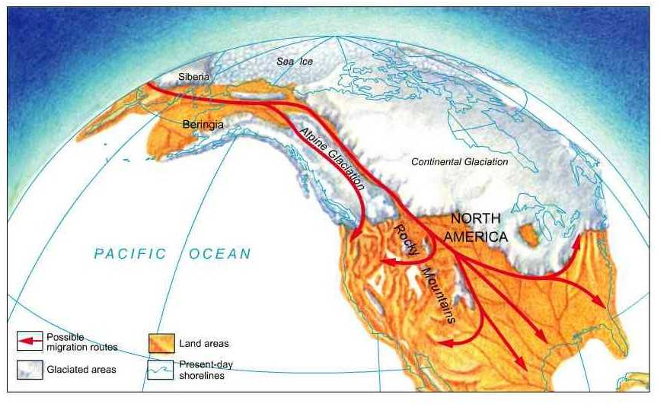
Notes:
Or very old modes…
Barring changes we would expect from the end of the last ice age, it’s come to our attention that we have another issue we need to address

Slide 7
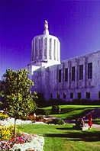
State policy direction to reduce greenhouse gas emissions
  Legislature adopts House Bill 3543
(Global Warming Actions)
Legislature adopts House Bill 2001
(Jobs and Transportation Act)
  LCDC adopts greenhouse gas
reduction targets for our region
(OAR 660-044)
  LCDC adopts Dec. 31, 2014 deadline for adopting Climate Smart Strategy
(OAR 660-044)
Notes:
2007 action defined the goal as 75% below 1990 levels by 2050
2009 bill provided funding for planning efforts and refined the scope to light duty vehicles with a 2035 horizon year
2011 Specific targets were developed
2012 Deadline was set for Portland Metro

Slide 8
Land Conservation and Development Commission (LCDC)
Members appointed by the Governor
Adopts state land-use goals and implement rules
Assures local plan compliance with the goals
Coordinate state and local planning

Slide 9
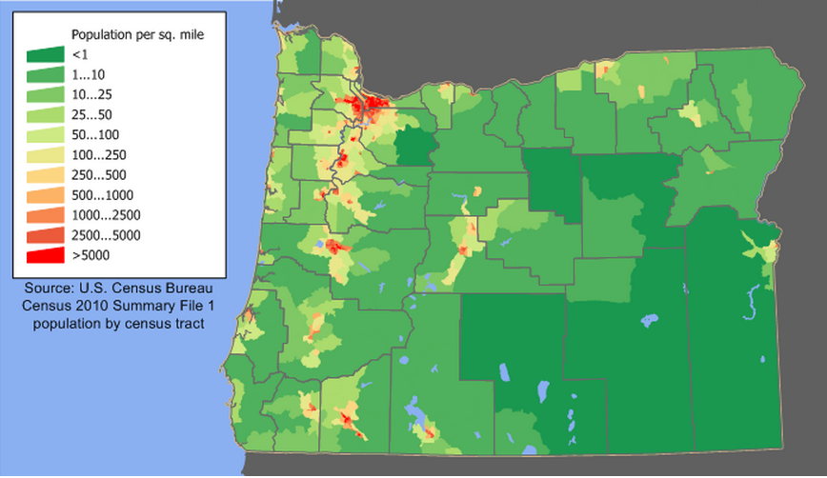
Nearly half the population of Oregon resides in the Portland metro area
Notes:
Nearly half the population of Oregon resides in the Portland Metro Area
Roughly 80% of the state’s population is along the I-5 corridor

Slide 10
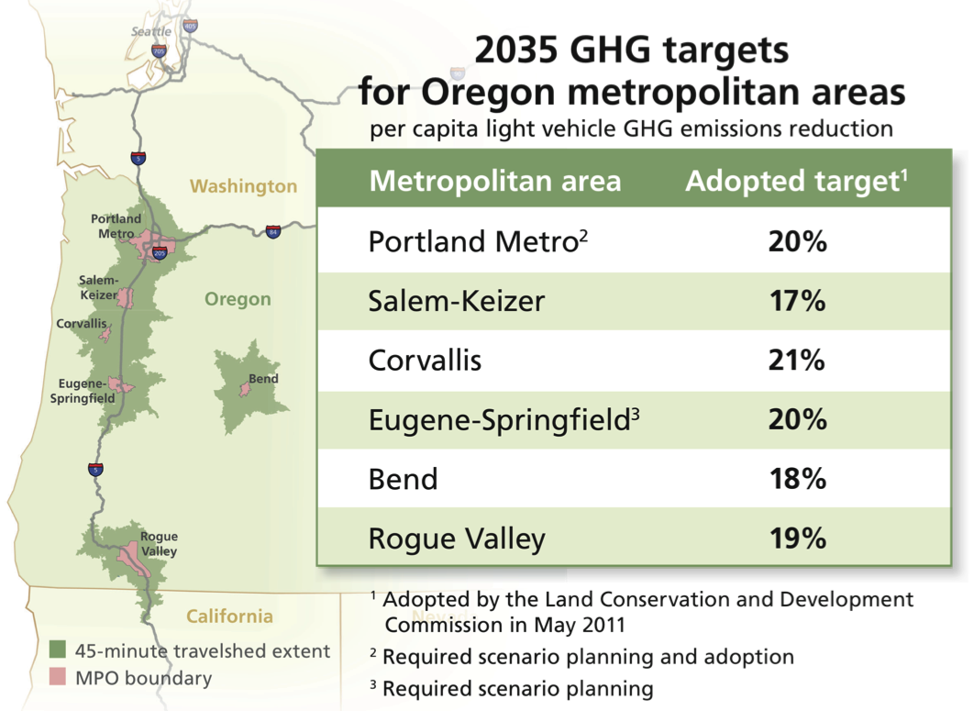
Notes:
Explain the target
-Tailpipe emission
-Target is a reduction beyond expected fleet and tech advances
-Portland planning/adoption
-LCOG planning
-Corvaillis voluntary planning
-Statewide effort to assist in framing/tool development but was also required

Slide 11
GreenSTEP and
Metropolitan GreenSTEP
GreenSTEP = Greenhouse gas Strategic Transportation Energy Planning Model
  Requested by Oregon Global Warming Commission
  Development Started in 2008
  2 Versions – Statewide and Metropolitan
GreenSTEP -> Rebranded as Regional Strategic Planning Model (RPMS)
Adapted by FHWA as EERPAT
Adapted by SHRP C16 as SmartGAP
Notes:
2007 decision led to OGWC
GreenSTEP Statewide -> Metropolitan GreenSTEP
GreenSTEP rebrand as RPSM Regional Strategic Planning Model
Adapted by FHWA (EERPAT model)
Adapted by SHRP2 C16 (SmartGAP tool)

Slide 12

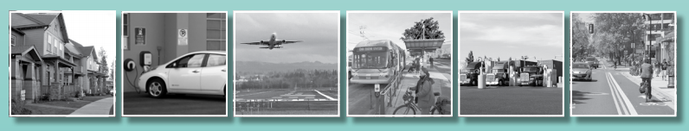
Notes:
-Statewide came first to assist in framing, build support, and refine tools
-Laid the groundwork for local planning efforts
-Was required by HB 2001, includes all modes of transportation –freight –aviation
-Finally provided a vision for subsequent planning efforts

Slide 13

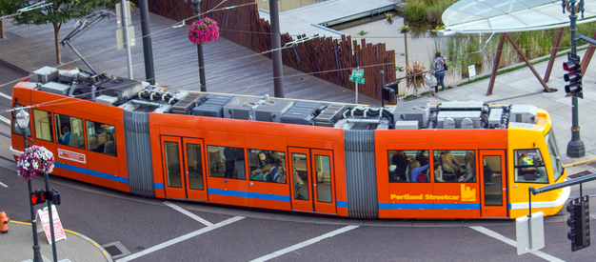

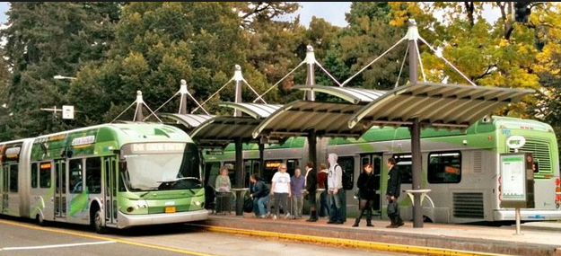

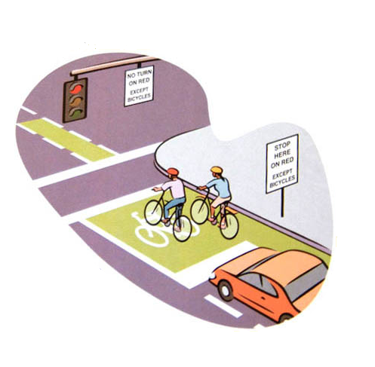
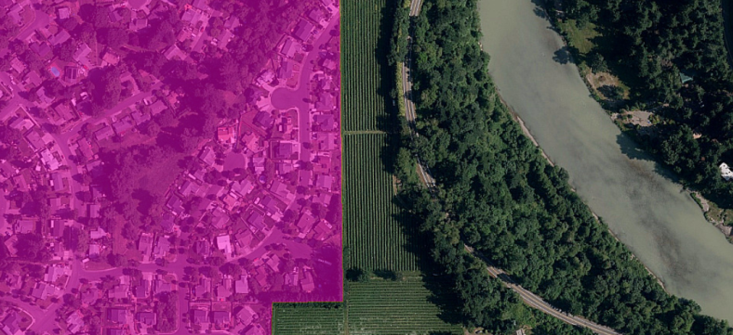

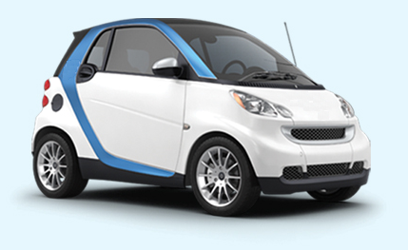

Notes:
Let’s talk about the tools we have for GHG reduction
-VMT tax, gas tax, pay as you drive insurance, carbon tax, parking costs
-Marketing and incentives, TDM programs
-Incident management, and limiting lane miles added

Slide 14
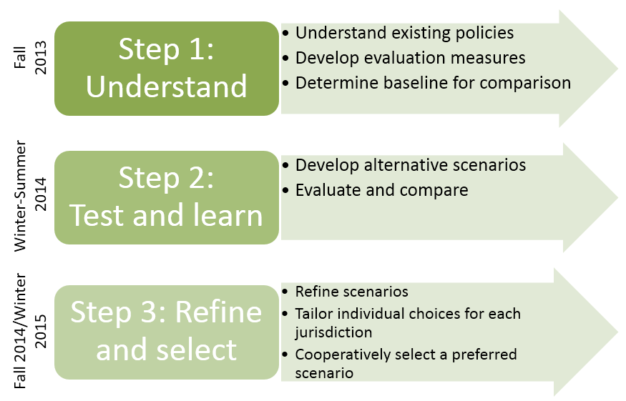
LCOG Process
Notes:
Eugene Spingfield MPO has just recently arrived at a preferred scenario
Their process has been similar to that of other MPOs in the state
Use slide
LCOG is currently working on a report to the legislature letting them know we can meet the target but will need more funding to do so

Slide 15
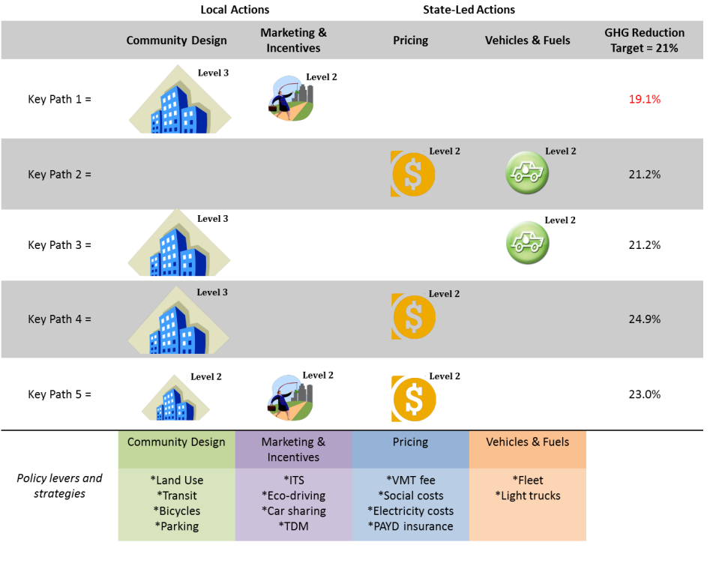
CAMPO Strategies
Notes:
Corvallis area MPO engaged in a voluntary planning effort to help frame future policies
Their existing policies alone only resulted in a 2% reduction, while combined with SWS they got as far as 18.5%
They conducted further testing to determine paths that would meet their target for GHG reduction
1 Adopted Plans
2 More Ambitious
3 Most Ambitious

Slide 16
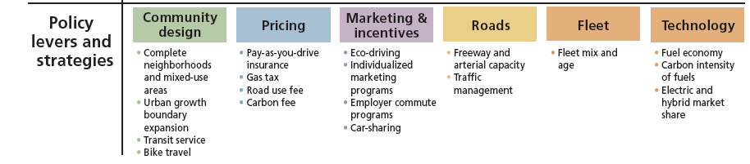
Portland Metro Process
Notes:
Our level one is akin to a No Build Scenario, resting on our laurels
Level is comparable to our Planning Vision
Level 3 was more ambitious than previous planning efforts
Every combination leaves you with 144 scenarios
Subsequent sensitivity testing

Slide 17
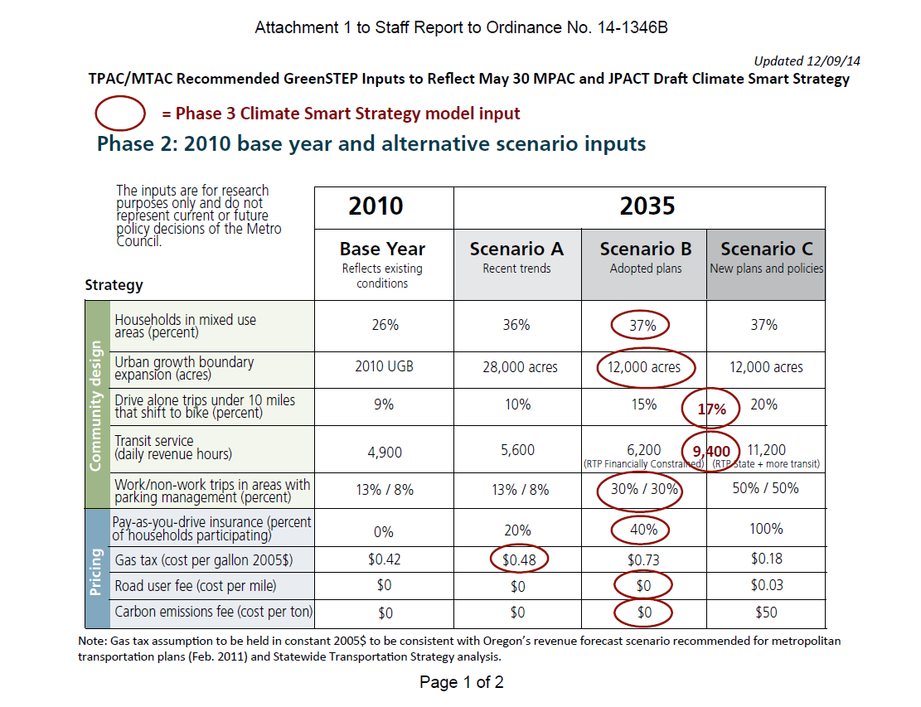
Metro Strategy Inputs
Notes:
After some refinement 3 strategic scenarios were developed to inform the preferred scenario
3 Levels -> red shows where we arrived at the preferred

Slide 18
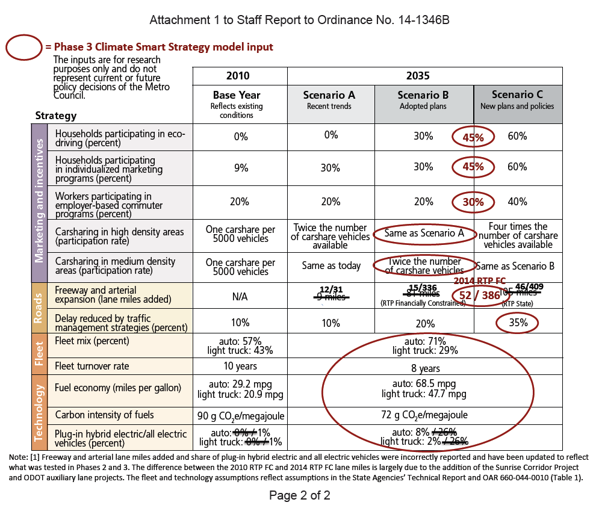
Metro Strategy Inputs

Slide 19
Climate Smart Strategy – Portland Metro
Past leadership and adopted plans exceed the target and support other goals
Source: GreenSTEP
Notes:
Results!
Preferred is a bit more ambitious than existing planning
Policy makers decided transit investment, system management should be a priority

Slide 20
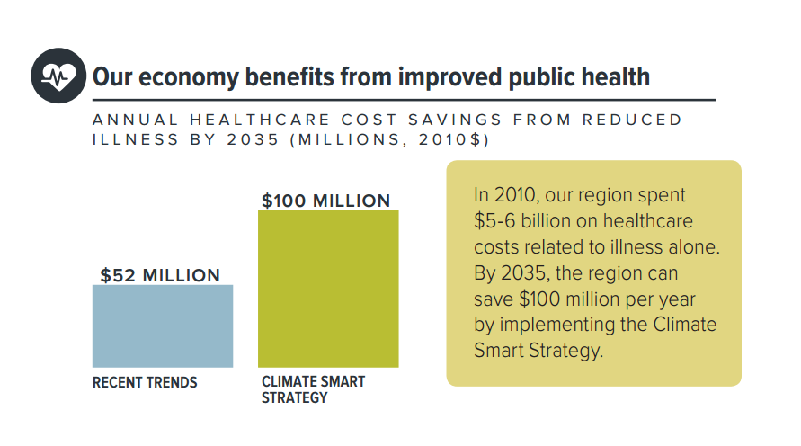
Climate Smart Strategy – Portland Metro
The return on investment is significant
Source: GreenSTEP and ITHIM
Notes:
OHA did an extensive HIA for this project
The inputs for some of their analysis came from GreenSTEP and ITHIM models, primary drivers physical activity/reduced pollution
Findings beyond GHG reduction included – Use slide

Slide 21
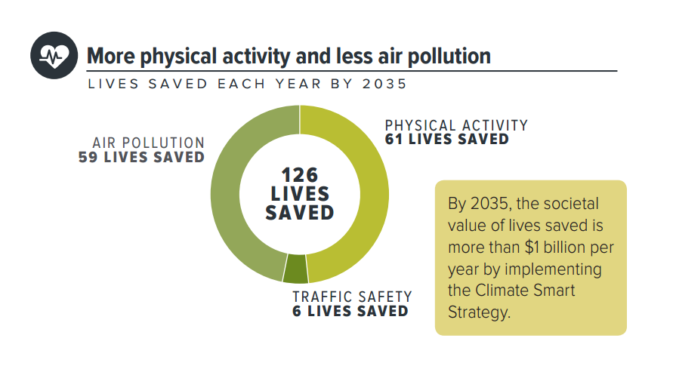
Climate Smart Strategy – Portland Metro
Source: GreenSTEP and ITHIM
Notes:
OHA did an extensive HIA for this project
The inputs for some of their analysis came from GreenSTEP and ITHIM models, primary drivers physical activity/reduced pollution
Findings beyond GHG reduction included – Use slide

Slide 22
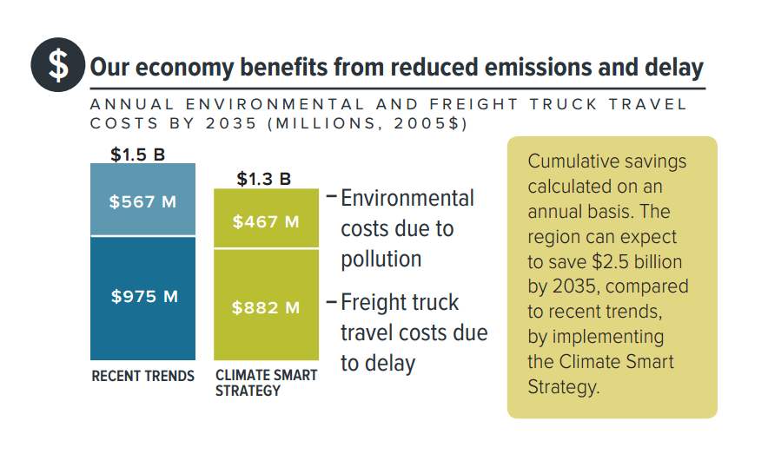
Climate Smart Strategy – Portland Metro
Source: GreenSTEP and ITHIM
Notes:
OHA did an extensive HIA for this project
The inputs for some of their analysis came from GreenSTEP and ITHIM models, primary drivers physical activity/reduced pollution
Findings beyond GHG reduction included – Use slide

Slide 23
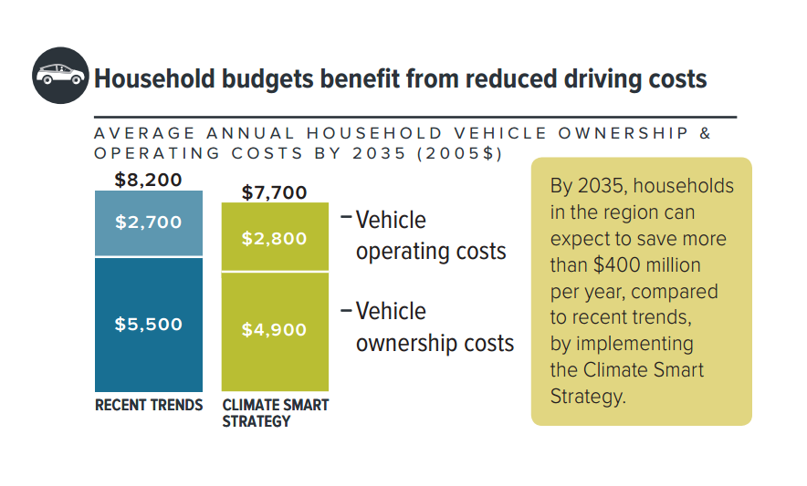
Climate Smart Strategy – Portland Metro
Source: GreenSTEP and ITHIM
Notes:
OHA did an extensive HIA for this project
The inputs for some of their analysis came from GreenSTEP and ITHIM models, primary drivers physical activity/reduced pollution
Findings beyond GHG reduction included – Use slide

Slide 24
Next steps
Tomorrow LCDC considers approval
Development of New Transportation and Health Model
Further refinements to GreenSTEP tool (RPSM)
Develop Regional Transit Plan
Incorporate Climate Smart Strategy into the next Regional Transportation Plan

Slide 25
More Information
Oregon Strategic Assessments and Scenario Planning
http://www.oregon.gov/ODOT/TD/OSTI/Pages/scenario_planning.aspx
Portland Metro MPO Climate Smart Strategy
www.oregonmetro.gov/climatestrategy
Central Lane MPO Scenario Planning
http://www.clscenarioplanning.org
Corvallis Area MPO Scenario Planning - Greenhouse Gas Emissions Reduction Project
http://www.corvallisareampo.org/Page.asp?NavID=64
Oregon Health Authority - Climate Smart Communities Scenarios HIA
https://public.health.oregon.gov/HealthyEnvironments/TrackingAssessment/HealthImpactAssessment/Pages/CSCHIA.aspx

Slide 26
Questions?

