Slide 1
15th TRB National Transportation Planning Applications Conference
The Evolution of Transit Ridership Forecasting Capabilities in Response to Changing Client Needs, Computing Capabilities and Data Availability
Steven E. Polzin, PhD. & Xuehao Chu, PhD.
Center for urban Transportation Research
University of South Florida
Rodney Bunner,
ServiceEdge Solutions, LLC.
Gabrielle Matthews,
Florida Department of Transportation
Tuesday, May 19, 2015

Slide 2




Once upon a time, over a decade ago …
/planners wanted a software tool for short-term transit service planning – designed specifically for transit.
  Aspire to be FAST, ACCURATE, and INEXPENSIVE
  Be uniquely sensitive to transit “not a retrofitted highway model”
Serve as FDOT provided ridership estimation technique for State mandated Transit Development Plans (TDPs)
And Transit Boardings Estimation and Simulation Tool (TBEST) was born in early 2000’s.
TBEST

Slide 3
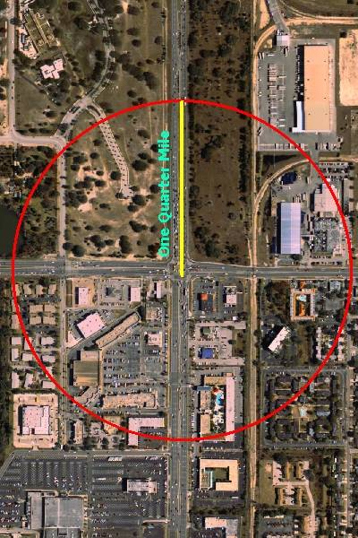
We Understand that a Quarter Mile is a Big Deal in Transit
Geographic precision at a scale more refined than traditional traffic analysis zones was critical and enabled by better data quality and greater computing capacity.
2001 NHTS Analysis
Notes:
This data reveals how dramatically mode share can change as a function of the distance from the bus stop to where the household is located. This suggests that very immediate proximity to transit produces substantially higher mode shares than is the case for individuals living a quarter mile or more away from transit service.

Slide 4
TBEST GIS Specifications
Desktop application requiring ArcGIS 10.1 Basic license
Utilizes ArcGIS Engine for map display, spatial analysis and network editing
SQL Server 2008 R2 (Express or Enterprise editions)
No Network Analyst or ArcSDE required
Utilizes ESRI Map Services, Bing Maps or preformatted .mxd for base map
No fee for TBEST except ArcGIS license

Slide 5
Utilization
Transit Planning and Management Software
Strategic Planning (TDP)
Service Planning
Comprehensive Operational Analysis
Grant Applications
FTA Title VI Analysis
Mobility Studies
NTD Route Miles
Market Analysis
Network Accessibility
Operations
Hastus
Trapeze
Others…
Short and mid-term
TBEST
Long Range
Cube Voyager
TransCAD
Others…
Win-Win-Win Situation
FDOT standardized model platform for consistent TDP ridership reporting across agencies
Agencies have a pre-built methodology for estimating ridership + many other applications
Consultants using TBEST for TDP’s have an easy-to-implement ridership estimation solution with available data, tools and modeling capabilities

Slide 6
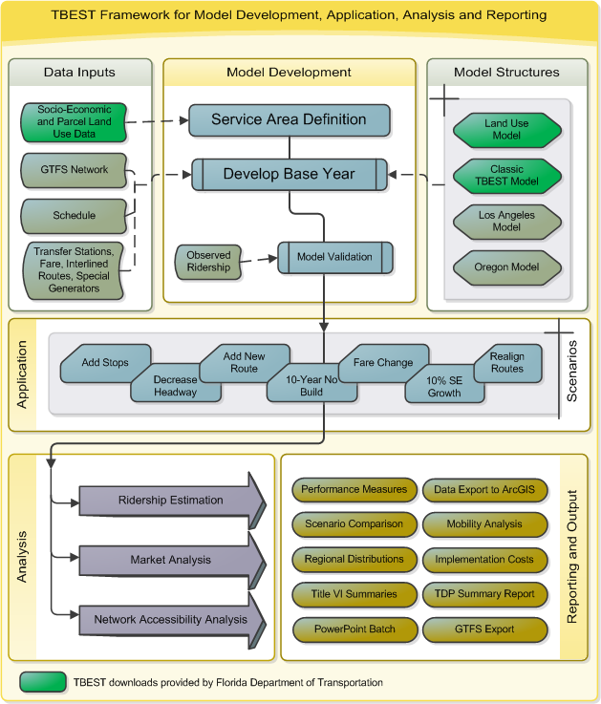

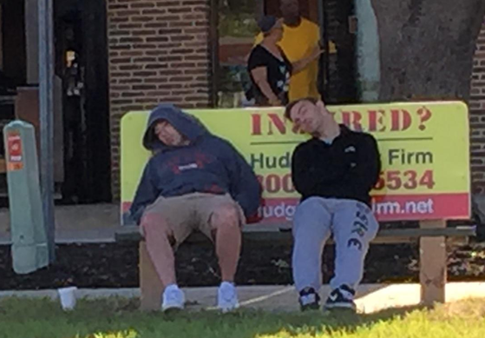
Framework Components
Model Development
Application
Analysis
Reporting and Output

Slide 7
Travel Demand Forecasting in a World of Change
Changing Client Priorities and Interests | Changing Computing Capabilities | Changing Data Availability | Changing Behaviors and Technologies
Ridership and stop level forecasting | Faster | Discontinuation of Census Long Form | BRT
Equity analyses | Cheaper | Emergence of ACS | Flex Routes
Accessibility Analysis | More seamless data interface | GTFS | Real time information and trip planning
TOD/land use analysis | Improved visualization | Parcel data, Trip generation data, NHTS data | Emerging complimentary modes: Bikeshare, Carshare, TNC,
Evolving modes |  | LEHD, CTPP data

Slide 8
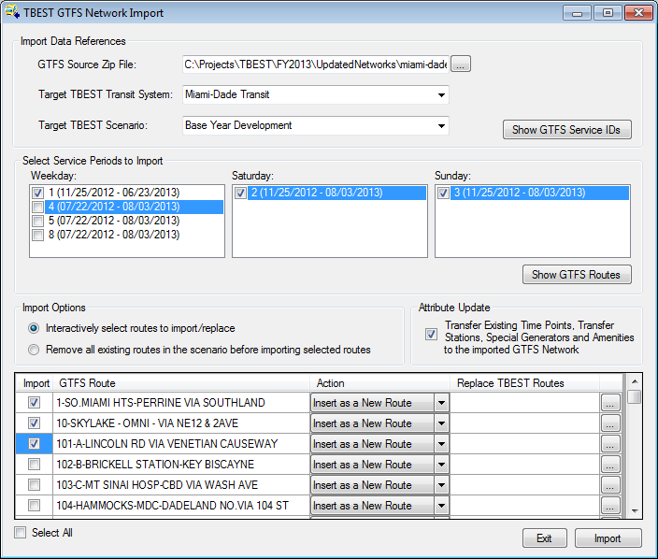
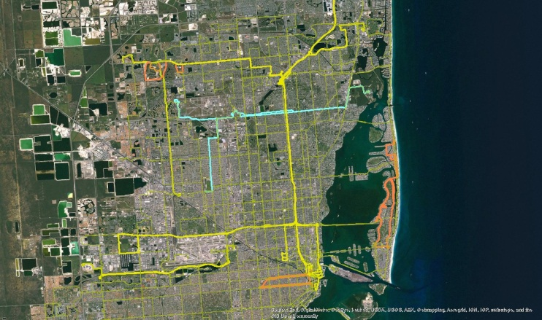
Data Interface
GTFS Import
  Imported networks for all FL agencies with GTFS feeds
  Also used nationally in Ft. Worth, Portland, Los Angeles, Savannah
GTFS Export
  Export TBEST network into GTFS
  Added TBEST attributes to exported data including ridership and stop amenities
ArcGIS
  Export TBEST maps and data into ArcGIS
  Import route alignments into TBEST from outside data sources
  Export “loaded networks” into geodatabases

Slide 9
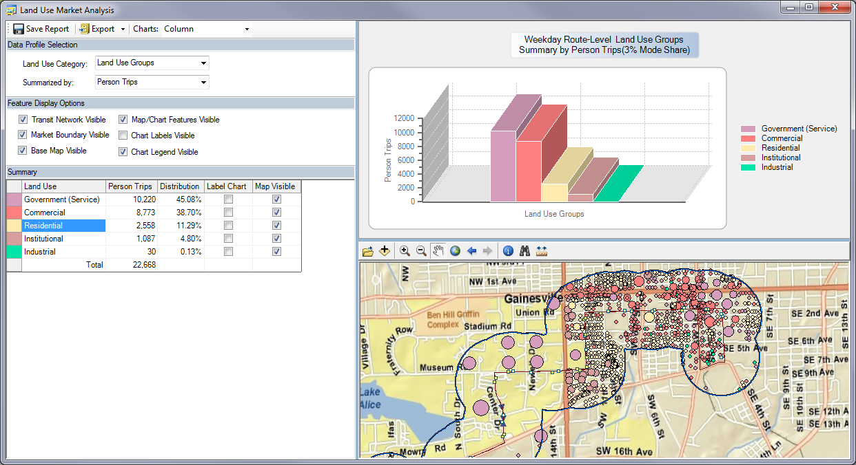
Parcel Data Market Analysis
Land Use Market Analysis

Slide 10
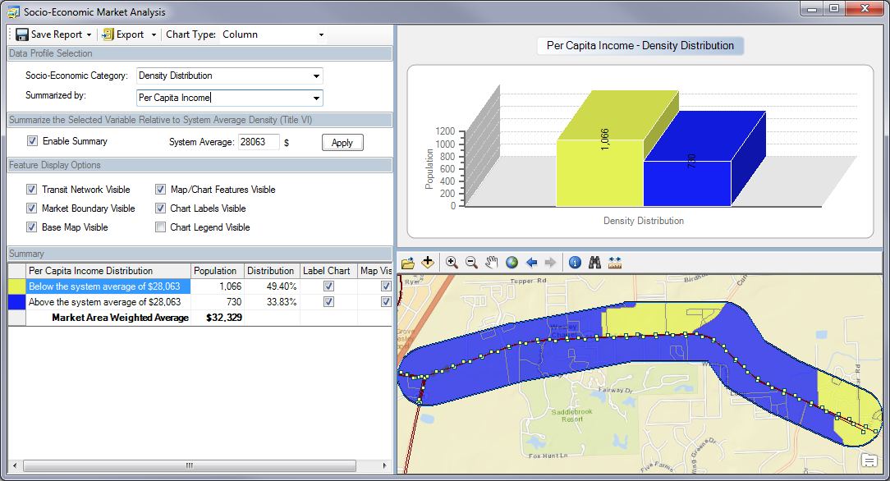
Title VI Analysis

Slide 11
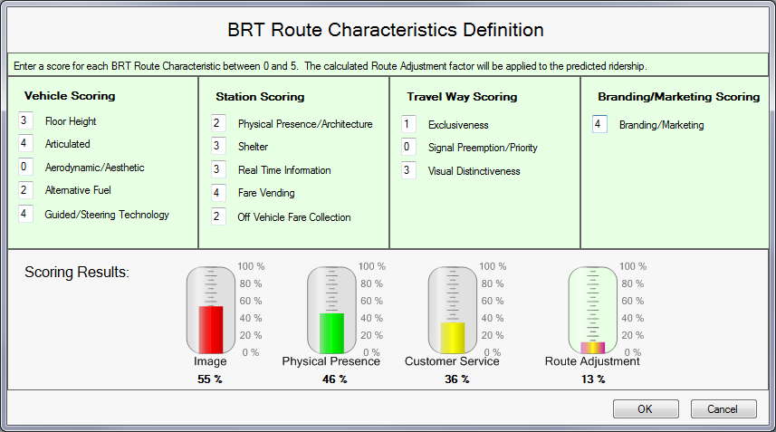
BRT Sensitivity
TBEST supports BRT route definition and model sensitivity
How it works
Users specify the implementation level of specific route-level BRT characteristics and
TBEST will adjust base
ridership forecasts with
an empirically derived
adjustment factor

Slide 12
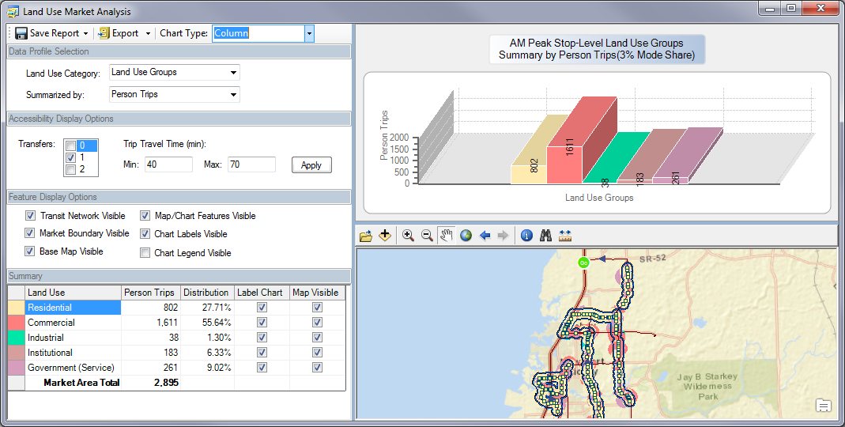
Network Accessibility Analysis
Network Accessible Market Analysis

Slide 13
Transit Accessibility
Access to transit (stop buffer analysis)
Access via transit (leverage parcel data)
Access from Parcel (distribution of land use relative to stop or stops)

Slide 14
Everything Affects Transportation and Transportation Affects Everything
Legal Political Governance Context
Land Use
Demographics
Transportation
Economy
Technology
Environment
Culture and Values

Slide 15
Fundamental Economic and Demographic Changes
Hispanics to reach 23% of the U.S. population by 2035
- Washington Examiner,
May 2015
Student Loans Could Cripple the U.S. Economy…
…student debt reaching almost $1.2 trillion last year, its highest level ever.
- Bloomberg Business,
May 2015
U.S. Birth Rate Hovers at All-Time Low
- Health Day,
May 2015
Millennials make up the largest share of the U.S. workforce…
- Wall Street Journal
May 2015
Women now hold the majority (52%) of management and professional related positions…
- BMO Wealth Institute
March 2015
Homeownership Rate Drops to Quarter-Century Low
- Market Watch,
April 2015
Census: Immigrant Population to Explode 85 Percent by 2060…
- Breitbart.com, March 2015

Slide 16

Keeping Up
Model logic updates
Model recalibration
Model revalidation

Slide 17
Institutional Issues
Agency Perspective
Mandated Tool (with opt out process) ☺ Standardized modeling method to ensure consistency and equity among agencies TBEST reduces burden on FDOT for evaluating a variety of ridership estimation methodologies TBEST reduces burden on agencies to prepare and conduct more expensive and complex modeling efforts
Low cost software ☺
Data provided by FDOT ☺
Learning curve versus application value (5 year TDP cycle) ☹
Staff capacity ☺☹
Consultant adaption ☺☹

Slide 18
Institutional Issues
Sponsor/Developer
Sustaining support from FDOT (staff changes)
Developing a critical mass of users (in state and other) RVTD (Oregon) Calibration and Implementation PennDOT Pilot Project Los Angeles Metro Calibration CAT (Savannah) Strategic Plan TheT (Ft. Worth) Model Development PeopleMover (Anchorage, AK)
Sustaining competencies/project team (affiliation changes)
No established mechanism for pooled funding of development
Dealing with open source public domain software
Economy of scale versus innovation

Slide 19
Pending Capabilities
TBEST
Transit Planning Framework
Ridership Estimation
Land Use Market Analysis
FTA Title VI Reporting
Network Accessibility Analysis
Socio-Economic Market Analysis
TDP Reporting
Integrating Park and Ride model that leverages TBEST accessibility features
Understanding “user fare burden” – how much comes out of pocket for a given trip

Slide 20
Emerging Challenges to the Ability to Forecast Transit Ridership
Socio-demographic and economic factors are changing more rapidly – I.E. millennial behaviors
Transit services are increasingly focusing on less-easy-to-predict non-work travel as transit targets activity centers, intermodal facilities, education, healthcare, tourism and other trips
Communication substitution for travel (e-commerce, telecommuting, distance learning, e-books, e-music, electronic document transmittal, etc.)
New technologies such as OneBusAway and Google trip planning, change customer awareness of transit service availability and wait times
Innovative services such as Uber and Lyft, rideshare, bridj, flex services, and others blur the definitions of transit, sometimes complement and sometimes compete with transit
Prospects of app-based trip aggregating, autonomous vehicles and changes in the models of offering mobility services
Transit modal concepts are continuing to emerge/evolve (i.e. BRT variants, urban streetcar, peoplemovers)

Slide 21
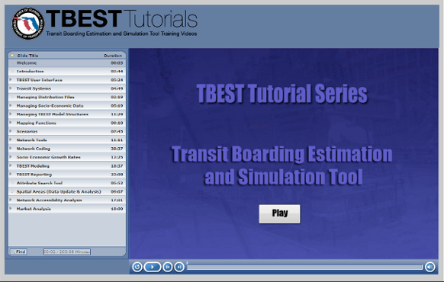


Questions?
TBEST Website:
http://tbest.org/
Software Developer/Instructor
ServiceEdge Solutions, LLC.
Rodney Bunner
Phone: (727) 455-4059
Email: rbunner@transcendspatial.com
Principal Investigator
Steve Polzin, PhD
Center for Urban Transportation Research
University of South Florida
Phone: (813) 974-9849
Email: polzin@cutr.usf.edu
FDOT Project Manager
Public Transit Office
Florida Department of Transportation
Phone: (850) 414-4532
Email: gabrielle.matthews@dot.state.fl.us

