Slide 1


Using EERPAT to Study Statewide and Region Greenhouse Gas Reduction Measures
Hejun (June) Kang¹, Sara Tomlinson², Charles Baber²
¹ Fairfax County Department of Transportation
² Baltimore Metropolitan Council

Slide 2
Maryland Transportation GHG Emission Targets
-90%

Slide 3

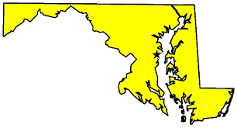


What is EERPAT?
  EERPAT: Energy and Emission Reduction Policy Analysis Tool
  Adapted from the Oregon DOT GreenSTEP model
FHWA is sponsoring 4 pilots

Slide 4
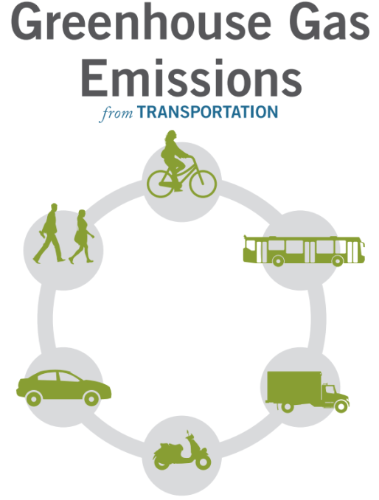
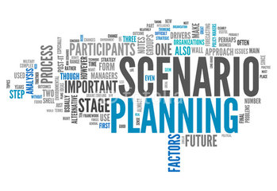

What is EERPAT?
  Help inform transportation and climate planning process
Notes:
Applications include:

Slide 5





How EERPAT Works?
Pricing
Marketing
Urban/ Roads
Technology /Fleet
Notes:
Forecasts are made at the household level, vehilce ownership number, type (auto, light truck), how much each vehicle travels, fuel/enegery use & ghg gas by vehcile, and household epxenditures, including vehicle ownership and vehicle use.
Here are some bullet points for comparison between the two methods:
Level of detail. EERPAT is not as detailed as MOVES, but does have fairly detailed vehicle fleet model, calibrated against state DMV data; EERPAT does have many of characteristics of MOVES, and emissions rates are consistent with MOVES
Level of region. EERPAT can help with state-level strategy analysis in situations where states would like to examine a large number of strategies quickly. It does not replace more robust models like EPA's MOVES model, and so, can be used rather as a screening tool for MOVES.
One strength of EERPAT is the micro simulation approach used for synthesizing households and population for each jurisdiction. The demographic synthesizer generates a jurisdiction database consisting of a record for each household and the synthesized household roster (population). The synthesizing process does not require a substantial amount of end user inputs, except for households by size (1-7 persons), population by age (six categories), statewide median income and economic region factor, which should not present a problem for other EERPAT users with limited knowledge of micro simulation. The Maryland pilot team obtained and processedbase and horizon year EERPAT jurisdiction demographic inputs from existing state and regional demographic data programs.
The synthetic data provides a rich data set of household and population characteristics which allows for micro simulation of current travel and household travel responses to transportation policies at the individual household level. Aggregation error, common to trip-based models, is eliminated allowing for capturing the synergies of two or more policies.
In addition, the EERPAT synthesizer generatesmeaningful summaries that an analyst can quickly accessand draw conclusions fromsimulation results. The output reports are developed from the jurisdiction household database in R, a publicly available software programing language and environment for statistical computing and graphics. EERPAT includes some built-in scripts for summarizing major outputs from the database, such as GHG, VMT. The database also contains other disaggregate information which can be potentially used for sketch level transportation planning applications/explorations. In many cases, extracting/summarizing such information would require the analyst’s proficiency in R scripting.
4-step model/MOVES
4-Step travel model (generation, distribution, mode choice, route assignment) evaluating aggregate household travel behavior considering cost for each interchange. Output – Person trips by purpose, mode, time period, destination, and route.
EERPAT
Disaggregate – synthesized households and Population household roster within county.
Probability models considering household demographic characteristics, urban area type and transportation (technology, fleet) and transportation system (TSM, TDM, price). Output – household vehicle ownership (by type/age) and household travel (VMT by vehicle type/age).
MOVES – inputs environment (temp. day, month), policies (I/M, RVP, Stage II), and motorized travel (stratified by source (Car, LT, Bus, HD), facility (Rural/Urban & Restricted/Unrestricted), fuel (Gasoline, Diesel, CNG, Electric). Internal Calculations – Activity (distance, hours, population, starts), process (exhaust, evaporative, refueling, extended idle, brake/tireware), and Vehicle Specific Power (VSP) (mathematical representation of engine load against aerodynamic drag, acceleration, rolling resistance, plus the kinetic and potential energies of the vehicle, all divided by the mass of the vehicle). GHG Output – estimated amount of fuel needed for vehicle travel – distance (exhaust), hours (operating, parked, extended idle), population (evaporative), non-road (refueling, starts).
EERPAT:
Estimates Fuel use based on household travel and non-household travel (vehicle type/age/fuel type (CAFÉ)). GHG Output – converts fuel used to GHG – carbon content of gallon of fuel converted to CO2.
Urban/Roads: Smart growth, transit, bicycle, traffic operations management
Marketing: TDM, Eco-driving
Pricing: Fuel tax, VMT fee, parking fee, congestion pricing
Technology/Fleet: EV, fuel, fleet turnover

Slide 6
Model Calibration – State Wide
Data
Notes:
Highway Performance Monitoring System (HPMS)
Data

Slide 7
Model Calibration – County Level

Slide 8
Sample Policy Test – Smart Growth in Metro Areas

Slide 9
Sample Policy Result: Smart Growth in Metro Areas
5.5%
4.0%
9.3%
5.3%

Slide 10
Sample Policy Result: Smart Growth in Metro Areas
3.0%

Slide 11
EERPAT
An effective planning tool for GHG analysis, helping inform transportation and climate planning process
Sensitive to capture household responses to polices
Can be calibrated and applied at the regional level, with local knowledge/inputs available

Slide 12
Regional Greenhouse Gas Study
“How Far Can We Get” initiative
  How far we can reduce GHG emissions in the Baltimore region through planning-related GHG strategies
  To inform transportation project selection for maximize2040 - the next regional transportation plan
Phase I - EERPAT Development, TERM Policy Catalog, MOVES GHG Emissions Analysis
Phase IV – Development of Recommendations
Phase II – Round 1 Scenario Testing – 15 Individual Measures
Phase III - Round 2 Scenario Testing - Combination Scenarios
Notes:
Maximize 2040 – How Far Can We Get (BRTB project selection)
Integrating GHGs into Transportation Planning

Slide 13
How Far? Process
Oversight committee members provided input through:
  in-person and webinar meetings, online surveys, and email
Decisions made on:
  Measures to analyze, Modeling assumptions
  Final list of recommended measures

Slide 14
How Far? Surveys
Survey 1: Interest level and feasibility of different emission reduction measures
Survey 2: Clarifying whether to choose projects to analyze based upon interest level and/or feasibility
Survey 3: Modeling assumption reasonableness
Notes:
Local jurisdictions and state agencies surveyed on:

Slide 15
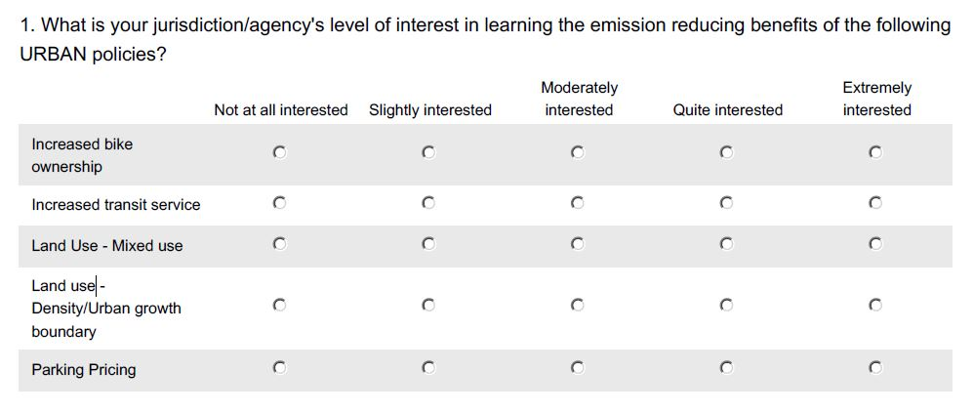
How Far? Survey 1 Example – Level of Interest

Slide 16
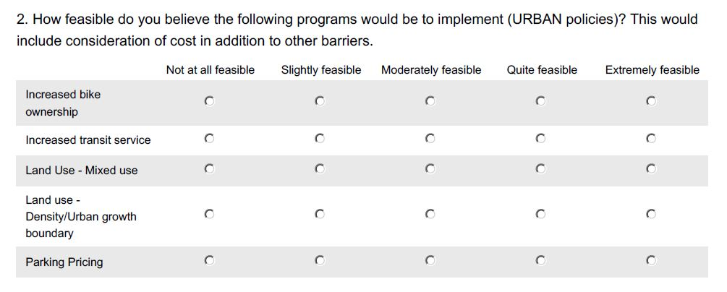
How Far? Survey 1 Example – Feasibility

Slide 17
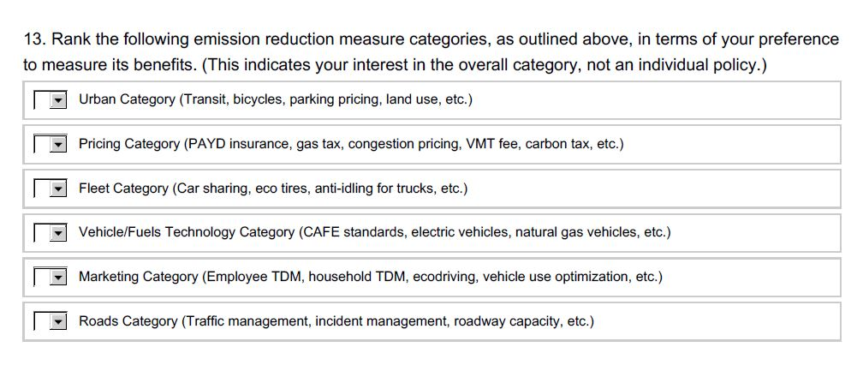
How Far? Survey 1 Example – Category Ranking
Notes:
I won’t show you survey 2 because it was very short, but the committee decided on testing 15 individual strategies based upon testing measures within each category with the highest level of interest. Each category had at least two measures that were tested.

Slide 18
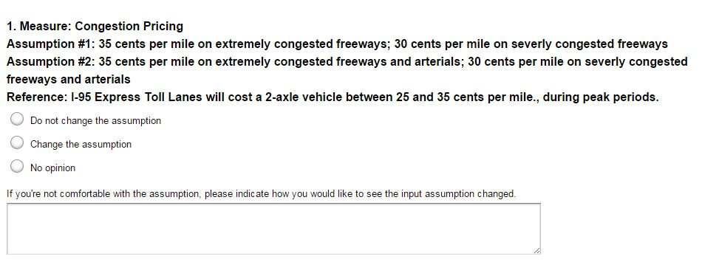
How Far? Survey 3 Example
Notes:
Based on feedback, we changed this to 10 cents per mile, considering that this wouldn’t just be on a single tolled road, but on all extremely and severely congested roads in the region.

Slide 19
How Far? Phase I: Individual TERM Testing
Pricing Category
Land use - mixed use
Pay as you drive insurance
Congestion pricing
VMT fee
Roads Category
Traffic operations management
Incident management
Marketing Category
Employer TDM programs
Household based TDM programs
Vehicle use optimization
Ecodriving
Vehicle and Fuels Technology Category
CAFE Standard
Electric vehicles
Fleet Category
Diesel truck idle reduction
Low rolling resistance tires
Urban Category
Increased transit service
Land use - density
Notes:
I won’t show you survey 2 because it was very short, but the committee decided on testing 15 individual strategies based upon testing measures within each category with the highest level of interest. Each category had at least two measures that were tested.

Slide 20
How Far? Phase II: Scenario Testing
Vehicle Technology (Plus)
Land use - Density
Urban
Vehicle Technology
TDM
Hypothetical CAFE 2026+
PAYD Insurance
Electric vehicles
Pricing
VMT fee
Congestion fee
Low rolling resistance tires
Transit
PAYD Insurance
Transit, TDM, Eco-driving
Operation programs
Vehicle use optimization
System/Mode Optimization
Urban (Plus)
Land use – Density + Mixed Use
Transit
TDM
PAYD Insurance
Low rolling resistance tires
Vehicle Technology Plus Marketing Scenario
TDM
Hypo. CAFE 2026+
Low rolling resistance tires
Eco-driving
Vehicle Use Optimization
Idle Reduction
Notes:
Tested 7 different combinations of measures (the last one with and without biking measure)

Slide 21
For More Information
  Sara Tomlinson
  Baltimore Metropolitan Council
  stomlinson@baltometro.org
  Hejun (June) Kang, Ph.D.
  Fairfax County Dept. of Transportation
  Hkang2@FairfaxCounty.gov

Slide 22
APPENDIX

Slide 23
MD Transportation Emissions – Base Case
Notes:
These are model-based Maryland transportation emissions by sector.
Fuel Economy: Derived from 2014 Annual Energy Outlook , based on operational fuel efficiency, not “sticker” fuel efficiency.
- This is slightly less than efficiency than the CAFÉ standards

Slide 24
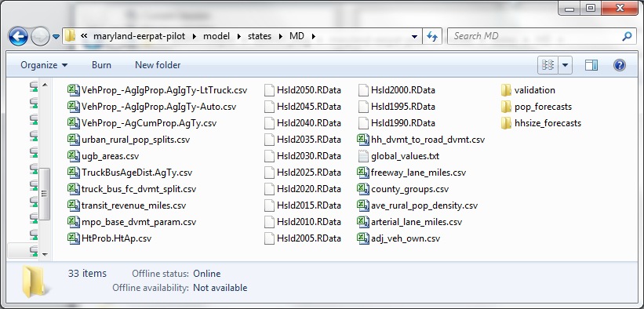
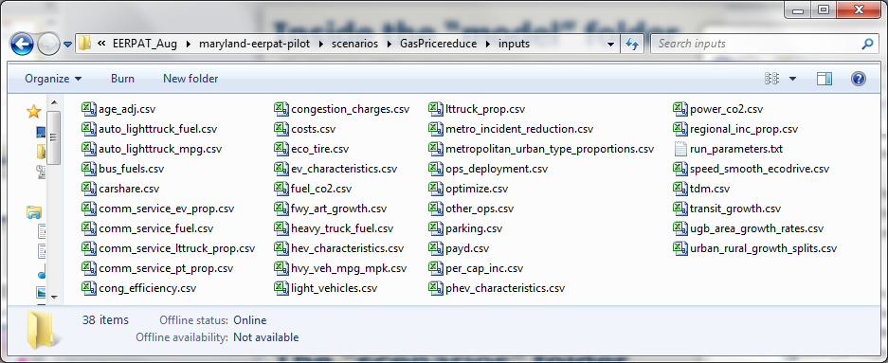
Inside the “model” folder
34 files
The “scenarios” folder
38 files
Notes:
Talking about timeline
110 hours out of 300
Some inputs can be gleaned from MOVES
Thefirsttaskof developing a pilot EERPAT model is building a statewide data repository. In Maryland, this step alone took about one third of the total amount of BMC staff hours allocated to the pilot project. All data inputs assummarized in Figure 1, include 14 model input files and 36 scenario input files.

