Slide 1
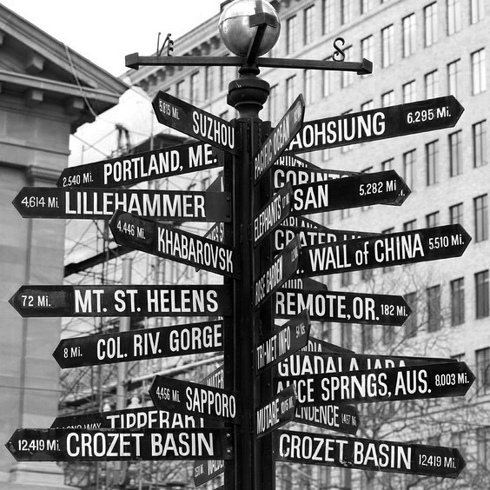
Development of a Pedestrian Demand Estimation Tool: a Destination Choice Model
CC Glenn Dettwiler, Flickr
Christopher D. Muhs*
Robert J. Schneider, PhD†
Kelly J. Clifton, PhD *
Patrick A. Singleton*
* Portland State Univ. † Univ. Wisconsin–Milwaukee
18 May 2015

Slide 2




Background
Why model pedestrian travel?
plan for pedestrian investments
& non-motorized facilities
mode shifts
health & safety
greenhouse
gas emissions
new data

Slide 3


Project overview
Metro: metropolitan planning
organization for Portland, OR
Two research projects
pedestrian environment
pedestrian scale
travel demand estimation model
pedestrian demand estimation model
mode
choice
destination
choice

Slide 4
Current method
TAZ = transportation analysis zone
Trip Generation (TAZ)
Trip Distribution or Destination Choice (TAZ)
Pedestrian Trips
Mode Choice (TAZ)
Trip Assignment
All Trips
Pedestrian Trips
Vehicular Trips

Slide 5
New method
Trip Generation (PAZ)
TAZ = transportation analysis zone
PAZ = pedestrian analysis zone
I
Walk Mode Split (PAZ)
Trip Distribution or Destination Choice (TAZ)
II
Destination Choice (PAZ)
Mode Choice (TAZ)
Pedestrian Trips
Trip Assignment
All Trips
Pedestrian Trips
Vehicular Trips

Slide 6
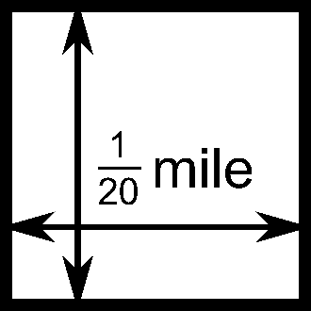
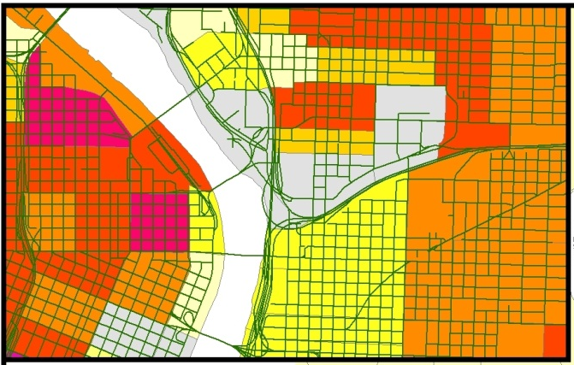
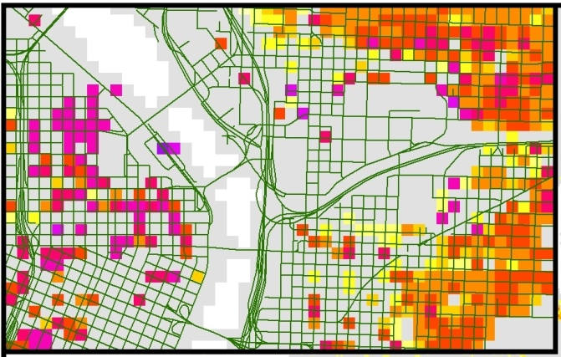
Pedestrian analysis zones
¹/₂₀ mile = 264 feet ≈ 1 minute walk
Metro: ~2,000 TAZs → ~1.5 million PAZs
TAZs
PAZs
Home-based work trip productions

Slide 7






Pedestrian environment
Pedestrian Index of the Environment (PIE)
PIE is a 20–100 score total of 6 dimensions, calibrated to observed walking activity:
People and job density
Block size
Transit access
Sidewalk extent
Urban living infrastructure
Comfortable facilities

Slide 8
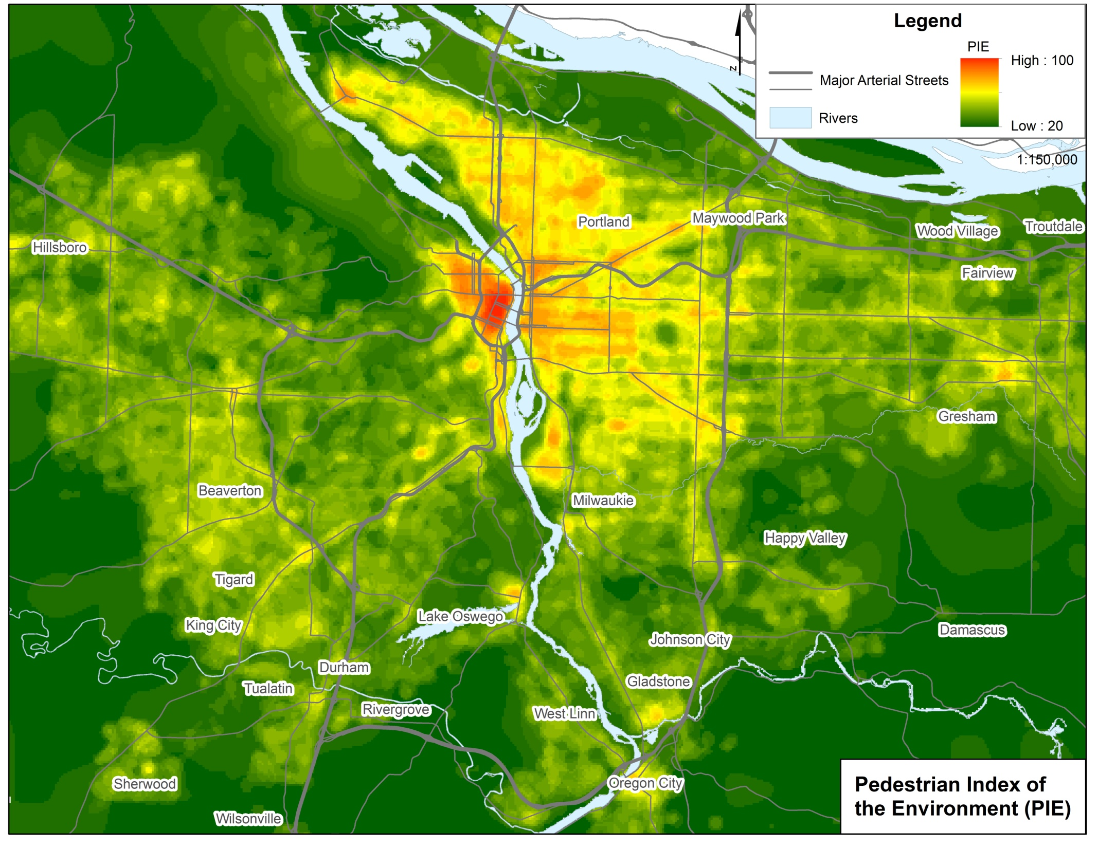

Slide 9
Walk mode split
I
Probability(walk) =
f(traveler characteristics,
pedestrian environment)
Walk Mode Split (PAZ)
Vehicular Trips
Pedestrian Trips
Data: 2011 OR Household Activity Survey: (4,000 walk trips) ÷ (50,000 trips) = 8% walk
Model: binary logistic regression

Slide 10
Walk Mode Split Results
I
Household characteristics
+ positively related to walking | – negatively related to walking
number of children | age of household
 | vehicle ownership
Pedestrian environment
+ positively related to walking
  + 1 point PIE
  associated with:
home–work trips
home–other trips
other–other trips

Slide 11
Destination choice
II
Prob(dest.) = function of…
  network distance
  size ( # of destinations )
  pedestrian environment
  traveler characteristics
Data: 2011 OHAS (4,000 walk trips)
Method: multinomial logit model
random sampling
Spatial unit: super-pedestrian analysis zone
Models estimated for 6 trip purposes
Destination Choice (PAZ)
Pedestrian Trips

Slide 12
DC Model Specification
Key variables
Impedance
Attractiveness
Network distance btw. zones
Employment by category (within ln)
Add’l variables
Ped supports
Ped barriers
Traveler attributes
PIE
Slope, x-ings, fwy

Slide 13
Destination choice results
 | HB Work | HB Shop | HB Rec | HB Other | NHB Work | NHB NW
Sample size | 305 | 405 | 643 | 1,108 | 732 | 705
Pseudo R² | 0.45 | 0.68 | 0.42 | 0.53 | 0.59 | 0.54

Slide 14
Results : key variables
 | HB Work | HB Shop | HB Rec | HB Other | NHB Work | NHB NW
Distance (mi) |  |  |  | -1.94** | -1.43** | -1.45**
Distance * Auto (y) | -1.35**
Distance * Auto (n) | -0.96**
Distance * Child (y) |  | -2.29** | -1.76**
Distance * Child (n) |  | -1.54** | -1.52**
Size terms (ln) | 0.50** | 0.88** | 0.05* | 0.41** | 0.36** | 0.39**
(‘ = p < 0.10, * = p < 0.05, ** = p < 0.01)

Slide 15
Results : key variables
 | HB Work | HB Shop | HB Rec | HB Other | NHB Work | NHB NW
Distance (mi) |  |  |  | -1.94** | -1.43** | -1.45**
Distance * Auto (y) | -1.35**
Distance * Auto (n) | -0.96**
Distance * Child (y) |  | -2.29** | -1.76**
Distance * Child (n) |  | -1.54** | -1.52**
Size terms (ln) | 0.50** | 0.88** | 0.05* | 0.41** | 0.36** | 0.39**
(‘ = p < 0.10, * = p < 0.05, ** = p < 0.01)
Distance has the most influence on destination choices
Auto ownership and children in HH moderate effects

Slide 16
Results : key variables
 | HB Work | HB Shop | HB Rec | HB Other | NHB Work | NHB NW
Distance (mi) |  |  |  | -1.94** | -1.43** | -1.45**
Distance * Auto (y) | -1.35**
Distance * Auto (n) | -0.96**
Distance * Child (y) |  | -2.29** | -1.76**
Distance * Child (n) |  | -1.54** | -1.52**
Size terms (ln) | 0.50** | 0.88** | 0.05* | 0.41** | 0.36** | 0.39**
(‘ = p < 0.10, * = p < 0.05, ** = p < 0.01)
No. of destinations inc. odds of choosing particular zone
# Retail destinations dominates shopping purpose

Slide 17
Results : ped variables
 | HB Work | HB Shop | HB Rec | HB Other | NHB Work | NHB NW
PIE (avg) | 0.03** | n.s. | n.s. | 0.03** | 0.02* | 0.02**
Avg. slope (°) | n.s. | -0.20* | n.s. | -0.42** | -0.16** | n.s.
Major-major xing (y) | n.s. | 0.60** | 0.42’ | n.s. | n.s. | n.s.
Freeway (y) | n.s. | -0.95** | n.s. | n.s. | n.s. | 0.27’
% Industrial jobs | -1.00* | -1.82** | n.s. | -0.40’ | -1.66** | n.s.
(‘ = p < 0.10, * = p < 0.05, ** = p < 0.01) n.s. = not significant

Slide 18
Results : ped variables
 | HB Work | HB Shop | HB Rec | HB Other | NHB Work | NHB NW
PIE (avg) | 0.03** | n.s. | n.s. | 0.03** | 0.02* | 0.02**
Avg. slope (°) | n.s. | -0.20* | n.s. | -0.42** | -0.16** | n.s.
Major-major xing (y) | n.s. | 0.60** | 0.42’ | n.s. | n.s. | n.s.
Freeway (y) | n.s. | -0.95** | n.s. | n.s. | n.s. | 0.27’
% Industrial jobs | -1.00* | -1.82** | n.s. | -0.40’ | -1.66** | n.s.
(‘ = p < 0.10, * = p < 0.05, ** = p < 0.01) n.s. = not significant
Ped supports: PIE increases odds of dest choice for many trip purposes

Slide 19
Results : ped variables
 | HB Work | HB Shop | HB Rec | HB Other | NHB Work | NHB NW
PIE (avg) | 0.03** | n.s. | n.s. | 0.03** | 0.02* | 0.02**
Avg. slope (°) | n.s. | -0.20* | n.s. | -0.42** | -0.16** | n.s.
Major-major xing (y) | n.s. | 0.60** | 0.42’ | n.s. | n.s. | n.s.
Freeway (y) | n.s. | -0.95** | n.s. | n.s. | n.s. | 0.27’
% Industrial jobs | -1.00* | -1.82** | n.s. | -0.40’ | -1.66** | n.s.
(‘ = p < 0.10, * = p < 0.05, ** = p < 0.01) n.s. = not significant
Ped barriers:
Slope, major crossings, and presence of freeways have mixed impacts

Slide 20
Results : ped variables
 | HB Work | HB Shop | HB Rec | HB Other | NHB Work | NHB NW
PIE (avg) | 0.03** | n.s. | n.s. | 0.03** | 0.02* | 0.02**
Avg. slope (°) | n.s. | -0.20* | n.s. | -0.42** | -0.16** | n.s.
Major-major xing (y) | n.s. | 0.60** | 0.42’ | n.s. | n.s. | n.s.
Freeway (y) | n.s. | -0.95** | n.s. | n.s. | n.s. | 0.27’
% Industrial jobs | -1.00* | -1.82** | n.s. | -0.40’ | -1.66** | n.s.
(‘ = p < 0.10, * = p < 0.05, ** = p < 0.01) n.s. = not significant
Ped barriers:
Ratio of industrial jobs to total jobs suggests industrial uses deter ped destination choices

Slide 21
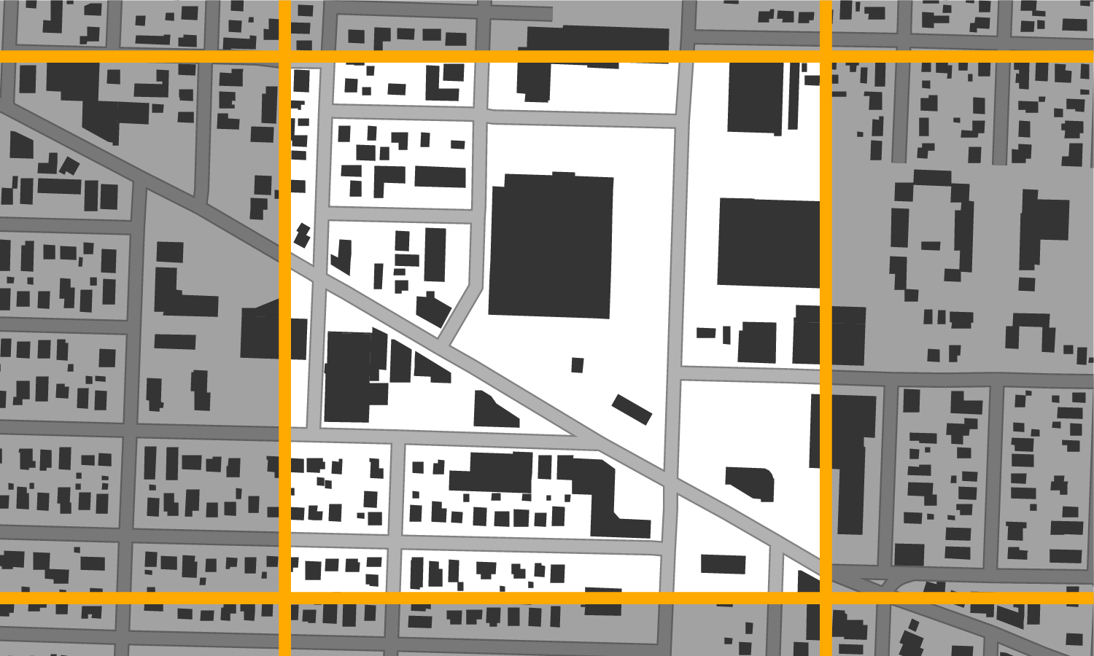
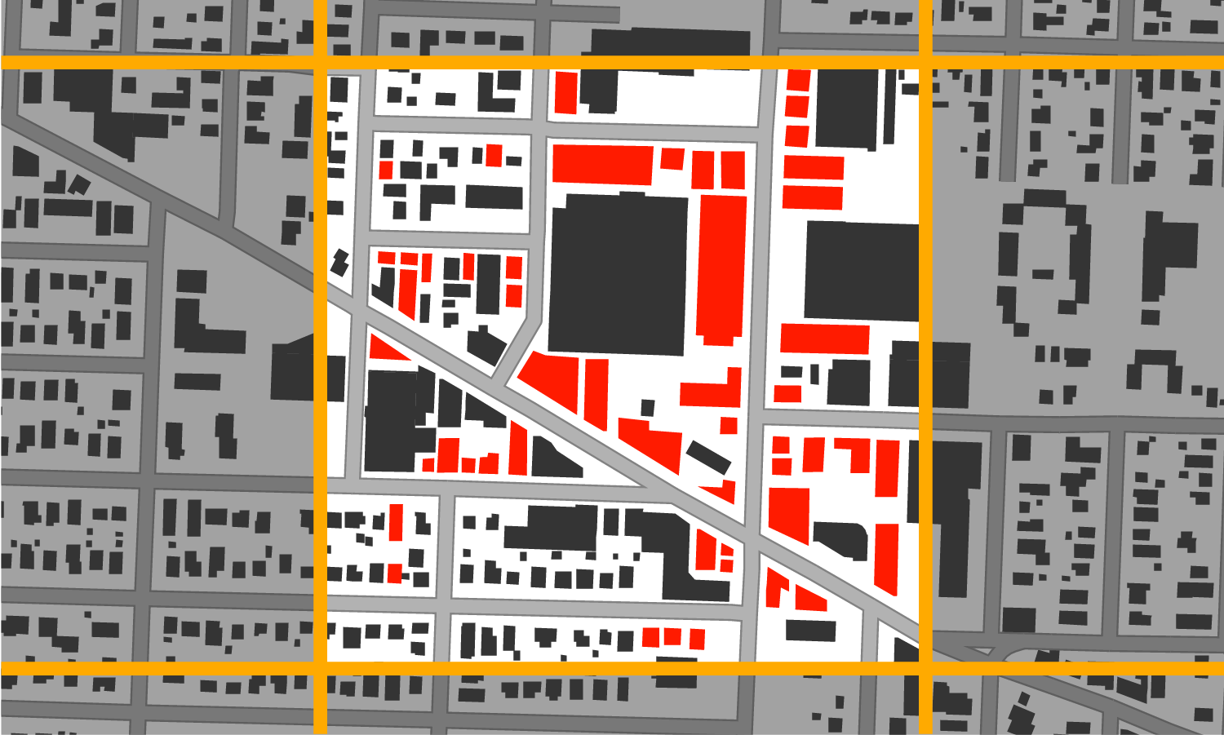
Some Interpretation
miles

Slide 22
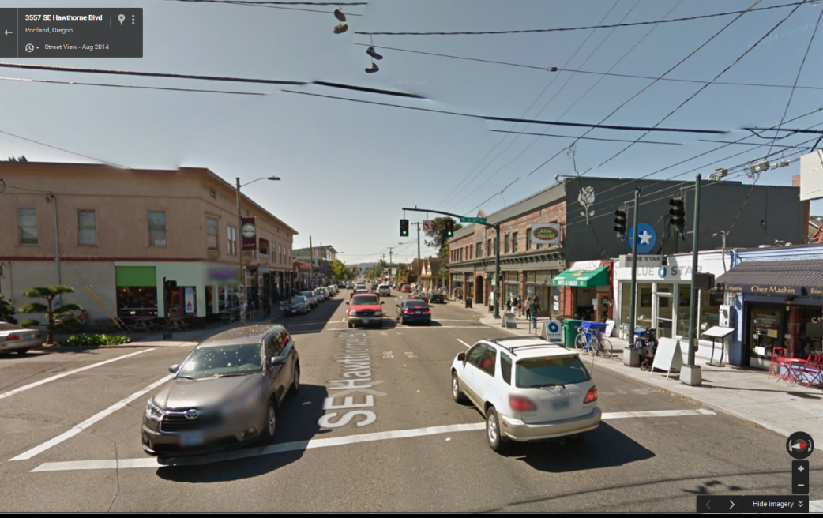
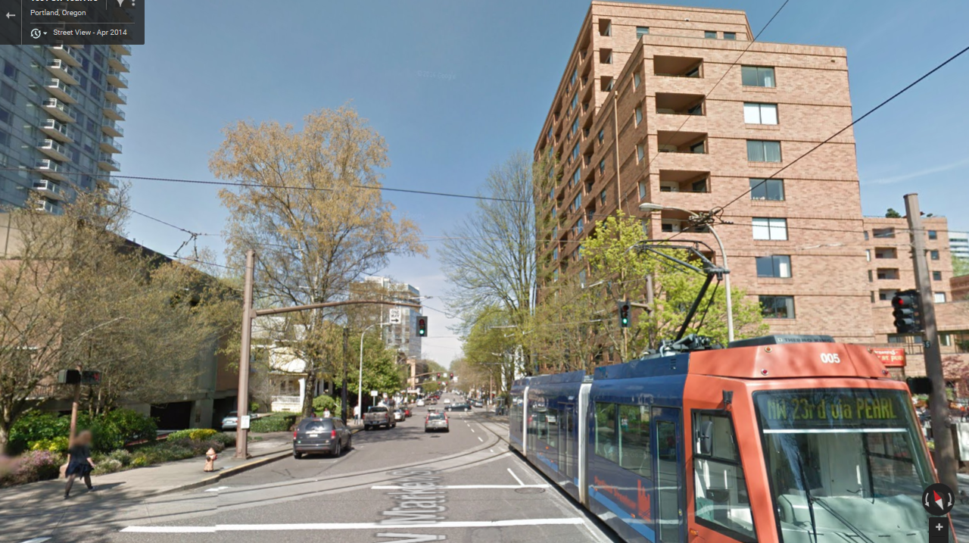
Some Interpretation
PIE = 75
PIE = 85
miles

Slide 23
Conclusions
One of the first studies to examine destination choice of pedestrian trips
Pedestrian scale analysis w/ pedestrian-relevant variables
Distance and size have the most influence on ped. dest. choice
Supports and barriers to walking also influence choice
Traveler characteristics moderate distance effect

Slide 24
Future work
Model improvements
  Choice set generation method & sample sizes
  Explore non-linear effects & other interactions
Model validation & application
Predict potential pedestrian paths
Test method in other region(s)
Incorporation into Metro trip-based model

Slide 25
Questions?
Project report/info:
http://otrec.us/project/510
http://otrec.us/project/677
Kelly J. Clifton, PhD kclifton@pdx.edu
Christopher D. Muhs muhs@pdx.edu
Patrick A. Singleton patrick.singleton@pdx.edu
Robert J. Schneider, PhD rjschnei@uwm.edu

Slide 26
Destination choice results
 | HB Work | HB Shop | HB Rec | HB Oth | NHB Work | NHB NW
Distance (mi) |  |  |  | -1.94** | -1.43** | -1.45**
Distance * Auto (y) | -1.35**
Distance * Auto (n) | -0.96**
Distance * Child (y) |  | -2.29** | -1.76**
Distance * Child (n) |  | -1.54** | -1.52**
Size terms (ln) | 0.50** | 0.88** | 0.05* | 0.41** | 0.36** | 0.39**
Retail Jobs (#) |  | + | + |  | + | +
Finance Jobs (#) |  |  |  |  | +
Gov’t jobs (#) |  |  | + |  |  | +
Retail + gov’t jobs (#) |  |  |  | +
Ret + fin + gov’t jobs (#) | +
Other jobs (#) | + | + | + | + | + | +
Households (#) |  |  | — | — |  | +
Park in zone (y) |  |  | 0.48** | n.s.
PIE (avg) | 0.03** | n.s. | n.s. | 0.03** | 0.02* | 0.02**
Avg. slope (°) | n.s. | -0.20* | n.s. | -0.42** | -0.16** | n.s.
Major-major xing (y) | n.s. | 0.60** | 0.42’ | n.s. | n.s. | n.s.
Freeway (y) | n.s. | -0.95** | n.s. | n.s. | n.s. | 0.27’
% Industrial jobs | -1.00* | -1.82** | n.s. | -0.40’ | -1.66** | n.s.
Sample size | 305 | 405 | 643 | 1,108 | 732 | 705
Pseudo R² | 0.45 | 0.68 | 0.42 | 0.53 | 0.59 | 0.54
Coefficients with #s are significant (‘ = p < 0.10, * = p < 0.05, ** = p < 0.01), others are not significant (p > 0.10).

