Slide 1


Discrete Choice Model for Vehicle Ownership in Dallas-Fort Worth Region
Hua Yang
Arash Mirzaei
Zhen Ding
North Central Texas Council of Governments
Travel Model Development and Data Management
Notes:
Good morning, today I will talk about vehicle ownership model we recently developed for our region: dallas –fort worth metropolitian area.

Slide 2
Contents
Background
NHTS data analysis
Vehicle Ownership Model Estimation
Vehicle Ownership Model Calibration
Vehicle Ownership Model Validation
Conclusion
Notes:
Today I will talk about these 6 parts. Background, data analysis, vehicle ownership model estimation, calibration and validation. The last part I will talk about some conclusion and future study.

Slide 3
Background
Texas had about 25,000 household samples in NHTS 2009
About 5,512 of the household samples are located in the MPA area of NCTCOG that fit for vehicle ownership (VO) model estimation
Combination of ACS 5-year and CTPP household tables provided an opportunity for a better implementation and calibration of a new VO model
Existing VO model has room for improvements
Notes:
Here is some background information, we got 2009 nhts data, so we want to develop a new vehicle ownership model. Total Texas has about 25,000 household samples in NHTS 2009 dataset. About 55 hundreds are in dallas fort worth metropolitan area. So based on this dataset, we developed a new vehicle ownership model, and we used the combination of CTPP and ACS 5 year data to better implement and calibrate this new model. So in the rest I will talk about the estimation, calibration and validation process.

Slide 4
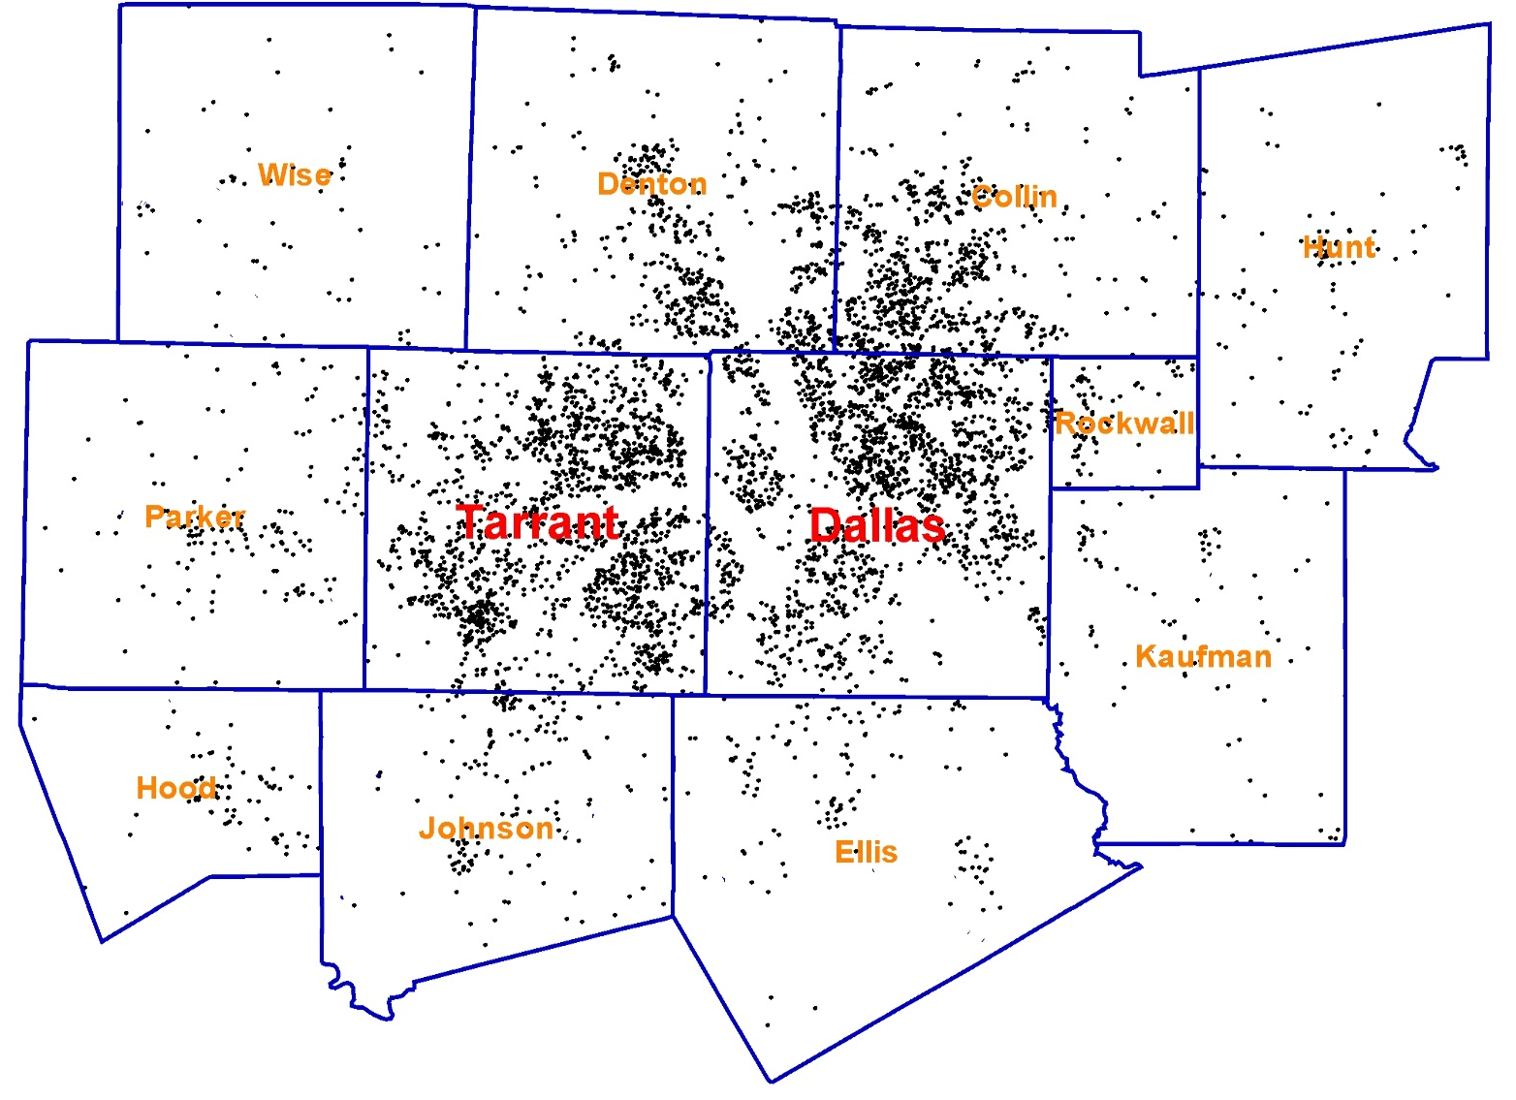
NHTS Data Analysis
  2009 NHTS data: 5,512 records/ weighted 2,161,610
Cover 12 counties, 9,448 square miles
Dallas and Tarrant counties are two major metropolitan areas: city of Dallas and Fort Worth
Notes:
First, I will talk about the NHTS data analysis process. As everyone know, To develop a reasonable model , we first need to understand data pretty well, we need to find strong and reasonable characters which impact vehicle ownership for each household. Here is the geographic distribution for all 5500 sample records, it covers all 12 counties , here is city of dallas, and here is city of fort worth in tarrant county.

Slide 5
NHTS Data Analysis( Cont’d )
Investigate characters impacting vehicle ownership for different household
  Some variables are significant:
    Household Income
VehicleOwn | IncomeLevel |  |  |  |  | Total | Percent
 | $0 - $29,999 | $30,000 - $49,999 | $50,000 - $74,999 | $75,000 - $100,000 | >$100,000
0 | 87,914 | 1,815 | 620 | 589 | 880 | 91,818 | 4.2%
1 | 315,697 | 187,923 | 108,890 | 54,543 | 37,921 | 704,974 | 32.6%
2 | 150,754 | 159,353 | 162,828 | 146,157 | 258,380 | 877,472 | 40.6%
3+ | 66,943 | 60,814 | 68,041 | 97,514 | 194,034 | 487,346 | 22.5%
Total | 621,308 | 409,905 | 340,380 | 298,803 | 491,214 | 2,161,610 | 100.0%
Percent | 28.7% | 19.0% | 15.7% | 13.8% | 22.7% | 100.0%
40% 3+ vehicle households’ income more than $100,000
Notes:
From NHTS data , here is the vehicle ownership distribution in our region. 0 vehicle household is only 4.2%, 1 vehicle household is 32.6% and 2 vehicle households have highest share, which is 40.6%, and 3+ vehicle households are 22.5%. Household income is one major variable affecting vehicle ownership, especially for 0 vehicle households, I will talk about detail in next slide. 40% 3+ vehicle households’ income are more than 100 thousands.

Slide 6
NHTS Data Analysis (Con’t)
  0 Vehicle Household size/Income distribution
  Household size
HH Size | IncomeLevel |  |  |  |  | Total | Percent
 | $0 - $29,999 | $30,000 - $49,999 | $50,000 - $74,999 | $75,000 - $100,000 | >$100,000
1 | 53,398 | 178 | 620 | 589 | 228 | 55,013 | 59.9%
2 | 12,661 | 1,637 | 0 | 0 | 154 | 14,451 | 15.7%
3 | 9,537 | 0 | 0 | 0 | 301 | 9,838 | 10.7%
4 | 10,002 | 0 | 0 | 0 | 198 | 10,201 | 11.1%
5 | 2,315 | 0 | 0 | 0 | 0 | 2,315 | 2.5%
6+ | 0 | 0 | 0 | 0 | 0 | 0 | 0.0%
Total | 87,914 | 1,815 | 620 | 589 | 880 | 91,818 | 100.0%
Percent | 95.7% | 2.0% | 0.7% | 0.6% | 1.0% | 100.0%
95.7% 0 vehicle households’ income lower than $30,000
59.9% 0 vehicle households’ size is 1
60.4% 1 vehicle households’ size is 1
VehicleOwn | HH Size |  |  |  | Total | Percent
 | 1 | 2 | 3 | 4+
0 | 55,013 | 14,451 | 9,838 | 12,516 | 91,818 | 4.2%
1 | 425,987 | 148,778 | 70,600 | 59,609 | 704,974 | 32.6%
2 | 69,369 | 365,765 | 179,284 | 263,054 | 877,472 | 40.6%
3+ | 8,518 | 125,779 | 134,382 | 218,667 | 487,346 | 22.5%
Total | 558,886 | 654,774 | 394,104 | 553,846 | 2,161,610 | 100.0%
Percent | 25.9% | 30.3% | 18.2% | 25.6% | 100.0%
41.7% 2 vehicle households’ size is 2
44.9% 3+ vehicle households’ size is 4+
Notes:
For 0 vehicle households, the major impacting variables are income and household size, we can see 95.7% households’ income are less than 30 thousand and almost 60% 0 vehicle households are size 1. not just for 0 vheicle households, for other 3 vehicle ownership households, household size is one important varaible, we can see 60.4% 1 vehicle household’s size is 1, 41.7% 2 vehcile households’ size is 2 and 44.9% 3+ vehicle households’s size is 4+.

Slide 7
NHTS Data Analysis (Con’t)
  Worker Count
Some other insignificant variables are investigated through iterative processes: No.of Children, No.of Adults, LifeCycle, UrbanSize.
Challenges:
  The much smaller number of samples in veh0 group may not provide the proper variation in independent variables.
  The maximum likelihood optimization will be largely biased towards the larger samples
67.6% 0 vehicle households’ WorkerCount is 0
VehicleOwn | Worker Count |  |  |  | Total | Percent
 | 0 | 1 | 2 | 3+
0 | 71,581 | 29,708 | 4,263 | 301 | 105,853 | 4.6%
1 | 253,498 | 456,801 | 39,461 | 9,220 | 758,980 | 33.1%
2 | 122,972 | 448,290 | 342,034 | 11001 | 924,297 | 40.3%
3+ | 34,194 | 164,270 | 225,506 | 81,443 | 505,413 | 22.0%
Total | 482,245 | 1,099,069 | 611,264 | 101,965 | 2,294,543 | 100.0%
Percent | 21.0% | 47.9% | 26.6% | 4.4% | 100.0%
85.5% 2 vehicle households’ WorkerCount is 1 or 2
60.2% 1 vehicle households’ WorkerCount is 1
Notes:
Worker count is also another important variable. 67.6% 0 vehicle households don’t have any worker. 60% 1 vheicle households have 1 worker, and 85.5% 2 vehicle households have 1 or 2 workers. We also checked other variables such as no. of children, adults, life cycle, urban size and race, but they turned out insignificant.
So during this process, we have found some challenges, one is we have very small number of samples for 0 vehicle group, this may not provide the proper variation in independent variables, this is probably same challenge for many other region. Second one is the maximum likelihood optimization will be largely biased towards the larger samples, for example, small changes for 1 and 2 vehicle households which are larger samples will dramatically impact the statistical results. However for 0 vehicle households, small changes won’t impact the overall model statistical results but they are significant change for this group. `

Slide 8
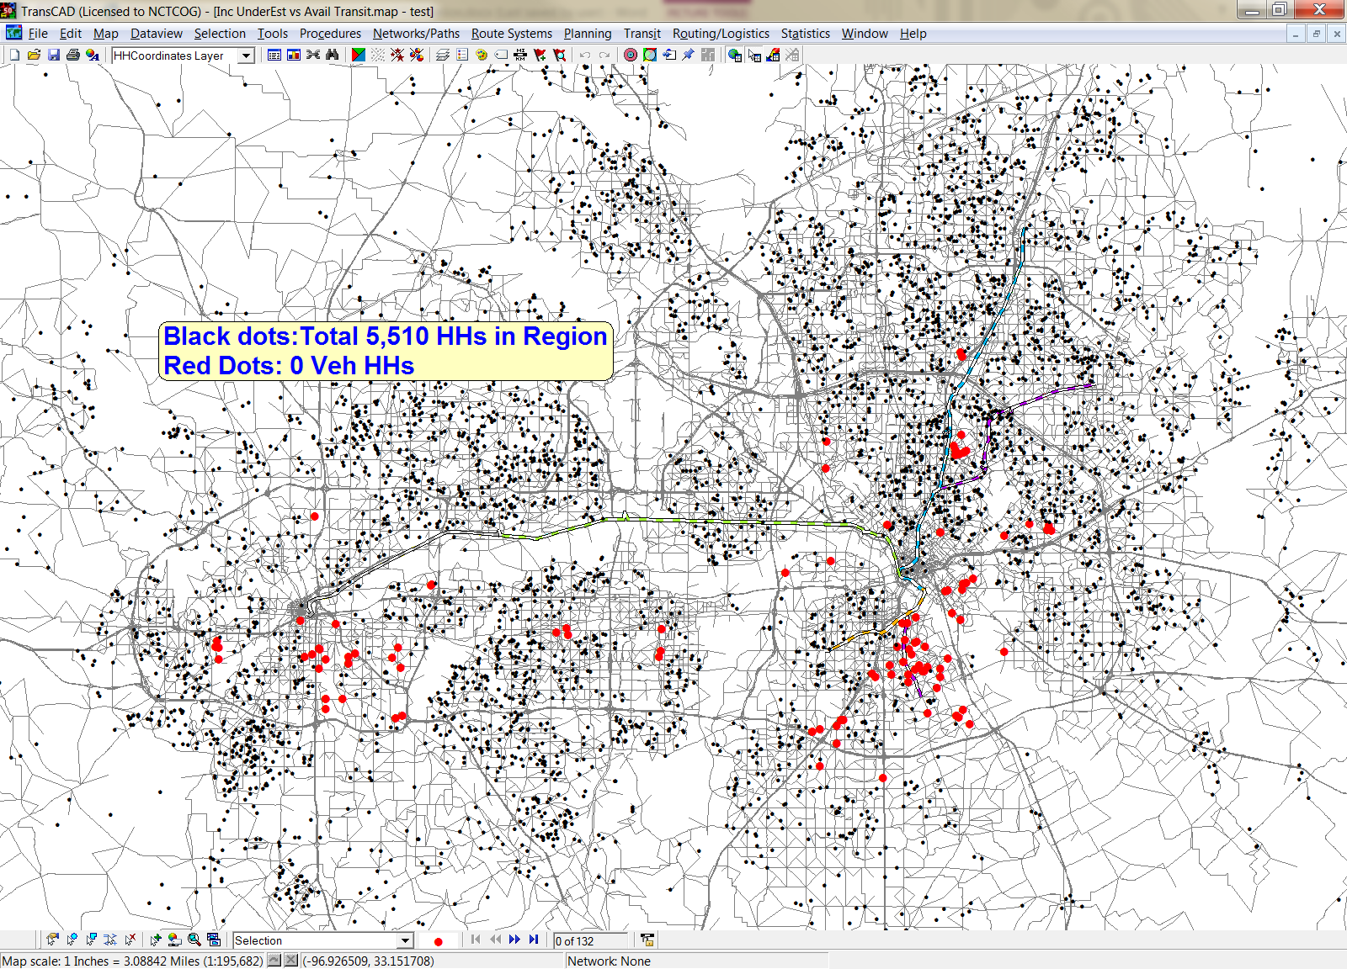
NHTS Data Analysis (Con’t)
  0 Vehicle Households are widely distributed and difficult to find common characters
Notes:
Another challenge is 0 vehicle households are widely distributed and difficult to find common characters. We can see the map, the red dots are 0 vehicle households, here is dallas area, and here is fort worth area, they are everywhere, some parts don’t have transit at all. For 0 vehicle households, the most common character is 95.7% households’ income are less than 30,000.

Slide 9
Vehicle Ownership Model Estimation
  Multinomial Logit (MNL) Model and Nested Logit (NL) Model are compared, MNL is selected because NL’s logsum doesn’t imply significant correlations.
Root
0 Car
1 Car
2 Car
3+ Car
Notes:
So after the data analysis and investigate the significant variables, we started to build model. We compared multinomial and nested logit model, eventually we picked multinomial logit model as our vehicle ownership model, here is the structure. In this model, we will have 4 alternatives: 0, 1, 2 and 3+ car

Slide 10
Vehicle Ownership Model Estimation (Cont’d)
  Variables
Variables
  Constant
  HHFAMINC_1 : 1, if HH income is <= 30k; 0, otherwise
  HHFAMINC_2 : 1, if HH income is >= 100k; 0, otherwise
  Hhsize_1_DMY : 1,if HHSize=1; 0, otherwise
  HHSize : No. of people in each HH
  WRKCOUNT : No. of workers in each HH
Zonal Variables
  UnEstInc : 1, Percentage of HHs with income equal or lower than 30k >55% for one tract; 0, otherwise
  Quad_RD : Quad root of Residence density for each Tract
  Residence Density: No.of HHs/Area of Residence
  TL_8Dummy : 1, No. of Transit Lines in each Tract >=8;
  0, Otherwise
Notes:
Here are all variables, family income dash 1 is used for 0 and 1 vehicle households, just like before I showed the data analysis, household income less than 30k is a significant variable for 0 and 1 car households. Familyincome dash 2 is the household income more than 100k, which is a significant variable for 2 and 3+ car households. Houeshold size 1 dummy is one significant variable for 0 and 1 car households. Then we have household size, worker count variables. We also used some zonal variables, the first one is unestinc, it only used for 0 vheicle utility. it is if the percentage of HHs with income equal or less than 30k for one tract is greater than 55%, it will be 1. the second one is quad rd, which is quad root of residence density for each tract. This one is used for 1 and 2 vheicle utilities. The last one is transit line 8 dummy, if no. of transit lines in each tract greater or equal to 8, it will be 1, this one is used for 0 vheicle utility.

Slide 11
Vehicle Ownership Model Estimation (Cont’d)
  Utility Functions
U_{0Car} = ASC_0CAR * one +
BETA_FAMINC_0CAR * HHFAMINC_1 +
BETA_RESIDENS_0CAR * Quad_RD +
BETA_HHSIZE1dmy_0CAR * Hhsize1_DMY +
BETA_UEinc_0CAR * UnEstInc +
BETA_TransLns_0CAR * TL_8Dummy
U_{1Car} = ASC_1CAR * one +
BETA_FAMINC_1CAR * HHFAMINC_1 + BETA_RESIDENS_1CAR * Quad_RD + BETA_HHSIZE1dmy_1CAR * Hhsize_1_DMY + BETA_WRKCOUNT_1CAR * WRKCOUNT
U_{2Car} = ASC_2CAR * one +
BETA_FAMINC_2CAR *HHFAMINC_2 + BETA_RESIDENS_2CAR * Quad_RD + BETA_HHSIZE_2CAR * HHSize + BETA_WRKCOUNT_2CAR * WRKCOUNT
U_{3+Car} = ASC_3CAR * one +
BETA_FAMINC_3CAR * HHFAMINC_2 + BETA_HHSIZE_3CAR * HHSize + BETA_WRKCOUNT_3CAR * WRKCOUNT
Notes:
Here are the utility functions

Slide 12
Vehicle Ownership Model Calibration
Vehicle ownership model is estimated based on 2009 NHTS data (total 5510 records)
This model is implemented by using 2005-2009 5 years ACS data by tract level.(Total 1058 tracts)
  Based on model variables, ACS data needs to be broken down by income ,HHSize and WorkerCount. However, no breakdown by these 3 variables together in ACS data. Only cross-table of HHSize and Workercount, income breakdown are aviliable.
  Therefore, IPF method is used and CTPP2000 is the base seed file.
Notes:
Ok, then I will talk about the calibration process. This model is estimated using 2009 nhts data as I mentioned before, so we used 2005 to 2009 5 years acs data to calibrate it, it is in tract level. But based on our utility functions, acs data needs to be broken down by income, hhsize and workercount, however , no breakdown by these 3 variables together in ACS data, so we used ipf method which has ctpp 2000 as seed file and acs data as total to develop calibration target

Slide 13
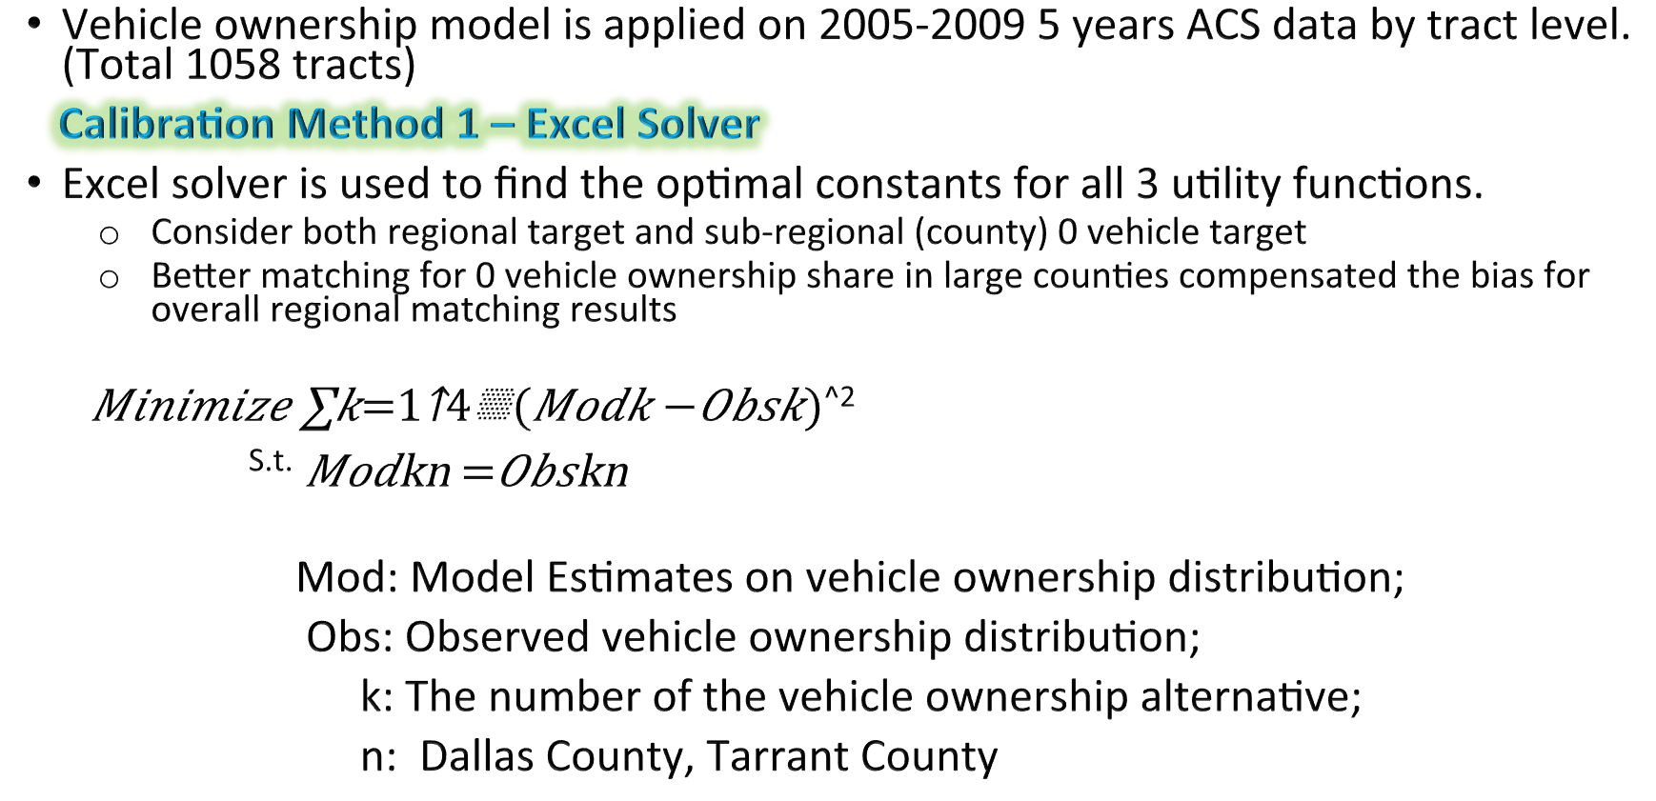
Vehicle Ownership Model Calibration (Cont’d)
Vehicle ownership model is applied on 2005-2009 5 years ACS data by tract level.(Total 1058 tracts)
Calibration Method 1 – Excel Solver
Excel solver is used to find the optimal constants for all 3 utility functions.
    Consider both regional target and sub-regional (county) 0 vehicle target
    Better matching for 0 vehicle ownership share in large counties compensated the bias for overall regional matching results
$Minimize \sum_{k=1}^{4}{(Modk}−Obsk)$^{^2}
^{S.t.} $Mod\text{k}\text{n} =Obs\text{k}\text{n}$
Mod: Model Estimates on vehicle ownership distribution;
Obs: Observed vehicle ownership distribution;
k: The number of the vehicle ownership alternative;
n: Dallas County, Tarrant County
Notes:
We have two calibration methods, one is using excel solver. We consider both regional target and county 0 vehicle target, because the better matching for 0 vehicle share in large conties compensated the bias for overall regional matching . So our objective function is to match total, and constranits are matching 0 vehicle households for dallas and tarrant counties.

Slide 14
Vehicle Ownership Model Calibration (Cont’d)
Calibration Method 2 – Brute Force Attacking (BFA)
Excel solver is hard to integrate into traditional planning software.
Therefore, an application program is developed in TransCAD to calibrate the vehicle ownership model.
Brute Force Attacking (BFA) theory is applied in this program, which simply performs a sequential search by comparing outputs from successive elements of an input list.
  Multi-objective function – Minimize the error between model estimates and ACS data
    All - Vehicle - Ownership - households (AVO)
    Zero - Vehicle - Ownership - households (ZVO)
Notes:
Another method is brute force attacking method. Since excel solver is hard to integrate into traditional planning software, we developed an application program in transcad, which simply performs a sequential search by comparing outputs from continuous input elements. So this one also has two objective functions, one is matching all vehicle ownership households, another one is matching zero vehicle ownership households.

Slide 15
Vehicle Ownership Model Calibration (Cont’d)
Dallas – Fort Worth Region
Error
Constants combination
AVO reaches optimal solutions in similar manner as ZVO’s does
Notes:
Here is our regional AVO and ZVO results. The green ones are AVO results, you can see the three points are optimal points, the yellow dots are zvo results, but the optimal point is the green one but meanwhile the avo is far from the optimal point, therefore we chose this combination which has the best avo results and not very bad zvo point, you can see this blue point is not very far from the green point for zvo. One observation is avo reaches opitmal solutions in similar manner as zvo’s does.

Slide 16
Vehicle Ownership Model Calibration (Cont’d)
Dallas – Fort Worth Region : Dallas County
AVO reach optimum simultaneously for region and Dallas county, but differently from other counties .
Error
Each County’s optimal solution is different from each other
Constants combination
Notes:
Here is dallas county avo and zvo comparison results, the blue lines are avo results, and orange line are zvo , again you can see we chose this combination. Two observations are from this results, one is avo reach optimal solutions for region and dallas county has same trend, but some other counties are different. Another observation is each county has different optimal solution.

Slide 17
Vehicle Ownership Model Calibration (Cont’d)
0 Vehicle HHs
Notes:
So here is our calibration results. I will go through this quickly. This is for 0 vehicle.

Slide 18
Vehicle Ownership Model Calibration (Cont’d)
1 Vehicle HHs

Slide 19
Vehicle Ownership Model Calibration (Cont’d)
2 Vehicle HHs

Slide 20
Vehicle Ownership Model Calibration (Cont’d)
3+ Vehicle HHs

Slide 21
Vehicle Ownership Model Validation
Notes:
After calibration, we did validation which is the vehicle ownership percentage comparison in county level. Here is 0 vehicle comparison.

Slide 22
Vehicle Ownership Model Validation (Cont’d)

Slide 23
Vehicle Ownership Model Validation (Cont’d)

Slide 24
Vehicle Ownership Model Validation (Cont’d)

Slide 25

Vehicle Ownership Model Validation (Cont’d)
MOE (Marginal of Error) is applied by each tract to calculate the range of No. of HHs with 0 vehicle
  No. of HHs with 0 vehicle in each tract comparing with observed range
  No. of HHs Group Comparison :
    MOE Calculation for a group of Tracts:
    i , Tract
    No. of HHs Group Comparison by median HH income
    No. of HHs Group Comparison by No. of HHs in each Tract
Notes:
We also did another validation which use marginal of error to calculate the range of no. of hhs with 0 vehicle in each tract. So we have no. of hhs with 0 vehicle comparison and group comparison. We have two groups comparison, one is by median hh income, another on is by no. of HHs in each tract.

Slide 26
Vehicle Ownership Model Validation (Cont’d)
Notes:
So here is no. of hhs with 0 vehcile in each tract comparison, the yellow dots are upper bond using MOE, and blue dots are lower bound, and the grey dots are model results, so model results are almost in the middle.

Slide 27
Vehicle Ownership Model Validation (Cont’d)
Notes:
Here is group compariosn by median hh income, so for median hh income less than 30k, our model are underestimated, and for hh median inomce are between 50k and 100k, our model are slightly overestimated.

Slide 28
Vehicle Ownership Model Validation (Cont’d)
Notes:
Here is group comparison by no. of hhs. So for small tracts which have no. of hhs less than 1000, model is underestimated. But for tracts having no. of hhs between 25 hundred and 10 thousand, we are overestimated.

Slide 29
Conclusion
Low number of samples for Veh0 HHs creates a challenge in maximum likelihood estimation method. The choice model understandably will NOT perform well for choices with much smaller samples. This creates a dilemma in using these models for estimation of low share choices because often these choices are the ones that we are more interested to know better.
Combination of ACS and CTPP provided new opportunities for implementation of the model
ACS MOE provided new meaning for evaluation of the model with new understanding of accuracy and expectation form the model
Optimization in calibration by important market segments is possible without influencing the estimation process. Paying attention to smaller areas, particularly when estimation is not working well for some choices provides new flexibility in calibration process without the risk of over-calibration.
VO model behavioral components in the form that is used in this work is probably weak because the economic and financing factors are not included in the model.
Notes:
Ok, the last one is about some conclusions: maximum likelihood estimation may not represent well for small number of samples, such as 0 veh HHs. Combination of ACS and ctpp data is a new opportunity for implementation of the model. ACS MOE caculation provide new evaluation and accuracy of the model. Special attention to important market segments is necessary, optimization in calibration just for this market segment is possible without the risk of over-calibration. The last one is the economic and financial factors are not included in the model, this probably will make the model weak.

Slide 30
Thank you !
Notes:
Ok, the last one is about some conclusions: maximum likelihood estimation may not represent well for small number of samples, such as 0 veh HHs. Combination of ACS and ctpp data is a new opportunity for implementation of the model. ACS MOE caculation provide new evaluation and accuracy of the model. Special attention to important market segments is necessary, optimization in calibration just for this market segment is possible without the risk of over-calibration. The last one is the economic and financial factors are not included in the model, this probably will make the model weak.

