Slide 1


2015
GDOT PowerPoint
Title Page
Project Prioritization Tool for Operational Planning Study
15th TRB National Transportation Planning Applications Conference
Kyle Mote, GDOT PM
Keli Kemp, AICP, HNTB PM
Chandra Khare, HNTB Task Leader
May 19, 2015
Sub Titles
Body Text

Slide 2
Agenda
Overview of OPS
  Bottlenecks and projects
OPS Project Prioritization Tool
  Project prioritization framework (goals, themes, and performance measures)
  Tool overview
  Project ranking and sensitivity analysis
Findings and Recommendations

Slide 3
Overview of OPS
Operational assessment of the interstate and limited-access system in the metro Atlanta region
  Identify bottleneck areas
  Identify and evaluate potential low-cost improvements
  Quick implementation – 6 months to 5 years
  Document a prioritized list of operational projects

Slide 4
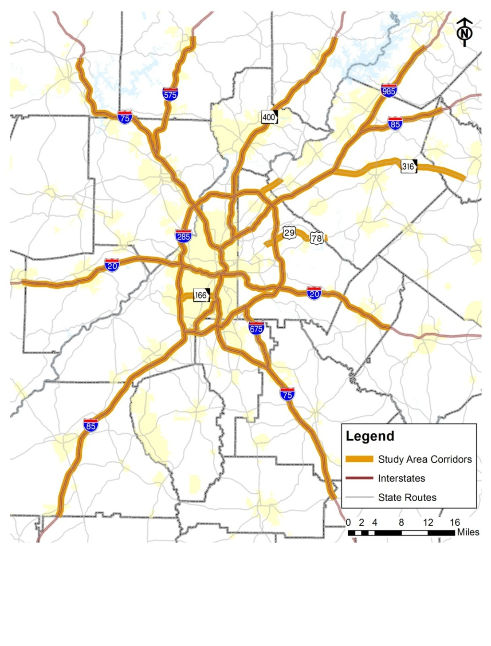
Study Area
All limited access facilities in Metro Atlanta
Emphasis on improving the Interstate mainline
22 Corridors

Slide 5
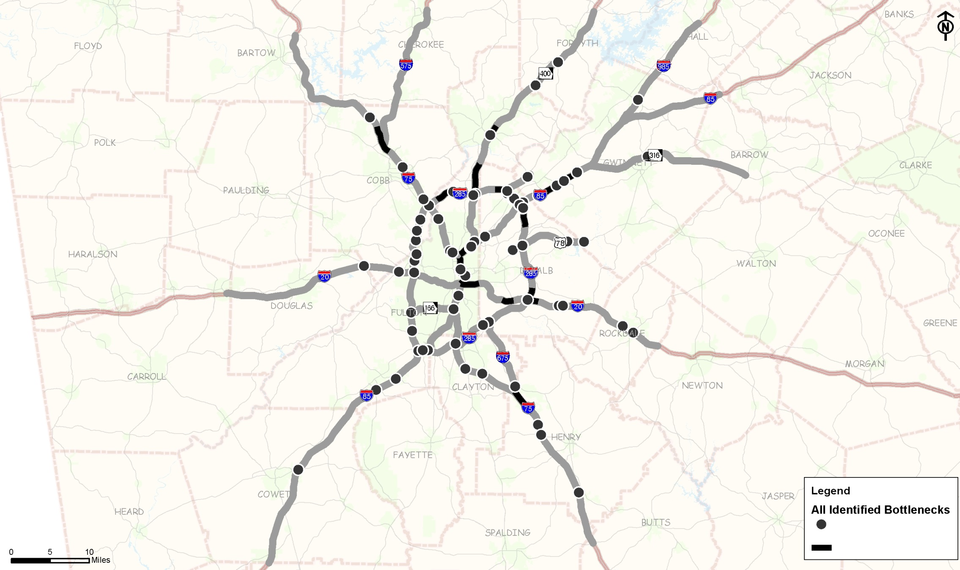
Identified Bottleneck Locations
129 bottlenecks

Slide 6
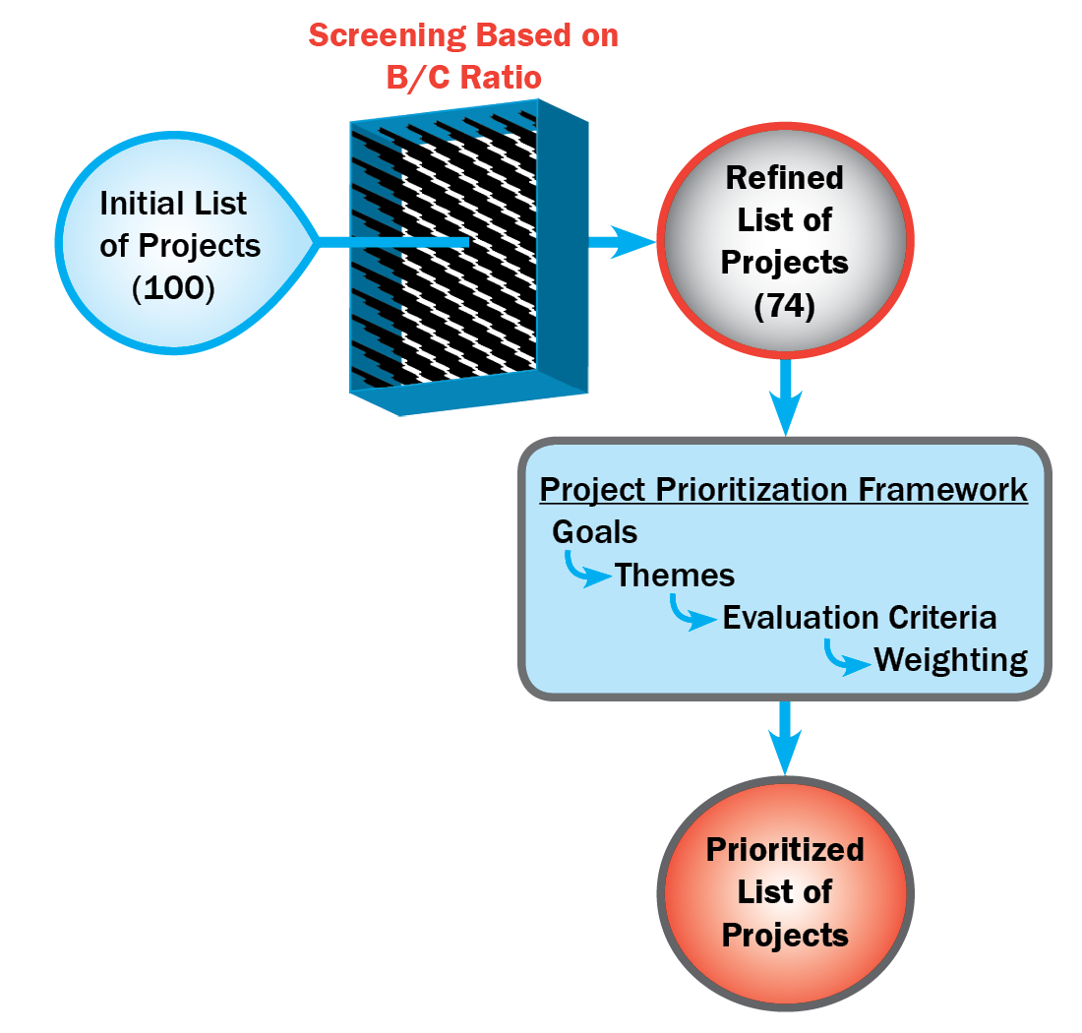
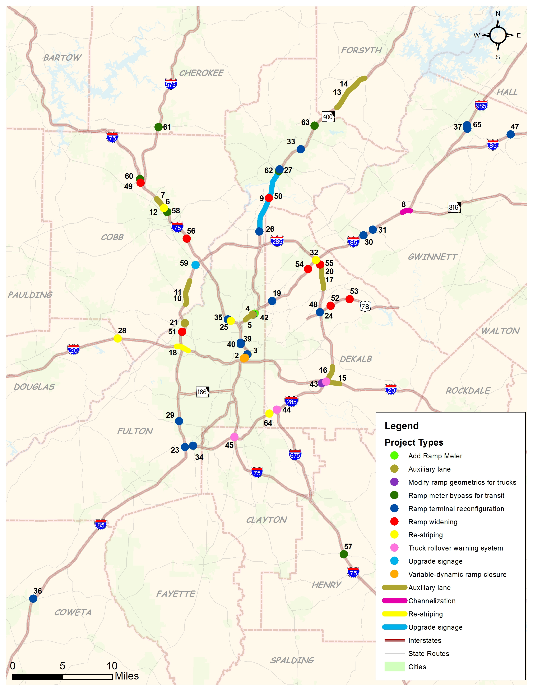
Projects
74 projects at
60 locations

Slide 7
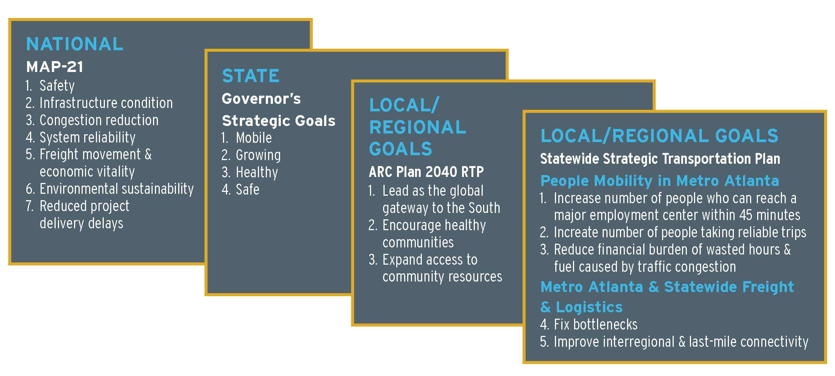
Project Prioritization Framework –
Development of OPS Goals

Slide 8
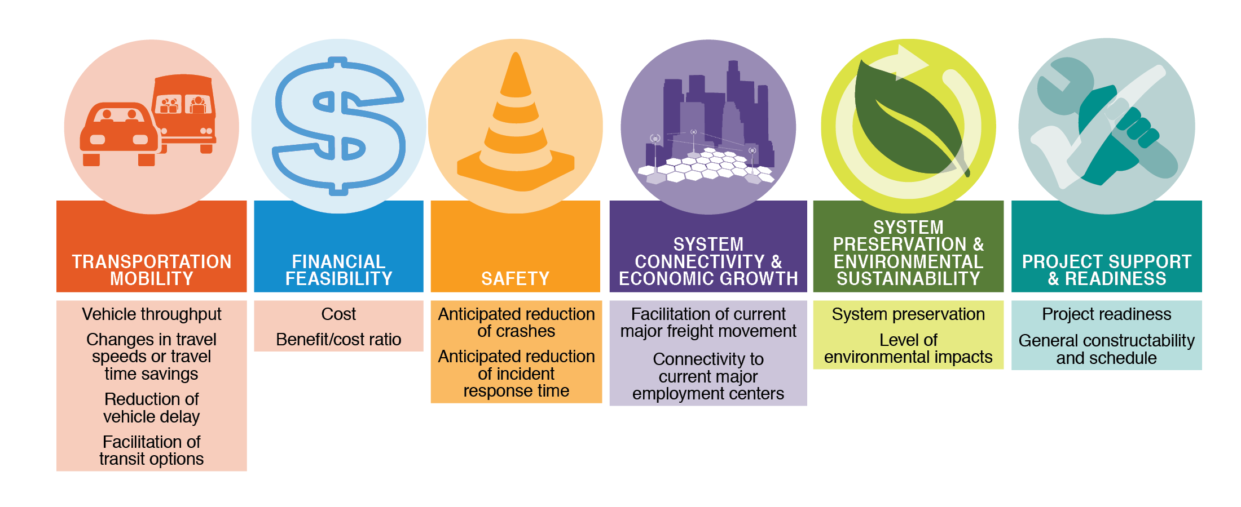
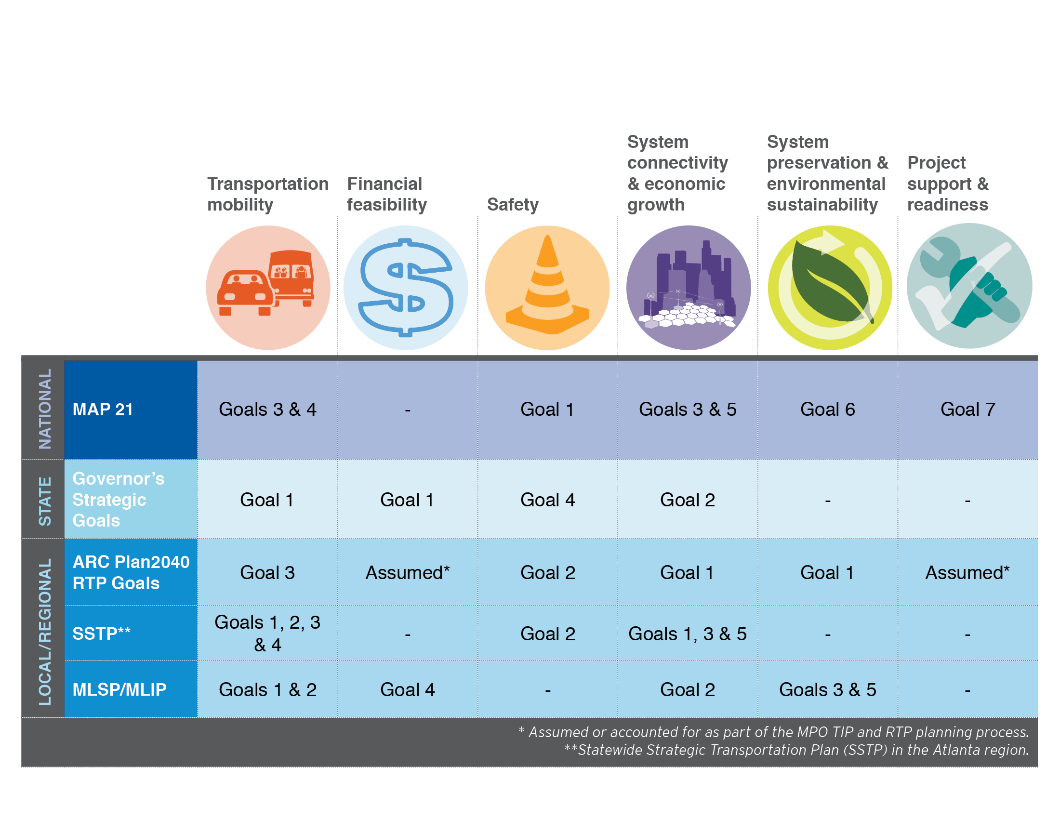
Planning Themes and Performance Measures

Slide 9

Planning Themes and Performance Measures
Theme #1: Transportation Mobility
Vehicle Throughput
  Number of vehicles in AM and PM peak hours
Travel Time Savings
  Average travel time saved per vehicle
Reduction of Vehicle Delay
  Daily total vehicle-hours saved
Facilitation of Transit Options
  Qualitative (Yes, No)
  Evaluation factors - Availability of transit option at the location of improvement

Slide 10

Planning Themes and Performance Measures
Theme #2: Financial Feasibility
Cost
  Quantitative
  Includes Engineering, ROW, and Construction
Benefit/Cost Ratio
  Quantitative
  Benefits include travel time savings and operating cost savings

Slide 11

Planning Themes and Performance Measures
Theme #3: Safety
Anticipated Reduction of Crashes
  Qualitative (High, Moderate and Low)
  Evaluation factors
    Reduction in congestion
    Reduction in conflict points
    Queuing reduction
Anticipated Reduction of Incident Response Times
  Qualitative (High, Moderate and Low)
  Evaluation factors
    Impacts to emergency vehicle accessibility
    Lack of accident accommodations (i.e. no shoulder)

Slide 12

Planning Themes and Performance Measures
Theme #4: System Connectivity and
Economic Growth
Facilitation of Current Major Freight Movement
  Qualitative (High, Moderate and Low)
  Evaluation factors
    Improvements to benefit trucks
    Truck percentage in the area of improvement
Connectivity to Current Major Employment Centers
  Quantitative
  Evaluated based on proximity to the activity centers and their associated employment numbers

Slide 13

Planning Themes and Performance Measures
Theme #5: System Preservation and
Environmental Sustainability
System Preservation
  Qualitative (High, Moderate and Low)
  Evaluated based on extent of damage/change to existing operating facilities
Level of Environmental Impacts
  Qualitative (High, Moderate and Low)
  Evaluation of Impacts to Environmentally Sensitive Areas (ESA)
    Wetlands and streams
    Historical properties
    Archeological areas
    Endangered species

Slide 14

Planning Themes and Performance Measures
Theme #6: Project Support and Readiness
Project Readiness
  Qualitative (High, Moderate and Low)
  Evaluation factors
    Extent of required studies
    Extent of required design
    Is ROW required?
General Constructability And Schedule
  Qualitative (High, Moderate and Low)
  Evaluation factors
    Complexity of construction
    Duration of construction
    Maintenance of traffic complexity and duration

Slide 15
Project Prioritization Tool Overview
Spreadsheet-based tool
User friendly and transparent
Provide flexibility to:
  Change the themes and performance measures as per the needs of an agency
  Provide a variety of project types and ability to expand the number of projects
  Re-assign weighting factors on the fly

Slide 16
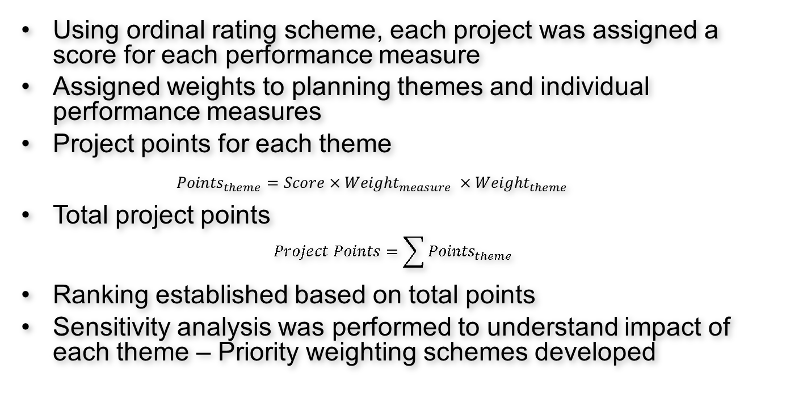
Project Ranking and
Sensitivity Analysis
Using ordinal rating scheme, each project was assigned a score for each performance measure
Assigned weights to planning themes and individual performance measures
Project points for each theme
  $${Points}_{theme}=Score×{Weight}_{measure} ×{Weight}_{theme}$$
Total project points
$$Project Points=\sum{{Points}_{theme}}$$
Ranking established based on total points
Sensitivity analysis was performed to understand impact of each theme – Priority weighting schemes developed

Slide 17
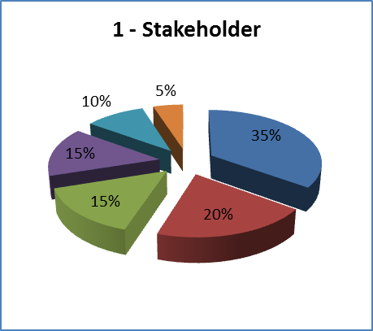
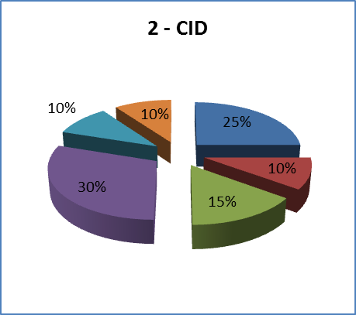
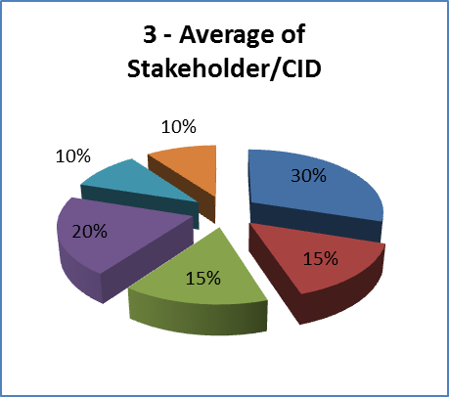
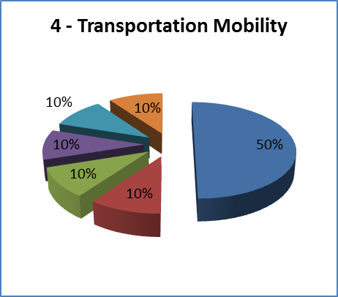
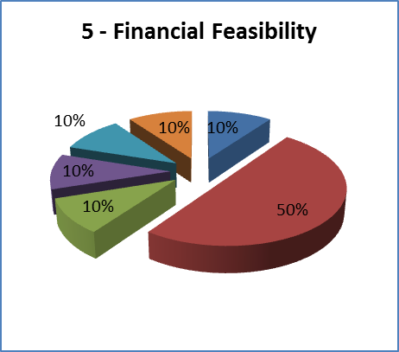
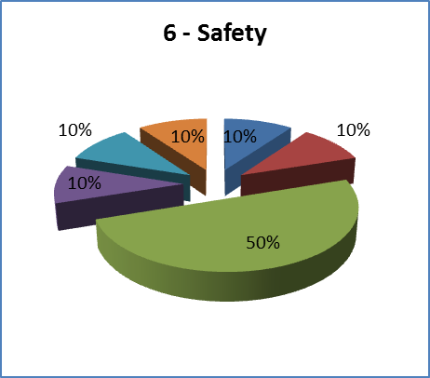
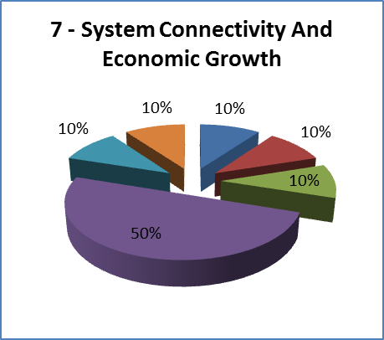
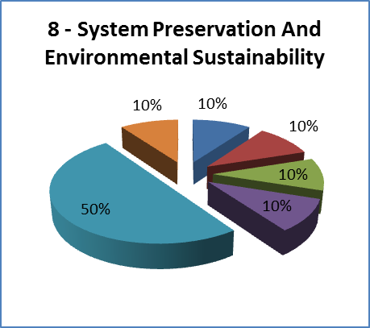
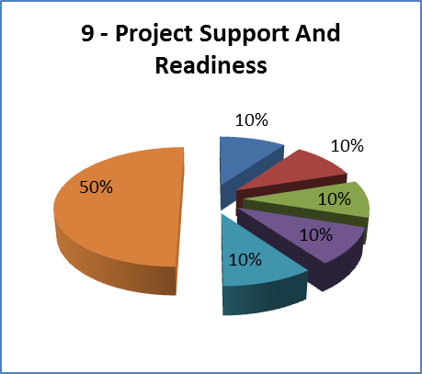
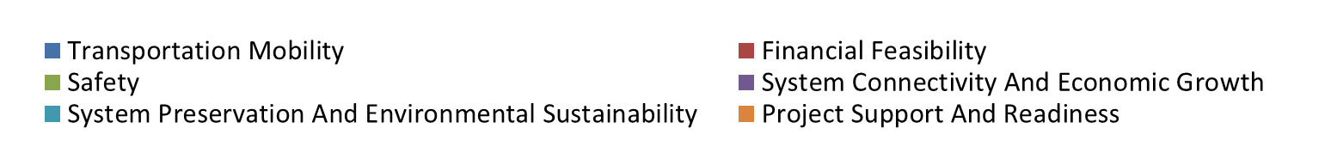
Priority Weighting Schemes

Slide 18
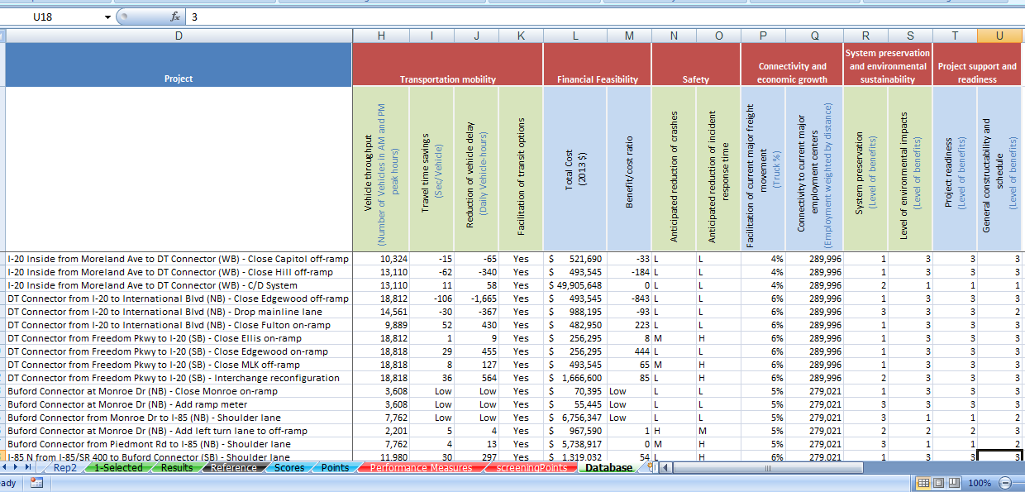
Prioritization Tool
Inputs

Slide 19
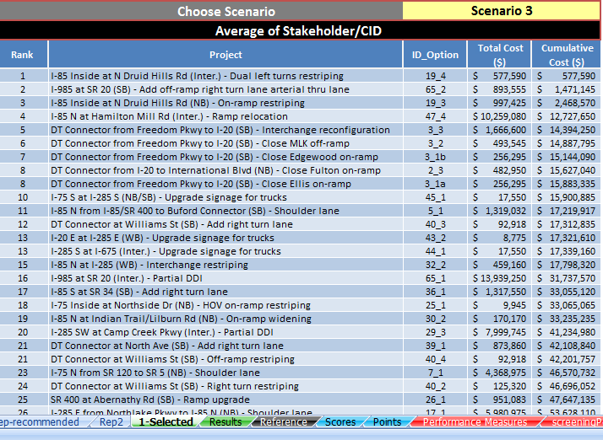
Prioritization Tool
Ranking by Scheme

Slide 20
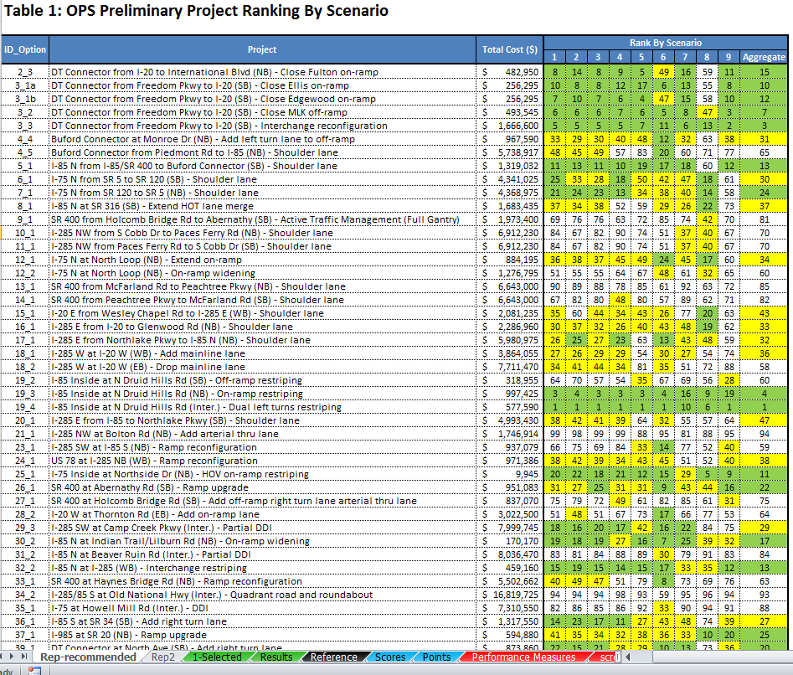
Prioritization Tool
Project Ranking for various Scenarios

Slide 21
Findings
Higher performing projects consistently rose to the top regardless of the weighting scheme
74 projects were recommended due to being low-cost strategies
Tool helped with prioritizing and phasing projects
Several of these projects are being implemented at this time

Slide 22
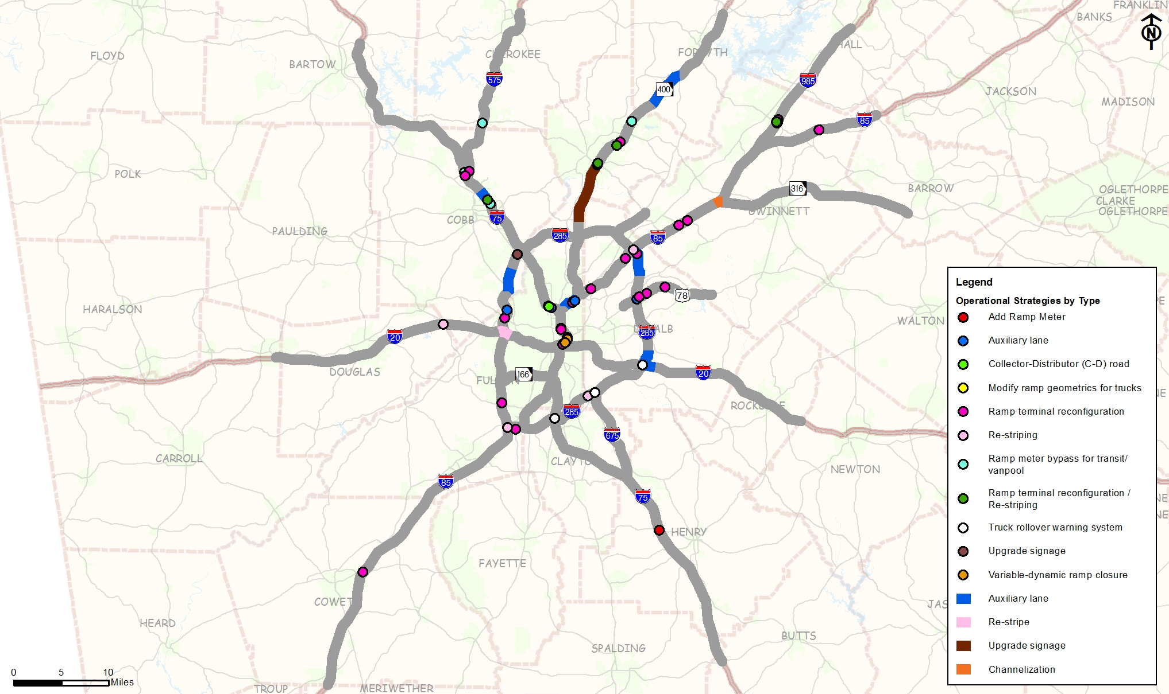
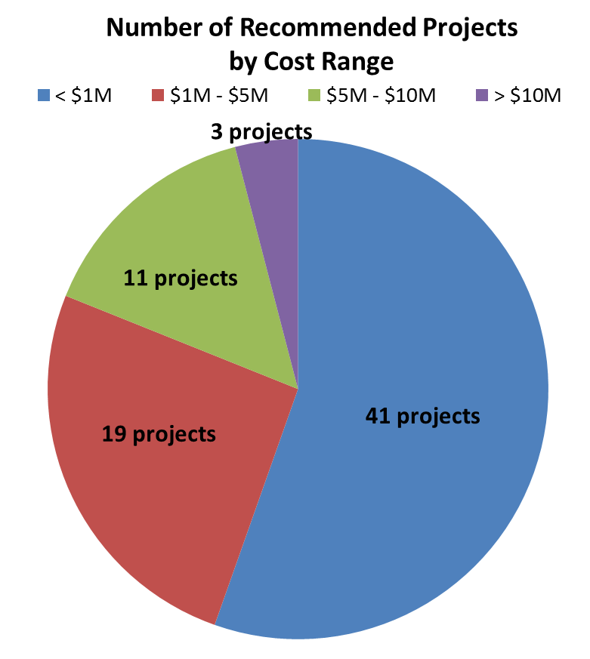
Recommendations

Slide 23
QUESTIONS
Kyle Mote, GDOT PM
GDOT Office of Planning
kmote@dot.ga.gov (404-631-1987)
Keli Kemp, AICP – Consultant PM
HNTB Corporation
kkemp@hntb.com (404-943-5747)
Chandra Khare, Consultant Task Leader
HNTB Corporation
ckhare@hntb.com (404-943-5797)

