Slide 1

Utilizing Multi-threading, Parallel Processing, and Memory Management Techniques to Improve Transportation Model Performance
Jim Lam
Andres Rabinowicz
Caliper Corporation
TRB Planning Applications 2015 Conference
May 18, 2015
Atlantic City, NJ

Slide 2
Overview
  Motivation
  Overview of Techniques
  Model Descriptions
  Performance Tests
  Limitations
  Implementation
  Conclusions

Slide 3
Motivation
Many more zones for conventional models
More complex models (Dynamic Traffic Assignments, choice model etc.)
Good modeling practice requires many feedback, calibration, and scenario runs and good assignment convergence
Time and budget constraints
Long run times lead to compromises

Slide 4
Hardware Improvements
Multi-core chips with hyperthreading
64-bit programming
More memory
Faster drives

Slide 5
Overview of Techniques
Multi-threading
  Operation is internally broken down and handled simultaneously by processing cores
  Order independent operations
Parallel Processing
  Operations invoked and managed simultaneously
Distributed Computing
  Operations are invoked on different computers simultaneously
Memory Management
  Entire datasets are completely processed in memory
Combination of Techniques
Notes:
Combination of techniques involves combining multi-threading with parallel, memory management with parallel, multi-threading with parallel and distributed computing, and other combinations.

Slide 6
Examples
Matrix Operations
  12,000 x 12,000 x multi cores Exp() operation
Data Operations
  170,000 records, 512 fields, reads, writes, formulas
Highway Skim
  12,000 x 12,000 x multi time periods and classes
Transit Skim
  12,000 x 12,000 x multi time periods and classes
Gravity
  12,000 x 12,000 x multi time periods and purposes
Highway and Transit Assignments
  5,000 x 5,000 x multi time periods
Notes:
Data examples are from real life large MPO models like SCAG, NYMTC, and other select MPOs.

Slide 7
Performance Tests – Multi-threading
Notes:
In general, performance improves as the number of cores allocated to the operation increases.
Some operations like highway and transit assignment maintain their efficiency as cores increase.
Some other operations such as matrix operations can experience diminishing returns as input/output and other hardware limitations can cause bottlenecks.

Slide 8
Parallel Processing - Results
Notes:
Running operations that are already multithreaded in parallel can improve performance further.
Some operations that experienced diminishing returns during multi-threading had good performance results when running in parallel (e.g. Highway Skim and Intrazonal).
Other operations such as highway assignment that took up almost 100% of processing power during a single operation run can be further improved when run in parallel, but does see diminishing returns.
Running too many processes in parallel can expose hardware limitations and cause bottlenecks.

Slide 9
Distributed Computing
Notes:
Some operations distribute very well.
In some other cases (e.g. NYMTC MDSC), if a single operation within the parallel operations typically take up the bulk of the processing time, the single operation may limit the performance improvements

Slide 10
Memory Management
Notes:
Putting certain operations completely into memory such as data operations and matrix import can dramatically speed up operations that are typically input/output intensive.
Combining in-memory management with parallel operations can further improve performance.

Slide 11
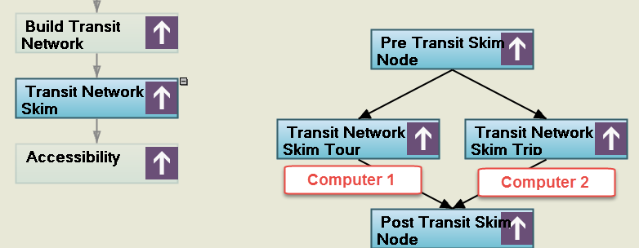
Combined Techniques
Data Example : Transit Skims for SCAG ABM
  130 skims for both Trips and Tours
Multi-threading only: 19 hours
Multi-threading with Parallel: 9 hours
Multi-threading with Parallel with Distributed: 5 hours
Notes:
The above examples shows a combination of multi-threading, parallel processing, and distribution processing which reduces runtime from 19 hours to 5 hours.

Slide 12
Limitations
Processing Cores
Available Memory
Disk Speed
Network Speed
File Conflicts
Different User Hardware
Notes:
The number of cores and number of parallel processes you assign is often limited to the number of available processing cores on your computer
Each additional core and parallel process you assignment requires additional memory, which may be limited
You can generally assign more cores and parallel processes to a faster SSD-like drive over a traditional 7200rpm magnetic drive
Network speed can limit the performance of operations distributed over multiple computers
For parallel processing, looping code may need to be revised if input or output files are accessed simultaneously
Cores and processes assigned will need to be scaled depending upon the available user hardware

Slide 13
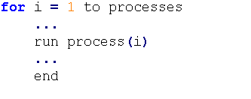
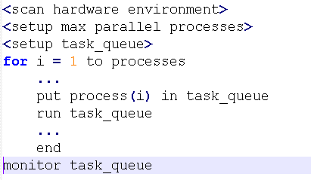
Implementation - Code
Traditional
Parallel
Notes:
When programming in parallel mode, additional statements can be added to scan the hardware environment and limit the number of parallel processes.
Processes are assigned into a queue that is then drawn from during the parallel run.
A monitor task monitors the status of each task being run and will give instructions to other tasks if error conditions are reached.

Slide 14
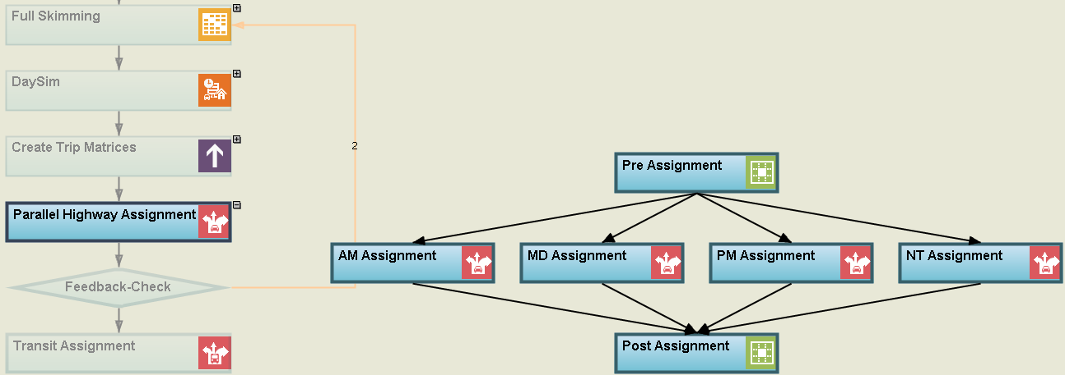
Implementation - Graphic
Notes:
A graphical flowchart interpretation of parallel processing.
In the graphic above, the AM, MD, PM, and NT assignment tasks are all specified at the same level and will be run in parallel.

Slide 15
Conclusions
New techniques have potential for dramatic performance improvements
Combining techniques can improve performance even further
Hardware limitations still exist
Additional improvements are still possible

