Slide 1
Use of Person-Level Variables in Household Survey Expansion to Support Activity-Based Models
TRB National Transportation Planning Applications Conference
Brent Selby
Anurag Komanduri
Kimon Proussaloglou
with Jonathan Ehrlich, Metropolitan Council
May 18, 2015

Slide 2


Why Expand Data?
Model estimation at individual level
  Activity-based ~ behavioral
Survey responses vs. population
Proper representation of market segments
Notes:
ABM – future, individual
Must capture survey
Doing only HH is insufficient

Slide 3


Methodology - Overview
Match household travel survey (HTS) responses to population by demographics
Start at the HH level
Finish at the person level
ACS Public Use Microdata Sample (PUMS)
  Household and person level

Slide 4
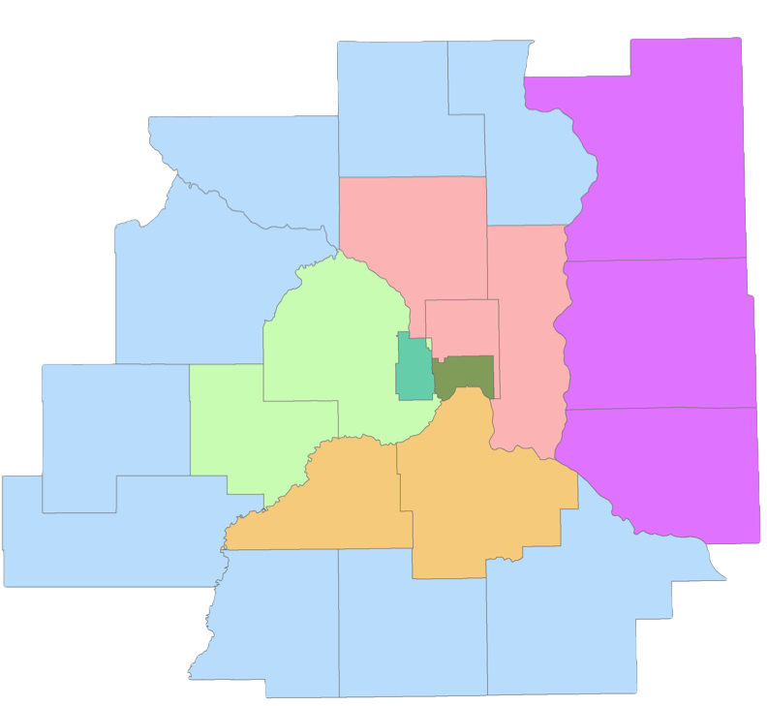
Household Travel Survey
Address-based
Multi-mode retrieval
HH-level survey targets
  Region (7)
  HH size (4)
  HH vehicles (3)

Slide 5
Step 1: Household Level Weighting
Iterative proportional fitting (IPF) in 4 stages
  HH Type X Region
  Stage 1 X HH Size
  Stage 2 X Vehicles
  Stage 3 X Workers

Slide 6
Step 1: Household Level Weighting
Iterations needed:
Few records (hard to reach):
  Households with children and 2+ workers
  Households with children and 0 vehicles
Many records:
  Non-working households
Stage 1 | Stage 2 | Stage 3 | Stage 4
2 | 18 | 20 | 28

Slide 7
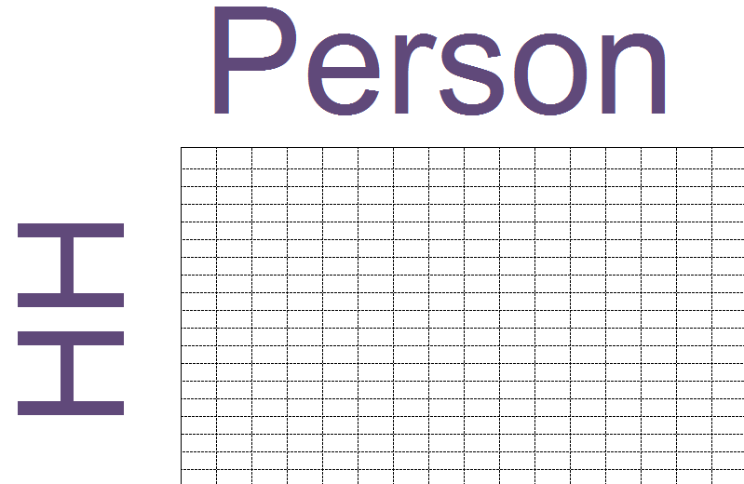
Step 2: Person Level Weighting
Maintain Household Segment Weights
Scale to Person and HH Targets with IPF
  Single stage – all person variables simultaneously
Segments
  Worker status
  Age
  Gender
  Region
415 X 157

Slide 8
Step 2: Person Level Weighting
20 Iterations
Household segments match exactly
Person segments match closely
  Of 154 segments
    75% of within 5% of target
    60% within 3%
    None over 9% off
Person weights averaged to HH

Slide 9
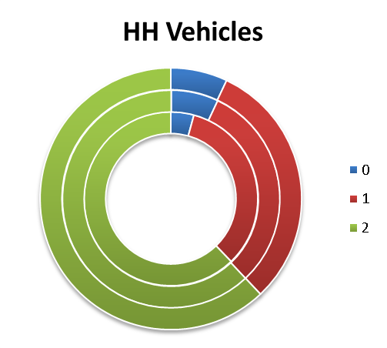
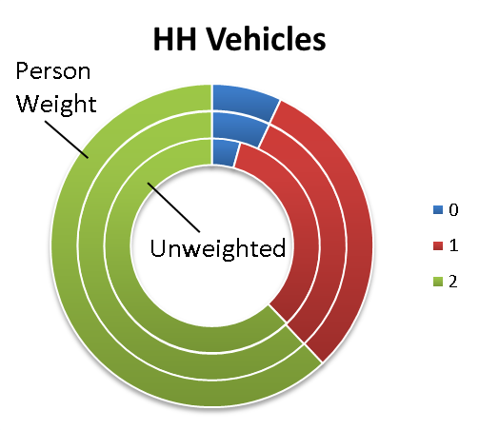
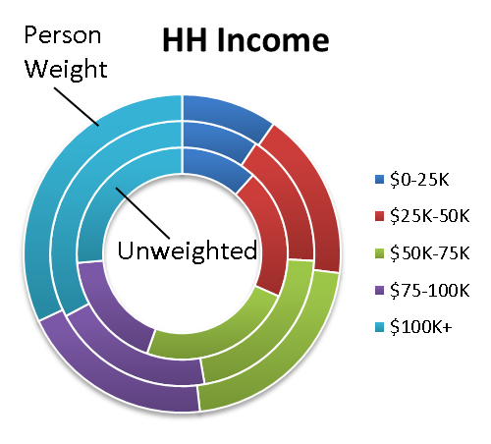
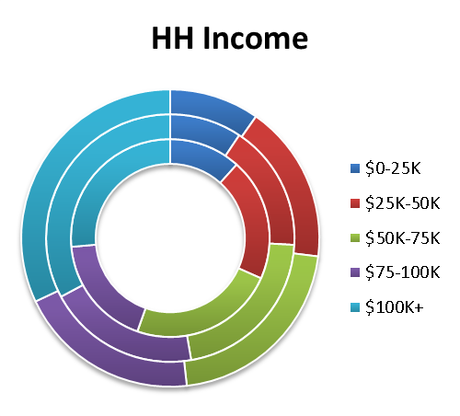
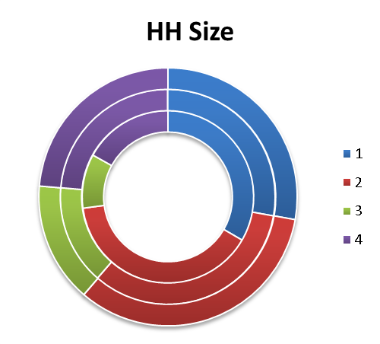
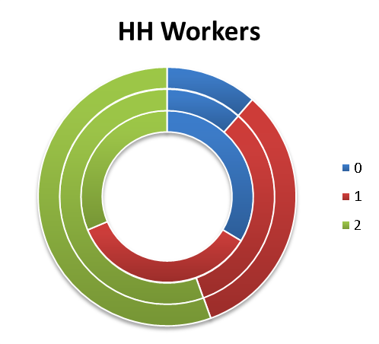
Demographic Changes - Household

Slide 10
Demographic Changes - Person
Notes:
Worker/nonworker flipped?

Slide 11
Demographic Changes - Person

Slide 12
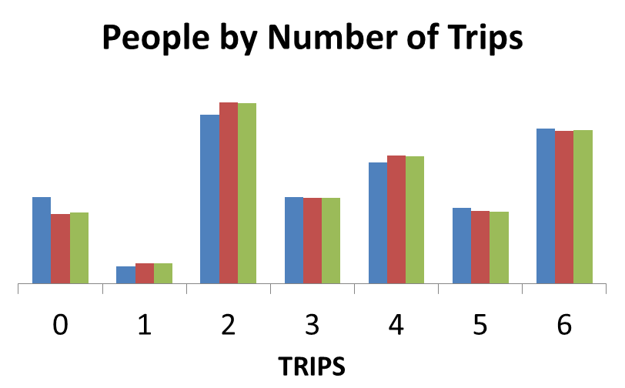
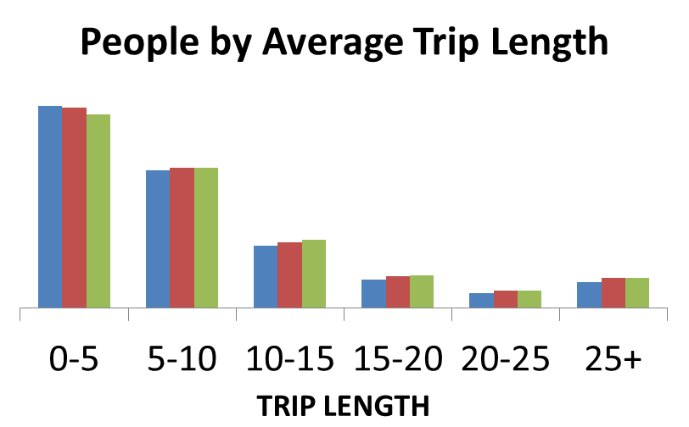

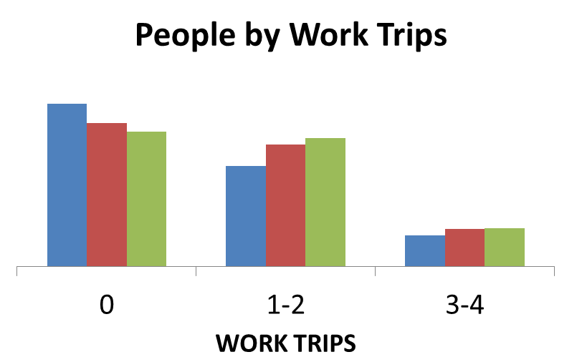
Results - Trip Changes
Total Work Trips
Unweighted | 3.2 M
HH Weight | 3.9 M
Person Weight | 4.0 M

Slide 13
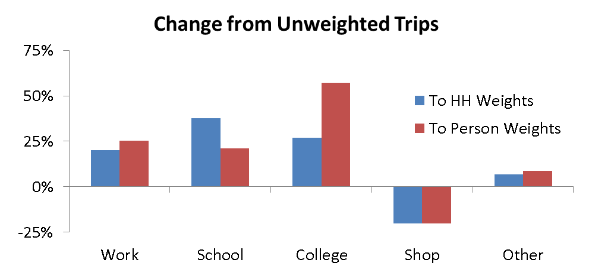
Results - Trip Changes

Slide 14
Conclusions
Model the individual - weight the individual
  Calibration at both levels
Effective method to match survey to population by HH and person segments
Transparent and easy to monitor
Robustness for ABM calibrations
Notes:
language

Slide 15

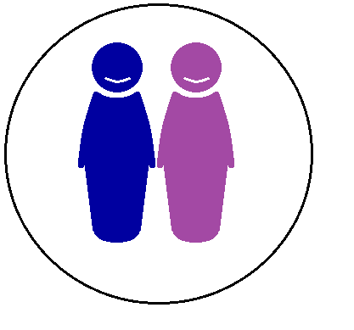








Questions

