Slide 1
Developing Travel Models in Rural Areas Based on Actual, Current, Local Data
Cy Smith, CEO
Sashi Gandavarapu, Data Services Manager
AirSage

Slide 2
Agenda
Examine how cellular data allows less-populated areas to develop travel models based on actual, current, local data versus relying on synthetic models.
Rural traffic planning challenges
How new, passive data are collected and applied
Solutions: review actual case studies and results:
  South Alabama Regional Planning Commission (SARPC)
  Ohio-Kentucky-Indiana Regional Council of Governments (OKI)
  Moore County, North Carolina

Slide 3
Rural Area Traffic Planning Challenges
Household travel surveys – expensive, time consuming
Traditional survey methods – often miscount and don’t differentiate between residents and visitors
Difficult to justify time and expense to conduct travel surveys
Data for entire regions or state-to-state to include urban and rural – financially and logistically impossible
Sometimes must resort to using data from nearby or similar areas

Slide 4
How New, Passive Data is Collected and Applied
Passively collected from the network signaling data between towers and phones
Anonymous mobile signals: all personal information is removed
Data is then geographically located via tower triangulation to yield a time-stamped location (lat/long)
The data is also tagged with estimated accuracy and validity of each location
Output then aggregated between census tracts or TAZs
Population is then synthesized

Slide 5
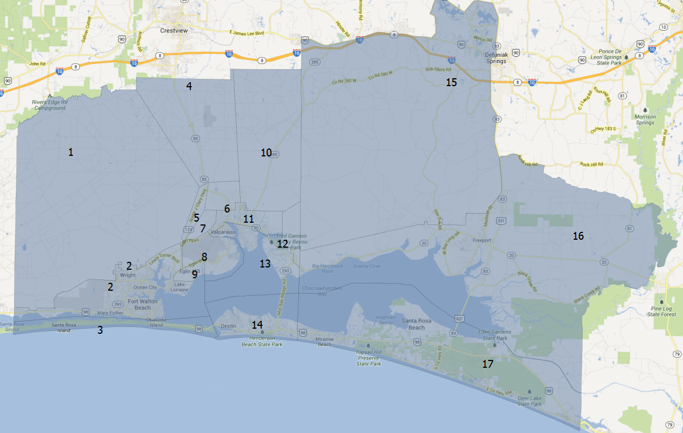
Synthesized Population Accuracy: Niceville, FL
“
The estimation of traffic flows using the AirSage data compares within 3% of the average daily machine counts for the same period. This is within range of counter error and provides very good correlation with the origin and destination
data.
- Tom Hiles, HDR
”
Notes:
As an example of accuracy – this map highlights a bridge crossing in Niceville, FL
With this project, AirSage was looking at travel patterns and the number of people crossing the bridge.
HDR also had machine counts that validated the AirSage data to within 3%, which is also within the margin of error of machine counts (this is also very consistent with across all these different types of studies we do).

Slide 6
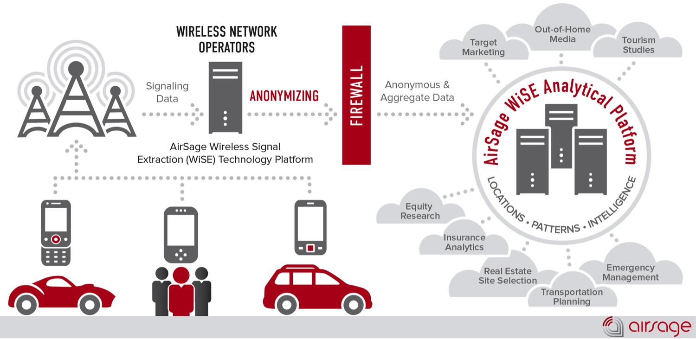

Slide 7
Case Study: SARPC
  South Alabama Regional Planning Commission

Slide 8
SARPC: Background
The SARPC built a multi-county travel demand model to guide regional transportation construction planning for the next 25 years
Used traditional methods to capture traffic data using pneumatic road tubes, network of traffic counts, and limited HHTS
Before committing the resources for implementation, SARPC used mobile data to capture and analyze one month of data

Slide 9
SARPC: Data Inputs
Assembled mobile data from carriers for the entire month of June 2012
Identified transactions being carried out by likely trip makers in study area
Aggregated estimated linked trip OD zonal pairs for each identified trip
Trip purpose identified:
  Home-Based Work (HBW)
  Home-Based Other (HBO)
  Non-Home-Based (NHB)

Slide 10
SARPC: Outcome
84% of the total trips were made by resident devices
Of those resident trips, 56% were resident commuter (47% of all trips)
44% were resident non-commuter (37% of all trips)
Planners had hoped to confirm statistics on carpooling, but discovered that 16% of identified trips were made by visitors to the region
Validating its model using data from every road – no matter how rural – in the three-county region showed:
  cellular signaling data has the potential to change the way people calibrate their models
  with unprecedented levels of confidence
  and significant cost savings over traditional traffic-planning methods
Percentages rounded

Slide 11
SARPC: Employment Trip Ends
Cell phone based county-to-county and intra-county trip interchanges compared to the US Census Longitudinal OD Employment Statistics (LODES) data for the Mobile metropolitan area.
County | Mobile | Baldwin | George | Jackson | Total
Mobile | 116,619 | 5,561 | 560 | 2,923 | 125,662
Baldwin | 8,419 | 44,879 | 9 | 272 | 53,580
George | 2,896 | 153 | 5,331 | 857 | 9,236
Jackson | 3,102 | 256 | 784 | 32,034 | 36,176
Total | 131,036 | 50,849 | 6,684 | 36,085 | 224,654
AirSage HBW
County | Mobile | Baldwin | George | Jackson | Total
Mobile | 120,684 | 8,767 | 354 | 87 | 129,892
Baldwin | 17,524 | 38,554 | 23 | 7 | 56,108
George | 1,970 | 145 | 1,755 | 2,028 | 5,898
Jackson | 985 | 77 | 779 | 28,530 | 30,371
Total | 141,163 | 47,543 | 2,911 | 30,652 | 222,269
Census LODES

Slide 12
SARPC: Calibration
Trip distribution parameters were tested in the model to determine reasonableness against observed travel behavior.
Trip length frequency distribution (TLFD) curves – analyzed available mobile data to estimate a gamma distribution function describing the shape of the TLFD curve for each trip purpose.
Trip Length Frequency Distribution Curves (gamma distribution function)
 | HBW | HBO | NHB
Trip Length | 18.1924 | 15.868876 | 17.19881006
a | 0.0000 | 0.0004 | 0.0001
b | 4.8049 | 3.3254 | 4.0215
c | -0.3190 | -0.2725 | -0.2919

Slide 13
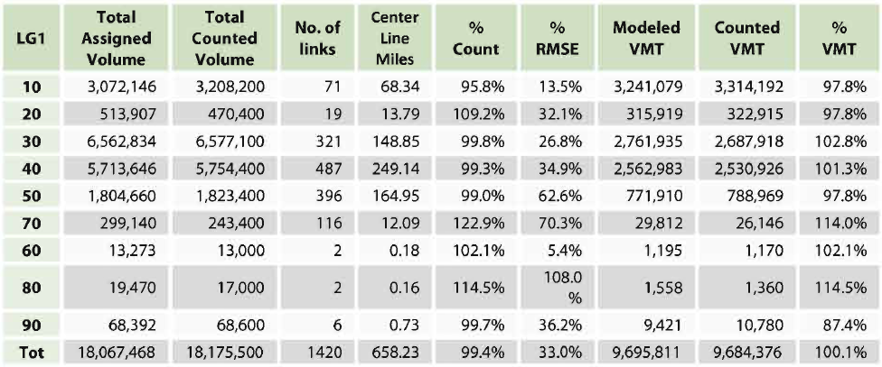
SARPC: Validation
After applying the calibrated trip distribution model, results entered into the new 2010 base year traffic assignment model and compared to Alabama DOT 2010 traffic counts by functional class
Final base year 2010 traffic assignment results:
Overall match against counts is within -0.6% at 99.4% of total counted volume and the overall match against VMT is within 0.1% at 100.1% of total counted volume.
RMSE% overall is at 33%; the RMSE by category is within acceptable ranges for each classification

Slide 14
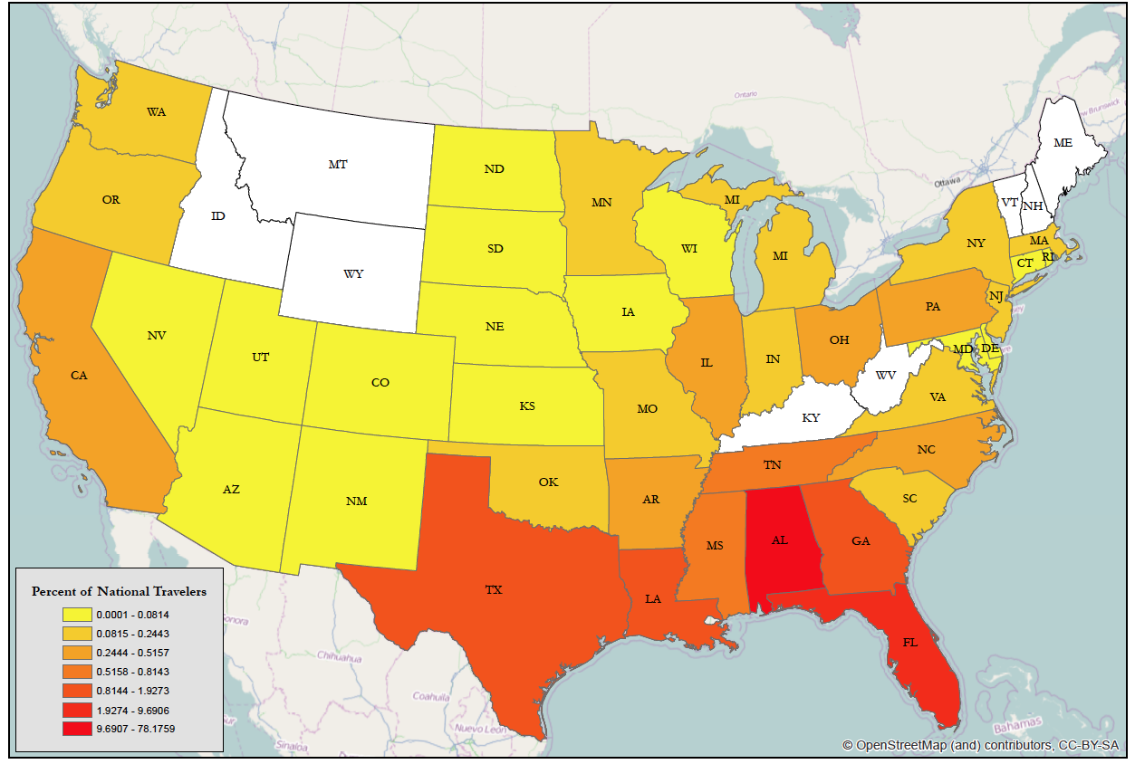
SARPC: Outcome
The mobile data also provided the home locations of travelers over the study period
Example: Travelers Across Mobile Bay, Alabama

Slide 15
Case Study: OKI
  Ohio-Kentucky-Indiana Regional Council of Governments

Slide 16
OKI: Background
Create updated travel model for the tri-state area that would accurately document current travel patterns and forecast transportation needs for the next 30 years
Last similar survey was done in 1995 and relied upon a combination of data sources, including household studies, GPS tracking and freeway surveys.
The last Household Travel Survey (HHTS) took more than two years to complete and cost $1.2 million
New study primary goals:
  Measure where people are coming from and going to
  Differentiate travelers who are part of the region from travelers simply going through the region

Slide 17
OKI: Challenge
No longer had access to a key data source: freeway surveys
98% of all traffic in the area travelled on the freeway
“If we mess up and the model says it should take 2 lanes and it really needed 4, the cost of getting it wrong could be 10-20 years of people sitting in traffic.”
- Andrew Rhone, Transportation Modeling Manager and Project Leader for OKI

Slide 18
OKI: Data Inputs
Mobile device data replaced the traditional freeway survey (to comply with legal restrictions) and created the Trip Matrix study
Population movement analytics and trip matrix study for the areas within the eight-county OKI region.
Covered an area serving:
  2+ million people
  1,300+ miles of freeway
The study using mobile data was able to capture (in pure trip count) almost 500 times the number of trips than the HHTS.

Slide 19
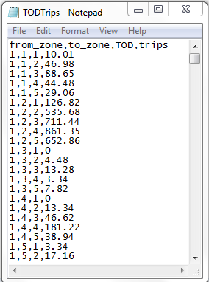
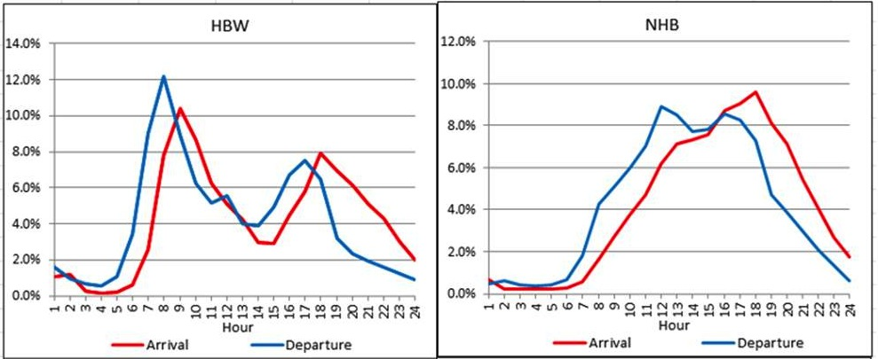
OKI: Outcome
Captured data from more than 2 million people on 1,300 miles of freeway
Delivered almost 500 times the number of trips from previous HHTS
Previous HHTS took 2+ years to complete at a cost of $1.2 million
The mobile data study was completed in 2 months at 93% cost savings

Slide 20
Case Study: Moore County
  Moore County, North Carolina
  Rhett Fussel, Parsons Brinckerhoff

Slide 21
Moore County: Background
Moore County’s transportation planning did not have access to reliable information about traffic volumes and travelers on U.S. 1, from Aberdeen through Southern Pine
Household travel survey was expensive and inaccurate
Previous small sample sizes often represented as few as 1/100 households
Study gathered 11.6 million trips representing 1/6 Moore County residents

Slide 22
Moore County: Data Inputs
OD data collected from cellular devices was compared to the Triangle Regional Model (TRM)
  Included more than 600,000 mobile devices in the TRM over a 60-day period
TRM household survey / travel demand model included:
  2,579 Traffic Analysis Zones (TAZ)
  Covering Wake, Durham, Orange Counties and portions of Chatham, Franklin, Granville, Harnett, Johnston, Nash, and Person Counties

Slide 23
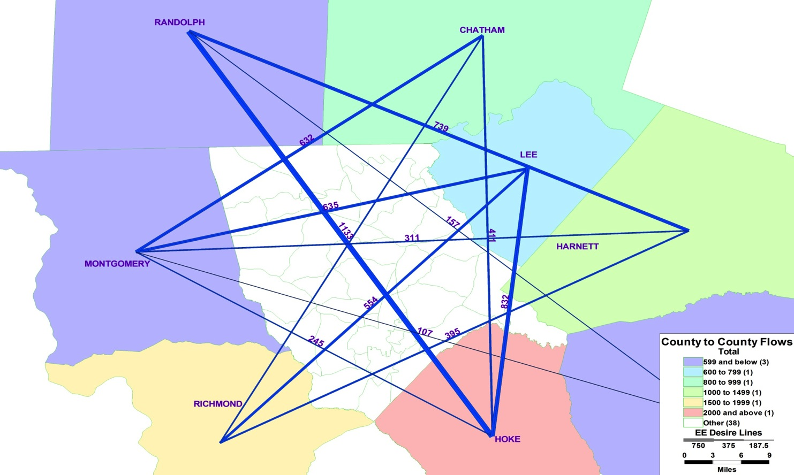
County-to-County Flows (Through Trips)

Slide 24
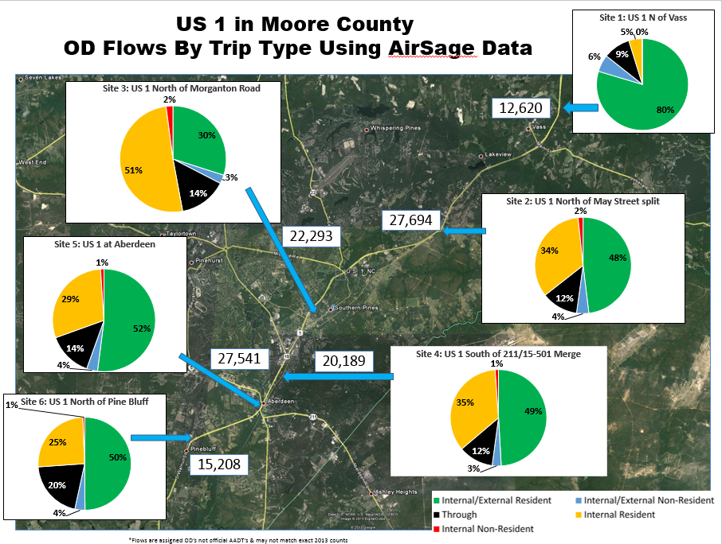

Slide 25
Moore County: Calibration
Advanced trip-based model estimated and calibrated using travel survey data collected in 2006
Key data elements supporting this research include:
  Socioeconomic data by TAZ
  Internal and external trip tables by time of day
  Attributed highway network

Slide 26
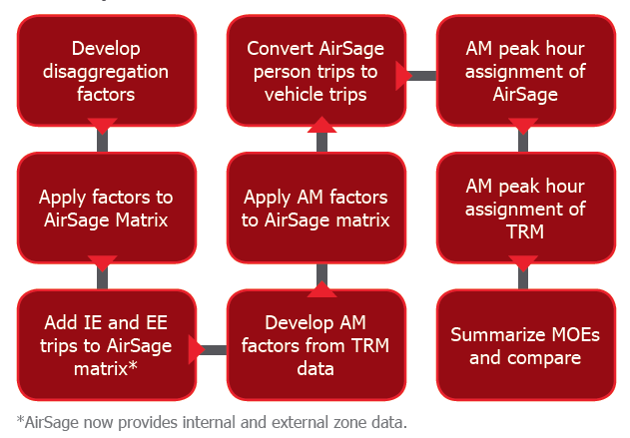
Moore County: Analyzing
To compare AirSage and TRM data, two separate AM peak hour assignments were performed using this analytical process

Slide 27
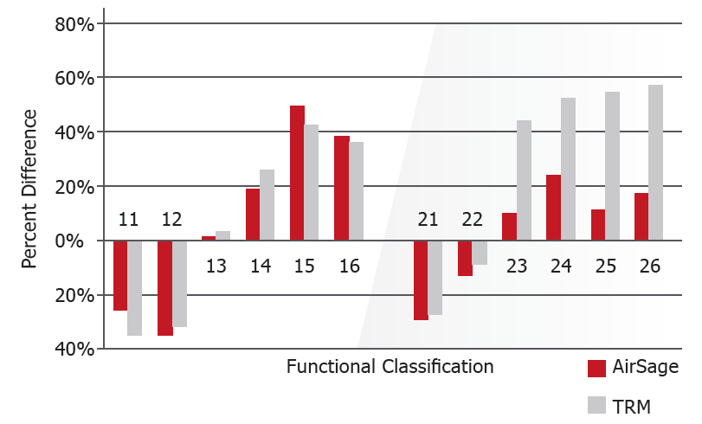
Moore County: Analyzing
Highway Assignment Comparisons by Functional Class
The area where the two methodologies differed greatly was the highway assignment comparisons to traffic counts by functional classification.
In rural areas, classifications 23-26, mobile data matched traffic counts more accurately than the TRM.

Slide 28
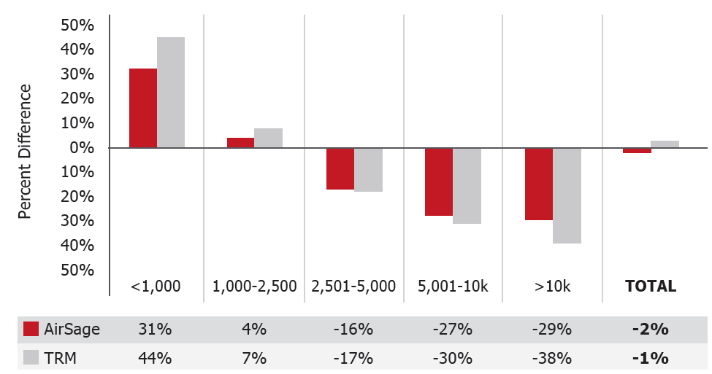
Moore County: Analyzing
Assignment Comparisons by Volume Group
When comparing highway assignments to traffic counts by volume group, results between the two methodologies are slightly closer, with the mobile data having a lower margin of error.

Slide 29
Moore County: Socioeconomic Factors
We were able to connect the mobile data with census data
This example compares employment data by type
  shows higher industrial employment for zones covered by rural facilities
  lower totals for office and service employment as compared to zones covered by urban facilities
  Compared county by county in addition to comparing employment type
This data can also be used to compare median income and persons per household

Slide 30
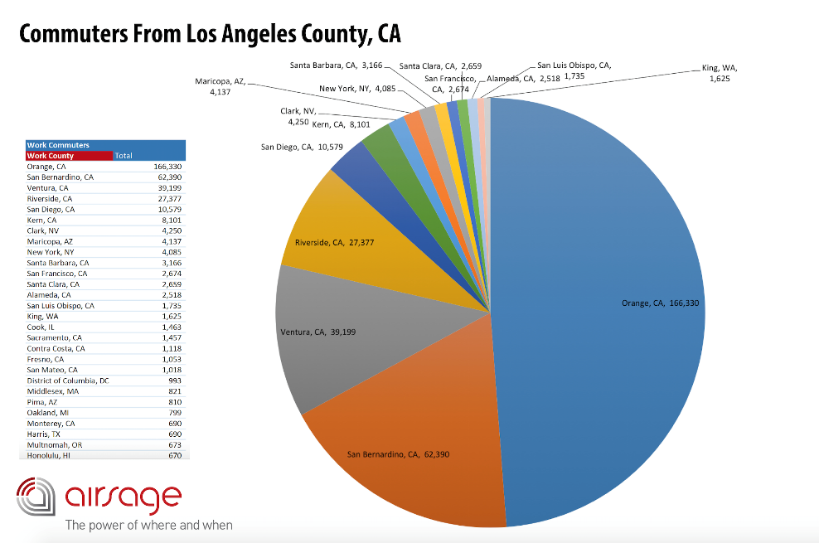
Test the Data – Nationwide Commute Report (Free)
AirSage offers free Nationwide Commute data that can answer questions like:
  How many people commute to my county and from which counties do they commute?
  Which top 20 counties do people commute from when commuting to my county?
  Which nationwide counties do people commute to that live in my county?
  How can I see indications of the labor market shifting across the nation?
Use the data to help:
  Analyze regional & state-wide commute patterns
  capital project / infrastructure prioritization
  understand consumer commute patterns
  transportation model validation
  transit planning and more…
http://airsage.com/News/Nationwide-Commute-Report/

Slide 31

Q & A
Cy Smith, CEO
www.airsage.com
csmith@airsage.com
404-809-2499
Notes:
Mention that much of the data presented can also be seen in the white paper on our site or grab their card after the session and we’ll email them a link.

Slide 32
Appendix

Slide 33
Appendix: SARPC

Slide 34
SARPC: Total Trips by Purpose
Comparison of trips obtained to the previous Mobile MPO TDM and the proportion of trips by purpose compared to NCHRP reported typical ranges
Trip Matrix: Purpose (Internal Trips)
 | MATS 2007 |  | AirSage 2012 |  | NCHRP 2009 Ranges
 | Trips | Percent | Trips | Percent | Low | High
HBW | 279,300 | 26.13% | 124,403 | 11.0% | 14.0% | 15.0%
HBO | 563,900 | 52.76% | 582,190 | 51.3% | 54.0% | 56.0%
NHB | 225,600 | 21.11% | 427,636 | 37.7% | 30.0% | 31.0%
Total | 1,068,800 | 100.0% | 1,134,229 | 100.0% | - | -

Slide 35
SARPC: Employment Trip Ends
Cell phone based county-to-county and intra-county trip interchanges compared to the US Census Longitudinal OD Employment Statistics (LODES) data for the Mobile metropolitan area.
County | Mobile | Baldwin | George | Jackson | Total
Mobile | 116,619 | 5,561 | 560 | 2,923 | 125,662
Baldwin | 8,419 | 44,879 | 9 | 272 | 53,580
George | 2,896 | 153 | 5,331 | 857 | 9,236
Jackson | 3,102 | 256 | 784 | 32,034 | 36,176
Total | 131,036 | 50,849 | 6,684 | 36,085 | 224,654
AirSage HBW
County | Mobile | Baldwin | George | Jackson | Total
Mobile | 120,684 | 8,767 | 354 | 87 | 129,892
Baldwin | 17,524 | 38,554 | 23 | 7 | 56,108
George | 1,970 | 145 | 1,755 | 2,028 | 5,898
Jackson | 985 | 77 | 779 | 28,530 | 30,371
Total | 141,163 | 47,543 | 2,911 | 30,652 | 222,269
Census LODES

Slide 36
SARPC: Employment Trip Ends
Difference: variance in the total is ~1% of the total trips, the deficit related to trips destined for Mobile County is significant because Mobile County is the core of the study area.
County | Mobile | Baldwin | George | Jackson | Total
Mobile | -4065 | -3,206 | 206 | 2,836 | -4,230
Baldwin | -9,105 | 6,325 | -14 | 265 | -2,528
George | 926 | 8 | 3,576 | -1,171 | 3,338
Jackson | 2,117 | 179 | 5 | 3,504 | 5,805
Total | -10,127 | 3,306 | 3,773 | 5,433 | 2,385

