Slide 1
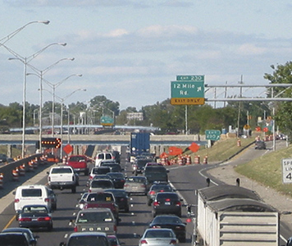
Council Bluffs Interstate System Model
Jon Markt
Source: FHWA

Slide 2
Preview
CBIS Project Overview
  Project challenges
  Project solutions
CBIS Model
  Applications
    Construction Phasing
    Construction Alternatives
    Traffic Impacts / User Costs
  Innovations
    Large Sub-area Microsimulation
    Dynamic Traffic Assignment
    Perpetually refined

Slide 3
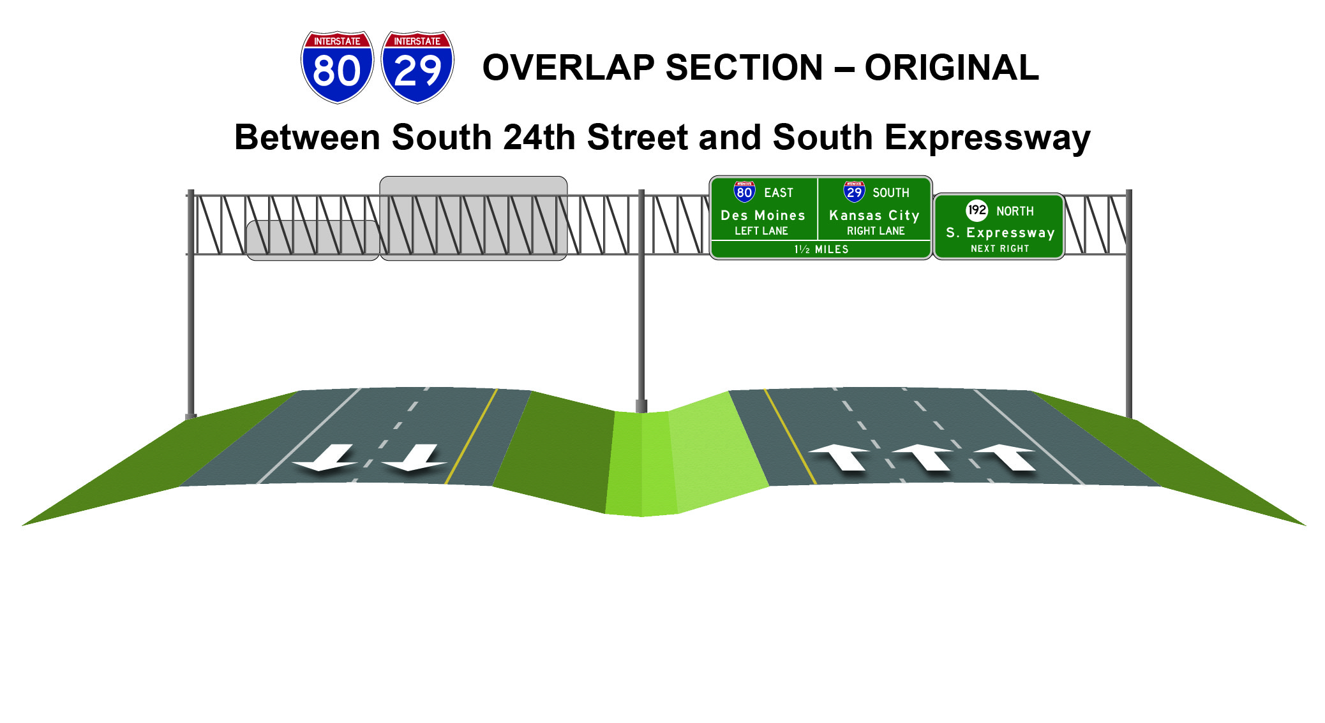
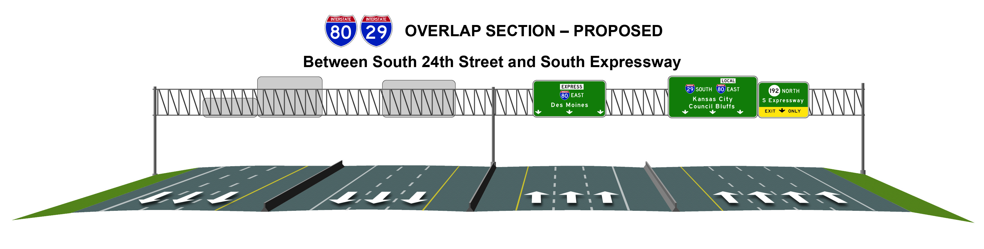
CBIS Program
By the numbers
  18 - miles of interstate system reconstructed
  32 – number of bridges reconstructed
  5 – number of lanes on existing I-80 / I-29
  12 – number of lanes on future I-80 / I-29
  50+ - number of years since the original construction of the CBIS
  130,000 – projected 2030 daily traffic volume on I-80 / I-29
Notes:
http://councilbluffsinterstate.iowadot.gov/files/8313/9100/7895/CBISProgramFactsheet-PRESS_Web.pdf

Slide 4
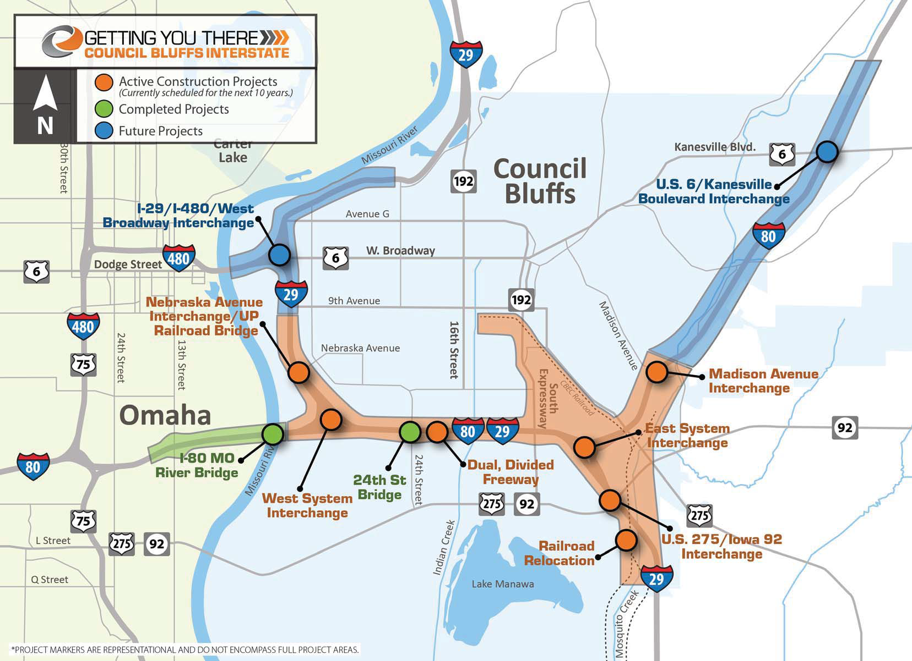

Slide 5
CBIS Model
  Traffic simulation model of Council Bluffs
  Applications
    Construction Phasing Analysis
    Construction Alternatives Analysis
    Traffic Impacts / User Cost
  Innovative Features
    Dynamic Traffic Assignment
    Large Sub-area Microsimulation
    Perpetually refined

Slide 6
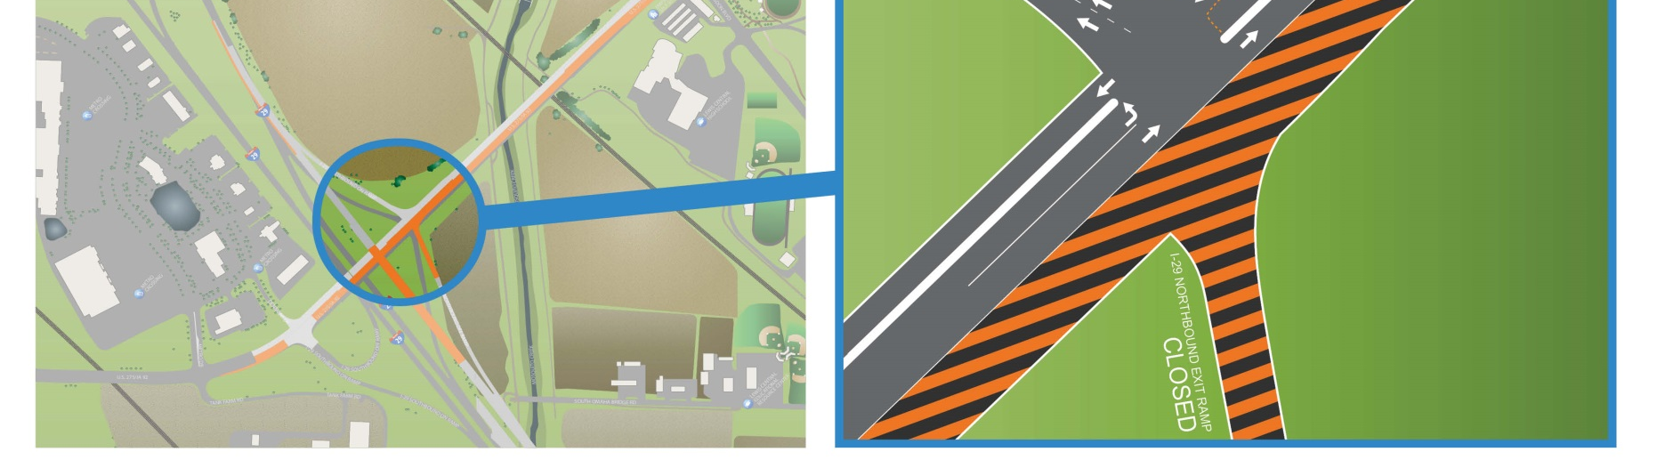
Applications

Slide 7
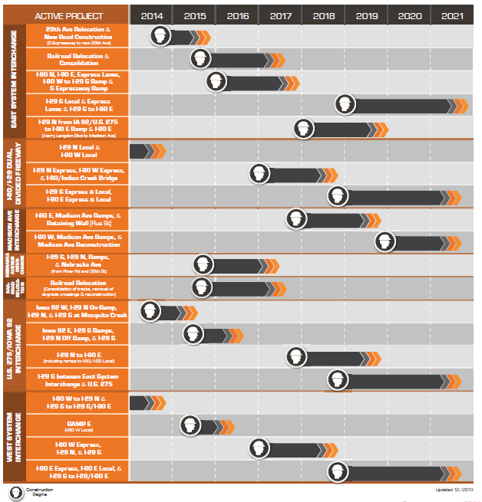
Construction Phasing
  Goal: Reduce overall program costs
  Strategy: Accelerate Construction
  Baseline Schedule
    Final work in fiscal year 2023
    Cumulative construction cost: $734 million
  Accelerate Schedule
    Final work in fiscal year 2020
    Cumulative construction cost: $706 million
  User benefits of accelerated schedule?
  User cost of concurrent work zones?

Slide 8
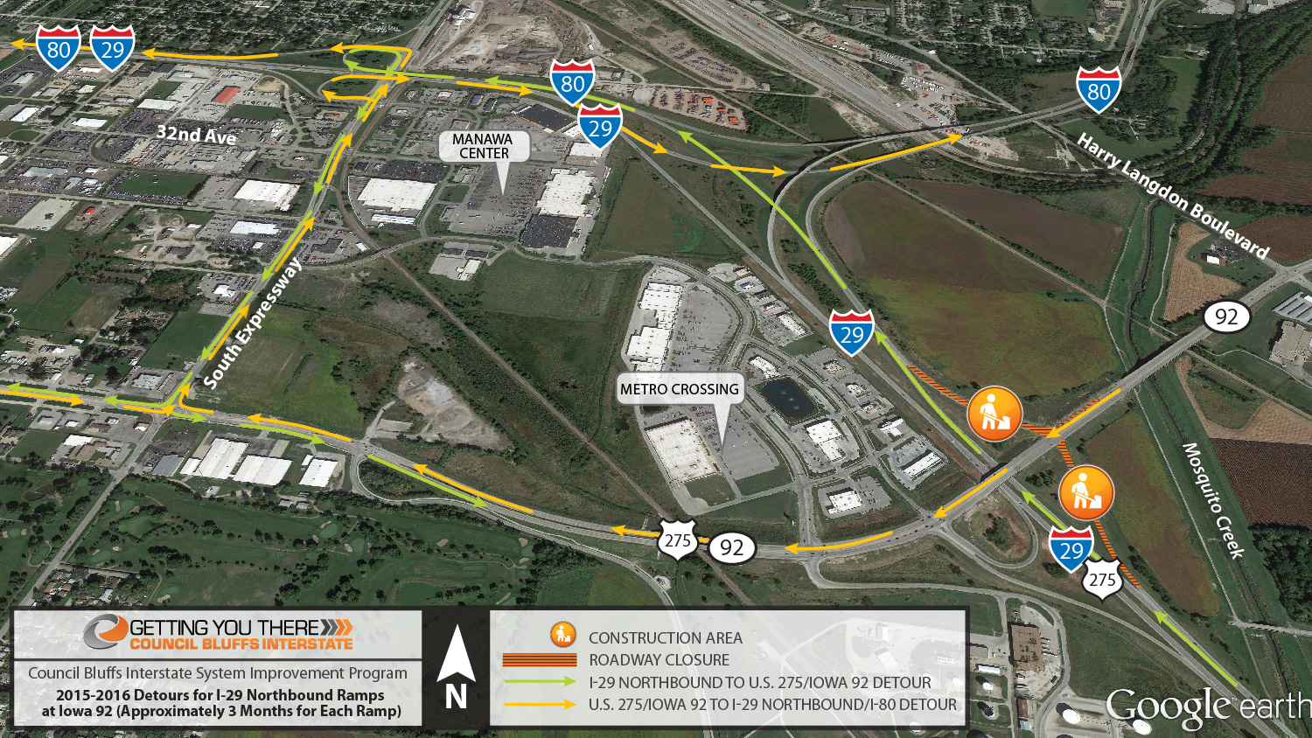

Slide 9
User Cost
Daily Vehicle Miles Traveled (VMT)
Daily Vehicle Hours Traveled (VHT)
Primary road user costs for economic evaluation

Slide 10
Innovative features

Slide 11
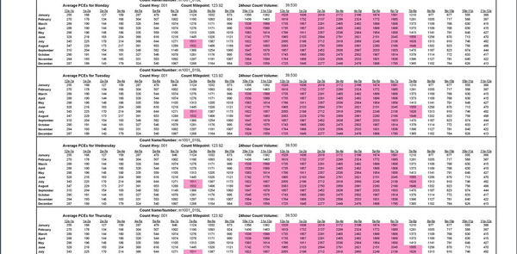
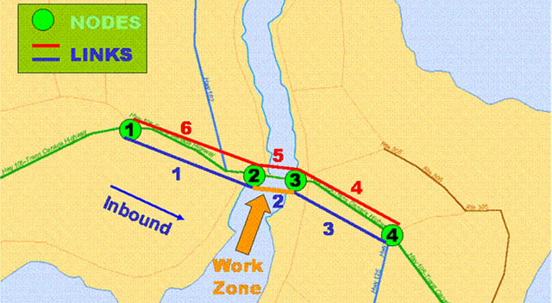
Work Zone Analysis
Limited to particular strategies
Small models, suited for localized impacts
Projects evaluated in isolation
Source: Oregon DOT
Source: FHWA

Slide 12
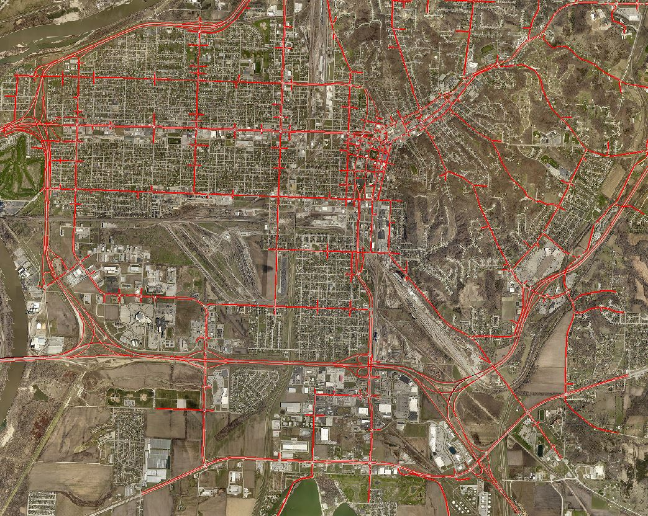
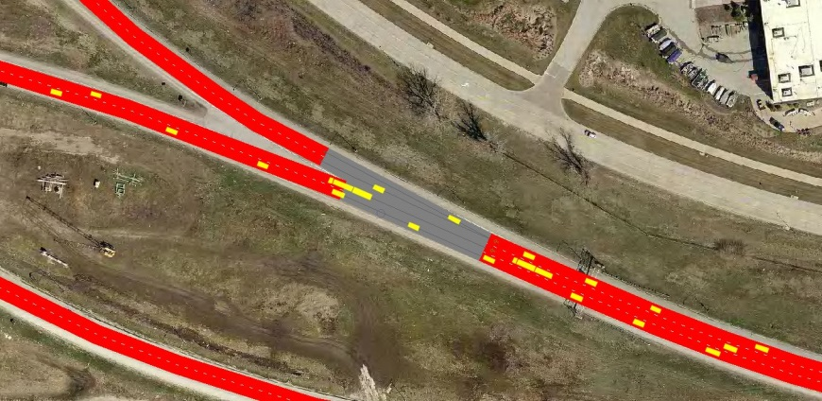
CBIS Model
  Large Sub-area Microsimulation
    Addresses network impacts
    Inclusion of boundary effects
    Couples with DTA to show spatial impacts of congestion on traffic flow and user costs
Notes:
Simulation Run Pictures

Slide 13
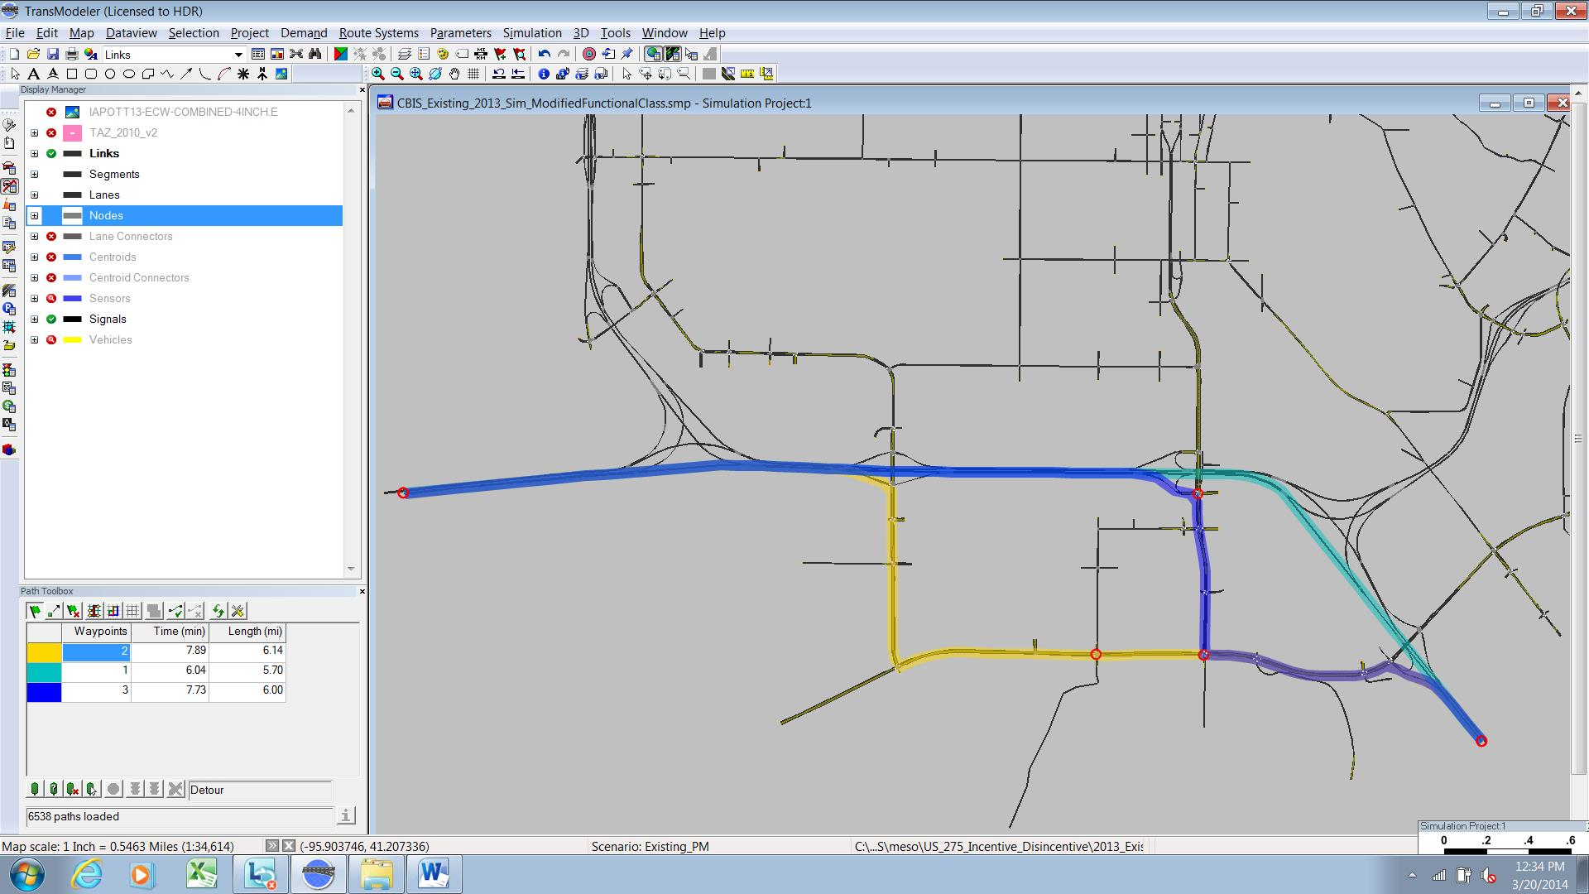
CBIS Model
  Dynamic Traffic Assignment (DTA)
    Time-sensitive routing tool
    Greater sensitivity to congestion than traditional assignment methods (permits queuing)
Notes:
Simulation Run Pictures

Slide 14
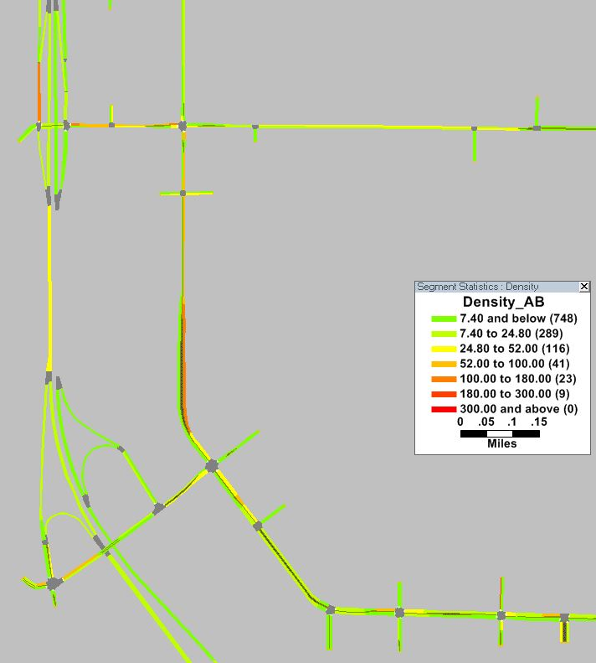
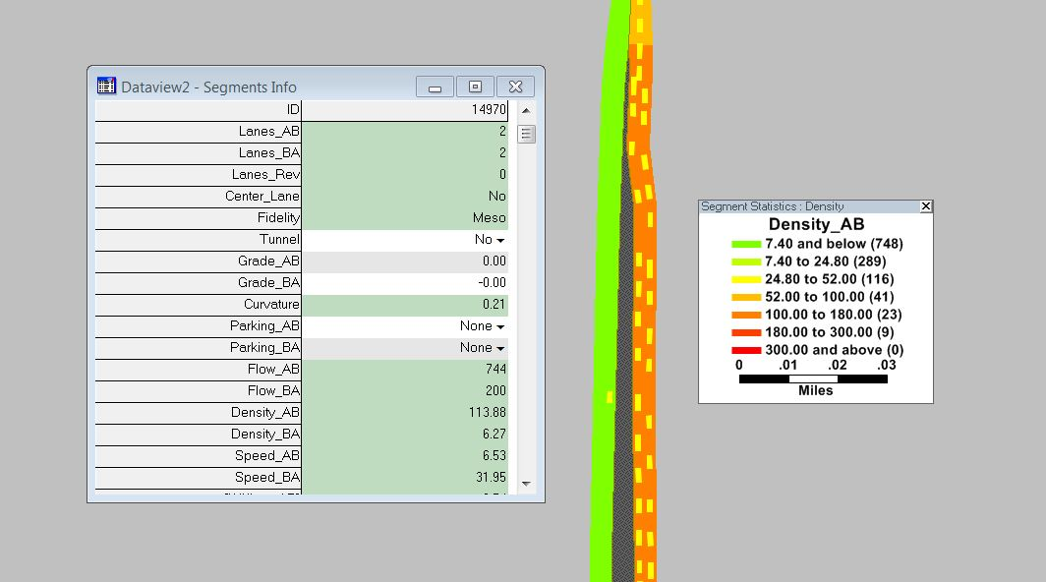
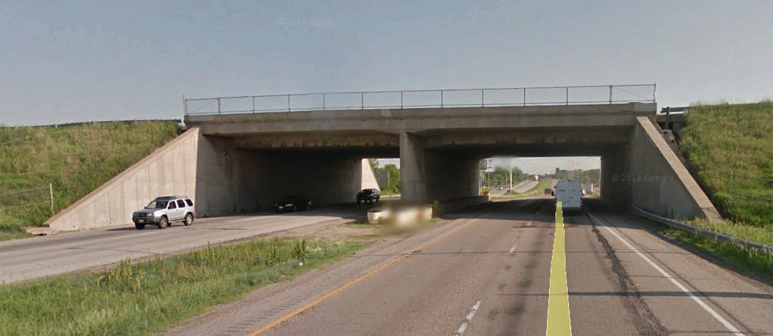
Identifying impacts
Union Pacific Railroad Bridge Reconstruction
  Single lane vs. full closures
  Ramp closures
  Extent of impacts?

Slide 15
Perpetually Refined
Dual calibration – before & “after” construction
  Before
    AirSage origin-destination data
    INRIX speed data
  After
    Iowa DOT sensor data and video
    INRIX speed data
Sub-area refinement and analysis
  Refined input values incorporated in the regional model

Slide 16
CBIS Innovations
Key insights
  DTA and larger microsimulation networks address gaps in traffic analysis and are becoming more practical for day-to-day use
  Model calibration is changing due to innovative new forms of data, better data collection infrastructure, advances in traffic models
  Model as an asset, rather than single use

Slide 17



Innovative features

Slide 18
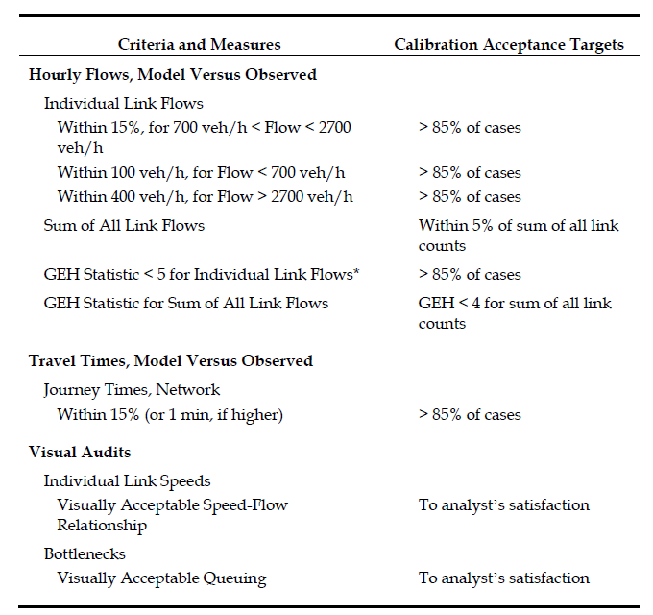
Perpetually Refined
Dual calibration – before & “after” construction
  Before
    AirSage origin-destination data
    INRIX speed data
  After
    Iowa DOT sensor data and video
    INRIX speed data
Sub-area refinement and analysis
  Refined input values incorporated in the regional model
Source: FHWA

Slide 19
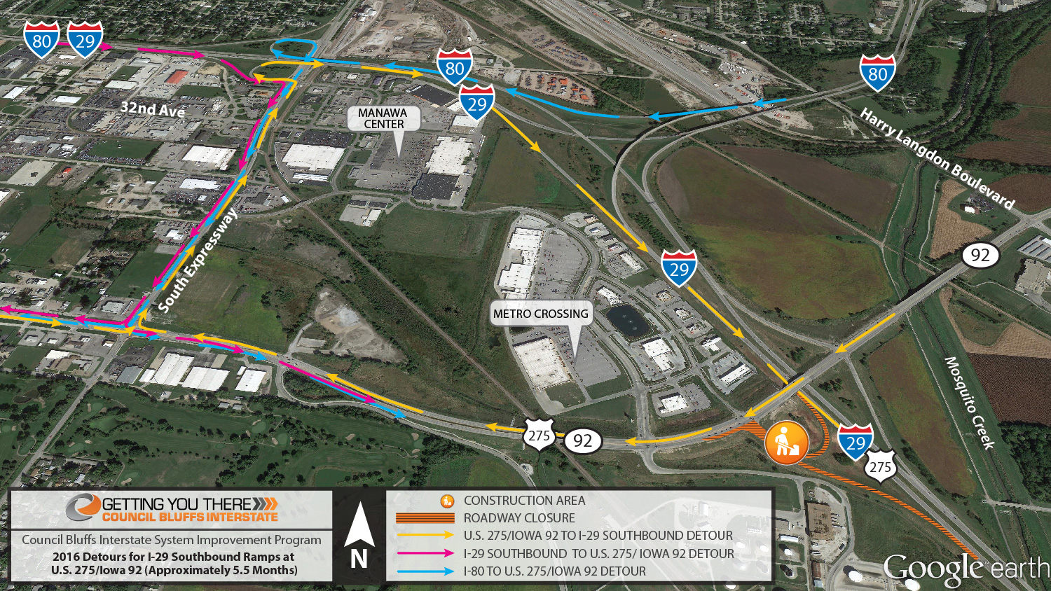

Slide 20
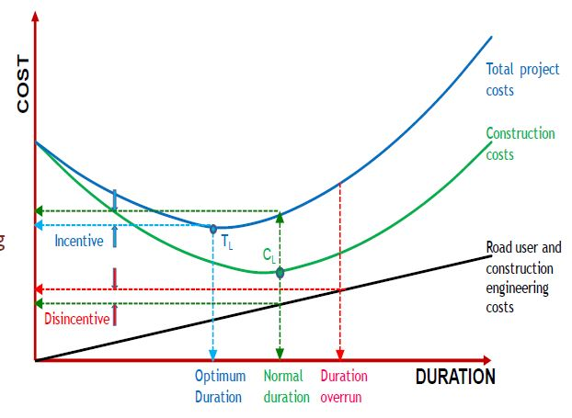
USER COSTs

Slide 22
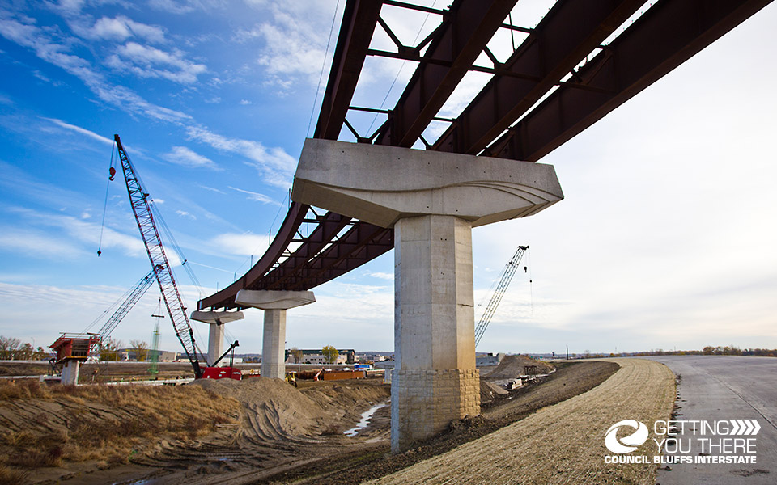
Notes:
http://councilbluffsinterstate.iowadot.gov/resources/photo-gallery/
I-80 / I-29 Overpass - West Interchange

Slide 23
Project Challenges
Project scale
  18 miles of corridor improvements
  Impacts freeways to local roads
Scope of Improvements
  Closures
  Additional capacity
Driver Behavior
  Route choice
Notes:
The CBIS program is being delivered over years, and thus construction will necessarily be performed under traffic. This leads the thought process, what impacts do work zones have on traffic. The impacts can vary widely and depend on a number of features. Some general impacts – Reduced speeds, Un-familiar geometry, close the road – divert traffic. Who do work zones affect? Certainly they affect travelers using the road under construction. They also can affect residents and businesses near construction. But how widespread is the impact. And how do concurrent work zones in close proximity interact with one another. These are the kinds of questions the project team was faced with when considering delivering the CBIS program on an accelerated schedule to reduce duplicated effort and reduce the overall cost of construction.

Slide 24
Work ZOnes
Operating conditions
Route decisions
User cost
Notes:
The CBIS program is being delivered over years, and thus construction will necessarily be performed under traffic. This leads the thought process, what impacts do work zones have on traffic. The impacts can vary widely and depend on a number of features. Some general impacts – Reduced speeds, Un-familiar geometry, close the road – divert traffic. Who do work zones affect? Certainly they affect travelers using the road under construction. They also can affect residents and businesses near construction. But how widespread is the impact. And how do concurrent work zones in close proximity interact with one another. These are the kinds of questions the project team was faced with when considering delivering the CBIS program on an accelerated schedule to reduce duplicated effort and reduce the overall cost of construction.

Slide 25
CBIS Model
  Development – TransModeler Model
    MAPA Regional Travel Demand Model
    AirSage Data
    Aerial Photography
    Signal Timing
    Traffic Counts
    INRIX Speed Data

Slide 35
CLIENT LOGO
TIER 1 HEADER
First Name Last Name
Business Title
TIER 2 HEADER
First Name Last Name
Business Title
First Name Last Name
Business Title
First Name Last Name
Business Title
First Name Last Name
Business Title
First Name Last Name
Business Title
First Name Last Name
Business Title

