Slide 1
Rob Bostrom
Monisha Khurana
Liza Amar
Texas Freight Forecasting
Planning Applications Conference 2015

Slide 2
Presentation Overview
Project Overview of Texas Freight Mobility Plan
Methodology
Forecasts by mode/deficiency analysis
Conclusions

Slide 3
Project overview

Slide 4
Project Overview
Client: Texas Department of Transportation
  CDM Smith Team
  Partnered with Atkins
  Used expertise in modeling/forecasting/data
Scope: First statewide freight plan for the state of Texas
  Inventory of freight assets
  Forecasting
  Economic Analysis
  Stakeholder engagement
Forecasting Task included:
  Modes: Highways, Rail, Water, Air, Pipelines, Border Crossings (International and Interstate), Special Generators
  Years of Analysis: 2010/2014 (base year), 2040 (forecast year)
Deliverables

Slide 5
Methodology

Slide 6
Methodology
Task: Freight forecasts for all freight modes for the base year and future year. Perform a deficiency analysis based on those forecasts.
Goal: to create a forecasting framework to cover:
  All Texas freight modes
  Base year of 2014 & future year of 2040
  Data & Tools
Forecasts developed at two levels:
  Statewide
  Detailed

Slide 7
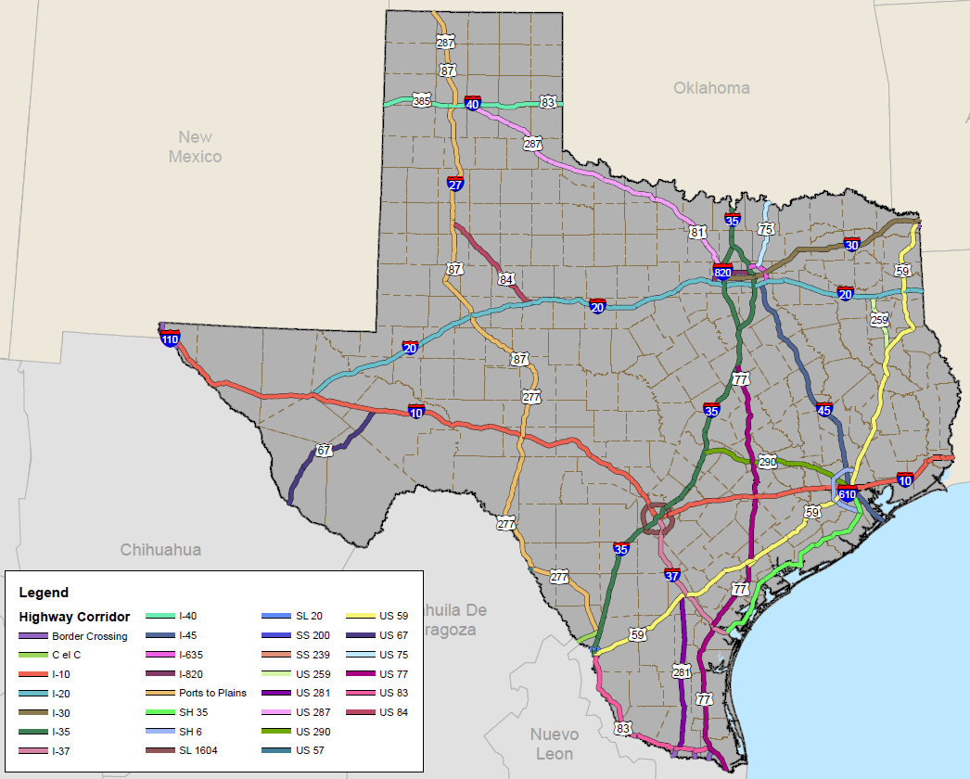
Forecast Modes and Geographic Levels
  Highways: corridors
  Rail: corridors
  Water: counties
  Air: counties
  Pipelines: Point of Entry, lines
  Border Crossing (International and Interstate): Point of Entry for Highway/Rail
  Special generators: counties

Slide 8
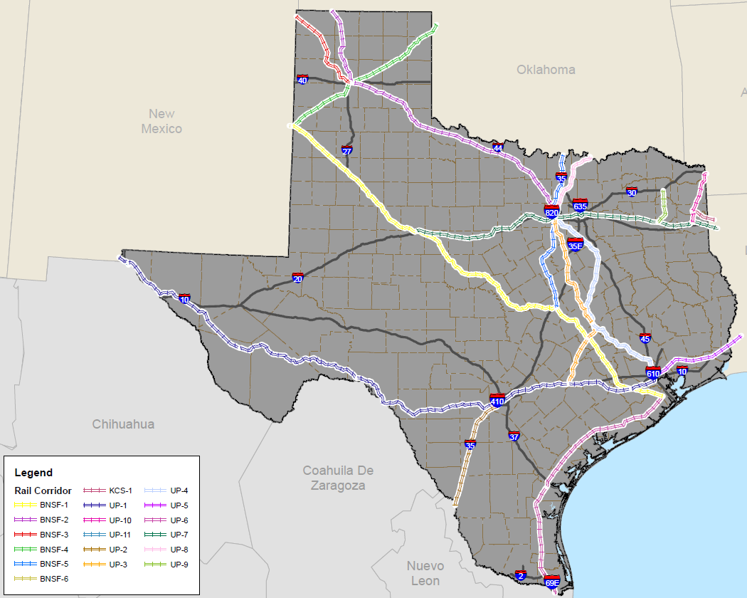
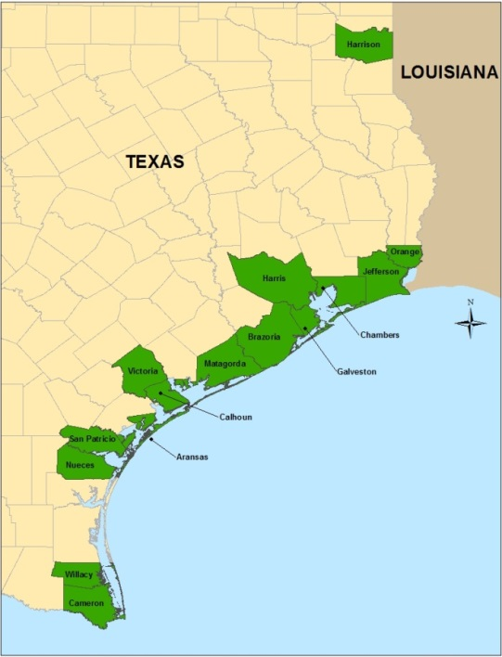
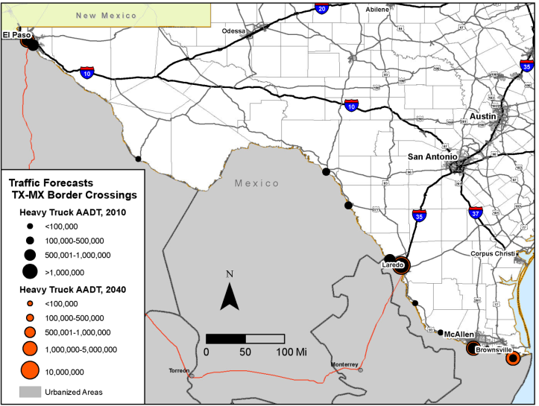
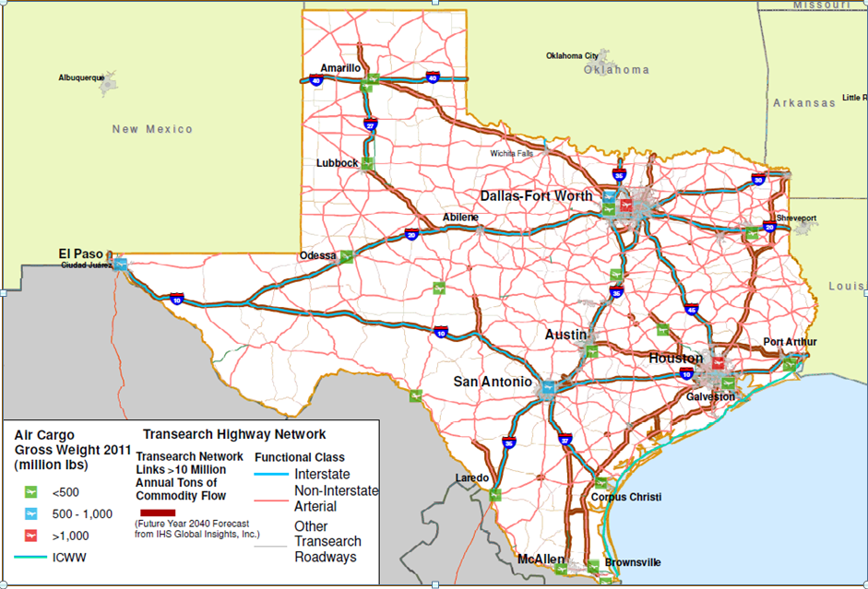
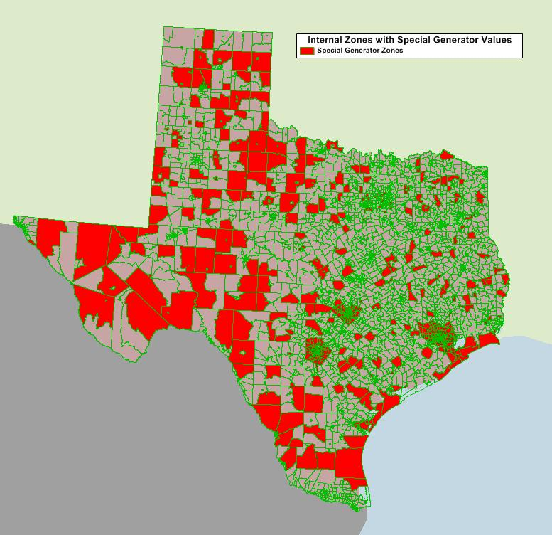
Forecast Areas

Slide 9
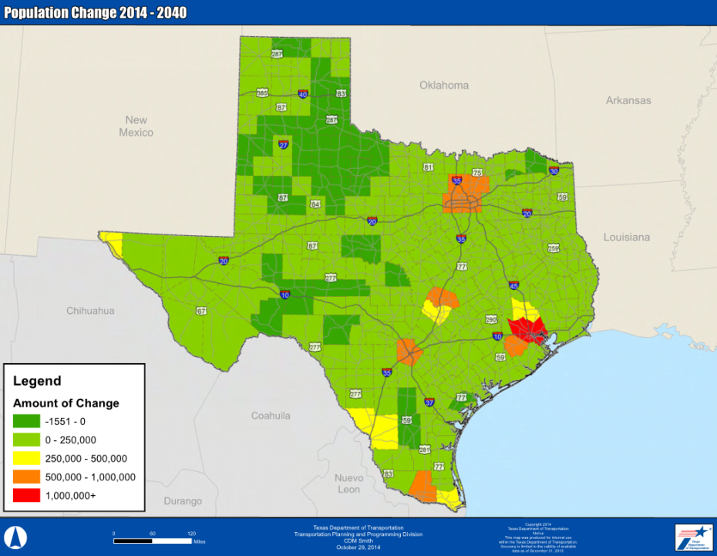
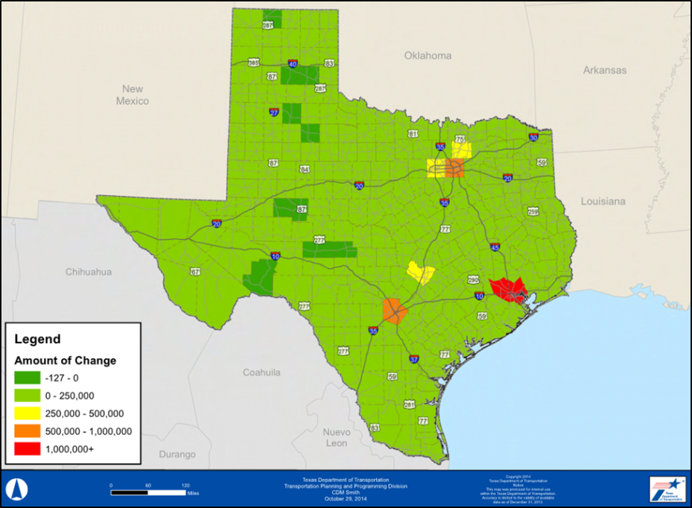
Projected Growth in Texas: 2014-2040
  Population: 48.8% growth from 2014 to 2040
    2014: 27.2 million people
    2040: 40.5 million people
  Employment: 62.4% growth from 2014 to 2040
    2014: 9.7 million jobs
    2040: 15.8 million jobs
Notes:
TX is 14th largest economy in the world!

Slide 10
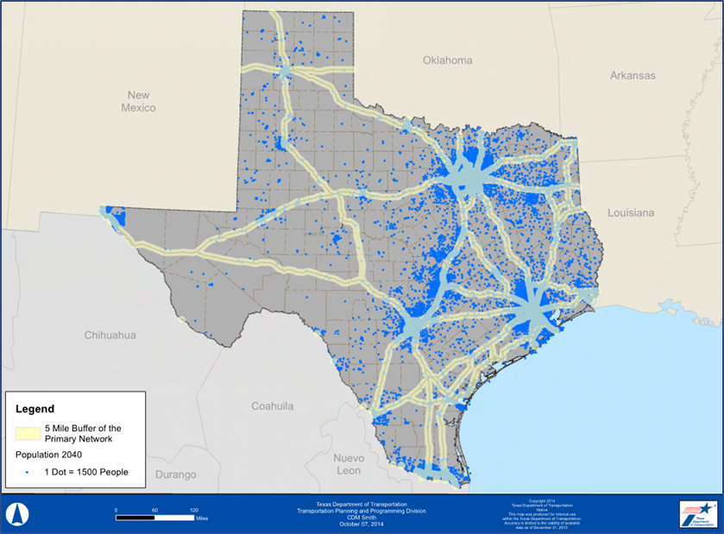
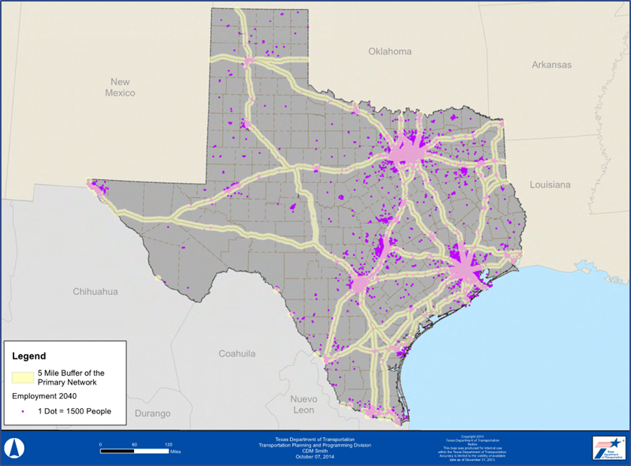
2040: Population & Employment Density
Within 5 mile buffer of Primary Freight Network

Slide 11
Forecast Framework Data Sources
Framework was basically a series of spreadsheets with input from all available data sources
Key data/tools included
  The Texas statewide model (TX SAM v3)
  TRANSEARCH®
  Many others: FAF, USACE, traffic counts/vehicle class data
Partial list shown on table on next slide

Slide 12
Data Sources

Slide 13
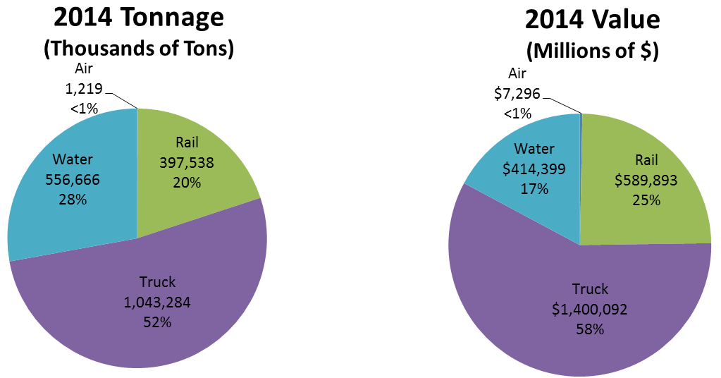
Statewide 2014 Texas Freight Summary
  2014: Over two billion tons of freight
  2014 breakdown of surface modes: truck is dominant mode for tonnage and value

Slide 14
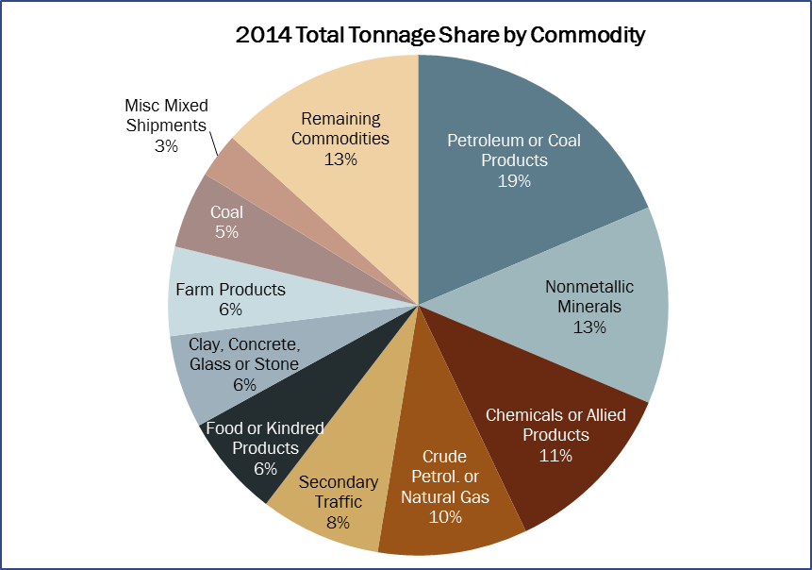
2014: Freight Tonnage by Commodity

Slide 15
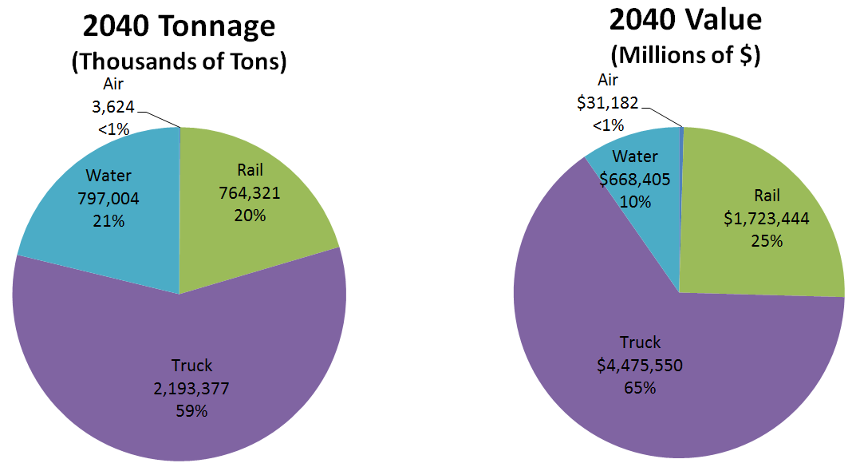
2040 Texas Forecast Summary
Four surface modes: 2 billion tons in 2014 to 3.76 billion tons in 2040
Truck mode: 59% of tonnage in 2040

Slide 16
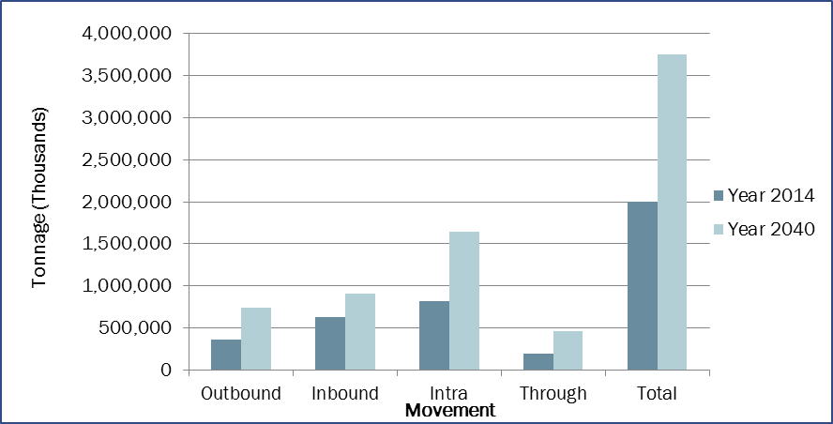
2014 and 2040 Total Freight Tonnage by Direction

Slide 17
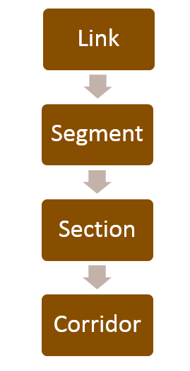
Trucks/Highways: Methodology
Get base data for current year
Develop forecasting framework
Aggregate from link level to segment level
Aggregate to corridor sections
Develop growth rates for 2040
Smooth results
Produce levels of service
Identify deficiencies

Slide 18
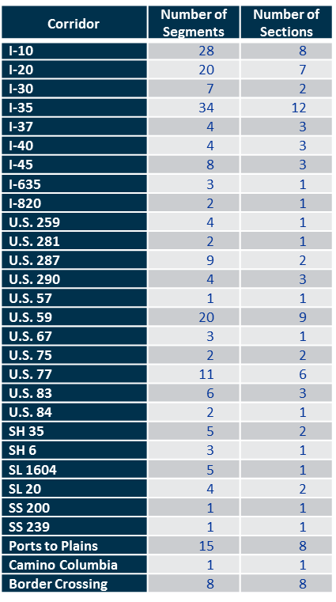
Trucks/Highways: Methodology

Slide 19
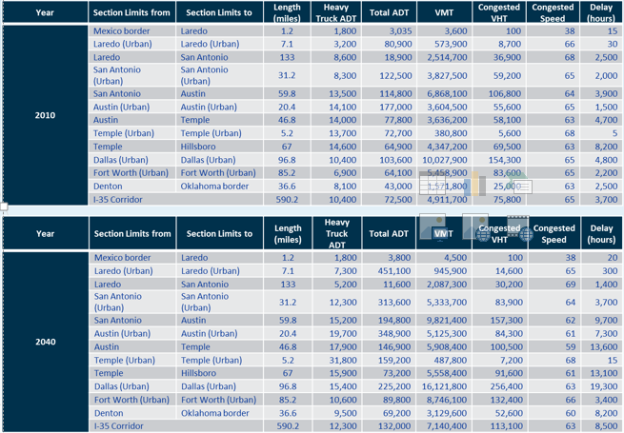
I-35 Prototype

Slide 20
Highway Capacity
Modified TX SAM highway capacity to fit forecasting framework.
Capacity adjustments:
  Parameterized and defined new alpha and beta values by functional class for the VDF
  Parameterized and defined K-factor of 10 to convert hourly capacity to daily capacity
  VC ratios calculated in terms of daily PCE / capacity

Slide 21
Forecasts by Mode

Slide 22
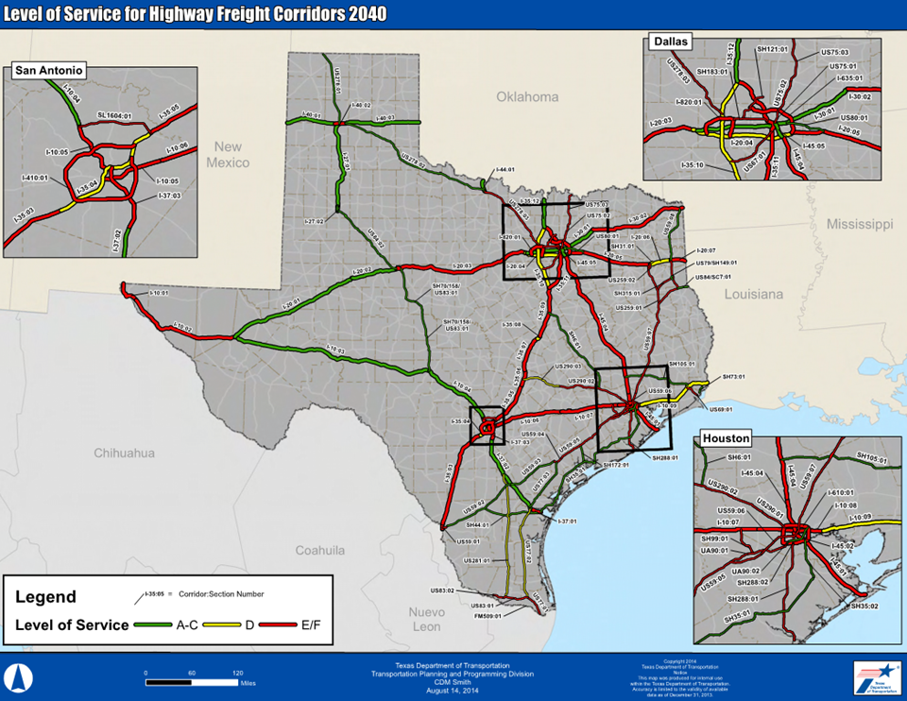
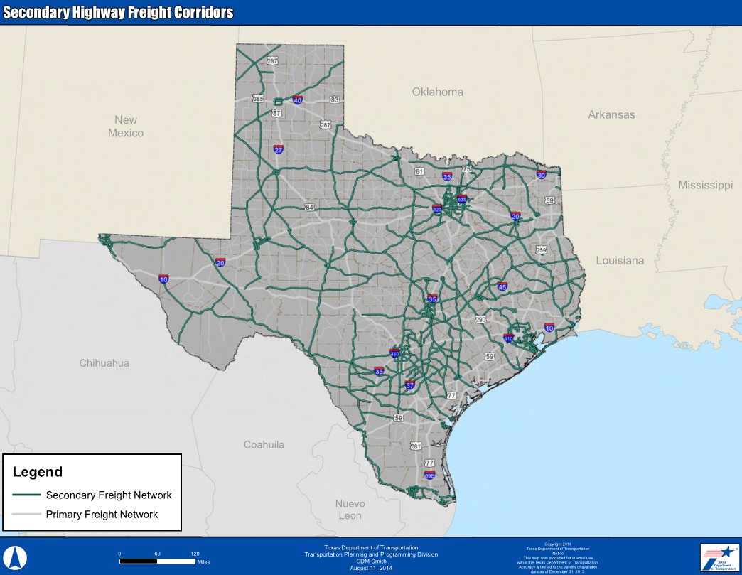
Trucks/Highways: Data Sources and Corridors
TRANSEARCH®
SAMv3 Travel Demand Model
RHiNO (counts)

Slide 23
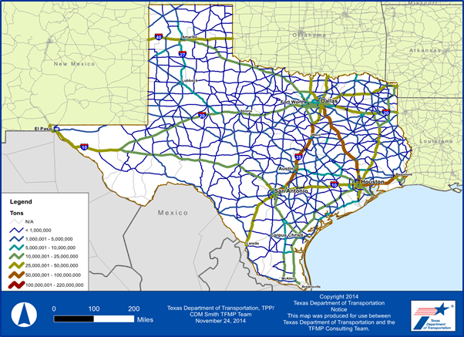
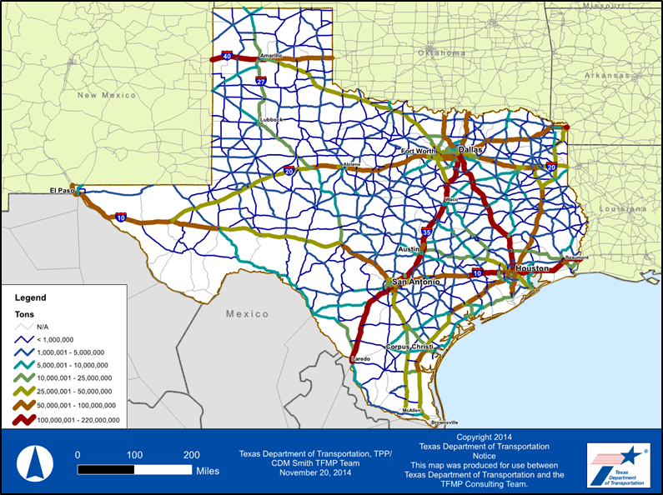
Trucks/Highway: 2010 vs. 2040
The highest increases in truck volumes are on I-35, I-10, I-45 and I-40.

Slide 24
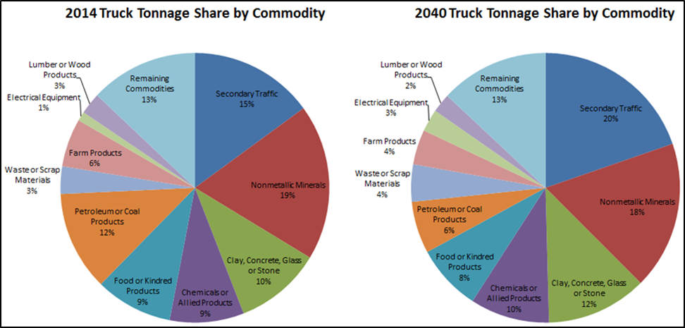
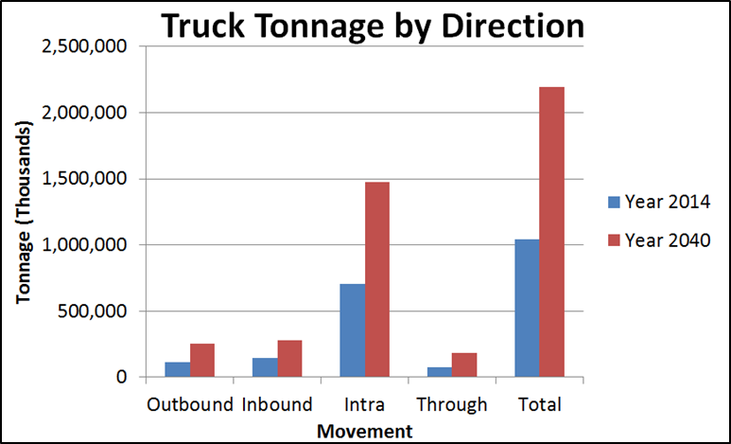
Trucks/Highways: Forecasts

Slide 25
Trucks/Highways: LOS and Deficiency Analysis
Deficient = LOS E/F
45.7% of the Primary Freight Network and 11% of the Secondary Freight Network will be deficient by 2040
2014: 19.4% of Primary Freight Network is deficient

Slide 26
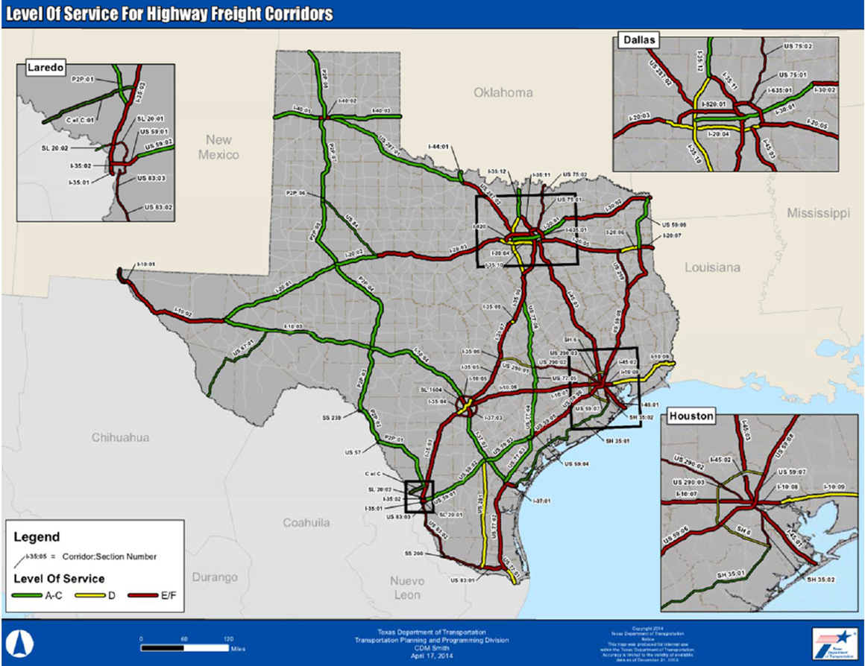
Trucks/Highways: LOS and Deficiency Analysis

Slide 27
Trucks/Highways: LOS and Deficiency Analysis
Highway sections predicted as unacceptable LOS in 2040 include:
  I-10 from I-20 to El Paso.
  I-10 from Houston to San Antonio.
  I-20 from Fort Worth to US 84.
  I-35 from Dallas-Fort Worth to Laredo.
  I-45 from Dallas-Fort Worth to Houston.
  US 59 from I-20 to Houston.

Slide 28
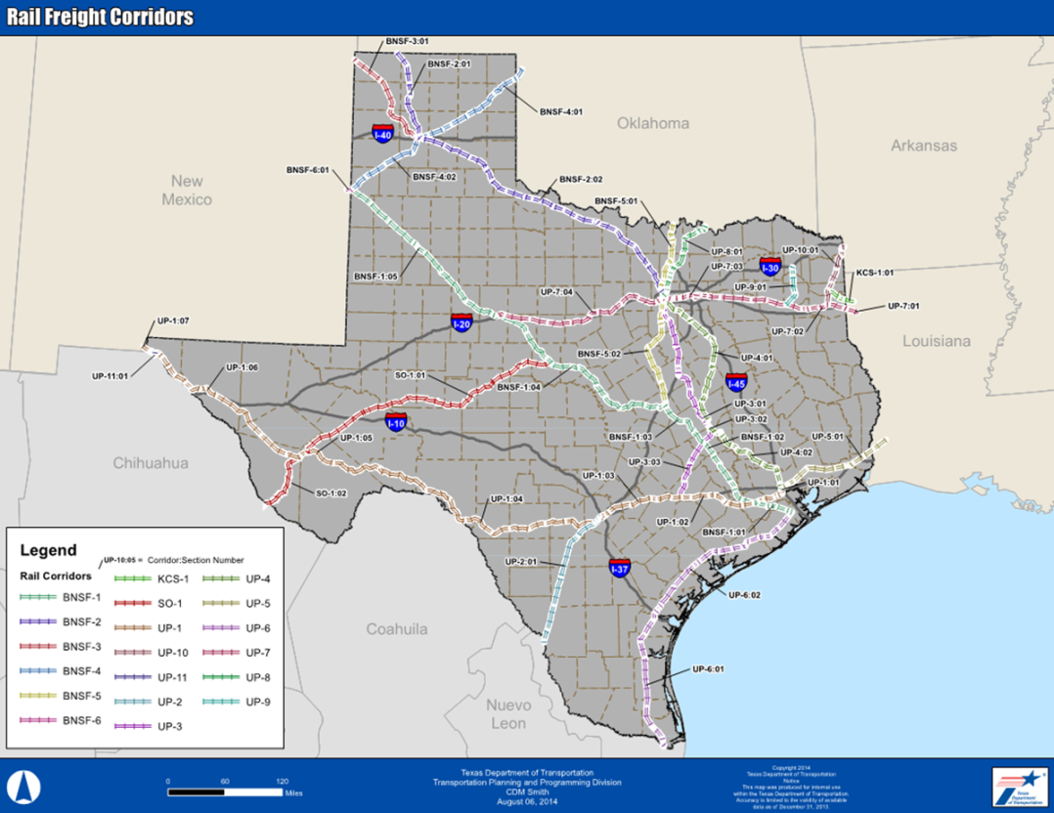
Rail: Data Sources & Corridors
SAMv3 Travel Demand Model
TRANSEARCH ®
TX-NAFF

Slide 29
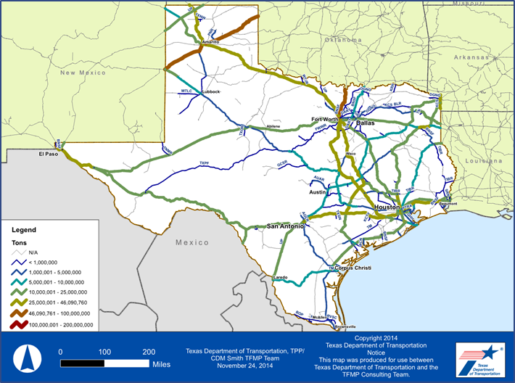
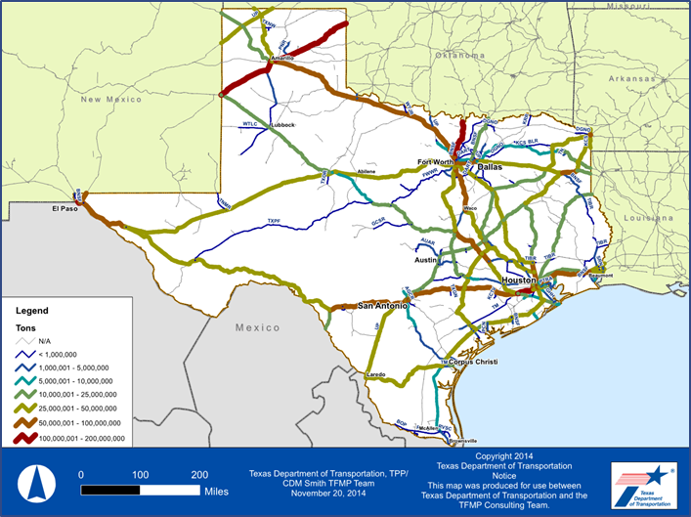
Rail: Forecasts
2014: 397.5 million tons
2040: 764.3 million tons
92 percent increase in tonnage

Slide 30
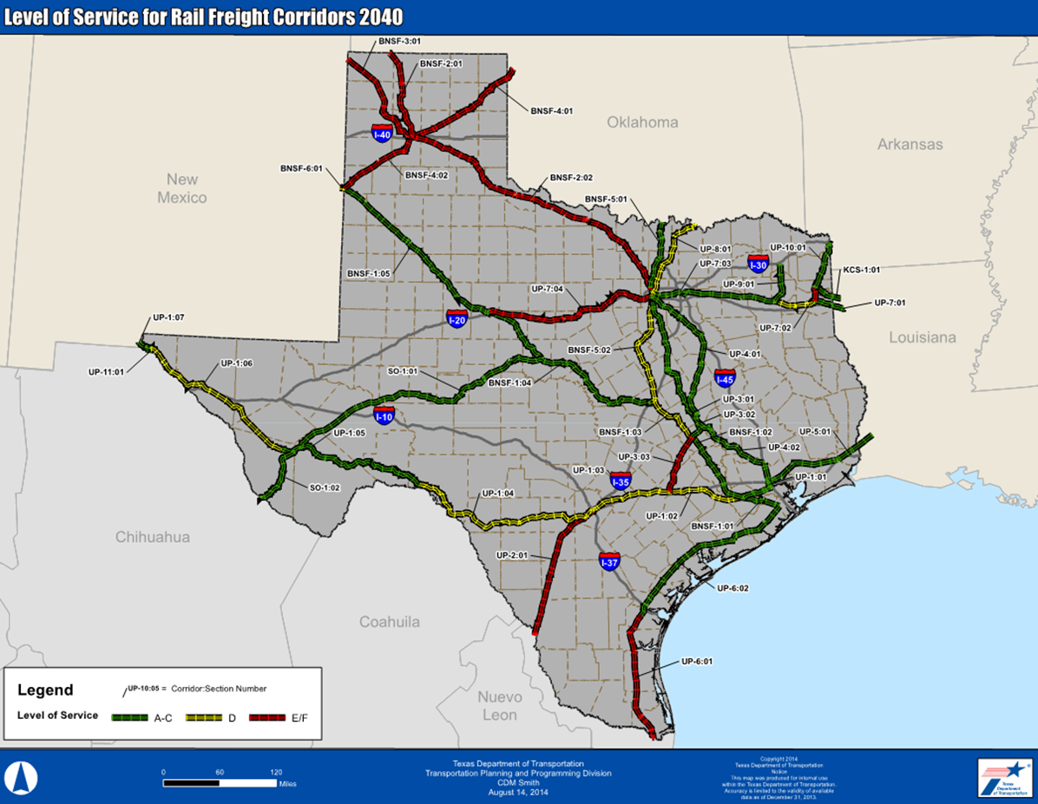
Rail: LOS and Deficiency Analysis

Slide 31
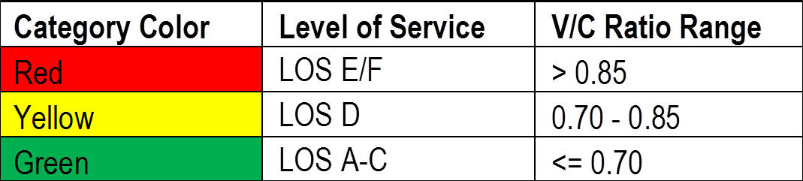
Rail: LOS and Deficiency Analysis
Deficient = LOS E/F
2010: 2 out of 41 sections are at LOS E/F
  5% corridor miles
2040: 10 out of 41 sections are at LOS E/F
  24% corridor miles

Slide 32
Water: Data Sources and Methodology
TRANSEARCH ®, SAMv3 and U.S. Army Corps of Engineers all provide tonnage data at the port or county level
County vs. port unit discrepancy between sources
  TRANSEARCH® and SAMv3: County level
  USACE: Port level
Base TRANSEARCH ® tonnage adjusted to account for international tonnage (captured in the U.S. Army Corps of Engineers data)
Forecasted to 2040 based on TRANSEARCH® growth rates and county-level forecasts adjusted to reflect statewide totals
Gulf Intracoastal Waterway

Slide 33
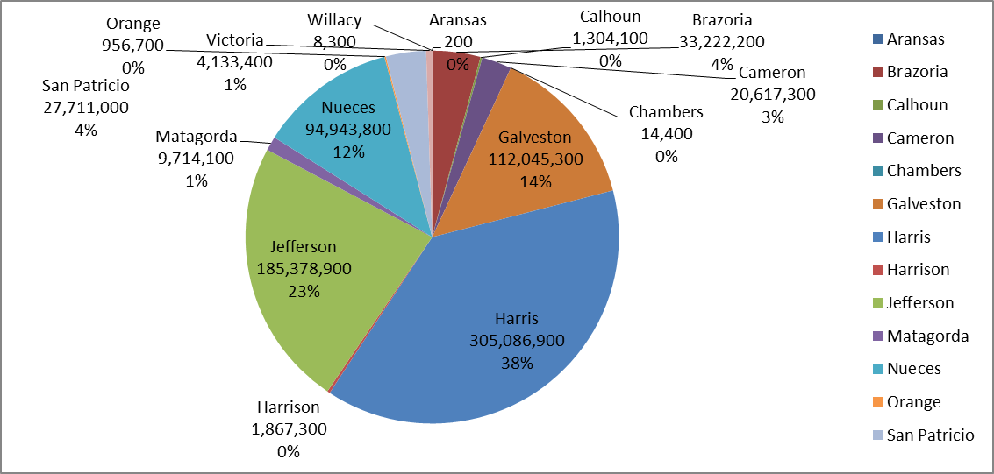
Water: 2040 Forecasts
Expected to increase by 43% (797 million tons in 2040)

Slide 34
Air: Data Sources and Methodology
TRANSEARCH ®, SAMv3 and Air Carrier Statistics
County vs. airport unit discrepancy between sources
Base TRANSEARCH ® tonnage adjusted to account for international tonnage (captured in the Air Carrier Statistics data)
Forecasted to 2040 based on TRANSEARCH® and/or SAMv3 growth rates

Slide 35
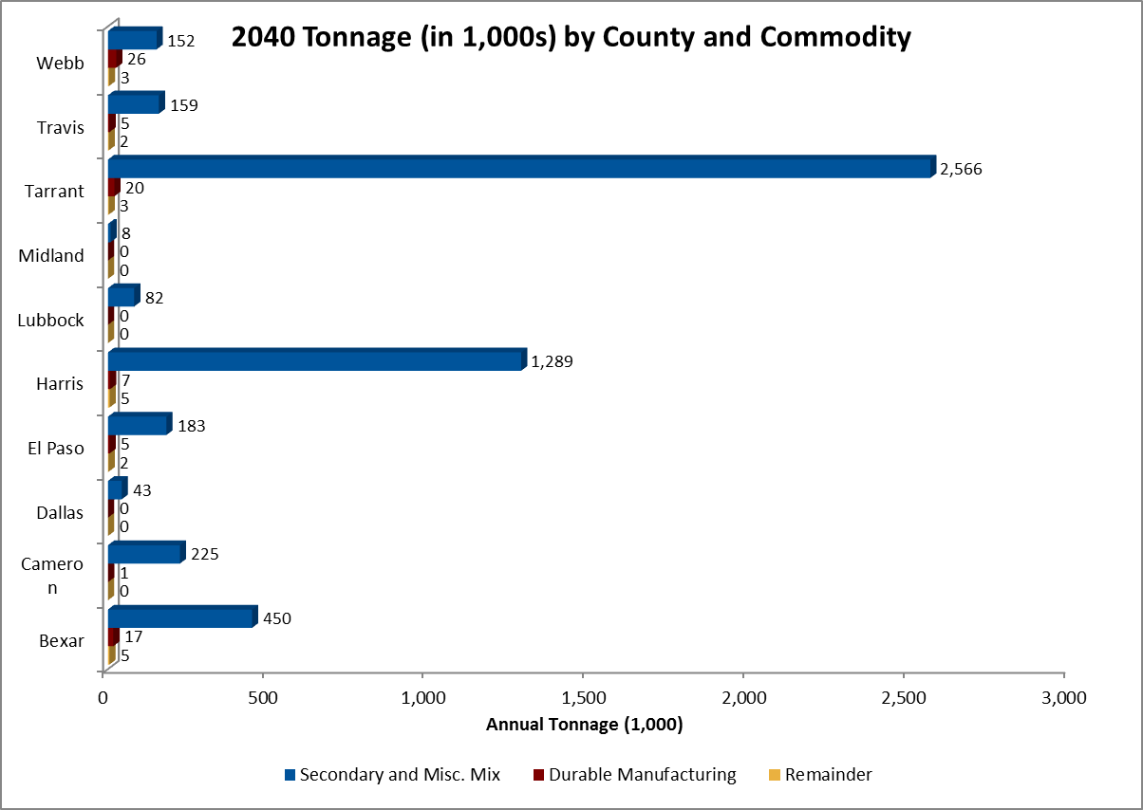
Air: 2040 Forecasts
1.2 million tons in 2014 to 3.6 million tons in 2040: 197.4% increase .

Slide 36
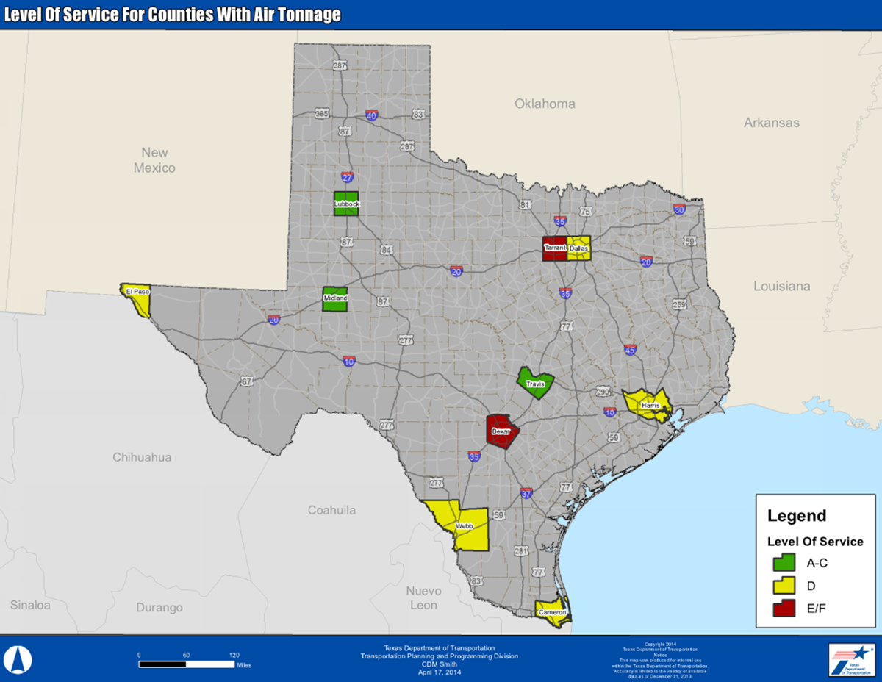
Air: LOS Deficiency Analysis

Slide 37
Pipelines: Data Sources
Energy Information Administration (EIA)
TRANSEARCH ®
FAF (Freight Analysis Framework)
Railroad Commission Data
Secondary sources including BTS Economic Indicators, reports from universities

Slide 38
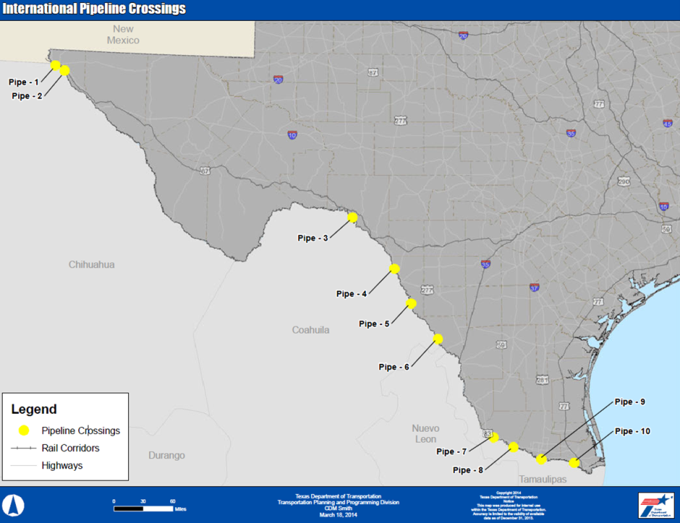
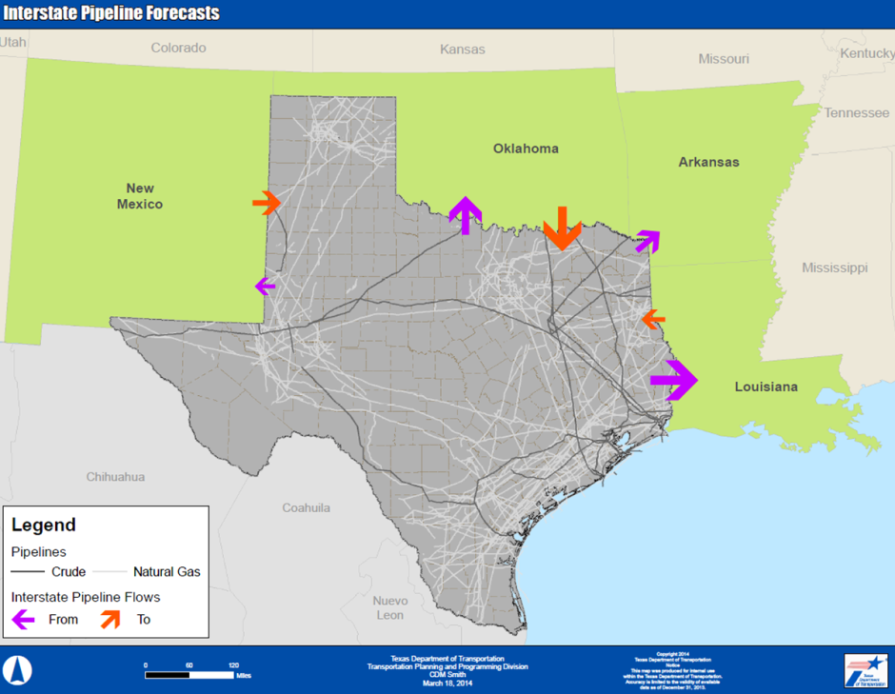
Pipelines: Challenges
Extreme differences in magnitude and growth rates between sources
Private investment: difficult to forecast

Slide 39
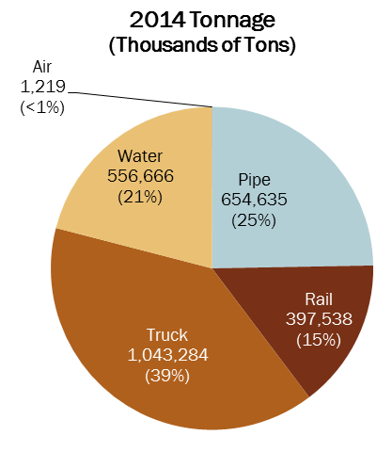
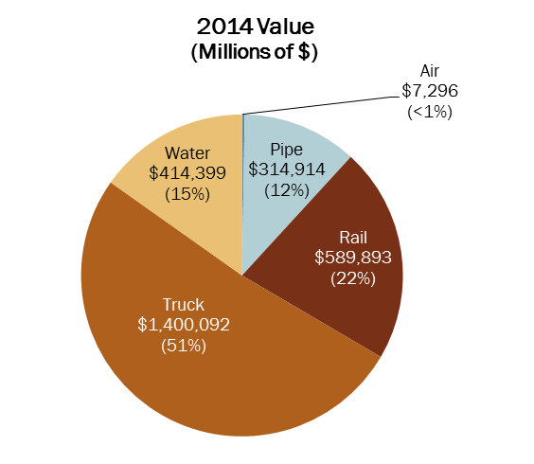
Freight in Texas, with pipelines
2014, data based on Freight Analysis Framework information

Slide 40
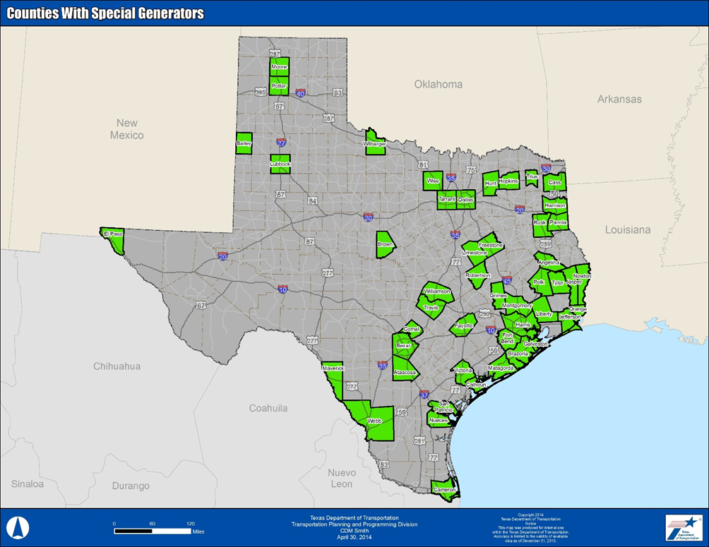
Special Generators: Data Sources and Methodology
Data available from SAMv3 and Freight Finder
Employment and industry information from Department of Labor and Texas Workforce Commission
Focus on:
  Intermodal connectors
  Fracking

Slide 41
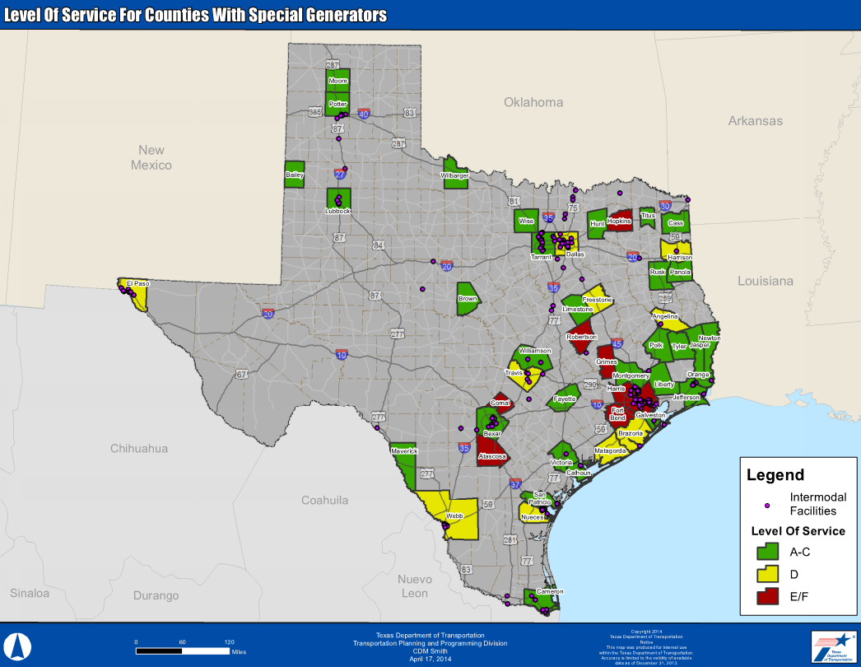
Special Generators: Forecasts and Deficiency Analysis

Slide 42
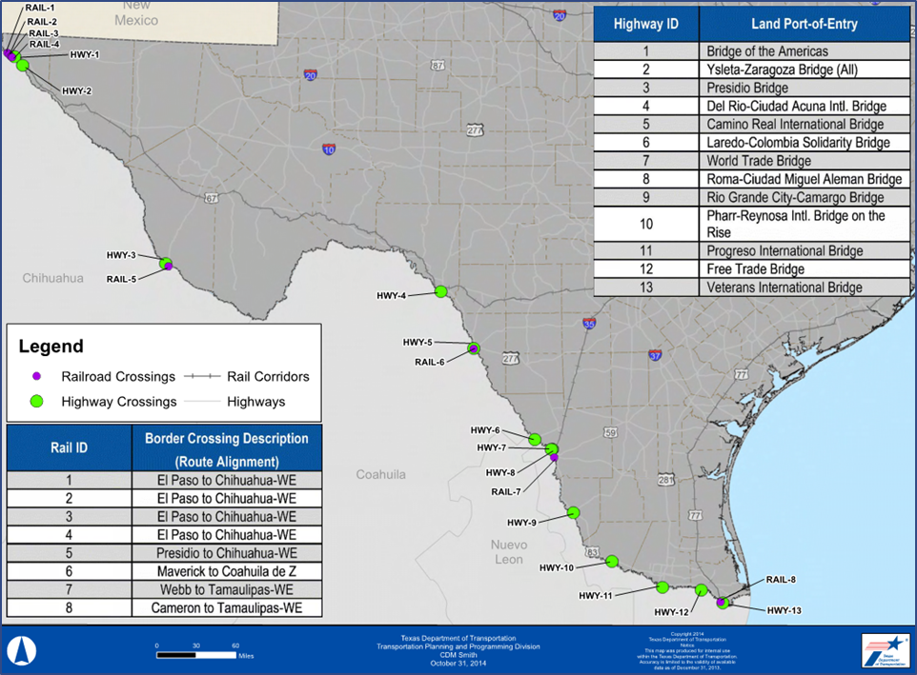
International Border Crossings: 2014-2040 growth
Trucks: 178% growth in daily heavy truck volume
Rail: 18.4 % growth in tonnage

Slide 43
Conclusions

Slide 44
Overall Deficiency and Conclusions
Key drivers of freight: Population and employment growth
Highway Corridors: 46% are in high deficiency category
Rail Corridors: 10 lines (~1,400 track miles) deficient,
Water: Key markets show high deficiencies,
Other – air, special generators, border crossings, also need improvements

Slide 45
Future Opportunities/Additional Analyses
Scenario analyses and corridor studies using framework
Data collection for intermodal connectors and non-highway modes
Improved definition of LOS for various modes

Slide 46
Questions?
Rob Bostrom, PE, bostromnr@cdmsmith.com, 859-244-8882
Monisha Khurana, AICP, khuranam@cdmsmith.com, 713-423-7436
Liza Amar, AICP, amarer@cdmsmith.com, 713-423-7421

