Slide 1
Visualizing Vehicle Census Time-Series Data in Online Maps
Maneesh Mahlawat
Phani Jammalamadaka
Worapong Hirunyanitiwattana
15th TRB National Transportation Planning Applications Conference
May 20, 2015

Slide 2
Project Summary
MassDOT & MAPC sought answers to, among others:
  Where does driving place the biggest burden on family budgets?
  Where might investments in walking, biking and transit have the biggest impact in reducing how much people drive?
  We combined the spatial dataset provided (250 meter grid cells with statistics on vehicles per household, mileage per vehicle, and greenhouse gas emissions) with publicly available datasets
  The datasets had records to represent 37 billion miles traveled on the Massachusetts highways every year for four years
Boston Data Challenge

Slide 3
The competition
The need: Visualizations, analysis, maps, animations, infographics, interactive web tools, games
A total of 30 teams (including Citilabs, Analysis group, and Zipcar)
The judges included Secretary of Transportation for Massachusetts, Deputy Director at MAPC, and data visualizer for the Boston Globe, among others
Boston Data Challenge

Slide 4
What did we do?
We answered: How much do households (%) spend on gas? Where is driving the biggest burden on family budgets?
Data in 5GB flat files (no structural relationship between records). Wrote programs to extract relevant data from the flat files. Grouped by Zip and Municipal ID
Results: dynamic online maps
Our proposal: create an index (combining miles driven, carbon-dioxide emissions, and Fuel Burden Index) at the grid level. The households with higher Fuel Burden Index will be more receptive to ideas that reduce driving.
Boston Data Challenge

Slide 5
Analysis methodology
Commercially available software such as Excel, ACCESS, MySQL, ArcGIS, R couldn’t open and work with the datasets.
It proved to be faster to write VB programs to extract relevant fields and data from the flat files.
Intuitive to work on spatial data on maps (such as ArcGIS maps) rather than spreadsheets.
Boston Data Challenge

Slide 6
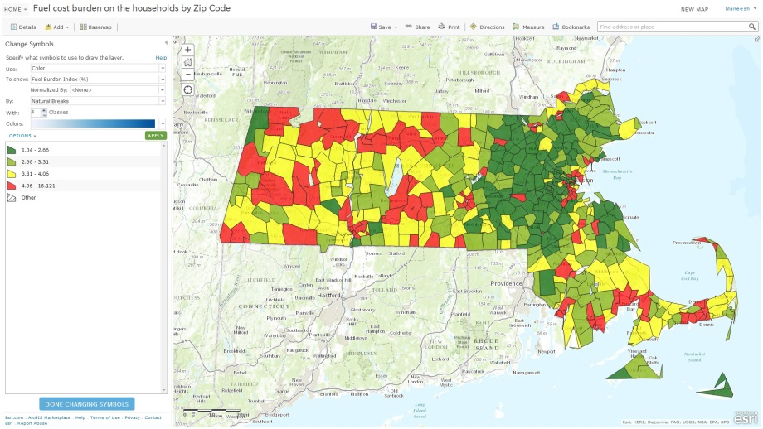
Analysis methodology
Fuel Burden Index (color coded)
Boston Data Challenge
Notes:
For example, looking at the map, we can see that fuel price burden looks higher in many counties in eastern Massachusetts and other sporadic locations. But it doesn’t give the whole picture. May be the counties have larger area and therefore, they look that way. What about the magnitude?

Slide 7
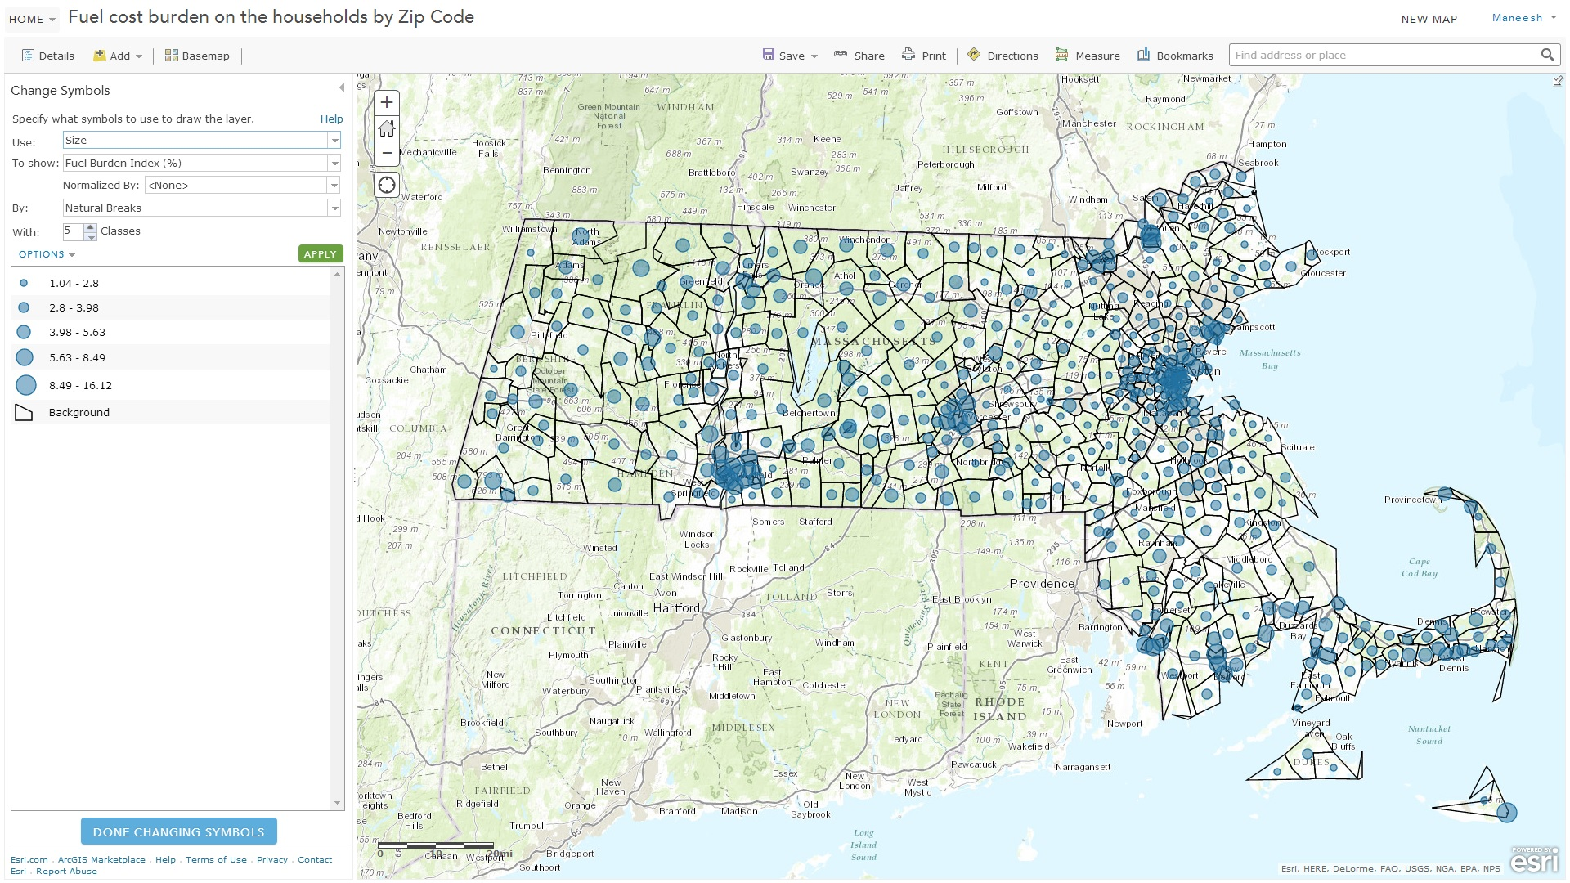
Analysis methodology
Fuel Burden Index (circles with magnitude)
Boston Data Challenge
Notes:
When we look at magnitude the picture changes. Indeed, eastern Massachusetts counties are bigger. So, if we have x amount of dollars where should we focus first?

Slide 8
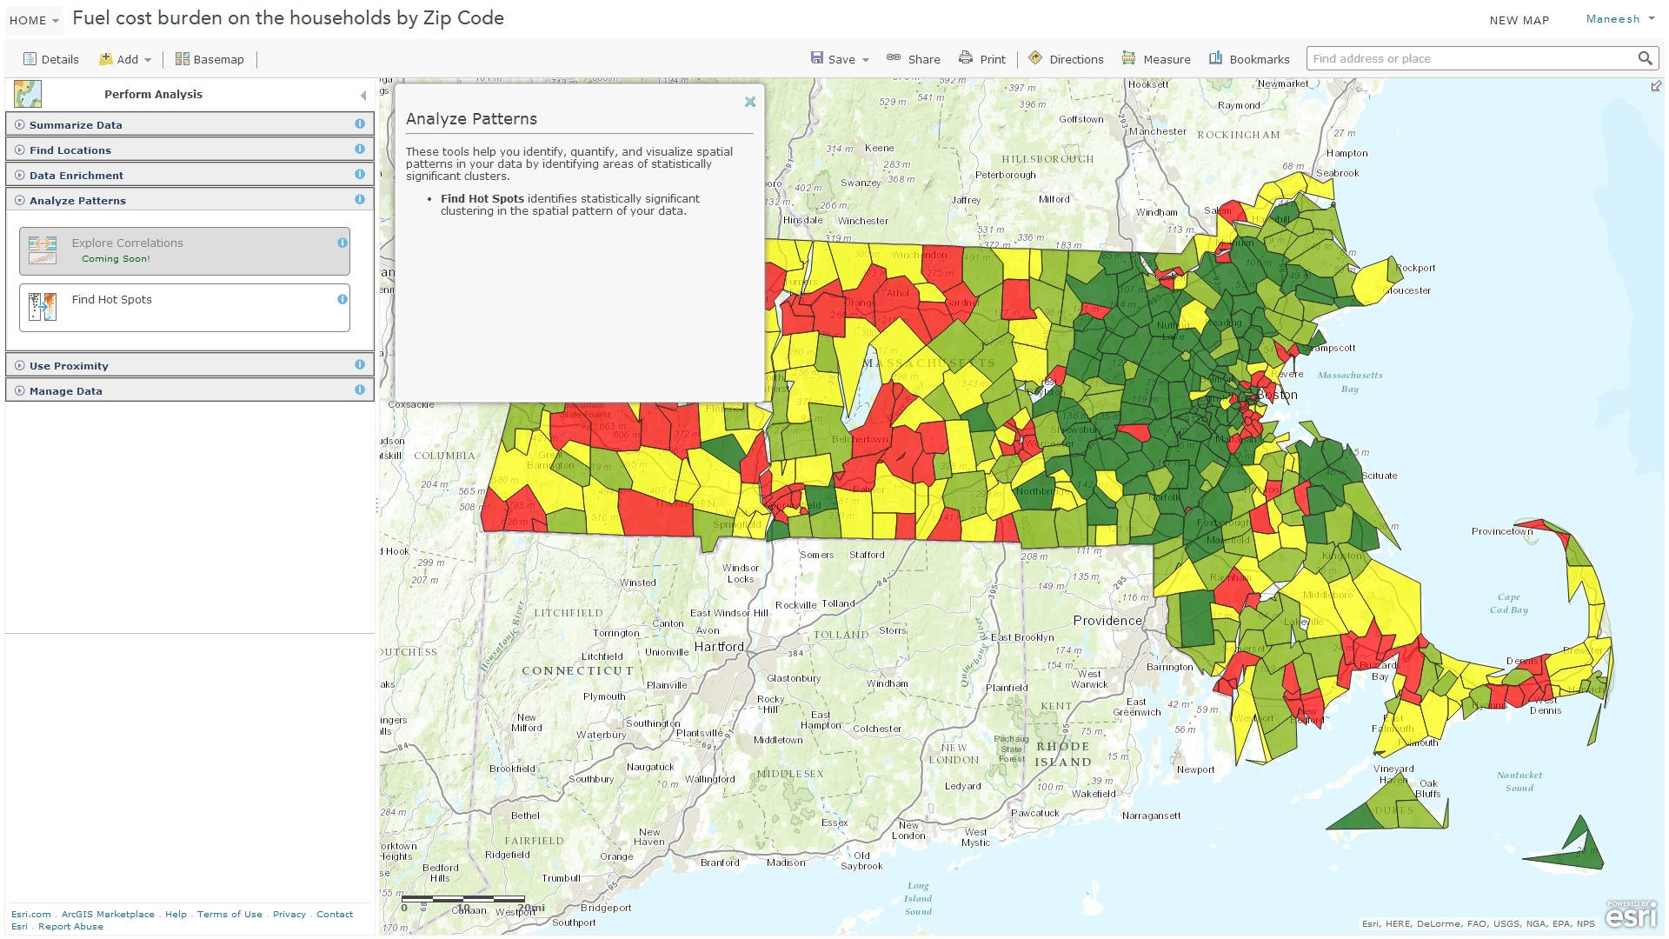
Analysis methodology
Hot spot analysis
Boston Data Challenge
Notes:
So, we can do a hot spot analysis. The analysis indicates clusters. After we pick a cluster of interest, we can do a hot spot analysis at finer level – 250 m grid. This analysis tells us the areas that need to be investigated. For example, it can pinpoint to areas with significantly higher CO2 emissions.

Slide 9
Result
Of the seven awards, we won two: Dollars and Sense and People’s Choice
Boston Data Challenge

Slide 10
Conclusions
Spatial data analysis is best performed using online maps (such as ArcGIS)
Dynamic webpages with online maps are most useful to see the fast-changing information
The online maps are dynamic. They can answer client questions on the go. For example we can change number of classes, symbology, do proximity analysis, combine online datasets, etc. on the fly
Boston Data Challenge

