Slide 1
Assessment of GPS Household Survey Data
Findings from Cincinnati and Minneapolis
2015 TRB Planning Applications Conference
Anurag Komanduri, Thomas Rossi, Kimon Proussaloglou Jonathan Ehrlich, Metropolitan Council Andrew Rohne, Ohio-Kentucky-Indiana Regional Council of Governments
May 18, 2015

Slide 2
Overview
Motivation for presentation
Data collection background
Data analysis - case studies

Slide 3
Background
GPS-based household travel surveys are becoming ubiquitous.
Harnessing technology is a great way to improve data quality.
Passive means of collecting data – reduces respondent burden
Recent improvements in GPS technology are phenomenal.
Longer lasting batteries + smaller devices
Smartphone-based apps improving options for data collection
Geolocation algorithms being constantly updated
Knowledge-sharing across industries

Slide 4
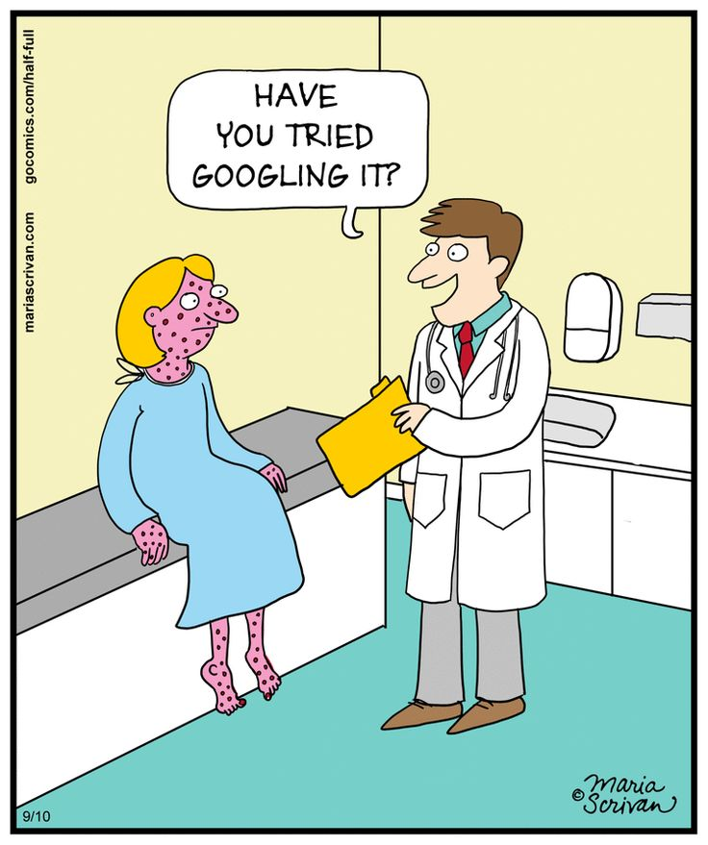
Motivation
Does not mean burden on analysts is completely gone.
Greater emphasis needed on…
Compact questionnaire design
Clear instructions for respondents
Travel behavior data algorithms
Travel behavior data analysis
Adjusting schedule and budget

Slide 5
Data Collection Background
Description | Metropolitan Council | Ohio-Kentucky-Indiana
Data collection period | 2011 | 2010-2012
Data analysis period | 2012-2013 | 2013-2014 (separate contract)
Type of data collection | Travel diary GPS sub-sample | GPS sample only
Total Households in GPS Sample | 250 (out of 14,000) | 2,050 (out of 2,050)
Validation-option for GPS data | Travel diary | Prompted recall sub-sample
Main purpose of GPS dataset | Modify diary reported trip rates | Model development dataset
Primary data analysis technique | Machine-driven Intense QC | Machine-driven Intense QC
Secondary data analysis technique | In-depth analysis of travel/activity behavior | In-depth analysis of travel/activity behavior

Slide 6
Travel Behavior-Driven Analysis of GPS Data
Respondent Training
Who carries devices?
For how long?
Comparative Analysis
Diary vs. GPS
Multiday Analysis
Behavioral Findings
Trip Rates
Travel Purpose
Joint travel?
Stop-making Characteristics

Slide 7
Respondent Training - 1
Training instructions must be very clear.
Respondents must be “ready to go” on day 1
Well explained, yet concise
Dates of data collection must be clear.
Describe start date & end date (inclusive)
Start time – Is 3 AM feasible? Define “travel day”
Who carries the device?
Be aware of sensitivity to monitor children’s activities
Technology challenges – especially for the older generation

Slide 8
Respondent Training – 1I
Respondent should carry device on all trips.
Intra-office
Intra-household
Walk pet
Run/exercise/bike?
Joint trips does not mean only one device is to be carried
Back-up plan if the device malfunctions/battery drains out.
If supplemented with diary, make instructions clear.
Device must be carried even on travel diary day
Diary must supplement the GPS for validation

Slide 9
Comparative Analysis – I
Typically, aggregate GPS vs diary analysis conducted.
Average trip adjustment factor is proposed.
Not a one-to-one comparison
Metropolitan Council Data Comparison Steps | Valid Records
Total households with GPS data | 262 households
Usable/complete diary data | 158 households
GPS device carried on diary day | 127 households
Households with functioning GPS devices | 125 households
Difference in diary vs. GPS observed trip rates
18 percent for full sample (262 households)
8 percent for matched sample (125 households)

Slide 10
Comparative Analysis - II
Can all days of data collection be used for modeling/analysis?
Day 1 vs. Day 2 vs. Day 3 trip rates
Account for technology learning curve
Battery drainage
OKI Region Findings | Day 1 | Day 2 | Day 3
Respondents with non-zero trips | 1,797 | 3,021 | 2,921
Total trips | 9,822 | 17,475 | 16,650
Respondents with drained battery | 177 | 278 | 229
Weighted trip rate/ respondent | 2.35 | 3.64 | 3.51

Slide 11
Behavioral Findings – I
What type of trips do we want the GPS to capture?
Are intra-office trips necessary?
What about “walk the pet” or “exercise”?
Diary Trip # | Origin Location | Destination Location | Start Time | End Time | Mode | Access-Egress
1 | Home | Work | 7:10 AM | 7:50 AM | Walk | N/A
2 | Work | Home | 5:35 PM | 6:38 PM | Walk | N/A
GPS Trip # | Origin Match Location | Destination Match Location | Start Time | End Time | Origin Matched with Trip Diary | Destination Matched with Trip Diary
1 | Home | Work | 6:57:00 AM | 7:49:04 AM | Yes | Yes
2 | Work | Work-Vicinity | 9:19:21 AM | 9:22:35 AM | Yes | Yes
3 | Work-Vicinity | Work-Vicinity | 9:22:55 AM | 9:25:25 AM | Yes | Yes
4 | Work | Home | 5:34:23 PM | 6:36:33 PM | Yes | Yes
5 | Home-Vicinity | Home-Vicinity | 6:58:46 PM | 7:12:27 PM | Yes | Yes

Slide 12
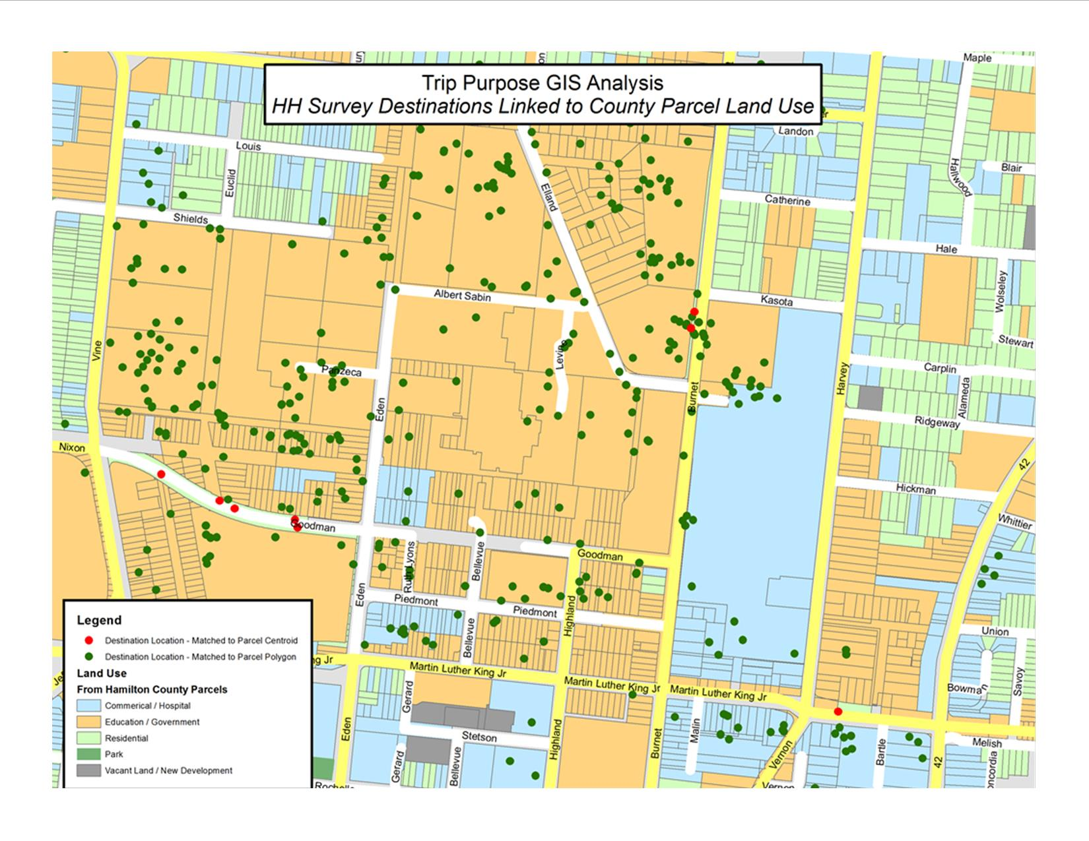
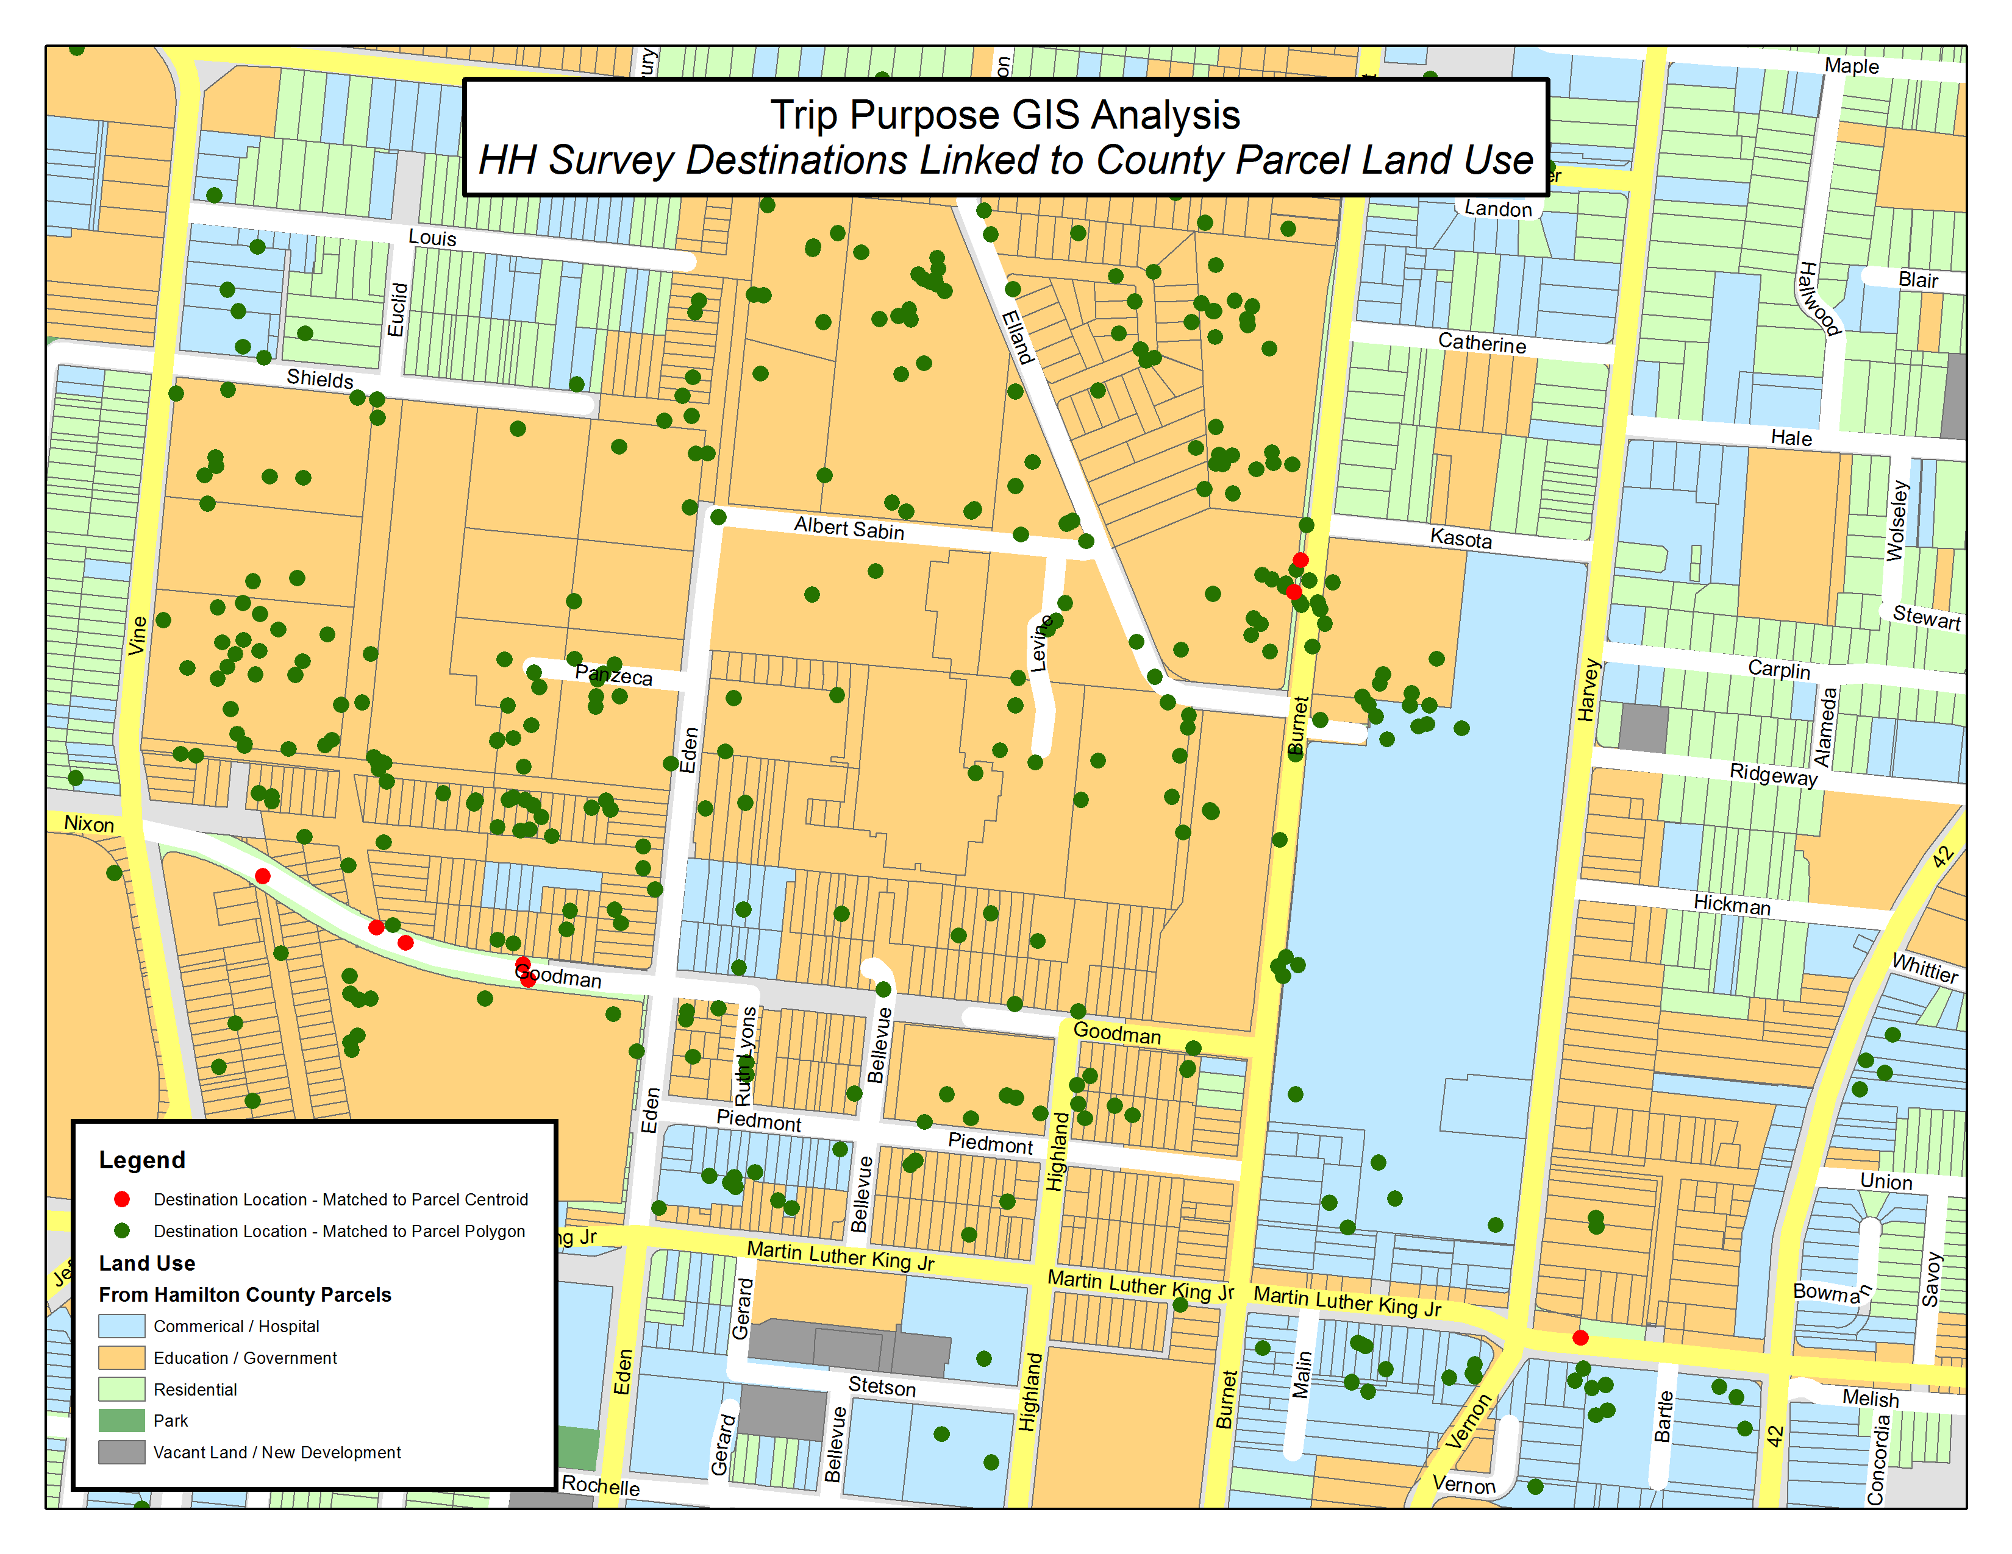
Behavioral Findings – 1I
If no prompted recall, how can trip purpose be imputed?
Collect “frequent” locations before-hand.
Use land-use parcel data to impute travel purposes.
Algorithm-based Activity | Land Use Parcel | Imputed Activity | Notes
Shop | 1. Bowling Alleys 2. Movie Theatres 3. Church 4. Restaurant 5. Fast-food 6. Residential | Social Recreation | Non-home and Non-work location
Other | 1. School 2. University | Pick-up/Drop-off | Non-mandatory location

Slide 13
Behavioral Findings – III
Assess number of stops to see if reasonable.
Algorithms must be customized for region.
Extra congestion on road may be construed for stops
Transit legs may be counted as stops
Diary Trip # | Origin Location | Destination Location | Start Time | End Time | Mode | Access-Egress
1 | Home | Drop-Off | 7:30 AM | 7:40 AM | Auto | N/A
2 | Drop-Off | Work | 7:45 AM | 8:30 AM | Bus | Drive-Walk
3 | Work | Eat | 3:00 PM | 3:15 PM | Walk | N/A
4 | Eat | Work | 3:45 PM | 3:53 PM | Walk | N/A
5 | Work | Pick-Up | 5:02 PM | 5:33 PM | Transit | Walk-Drive
6 | Pick-Up | Home | 5:46 PM | 5:53 PM | Auto | N/A
GPS Trip # | Origin | Destination | Start Time | End Time | O Matched? | D Matched?
1 | Home | Drop-Off | 7:32:26 AM | 7:39:33 AM | Yes | Yes
2 | Drop-Off | Work | 7:44:41 AM | 8:12:25 AM | Yes | Yes
 | WORK TO LUNCH MISSING
 | WORK TO LUNCH MISSING
3 | Work | Unknown | 5:11:37 PM | 5:14:14 PM | Yes | No
4 | Unknown | Pick-Up | 5:14:14 PM | 5:34:02 PM | No | Yes
5 | Pick-Up | Home | 5:40:30 PM | 5:50:22 PM | Yes | Yes

Slide 14
Future Lessons
Use GPS technology to the extent possible.
Design prompted recalls
Invest in customized algorithms – test extensively
Collect supporting data (land use, for instance)
Spend time analyzing algorithm-driven results.
Complex trip-making HHs will have poor information on some trips…manual cleaning may be needed
Consider impact on trip rates
Plan budget and schedule accordingly

Slide 15
Questions/Comments? akomanduri@camsys.com

