Slide 1
NHTS 2008-09 in Dallas Fort Worth
Arash Mirzaei, 000Kathy yu, Behruz paschai
NCTCOG
TRB Planning application conference 2015

Slide 2
Background
While NCTCOG has set aside about $2 million to update its 1996 HH survey, through coordination with TxDOT, state purchased 20,000 samples of NHTS. It would have looked inefficient to move forward with a new HH survey without taking advantage of about 6000 HH samples provided through NHTS. This project was designed to understand, examine, and re-expand NHTS 08-09 survey dataset for real application in the region.

Slide 3
Project Design
Understand the design, sampling, recruitment, and data collection
Data checks
Data cleanup and imputation if necessary
Sample re-expansion
Report and final dataset creation
Sample adequacy analysis for
Understanding present trip pattern [what does this mean!]
Development of analytical techniques for forecasting [models? What else?]

Slide 4
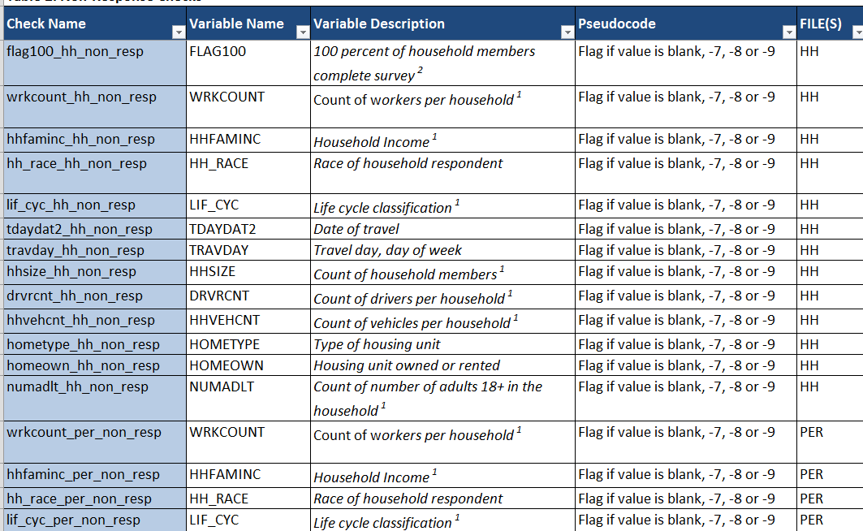
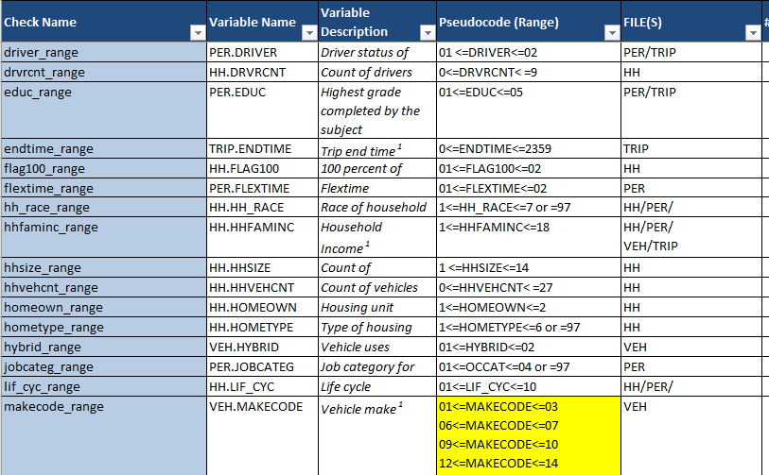
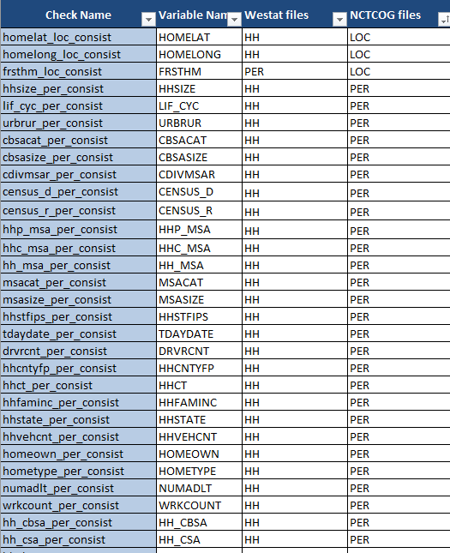
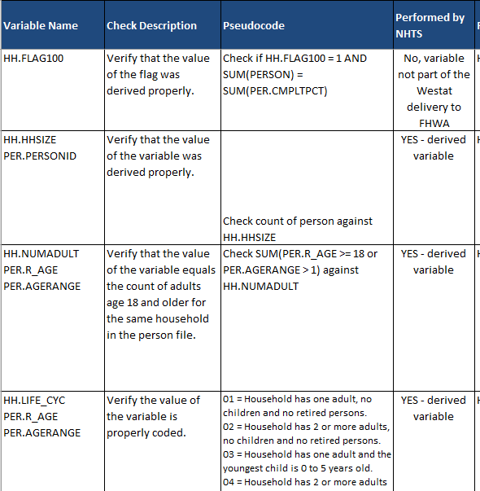
Data Checks (284)
Non-response checks (83)
If the responses are provided or blank
Range checks (57)
Accuracy and logic checks(38)
Ex: verify the derived values
Consistency checks(106)
Values from different files

Slide 5
Records excluded from NCTCOG NHTS Dataset
In order to create the best dataset for use in the NCTCOG Travel Model, it was decided to remove records from the original set of households.
Households in 2009 NHTS Database for NCTCOG Area | 5,943
Households which are not 100% Complete (Each person had to complete post-survey interview) | -920
Households with Weekends Travel Day | -1,450
Households with Travel Day on Federal Holidays, Thanksgiving Break, Winter Break | -330
Households which did not specify Household Income | -220
Final Records in NCTCOG NHTS Dataset | 3,023

Slide 6
Expansion – Target and Variables
Target: American Community Survey 2011 5-Year
Household Variables (133)
Household Income by Geography (35)
Worker Count by Household Vehicles by Geography (51)
Household Size by Worker Count by Geography (47)
Person Variables
Sex by Age by Geography (54)

Slide 7
Expansion - Cells
Original NHTS data was expanded to population of the state of Texas.
NCTCOG NHTS data was expanded to local geography
Ideally wanted to breakdown each variable into 12 counties
Where there were not enough records(minimum 20), NCTCOG followed the following collapsing strategy
Collapsed counties into 7 county groups: individual Core counties (Collin, Dallas, Denton, Tarrant) and 3 other county groupings(South, West, East)
Collapsed counties into 5 county groups: individual Core Counties and a Non-Core grouping of remaining seven counties.
Collapsed counties into 2 county groups: Core and Non-Core

Slide 8
HH Variable – Household Income by Geography
Sample Breakdown from NCTCOG NHTS Database
County Name | 0K-25K | 25K – 50K | 50K – 75K | 75K – 100K | 100K+ | TOTAL
Collin | 33 | 56 | 57 | 67 | 174 | 387
Dallas | 189 | 237 | 149 | 133 | 219 | 927
Denton | 29 | 62 | 61 | 52 | 114 | 318
Tarrant | 131 | 233 | 159 | 144 | 274 | 941
South (Ellis, Johnson) | 43 | 38 | 32 | 26 | 25 | 164
West (Hood, Parker, Wise) | 29 | 46 | 24 | 18 | 35 | 152
East (Hunt, Kaufman, Rockwall) | 31 | 41 | 29 | 26 | 37 | 164
Total | 485 | 713 | 511 | 466 | 878 | 3,053

Slide 9
HH Variable – Household Income by County
Target Cells from ACS 2011 5-Year
 | Income
County Name | 0-25K | 25K – 50K | 50K – 75K | 75K – 100K | 100K+ | TOTAL
Collin | 30,184 | 48,542 | 45,997 | 40,131 | 111,380 | 276,234
Dallas | 200,603 | 227,787 | 155,226 | 90,620 | 166,427 | 840,663
Denton | 30,635 | 45,911 | 43,531 | 31,341 | 79,937 | 231,355
Tarrant | 128,021 | 157,506 | 122,963 | 82,670 | 152,757 | 643,917
South (Ellis, Johnson) | 17,287 | 24,401 | 20,765 | 15,317 | 22,683 | 100,453
West (Hood, Parker, Wise) | 15,104 | 19,343 | 15,893 | 11,542 | 20,608 | 82,490
East (Hunt, Kaufman, Rockwall) | 17,453 | 18,966 | 17,843 | 13,810 | 22,283 | 90,355
Total | 439,287 | 542,456 | 422,218 | 285,431 | 576,075 | 2,265,467

Slide 10
HH Variable - Worker by HH Veh by Geography
#Workers \ # Veh | 0 |  | 1 |  | 2 |  | 3 |  | 4+ |  | Total
0 | All Counties | 77 | Collin | 34 | Collin | 24 | Core | 50 | All Counties | 24
 |  |  | Dallas | 157 | Dallas | 94
 |  |  | Denton | 33 | Denton | 23
 |  |  | Tarrant | 142 | Tarrant | 90
 |  |  | South | 35 | South | 18 | Non-Core | 21
 |  |  | West | 21 | West | 20
 |  |  | East | 27 | East | 20
 |  |  | TOTAL | 449 | TOTAL | 289 | TOTAL | 71
1 | All Counties | 17 | Collin | 31 | Collin | 80 | Core | 123 | All Counties | 52
 |  |  |  |  | Dallas | 169
 |  |  | Dallas | 143 | Denton | 75
 |  |  |  |  | Tarrant | 165
 |  |  | Denton | 29 | South | 28 | Non-Core | 28
 |  |  |  |  | West | 22
 |  |  | Tarrant | 113 | East | 24
 |  |  | Non-Core | 33
 |  |  | TOTAL | 349 | TOTAL | 563 | TOTAL | 151
2 |  |  | All Counties | 26 | Collin | 105 | Collin | 35 | All Counties | 98
 |  |  |  |  | Dallas | 137
 |  |  |  |  | Denton | 73 | Dallas | 50
 |  |  |  |  | Tarrant | 167
 |  |  |  |  | South | 26 | Denton | 22
 |  |  |  |  | West | 21
 |  |  |  |  | East | 26 | Tarrant | 72
 |  |  |  |  |  |  | Non-Core | 38
 |  |  |  |  | TOTAL | 555 | TOTAL | 217
3+ |  |  | All Counties |  | 20 |  | All Counties | 58 | All Counties | 37
Total |  |  |  |  |  |  |  |  |  |  | 3,053

Slide 11
HH Variable – HH Size by Worker by Geography
HHPERS \ WRKCOUNT | 0 |  | 1 |  | 2 |  | 3 |  | Total
1 | Collin | 26 | Collin | 23
 | Dallas | 166 | Dallas | 124
 | Denton | 32 | Denton | 32
 | Tarrant | 119 | Tarrant | 98
 | Non-Core | 81 | Non-Core | 28
 | TOTAL | 424 | TOTAL | 305
2 | Collin | 40 | Collin | 62 | Collin | 70
 | Dallas | 131 | Dallas | 138 | Dallas | 123
 | Denton | 35 | Denton | 40 | Denton | 44
 | Tarrant | 140 | Tarrant | 145 | Tarrant | 127
 | South | 28 | South | 22 | South | 24
 | West | 31 | West | 19 | West | 22
 | East | 31 | East | 25 | East | 31
 | TOTAL | 436 | TOTAL | 451 | TOTAL | 441
3 | All Counties | 50 | All Counties | 154 | Collin | 41 | All Counties | 51
 |  |  |  |  | Dallas | 47
 |  |  |  |  | Denton | 25
 |  |  |  |  | Tarrant | 79
 |  |  |  |  | Non-Core | 21
 |  |  |  |  | TOTAL | 213
4+ |  |  | Core | 182 | Collin | 46 | All Counties | 65
 |  |  |  |  | Dallas | 50
 |  |  | Not-Core | 36 | Denton | 41
 |  |  |  |  | Tarrant | 75
 |  |  |  |  | Non-Core | 33
 |  |  | TOTAL | 218 | TOTAL | 245
Total |  |  |  |  |  |  |  |  | 3,053

Slide 12
Person Variable – Sex by Age by Geo.
SEX\AGE | <5 |  | 5-17 |  | 18-29 |  | 30-49 |  | 50-64 |  | 65+ |  | TOTAL
Male | Collin | 37 | Collin | 91 | Core | 160 | Collin | 150 | Collin | 123 | Collin | 76 | 3,373
 |  |  | Dallas | 141 |  |  | Dallas | 189 | Dallas | 259 | Dallas | 220
 | Dallas | 43 | Denton | 90 |  |  | Denton | 111 | Denton | 94 | Denton | 55
 |  |  | Tarrant | 182 |  |  | Tarrant | 261 | Tarrant | 269 | Tarrant | 225
 | Denton | 26 | South | 30 | Non-Core | 28 | South | 39 | South | 43 | South | 39
 |  |  | West | 23 |  |  | West | 40 | West | 49 | West | 45
 | Tarrant | 49 | East | 19 |  |  | East | 38 | East | 60 | East | 41
 | Non-Core | 28
 | TOTAL | 183 | TOTAL | 576 | TOTAL | 188 | TOTAL | 828 | TOTAL | 897 | TOTAL | 701
Female | Collin | 31 | Collin | 96 | Core | 202 | Collin | 142 | Collin | 154 | Collin | 69 | 3,829
 |  |  | Dallas | 147 |  |  | Dallas | 217 | Dallas | 344 | Dallas | 298
 | Dallas | 36 | Denton | 60 |  |  | Denton | 128 | Denton | 107 | Denton | 61
 |  |  | Tarrant | 174 |  |  | Tarrant | 284 | Tarrant | 310 | Tarrant | 275
 | Denton | 41 | South | 36 | Non-Core | 28 | South | 46 | South | 50 | South | 64
 |  |  | West | 30 |  |  | West | 40 | West | 54 | West | 49
 | Tarrant | 54 | East | 22 |  |  | East | 41 | East | 62 | East | 52
 | Non-Core | 25
 | TOTAL | 187 | TOTAL | 565 | TOTAL | 230 | TOTAL | 898 | TOTAL | 1,081 | TOTAL | 868
Total | 370 |  | 1,141 |  | 418 |  | 1,726 |  | 1,978 |  | 1,569 |  | 7,202

Slide 13
Person Variable– Sex by Age by Geo.
 | AGE
SEX | <5 |  | 5-17 |  | 18-29 |  | 30-49 |  | 50-64 |  | 65+ |  | TOTAL
Male | Collin | 29,980 | Collin | 82,038 | Core | 481,900 | Collin | 126,301 | Collin | 60,059 | Collin | 25,117 | 3,122,375
 | Dallas | 99,350 | Dallas | 232,970 |  |  | Dallas | 348,788 | Dallas | 177,013 | Dallas | 84,704
 | Denton | 25,457 | Denton | 66,045 |  |  | Denton | 102,918 | Denton | 48,573 | Denton | 19,074
 | Tarrant | 72,479 | Tarrant | 182,391 | Non-Core | 57,195 | Tarrant | 258,302 | Tarrant | 142,737 | Tarrant | 66,283
 | Non-Core | 27,868 | South | 20,480 |  |  | South | 25,919 | South | 18,719 | South | 11,242
 |  |  | West | 34,692 |  |  | West | 46,714 | West | 30,583 | West | 17,492
 |  |  | East | 26,288 |  |  | East | 35,968 | East | 23,866 | East | 12,870
 | TOTAL | 255,134 | TOTAL | 644,904 | TOTAL | 539,095 | TOTAL | 944,910 | TOTAL | 501,550 | TOTAL | 236,782
Female | Collin | 28,603 | Collin | 78,678 | Core | 479,445 | Collin | 131,693 | Collin | 64,080 | Collin | 32,039 | 3,203,571
 | Dallas | 94,649 | Dallas | 223,140 |  |  | Dallas | 345,531 | Dallas | 190,832 | Dallas | 119,095
 | Denton | 24,236 | Denton | 63,114 |  |  | Denton | 105,531 | Denton | 51,683 | Denton | 24,763
 | Tarrant | 69,860 | Tarrant | 174,560 | Non-Core | 54,603 | Tarrant | 266,502 | Tarrant | 151,156 | Tarrant | 90,627
 | Non-Core | 26,852 | South | 19,261 |  |  | South | 26,958 | South | 19,416 | South | 13,690
 |  |  | West | 32,614 |  |  | West | 47,168 | West | 31,323 | West | 21,412
 |  |  | East | 24,767 |  |  | East | 36,406 | East | 24,068 | East | 15,216
 | TOTAL | 244,200 | TOTAL | 616,134 | TOTAL | 534,048 | TOTAL | 959,789 | TOTAL | 532,558 | TOTAL | 316,842
Total | 499,334 |  | 1,261,038 |  | 1,073,143 |  | 1,904,699 |  | 1,034,108 |  | 553,624 |  | 6,325,946

Slide 14
Expansion Weight Freq. Distribution
 | Avg | Std.Dev
2009 NHTS | 383.89 | 415.6768
NCTCOG NHTS | 742.05 | 415.696

Slide 15
Sample Output- Trip Rates by Income

Slide 16
Household Survey Comparison
 | 1996 HHS | 2009 NCTCOG NHTS | 2009 National NHTS
Households | 3,394 | 3,053 | 150,147
Persons | 7,658 | 7,202 | -
Trips | 31,928 | 27,066 | -

Slide 17
Household Survey Comparison
Trip Rates by Purpose
Trip Rate | NCTCOG 1964 | NCTCOG 1984 | NCTCOG 1996 | NCTCOG NHTS 2009 | National NHTS 2009
HBW | 1.91 | 2.29 | 1.99 | 1.39 | -
HNW | 5.42 | 4.32 | 4.84 | 5.75 | -
NHB | 1.79 | 2.07 | 2.31 | 3.08 | -
Total | 9.12 | 8.68 | 9.15 | 10.25 | 9.50
21%
27%
22%
14%
59%
48%
53%
56%
20%
25%
25%
30%
100%
100%
100%
100%

Slide 18
Household Survey Comparison
Due to waterfall method of expansion
The person table gets a different weight
Than the HH of that record. In this table
The results are from HH table to be
Comparable with other surveys that did
Not have person level expansion.
Using person weights, 3.67 is 3.94.
Person trip rates in 1964 and 1984 was
2.73 and 3.40.
Person Trip Rates by Gender
Household Trip Rates by Mode
Gender | 1996 HHS | 2009 NCTCOG NHTS | 2009 National NHTS%
Male | 3.52 | 3.52 | 3.74
Female | 3.50 | 3.82 | 3.83
TOTAL | 3.51 | 3.67 | 3.80
Trip Rate | 1996 HHS | 2009 NCTCOG NHTS | 2009 National NHTS
Motorized | 8.19 | 9.36 | 8.51
Non-Motorized | 0.60 | 0.82 | 0.99
Unspecified | 0.36 | 0.08 | -

Slide 19
Household Survey Comparison
 | 1996 HHS | 2009 NCTCOG NHTS | 2009 National NHTS*
Persons Per Households** | 2.45 | 2.79 | 2.50
Workers Per Households | 1.31 | 1.27 | 1.34
DL Driver Per Households | 1.74 | 1.81 | 1.88
Vehicles Per Household | 1.69 | 1.82 | 1.86
Vehicles Per DL Driver | 0.97 | 1.00 | 0.99
Vehicles Per Worker | 1.29 | 1.43 | 1.39
*Source: Summary of travel trends, 2009 NHTS, FHWA June 2011
**based on NCTCOG HH surveys in 1964 and 1984, these values were 3.22 and 2.55

Slide 20
Household Survey Comparison
Reconciliation of HBW trip percentage differences
Gender | 2009 NCTCOG NHTS | 1996 HHS
Original Survey Results | 14% | 22%
Direct Work Trips | 14% | 18.1%
Includes Work-related | 15.2% | 18.1%
Correction for Work from Home | 15.2% | 16.1%

Slide 21
Points of Discussions
Uses of the HHTS are predictable and should be documented prior to the design in a formal manner. Future introspection of expectation provides valuable lessons both in design and application of the survey.
Usual HHTS does not produce useful trip tables but it can be very useful for quantification the underlying travel behavior, such as trip rates and length by market segments. These can be used to expand a sample seed trip table from other sources to create a trip table for short term forecasting.
Expansion method usually focuses on HH characteristics but application of the data uses person and trips extensively. Attention to person, trip, and vehicle tables in creation of expansion method is practical and necessary for comparative analysis.

