Slide 1
Estimating Intrazonal Impedances in Macroscopic Travel Demand Models
Matthew Bediako Okrah
Technical University of Munich
15th Transportation Planning Applications Conference
20 May 2015

Slide 2
Contents
Background
Proposed Method
Application and Suitability Checks
Significant Observations

Slide 3
Background
Existing approximate methods
  Nearest Neighbour Techniques
  Functions of Area Size
Questions
  Good estimates of intrazonal impedances?
  Good estimates of intrazonal flows?

Slide 4
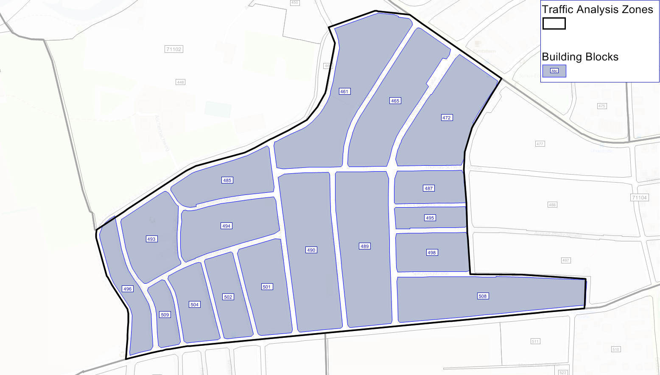
Intrazonal Trips

Slide 5
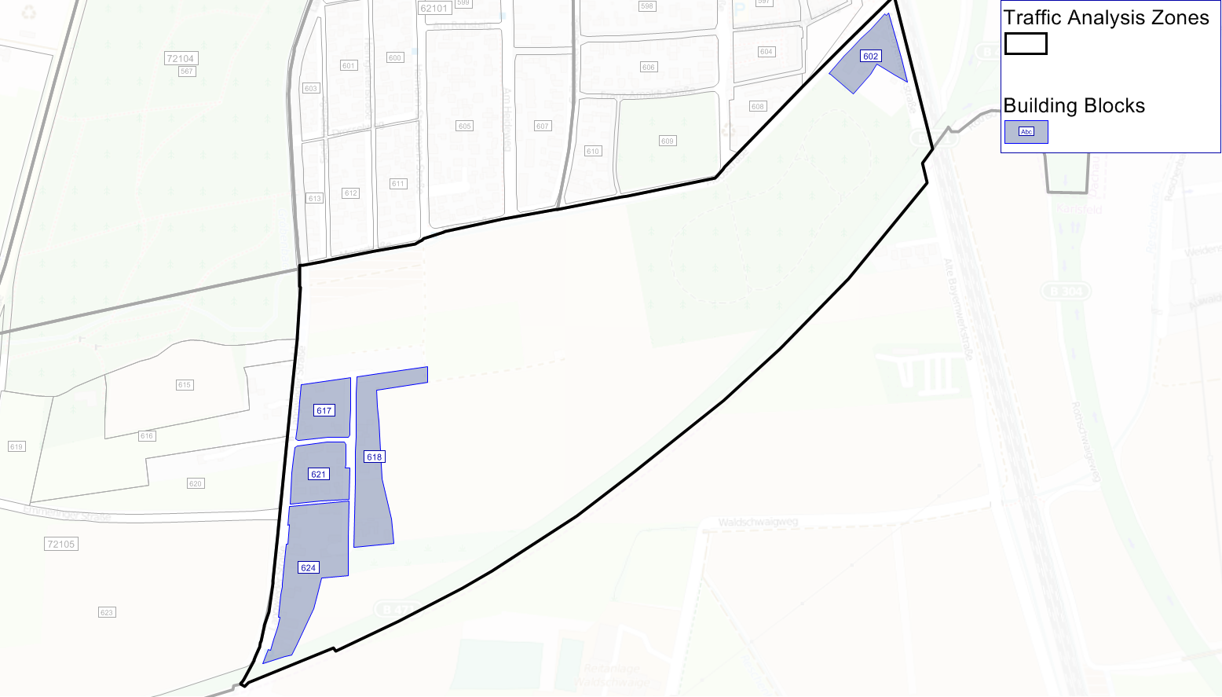
Intrazonal Trips

Slide 6
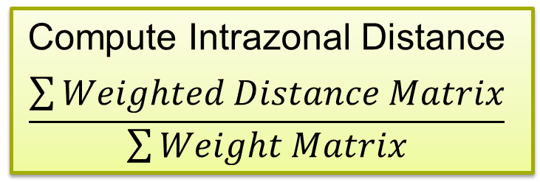
Proposed Method
Select Nodes
Assign Node Weights
Calculate Distance Matrix
Calculate Weight Matrix
Weighted Distance Matrix
Compute Intrazonal Distance
$$\frac{\sum{Weighted Distance Matrix}}{\sum{Weight Matrix}}$$

Slide 7
Proposed Method
  Variants of Method
    Unweighted Nodes
    Nodes Weighted by Closeness Centrality
    Nodes Weighted by Degree Centrality

Slide 8
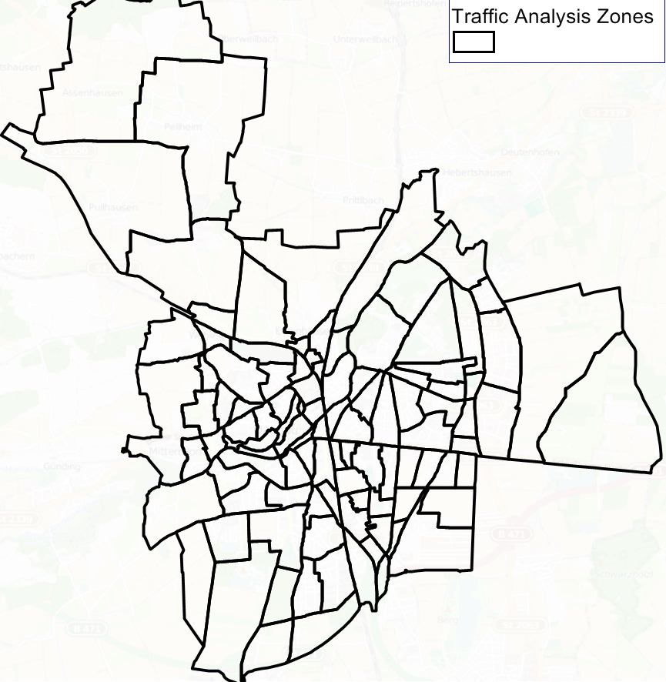
Application of Method
  Dachau with 102 TAZ
  Area= 13 sq.mi.
  Pop= 46,000

Slide 9
Suitability Check 1
  Aggregate 102 Zones into:
    25 Zones
    10 Zones
    5 Zones
    2 Zones
  Intrazonal distance with different methods
  Compare estimated intrazonal distances

Slide 11
Suitability Check 2
  Trip Distribution with the different methods
    Home-Work Trips
    Non-Home-Based Trips
    Home-Shopping Trips
  Between modeled and observed trips;
    Compare TLFDs (Coincidence Ratio)
    Compare Total Number of Intrazonal Trips

Slide 18
Conclusions
  Unweighted provides better estimates of intrazonal impedances
  Better intrazonal impedance no guarantee for better estimates of intrazonal flows
  Nearest neighbour method sufficient given ease of measurement
  Need for smaller zones to avoid intrazonal trips

Slide 19
Thanks for your Attention

