Slide 1
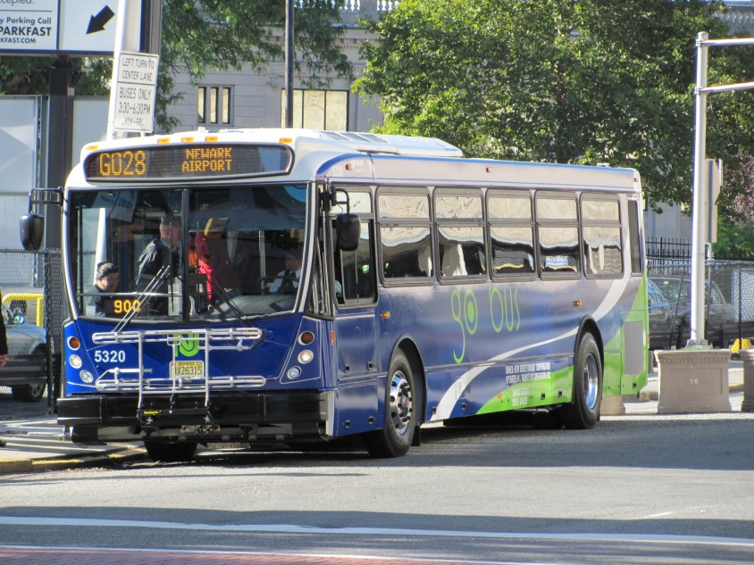
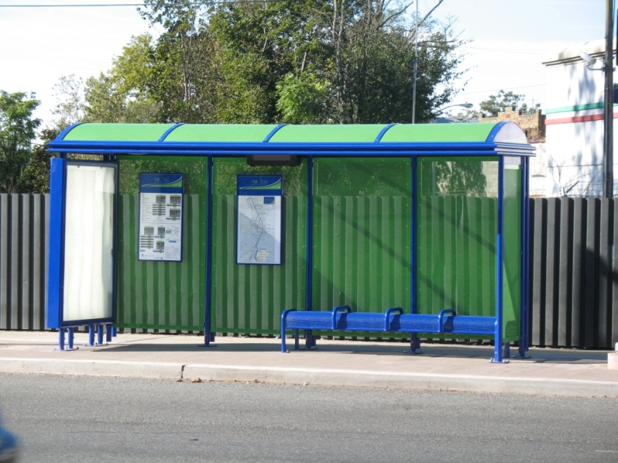
go bus Impact Study
TRB National Transportation Planning Applications Conference
Atlantic City, May 2015

Slide 2
Background
In 2008, NJ TRANSIT introduced an enhanced bus service called go 25 along the 4.8-mile corridor between Newark Penn Station and Irvington Bus Terminal
In 2009, NJ TRANSIT introduced go 28, which serves a 12.1-mile corridor connecting Bloomfield Train Station, downtown Newark, and Newark Airport

Slide 3
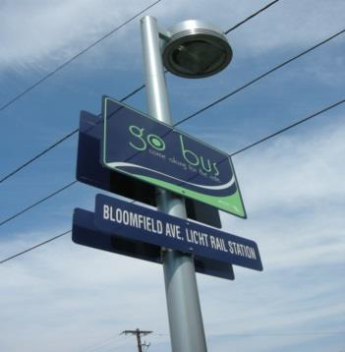
Branded Buses and Shelters

Slide 4
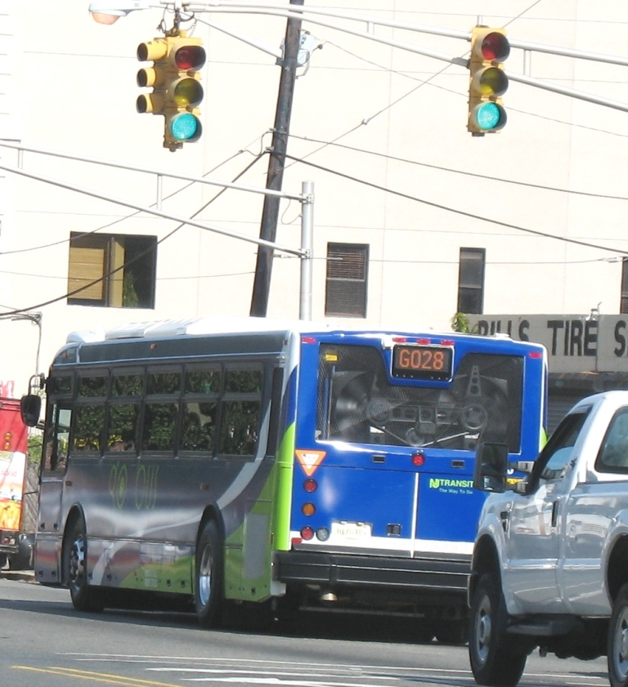
Traffic Signal Priority

Slide 5
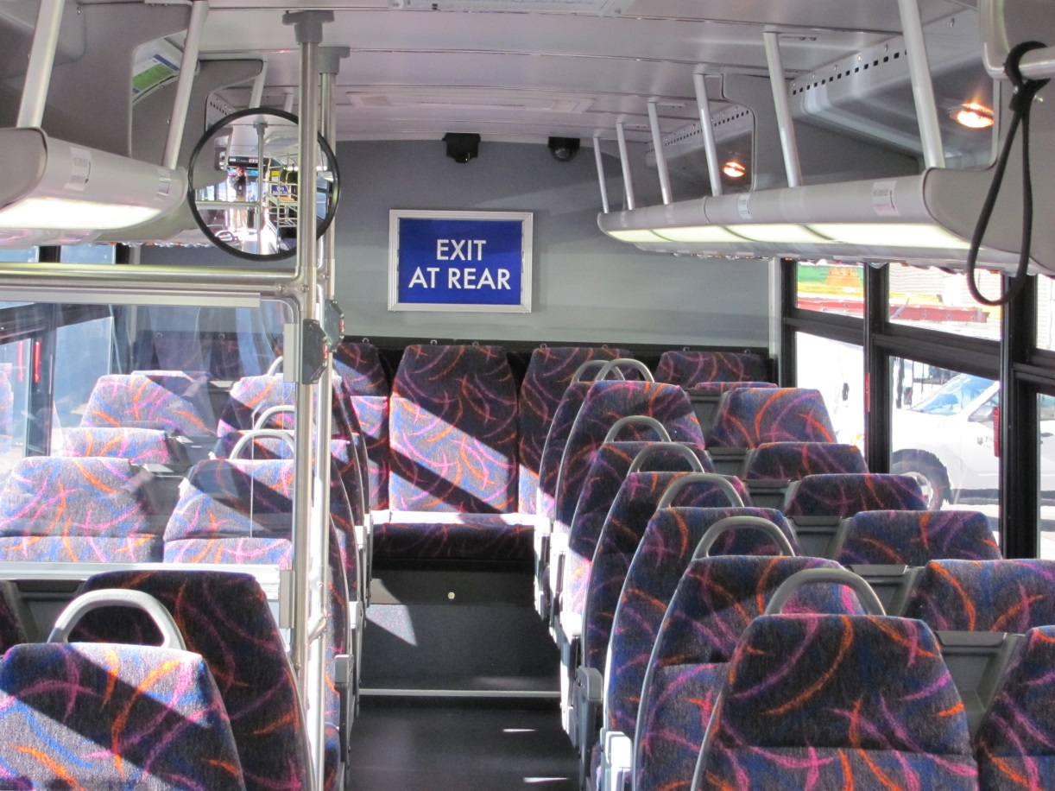
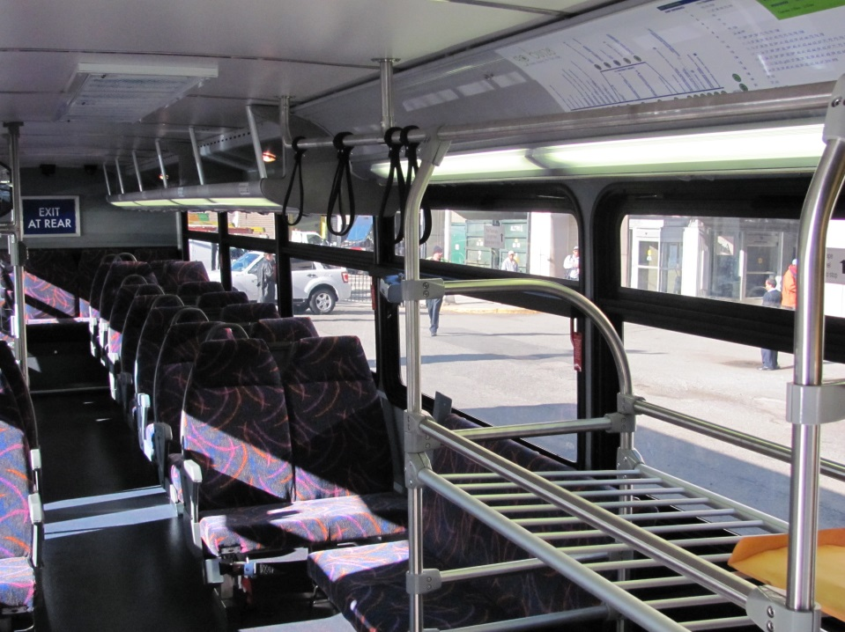
Enhanced Interiors

Slide 6
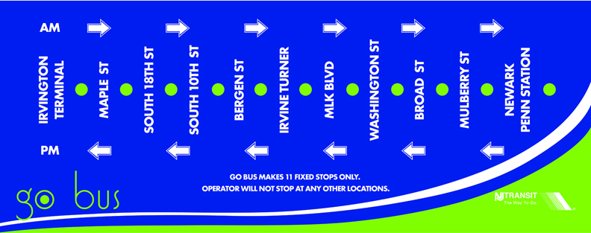
Additional go bus Features
Frequent service
Extended hours
Fewer stops
Board in Front, Exit in Rear

Slide 7
Project Goals
Identify and understand shifts in travel patterns and customer satisfaction
Understand how the enhanced service affects customers’ perceptions of time savings
Identify which features of go bus service customers value the most
Understand the characteristics of customers utilizing go bus services and how they compare to our traditional local bus markets

Slide 8
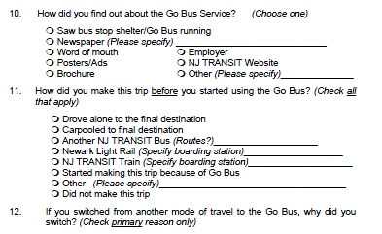
Methodology Overview
Literature Review
Onboard Survey
Focus Groups
Web-based Maximum Difference Scaling (MaxDiff) Survey

Slide 9
Methodology: Onboard Survey
Surveys were administered onboard go 25 and go 28, as well as on parallel local routes 25, 11, 28, and 72
All inbound and outbound trips btwn 6AM-3PM
Response rate of 19%
Surveys were weighted by route, time of day, and direction using ridership counts from the farebox

Slide 10
go bus Customers Perceive Greater Time Savings Than Exist
go 25 - 16 min
go 28 - 19 min
91%
Yes, I save time
85%
Yes, I save time

Slide 11
go bus Customers Express Higher Satisfaction

Slide 12
go bus Attracts More “Choice” Riders
go bus
local bus

Slide 13
go bus Provides Crucial Links to Employment Centers
Nearly 8 in 10 go bus customers were traveling to or from work
About 25% of go 25 customers transfer to or from the PATH train at Newark Penn Station
<10% of local route 25 customers do the same
Approximately 64% of go 28 customers were traveling to or from Newark Liberty International Airport for work

Slide 14
Methodology: Focus Groups
7 focus groups held at NJ TRANSIT Headquarters with go bus and local bus customers
Midway through each group, participants were asked to complete a web-based MaxDiff survey, which involved ranking 24 attributes of service through a series of exercises

Slide 15
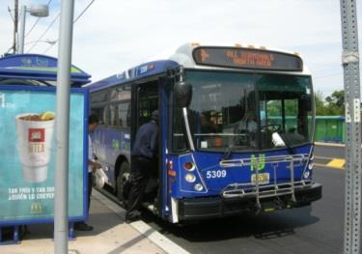
go bus Branding Raises its Visibility
Easier to identify bus stop locations
Customers can see go bus coming
Shelters seem cleaner, better maintained

Slide 16
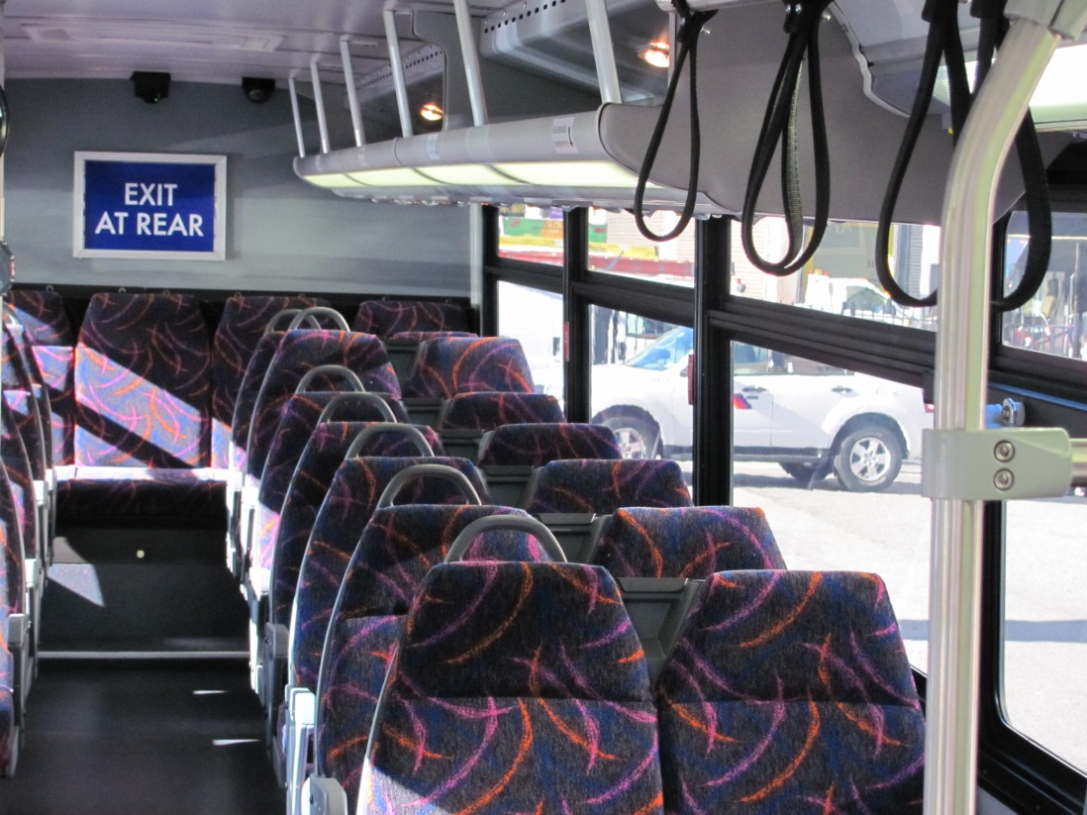
Customers Like Enhanced Interiors
go buses seem cleaner and more comfortable
Customers enjoy features like overhead lighting, high-back seats, and luggage racks on go 28

Slide 17
More Education Needed about “Exit from Rear” Policy
Customers agree that entering through the front and exiting through the back is effective at speeding trip times
However, policy is not always enforced and can actually slow things down when a rider is unaware of the rule

Slide 18
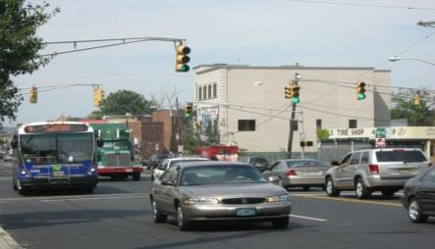
Customers Unaware of Signal Priority
Customers were unaware of the traffic signal priority
However, did notice that the bus seemed to move faster down Bloomfield Ave

Slide 19
Methodology: MaxDiff Scaling
Determines the magnitude by which certain attributes are valued in comparison to others by forcing respondents to make trade-offs

Slide 20
Travel and Frequency Valued Twice as High as Branding Attributes

Slide 21
Branding and Fare Payment Options Rank Lower in Importance

Slide 22
Conclusions
Travel time, frequency of service & convenience are most valued
Perceived time savings were greater than actual time savings on go bus
While less valued by customers, branding and visibility play a large role in garnering interest and awareness about the go bus

Slide 23
Conclusions
go 25 and go 28 customers report higher customer satisfaction
go 25 and go 28 took some cars off the road
Opportunities exist to use go bus service to improve trans-Hudson travel

