Slide 1
Automatic loading of inputs for Real Time Evacuation Scenario Simulations: evaluation using mesoscopic models
Josep M. Aymamí
15th TRB National Transportation Planning Applications Conference, May 17-21, 2015

Slide 2
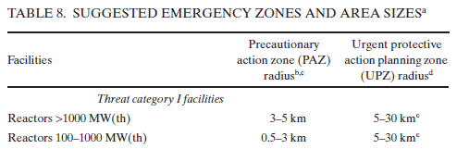
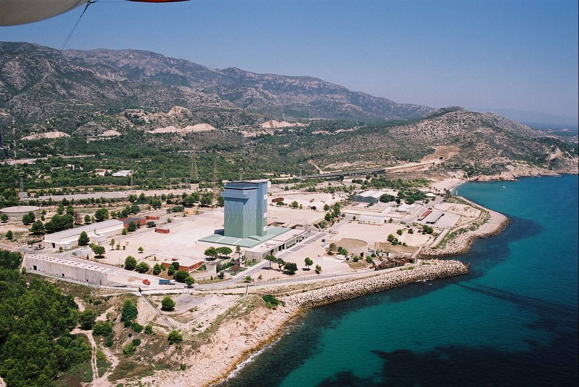
Background
Current methodology to determine Evacuation Time Estimates (ETE) from incident in Three Mile Island (1979). Nuclear evacuations.
Usually Static Aproach is considered (and was the only feasible solution at that time).
For us (Aimsun), projects related to evacuations where some steps were difficult to handle with a ‘standard’ tool.
Notes:
On October 19th 1989, and due to a mechanical failure, there was a fire in the site. The event was classified as level 3 (important incident) on the INES Scale.
The fire seriously affected the installations, though there were no consequences whatsoever, as regards radioactive emissions, for the environment. According to all the reports, there were no repercussions to the outside, nor was there any environmental or personal damage.
The event began through a fire in a conventional building of the plant, the turbine building, which has no relation to radioactive components. The fire started because of the rupture of lubrication pipes. This caused a considerable oil leak in a very short time. Following this, and as a consequence of the fire, there was a chain of system failures, especially due to the flooding of the lower floors at the turbine building with a water leakage from various circuits as well as from the water used to extinguish the fire. This all caused considerable damage to the electric systems.
PENTA: PLAN DE EMERGENCIA NUCL
EAR, exterior a las CENTRALES NUCLEARES DE ASCÓ y VANDELLÓS (TARRAGONA).
Cada PEN debe integrar los siguientes planes:

PLAN DIRECTOR (Directrices Básicas a nivel territorial)

PLANES DE ACTUACIÓN EN EMERGENCIA NUCLEAR DE
LOS GRUPOS OPERATIVOS:
COORDINACIÓN Y ASISTENCIA TÉCNICA, RADIOLÓGICO,
SEGURIDAD CIUDADANA Y ORDEN PÚBLICO, SANITARIO,
APOYO LOGÍSTICO.

PLANES DE ACTUACIÓN MUNICIPAL EN EMERGENCIA
NUCLEAR (PAMEN):
MUNICIPIOS: ZONA I, ZONA II, ECD Y ABRS.
Zonas de planificación genéricas:
Círculo concéntrico CN radio hasta 30km.
Tres zonas : Zona 0, Zona I y Zona II.
•
Tipología de municipios, a efectos de los PAMEN a
elaborar, en función de las actuaciones de
respuesta:
Municipios Zona I, Municipios Zona II, Municipios sede ECD, Municipios con funciones ABRS.
PAZ (“Precautionary Action Zone”) y la UPZ (“Urgent Protective Zone”).

Slide 3
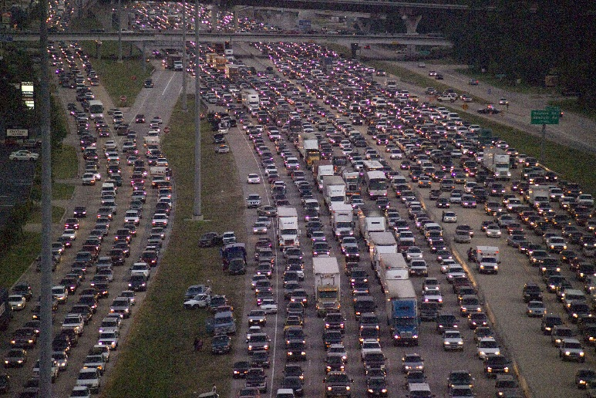
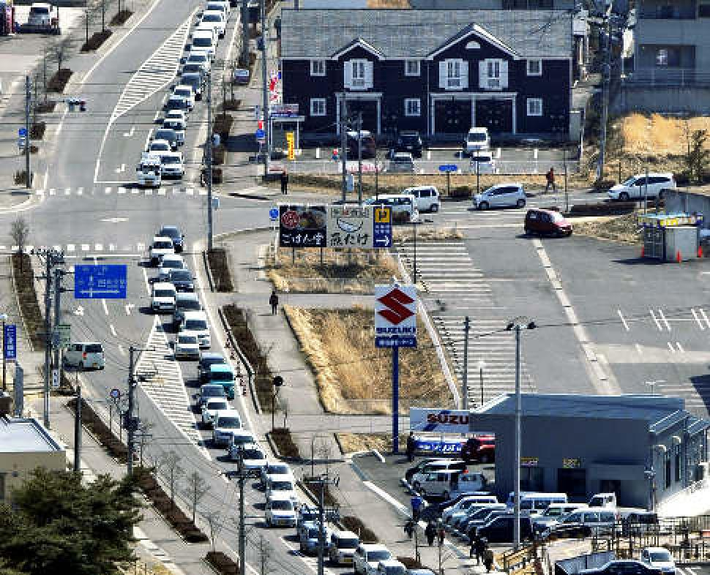
Challenges
Fortunately, not so much experiences coming from Real cases (Nuclear Evacuations Especially). Difficult to Validate Scenarios and obtain Calibration Guidelines on certain aspects:
  Route Choice
    Information to population: pre-trip decisions
    On-trip decisions
  Driving Characteristics
Many assumptions to be considered. This is why a virtual environment to obtain best practices (and commonly complex combinations of them). Ideally, a dynamic environment.

Slide 4
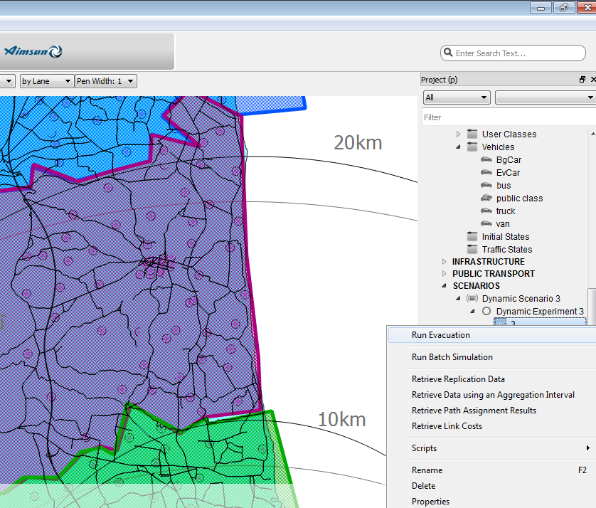

New Approach. Using dynamic simulation
Adapting Aimsun with a New Module (Aimsun ETE) to:
  Accept evacuation type inputs: zoning and evacuees, evacuees per vehicles
  Produce demanded results for such purposes. ETE, waiting times, etc…
  Non predefined duration of the simulation
  Dynamic simulation (meso/hybrid): evolution of evacuation, temporary conditions or measures, lane based (for events, closures, contraflow, …), large areas being covered

Slide 5
New Approach. Using dynamic simulation
  Combination of usual traffic + evacuation: evacuation profiles, background, voluntary…
  Screening points, shelters, etc…
  Intermodal trips. PT very important and rather complex to simulate
Evaluate strategies for management
5

Slide 6
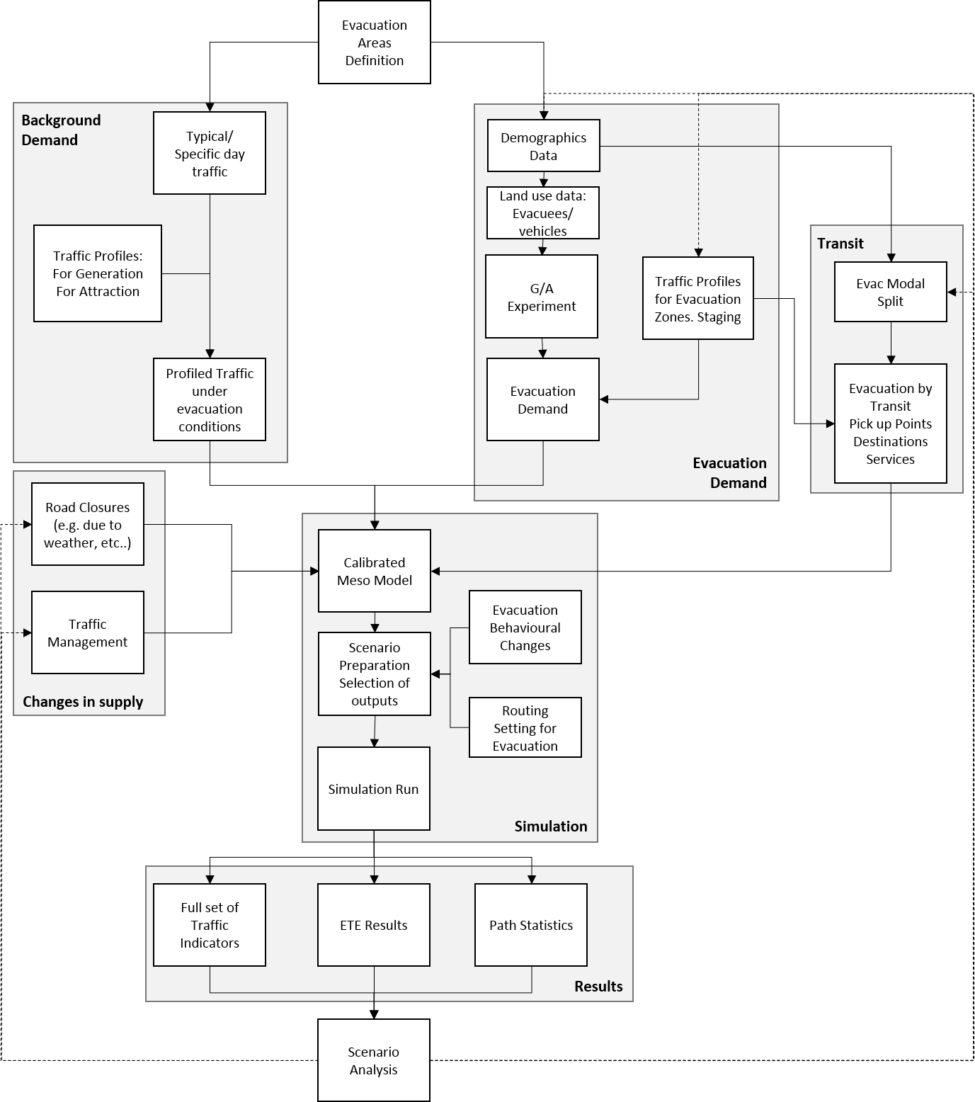
The Evacuation Framework
6

Slide 7
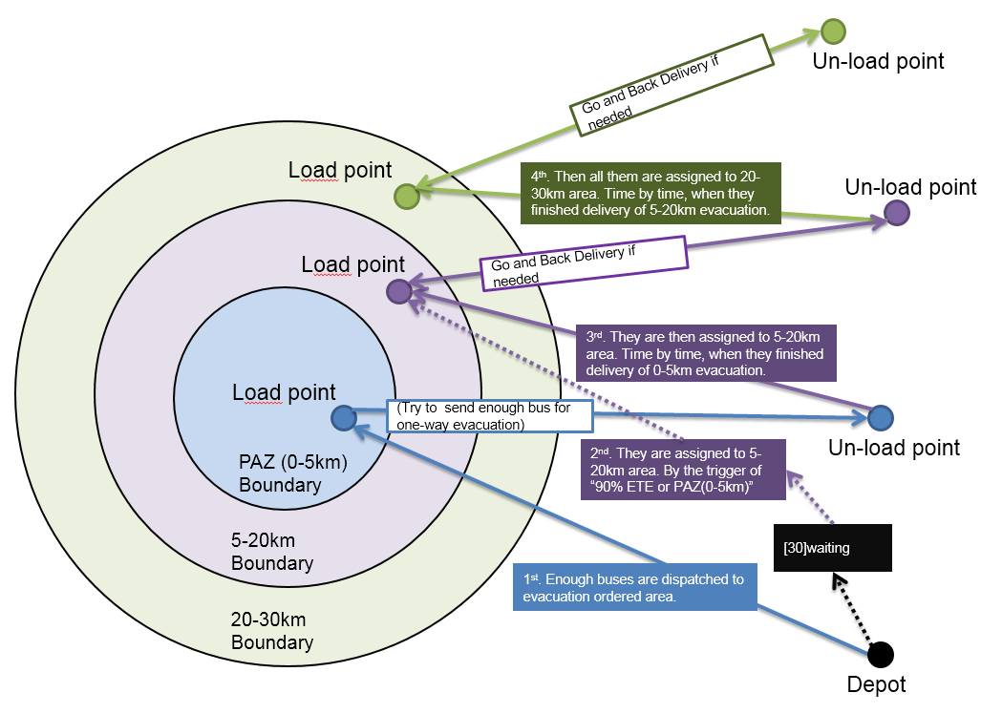
Evacuation Demand Complexity
Example: Transit Evacuation using a limited- amount of available vehicles

Slide 8
Inputs
Road and transport network: from GIS, plus model specific needed attributes (road hyerarchy, capacity, …)
Evacuation demand
  Residents, workers, students, holidaymakers (seasonal depending)
  Socio economical data: car ownership
  Set generation attraction points and its connectivity with the network (centroids)
Zoning: set the evacuation areas (in Nuclear Evac: ERPAs, PAZs, UPZs,…)
Transit plans (regular and shuttle services)
Background demand
Set Signals
Road Closures (due to the event itself, due to weather, etc…)
Set Decreased road conditions (speed reductions, etc…)
Traffic Management to be evaluated (Response Plans to improve Evacuation perfromance)
Scripting

Slide 9
Case Study: Nuclear Evacuation

Slide 10
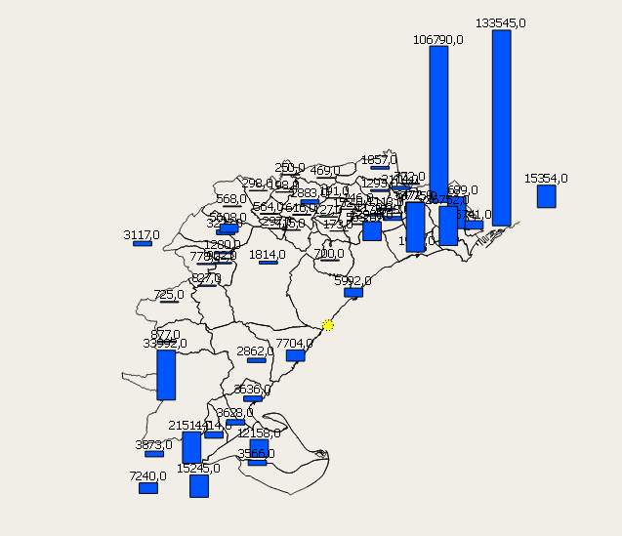
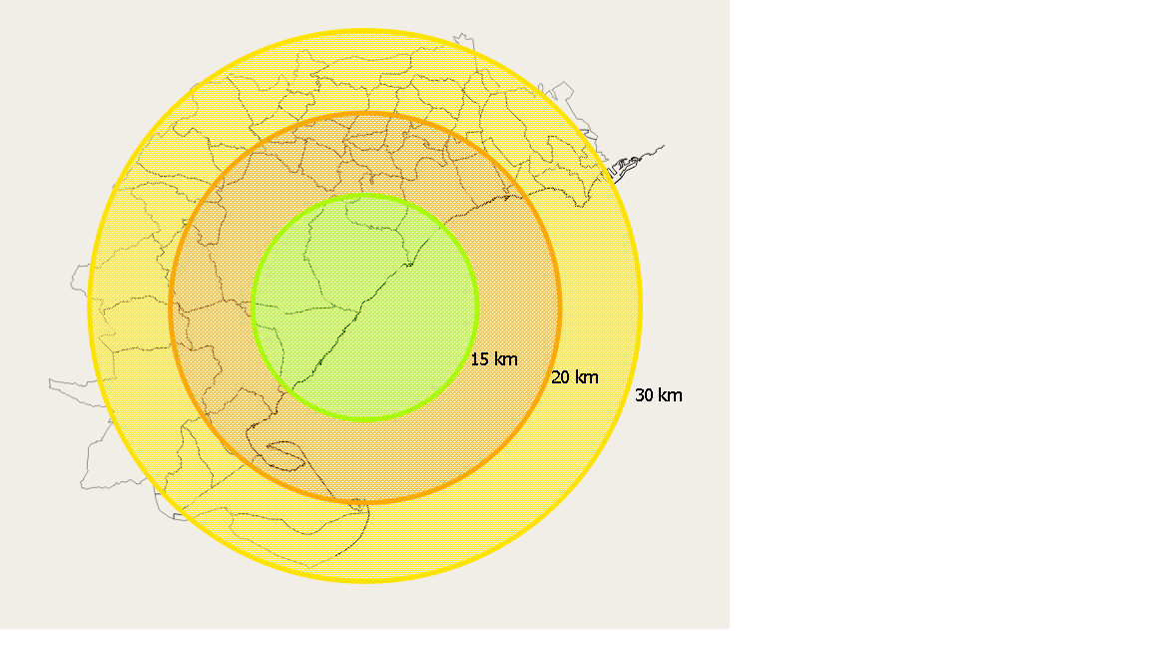
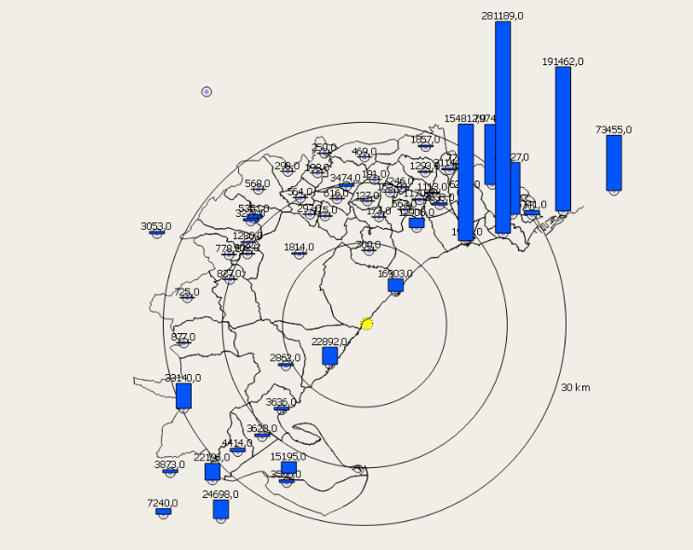
Case Study: Nuclear Evacuation. Basics
UPZ zones means 60x60 km at least…and large volumes of evacuees.
10
Notes:
ABRS (Área Base de Recepción Social ): Tarragona, Reus, Tortosa y Lleida

Slide 11
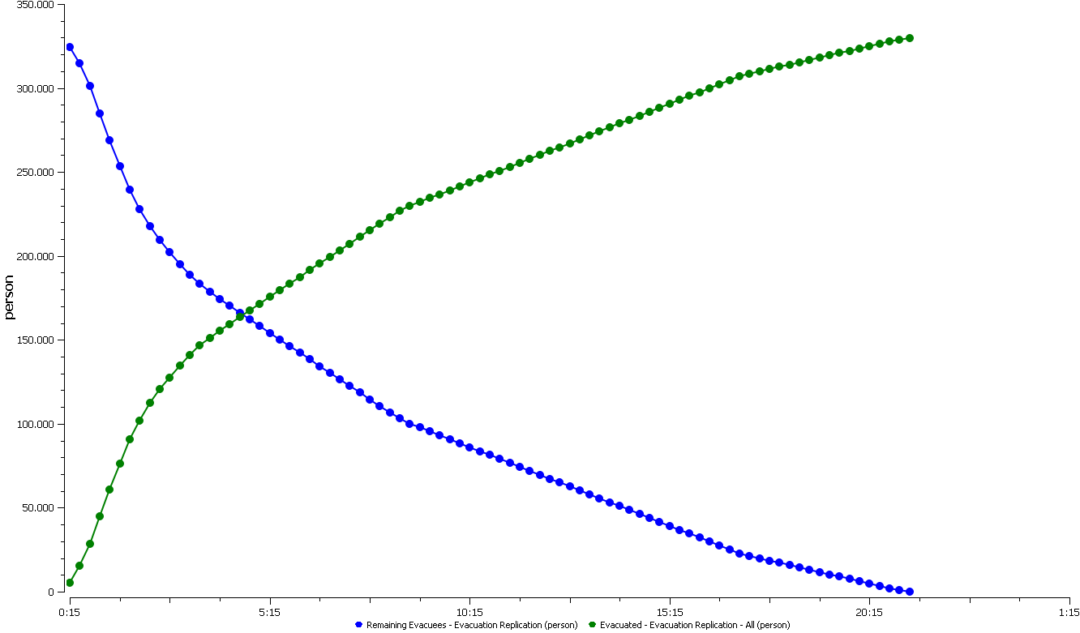
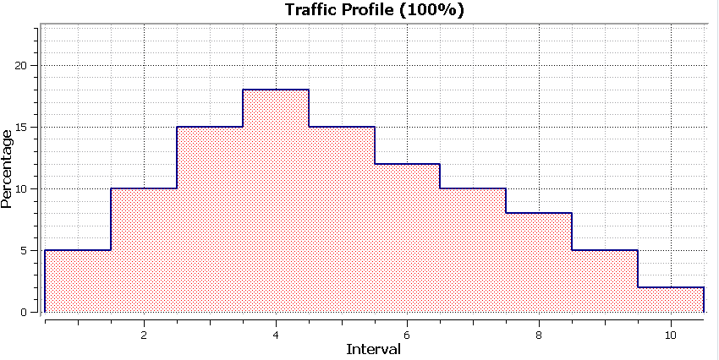
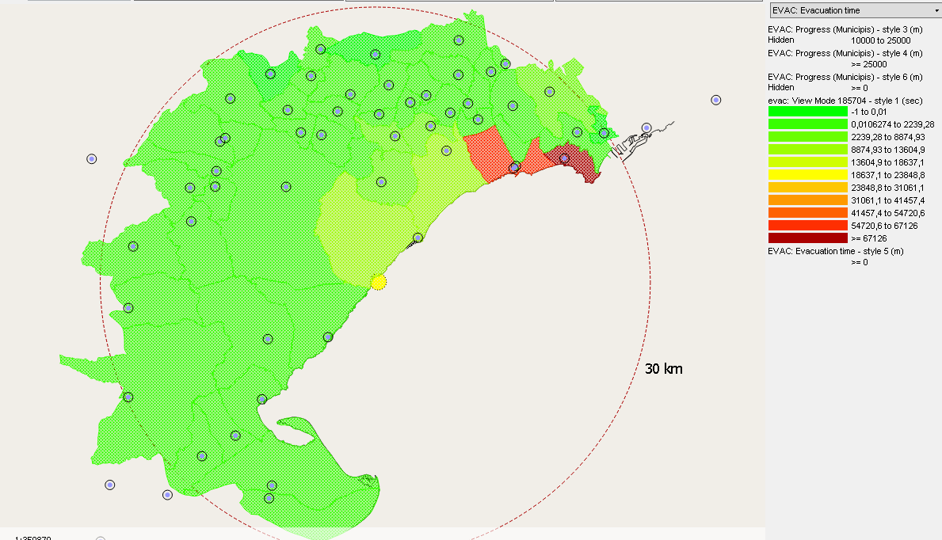
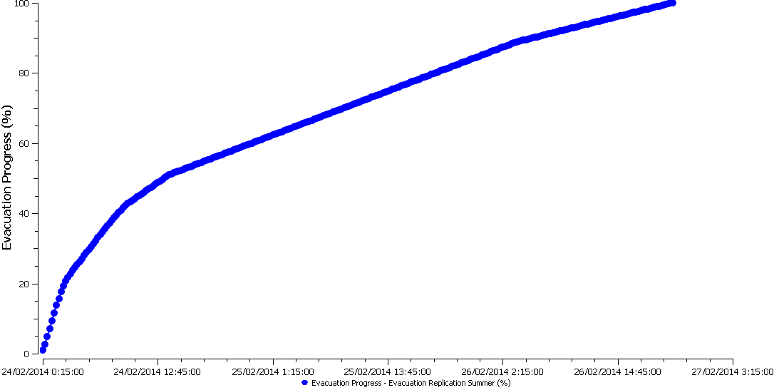
Adapting inputs and outputs
11

Slide 12
Case Study: Bushfire Evacuation

Slide 13
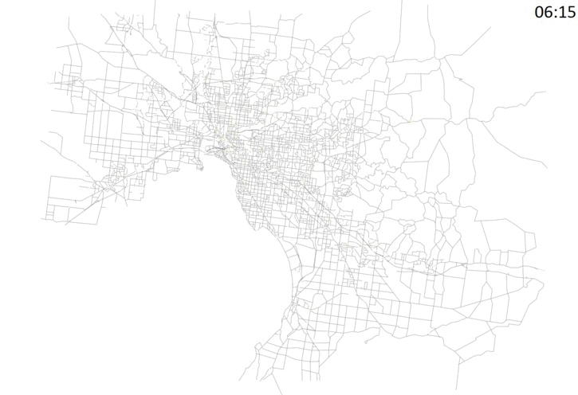
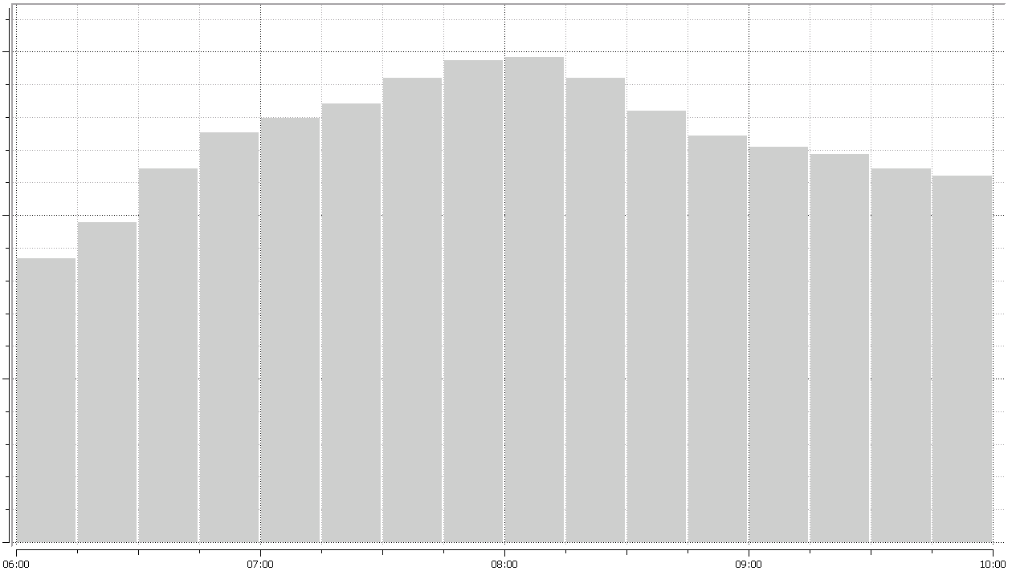
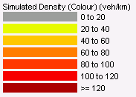
Melbourne: Aimsun Model
Total number of centroids: 2913
Total section length: 13508 km
Total lane length: 18396 km
Traffic profile
Simulated density. Meso DUE Experiment
6 AM
7 AM
8 AM
9 AM
10 AM

Slide 14
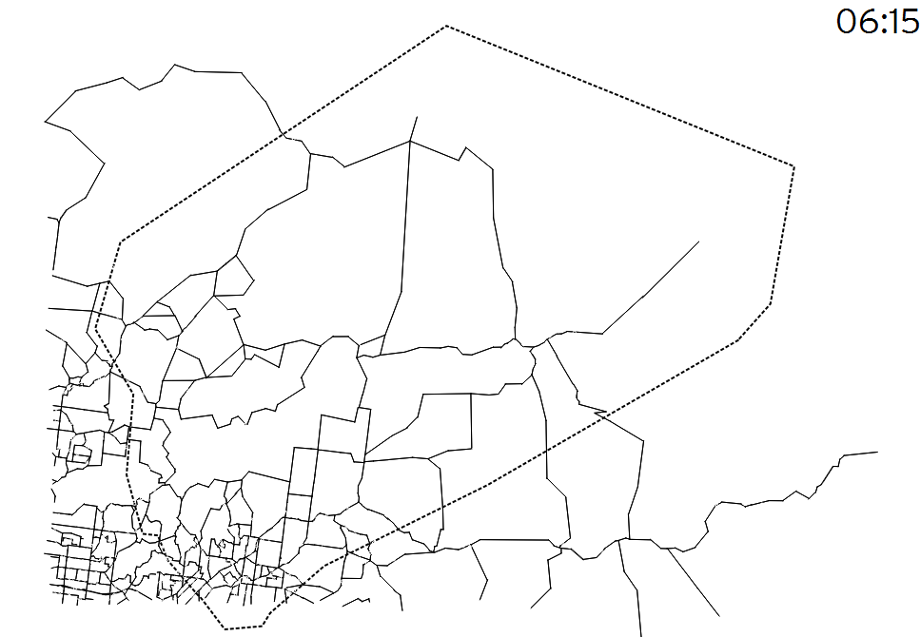
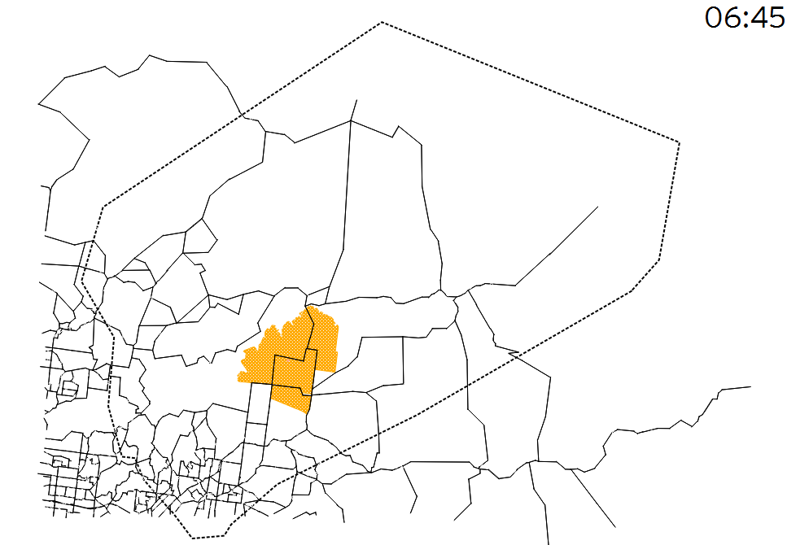
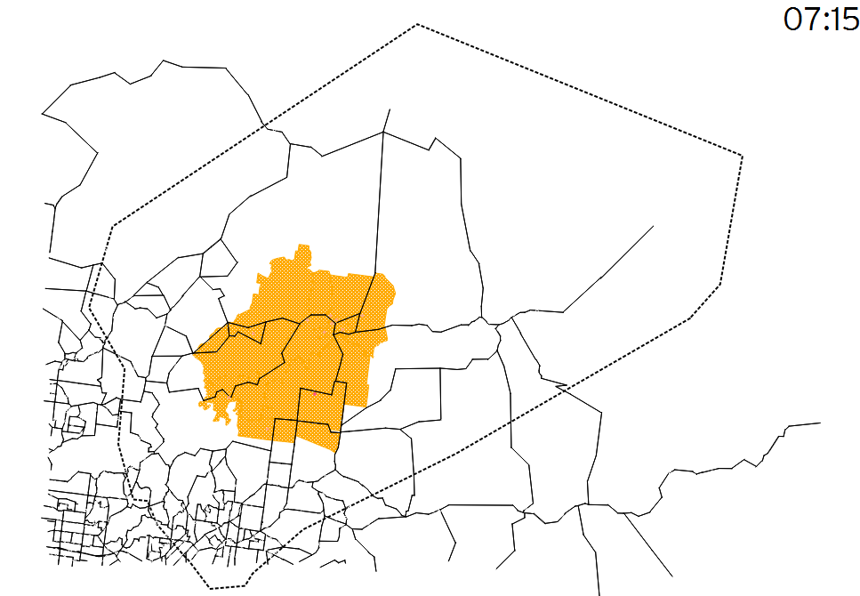
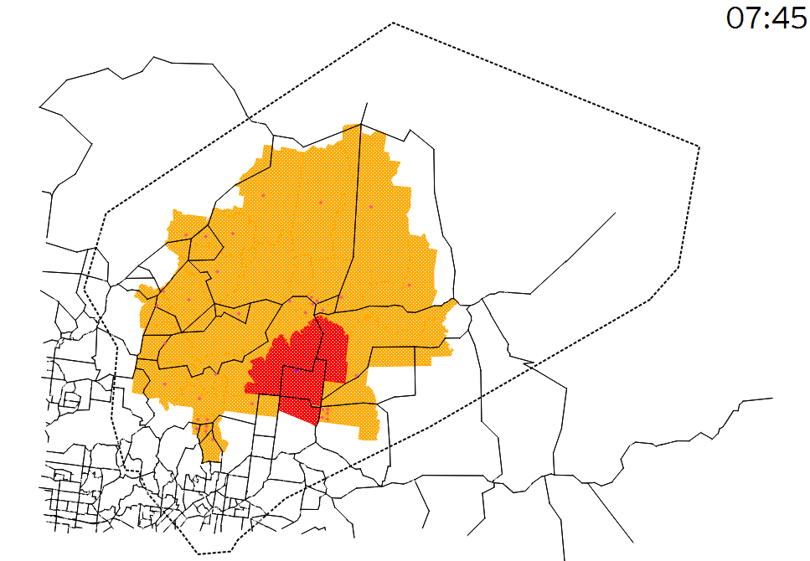
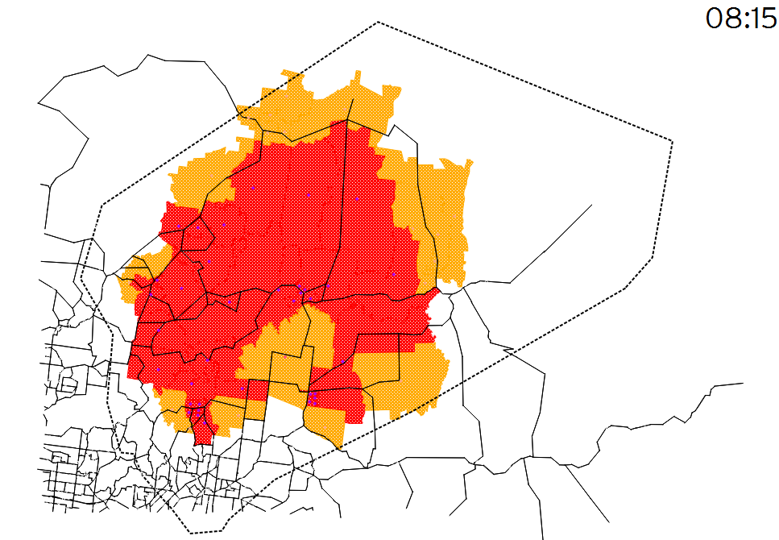
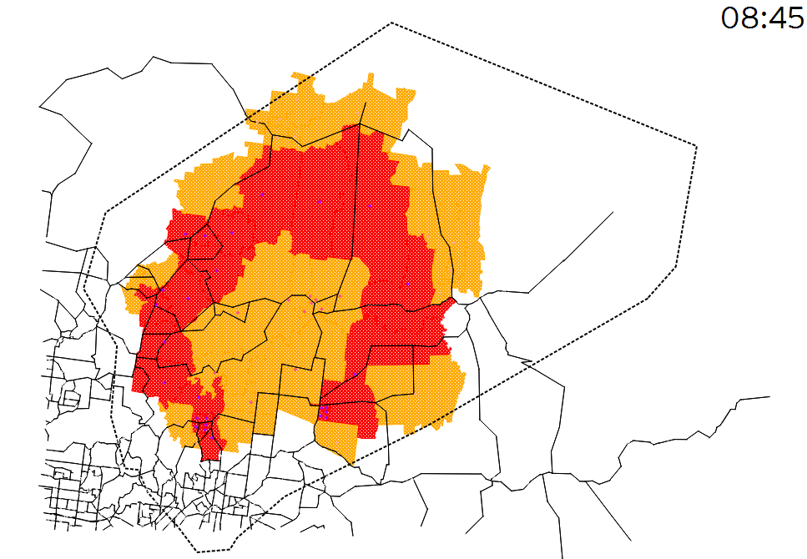
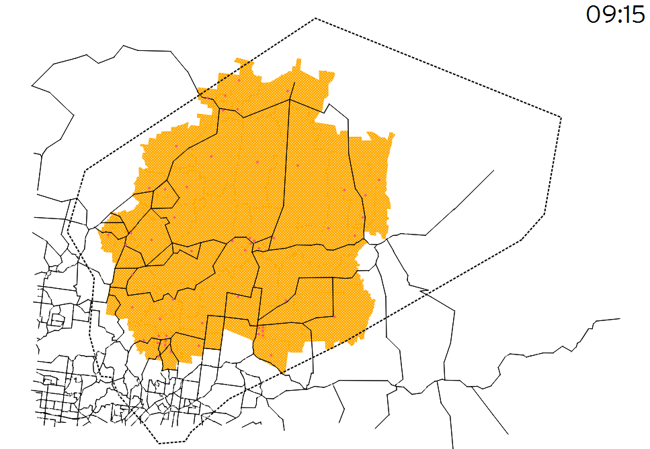
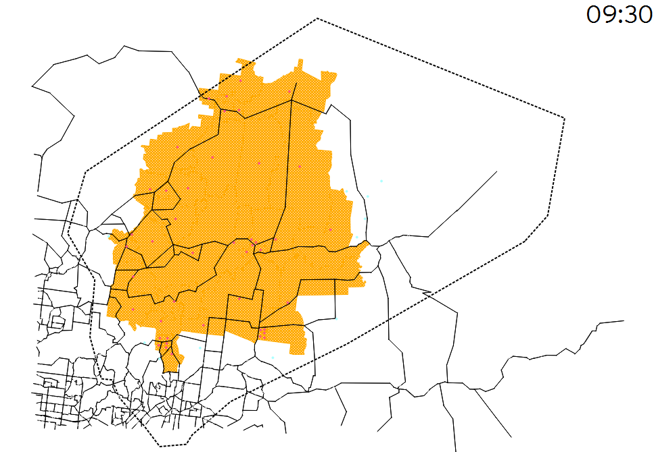

ETE: Fire Devices
Fire evolution based on detector information:
Temperature (ºC):

Slide 15
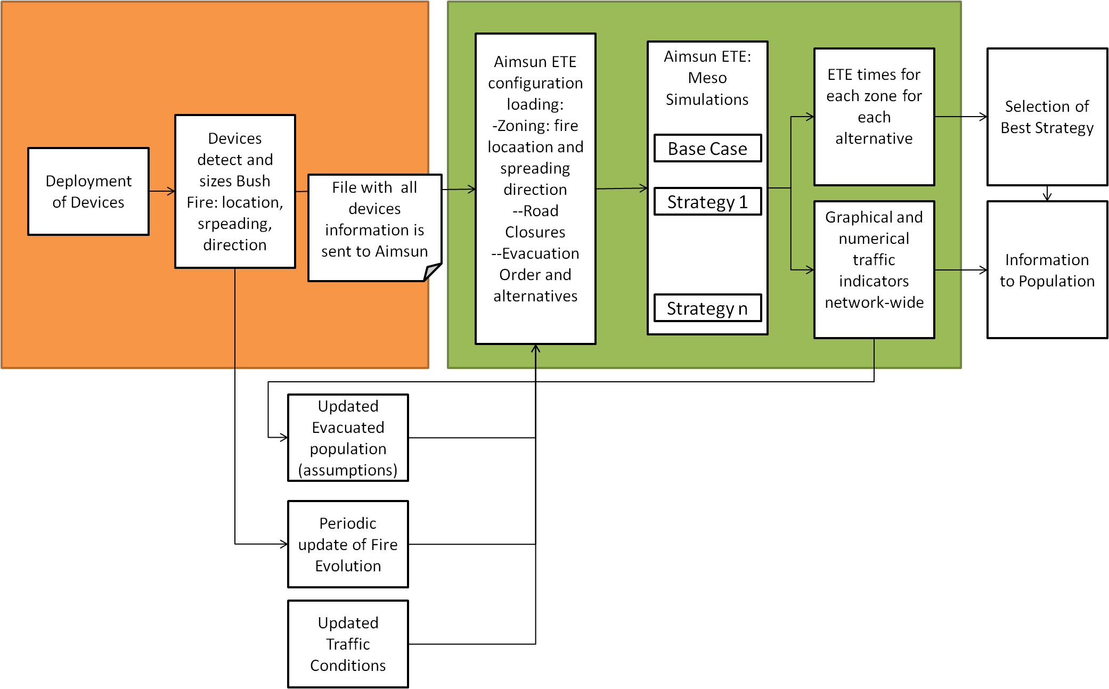
Live evacuation (updating situation)

Slide 16
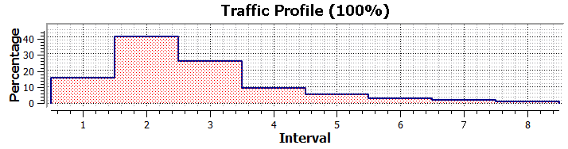
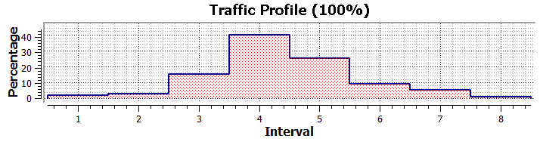
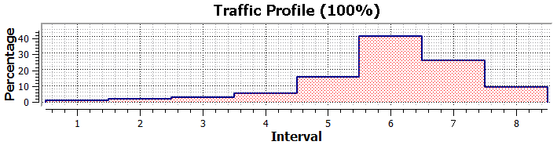
ETE: Scenario Description
STAGED: Depending on the position of the fire, evacuees are generated in different time periods.
Fire Area:
Close to Fire Area:
External Areas:
Interval: 15 min

Slide 17
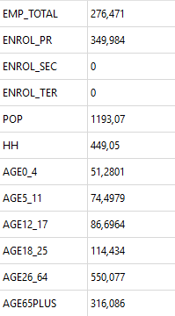
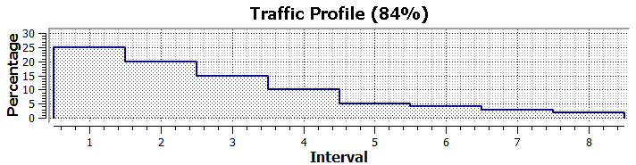
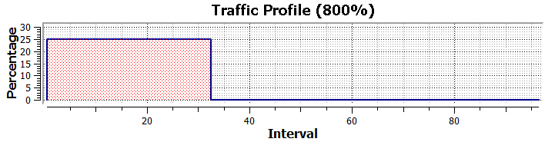
ETE: Inputs
Centroid population
Evacuation Area
Evacuation generation profiles
Background Traffic:
  Inside Evacuation Area:
  Outside Evacuation Area:
Interval: 15 min

Slide 18
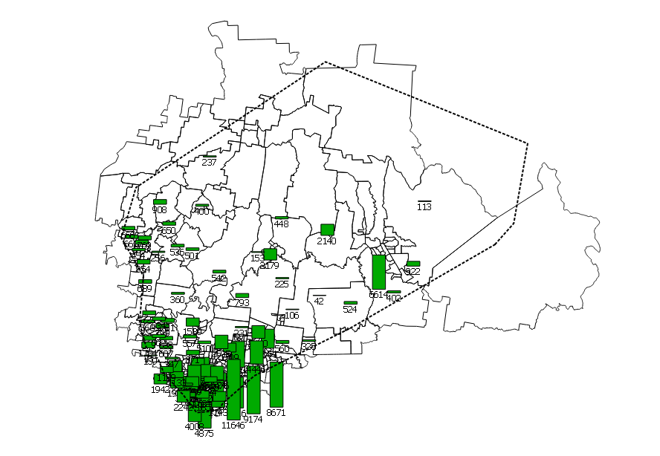
Evacuee Generation
Map: Generated Evacuees in Centroids

Slide 19
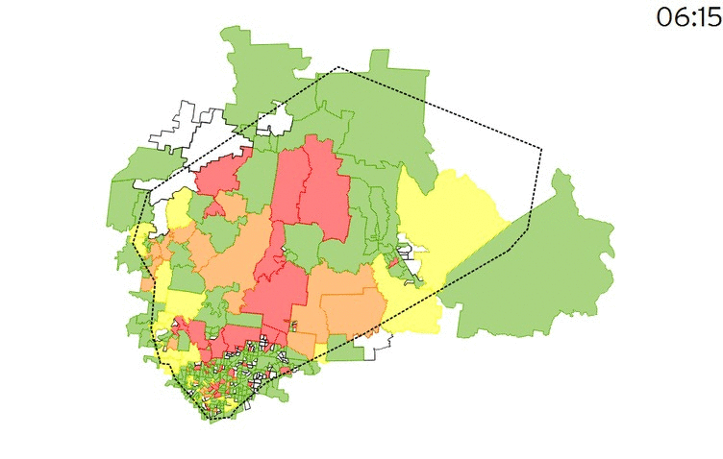

Chaos ETE: Results Summary
Video: Evacuation Progress

Slide 20
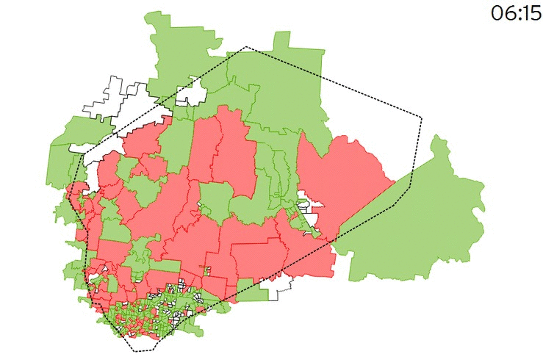
Staged ETE: Results Summary
Video: Evacuation Progress

Slide 21
Chaos vs. Staged Comparison
Evacuation Progress Comparison:
Evacuation Time reduction of 2 h 15 min (40%) when applying a Staged Evacuation.
The Staged evacuation makes evacuees closer to fire areas are the first to be evacuated which ends up optimizing the whole system.

Slide 22
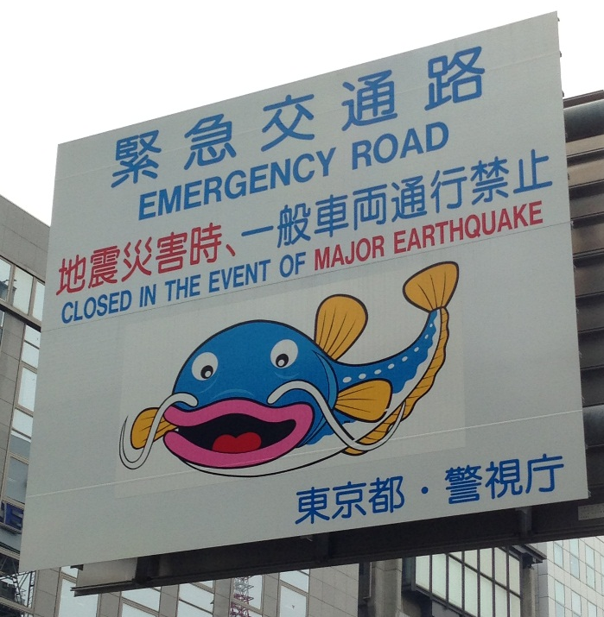
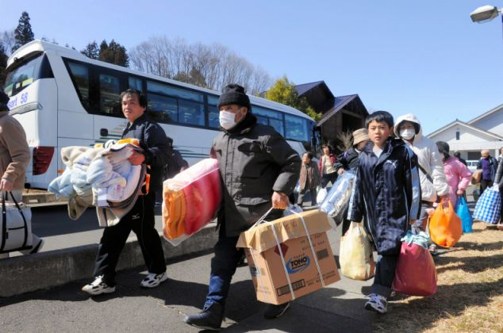
Lessons learnt
Study multitude of combinations , scenarios , mixes, items available for the management of the emergency
VERY important cultural aspects
Structuring evacuation where possible, but there will always be considered "voluntary" evacuation : there may be congestion due to this factor
Pre-trip information vs On-trip information
Prepare infrastructure in areas of risk to allow flexibility . E.g. Contraflow on highways require the infrastructure to be ready for it.
Evacuation using Mass Transit: ideal if possible, but complex management
Infrastructure and ITS systems prepared for emergencies

Slide 23
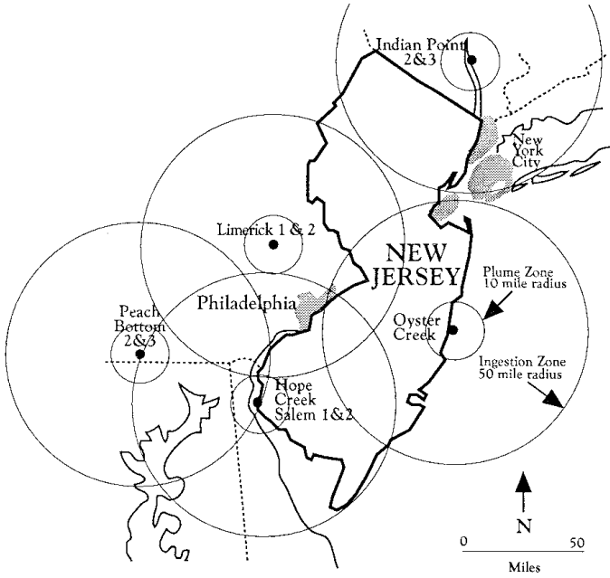
Conclusions
The evacuation scenarios present challenges for dynamic simulators, but provides interesting benefits over classical methodologies in this field.
Evacuation times less optimistic than previous methods 'static' type. Seems more realistic times
Aimsun ETE proved as a tool prepared for
these cases, and versatile enough for
a variety of cases and evacuation type
(nuclear, forest fires, etc ...)
Optimize the evacuations through traffic strategies. In some cases, up to 300 sets of actions. Select good and bad practices and get
evacuation guides and recommendations.

Slide 24

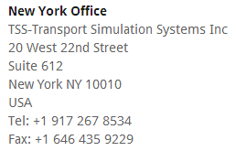
Thank You!
info@aimsun.com

