Slide 1
The Travel Impact of Autonomous Vehicles in Metro Atlanta through Activity-Based Modeling
Kyeil Kim, Ph.D., PTP, Atlanta Regional Commission
Guy Rousseau, Atlanta Regional Commission
Joel Freedman, Resource Systems Group
Jonathan Nicholson, Atkins
May 18, 2015
The 15th TRB National Transportation
Planning Applications Conference

Slide 2
Autonomous Vehicle?
Driverless car, self-driving car, robotic car, …
Takes over driver’s tasks to perform transportation capabilities of conventional cars
Sensors to map surroundings and navigation paths
Vehicle-to-Vehicle communications (V2V)
Cooperative Adaptive Cruise Control (CACC)
Vehicle-to-Infrastructure communications (V2I)

Slide 3
NHTSA Levels of Automation
Level 0 | No automation | Steering and braking by driver
Level 1 | Single function automation | Car controls steering or brakes
Level 2 | Combined function automation | Car controls steering and brakes | Driver ready to take control
Level 3 | Limited self-driving automation | Car controls steering and brakes | Ample warning, Driver involvement in rare condition
Level 4 | Full self-driving automation | Car can drive itself empty | No driver involvement

Slide 4
Important to Note
Limited to “What-if” scenarios
A number of factors affecting AV modeling
Restricted to select factors, while assuming others constant
Any modeling components in AV require in-depth analysis

Slide 5
Assumptions
Fuel efficiency
Based on the trend in CAFE standards and annual energy outlook by U.S. Energy Information Administration
CAFE standards: 54.5 mpg in model year 2025
Extrapolated to 2040 (light and heavy duty)
Additional fuel economy due to efficient operation of autonomous vehicle
Result in a reduction in overall vehicle operating cost

Slide 6
Assumptions
Perceived travel time disutility
Less onerous in-vehicle travel time
In-vehicle productivity – Reduced disutility
Affects tour/trip mode choice utilities
Parking cost
Driverless cars significantly reduce the need for paid parking
Work and non-work trips

Slide 7
Assumptions
Increased roadway capacity
CACC/V2V communications
Tighter spacing between AVs due to short P/R times
Steady flows with limited traffic interruptions (in high speed?)
Depends on market penetration levels
Level 4 - 100% market penetration in 2040

Slide 8
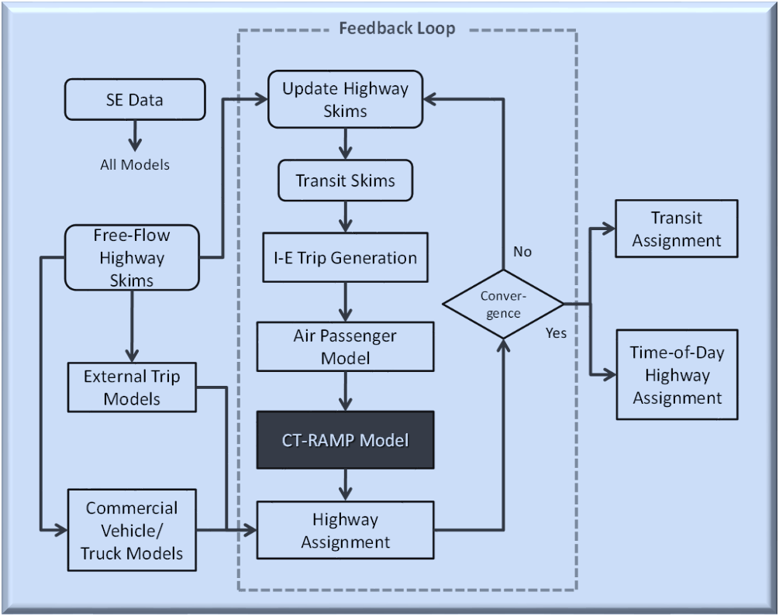
ARC Activity-Based Model
Model Structure

Slide 9
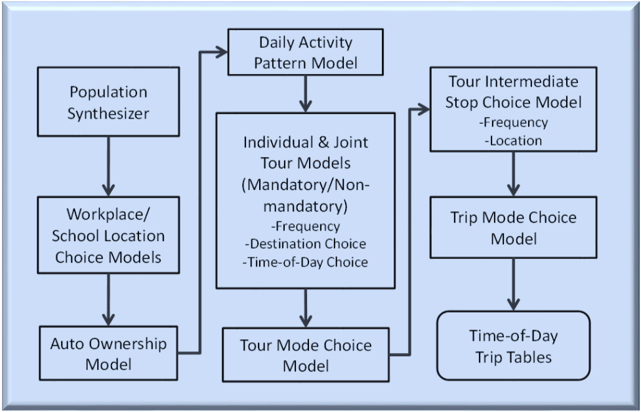
ARC Activity-Based Model
Internal Demand Generation

Slide 10
Methodology
Tour and trip mode choice utility expression calculators (UECs)
AV_Perc_Factor: Reduce the IVT coefficients for autos by 50%
Increased fuel efficiency in operating cost
71% reduction in vehicle operating cost from present
Parking costs at primary destinations set to zero
Generalized cost in highway assignment
Reduced auto and truck operating costs
Increased roadway capacity by 50%

Slide 11
Scenarios
Incremental
Scenario
2040 NB | C | CT | CTO | CTOP
baseline | capacity increase | capacity increase | capacity increase | capacity increase
 |  | decrease in travel time disutility | decrease in travel time disutility | decrease in travel time disutility
 |  |  | reduction in vehicle operating cost | reduction in vehicle operating cost
 |  |  |  | reduction in parking cost

Slide 12
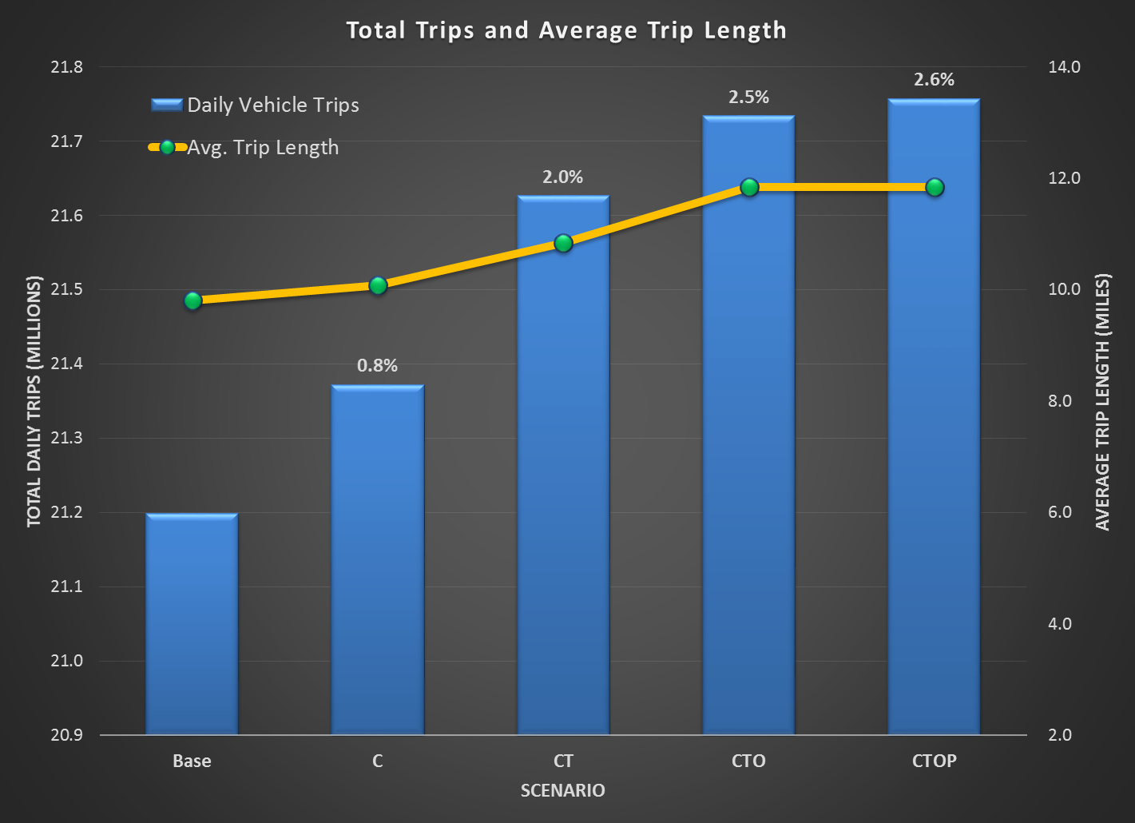
Model Results

Slide 13
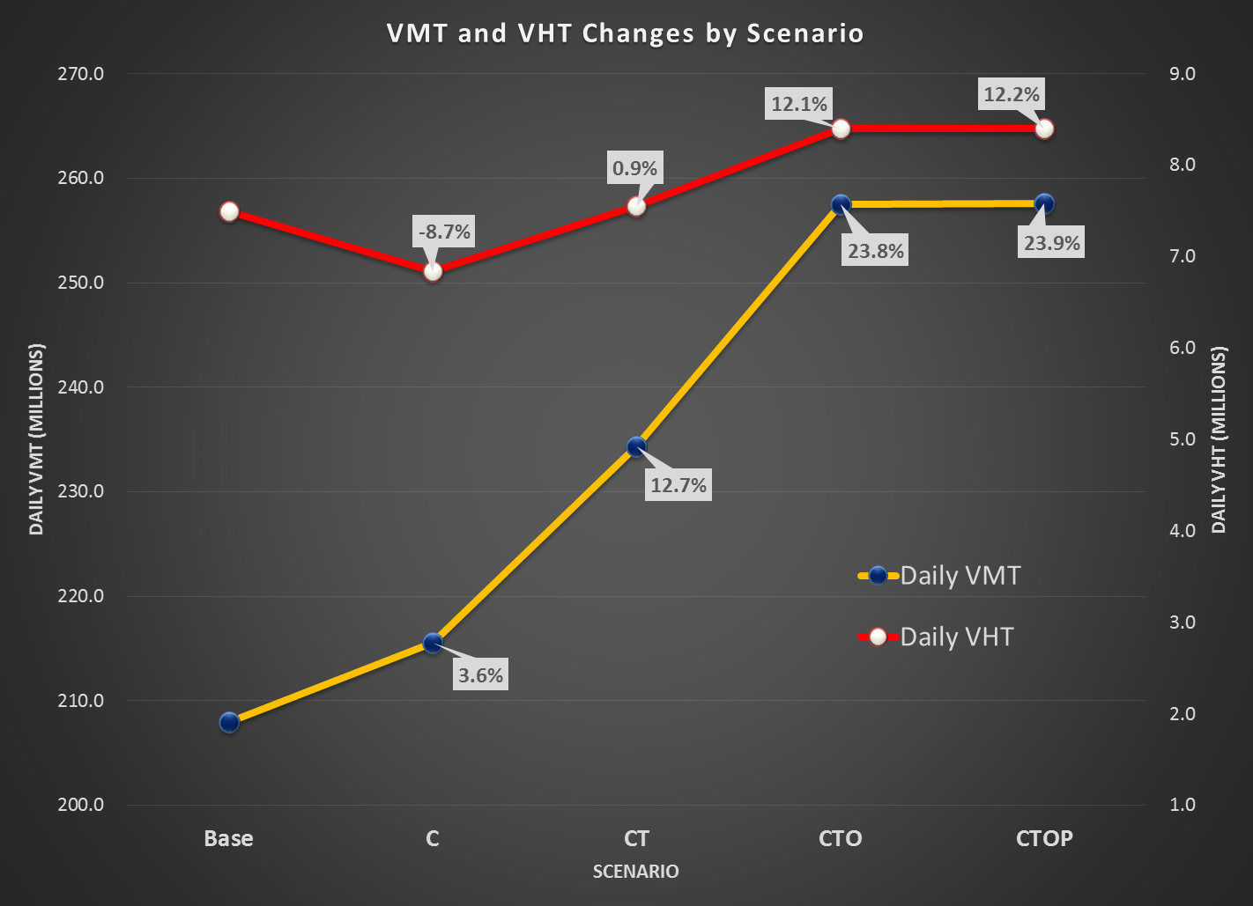
Model Results

Slide 14
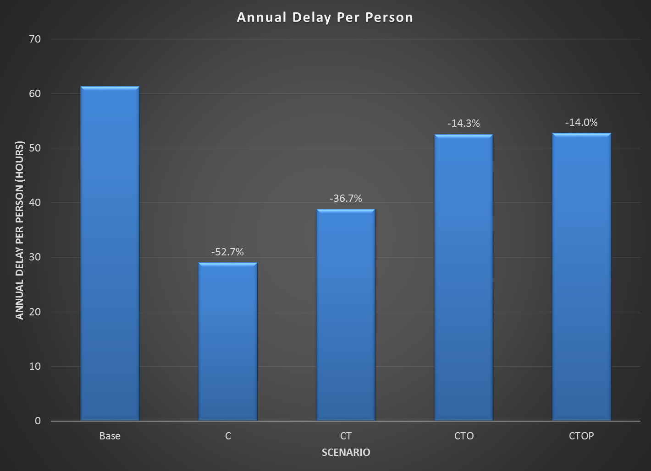
Model Results

Slide 15
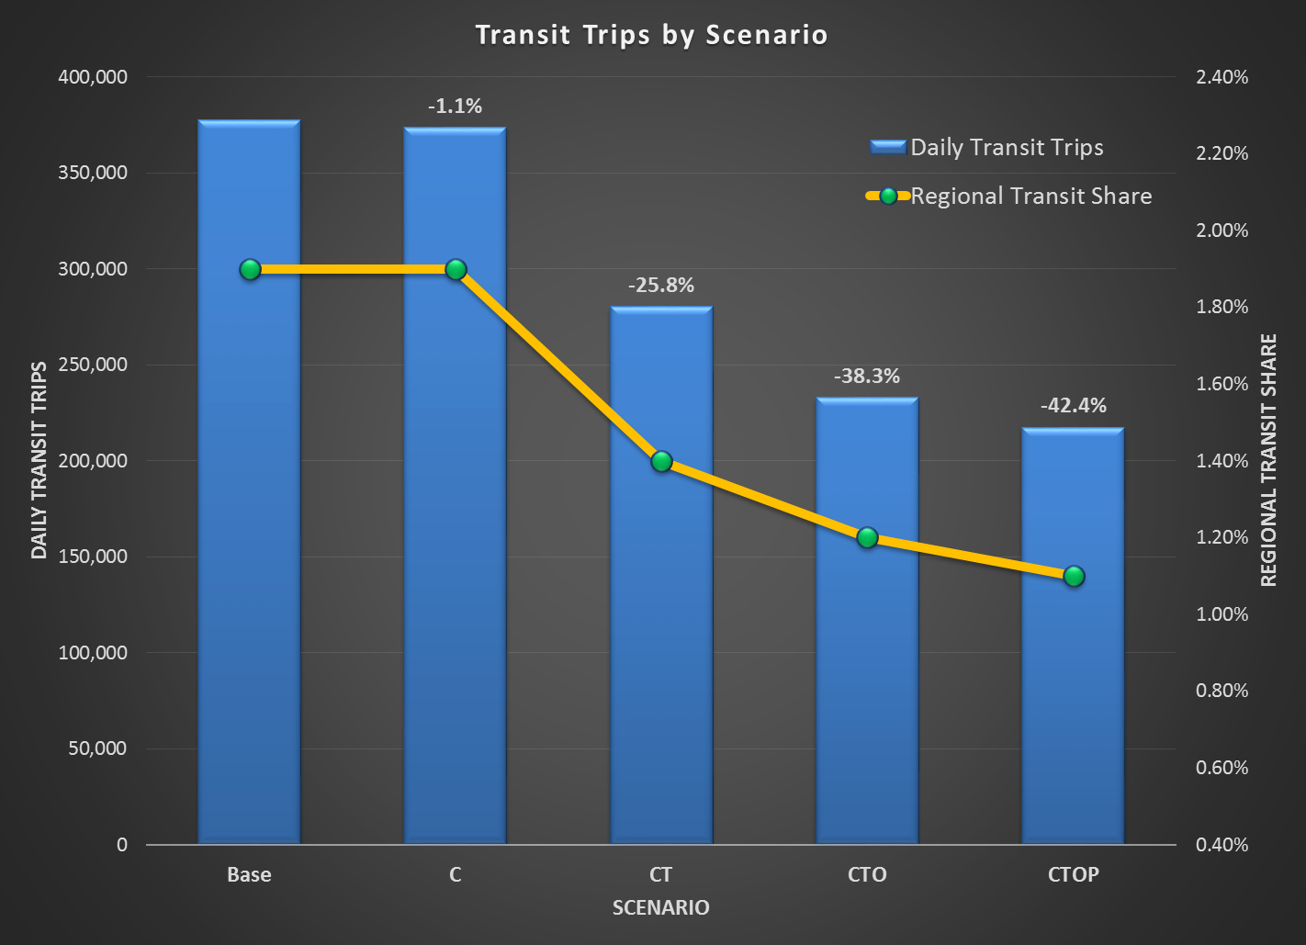
Model Results

Slide 16
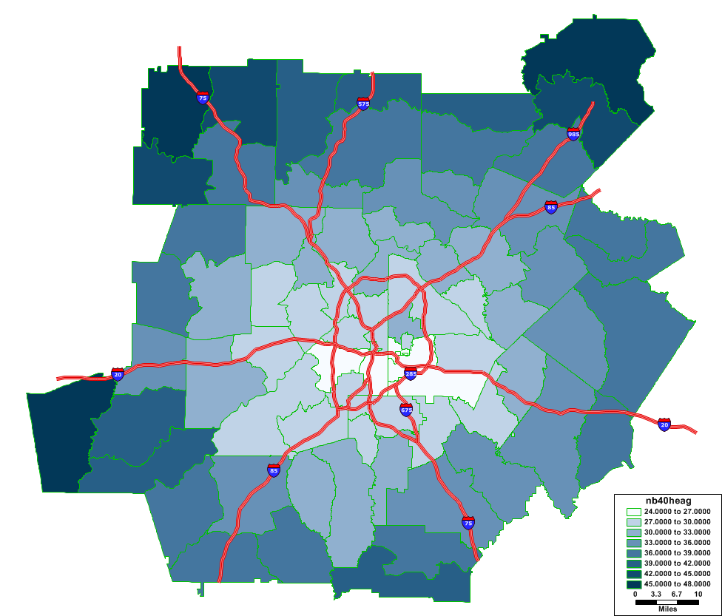
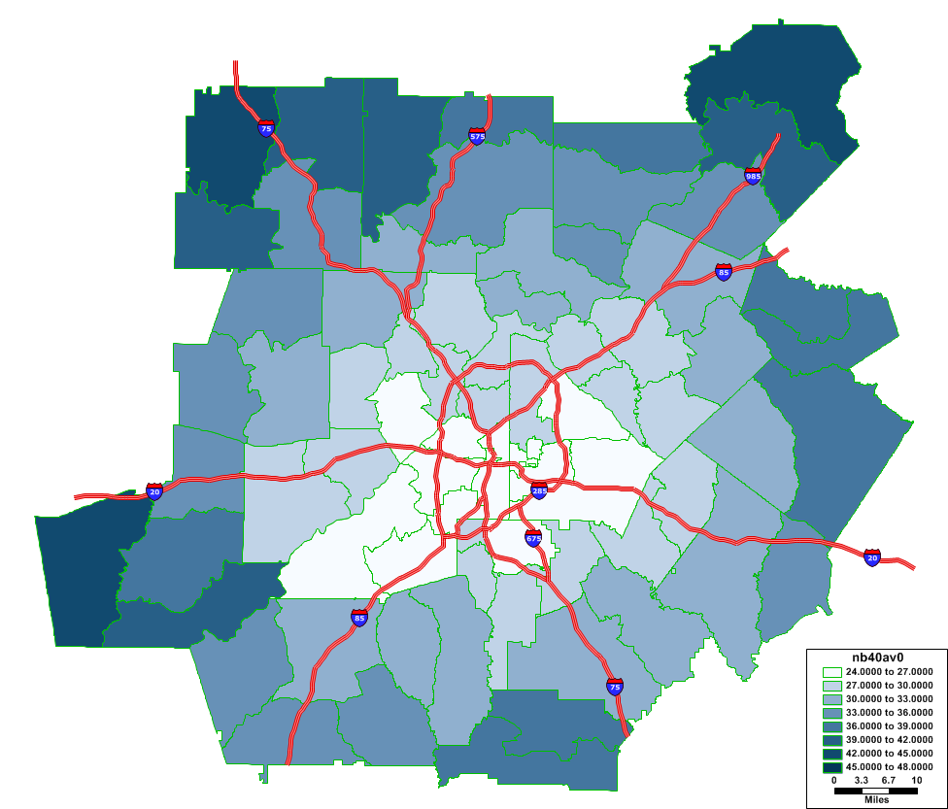
Accessibility
Average travel time from origin zone
Baseline CTOP

Slide 17
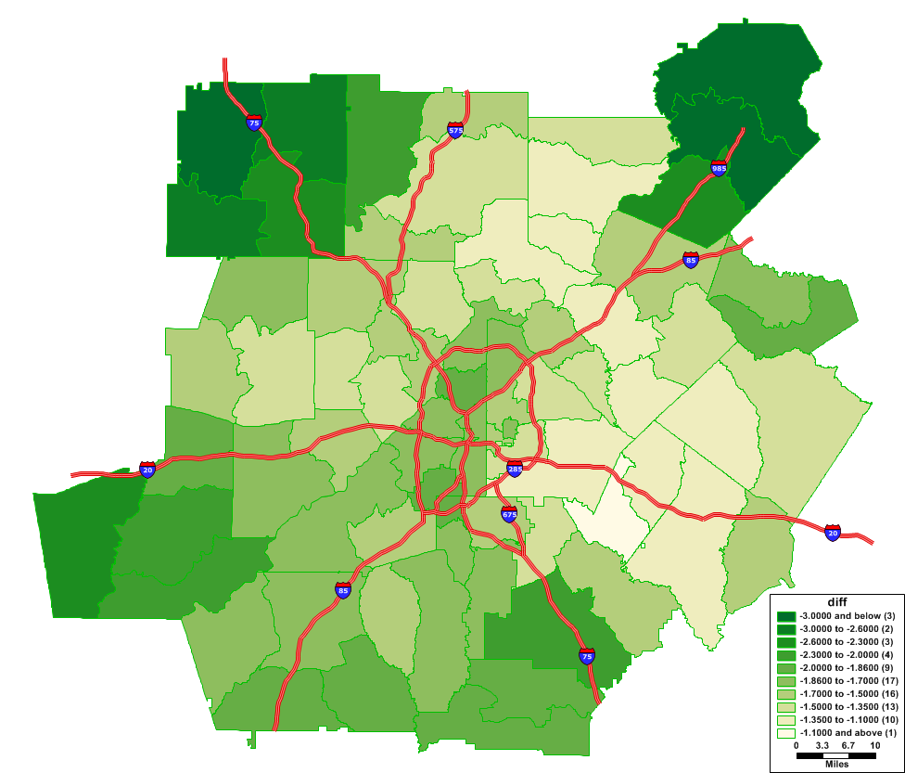
Accessibility
Difference

Slide 18
Other Potential Impacts
Empty vehicle VMT due to self-parking
Possible reduction in vehicle ownership due to efficient use of vehicle
AV availability to non-driving younger population
Availability of AVs for 0-car households
A number of other potential impacts driven by autonomous vehicle

Slide 19
Concluding Remarks
Travel demand modeling on AV addresses only recurrent delay
Non-recurrent delay reduction
Safety benefits would be greater
Further research
Test different market penetration levels
Different assumptions for capacity, fuel economy, vehicle operating cost, parking cost, and 0-car household

Slide 20
Acknowledgment
Rosella Picado, Parsons Brinckerhoff
Sriram Narayanamoorthy, Parsons Brinckerhoff
Jessica Guo, Parsons Brinckerhoff
Patrick Bradshaw, Atlanta Regional Commission
Ranjani Prabhakar, Atlanta Regional Commission

Slide 21
Contact Kyeil Kim, Ph.D., PTP Atlanta Regional Commission kykim@atlantaregional.com (404) 463-3276

