Slide 1
Evaluation of Advanced Driver Assistance Systems: Data and Planning Implications
Krishnan Viswanathan, CDM Smith
Roberto Miquel, CDM Smith
Chris Edmonston, Florida DOT
Ed Hutchinson, Florida DOT

Slide 2
Agenda
Purpose
Study Design
Technology
User Interface
Data Processing
Results
Performance Measures
Summary and Next Steps

Slide 3
purpose
Study Level 0 Automation
Evaluate impacts of Advanced Driver Assistance System (ADAS)
Measure changes in driver behavior in face of driver feedback technology
Measure performance improvements as a result of feedback
Incorporate performance improvements into the Planning Process

Slide 4
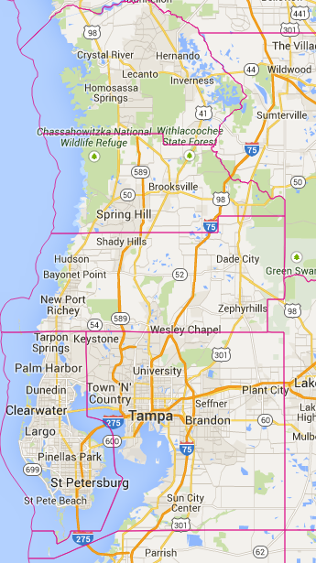
study design
Instrument 100 vehicles in Florida DOT District 7
Vehicles from Florida DOT and local transit agencies
100 vehicles have GeoTab devices
50 vehicles have Mobileye devices
Study duration is 1 year
Installs completed in August
Data collection underway

Slide 5
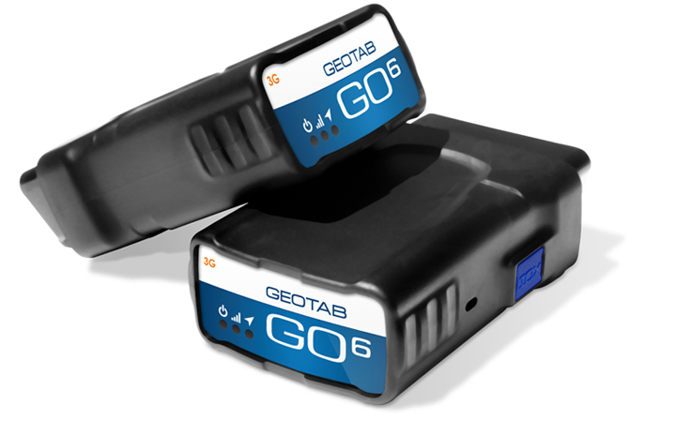
Technology - geotab
Provides vehicle diagnostics information
Real time data on vehicle exceptions and performance
Data transmitted via cellular signals
Dashboard to visualize data

Slide 6
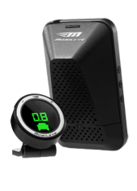
Technology - mobileye
Daylight Pedestrian Collision Warning, including Bicycle Detection
Forward Collision Warning, both in Highway and Urban areas, including Motorcycle Detection
Lane Departure Warning
Headway Monitoring and Warning

Slide 7
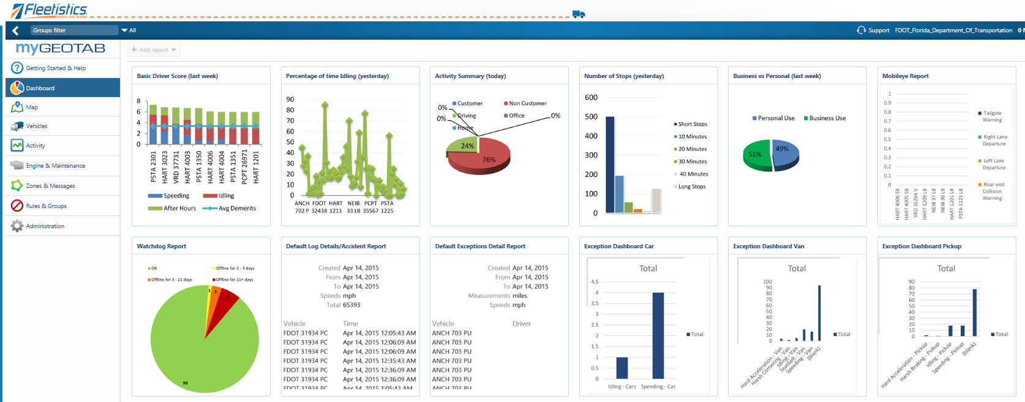
User interface

Slide 8
User interface

Slide 9
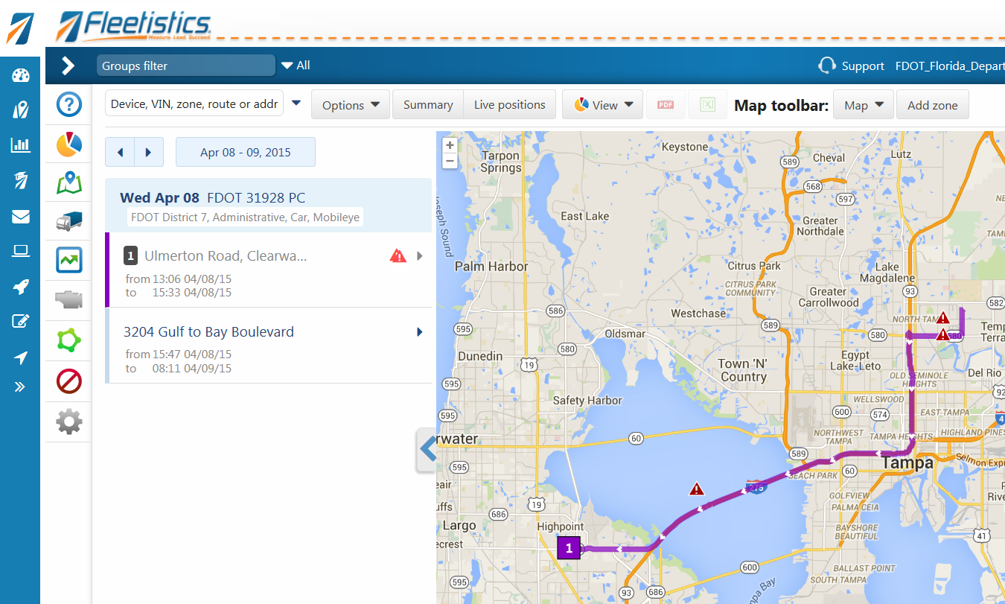
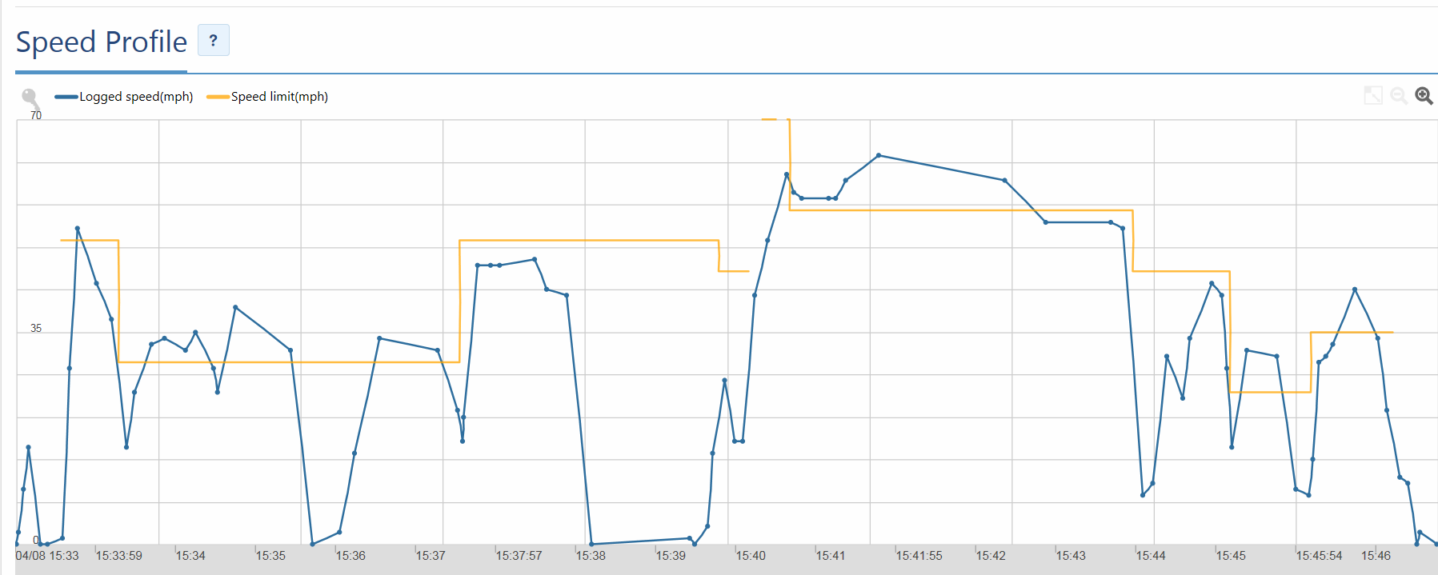
User interface

Slide 10
Data processing
Daily stream of data
Mobileye exceptions
Geotab exceptions
Data arrives with lat/long information, time of day, and vehicle id for each type of Mobileye or Geotab exception
Data converted into R data.table for processing and analysis
ArcGIS used to spatially locate data

Slide 11
Results ODOMETER READINGS
 | Sep 2014 | Oct 2014 | Nov 2014 | Dec 2014 | Jan 2015 | Feb 2015 | Mar 2015
Min | 47 | 68 | 13 | 104 | 1 | 1 | 1
Max | 18,001 | 21,382 | 22,440 | 19,634 | 23,968 | 13,820 | 12,838
Median | 3,896 | 4,049 | 3,189 | 3,216 | 3,388 | 3,203 | 2,765
Mean | 4,461 | 4,812 | 4,301 | 4,301 | 4,414 | 4,274 | 3,863

Slide 12
Results Monthly mileage by vehicle

Slide 13
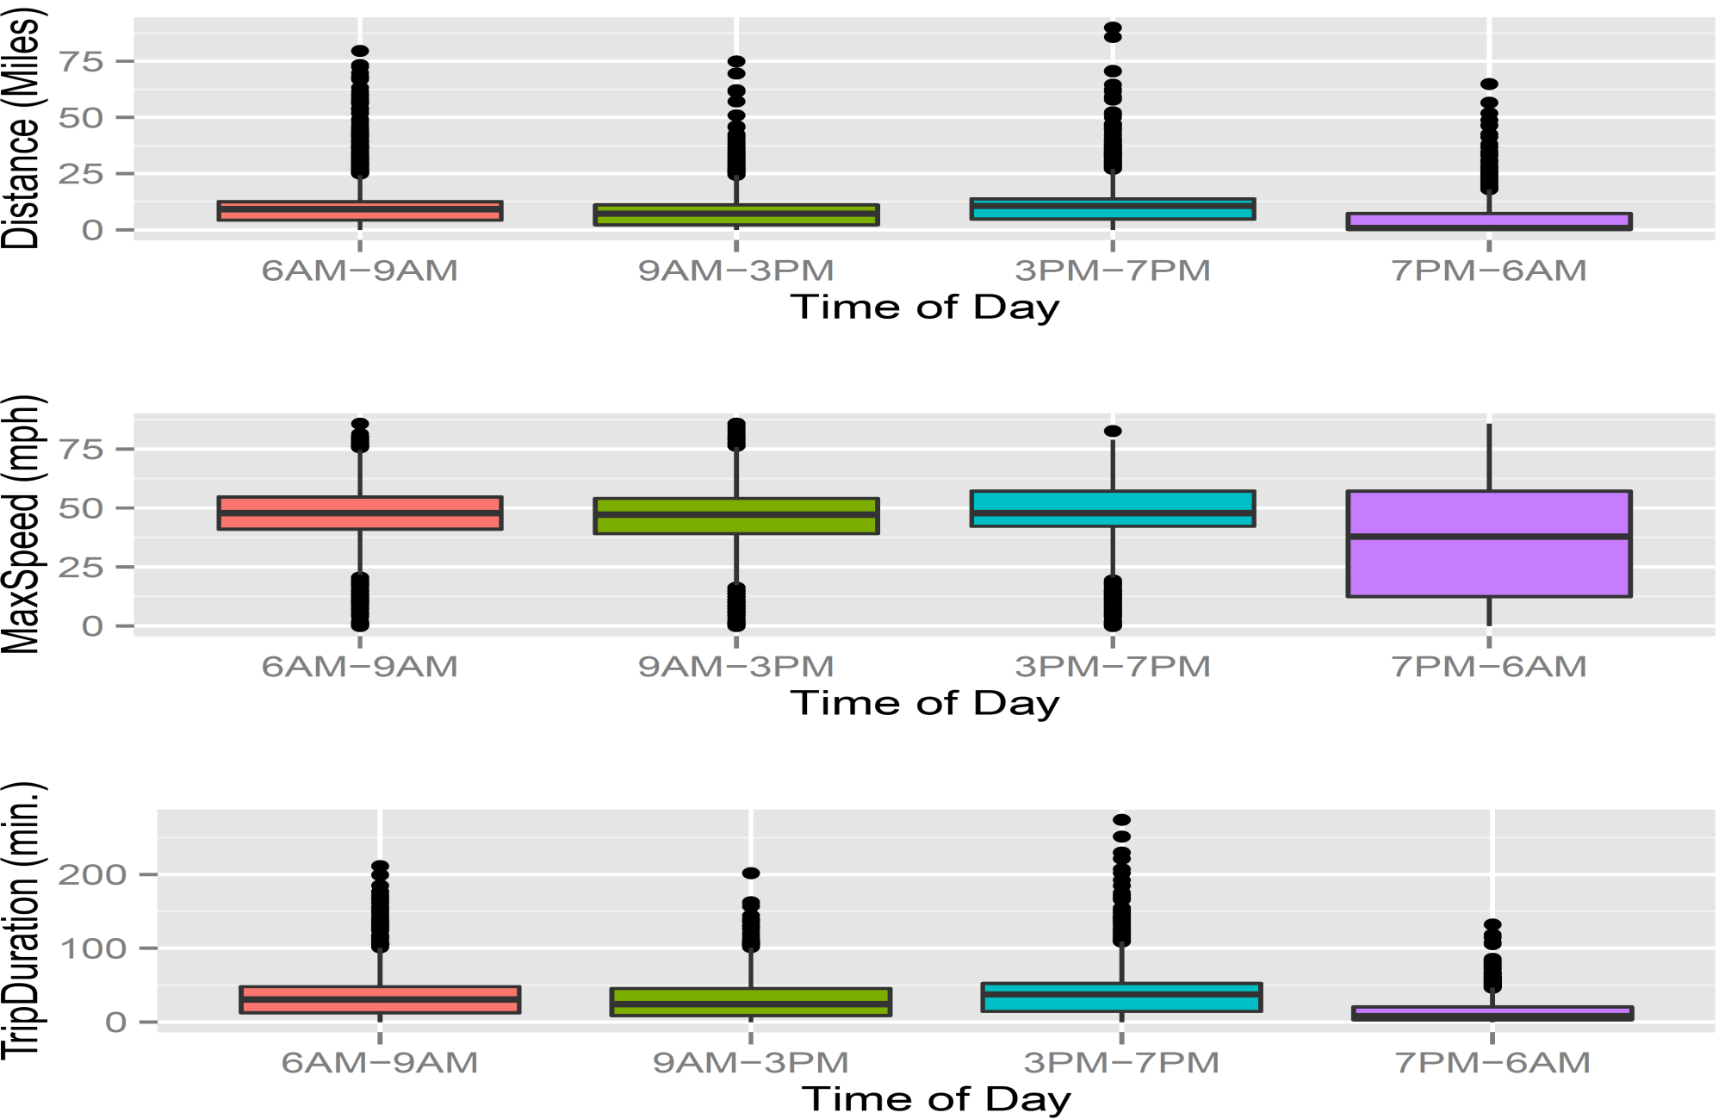
Results distance, speed, trip duration

Slide 14
Results Mobileye exceptions
 | Mobileye Events
Type of Warning | Sep-14 | Oct-14 | Nov-14 | Dec-14 | Jan-15 | Feb-15 | Mar-15
 | Number | Number | Number | Number | Number | Number | Number
ME Forward Collision Warning | 1,107 | 1,034 | 189 | 179 | 218 | 180 | 162
ME Headway Warning (Tailgating) | 69,967 | 65,401 | 8,310 | 7,547 | 11,860 | 10,077 | 8,283
ME Left Lane Departure | 14,124 | 10,653 | 1,743 | 2,140 | 2,233 | 2,290 | 1,815
ME Pedestrian Collision Warning | 645 | 433 | 164 | 144 | 178 | 127 | 75
ME Right Lane Departure | 29,617 | 21,816 | 7,504 | 7,517 | 9,069 | 8,778 | 7,728
ME Urban Forward Collision Warning | 2,204 | 724 | 432 | 345 | 544 | 338 | 361
Total | 117,664 | 100,061 | 18,342 | 17,872 | 24,102 | 21,790 | 18,424

Slide 15
Results Mobileye events by vehicle type

Slide 16
Results GEOTAB exceptions
 | Sep-14 | Oct-14 | Nov-14 | Dec-14 | Jan-15 | Feb-15 | Mar-15
Speeding | 19,380 | 23,176 | 17,707 | 16,966 | 16,846 | 14,448 | 16,517
Hard Acceleration | 1,423 | 1,195 | 986 | 1,199 | 1,042 | 1,166 | 1,120
Harsh Cornering | 570 | 877 | 622 | 757 | 717 | 688 | 906
Harsh Braking | 106 | 264 | 125 | 242 | 268 | 110 | 194
Total | 21,479 | 25,512 | 19,440 | 19,164 | 18,873 | 16,412 | 18,737

Slide 17
Results Comparisons of vehicles with and without mobileye

Slide 18
Precipitation Effects
Exception Type | 10-Nov | 17-Nov | 18-Nov
ME Forward Collision Warning | 7 | 8 | 6
ME Headway Warning (Tailgating) | 434 | 205 | 326
ME Left Lane Departure | 151 | 100 | 86
ME Pedestrian Collision Warning | 4 | 5 | 6
ME Right Lane Departure | 637 | 300 | 519
ME Urban Forward Collision Warning | 23 | 18 | 14
Total | 1256 | 636 | 957
0.5 in or more rain measured

Slide 19
Results Total mobileye exceptions densities

Slide 20
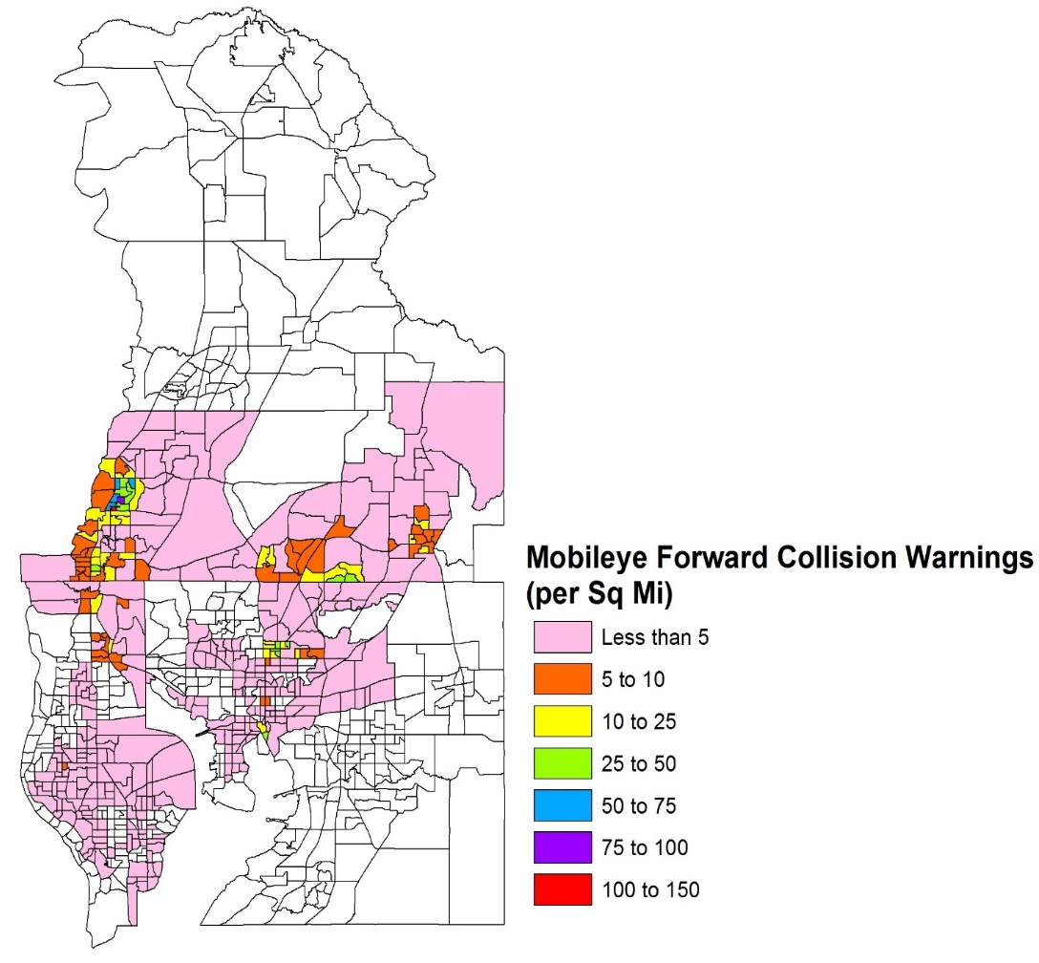
Results forward collision exceptions densities

Slide 21
Some performance measures
Driver safety metrics
Lateral Vehicle Control – such as lane positioning
Longitudinal Vehicle Control – such as speed maintenance
Overall roadway safety
Number of collisions averted
No. of accidents

Slide 22
Summary and next steps
Noticeable change in driver behavior by number of incidents
Reduced number of incidents
However, don’t notice statistically significant changes in the vehicles with and without Mobileye
Critical to know context of operations
Develop performance measures to quantify change due to these devices

Slide 23
CONTACT
Krishnan Viswanathan
CDM Smith
viswanathank@cdmsmith.com
850-386-9500

