Slide 1
Simultaneous Travel Model Estimation from Survey Data and Traffic Counts
Vince Bernardin, PhD, RSG
Steven Trevino, RSG
John-Paul Hopman, MACOG
John Gliebe, PhD, RSG
May 20, 2015

Slide 2
Our Mission
CALIBRATE A NEW TDM FOR THE SOUTH BEND,
IN MPO (MACOG)
Small HH travel survey
  518 HH sample + 173 HH NHTS sample = 681 HH
Large, detailed traffic count database
  1,536 count stations with volumes by
    direction
    vehicle class
    time of day
  27,648 observed volumes

Slide 3
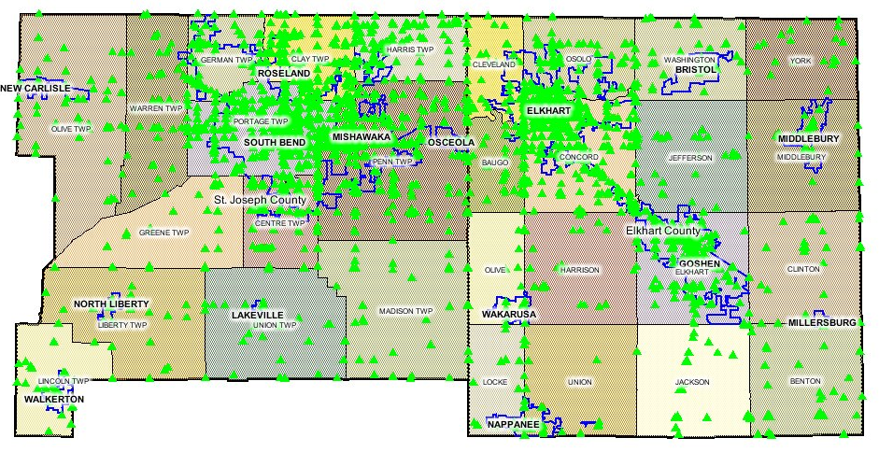
The Counts

Slide 4
Business-as-Usual (1)
Collect survey.
Sequentially estimate / calibrate component demand
model parameters.
Assign modeled demand to the highway network.
Look at traffic counts versus modeled volumes.
Groan…

Slide 5
Business-as-Usual (2)
Scratch head…
Engage in highly sophisticated random number
draw or other quasi-random process to select
demand model parameter to adjust.
Take a wild guess at how much to adjust said
parameter.
Assign modeled demand and compare to counts.
Repeat ad nauseam…

Slide 6
A Better Way?
  What if…
  We didn’t ignore traffic counts
  until the end?
Like all great ideas…
someone has thought of this before.

Slide 7
Isn’t this just ODME?
There’s been LOTS of research on and application of methods for estimating OD matrices or trip tables from counts or sometimes even from counts and survey data.
ODME (from counts) is powerful – and dangerous.
The power comes from harnessing the information in traffic counts.
The danger comes from under-determination.
  In a typical mid-sized model with 1,000 zones & 1,000 counts
    1 million degrees of freedom vs. 1,000 observations.
    There are many, many, MANY OD matrices that can
    produce the observed counts – one real solution – many that bear no resemblance to it.

Slide 8
Parameter Estimation from Counts (& Survey)
Although technically, ODME could be considered an extreme (over-saturated) example, model parameter estimation from counts is generally a different problem.
Even a model with a fair amount of advanced components and a lot of parameters generally
has fewer degrees of freedom (unknowns) than observations (knowns).
A unique solution can be found to properly specified problem of fitting parameters to observations!
And people have done it.

Slide 9
Literature Review
About 15 references in the lit going back to the 1970s
Most estimate demand models only from traffic counts, ignoring survey data.
Most adopt unrealistically simplistic travel models.
  Single trip purpose
  No mode choice
  No advanced components (destination choice, etc.)
  No equilibrium assignment
  No feedback
A few are worth a good read… but in the end remain academic research.

Slide 10
Challenge
Previous attempts have usually simplified – because this problem is HARD (NP-hard to be nerdy about it).
  Any realistic model including an equilibrium assignment (or even worse, feedback) turns the parameter estimation problem into a MPEC (mathematical program with equilibrium constraints).
  No analytic gradients.
  No expectation of global concavity.
  Heuristics / Metaheuristics necessary.

Slide 11
Metaheuristic
Iterative Bi-Level Program
Bi-level program formulation typical
Stackelberg leader-follower game
Genetic Algorithm
Evolve parameters to maximize
fitness vs. counts & survey
Travel Model
Apply the base model given a
set of parameters as inputs

Slide 12

Genetic Algorithm
Overview
  Initial “population” of solutions
  Evaluate “fitness” of each solution
  Kill least fit solutions
  Create new generation of solutions by
    Randomly mutating fit solutions
    Combining fit solutions

Slide 13
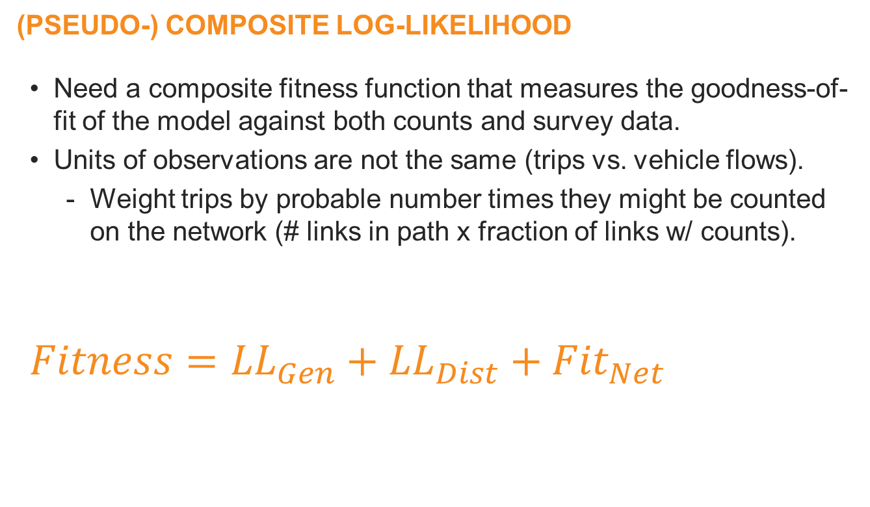
Fitness
(Pseudo-) Composite Log-Likelihood
  Need a composite fitness function that measures the goodness-of-fit of the model against both counts and survey data.
  Units of observations are not the same (trips vs. vehicle flows).
    Weight trips by probable number times they might be counted on the network (# links in path x fraction of links w/ counts).
  $$Fitness={LL}_{Gen}+{LL}_{Dist}+{Fit}_{Net}$$

Slide 14
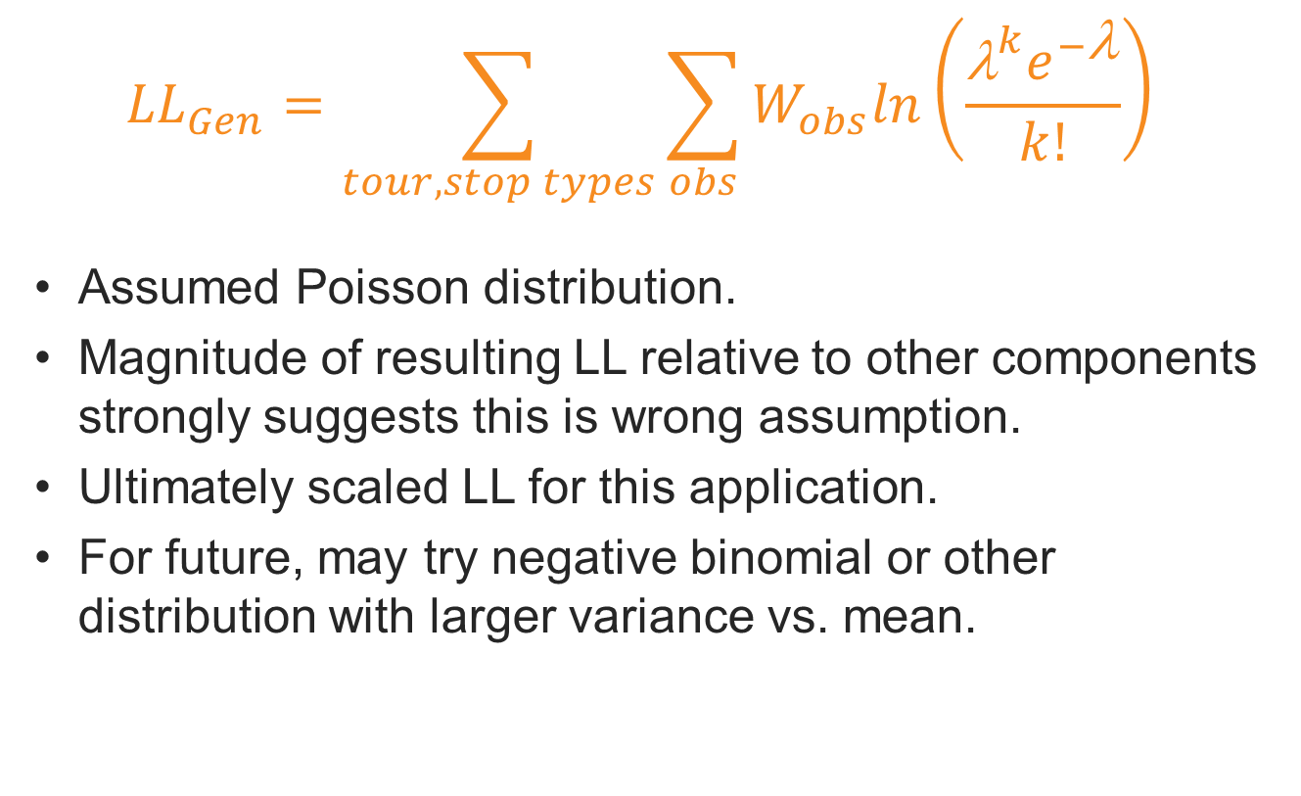
Generation
$${LL}_{Gen}=\sum_{tour, stop types}{\sum_{obs}{W_{obs}ln\left(\frac{{\text{λ}}^{k}e^{−\text{λ}}}{k!}\right)}}$$
Assumed Poisson distribution.
Magnitude of resulting LL relative to other components strongly suggests this is wrong assumption.
Ultimately scaled LL for this application.
For future, may try negative binomial or other distribution with larger variance vs. mean.

Slide 15
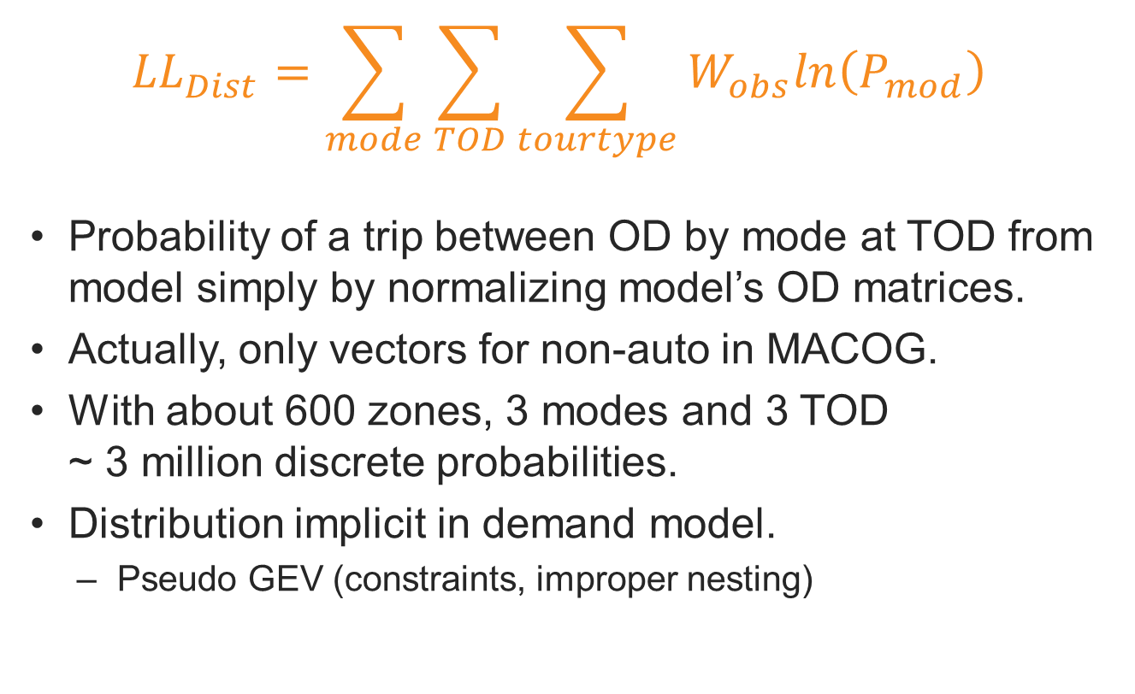
Distribution
$${LL}_{Dist}=\sum_{mode}{\sum_{TOD}{\sum_{tourtype}{W_{obs}ln\left(P_{mod}\right)}}}$$
Probability of a trip between OD by mode at TOD from model simply by normalizing model’s OD matrices.
Actually, only vectors for non-auto in MACOG.
With about 600 zones, 3 modes and 3 TOD
~ 3 million discrete probabilities.
Distribution implicit in demand model.
  Pseudo GEV (constraints, improper nesting)

Slide 16
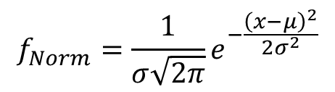
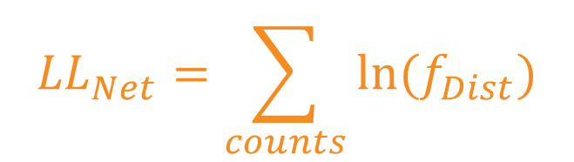
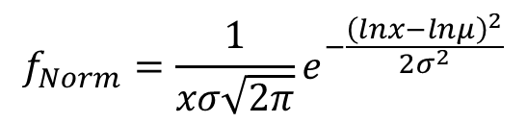
Network Assignment (1)
$${LL}_{Net}=\sum_{counts}{{ln(f}_{Dist})}$$
Assume network loading error distribution and calculate log-likelihood.
Started by assuming Normal.
Changed to Log-normal.
Much better but still had trouble.
$$f_{Norm}=\frac{1}{σ\sqrt{2π}}e^{−\frac{{\left(x−μ\right)}^{2}}{2σ^{2}}}$$
$$f_{Norm}=\frac{1}{xσ\sqrt{2π}}e^{−\frac{{\left(lnx−lnμ\right)}^{2}}{2σ^{2}}}$$

Slide 17
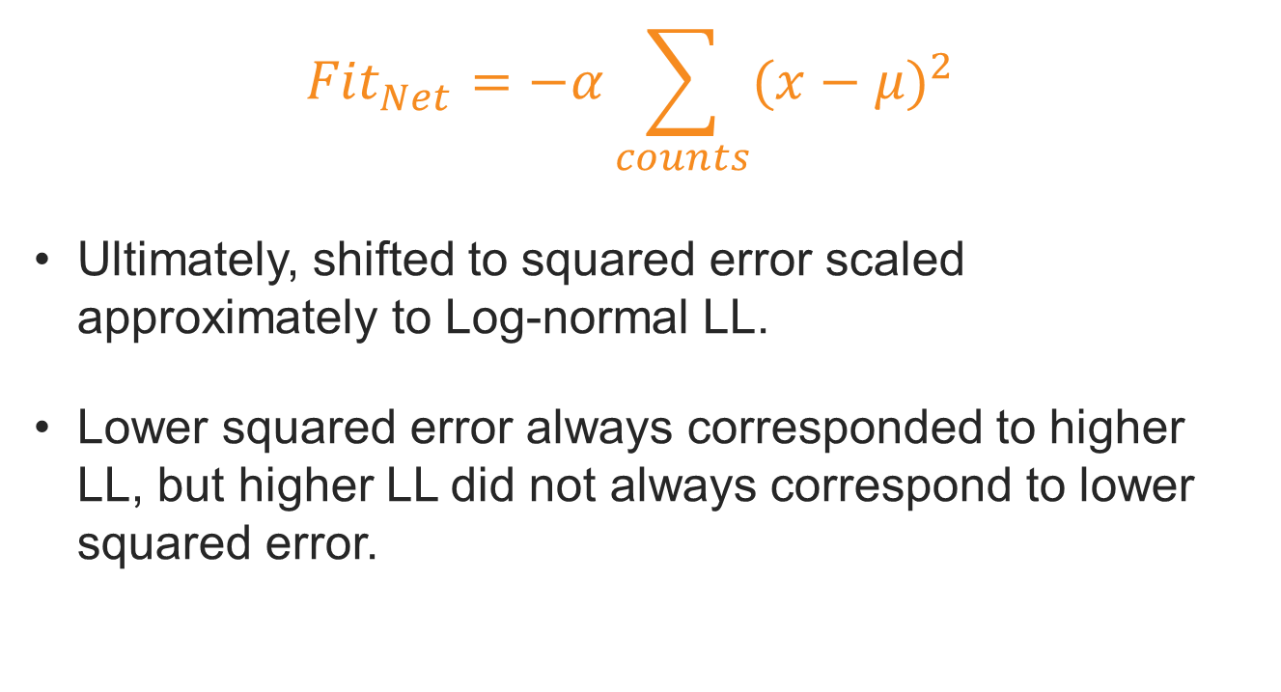
Network Assignment (2)
$${Fit}_{Net}=−α\sum_{counts}{{(x−μ)}^{2}}$$
Ultimately, shifted to squared error scaled approximately to Log-normal LL.
Lower squared error always corresponded to higher
LL, but higher LL did not always correspond to lower squared error.

Slide 18
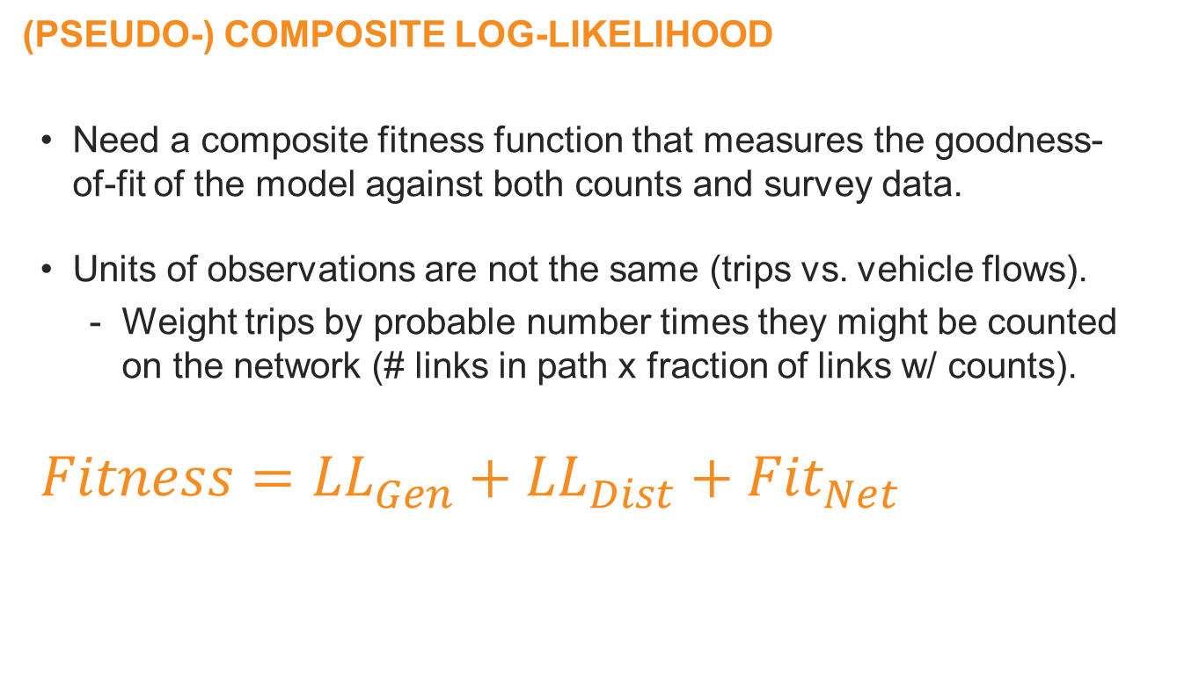
Fitness
(Pseudo-) Composite Log-Likelihood
  Need a composite fitness function that measures the goodness-
  of-fit of the model against both counts and survey data.
  Units of observations are not the same (trips vs. vehicle flows).
    Weight trips by probable number times they might be counted on the network (# links in path x fraction of links w/ counts).
  $$Fitness={LL}_{Gen}+{LL}_{Dist}+{Fit}_{Net}$$

Slide 19


Mutation and Combination
MUTATION
  Draw new parameter randomly from normal distribution around previous solution parameter.
  Currently only mutating best solution.
  A couple of ‘hyper-mutants’ (mutate all parameters) each generation.
Re-Combination
  ‘Mate’ two attractive solutions.
  ‘Child’ solution has a 50% chance of getting each parameter
  from either parent solution.

Slide 20
GA: Pros and Cons
PROs
  Robust to multiple optima – which are possible.
  Reduces possibility for inconsistencies between
  estimation and application.
  Allows inequality constraints on parameters 0 < β < β_{max}
  Approach obviates need for sampling – improving
  the statistical efficiency of the estimator, better use of data.
CONS
  Computationally intense.
    Ran about 16 processor days.
    Didn’t have time to run to convergence.
  (Need better distributed processing)

Slide 21
Results
Ran 1,500 iterations.
Obtained improved, not converged solution.
  Overall pseudo-LL improved 5.5%
  Actual estimate of LL using strict Poisson/Log-normal assumptions improved 1.4%
  LL_{gen} only improved marginally 0.2%
  LL_{dist} improved 2.6%
  LL_{net} only improved 1.7%, but
  RMSE improved 8.1% relative to start (34% to 31%)

Slide 22
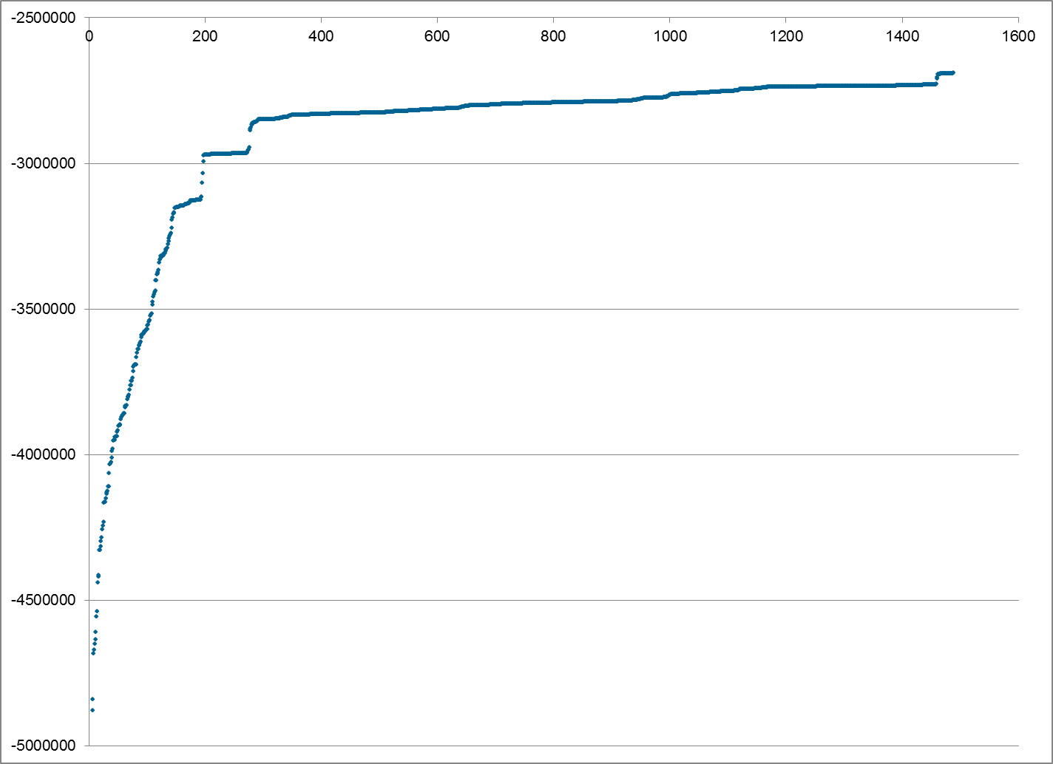
Improvement
GENETIC ALGORITHM
  Slow, not fully converged, but found solution that better fit both survey data and counts.

Slide 23
Conclusions
Modest, but promising results.
  Took more time (effort and run time) than initially hoped.
  Should take less effort next time.
  Obtained modestly improved results,
  similar to manual calibration.
  Could likely obtain better results with more run time.
  Could ultimately be cheaper than manual calibration.
Will definitely try again!
  Continue exploring functional/distributional assumptions.
  Need to work on better parallelization.
  Want to try technique for model transfers.

