Slide 1



Understanding Cellular-based Travel Data Experience from Phoenix Metropolitan Region
Wang Zhang, Maricopa Association of Governments
Arun Kuppam (Presenter), Cambridge Systematics, Inc.
Vladimir Livshits, Maricopa Association of Governments
Bill King, AirSage
15th TRB National Transportation Planning Applications Conference
May 17-21, 2015
Atlantic City, New Jersey
Notes:
A joint study effort done by Maricopa association of Governments (Phoenix MPO), Cambridge Systematics and AirSage in 2014.

Slide 2
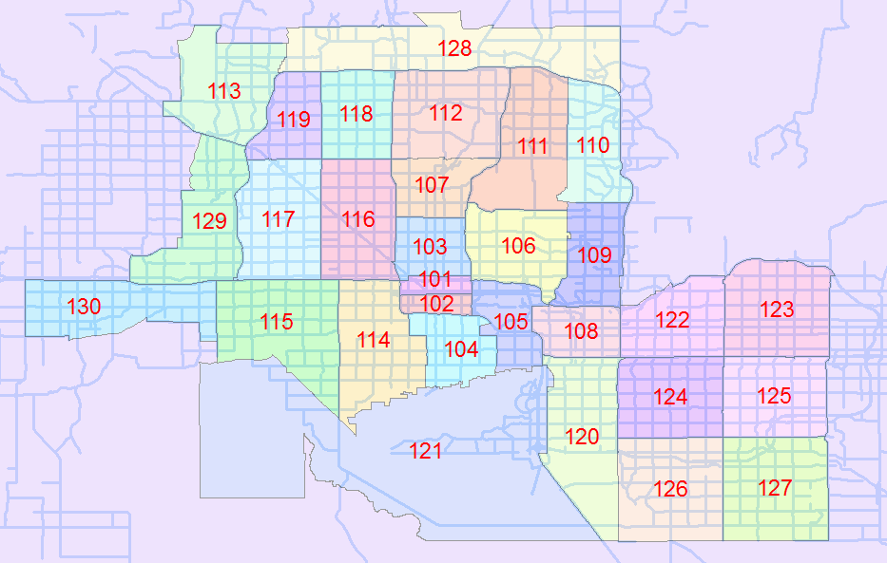
AirSage Data
Origin_Zone: origin zone ID
Destination_Zone: destination zone ID
Start_Date: first day date stamp
End_Date: last day date stamp
Aggregation: average weekday (WD) Tuesday to Thursday
Subscriber_Class: Resident/Visitor
Time_of_Day: Represents the time of day (H06:H09 – 6 to 9am, H09:H14 – 9 am to 2 pm, H14:H18 – 2 to 6 pm)
Count: Average weekday (Tuesday to Thursday) person trips by time of day.
AirSage O-D Trip Matrix
30 x 30 zones configuration
Weekday (Tue, Wed and Thu) for the month of October 2013
Data divided by Resident and Visitor
Data grouped by AM, MD, PM and Daily
Notes:
Out of many data products offered by AirSage, trip matrix data is obtained and analyzed.
Read the second bullet point

Slide 3
Data Evaluation
Comparison:
Total trips by TOD
Trip O-D
Trip length distribution
Screenline
Comparing AirSage (2013) to MAG travel demand model (2011) (developed from 2008 NHTS)
Notes:
AirSage person trip converted to vehicle trip using auto occupancy rate from MAG 2012 study

Slide 4
AirSage vs. Model (total trips) – AM
Blue (>= 2,000), red (<=500), white (500-2000)
Notes:
This table shows O-D trips between these 30x30 zones in AM, based on MAG TDM data.
You can visually compare above two tables, and see similarity of the color distribution between two datasets.
In large scale they agree with each other.

Slide 5
AirSage vs. Model % (trip/tot dest) – AM
Blue (>= 25%), red (<=1%), white (1%-25%)
Notes:
Using AM as the example again, though such analysis is done on MD and PM as well.
This one shows percentage of trips to each zone

Slide 6
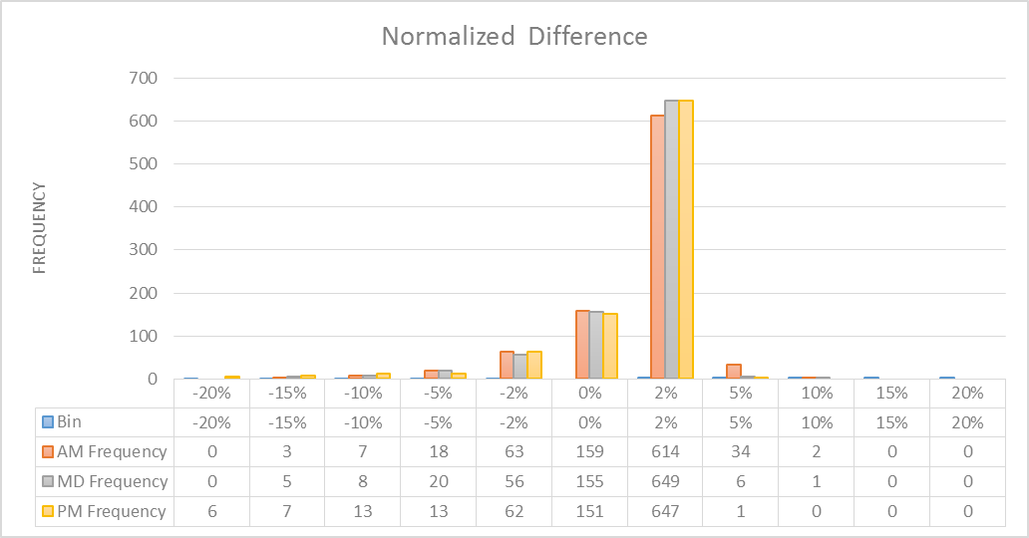
Normalized Percentage (AM)
[(AirSage trip – MAG TDM trip)/MAG TDM trip]*MAG TDM %
Most of normalized difference within -2% to 2% range.
Notes:
This table shows the normalized comparison between AirSage and TDM;
The color highlights where the problematic O-D pairs are, such as red one shows underestimation and blue one shows overestimation. The white cells are the one matched up well between two sources.

Slide 7
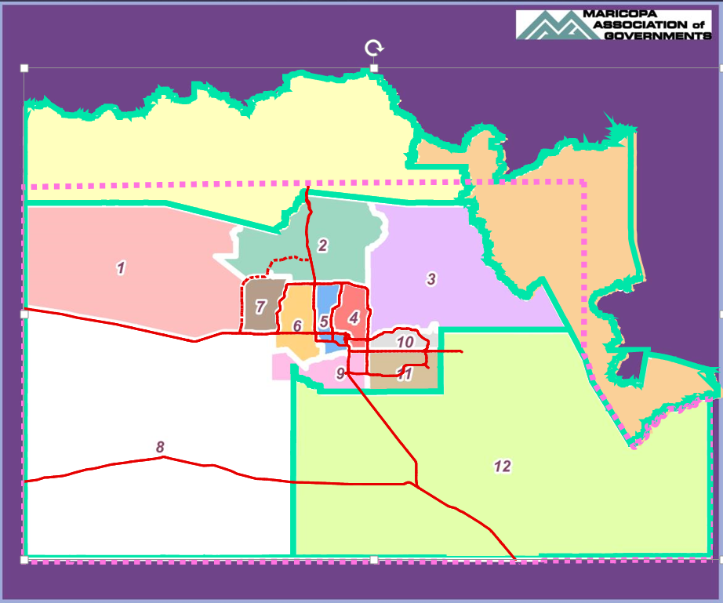
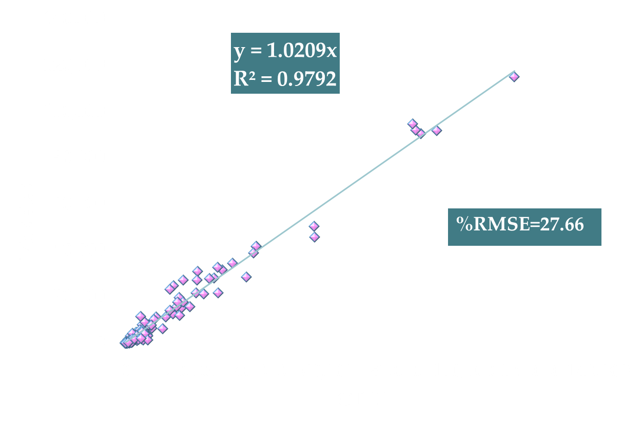
MAG Model vs. CTPP 5-year Estimates
Notes:
This slide demonstrates that MAG TDM trips validate well against CTPP data on district level.

Slide 8
MAG Model vs. CTPP 5-year Estimates
Left Chart – Origin District
Right Chart – Destination District
MAG TDM matches CTPP data in percentage of trips (district 4 and 5 and overall)
Notes:
This slide shows Mag TDM trip OD at district level validates well against CTPP.

Slide 9
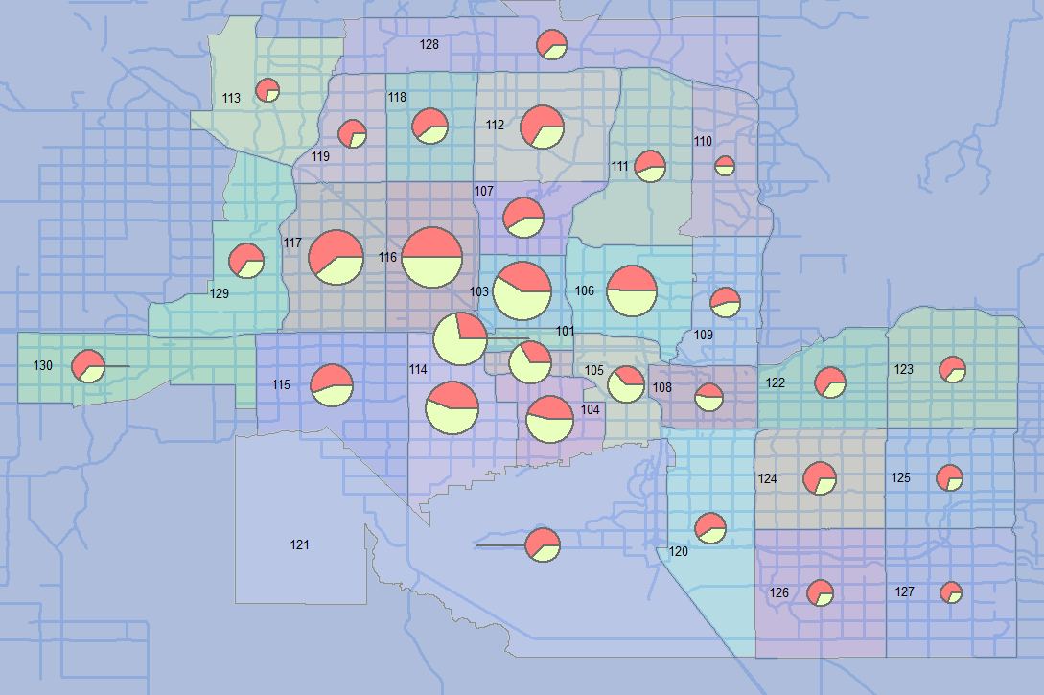
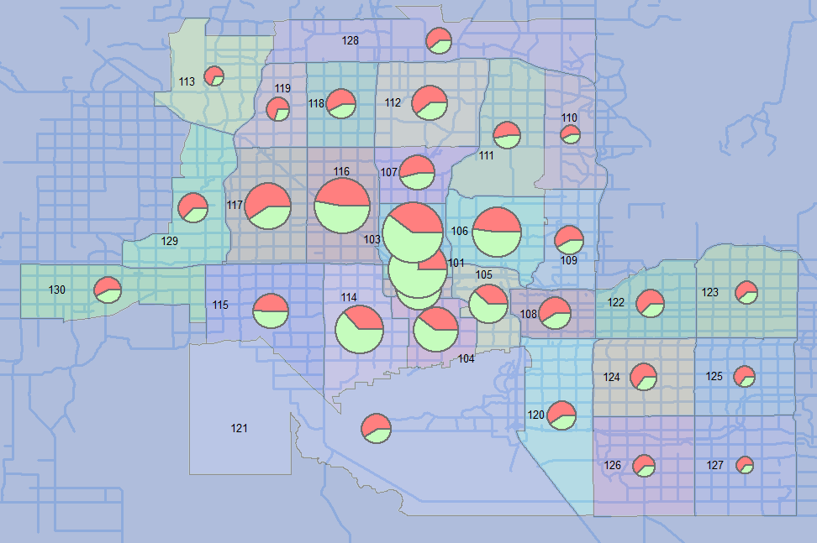
AM Trips going to Phoenix downtown (101 and 102)
AirSage (Green) vs. TDM (Red)
PM Trips leaving downtown (101 and 102)
AirSage (Green) vs. TDM (Red)
Notes:
Zone to zone comparison.
This map shows where do trips going to Phoenix downtown come from in AM .
The round size proportionally represents the total trips, and green and red indicate the amount of trips reported by AirSage and TDM, respectively.
Slide 16 to 21 could go slower or faster, depending on audience reaction and time constraint situation.

Slide 10
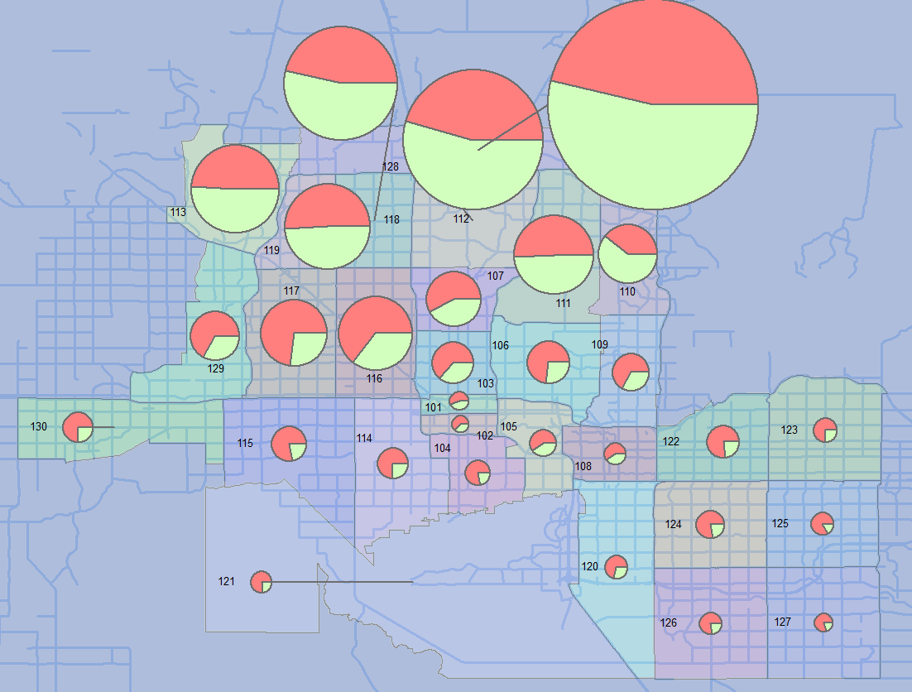
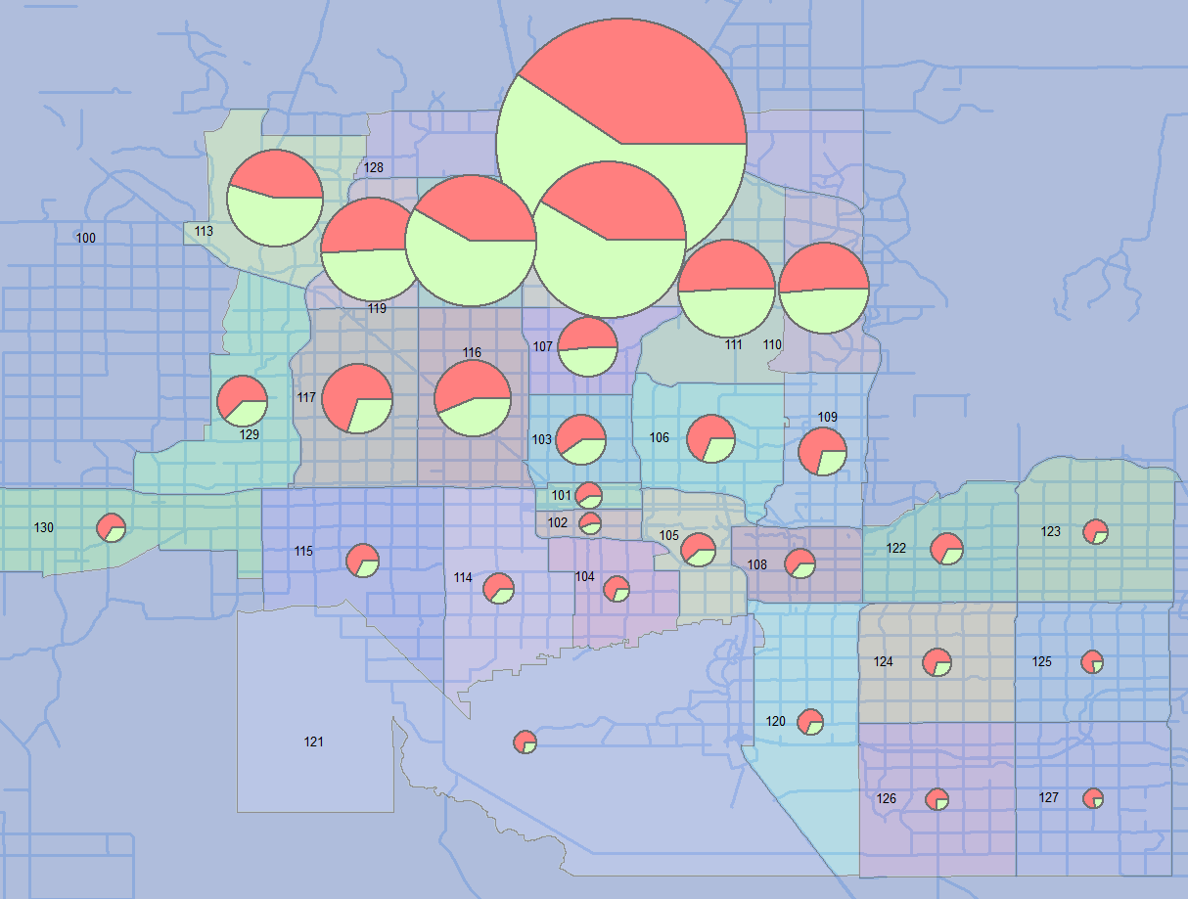
AM Trips going to North Phoenix (128)
AirSage (Green) vs. TDM (Red)
PM Trips leaving North Phoenix (128)
AirSage (Green) vs. TDM (Red)
Notes:
Zone to zone comparison.
This map shows where do trips going to Phoenix downtown come from in AM .
The round size proportionally represents the total trips, and green and red indicate the amount of trips reported by AirSage and TDM, respectively.
Slide 16 to 21 could go slower or faster, depending on audience reaction and time constraint situation.

Slide 11
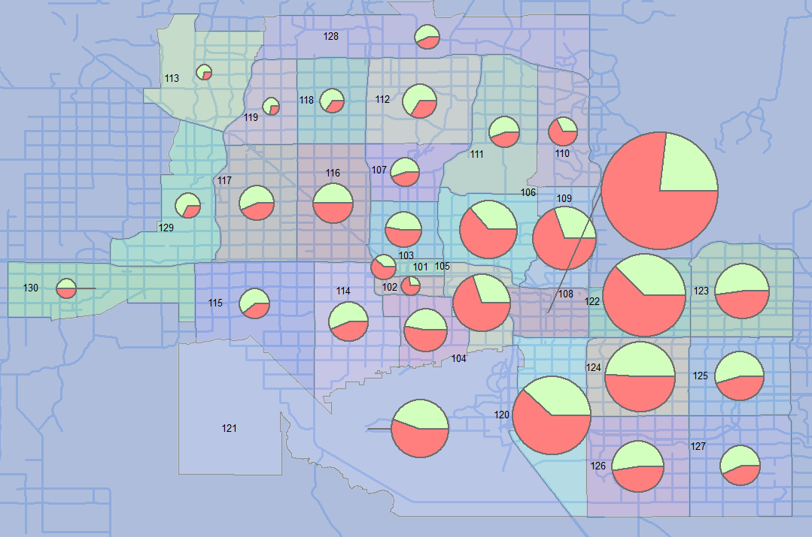
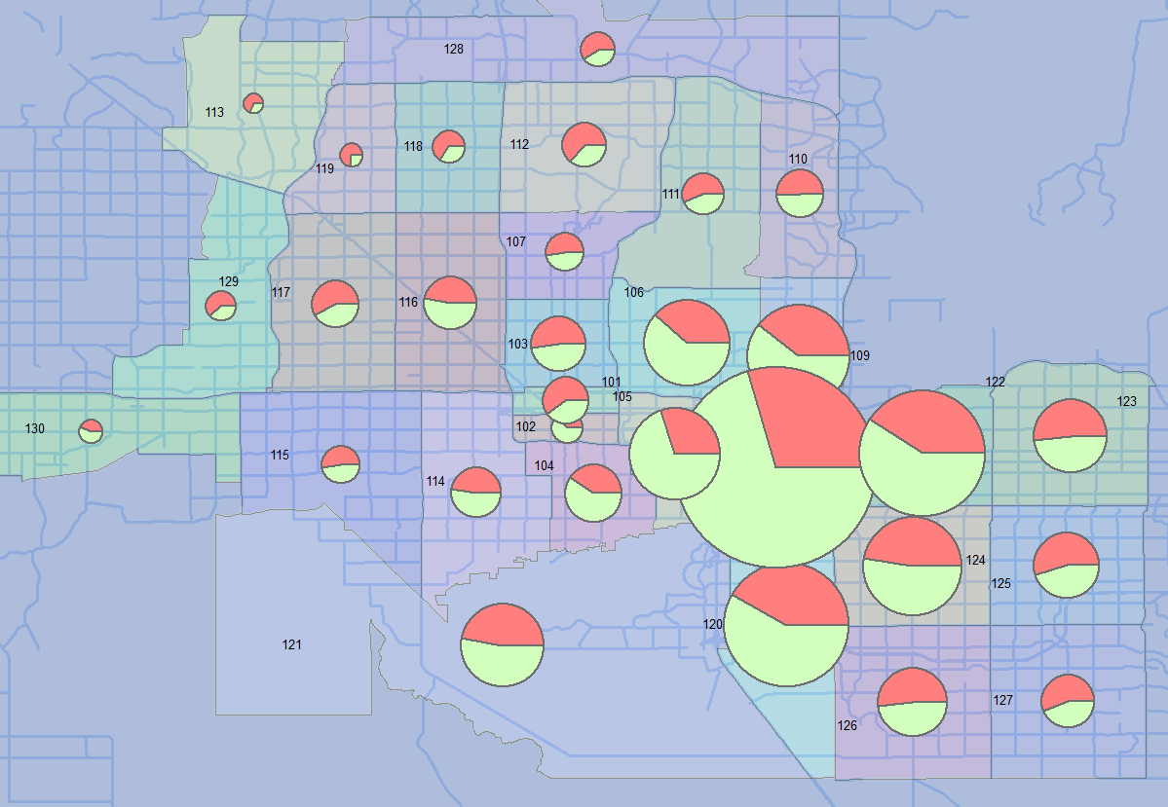
AM Trips going to Tempe (ASU) (108)
AirSage (Green) vs. TDM (Red)
PM Trips leaving Tempe (ASU) (108)
AirSage (Green) vs. TDM (Red)
Notes:
Zone to zone comparison.
This map shows where do trips going to Phoenix downtown come from in AM .
The round size proportionally represents the total trips, and green and red indicate the amount of trips reported by AirSage and TDM, respectively.
Slide 16 to 21 could go slower or faster, depending on audience reaction and time constraint situation.

Slide 12
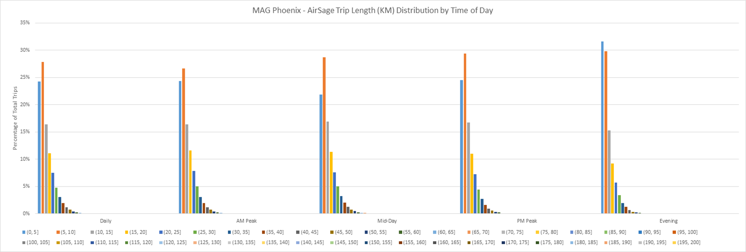
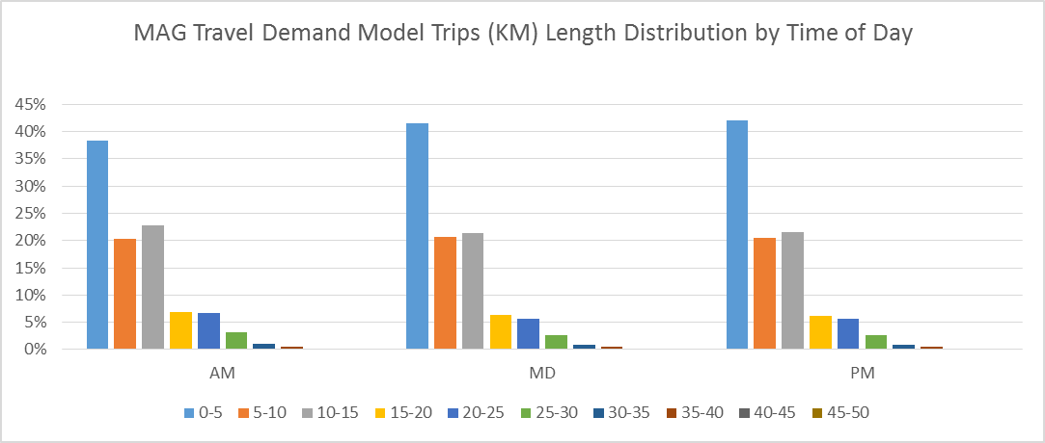
Trip Length Distribution
AirSage
Model
Notes:
Notice the vast difference in 6-mile and 8-mile bin size in PM. Bear in mind that MAG TDM trips is 19% less than AirSage trips, so you are not looking at a perfect match.
Blue is AirSage, and Orange is MAG TDM.

Slide 13
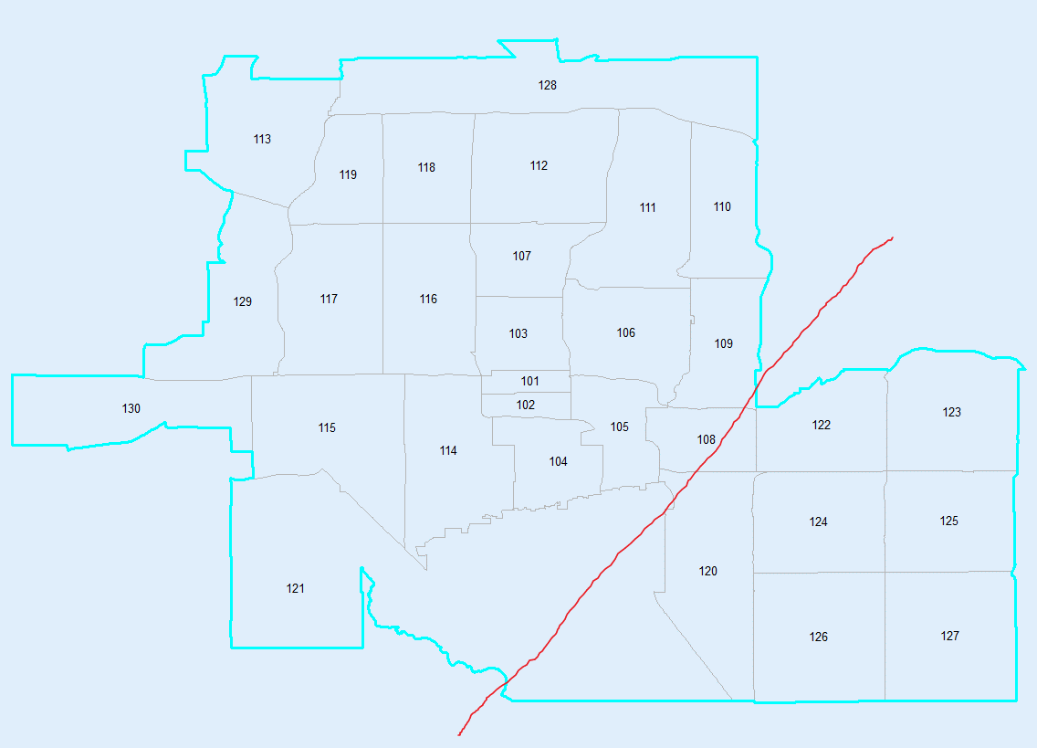
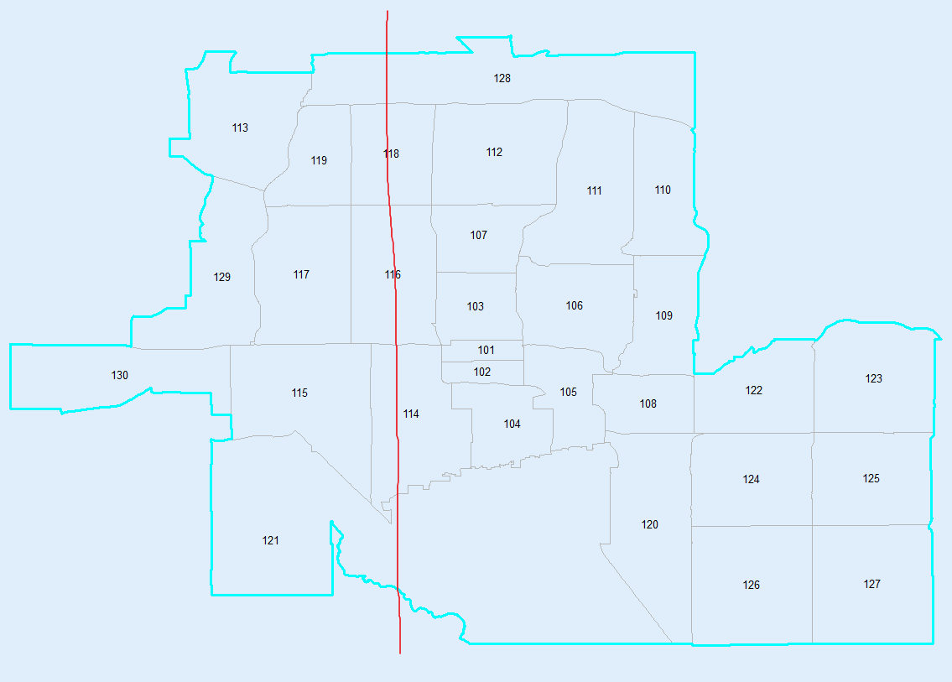
Screenline Comparisons
Screenline 1 (Salt river)
Screenline 2 (43rd Ave)
ScreenLine Analysis Model vs. Count
ScreenLine Name | Screenline 1 | Screenline 2
E to W | 4% | 5%
W to E | 0% | 8%
W to E
W to E
E to W
E to W
Notes:
The table on the right shows that these two screenlines validate well in TDM when comparing it to actual traffic counts.
Good match in both directions on two screenlines in PM.
Blue as AirSage, Orange as MAG TDM.

Slide 14
Conclusions
(1) The daily total trips matched well between AirSage and the validated travel demand model; while the number of trips by peak period varied in different parts of the region;
(2) The number of trips by zones were close enough in AirSage and the model; MAG model validates well against CTPP, traffic count, and speed data per previous study.
(3) The intrazonal differences are pretty significant; The AirSage data seem to capture a very low number of short-distance trips compared to the model.
(4) Screenline comparison showed a good match between two, while the AirSage data was consistently higher in each peak periods.
Notes:
- Read the bullet points

Slide 15

Questions and Comments?
Wang Zhang (MAG): wzhang@azmag.gov
Arun Kuppam(Cambridge Systematics): akuppam@camsys.com

