Slide 1
Building Stated Preference Experiments into a Household Travel Survey – a Balancing Act
15th TRB National Transportation Planning Applications Conference
May 18, 2015
Åsa Bergman
Elizabeth Greene
Leah Flake
Robert Wertman
Notes:
Authors: Åsa Bergman, Elizabeth Greene, Leah Flake, Robert Wertman

Slide 2

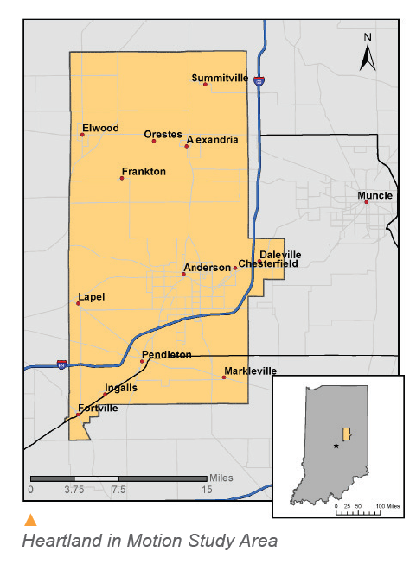
Madison County Council of Governments (MCCOG) MPA, Indiana: 55,000 HHs
Spring 2014: 1st household travel survey since 1970
Target 1,650 HHs, 3% sampling rate; final sample 1,800 HHs
Address-based sampling,
web-survey
Goals:
  Data to update travel and land use models
  Evaluate potential for new transit connections to Indianapolis

Slide 3
Five Stated Preference Experiments Immediately after Travel Diary Questions
Purpose: “Gauge regional attitudes and preferences toward regional mass transit connections between the MCCOG MPA and the Indianapolis metropolitan area”
Exploratory and broadly designed to be relevant to participants from the entire MCCOG study region
Notes:
Because of general/broad approach, transit access/egress, and time of day were not part of design

Slide 4
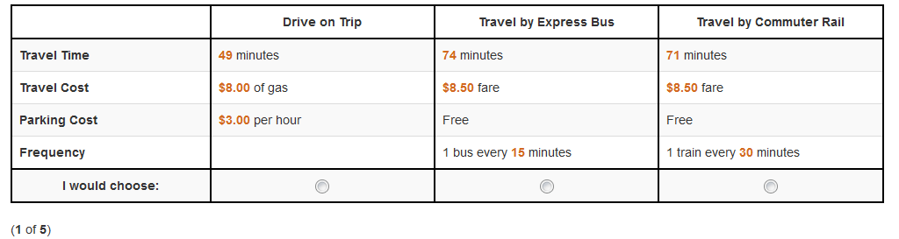
Stated Preference (SP) Design
5 questions (or experiments) shown per person
Each experiment had 3 alternatives
  Drive, express bus, or commuter rail (possible future modes)
Each mode had attributes:
  Travel time, travel cost (gas, fare), transit frequency & parking cost (if destination located in downtown Indianapolis)
Alternatives
Attributes

Slide 5
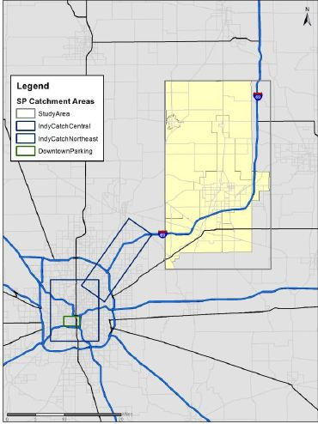
“Catchment Areas”
Defined to be inclusive of possible future transit stops
Downtown Anderson to Indianapolis is ~45 miles
Balance:
  If area too small, not enough data
  If catchment area too large, not realistic for future transit stops
Paid
parking

Slide 6
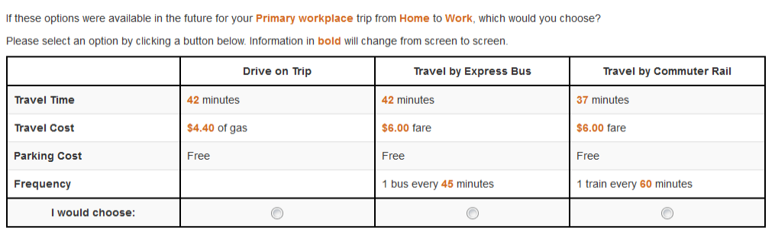
Ways to Qualify 1: Diary Trip
“Diary trip” respondents saw experiments based on their actual reported diary trip to the Indianapolis area
Hierarchy logic: If multiple trips in diary, prefer commute trip
“Diary trip” experiments are more realistic: Revealed and stated preferences in one sitting
“Diary Trip” wording

Slide 7
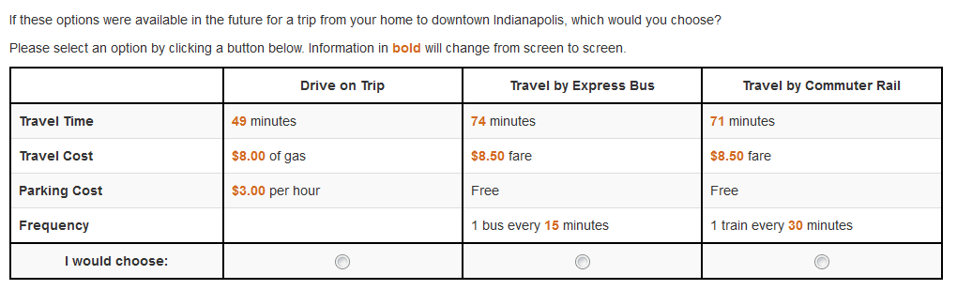
Ways to Qualify 2: Generic Trip
Intended to capture those who travel occasionally, but not every day
  Reported traveling to downtown Indianapolis or Castleton Square Mall at least once in the last 30 days (e.g., “generic trip”)
  Trip purpose not specified
“Generic Trip”
wording

Slide 8
Screener Summary
  41% of adults took the SP, 15% via call center
    Proxy response not allowed
  Median duration: 5 minutes
  Screener criteria ensured questions would be relevant to respondents
    Reduces respondent burden
    Provides more relevant data
Two Ways to Qualify | Respondents
Reported trip in diary to/from Indianapolis area (e.g., “diary trip”) | 380 (28%)
Reported traveling to downtown Indianapolis or Castleton Square Mall in the last 30 days (e.g., “generic trip”) | 970 (72%)
Total SP respondents | 1,350

Slide 9
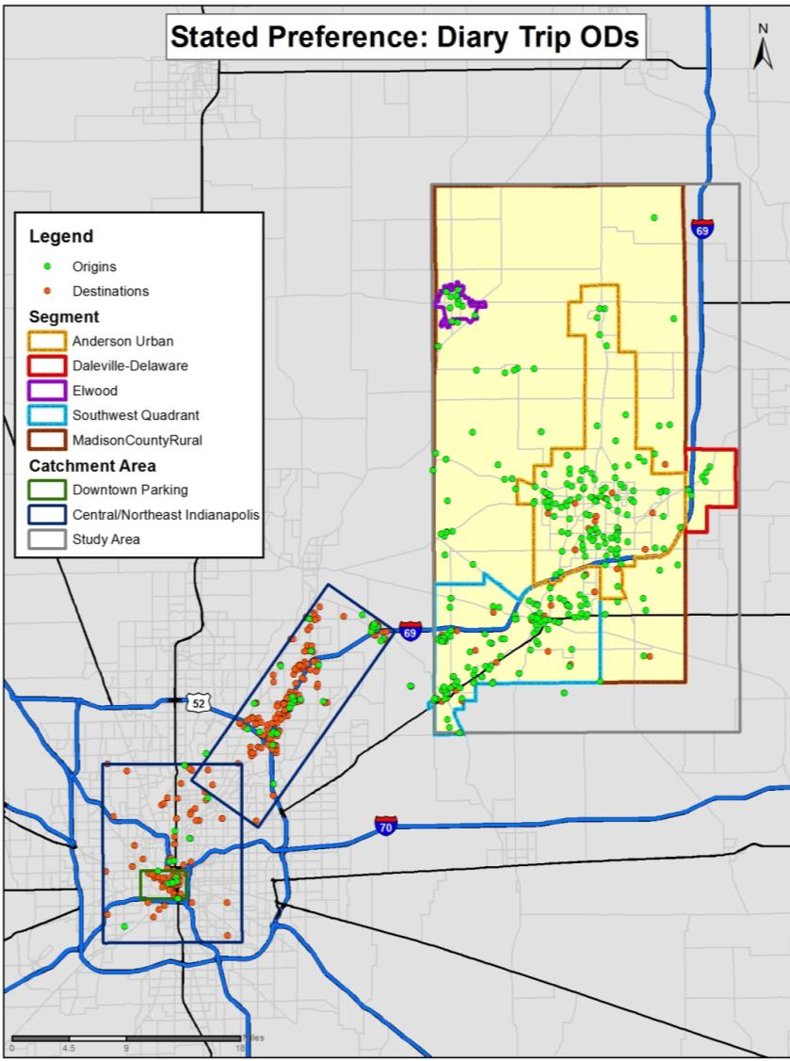
Stated Preference Results: Diary Trips
50% are commute trips
Many short trips between SW area & I-69 corridor
Average trip: 26 miles
Parking cost shown:
20% of respondents
Survey designed to select trip starting in MCCOG MPA going to Indianapolis
  Because typically return-trip mode is dependent on outbound mode
N=380 respondents

Slide 10
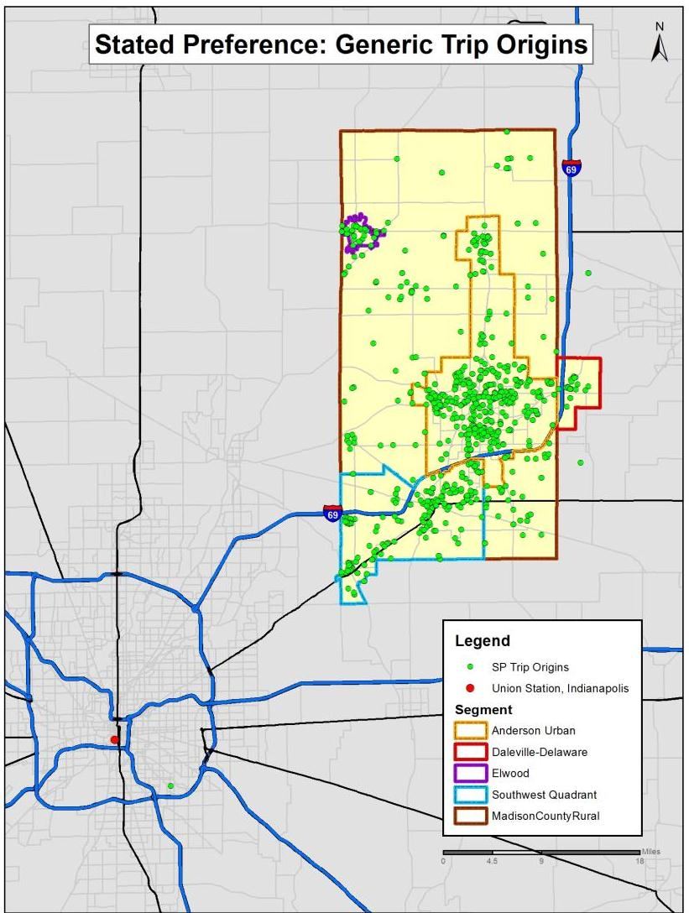
Stated Preference Results
Stated Preference Results:
Generic Trips
1 bullet summarizing map
Home locations used for trip origin
Destination in downtown Indianapolis
Average trip: 40 miles
People from all the MCCOG MPA travel to Indianapolis occasionally
Parking costs shown to all for generic trip (100%)
N=970 respondents

Slide 11
Data Checks before Modeling
1,350 respondents; 6,750 choices in dataset for modeling
Survey had real-time built-in checks to reduce need for data cleaning
Also reviewed data for:
  Reasonableness of origin/destinations
  Implied travel speeds (diary trips)
  Extreme survey durations and invariance
  Call center respondents’ mode choice split; this was compared to the aggregate choice split. Found no choice bias related to the method of participation (call center vs. online)
Invariance: 46% of respondents chose the same mode in all experiments (typically drive)
  Reflects expected mode preferences in the region

Slide 12
Stated Preference Results: Mode Choice Split
Mode choice split choices:
  Illustrate preliminary interest in transit
  Reflect the 2 profiles (diary trips vs. generic trips) and potential frequency of travel
Survey to be considered an initial exploration – the transit options are still theoretical to respondents
Experiment Travel Mode | Diary Trip Respondents | Generic Trip Respondents | Total
Drive | 69% | 53% | 57%
Commuter Rail | 21% | 33% | 29%
Express Bus | 11% | 14% | 13%
Total | 1,890 choices | 4,860 choices | 6,750 choices
*Percentages may not sum to 100 due to rounding

Slide 13
Stated Preference: Models
SP data used to estimate multinomial logit models (MNL)
Coefficients provide info about travelers’ sensitivities to the attributes shown:
  Travel time, transit fare, frequency and parking cost
From coefficients, calculate ‘willingness to pay’ (WTP) for each travel mode
  WTP per hour =
  Travel Time Coefficient / Cost Coefficient * 60

Slide 14
Stated Preference: Models
Models estimated:
    WTP by mode chosen:
      Drive vs. Transit (express bus & commuter rail)
      Drive vs. Transit & if saw parking cost or not
    WTP by trip purpose (diary trips only)
      Work vs. Non-work
      Work vs. Non-work & if saw parking cost or not
    WTP by household income
    WTP by home area
Also tried separate models for the 2 trip types – diary vs. generic for the above segmentations
Notes:
One set of time, cost, and frequency coefficients were estimated on transit (instead of one set for bus and one set for rail). This because their coefficients were similar.

Slide 15
Stated Preference Results:
Willingness to Pay (WTP) for Travel
Simplest model:
  On average, people are willing to pay more to drive than to take transit (express bus or commuter rail)
Experiment Travel Mode | WTP per hour
Drive | $10.20
Transit | $6.30

Slide 16
Stated Preference Results:
Willingness to Pay (WTP) for Travel
Having to pay for parking makes transit more attractive (though still not more attractive than driving):
  Those choosing transit are willing to pay more to avoid having to pay for parking
Pay for Parking | Experiment Travel Mode | Diary Trip Group | Generic Trip Group
No | Drive | $4.55 | -
 | Transit | $5.55 | -
Yes | Drive | $12.55 | $13.50
 | Transit | $9.20 | $9.55
Notes:
Reminder that all in generic trip group paid for parking (destination downtown Indianapolis)

Slide 17
Stated Preference: Draft Model Results
Findings made sense:
  Transit is more attractive when the destination has parking costs
  WTP is lower for work trips; this is intuitive because these are more frequent trips
  WTP increases with distance from Indianapolis
    This is consistent with theory: Those living closer make shorter trips and are likely to travel more frequently
Notes:
The analysis did not include tests for “reliability” or vehicle occupancy.

Slide 18
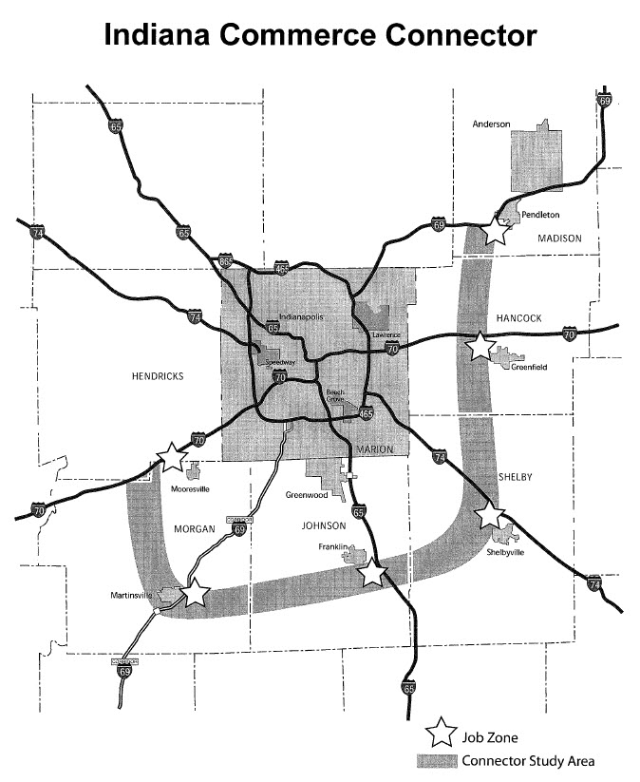
1 year later: Leveraging the Results
Transit Stated Preference Survey
Congestion
Present transit as a viable alternative to highway expansion/ new terrain projects.
I-69 Major Moves 2020 added travel lanes project.
Indiana Commerce Connector new terrain outer beltway around Indianapolis.
Senate Bill 176
Anticipated that Madison County and Hancock County will get opportunity to vote on and approve transit tax after Indianapolis and Hamilton County.
MCCOG will need to show public there is local preference/ interest for mass transit.
Identify future regional transit corridor(s) in new Metropolitan Transportation Plan (MTP).

Slide 19
The Balancing Act:
When to conduct a built-in SP vs. a stand-alone SP?
If these factors are true, consider a built-in SP:
  You are interested in concurrent revealed & stated preference data
  Your household travel survey does not already have a set of ‘extra’ questions at the end (land-use, opinion, etc.)
  Your household travel survey sample size will be large enough to facilitate SP modeling segments
  You can identify specific enough criteria (corridor, rapid transit option, etc.) to yield useful data
  Your study is not investment grade
  You have time to conduct a pilot and evaluate results
Typical SP challenges remain:
Are the experiments realistic enough that respondents reveal their true preferences?

Slide 20
Key Benefits of a Built-in SP
Cost-effective
  Recruit once, pilot once, pay incentives once – but richer data
Leverage capabilities of web-based survey instruments
  Real-time validation/customization of experiments based on data collected earlier in survey
Many more explanatory variables than typical stand-alone SP
  Examples: typical locations (home, work, school), very detailed HH composition, tenure at current home residence
SP data reflects same time period as HTS data
  Concurrent revealed and stated preference data
Context may help anchor respondents
  Survey is both “tell us what you did” and “tell us what you would choose in future”
SP data more quantifiable than some attitudinal questions
  Better informs agency’s planning decisions and awareness of public sentiment

Slide 21

ÅSA BERGMAN
CONSULTANT
Asa.Bergman@rsginc.com
THANK YOU TO MY COLLABORATORS:
THE MADISON COUNTY COUNCIL OF GOVERNMENTS
Robert Wertman & Jerry Bridges
RSG
Elizabeth Greene, Leah Flake, & Nikhil Sikka

