Slide 1
Application Experience of Multiple Discrete Continuous Extreme Value (MDCEV) Model for Activity Duration and Trip Departure Prediction in the Jerusalem ABM
Gaurav Vyas, Peter Vovsha (Parsons Brinckerhoff)
Danny Givon, Yehoshua Birotker (Jerusalem Transportation Master Team)

Slide 2
Modeling Trip Departure Time: Why?
Trip Departure Time Models:
Important component of Travel Demand Models
Directly impact temporal distribution of flows in the network
Essential for integration with Dynamic Traffic Assignment (DTA)

Slide 3
Modeling Trip Departure Time: Existing Methods
Sequence of regression or hazard duration models:
For activity duration and trip departure time
Pros:
Continuous time
Cons:
Scheduling decisions for activities are strictly sequential w/o forward thinking and necessary time reservations

Slide 4
Modeling Trip Departure Time: Existing Methods
Discrete choice approach:
Joint activity departure time model for all stops on tour
Discretized time by departure time/duration bins
Pros:
Joint scheduling decision for all stops
Cons:
Number of alternatives explodes when the number of duration bins and/or stops increase

Slide 5
Desired features
Model trip departure and activity duration jointly for all stops on the tour
Incorporate continuous time preferred for a seamless ABM-DTA integration
Crude discrete departure time results in “lumpiness” of trip loadings for DTA
Post randomization is arbitrary and violates individual schedule consistency

Slide 6
Problem Statement
The information known for the tour (example):
Activities set → {Shopping, Maintenance, Eat Out}
Sequence: Home → Shopping → Maintenance → Eat Out → Home
Location of activities
Tour start and end time

Slide 7
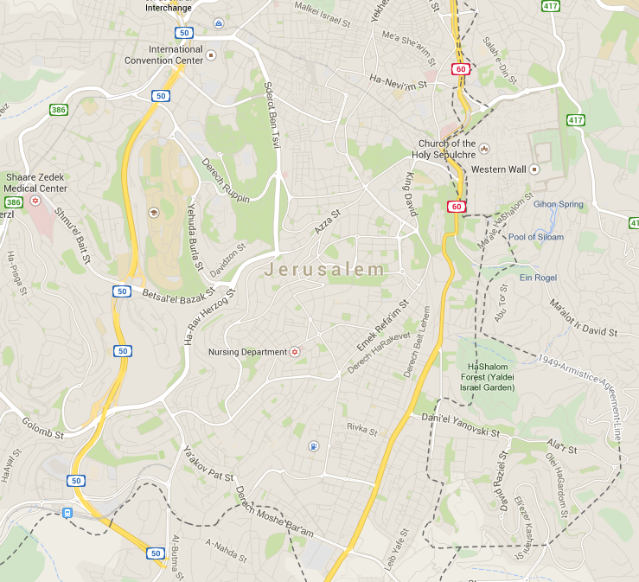
Maintenance
Dep ?,
Arr ?
Dep ?,
Arr ?
Dep 5:00 PM
Shopping
Arr 9:00 PM
Home
Eat Out
Dep ?,
Arr ?

Slide 8
Problem Statement
Trip mode is not known at 1st iteration:
2 min/mile as preliminary estimate of travel time
Trip mode known for 2nd and subsequent iteration:
Simulated travel time

Slide 9
Maintenance
Act Dur?
Travel time
Travel time
Act Dur?
Dep 5:00 PM
Travel time
Shopping
Arr 9:00 PM
Home
Travel time
Eat Out
Act Dur?

Slide 10
Problem Statement
Allocate total activity time on the tour among different activities/stops:
Given the travel time, activity durations fully define trip departure times
Travel time
Activity time
Trip Departure time
O
D
Home
Shopping
Maint.
Eat-out
Home

Slide 11
Methodology
Time budget allocation problem
A few budget allocation models in the literature
Model used → Multiple Discrete Continuous Extreme Value (MDCEV) by Bhat (2008)

Slide 12
What is MDCEV?
Selects from available alternatives (discrete component) and allocates provided budget/time (continuous component) among chosen alternatives
For instance:
Monday, TPAC 2015
Time frame → 8:30 AM – 5:00 PM
Given the limited time frame, what sessions one wants to join (discrete component) and for how long (continuous component)

Slide 13
MDCEV
Generic form of the utility function for activity duration $x_{k}$
3 important parameters:
$ψ_{k}$: Base line utility for alternative k
$α_{k}$: Satiation parameter for alternative k
$γ_{k}$: Translation parameter for alternative k

Slide 14
Why MDCEV?
Satiation effects: Diminishing marginal utility that leads to multiple discrete choices
0.25 hrs

Slide 15
Model Application: Classic MDCEV
Defines activity participation set (discrete component)
Defines duration of chosen activities (continuous component)
Non-chosen alternatives have zero duration

Slide 16
Model Application: Tour Context
The activity participation set is already known (discrete component is fixed)
A minimum value of activity duration (~5 min) allocated to each stop
MDCEV then applied for the rest of activity time on the tour
MDCEV serves as time allocation model

Slide 17
HTS Jerusalem 2010
100% GPS-Prompted Recall
Population Sector | Number of households | Average household size
Secular | 4,887 | 3.19
Orthodox | 2,119 | 5.07
Arab | 1,224 | 5.62
Total | 8,230 | 4.03

Slide 18
Estimation and Application Results for Long (daily) Non-Mandatory Tour (constants only)
Activities | Time allocated (hrs)
1=Escorting | 0.5
2=Shopping | 0.9
3=Maintenance | 1.3
4=Breakfast | 0.9
5=Lunch | 1.9
6=Dinner | 3.0
7=Visiting | 2.4
8=Discretionary | 1.1
Total | 12.0

Slide 19
Estimation Results (key findings)
Explanatory variables | Escorting | Shopping | Maint. | Breakfast | Lunch | Dinner | Visiting | Discretionary (base)
Individual effects
Orthodox female | High
Secular female |  | High
Full-time worker |  |  |  |  | High
Part-time worker | High
Age | Decreases with age
Household effects
Lower income |  |  | High |  | High |  | High
Tour characteristics
If activity is primary on the tour | High

Slide 20
Model Application
Total activity time in the tour for MDCEV = Tour end – tour start – total distance * (2 minute per mile) – 5 (mins/activity) * # stops
Time allocation to activities on the tour (MDCEV)
Adjusted total activity time after account for known travel time
Trip mode choice
Known travel time
Highway and Transit Assignment

Slide 21
Conclusion
Trip departure time for all stops on the tour should be modeled jointly
Continuous time is preferred for ABM-DTA integration
MDCEV is a valuable tool for the problem statement
Further testing of the model in the equilibrium context with DTA is needed

