Slide 2

About TMIP
The Travel Model Improvement Program (TMIP) is a program within the FHWA Office of Planning, Environment and Realty (HEP)
TMIP has conducted research, provided technical assistance, and delivered training to local, regional and state transportation planning professionals since 1994.
Today, TMIP continues its mission of improving analysis practices to ensure that transportation professionals are well equipped to inform and support strategic transportation decisions.
Notes:
Please contact Sarah Sun at Sarah.Sun@dot.gov if you have any questions about TMIP.

Slide 3
Disclaimer
The views and opinions expressed during this webinar are those of the presenters and do not represent the official policy or position of FHWA and do not constitute an endorsement, recommendation or specification by FHWA. Even though initial testing bears out these hypotheses for a particular region, it only provides an initial indication of their validity and results may not be generalizable to all regions.

Slide 4
Goals

Slide 5
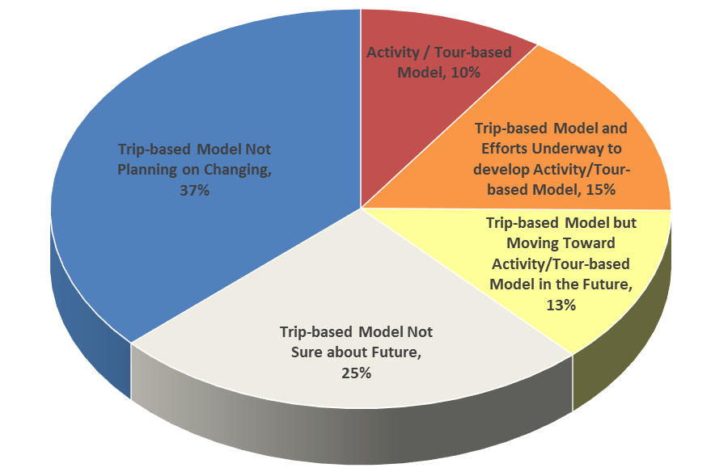
Options for Agencies
Main option for dealing with NHB trips has been just to develop an entirely new activity-based model
According to a TMIP survey at the end of 2013:
  Near term, 3/4 of agencies will not have an activity-based model
  Long term, 1/3 – 2/3 of agencies will stay with trip-based models
As TRB Special Report 288 states: “there is no single approach to travel forecasting or set of procedures that is ‘correct’ for all applications or all MPOs.”

Slide 6
Overall Objective
Objective:
  Provide more options to agencies for addressing issues related to non-home-based trips by
  providing inexpensive enhancements to existing trip-based models
  that can be implemented quickly as part of a model update without requiring the development of a whole new model
  that improve the model’s ability to represent non-home-based trips

Slide 7
Range of Options
  Tested three alternative methods to offer agencies a range of options to suit their particular needs, available time and scripting skill
  Each method is successively more complex
  Each builds on and assumes the implementation of the prior
  None require any changes to the HB trip model components
  All can be scripted in standard modeling packages

Slide 8
The Challenge: The Problem with NHB trips
Technical Objective:
  address fundamental problems with the accuracy and response properties of non-home-based (NHB) trips in trip-based models
    When four-step models evolved in the 1950’s & 60’s NHB trips only accounted for ~15% of trips
    According to surveys they now account for ≥30% of all trips
    By definition, NHB trips are disconnected from the households that make them and thus from the other HB trips made by the household
    This disconnect affects all dimensions of travel – location, mode & time
    NHB trips are like noise in most models – pumped up to produce the right amount of overall traffic – but adding error to results

Slide 9
Spatial Problems with NHB Trips
NHB trip patterns in four-step models can be physically impossible, implying that travelers/vehicles appear and disappear, making trips between places they never went in the first place
NHB trips can respond in illogical ways (e.g., new homes can generate new NHB trips in remote locations they almost never visit on home-based trips)

Slide 10
Other Problems with NHB Trips
Mode and time of NHB trips are very difficult to model in 4Step framework
NHB trip modes are conditional on HB trip mode choice, but not modeled this way in the four-step procedure.
For example,
  In 4Step, transit improvements shift both HB and NHB trips to transit
  and decrease HB & NHB walk trips
  In reality, more HB transit trips can lead to more NHB walk trips

Slide 11
Methods

Slide 12
Understanding the Problem
The Problem:
  Four-step models represent all trips through two component models – trip generation and trip distribution
    These correspond to the decision of whether/how frequently to make a trip and where to go (destination)
  These two models cannot (properly) define a NHB trip
  A NHB trip requires a third piece of information / decision: an origin, where to visit the destination from
    In other words, two spatial (distribution) models are necessary to represent a NHB trip because neither its origin or destination are known

Slide 13
A Simple Solution
A Solution:
  Simplest solution is by linking and running NHB distribution in series rather than in parallel with the HB distribution models
  Sequenced and linked in this way, HB & NHB distribution can assign both the origin and destination to NHB trips
  This solution requires no changes to the HB model components

Slide 14
A Few Details
Method 1 details:
  Generation of NHB trips is done by mode, as a simple function of the HB attractions to that zone by each mode
  Mode choice is therefore unnecessary

Slide 15
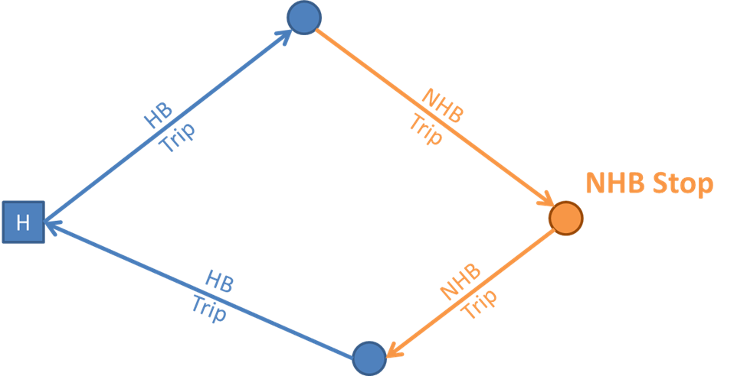
One complication: NHB stops
Method 1 treats all NHB trips as if both trip ends were HB trip attractions (only 1 NHB trip per tour)
This is true for a large portion of NHB trips, but there are still many NHB stops
Pseudo-HB Trip

Slide 16
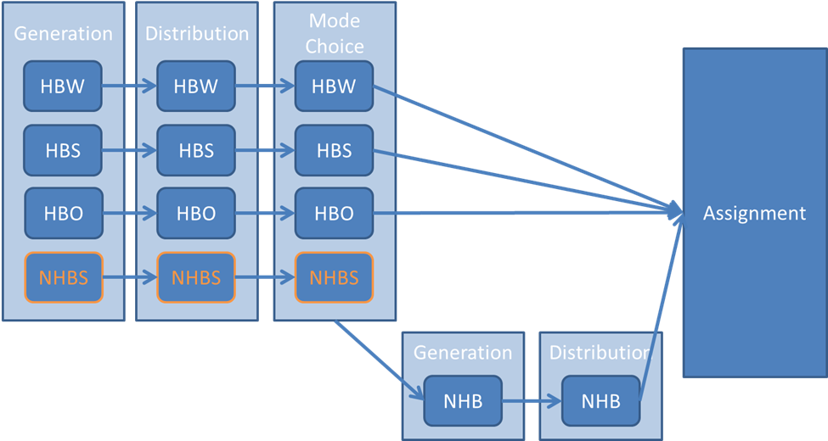
Method 2
Method 2 addresses this by generating and distributing NHB stops (as pseudo-HB trips)

Slide 17
Consistency with Tours
Methods 1 & 2 achieve Weak Consistency with tours
  Weak Consistency with Tours – the model cannot be proved to be inconsistent with tours
Method 3 is required to achieve Strong Consistency with tours
  Strong Consistency with Tours – the model can be positively proven to be consistent with tours

Slide 18
Method 3
Method 3 enforces consistency with tours in a more strict way by doing the NHB distribution separately for each home zone, rather than all together for all travelers at once, regardless of home zone
This method is almost identical to the method employed in hybrid tour-based models which have been demonstrated to produce superior results to their trip-based predecessors
 | H | a | b | c
f | 0 | 5 | 0 | 3 | 8
g | 1 | 1 | 0 | 3 | 5
H | 2 | 3 | 1 | 1 | 7
a | 1 | 4 | 0 | 2 | 7
 | 4 | 13 | 1 | 9 | 27
 | H | a | b | c
H | 0 | 1 | 1 | 0 | 2
a | 2 | 0 | 0 | 1 | 3
b | 0 | 1 | 0 | 0 | 1
c | 0 | 1 | 0 | 0 | 1
 | 2 | 3 | 1 | 1 | 7

Slide 19
Testing

Slide 20
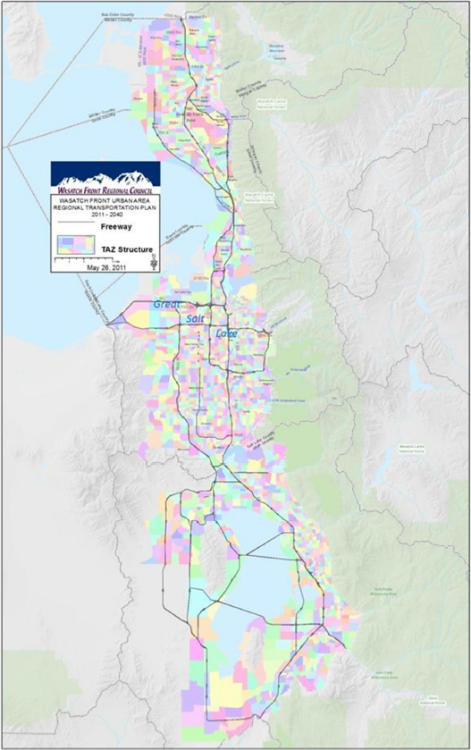
Pilot: Salt Lake City
Each of the three methods were implemented and tested using the Wasatch Front Regional Council (WFRC)’s model
1.7 million population
Large transit ridership
Recent household and on-board survey data
Reasonably typical four-step model
  2,200 TAZ
  6 trip purposes (HBW, HBC, HBSch, HBO, NHBW, NHBNW)
  6 modes (DA, HOV2, HOV3, SB, TR, NM)
  Auto ownership, mode choice & feedback
  No destination choice, etc.

Slide 21
Method 1 NHB Trip Generation Results
Simple regression models from household survey data
Extremely plausible, intuitive results
Example results:
NHBNW NM
NHBW HOV2
Coefficient | Estimate | Std. Error | t value
HBO_TR | 0.4071 | 0.0209 | 19.526
HBC_TR | 0.1261 | 0.0271 | 4.650
HBO_NM | 0.1200 | 0.0045 | 26.774
HBC_NM | 0.0980 | 0.0196 | 5.001
HBSch_NM | 0.0656 | 0.0098 | 6.695
HBSch_DR | 0.0291 | 0.0108 | 2.694
HBO_HOV2 | 0.0208 | 0.0033 | 6.261
HBO_DR | 0.0185 | 0.0030 | 6.222
HBO_HOV3 | 0.0116 | 0.0027 | 4.257
HBSch_HOV3 | 0.0112 | 0.0056 | 2.011
Coefficient | Estimate | Std. Error | t value
HBW_HOV2 | 0.2840 | 0.0087 | 32.708
HBW_HOV3 | 0.0862 | 0.0111 | 7.784
HBW_DR | 0.0808 | 0.0033 | 24.407
HBW_TR | 0.0534 | 0.0156 | 3.413
HBW_NM | 0.0326 | 0.0130 | 2.514
HBO_HOV2 | 0.0173 | 0.0037 | 4.744

Slide 22
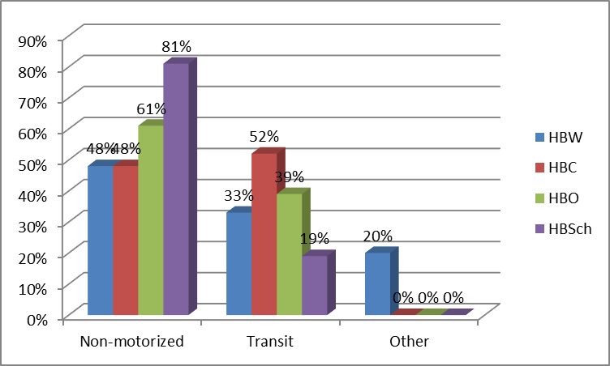
Clear Linkage between Transit and Walking
Transit HB trips more likely to generate non-motorized NHB trips than transit NHB trips
Mode Shares of NHB Trips Generated by Transit HB Trips

Slide 23
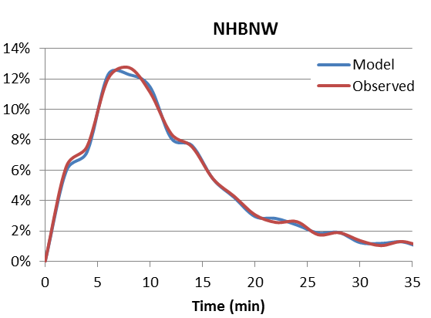
Method 1 NHB Trip Distribution Results
Simple gravity models for NHBW and NHBNW
Easily calibrated to observed TLFDs from survey
Could use destination choice models instead if desired
NHBW Trip Length Frequencies
NHBNW Trip Length Frequencies

Slide 24
Method 2 Notable Results
Overall, pseudo-trip generation & distribution similar to HBO
  NHB stop attractions dominated by FOOD employment (followed by retail, office, etc.)
  NHB pseudo-trip lengths were long as expected
Small changes in NHB generation
  NHBW slightly more affected / more likely to involve complex tours
  NHB trips by TR and NM are least affected (least likely to involve complex tours)
Very small changes in NHB distribution

Slide 25
Method 3 Issues
While simple in theory and simple to script, Method 3 is extremely computationally intense and this lead to practical problems including memory overflows
Currently still trying to complete testing of Method 3, but possible that it will prove infeasible in practice
However, a much milder version of Method 3, where NHB distribution is done not for each residence zone, but for each residence super district may be feasible and offer many of the benefits of Method 3

Slide 26
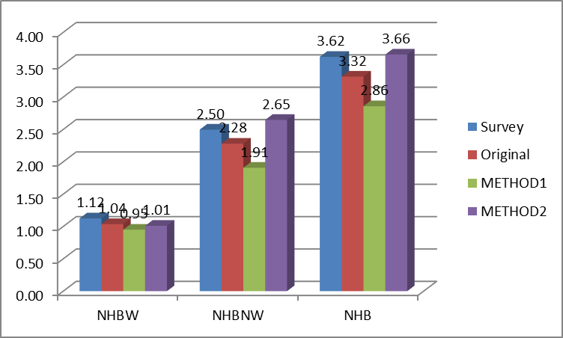
Calibration Comparisons - Generation
Estimated Method 1 NHB generation models are slightly worse than the original four-step model’s and would require modest calibration adjustments to match survey rates
Estimated Method 2 NHB generation models match survey rates better than the original model and would require no calibration adjustment
NHB Trip Rates

Slide 27
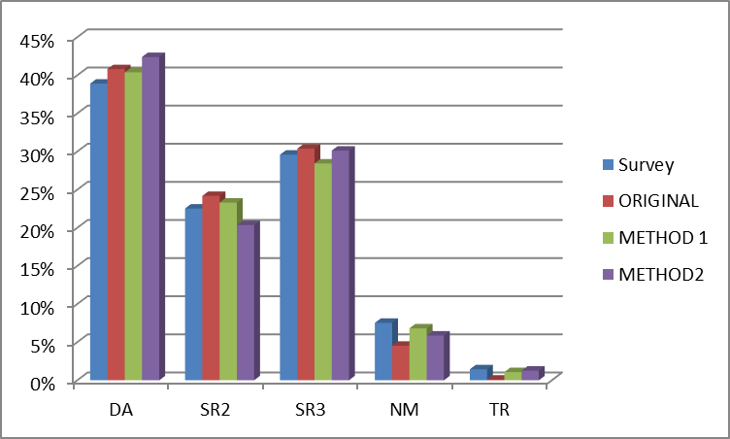
Calibration Comparisons – Mode Shares
Resulting mode shares from Methods 1 & 2 estimated models agree with survey data better than the original, calibrated model
  especially for transit and non-motorized modes
  with no calibration (alternative specific constants)
NHB Mode Shares

Slide 28
Calibration Comparisons – Distribution
TLFD can be calibrated to match observed distribution for either four-step or enhanced models, so not much basis for comparison
Actual agreement of the overall OD pattern between the models and the observed patterns for autos from the HH survey and for transit from the on-board survey was calculated using a ρ² statistic
The enhanced models offer statistically significant (10%) improvement in goodness-of-fit (using Horowitz’s Non-Nested Hypothesis Test) and are better able to replicate the observed OD pattern of NHB trips than the original four-step model
 | Rho-Squared
Original Model | 0.294
Enhanced Method 1 | 0.328
Enhanced Method 2 | 0.323

Slide 29
Sensitivity Testing
Four sensitivity / dynamic validation tests of model response properties
  New Residential Development
  New Commercial Development
  Added Highway Capacity
  Enhanced Transit Service
Differences in responses between original and enhanced models were insignificant for New Commercial Development and Added Highway capacity scenarios
However…

Slide 30
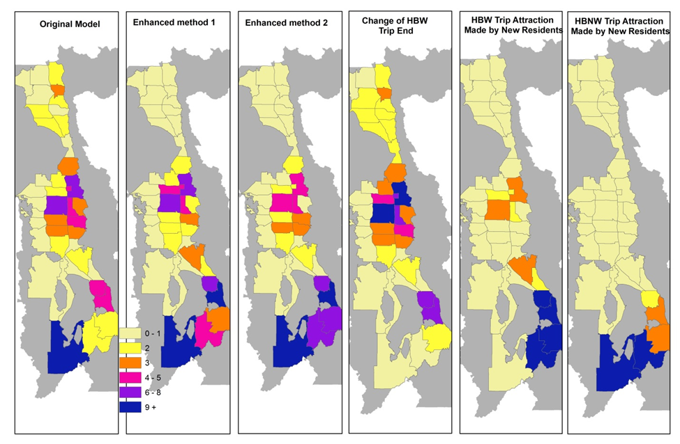
New Residential Development
Enhanced methods showed much better consistency between new HB trips generated by new development and new NHB trips generated by new development
Also revealed significance of balancing procedures in results
Percent Change in NHBW Trip Attractions

Slide 31
Enhanced Transit Service
Original four-step model shows very large increase in NHB trips by transit
Enhanced models show much more modest increase in NHB trips by transit
Actual before and after study would be required to prove which is right, but enhanced model seems more plausible

Slide 32
Conclusions
Overall, the enhanced methods appear to perform better than the original four-step model
  Produce significantly more reasonable responses to hypothetical new residential growth and more plausible mode shifts in response to hypothetical enhanced transit service
  Better able to replicate observed NHB trip rates, mode shares and OD patterns with less calibration
  Make clearer, more intuitive and reasonable connections between NHB and HB modes
  Allows demographic market segmentation of NHB trips for toll modeling or equity/EJ analysis, etc.

Slide 33
Conclusions (2)
Comparing enhancement methods,
  Method 2 better replicated observed trip rates and may have produced best response to residential growth
  Method 1 may have better replicated observed mode shares and OD patterns
  Method 3 may have proven infeasible in practice

