Slide 1
Utilizing Big Data Methods for a Long-Distance Automobile Origin-Destination Study
15th TRB National Transportation Planning Applications Conference
May 19, 2015
Presented by Polly Ramsey

Slide 2
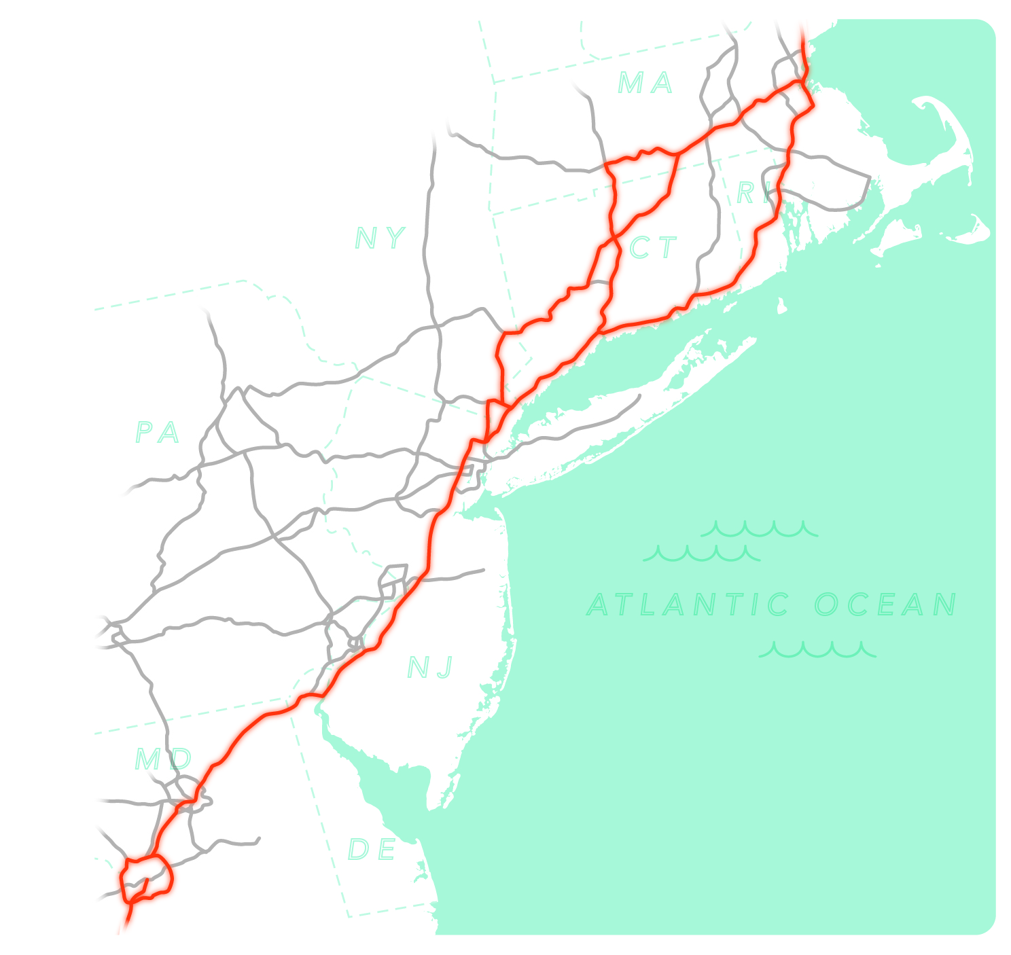
Project Overview
GOAL
Gather data to:
Understand intercity auto movement
Identify active and potential rail markets
Notes:
Overview of project:
-Northeast Corridor (DC to Boston)
-Intercity trips only
-We had pretty robust air and rail data, nothing on auto
-This project was followed by a bus study
-Auto flows very important
-Identify potential rail markets with currently high auto share
-Also important: Trip details! Driver details! E.g. why did they choose auto??
-This is MILLIONS of annual trips, how do we go about understanding all of them???

Slide 3

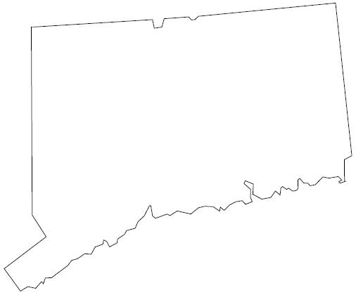

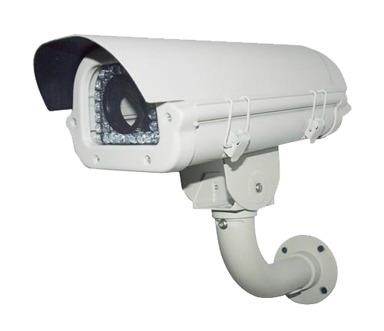
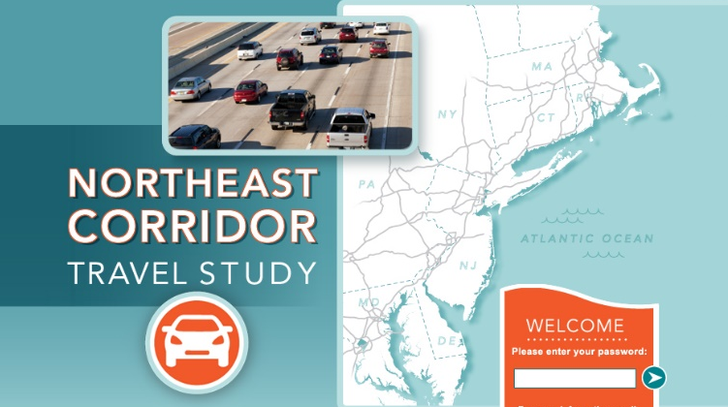
Methods Used
PRIMARY METHOD
ADDITIONAL METHODS
Notes:
E-ZPass: Backbone of the project. Primary source of auto flow data.
To supplement we used…
LPC: Filled gap in CT
rSurvey: To get specific trip and traveler information

Slide 4
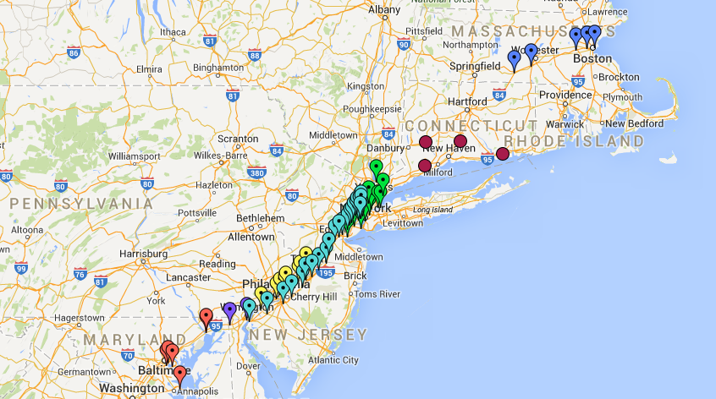
E-ZPass Data Pros and Cons
No Connecticut tolls
Managed by multiple agencies
More sparse at ends of corridor
CONS
Notes:
Map shows what we determined to be “relevant” E-ZPass plazas.
No Connecticut Tolls
- They simply don’t have any tolls in the whole state, caused a big “black spot” on our toll plaza map
- E.g., Southern CT -> Providence trips completely excluded from EZP data
- Fixed with License Plate Capture
- LPC used 4 probe sites in CT (red dots on map)
Managed by Multiple Agencies
- We made arrangements with NINE E-ZPass agencies
- All had own reservations about privacy, etc. Logistics!!
- Received TXN data from 8 agencies over the same 3 day sample period
- One agency wouldn’t give up their TXN data (we sampled their entire customer base!)
More Sparse at ends of corridor
- Just something we had to make do with
- Our dataset isn’t quite as robust at the ends

Slide 5
E-ZPass Data Pros and Cons
Very granular data
Can follow an individual’s path
Transactions linked to contact info
PROS
Notes:
Very Granular Data
- We received every transaction from 8 different agencies over a 3 day period
- 7.5 MILLION TRANSACTIONS
- All time and location stamped, plus direction of travel
Can Follow an Individual’s Path
- If they used more than 1 toll plaza – great for determining long-distance trips
Transactions Linked to Contact Info
- We were able to determine likely long-distance (relevant) trips and send them a survey invitation
- We (RSG) never had access to the contact info itself, we had to rely on the EZP agency to help (more details later)

Slide 6








E-ZPass Transaction Data
EIGHT E-ZPASS MANAGING AGENCIES
THREE CONSECUTIVE DAYS
Saturday, Sunday, Monday
ALL RECORDED TRANSACTION INFORMATION
7.5 MILLION TRANSACTIONS
Notes:
We wanted both weekend days plus a weekday. April 27 – April 29, 2013
Data provided:
Obfuscated tag number
On Plaza
- Managing agency
- Name
- Date/Time
- Lane # (useful for directionality)
Off Plaza info (if applicable, e.g., NJTP transactions always in pairs)
Traveler Home ZIP (when available)
Goal: Aggregate the data so it’s useful, while keeping as much granularity as possible

Slide 7
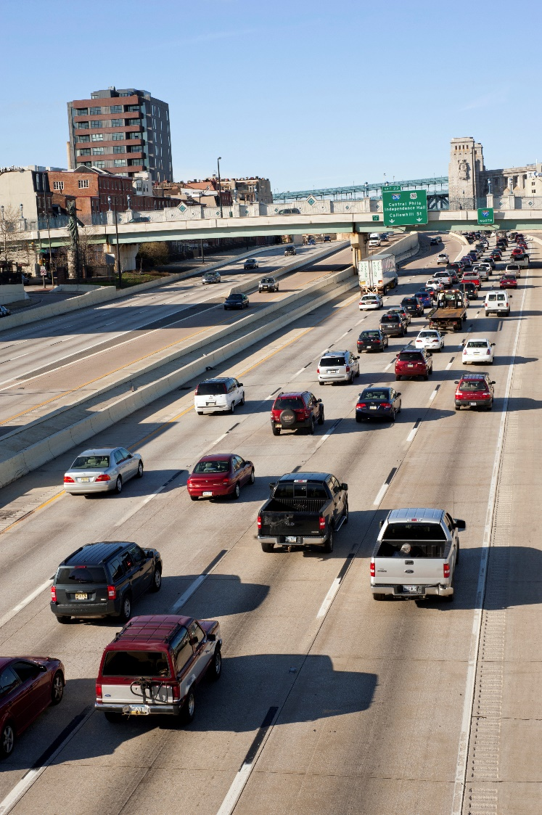
Convert Transactions into Trips
CRITERIA FOR START
OF NEW TRIP
  Same plaza is repeated
  Time elapsed between consecutive
  toll plazas
      >3 hours within agency
      >6 hours between agencies
  Two plazas used consecutively that cannot be in same trip
5 MILLION TRIPS
Notes:
1 – Driver is on their return trip
2 – Driver stopped for a long period and therefore is starting a new trip
3 – If impossible that driver would use the two plazas for the same one-way trip (e.g., Lincoln Tunnel and George Washington Bridge, both only tolled Eastbound.). Had list of pairs that would determine new trip

Slide 8
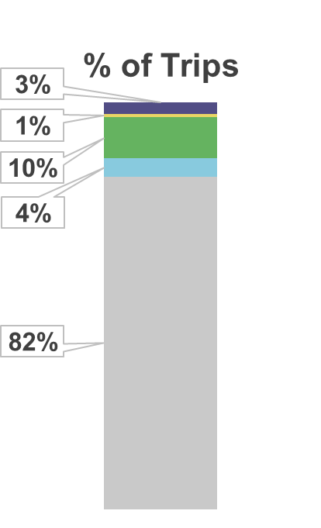
Determine Relevant Trips to Send a Survey
CREATE PRIORITY SAMPLING SYSTEM
FLAG | DESCRIPTION | EXAMPLE
1 | High Relevance Plaza Pair | Fort McHenry Tunnel a Lincoln Tunnel
2 | Secondary Relevance Plaza Pair | PA Turnpike Plaza a NH DOT Plaza
3 | High Relevance Single Plaza | Tappan Zee Bridge
4 | Secondary Relevance Single Plaza | Holland Tunnel
0 | Not Relevant | Wrong direction, too short, or not near corridor
TOTAL TRIPS SAMPLED: 185,000
Notes:
This was the hardest part – we determined the entire priority system before sampling was done
Examples show the first and last plazas of trips (many trips had more than 2 plazas)
1 – Clearly on a long-distance trip on the corridor (here, DC area to NYC)
2 – Definitely a long distance trip, possibly on the corridor
3 – Only 1 plaza but very possibly a relevant trip
4 – Could be a relevant trip, could be a local trip
0 – We have no interest. E.g. Traveling Southbound (we only sampled Northbound), 2 NJTP toll plazas very close to each other, or toll plazas in Illinois,
Created an executable that would convert the transactions into trips and then flag their priority
- That way we could get the survey sampling done as fast as possible so people would still remember their trip!
# of trips sampled limited by agencies (cost of printing survey invitation postcards, mostly). Sampled higher priority trips first.

Slide 9
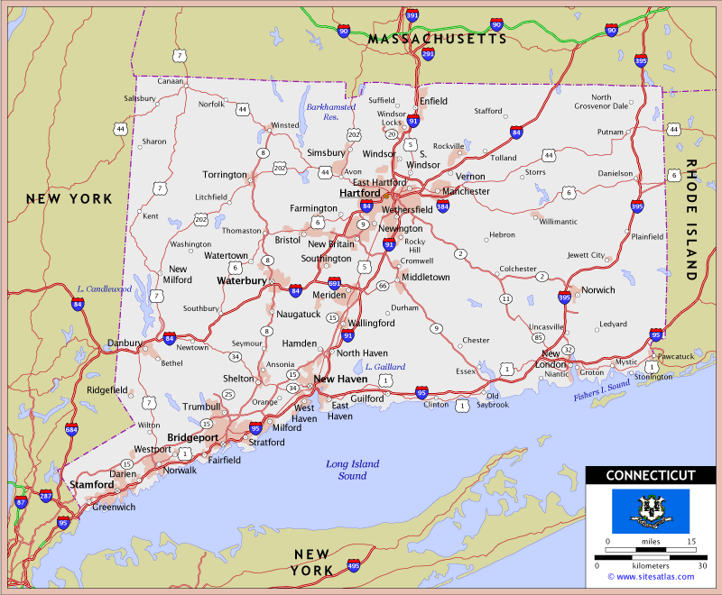
License Plate Capture (LPC)
Four probe sites
Near Continuous Traffic Counters (CTCs) in order to pair with traffic volumes
Same 3 day sample
TOTAL ADDRESSES SAMPLED: 17,000
Notes:
4 Probe Sites:
I-84 West of Hartford/Waterbury
I-91 in Wallingford
Merritt Parkway in Trumbull
I-95 East of New London
LP info sent to DMV’s in CT, MA, RI, and NY. All other states could not be sampled.

Slide 10
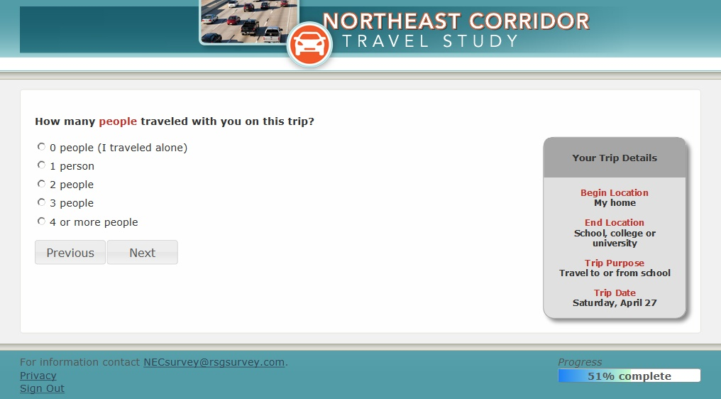
Web Survey
COLLECTED 5,577 RELEVANT RESPONSES
Notes:
Survey invitations (email or postcard) sent to:
187,000 E-ZPass customers from the 8 agencies that provided transaction information
17,000 addresses obtained from LPC
All NJTP customers
15,195 Total Survey Responses
5,577 RESPONSES WITH RELEVANT TRIPS (76% Mail EZP, 21% NJ EZP, 2% LPC)
“Relevant” def’n:
- Direction of travel
- Location of trip ends
- Trip distance (>30 miles)
- Cleaned reported toll plazas in some cases. E.g., respondent only reported 1 NJTP plaza

Slide 11
Weighting: Main E-ZPass Recruits
DETERMINE RELEVANT E-ZPASS TRANSACTIONS
Kept all trips with relevant plaza pair
Single-plaza trips were reduced to account for short trips not pertinent to this study
  This was done using the most recent OD data available for each facility
Scaled using E-ZPass penetration values for each agency
WEIGHT SURVEY DATA TO RELEVANT TRIPS
Aggregated plazas into 12 groups
Iterative Proportional Fit (IPF) to expand survey data to plaza group and day of week
Notes:
Couple slides on weighting – I don’t want to bore people so I’ll try to go through them quickly, but some may be interested in this!
Relevant plaza pair:
Both plazas on corridor, clear it’s a long trip, traveling Northbound. Used same sample flag system as during sampling (Flag = 1)
OD data used to reduce single plaza trips:
2012 MTA B&T OD Study (e.g., HHB)
2006 PANYNJ OD Study (e.g., GWB)
2004 Tappan Zee Bridge Study
E-ZPass Penetration values ranged from 69% (VA) to 83% (B&T)
This was done to account for Cash travelers
Groups decided based on # of survey responses and location

Slide 12
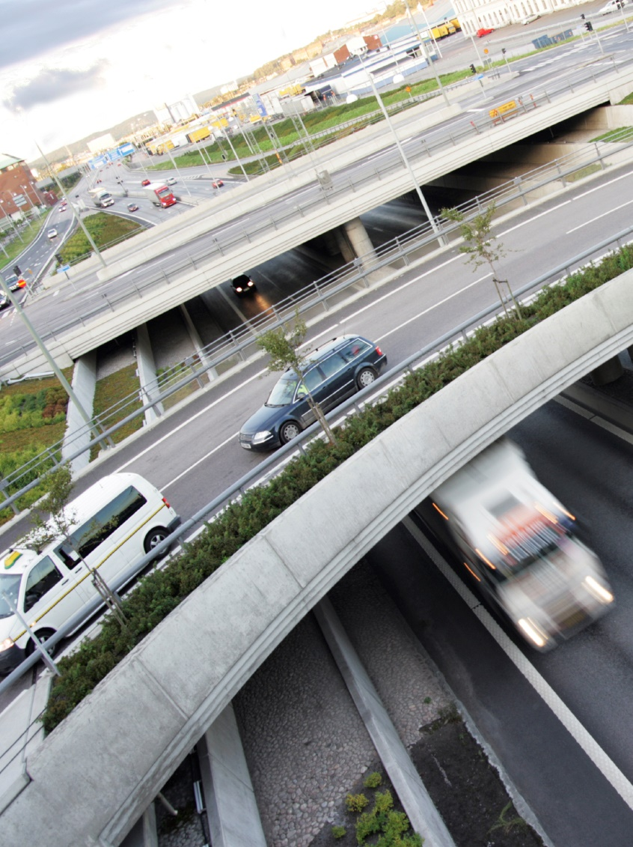
Weighting: LPC Recruits
DETERMINE RELEVANT LICENSE PLATE CAPTURES
Used distance between LPC capture site and vehicle home owner’s home ZIP code centroid
WEIGHT SURVEY DATA TO RELEVANT TRIPS
By capture site and day of week
Notes:
Distance used was 50 miles (shorter than that considered short trip and therefore not relevant)
The proportion of long-distance trips ranged from 6% to 35% and varied by day of week and capture site.
Weighted up to total (relevant) traffic even though we could only sample license plates from CT, MA, RI, and NY

Slide 13
Weighting: NJ E-ZPass Recruits
PROBLEM
NO TRANSACTION DATA! We did have…
2011 AADT flows between each NJTP interchange
  Reduced to represent only Class 1, Northbound
Full transaction data of customers from 8 other E-ZPass agencies traveling on the NJTP
IPF with AADT flows as margins and other agencies’ full transaction data as seed matrix
Removed short trips, scaled using NJTP E-ZPass penetration, and weighted to resulting matrix
SOLUTION
Notes:
AADT = Annual average daily traffic
Class 1 = personal 2-axle vehicle, 76.1%
Northbound = 50% (assumed)
AADT flows don’t show counts for interchange-to-interchange PAIRS, which is what we need.
AADT can’t tell us % of people traveling interchange 1 to interchange 2 compared to interchange 1 to interchange 15.
#3 – end result is full on/off matrix with all NJTP traffic. So, we removed Cash transactions using NJTP E-ZPass penetration, and also removed the transactions from the 8 other agencies
NJTP E-ZPass penetration = 79%
Removed short trips – This was not an exact science. We used the other agencies’ transaction data and geography to estimate % relevant trips for each interchange-to-interchange pair

Slide 14
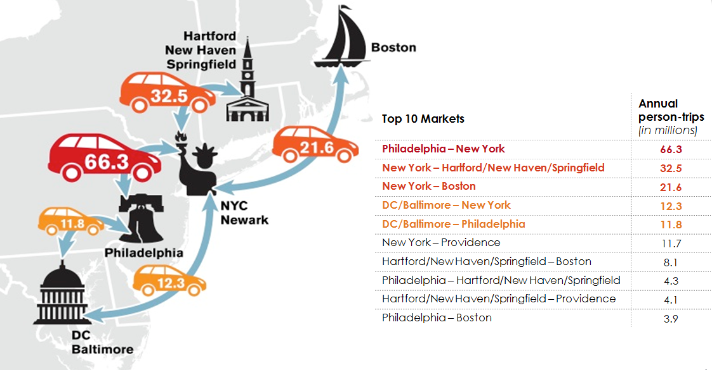
Results
Notes:
Image shows very broad market definitions, can also be more granular
Especially in middle of corridor where there are a lot of toll plazas

Slide 15
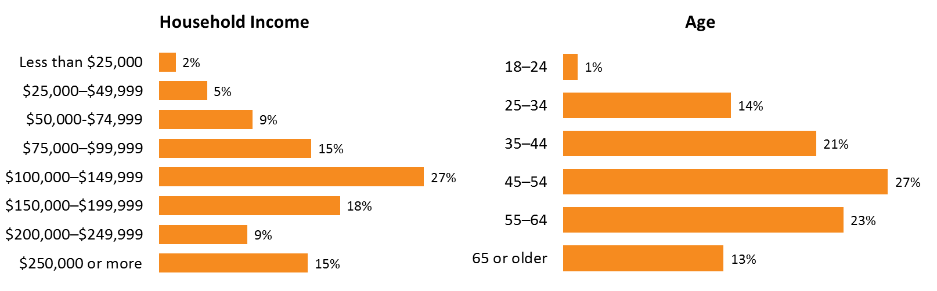
Results
Notes:
Many more variables obtained:
Trip information
- Exact OD, purpose, occupancy, trip frequency, stops made, return trip info
Traveler information
- Demographics
- Attitudinal questions about travel (“Privacy is important to me when I travel”, “I like to engage in other activities when I’m traveling (e.g., reading, working, relaxing)”

Slide 16
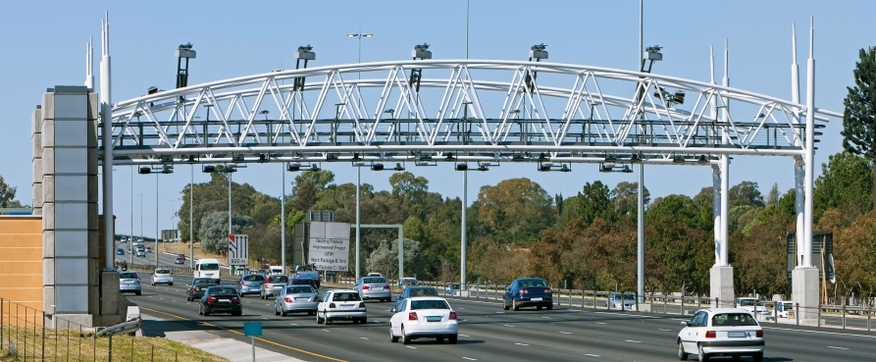
Considerations and Limitations
Represents tolled travel only
Some market pairs are underestimated
NJ E-ZPass customers sampled differently
Notes:
Except LPC. We scaled up to accommodate for Cash customers, but their trip/traveler info may be systematically different. Also, no way to represent toll avoiders.
Providence -> Boston and DC -> Baltimore. This is because there are few (if any) tolls between them. In all analyses we combined these markets together.
Also, CT: mitigated using LPC but that data isn’t as strong
3. We had to sample their entire customer base instead of only relevant trips. Additionally we did not have their TXN data to weight to. We calculated the best weighting scheme we could with what we had, though.

Slide 17

Contacts
POLLY RAMSEY
SENIOR ANALYST
Polly.Ramsey@rsginc.com
802.861.0508
www.rsginc.com
GREG SPITZ
DIRECTOR
Greg.Spitz@rsginc.com
802.359.6424
MARGARET CAMPBELL
SENIOR CONSULTANT
Margaret.Campbell@rsginc.com
802.359.5589
DONNIE MALEY
DIRECTOR, PLANNING
DMaley@nec-commission.com
202.847.0283

